Slide 1
BUILD WITH AI: CODE FOR COMMUNITIES · SECOND EDITION
Team Predators
PS
SP
Problem statement 01: AI for Digital Public Infrastructure & Governance
Punya Surana
Shreyam Pandey
Team Leader
Team Member
punyasurana23@gmail.com
p.shreyambbk@gmail.com
Our solution: INFRA-AI
SV
LS
A multilingual, location-first infrastructure intelligence platform for India, built as a Digital Public Good.
Shubham Veer
Laksh Sorathiya
Team Member
Team Member
shubham.veer24@pcu.edu.in
sorathiyalaksh37@gmail.com

Slide 2
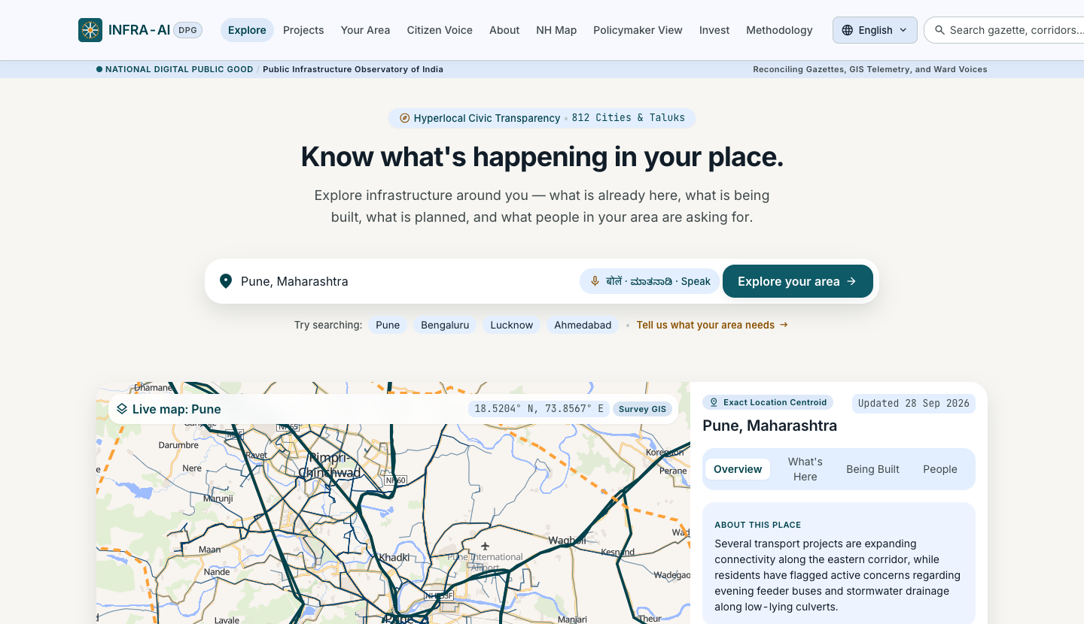
NATIONAL DIGITAL PUBLIC GOOD · INDIA
INFRA-AI
infra-ai · Explore your area
Pin any place in India. See what was built, what is coming, and what people are asking for — every claim cited.
1,42,905 km
381
22
national highways mapped
cities scored
languages targeted
Location-first infrastructure intelligence · Problem · Solution · Feasibility
Notes:
INFRA-AI: a multilingual, location-first infrastructure intelligence platform built as a Digital Public Good. Screenshot is the running app, not a mockup. Stats: 1,42,905 km NH mapped from OSM (97.8% of official length); 381 cities scored; 22 scheduled languages targeted via Bhashini / AI4Bharat.

Slide 3
Problem statement 01: AI for Digital Public Infrastructure & Governance
Build with AI: Code for Communities, Second Edition · Theme: Innovation · Our chosen problem
THE PROBLEM
How INFRA-AI answers it
Governments across India struggle to consolidate citizen feedback and align it with national infrastructure priorities. Development requests live in fragmented systems, leading to misaligned public spending, unaddressed infrastructure gaps, and no way to measure the impact of large-scale digital public infrastructure initiatives.
Every request, every language
Voice, text and messaging intake in 22 languages
One view of a place
THE CHALLENGE
Requests joined to demographics, infrastructure and investment plans
Build a scalable, multilingual AI platform, designed as a Digital Public Good, that aggregates citizen development requests via voice, text, and messaging apps across diverse linguistic regions of India. The system should analyse large datasets combining citizen feedback with national demographic data, infrastructure indices, and public investment plans, surfacing demand hotspots and recommending high-priority development projects to national policymakers.
Hotspots and priorities
Explainable scores for policymakers, each with cited facts
Open by design
A Digital Public Good: open data, open code, privacy by default
INFRA-AI · Digital Public Good
3

Slide 4






Infrastructure data is scattered — so needs go unseen
Citizen requests, plans and spending live in separate systems and languages. Nobody sees one place whole.
What the gaps cost — national highways
73%
Map apps & OSM
Agency PDFs
Tender portals
Show what exists. Miss history, plans, project status.
Each agency shows its own projects. No common map.
Earliest signal of new work. No plain-language meaning, no location.
of NH length is two lanes or fewer
68%
of NHAI projects under construction are past schedule — median 19 months late
News & releases
Grievance portals
Census & satellite
64,772
Announcements and delays. No reliability check, no timeline.
Single complaints. Never added up into demand.
Who lives where. Not linked to any of the above.
deaths on national highways in 2024, rising every year since 2020
Sources: NHAI Datalake layer, MoRTH Road Accidents in India 2024; INFRA-AI analysis as of 2026-09-29.
INFRA-AI · Digital Public Good
4
Notes:
Problem statement: requests are fragmented across systems and languages; spending drifts from need; impact of large programmes is not measured. Right panel is real analysis: 99,931 of 1,36,758 km NHAI length is <=2 lanes; 264 of 388 NHAI projects under construction are overdue; NH deaths 50,251 (2020) to 64,772 (2024).

Slide 5
One pin answers five questions
Join every dataset by place and time — then let people in any language ask, and policymakers act.
1
2
3
4
5
What's here?
What changed?
What's coming?
What people need?
So what?
Roads, metro, rail, hospitals, schools — public and private.
20+ years of built-up and night-light growth.
Under construction, approved, announced — cited, with confidence.
Requests by voice or text, deduplicated into issues.
Gaps, ranked priorities and a growth outlook.
HOW IT WORKS
Open sources
One H3 grid
Explainable scores
Cited AI briefs
Three audiences
OSM, MoRTH, PIB, WorldPop, GHSL, tenders, news
›
Every record joined in Postgres / PostGIS
›
Weighted sums of facts, drivers stored. No black box
›
Claims need a verbatim evidence quote
›
Citizen · policymaker · investor
INFRA-AI · Digital Public Good
5
Notes:
Location-first is the angle: every dataset keyed to an H3 hexagon and a time. Analytics are config-weighted sums with stored drivers (ADR-0003) — no predictive model. LLMs only read and structure text; briefs cite fact ids (ADR-0008). Growth outlook is informational, never investment advice.

Slide 6
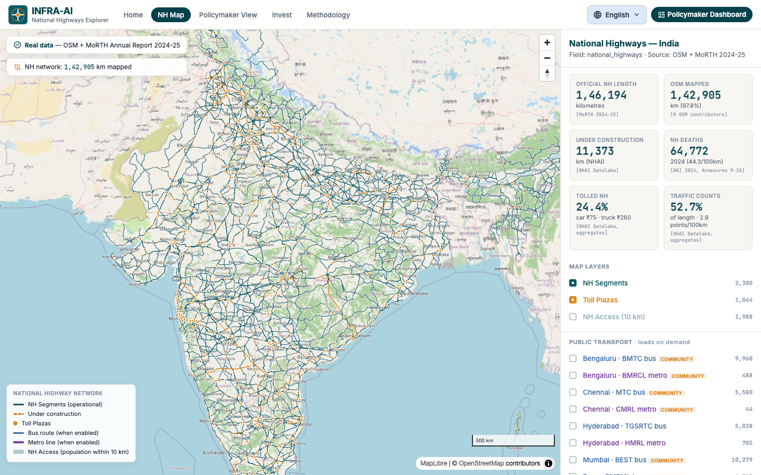
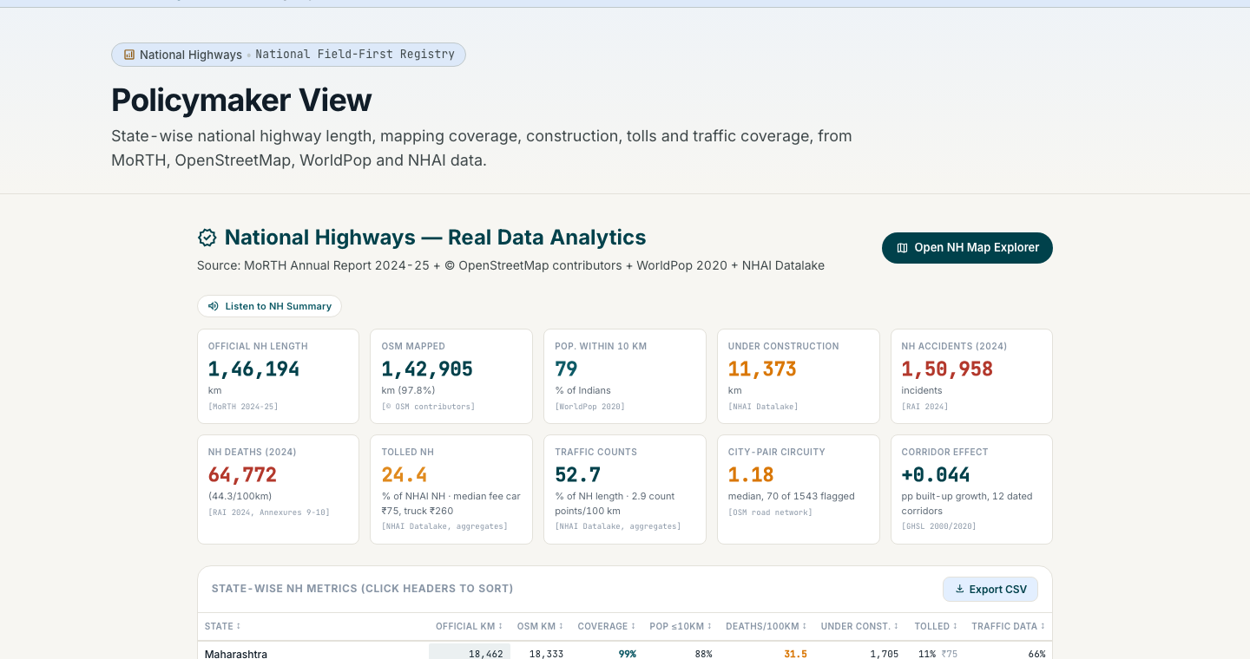
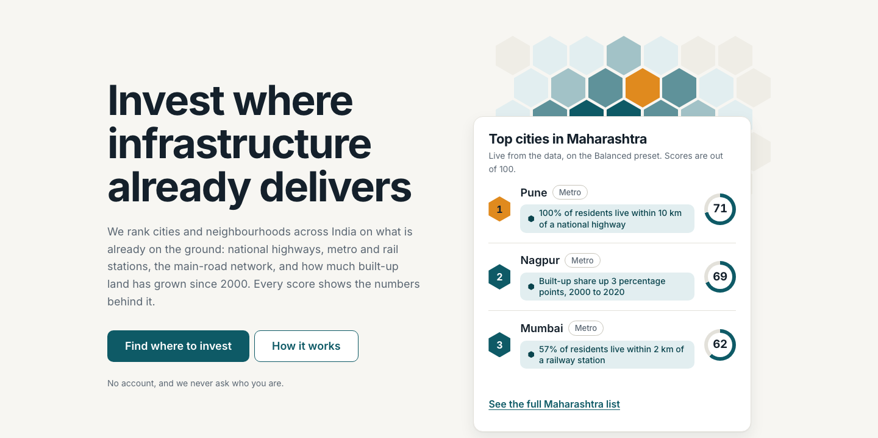
Working today — on real data, not mockups
NH Explorer · 1,42,905 km of national highways, toll plazas, public transport
Policymaker View · state-wise NH metrics
Invest · top cities, scored from facts
Screenshots of the running app (fixture data as of 2026-09-29). Every number links to a source.
INFRA-AI · Digital Public Good
6
Notes:
Left: NH Explorer with real OSM network plus NHAI toll plazas. Top right: Policymaker View with state-wise length, OSM coverage, deaths per 100 km, tolls and traffic counts, CSV export. Bottom right: investor flow landing page — cities ranked, every score shows its numbers.

Slide 7
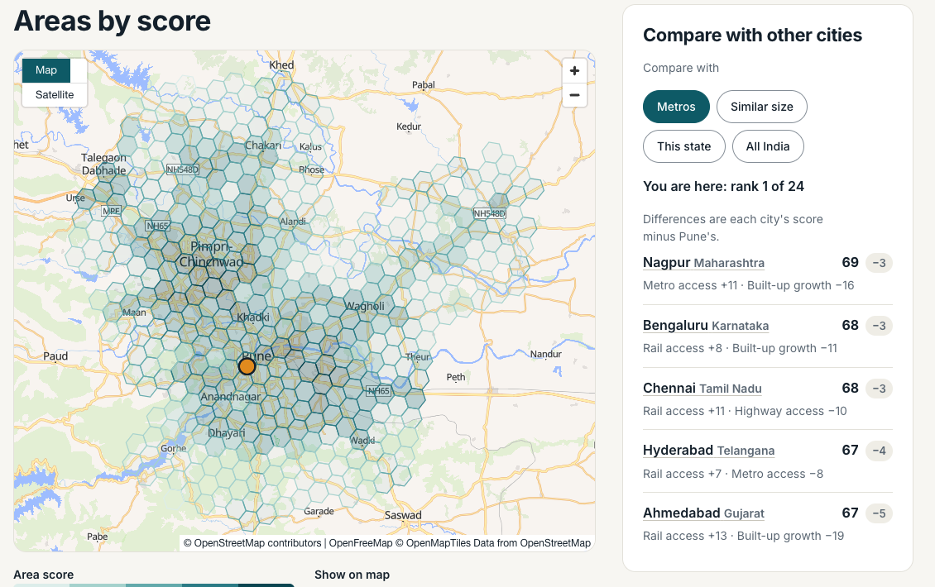
Feasible: data exists, stack is lean, core is built
Pune · area scores on the H3 grid
Data
Proven
Technology
Built, DB next
Open, licensed sources: OSM, MoRTH, WorldPop, GHSL, PIB. OSM covers 97.8% of official NH length (1,42,905 of 1,46,194 km). 381 cities scored.
Postgres/PostGIS on an H3 grid, Go API, Python for ML. Scores are config-weighted sums with stored drivers — no black-box model.
Legal & privacy
By design
Delivery
On track
Redact before storage; counts under 5 suppressed; never collect Aadhaar. Every record carries source, licence and confidence.
NH data and analysis done; pipeline half done. Investor flow live. Next: DB, API and UI shell. A new city is one config file.
Risks we track
NHAI layer has no stated licence: used for analysis, never redistributed
OSM lags openings: checked against official dates
Ambiguous or invalid input goes to a review queue, never guessed
INFRA-AI · Digital Public Good
7
Notes:
Feasibility across data, technology, legal/privacy and delivery. Honest risks: NHAI GeoServer data has no stated licence (ADR-0014); OSM lags official openings. Invariants: provenance on everything, fail closed, AI never originates facts, explainable analytics only.

Slide 8
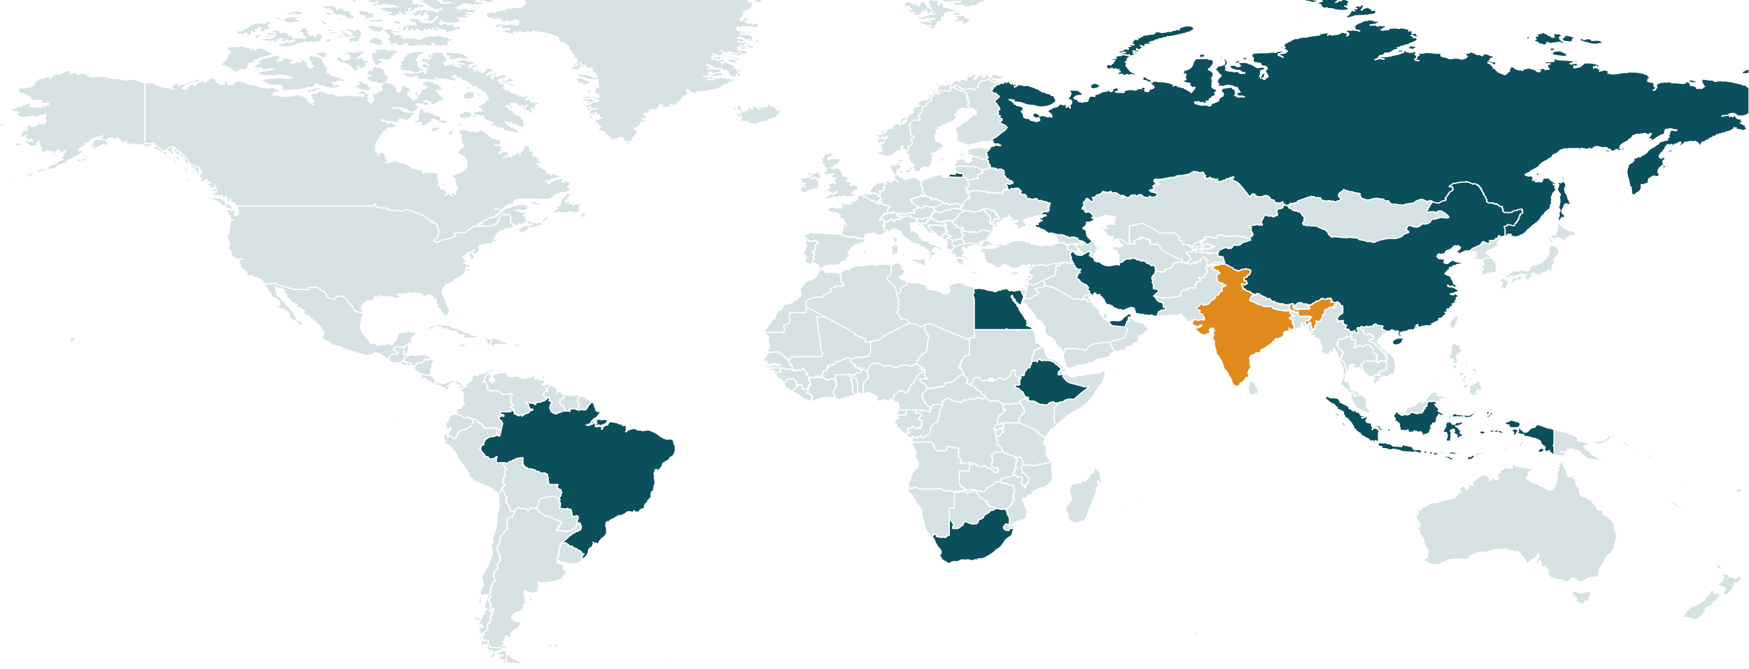
BRICS: one infrastructure lens
PROPOSED · NOT BUILT
Today INFRA-AI covers India only. Here is what the same platform could do for the ten BRICS members.
MEMBERS AND MAIN LANGUAGES
India
Hindi, English +20
Brazil
Portuguese
Russia
Russian
China
Mandarin
South Africa
English +10
Indonesia
Bahasa
Egypt
Arabic
Ethiopia
Amharic
Iran
Persian
UAE
Arabic
India: live today
Other members: proposed
Not in scope
Why it can travel
What we can do
What we should do first
A new place is one config file
Global open data: OSM, WorldPop, GHSL
Open-source DPG; UI already has pt, ru, zh
Pilot one city per member
Comparable access scores across countries
Voice and text intake in national languages
Write an ADR: scope is India only today
Licences, boundaries, privacy law per country
Gold-set quality check per language
Borders: Natural Earth, India view; not the official Survey of India layer. Members as of 2025. Scores describe infrastructure, never rank countries. Nothing here is built yet.
INFRA-AI · Digital Public Good
8
Notes:
BRICS is a proposal, not implemented. Why it can travel: the core is city/field-agnostic (AGENTS.md invariant 8), uses global open data, and the UI language picker already has a BRICS / international group (pt, ru, zh). Should-do list comes from the invariants: ADR before changing scope (ADR-0013), licences before data (ADR-0012), official boundaries per country (ADR-0007 is Survey of India for India), privacy law per country (ADR-0011 is DPDP-aligned), gold-set evaluation for languages (ADR-0008/0009).

Slide 9

From two fields to all of India
Each field follows one template. Each new city is one config file.
DONE
LIVE
NEXT
THEN
NH data + analysis
Investor flow
M0 Foundation
Metro + more fields
97.8% OSM coverage, first findings, delay flags, cited PIB events
381 cities, Go API, onboarding and city pages
Postgres DB, API, UI shell, citizen intake
Metro, railways, airports, water — one at a time
WHO BENEFITS
What we need next
Citizens: report a need by voice, in their language; see what is coming nearby
Policymakers: ranked, evidence-backed priorities; spending-versus-need view
Investors and journalists: cited timelines, delays and growth drivers
Access to PM GatiShakti data
A pilot state or city partner
Bhashini API access for 22-language intake
INFRA-AI · Digital Public Good
9
Notes:
Milestones follow README section 13 and AGENTS.md status: NH M1/M2 done, M3 half done; investor flow landed ahead of M0; M0 is next. Asks are taken from the plan: GatiShakti access is listed as restricted and needs organizer help; Bhashini for the language stack; a pilot partner for real citizen intake.

