Slide 1
Database Foundations for Business Analytics

Slide 2
Contents
Database Objective and Introduction
Design Introduction
Data Definition
Data Manipulation
Data Triggers, Indices and Sequences
Data Queries
Assumptions
Challenges
Conclusion
References

Slide 3
Database Objective and Introduction
A system that stores details of the store, orders, purchases, product, and order detail
Triggers and sequences have been developed to automate the process
Relations, business rules, and cardinalities have been put in place based on the tables and their respective connection with the datasets.
Some assumptions have been taken into consideration based on the datasets
Scalability and customization - this is quite a flexible design that can be remolded as the requirements and needs

Slide 4
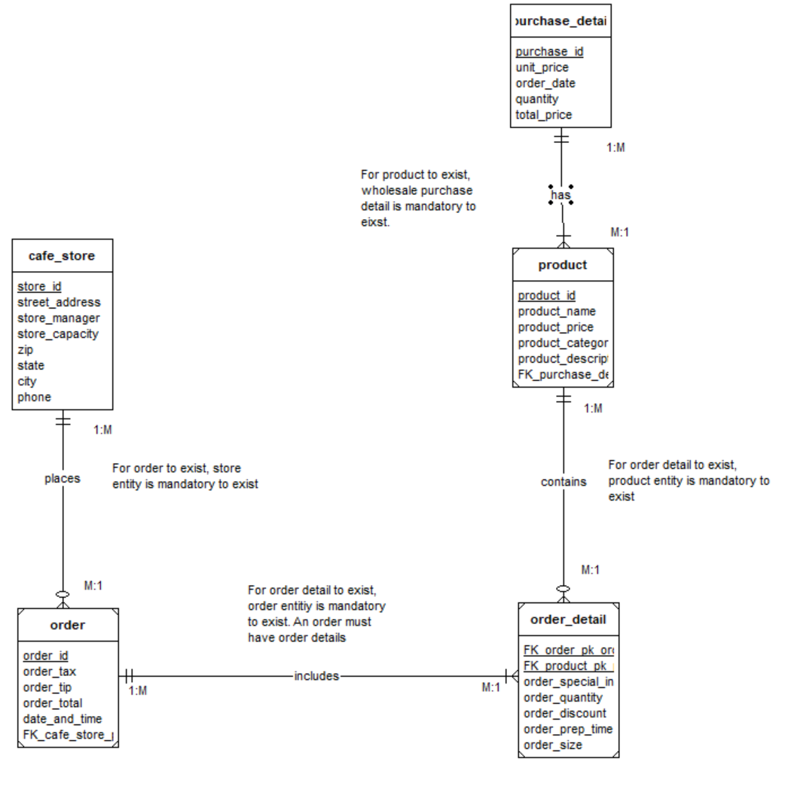
Design Introduction

Slide 5
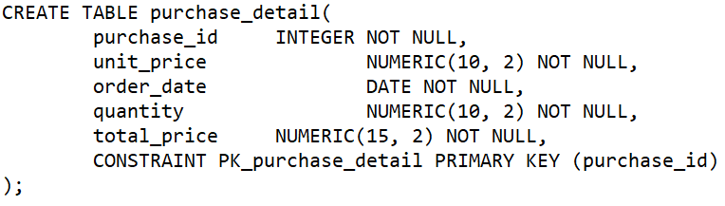
Data Definition
The following schemas have been defined in our database cafe_store, orders, purchase_detail, product, and order_detail
DDL queries which we have used in define the structure of our DB are as follows - create, drop
Data structures which have been defined using DDL queries are as follows – triggers, tables, sequences, indices, trigger function
Snapshot of DB DDL query -

Slide 6
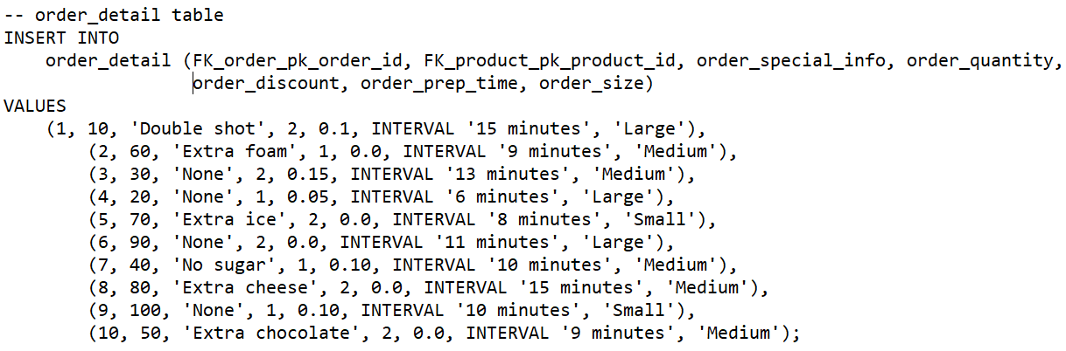
Data Manipulation
DML queries which we have been used to manipulate the structure of our DB are as follows – insert
Schemas which have been manipulated using DML queries are as follows - cafe_store, orders, purchase_detail, product, and order_detail
Structure of DML queries which have been used to manipulate the data is as follows -
INSERT INTO <table_name> (<colume1>,…..,<columnn>) VALUES('<>','<>',….<>)
Snapshot of DB DDL query -

Slide 7
Data Triggers, Indices and Sequences
Trigger and Trigger Functions - These are SQL blocks of code that allow us to perform specific SQL actions that should be executed automatically when a specific event occurs in the database. A trigger defines how a function is invoked and a function must have exactly one trigger.
Indices – A data structure associated with a table or view that speeds up the retrieval of rows from the table based on the values in one or more columns.
Sequences - A sequence is a user-defined schema-bound object that generates a sequence of numeric values

Slide 8
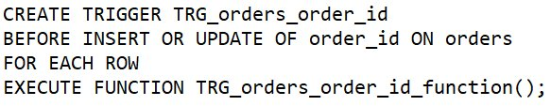
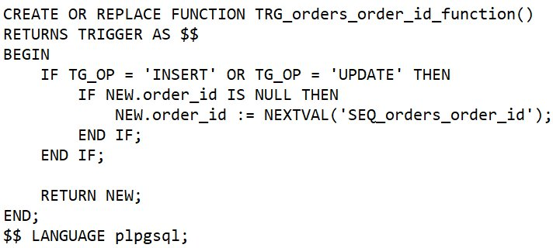
Data Triggers and Functions
Trigger-
Trigger Function -

Slide 9

Indices and Sequences
Index -
Sequence -

Slide 10
Data Queries
A few queries which were written to address the data, based on the output requirement -
-- Select all columns from all rows from one view
CREATE VIEW main_order_details AS select order_special_info, order_quantity, order_discount, order_prep_time, order_size from order_detail
-- Select and order data retrieved from one table
select * from orders
ORDER BY order_total DESC
-- Use IN clause to select data from one or more tables
SELECT * FROM orders WHERE order_id IN (1,4,7)

Slide 11
Assumptions
Some of the assumptions that we have considered in for the tables in our database are as follows -
Have considered that all the branches are at one geographical place, for example – USA
All the stores have a common set of items be sold
The items that will be available in the inventory will be visible in product table

Slide 12
Challenges
Initially, we encountered query failures with errors. However, after working on them, the issues were successfully resolved.
We had to keep GDPR and PCI compliance requirements in mind.
Placing the correct data constraints was a task that required careful consideration and responsibility.
Designing a scalable schema to accommodate future data and user growth while maintaining performance can be challenging without clear scalability requirements.
The schema needed to be optimized for optimal performance.

Slide 13
Conclusion
The Database schema that has been designed for the café incorporates all the necessary schemas and columns which would be required by the store to maintain itself.
This Database design streamlines operations, enhance customer experiences, and drive for business growth
This DB design improves the scalability and adaptability of the database framework, empowers us to navigate evolving market trends and seize emerging opportunities in the ever-changing cafe industry landscape

Slide 14
References
https://stackoverflow.com/questions/70996759/how-to-create-a-database-schema-which-can-hold-info-about-the-order-and-its-item
https://medium.com/@anajessica15022002/designing-a-relational-database-for-a-caf%C3%A9-69e5c170f57f
https://schema.org/CafeOrCoffeeShop
https://in.pinterest.com/pin/658018195552441678/

