Slide 1
Big Data Project

Slide 2
Overview:
The Fleet Manager for Az National Trucking (ANT) follows compliance guidelines and risk management practices as dictated by the Federal Motor Carrier Safety Administration (FMCSA).
With 310 drivers traveling through many states and even several countries in North America, the ANT would like to impose more stringent rules regarding to certain risk factors as warranted by telematics data or business exigencies, within bounds of legal permissibility. Ultimately, we would like to enhance safety within the trucking industry.
Objective of the project:
Our objective is to grasp an understanding of the risk factors associated with commercial truck operations through data visualizations and various types of data analysis using Tableau.

Slide 3








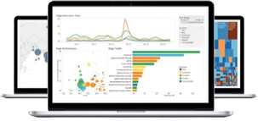
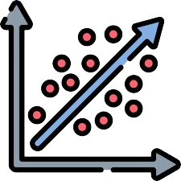

Project Workflow
Create additional tables: trucks_mileage, avg_mileage, driver_mileage, and riskfactor
START: Download Tableau, essential Tableau drivers, and
and files from eLearning
Create table for geolocation, trucks, and trucks_mg files in Hive using DDL
Verify tables are in default database, then import data into the created tables
Move files to HDFS default location
Populate riskfactor table using the provided PIG script
Establish a connection for HDFS in Tableau
Import data from Cloudera server and establish relationship between the tables and combine the data
Integrate tableau with R using Rserve library
Use Exploratory Data Analysis to create dashboards and other visualizations for business questions
Use Regressional Analysis and create a regression model to predict the risk factor

Slide 4
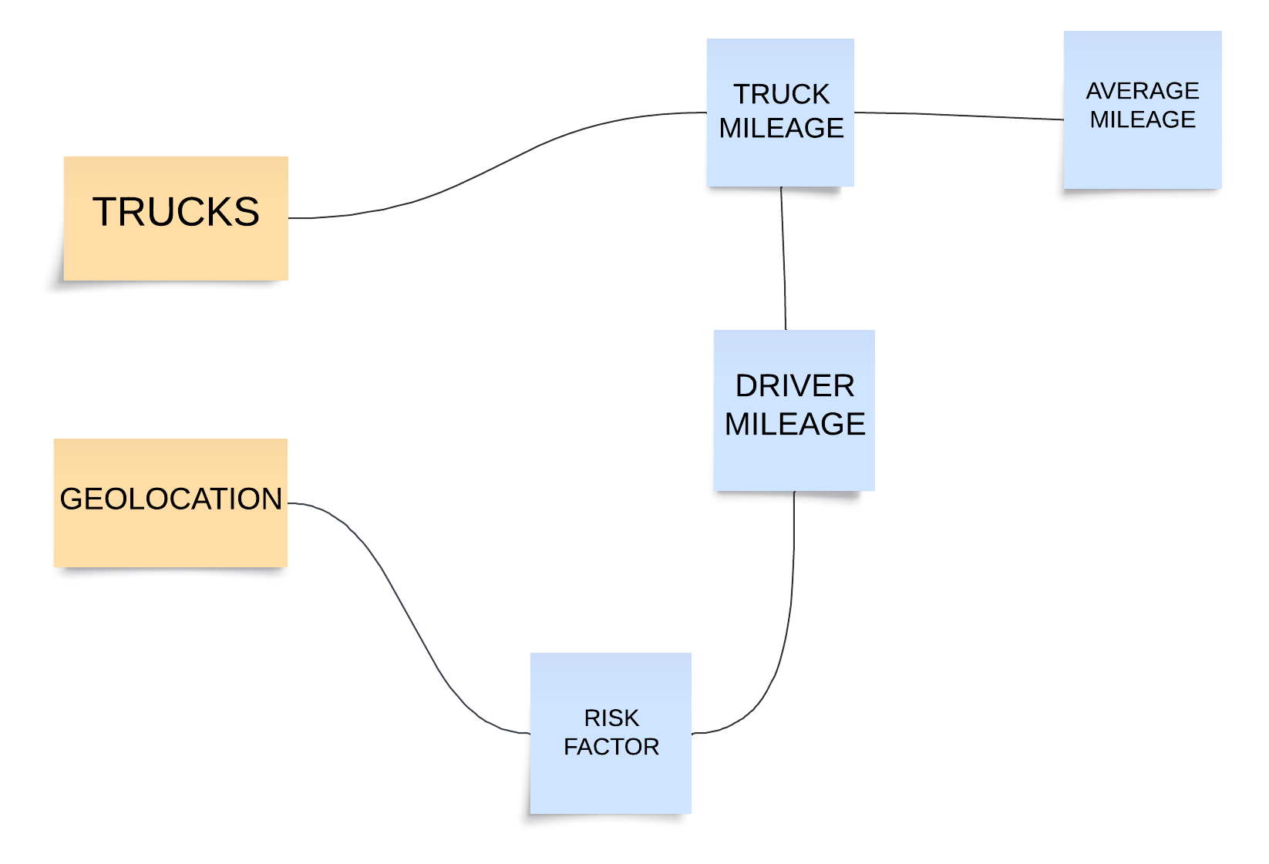
Relational Database/Dataset
Key Risk Factor Thresholds
Mileage
Speed
Other thresholds based on regulatory mandates, business imperatives, and telematic data observations
Truck Driver Risk Factor Cases
In this phase, the "Mileage/Speed risk factor threshold is employed to assess individual driver' risk levels.

Slide 5
Business Questions
Which are the cities where drivers have been found to be having higher speeds and what is the average speed of vehicles in the cities?
What is the actual count of cases of non-normal events causing the risk for the company?
Who are the drivers with the highest risk factors? (The firm needs to know this to keep check on such drivers)
Are there particular truck models attributing more to the risk? Does the risk arise from any particular truck model being driven by the drivers.
How do the risk factors and events in different cities correlate with the total miles driven by truck drivers, and how can this information be used to improve fleet safety and efficiency?

Slide 6
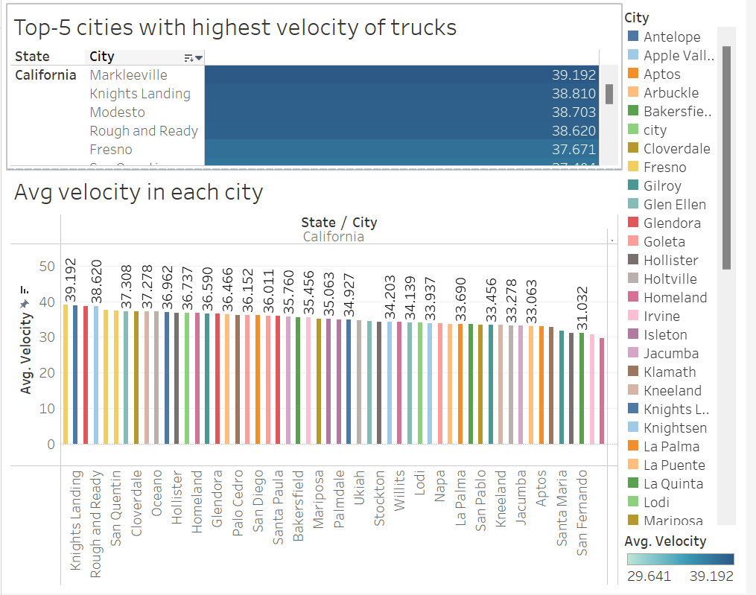
Question 1: The cities where drivers have been found to have higher speed than the average
Velocity > 37 mph found in cities
Markleeville
Knights Landing
Modesto
Rough & Ready
Fresno
So, these cities need to be monitored closely.

Slide 7
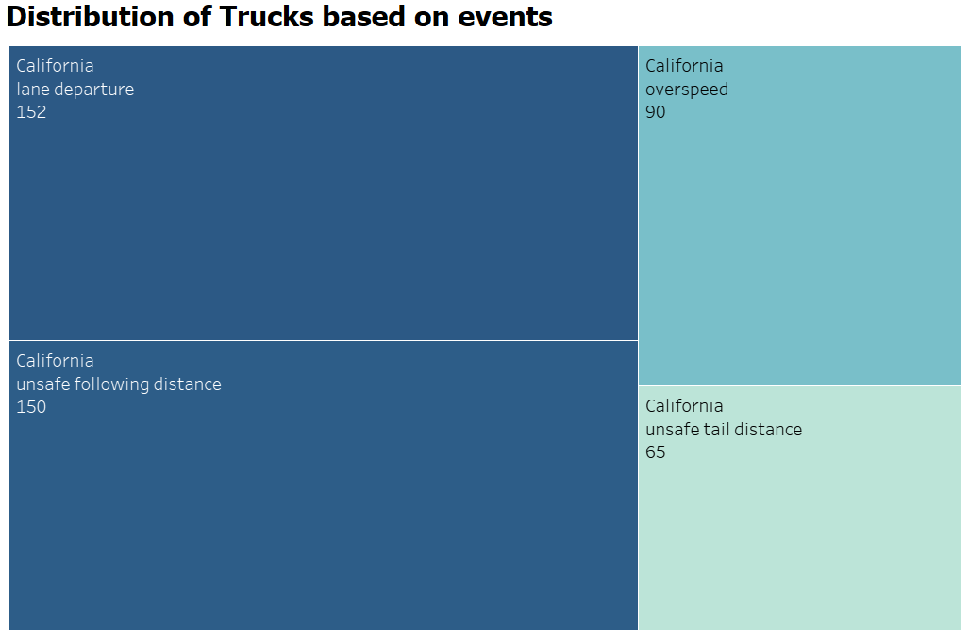
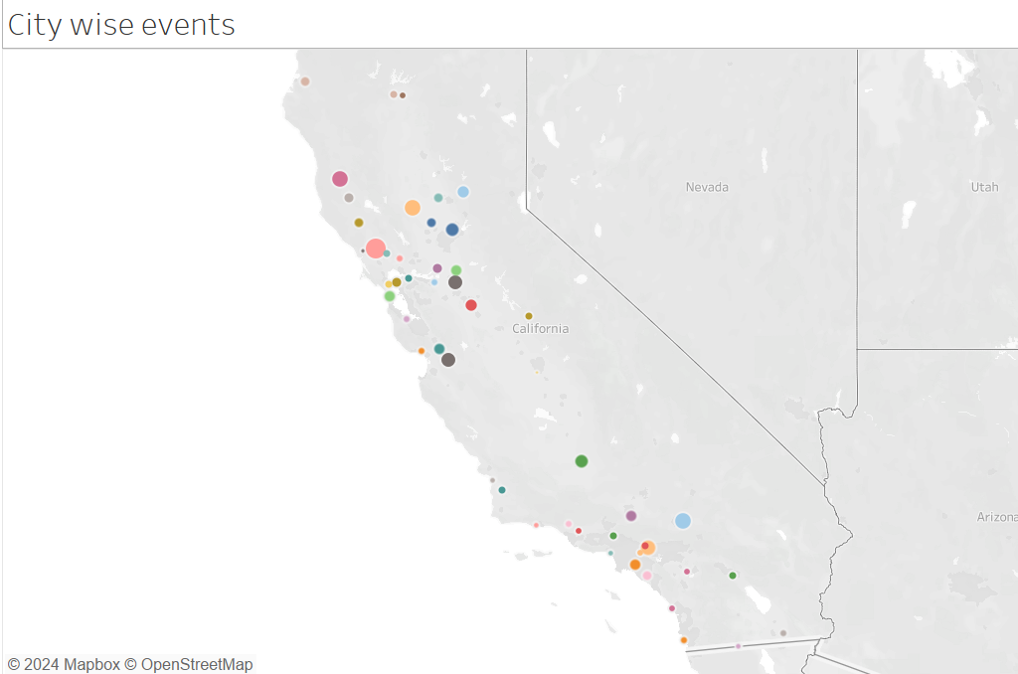
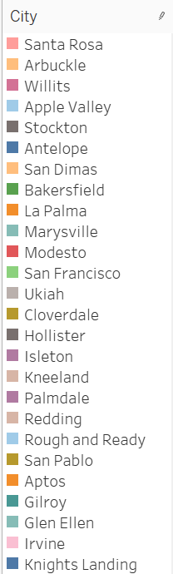
Question 2: The count of various cases of non-normal events : It was found that Lane departure cases were prominent among all the events causing risk
Top three events causing risks:
Land departure
Unsafe following distance
Over speeding
Cities like Santa Rosa(72), Arcbuckle(45), Willits(44), Apple Valley(41) & San Dimas(38) need to have greater oversight by the company.

Slide 8
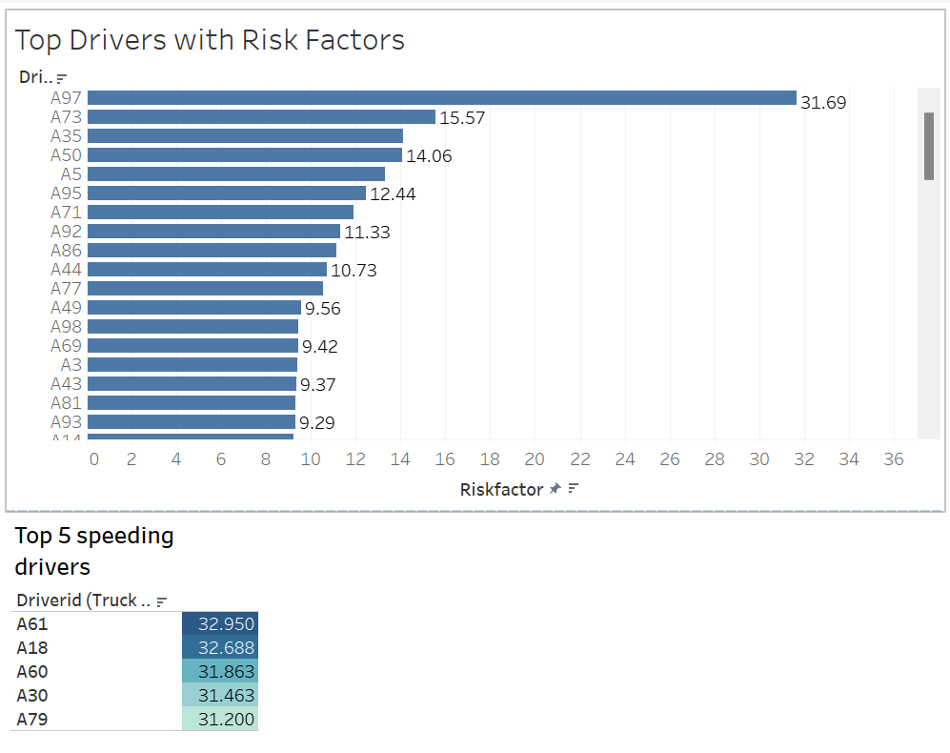
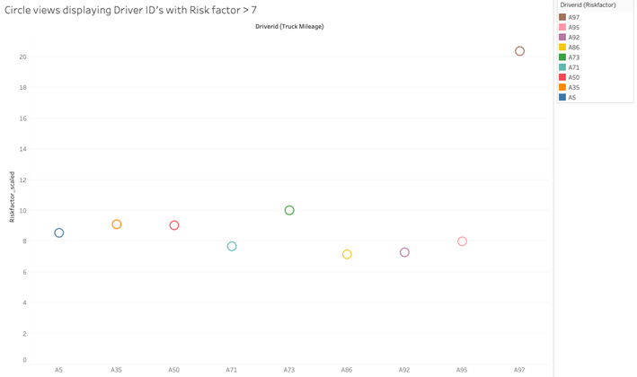
Top 5 risky drivers: A97, A73, A35, A50, A5
Question 3: Drivers contributing to highest no. of events i.e risky drivers?
When Focusing on Driver IDs with Risk
Factor > 7
A97 proves to be the outlier however with a Risk factor of 20.35

Slide 9
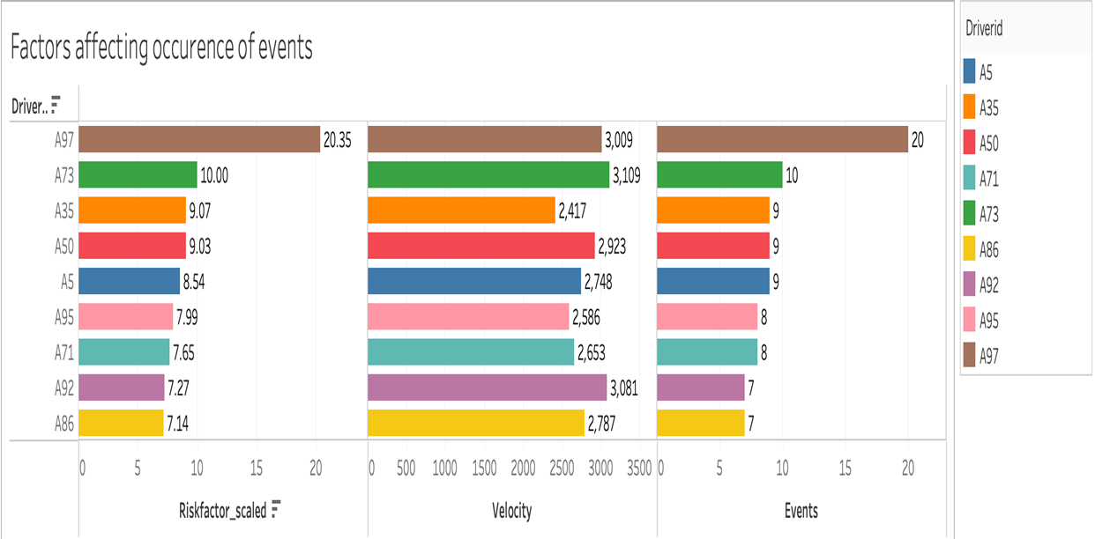
Question 3: Drivers contributing to highest no. of events (contd.)
Driver IDs with risk factor > 7 have been presented here
The speed (velocity) of the vehicle is a significant contributing factor to lane departure incidents.
Following A97, it is evident that Driver ID A73 requires particular attention to effectively reduce accidents.

Slide 10
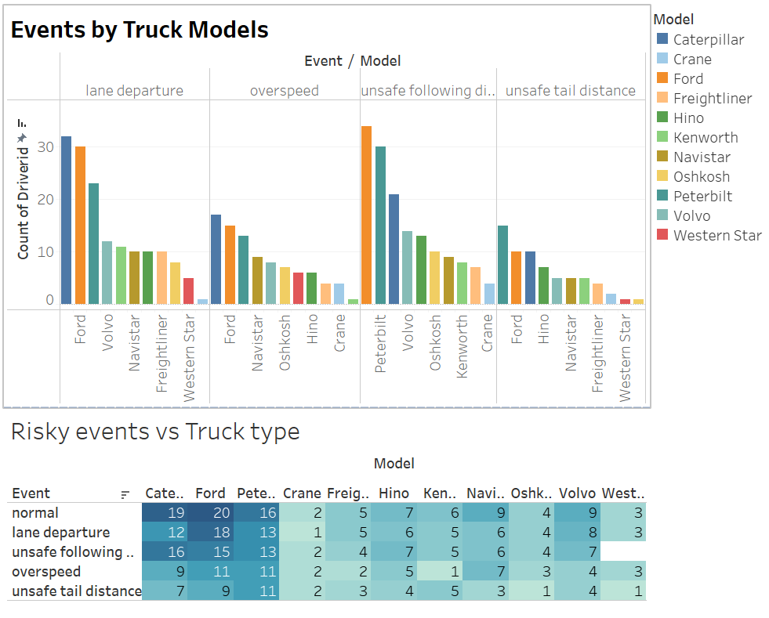
Question 4: Drivers driving the truck models: Ford, Caterpillar & Peterbilt found causing more issues falling under issues.

Slide 11
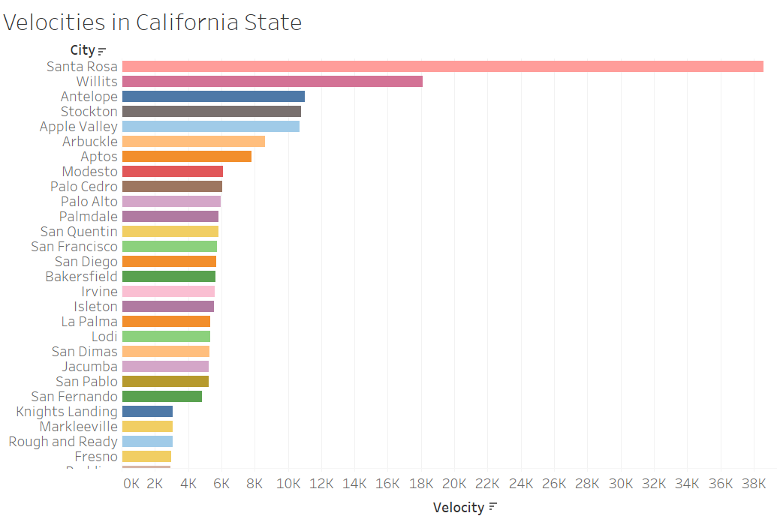
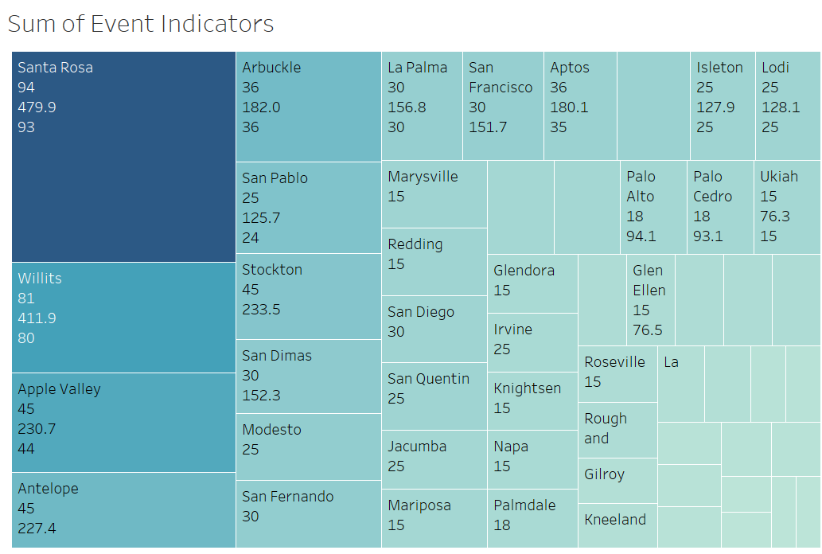
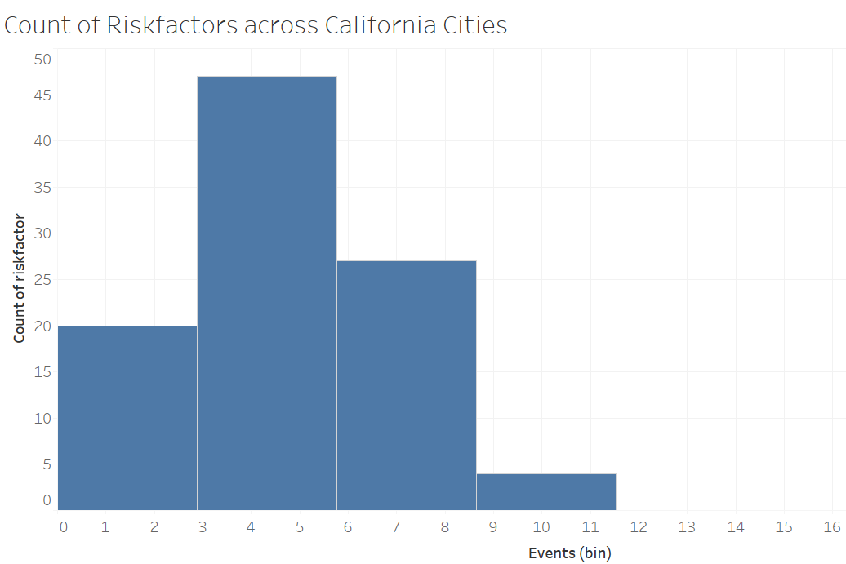
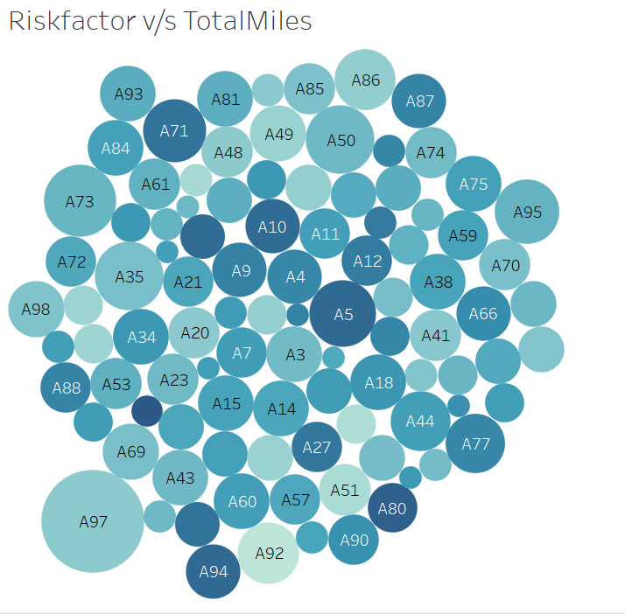

Slide 12
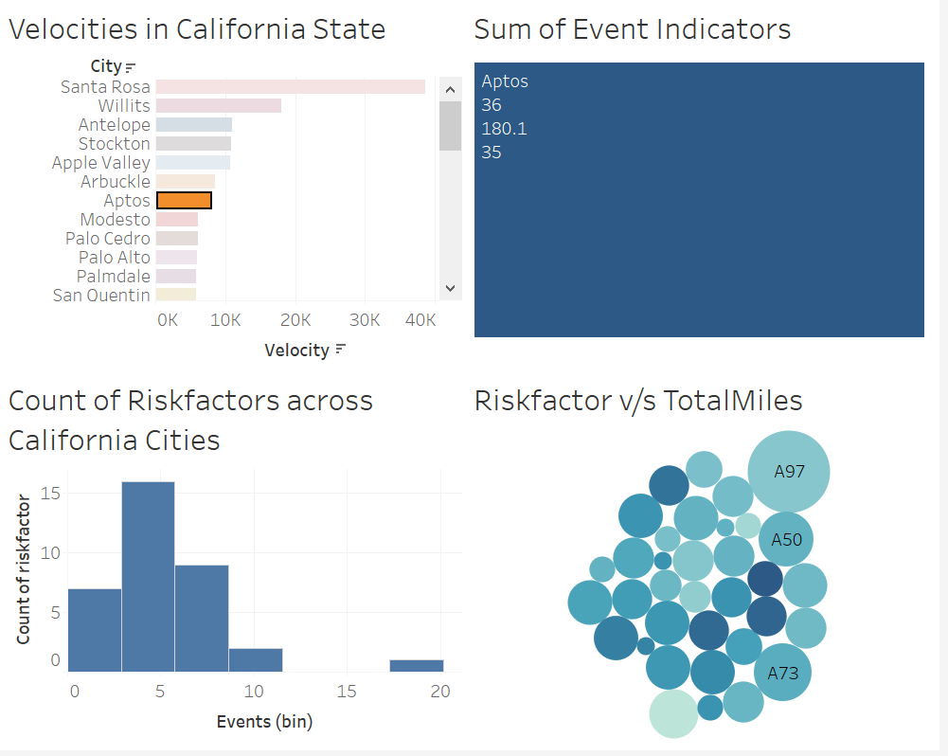
Question 5: How do the risk factors and events in different cities correlate with the total miles driven by truck drivers, and how can this information be used to improve fleet safety and efficiency?
For each city the graph shows the total event indicators and
count of risk-factors and
the drivers contributing to those riskfactors.

Slide 13
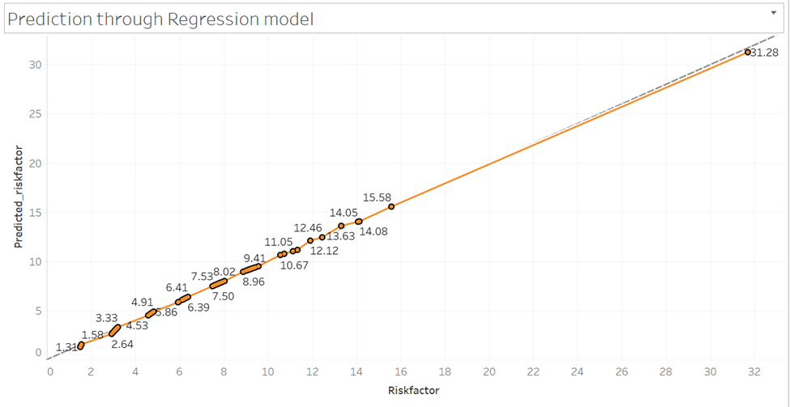
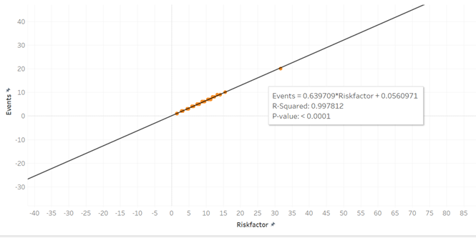
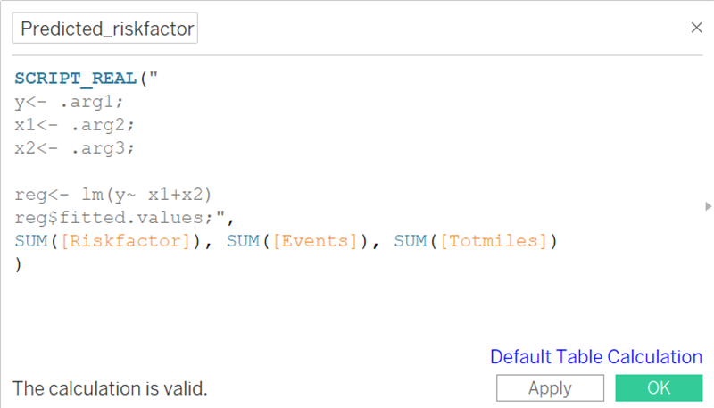
R-integration with Tableau
Simple Linear Regression Model
Linear Regression Model with additional parameters

Slide 14
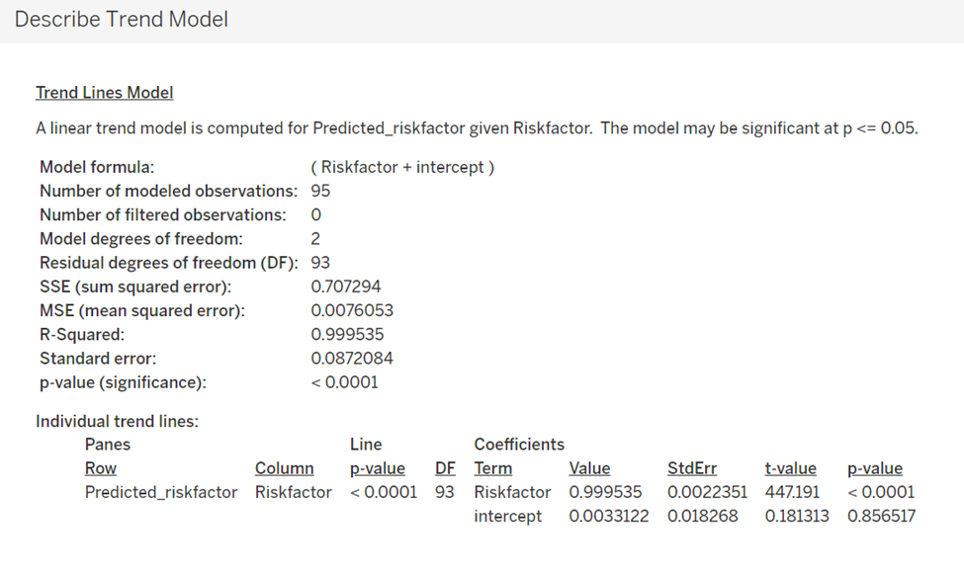
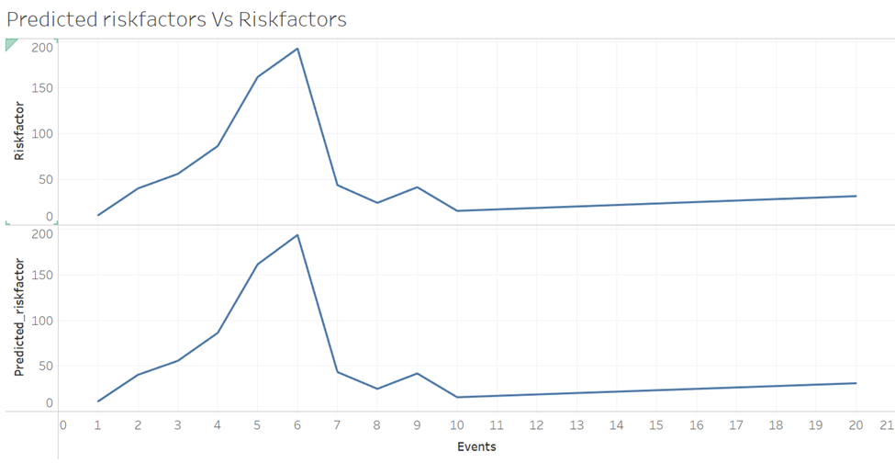
Our model's fit and Accuracy

Slide 15
Challenges
Importing the dataset from Cloudera VM
Integration with R: Compatibility & Configurations
Connecting with EC2 for Mac Systems
Domain knowledge

Slide 16
Conclusion (Action items)
Implement stringent speed regulations for vehicles, especially in cities prone to unsafe events.
Implement strict regulations for drivers with higher risk factors and frequent speeding violations.
Conduct further analysis on Ford, Caterpillar, and Peterbilt models, which are linked to numerous lane departure and unsafe following events.
Total events and miles traveled are key contributors to driver risk, by leveraging a regression model based on historical data.

Slide 17
Thank you!

