Slide 1
The Stitch and Rotten Woods
By Matthew Tucker, Zakkary Huckaby, Johnathan Terry

Slide 2

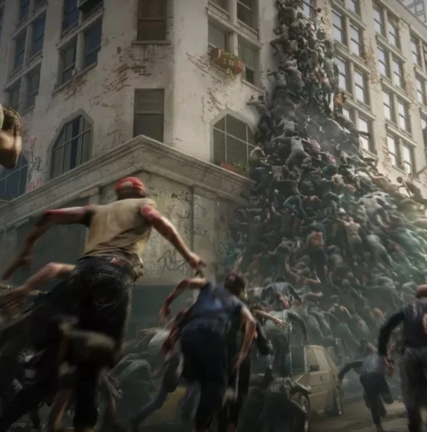
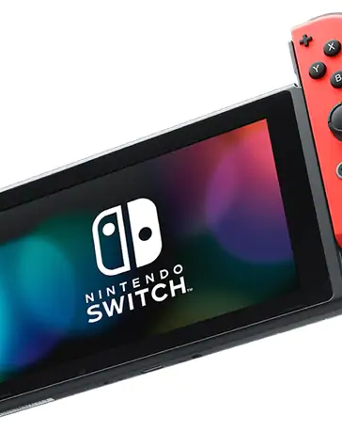
Project Summary
This project is making a mobile platform to play a Zombie game. The game is survival that can go on indefinitely. Zombies will continuously spawn and hunt the player down wherever the player goes. Can you survive the Zombie Apocalypse?

Slide 3
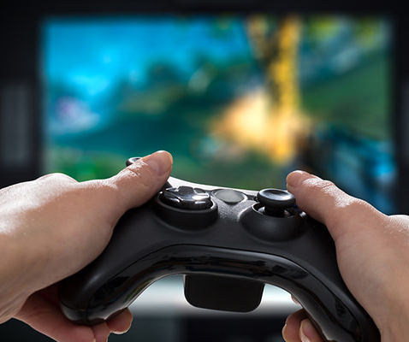
Goals
The goal of this project was to make a mobile platform to play games on and a game to play. The game and platform should be simple and not need internet, as well not require to be plugged in or wired so that in case of a power outage, the platform and game can give someone something to do to pass time.

Slide 4
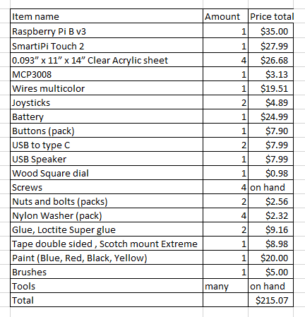

Materials Needed
Software:
Python v2.7.9
Pygame v1.9.6
On Raspberry pi need to enable SPI.
This allows the program to import spidev and use the MCP3008 as needed in game.
https://www.raspberrypi.org/documentation/hardware/raspberrypi/spi/README.md

Slide 5
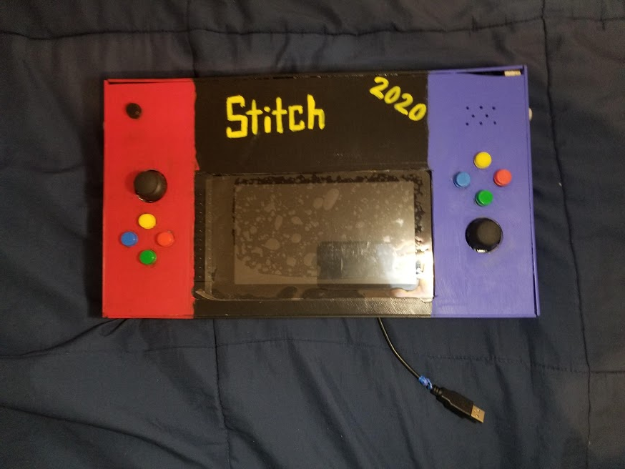
Dimensions
___ Long
___ Wide
___ Tall

Slide 6
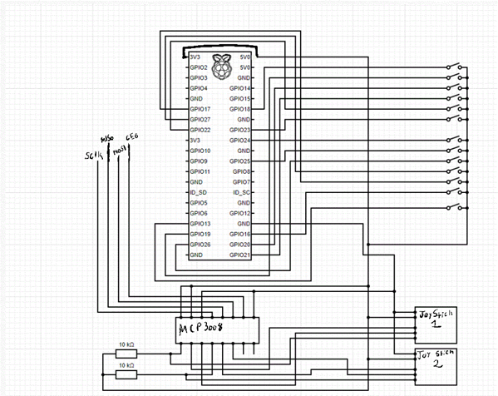
GPIO
GPIO is done through a breadboard and is connected with wires to buttons, MCP3008, and Joysticks.
The MCP3008 turns the Joysticks analog input to digital numbers that a function in the code takes and moves the player.

Slide 7
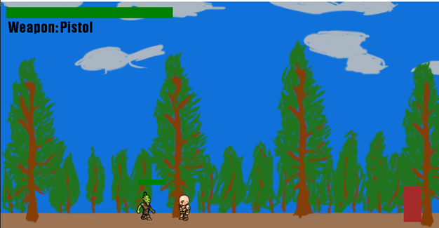
GUI
GUI is told to print an image and or object in code to LCD touchscreen to provide images.
Some images like the player and the Zombie are animated.
Other images like the bullets, arrows, and knife are simple drawings that move in on direction.

Slide 8
Lessons learned
Hardware:
MCP3008 and joystick set up and code
Software:
Print/load an image
Animate movement
Relate to Living with Cyber:
Needed to code a lot. The class and the project had to deal with GPIO, inputs, outputs, and GUI.
Problem solving experience:
Needed to find ways around small problems such as:
Bullets changing to arrows when change weapons
When changing to GPIO quick changing weapons too fast
Sized down:
Sized done the project once realized was trying for too much in short time
Fix analog output from joysticks:
We bouget the joysticks not knowing we needed MCP3008 to change the output. This took an extra week to fix due to shipping
Future:
Know more about how not to over promise a project in short time
Hardware capabilities and need to do more research
How to do GUI better and simple game style.

Slide 9
Future Development
Game:
Fix/better scaling
Fix doors
Add weapons image
More than one enemy
Aiming system
More levels
Day and night cycle
Water/Hunger
Item Drop
Limited ammo
Change zombie and player animations
Add different zombies
Platform:
Allow other games to be played
GUI to select a game

Slide 10

Any Questions?

