Slide 1
ASM 1
Tran Phuc Truong

Slide 2
Create a design specification for data structures, explaining the valid operations that can be carried out on the structures.
1. Array
Description:
An array is a fixed-size collection of elements of the same data type, stored in contiguous memory locations.
Valid Operations:
Access (arr[index]): Retrieve an element at a specific index.
Insert/Update (arr[index] = value): Set or modify the element at a specific index.
Traverse: Iterate through all elements in the array.

Slide 3
Create a design specification for data structures, explaining the valid operations that can be carried out on the structures.
Input Parameters:
Access/Insert: Index (int), Value (for Insert/Update).
Pre-conditions:
Index must be within the bounds of the array (0 ≤ index < size).
Post-conditions:
The value at the specified index is either retrieved (Access) or updated (Insert/Update).
Time Complexity:
Access: O(1)
Insert/Update: O(1)
Traversal: O(n)
Space Complexity: O(n), where n is the number of elements.

Slide 4
Create a design specification for data structures, explaining the valid operations that can be carried out on the structures.
Example:
int[] arr = new int[5];
arr[0] = 10; // Insert
int value = arr[0]; // Access

Slide 5
Create a design specification for data structures, explaining the valid operations that can be carried out on the structures.
2. ArrayList
Description:
ArrayList is a resizable array that can grow dynamically as elements are added.
Valid Operations:
Add (list.add(value)): Append an element.
Get (list.get(index)): Retrieve an element by index.
Set (list.set(index, value)): Update an element at the specified index.
Remove (list.remove(index)): Remove an element at the specified index.
Size (list.size()): Return the current size of the list.

Slide 6
Create a design specification for data structures, explaining the valid operations that can be carried out on the structures.
Input Parameters:
For Add/Set: Value to be added/updated.
For Get/Remove: Index of the element.
Pre-conditions:
Index must be within bounds for Get, Set, or Remove.
Post-conditions:
The ArrayList is updated accordingly after Add, Set, or Remove.
Time Complexity:
Add (amortized): O(1)

Slide 7
Create a design specification for data structures, explaining the valid operations that can be carried out on the structures.
Space Complexity: O(n), where n is the number of elements.
Example:
ArrayList<Integer> list = new ArrayList<>();
list.add(1); // Add
list.set(0, 10); // Update
int value = list.get(0); // Get
list.remove(0); // Remove

Slide 8
Create a design specification for data structures, explaining the valid operations that can be carried out on the structures.
3. LinkedList
Description:
A LinkedList is a linear data structure where each element (node) points to the next element, allowing dynamic memory usage.
Valid Operations:
• AddFirst/AddLast (list.addFirst(value), list.addLast(value)): Insert at the beginning or end.
• RemoveFirst/RemoveLast (list.removeFirst(), list.removeLast()): Remove the first or last element.
• Get (list.get(index)): Retrieve an element by index.
• Size (list.size()): Get the size of the list.
Input Parameters:
• For Add: Value to be added.
• For Get: Index of the element.

Slide 9
Create a design specification for data structures, explaining the valid operations that can be carried out on the structures.
Pre-conditions:
• The list must not be empty for Remove operations.
• Index must be within bounds for Get operations.
Post-conditions:
• The LinkedList is modified with the newly added or removed elements.
Time Complexity:
• AddFirst/AddLast: O(1)
• RemoveFirst/RemoveLast: O(1)
• Get: O(n)
Space Complexity: O(n)

Slide 10
Create a design specification for data structures, explaining the valid operations that can be carried out on the structures.
Example:
LinkedList<String> linkedList = new LinkedList<>();
linkedList.addFirst("Dau");
linkedList.addLast("Duoi");
String element = linkedList.get(0);
linkedList.removeFirst();

Slide 11
Create a design specification for data structures, explaining the valid operations that can be carried out on the structures.
4. HashMap
Description:
HashMap is a key-value pair data structure where keys are mapped to values. It allows for fast lookups.
Valid Operations:
• Put (map.put(key, value)): Insert or update a key-value pair.
• Get (map.get(key)): Retrieve the value associated with a key.
• Remove (map.remove(key)): Remove a key-value pair by key.
• ContainsKey (map.containsKey(key)): Check if a key exists in the map.
Input Parameters:
• Put/Remove/Get: Key and Value for Put; Key for Remove and Get.

Slide 12
Create a design specification for data structures, explaining the valid operations that can be carried out on the structures.
Pre-conditions:
• Key must be non-null.
Post-conditions:
• The HashMap is modified after Put or Remove operations.
Time Complexity:
• Put/Get/Remove: O(1) (in the average case)
Space Complexity: O(n), where n is the number of key-value pairs.
Example:
HashMap<String, Integer> map = new HashMap<>();
map.put("Truong", 25); // Add
int age = map.get("Truong"); // Get
map.remove("Truong"); // Remove

Slide 13
Create a design specification for data structures, explaining the valid operations that can be carried out on the structures.
5. Stack
Description:
Stack is a Last-In-First-Out (LIFO) data structure. Elements are added and removed from the same end.
Valid Operations:
• Push (stack.push(value)): Add an element to the top.
• Pop (stack.pop()): Remove and return the top element.
• Peek (stack.peek()): View the top element without removing it.
• isEmpty (stack.isEmpty()): Check if the stack is empty.
Input Parameters:
• For Push: Value to be added.

Slide 14
Create a design specification for data structures, explaining the valid operations that can be carried out on the structures.
Pre-conditions:
• The stack must not be empty for Pop and Peek operations.
Post-conditions:
• The stack is modified by the Push and Pop operations.
Time Complexity:
• Push/Pop/Peek: O(1)
Space Complexity: O(n)
Example:
Stack<Integer> stack = new Stack<>();
stack.push(1); // Push
int top = stack.peek(); // Peek
int popped = stack.pop(); // Pop

Slide 15
Create a design specification for data structures, explaining the valid operations that can be carried out on the structures.
5. Stack
Description:
Stack is a Last-In-First-Out (LIFO) data structure. Elements are added and removed from the same end.
Valid Operations:
• Push (stack.push(value)): Add an element to the top.
• Pop (stack.pop()): Remove and return the top element.
• Peek (stack.peek()): View the top element without removing it.
• isEmpty (stack.isEmpty()): Check if the stack is empty.
Input Parameters:
• For Push: Value to be added.

Slide 16
Create a design specification for data structures, explaining the valid operations that can be carried out on the structures.
6. Queue
Description:
Queue is a First-In-First-Out (FIFO) data structure where elements are added to the rear and removed from the front.
Valid Operations:
• Enqueue (queue.add(value)): Add an element to the rear.
• Dequeue (queue.remove()): Remove and return the front element.
• Peek (queue.peek()): View the front element without removing it.
• isEmpty (queue.isEmpty()): Check if the queue is empty.
Input Parameters:
• For Enqueue: Value to be added.

Slide 17
Create a design specification for data structures, explaining the valid operations that can be carried out on the structures.
Pre-conditions:
• The queue must not be empty for Dequeue and Peek operations.
Post-conditions:
• The queue is modified after Enqueue and Dequeue operations.
Time Complexity:
• Enqueue/Dequeue: O(1)
Space Complexity: O(n)
Example:
Queue<String> queue = new LinkedList<>();
queue.add("Task 1"); // Enqueue
String task = queue.remove(); // Dequeue

Slide 18
Determine the operations of a memory stack and how it is used to implement function calls in a computer.
1. Memory Stack Overview
The memory stack is used to:
• Keep track of function calls and their execution order.
• Store local variables, return addresses, and function arguments.
• Facilitate function call returns by keeping track of the execution point where the function was called.
2. Operations of a Memory Stack
The main operations performed on a memory stack are:
• Push: Add a new stack frame when a function is called.
• Pop: Remove a stack frame when a function call returns.
• Peek: Access the top stack frame to determine the current function's state.
• Stack Overflow: Occurs when too many function calls are made, exceeding the stack's memory limit.

Slide 19
Determine the operations of a memory stack and how it is used to implement function calls in a computer.
These operations follow the LIFO principle, where the most recently pushed item (the top of the stack) is the first to be popped.
Push Operation:
When a function is called, a new stack frame is created and pushed onto the stack. A stack frame contains:
• Return address: Location in the program where control returns after the function finishes.
• Function parameters: Arguments passed to the function.
• Local variables: Variables declared within the function.
Pop Operation:
When a function finishes executing, its stack frame is popped from the stack. Control is transferred to the return address saved in the stack frame, and the function's local data is cleared from memory.

Slide 20
Determine the operations of a memory stack and how it is used to implement function calls in a computer.
3. Function Call Implementation Using a Memory Stack
The memory stack plays a crucial role in managing function calls in procedural programming languages like C, Java, and Python. Here's how it works:
Function Call Process:
1. Function Call: When a function is invoked, the program's current state is saved on the stack. A new stack frame is created, and the following information is stored:
o The return address: The point in the code where the function was called.
o The arguments: The parameters passed to the function.
o The local variables: Variables defined within the function.
2. Function Execution: Once the function is called, the CPU starts executing the function code. The local variables and parameters remain in the stack frame throughout the function's execution.

Slide 21
Determine the operations of a memory stack and how it is used to implement function calls in a computer.
Return: After the function completes its execution, the stack frame is popped from the stack. The control is transferred to the return address, and the local variables and function arguments are discarded.
Example: Function Call Stack in Action (C-style pseudocode)
int main() {
int x = 5;
int result = multiply(x, 3);
}
int multiply(int a, int b) {
return a * b;
}

Slide 22
Determine the operations of a memory stack and how it is used to implement function calls in a computer.
Stack Frame Process:
Call main():
• A stack frame is created for main(), containing the local variable x and space for result.
Call multiply(5, 3):
• A new stack frame is created for multiply(), containing the arguments a = 5 and b = 3.
• The return address (pointing to where main() called multiply()) is stored in the stack frame.
Return to main():
• The multiply() function completes and its stack frame is popped. Control returns to main(), and the result is assigned to result.

Slide 23
Determine the operations of a memory stack and how it is used to implement function calls in a computer.
4. Stack Frames and Their Structure
A stack frame is the structure that holds information about function calls. When a function is invoked, a stack frame is pushed onto the memory stack. Each stack frame typically contains the following:
• Return Address: The memory address where the function will return after execution.
• Function Parameters: Arguments passed to the function.
• Local Variables: Variables defined within the function.
• Saved Registers: Some functions may save the values of certain registers before they execute.
Example of a Stack Frame in Action:
Consider a simple program with nested function calls:

Slide 24
Determine the operations of a memory stack and how it is used to implement function calls in a computer.
4. Stack Frames and Their Structure
A stack frame is the structure that holds information about function calls. When a function is invoked, a stack frame is pushed onto the memory stack. Each stack frame typically contains the following:
• Return Address: The memory address where the function will return after execution.
• Function Parameters: Arguments passed to the function.
• Local Variables: Variables defined within the function.
• Saved Registers: Some functions may save the values of certain registers before they execute.
Example of a Stack Frame in Action:
Consider a simple program with nested function calls:

Slide 25
Determine the operations of a memory stack and how it is used to implement function calls in a computer.
int funcB(int y) {
int z = y + 5;
return z;
}
int funcA(int x) {
return funcB(x * 2);
}
int main() {
int result = funcA(3);
}

Slide 26
Determine the operations of a memory stack and how it is used to implement function calls in a computer.
Stack Frames for This Program:
1. Stack Frame for main():
o Local variable: result
o Function call: funcA(3)
2. Stack Frame for funcA(3):
o Argument: x = 3
o Local variable: None
o Function call: funcB(6)

Slide 27
Determine the operations of a memory stack and how it is used to implement function calls in a computer.
3. Stack Frame for funcB(6):
o Argument: y = 6
o Local variable: z = 11
After funcB completes, its stack frame is popped, and control returns to funcA, which then completes and returns control to main().

Slide 28
Determine the operations of a memory stack and how it is used to implement function calls in a computer.
5. Importance of Memory Stack in Function Calls
The memory stack is essential for managing function calls in modern programming for several reasons:
• Efficient Control Flow: It maintains the order of function calls and ensures that each function returns control to the correct location in the program.
• Memory Management: Each function’s local variables and arguments are isolated in its stack frame, preventing conflicts between different function calls.
• Recursion Handling: The stack allows recursive function calls by creating new frames for each recursive call. This is critical for recursion to function correctly.
Stack Overflow:
One of the risks of the memory stack is stack overflow, which happens when the stack runs out of memory. This can occur if there are too many nested or recursive function calls without termination.

Slide 29
Determine the operations of a memory stack and how it is used to implement function calls in a computer.
6. Example of Recursive Function and Stack Overflow
Consider the following recursive function:
public int factorial(int n) {
if (n == 0) return 1;
return n * factorial(n - 1);
}
Each call to factorial() pushes a new stack frame onto the memory stack. If n is very large or if the base case (n = 0) is never reached, the stack will grow until it exceeds the available memory, resulting in a stack overflow.

Slide 30
Illustrate, with an example, a concrete data structure for a First in First out (FIFO) queue.
A First-In-First-Out (FIFO) queue is a type of data structure where elements are added at one end (the rear) and removed from the opposite end (the front). The first element added to the queue will be the first one to be removed, which is why it's referred to as "first in, first out." This behavior mimics real-world queues, such as a line of people waiting at a checkout counter.
1. Defining the Structure of a FIFO Queue
In a FIFO queue, the operations are as follows:
• Enqueue (Add): Insert an element at the rear of the queue.
• Dequeue (Remove): Remove an element from the front of the queue.
• Peek/Front: View the front element without removing it.
• IsEmpty: Check whether the queue is empty.
A FIFO queue can be implemented using various data structures, such as arrays or linked lists. We'll explore both implementations.

Slide 31
Illustrate, with an example, a concrete data structure for a First in First out (FIFO) queue.
2. Array-Based Implementation of a FIFO Queue
In an array-based queue, we use an array to store the elements. Two pointers (indices) are maintained:
• Front: Points to the first element in the queue.
• Rear: Points to the last element in the queue.
Array-Based Queue Structure:
• Capacity: The maximum size of the queue (fixed).
• Array: Stores the elements.
• Front and Rear pointers to track where elements are added and removed.

Slide 32
Illustrate, with an example, a concrete data structure for a First in First out (FIFO) queue.
Example Implementation (Java-style Pseudocode):
class ArrayQueue {
int[] queue;
int front, rear, capacity, size;
public ArrayQueue(int capacity) {
this.capacity = capacity;
queue = new int[capacity];
front = 0;
rear = -1;
size = 0;
}

Slide 33
Illustrate, with an example, a concrete data structure for a First in First out (FIFO) queue.
Example Implementation (Java-style Pseudocode):
// Enqueue operation
public void enqueue(int value) {
if (size == capacity) {
System.out.println("Queue is full!");
return;
}
rear = (rear + 1) % capacity; // Circular increment
queue[rear] = value;
size++;
}

Slide 34
Illustrate, with an example, a concrete data structure for a First in First out (FIFO) queue.
Example Implementation (Java-style Pseudocode):
// Dequeue operation
public int dequeue() {
if (size == 0) {
System.out.println("Queue is empty!");
return -1;
}
int value = queue[front];
front = (front + 1) % capacity; // Circular increment
size--;
return value;
}

Slide 35
Illustrate, with an example, a concrete data structure for a First in First out (FIFO) queue.
Example Implementation (Java-style Pseudocode):
// Peek operation
public int peek() {
if (size == 0) {
System.out.println("Queue is empty!");
return -1;
}
return queue[front];
}
// Check if the queue is empty
public boolean isEmpty() {
return size == 0;
}
}

Slide 36
Illustrate, with an example, a concrete data structure for a First in First out (FIFO) queue.
Array Queue Example:
ArrayQueue q = new ArrayQueue(5);
q.enqueue(10); // Queue: [10]
q.enqueue(20); // Queue: [10, 20]
q.enqueue(30); // Queue: [10, 20, 30]
q.dequeue(); // Queue: [20, 30] (10 is removed)
q.peek(); // Returns 20, the front of the queue
After the operations, the front points to 20, and the rear points to 30. The size of the queue is 2.

Slide 37
Illustrate, with an example, a concrete data structure for a First in First out (FIFO) queue.
3. Linked List-Based Implementation of a FIFO Queue
A linked list-based queue uses a linked list to store elements. In this implementation:
• Each node contains an element and a pointer to the next node.
• Two pointers are maintained:
o Front: Points to the first node (head) in the queue.
o Rear: Points to the last node (tail) in the queue.
Linked List-Based Queue Structure:
• Node: Each element in the queue is represented by a node.
• Front and Rear: Pointers to the first and last nodes in the list.

Slide 38
Illustrate, with an example, a concrete data structure for a First in First out (FIFO) queue.
Example Implementation (Java-style Pseudocode):
class Node {
int data;
Node next;
public Node(int data) {
this.data = data;
this.next = null;
}
}

Slide 39
Illustrate, with an example, a concrete data structure for a First in First out (FIFO) queue.
class LinkedListQueue {
Node front, rear;
public LinkedListQueue() {
this.front = this.rear = null;
}
// Enqueue operation
public void enqueue(int value) {
Node newNode = new Node(value);
if (rear == null) {
front = rear = newNode;
return;
}
rear.next = newNode;
rear = newNode;
}

Slide 40
Illustrate, with an example, a concrete data structure for a First in First out (FIFO) queue.
// Dequeue operation
public int dequeue() {
if (front == null) {
System.out.println("Queue is empty!");
return -1;
}
int value = front.data;
front = front.next;
if (front == null) {
rear = null; // Queue is empty
}
return value;
}

Slide 41
Illustrate, with an example, a concrete data structure for a First in First out (FIFO) queue.
// Peek operation
public int peek() {
if (front == null) {
System.out.println("Queue is empty!");
return -1;
}
return front.data;
}
// Check if the queue is empty
public boolean isEmpty() {
return front == null;
}
}

Slide 42
Illustrate, with an example, a concrete data structure for a First in First out (FIFO) queue.
Linked List Queue Example:
LinkedListQueue q = new LinkedListQueue();
q.enqueue(10); // Queue: [10]
q.enqueue(20); // Queue: [10, 20]
q.enqueue(30); // Queue: [10, 20, 30]
q.dequeue(); // Queue: [20, 30] (10 is removed)
q.peek(); // Returns 20, the front of the queue
• After the operations, the front points to 20, and the rear points to 30. The previous front (10) is removed.

Slide 43
Illustrate, with an example, a concrete data structure for a First in First out (FIFO) queue.
4. Concrete Example to Illustrate a FIFO Queue
Let's illustrate a real-world example using a ticket counter scenario, where people line up to buy tickets. The first person to enter the line will be the first one to be served, and new people will join the line at the end.
Queue Operations:
• Person 1 enters the queue (enqueue 1)
• Person 2 enters the queue (enqueue 2)
• Person 3 enters the queue (enqueue 3)
• Person 1 is served and leaves the queue (dequeue)
• Person 2 is served and leaves the queue (dequeue)
• Person 4 enters the queue (enqueue 4)

Slide 44
Illustrate, with an example, a concrete data structure for a First in First out (FIFO) queue.
Visual Representation:
Operation | Queue State
Enqueue(1) | [1]
Enqueue(2) | [1, 2]
Enqueue(3) | [1, 2, 3]
Dequeue() | [2, 3]
Dequeue() | [3]
Enqueue(4) | [3, 4]
After these operations, the front of the queue is 3 and the rear is 4.

Slide 45
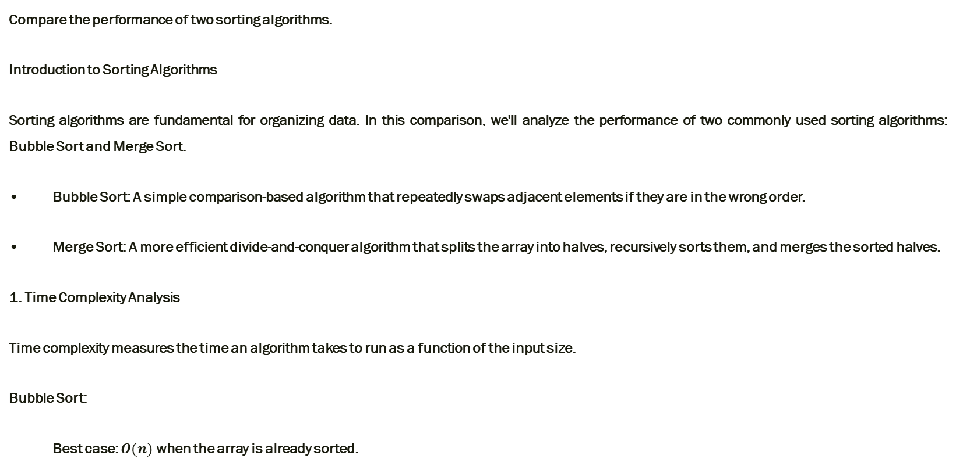
Compare the performance of two sorting algorithms.
Compare the performance of two sorting algorithms.
Introduction to Sorting Algorithms
Sorting algorithms are fundamental for organizing data. In this comparison, we'll analyze the performance of two commonly used sorting algorithms: Bubble Sort and Merge Sort.
• Bubble Sort: A simple comparison-based algorithm that repeatedly swaps adjacent elements if they are in the wrong order.
• Merge Sort: A more efficient divide-and-conquer algorithm that splits the array into halves, recursively sorts them, and merges the sorted halves.
1. Time Complexity Analysis
Time complexity measures the time an algorithm takes to run as a function of the input size.
Bubble Sort:
Best case: $O(n)$when the array is already sorted.

Slide 46
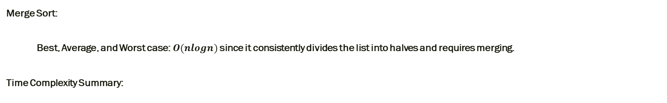
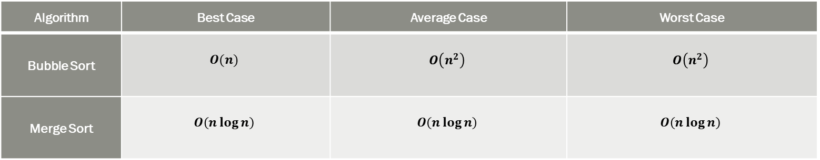
Compare the performance of two sorting algorithms.
Merge Sort:
Best, Average, and Worst case:$O(nlogn)$ since it consistently divides the list into halves and requires merging.
Time Complexity Summary:
Algorithm | Best Case | Average Case | Worst Case
Bubble Sort | $$O(n)$$ | $$O\left(n^{2}\right)$$ | $$O\left(n^{2}\right)$$
Merge Sort | $$O\left(n\log{n}\right)$$ | $$O\left(n\log{n}\right)$$ | $$O\left(n\log{n}\right)$$
2. Space Complexity Analysis
Space complexity measures the amount of extra memory an algorithm needs to function.

Slide 47

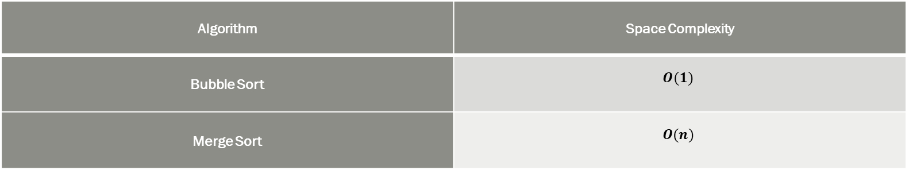
Compare the performance of two sorting algorithms.
Bubble Sort:
Space complexity: $O(1)$, because sorting is done in-place with no additional data structures.
Merge Sort:
Space complexity: $O(n)$, since it requires additional space to store the halves during the merge process.
Space Complexity Summary:
Algorithm | Space Complexity
Bubble Sort | $$O(1)$$
Merge Sort | $$O(n)$$

Slide 48
Compare the performance of two sorting algorithms.
3. Stability
Stability refers to maintaining the relative order of equal elements in the sorted array.
Bubble Sort:
• Stable: Bubble Sort is stable because adjacent elements are only swapped when necessary, preserving order for equal elements.
Merge Sort:
• Stable: Merge Sort is also stable because it only merges sorted subarrays, preserving the order of equal elements.
Stability Summary:
Algorithm | Stability
Bubble Sort | Stable
Merge Sort | Stable

Slide 49
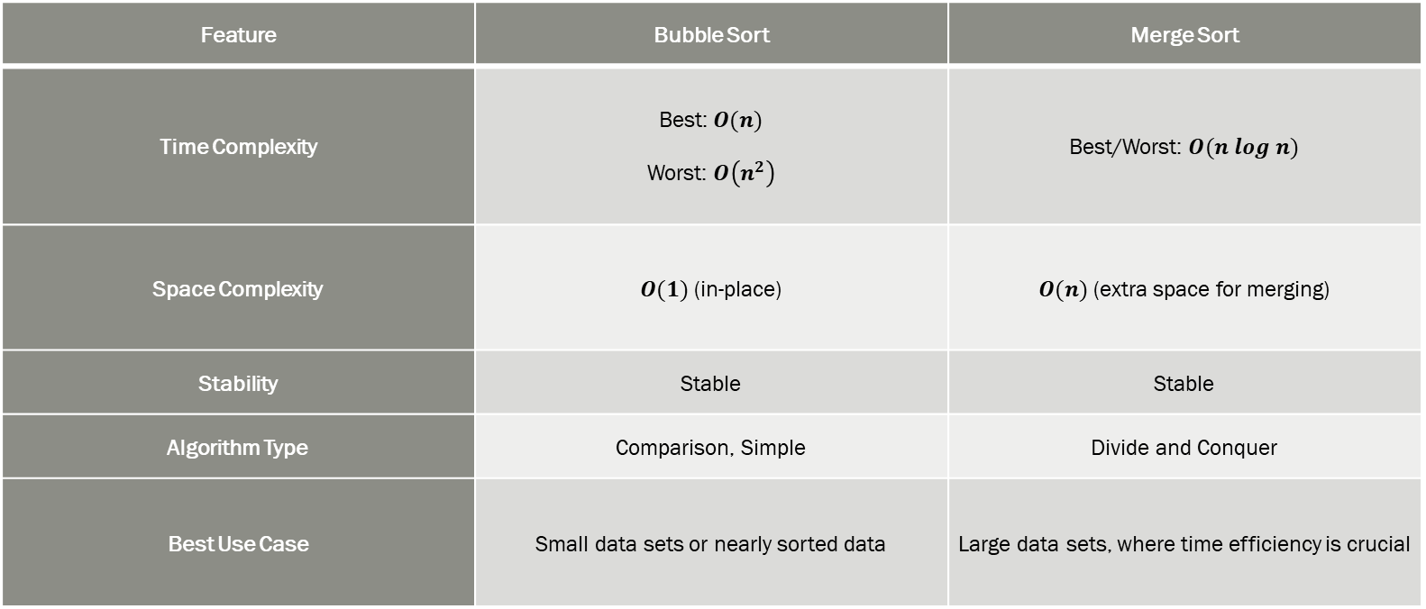
Compare the performance of two sorting algorithms.
4. Comparison Table
Feature | Bubble Sort | Merge Sort
Time Complexity | Best: $O(n)$ Worst: $O\left(n^{2}\right)$ | Best/Worst: $O(n log n)$
Space Complexity | $O(1)$ (in-place) | $O(n)$ (extra space for merging)
Stability | Stable | Stable
Algorithm Type | Comparison, Simple | Divide and Conquer
Best Use Case | Small data sets or nearly sorted data | Large data sets, where time efficiency is crucial

Slide 50
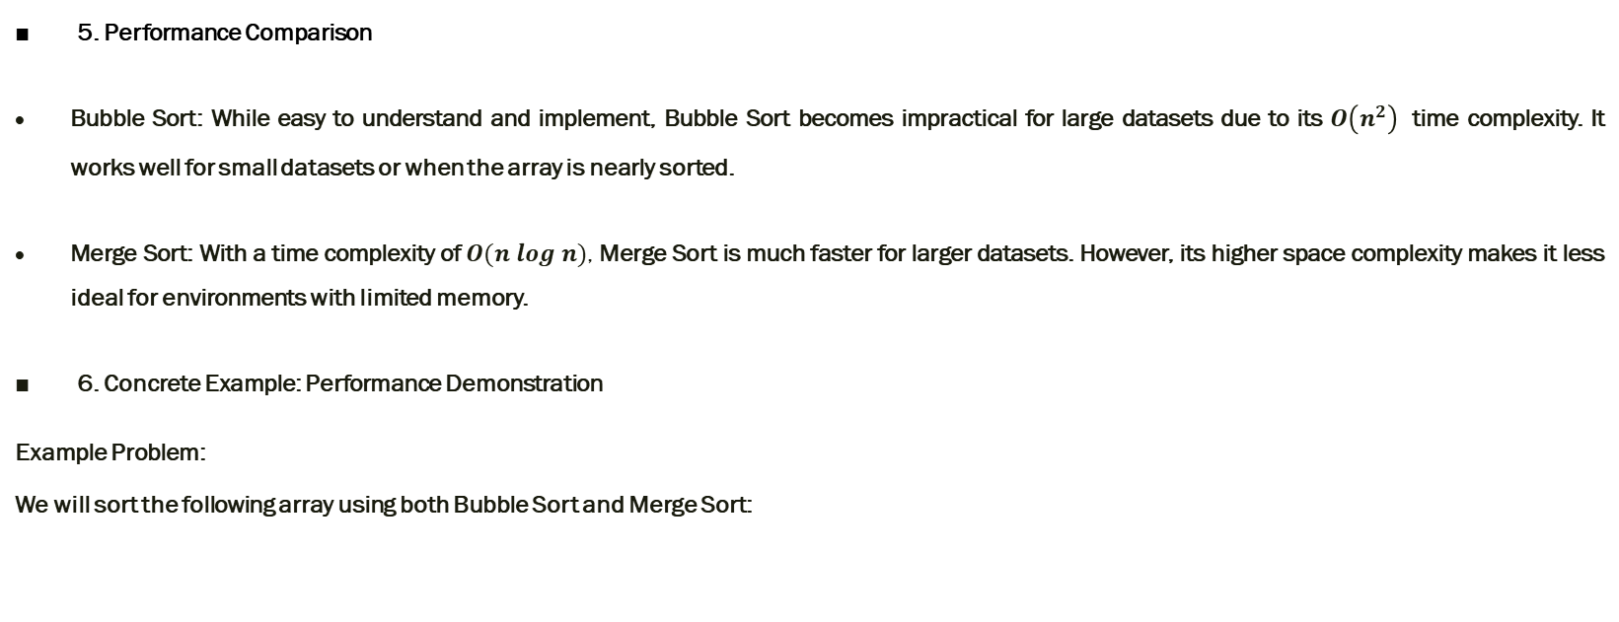
Compare the performance of two sorting algorithms.
5. Performance Comparison
Bubble Sort: While easy to understand and implement, Bubble Sort becomes impractical for large datasets due to its $O\left(n^{2}\right)$ time complexity. It works well for small datasets or when the array is nearly sorted.
Merge Sort: With a time complexity of $O(n log n)$, Merge Sort is much faster for larger datasets. However, its higher space complexity makes it less ideal for environments with limited memory.
6. Concrete Example: Performance Demonstration
Example Problem:
We will sort the following array using both Bubble Sort and Merge Sort:
Array = [5, 3, 8, 4, 2, 7, 1, 10]

Slide 51
Compare the performance of two sorting algorithms.
Bubble Sort (Pseudocode):
void bubbleSort(int[] arr) {
int n = arr.length;
for (int i = 0; i < n-1; i++) {
for (int j = 0; j < n-i-1; j++) {
if (arr[j] > arr[j+1]) {
// Swap arr[j] and arr[j+1]
int temp = arr[j];
arr[j] = arr[j+1];
arr[j+1] = temp;
}
}
}
}

Slide 52
Compare the performance of two sorting algorithms.
Steps of Bubble Sort:
First pass: After the first pass, the largest number 10 moves to the last position.
Array: [5, 3, 4, 2, 7, 1, 8, 10]
Second pass: The second-largest number 8 moves to its correct position.
Array: [5, 3, 4, 2, 7, 1, 8, 10]
3Continue this process until the array is fully sorted:
Array: [1, 2, 3, 4, 5, 7, 8, 10]

Slide 53
Compare the performance of two sorting algorithms.
Merge Sort (Pseudocode):
void mergeSort(int[] arr, int left, int right) {
if (left < right) {
int mid = left + (right - left) / 2;
mergeSort(arr, left, mid);
mergeSort(arr, mid + 1, right);
merge(arr, left, mid, right);
}
}
void merge(int[] arr, int left, int mid, int right) {
int n1 = mid - left + 1;
int n2 = right - mid;

Slide 54
Compare the performance of two sorting algorithms.
int i = 0, j = 0, k = left;
while (i < n1 && j < n2) {
if (L[i] <= R[j]) {
arr[k] = L[i];
i++;
} else {
arr[k] = R[j];
j++;
}
k++;
}

Slide 55
Compare the performance of two sorting algorithms.
while (i < n1) {
arr[k] = L[i];
i++;
k++;
}
while (j < n2) {
arr[k] = R[j];
j++;
k++;
}
}

