Slide 1
ASM 1
Tran Phuc Truong

Slide 2
1. A stack ADT, a concrete data structure for a First In First out (FIFO) queue.

Slide 3
1. A stack ADT, a concrete data structure for a First In First out (FIFO) queue.
What is DSA?

Slide 4
1. A stack ADT, a concrete data structure for a First In First out (FIFO) queue.
Data Structures

Slide 5
1. A stack ADT, a concrete data structure for a First In First out (FIFO) queue.
Definition: A data structure is a way of organizing, managing, and storing data so that it can be accessed and modified efficiently. They define the layout of data and enable efficient data manipulation.

Slide 6
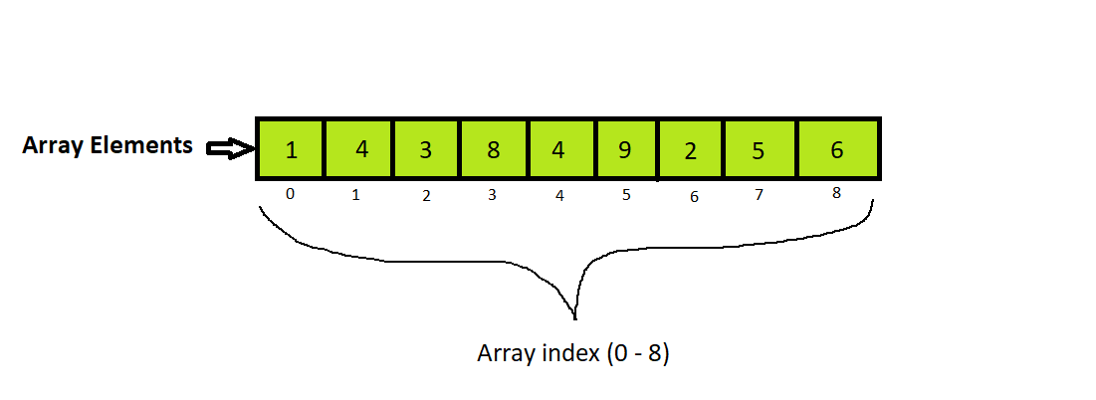
1. A stack ADT, a concrete data structure for a First In First out (FIFO) queue.
Examples: Common data structures include:
Arrays: A collection of elements identified by index, useful for storing a list of items of the same type.

Slide 7
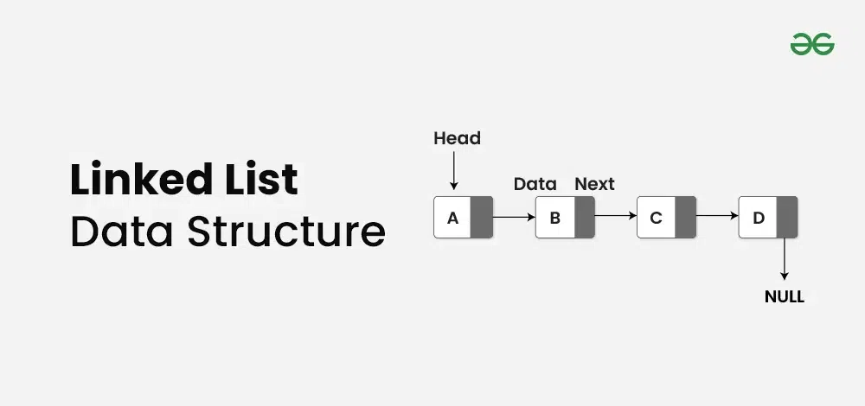
1. A stack ADT, a concrete data structure for a First In First out (FIFO) queue.
Examples: Common data structures include:
Linked Lists: A sequence of nodes, where each node contains data and a pointer to the next node, useful for dynamic memory allocation.

Slide 8
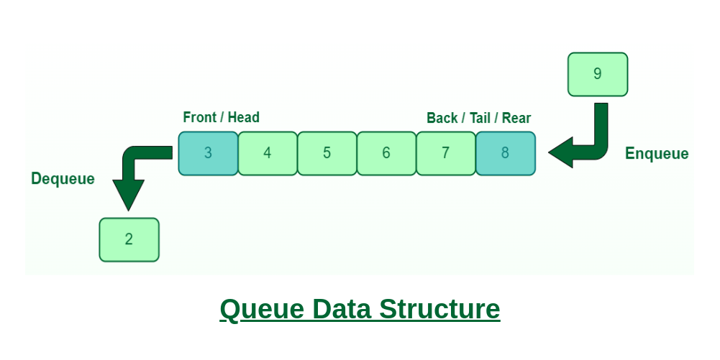
1. A stack ADT, a concrete data structure for a First In First out (FIFO) queue.
Examples: Common data structures include:
Queues: A First In First Out (FIFO) data structure where elements are added at the end and removed from the front.

Slide 9
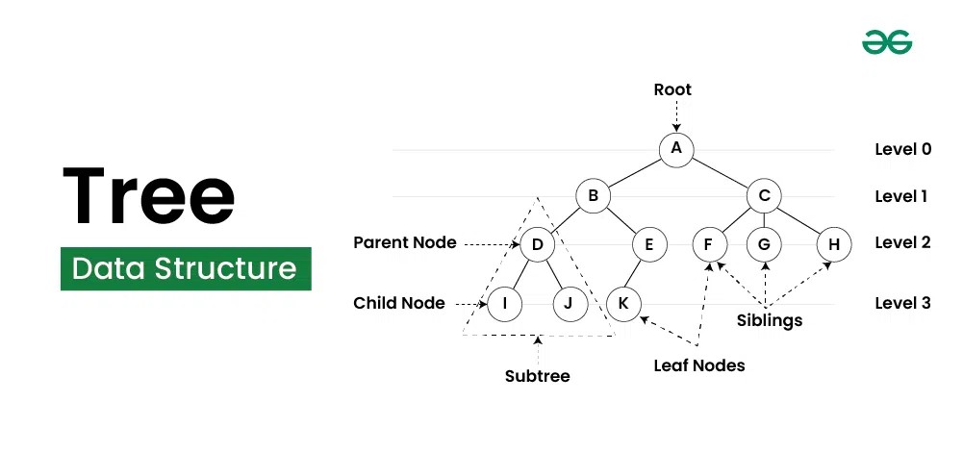
1. A stack ADT, a concrete data structure for a First In First out (FIFO) queue.
Trees: A hierarchical data structure consisting of nodes, useful for representing relationships and hierarchies.
Examples: Common data structures include:
Trees: A hierarchical data structure consisting of nodes, useful for representing relationships and hierarchies.

Slide 10
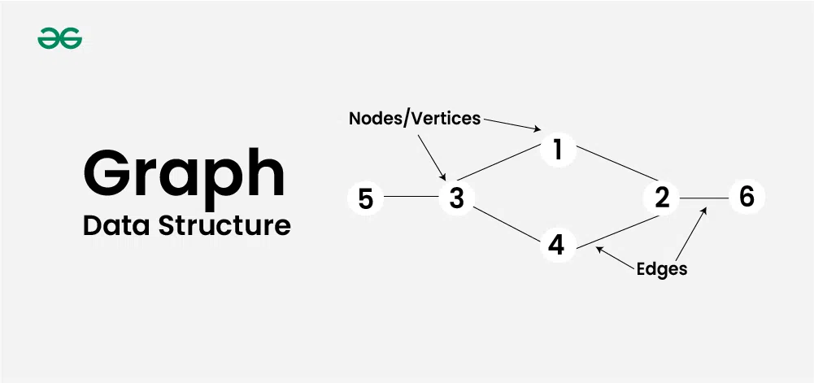
1. A stack ADT, a concrete data structure for a First In First out (FIFO) queue.
Trees: A hierarchical data structure consisting of nodes, useful for representing relationships and hierarchies.
Examples: Common data structures include:
Graphs: A set of vertices connected by edges, useful for modeling networks.

Slide 11
1. A stack ADT, a concrete data structure for a First In First out (FIFO) queue.
Trees: A hierarchical data structure consisting of nodes, useful for representing relationships and hierarchies.
Data structures are chosen based on the requirements of the application. For example, a stack is ideal for problems where the most recently added data needs to be accessed first, while a queue is used when the earliest added data should be processed first.

Slide 12
1. A stack ADT, a concrete data structure for a First In First out (FIFO) queue.
Trees: A hierarchical data structure consisting of nodes, useful for representing relationships and hierarchies.
Algorithms

Slide 13
1. A stack ADT, a concrete data structure for a First In First out (FIFO) queue.
Trees: A hierarchical data structure consisting of nodes, useful for representing relationships and hierarchies.
Definition: An algorithm is a step-by-step procedure or formula for solving a problem. It defines a sequence of instructions to perform a specific task and works with data structures to manipulate and retrieve data.

Slide 14
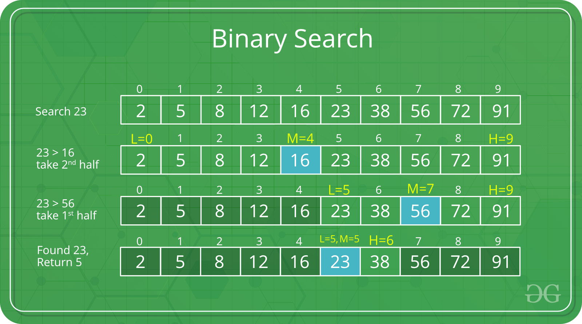
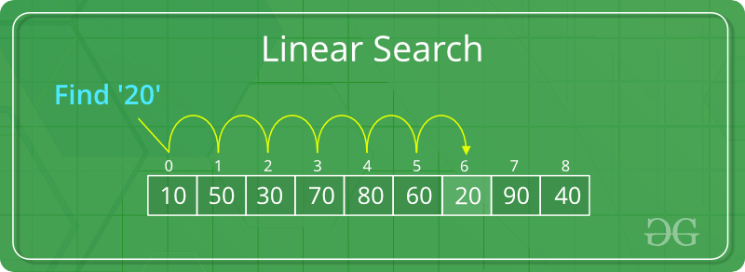
1. A stack ADT, a concrete data structure for a First In First out (FIFO) queue.
Trees: A hierarchical data structure consisting of nodes, useful for representing relationships and hierarchies.
Examples: Some commonly used Searching Algorithms include:
Searching Algorithms: Like binary search and linear search, used to find elements in a data structure.

Slide 15
1. A stack ADT, a concrete data structure for a First In First out (FIFO) queue.
Trees: A hierarchical data structure consisting of nodes, useful for representing relationships and hierarchies.
Binary Search
Definition: Binary search is a more efficient algorithm for finding an element in a sorted list by repeatedly dividing the search interval in half.
Precondition: The list must be sorted in ascending or descending order.

Slide 16
1. A stack ADT, a concrete data structure for a First In First out (FIFO) queue.
Trees: A hierarchical data structure consisting of nodes, useful for representing relationships and hierarchies.
Binary Search
Steps:
1. Set two pointers, one at the start (low) and one at the end (high) of the list.
2. Find the middle element of the list.
3. Compare the middle element with the target:
If the middle element matches the target, return the index.
If the target is less than the middle element, focus on the left half (adjust high to be mid - 1).
If the target is greater than the middle element, focus on the right half (adjust low to be mid + 1).
4. Repeat steps 2-3 until you find the target or low becomes greater than high, meaning the target is not in the list.

Slide 17
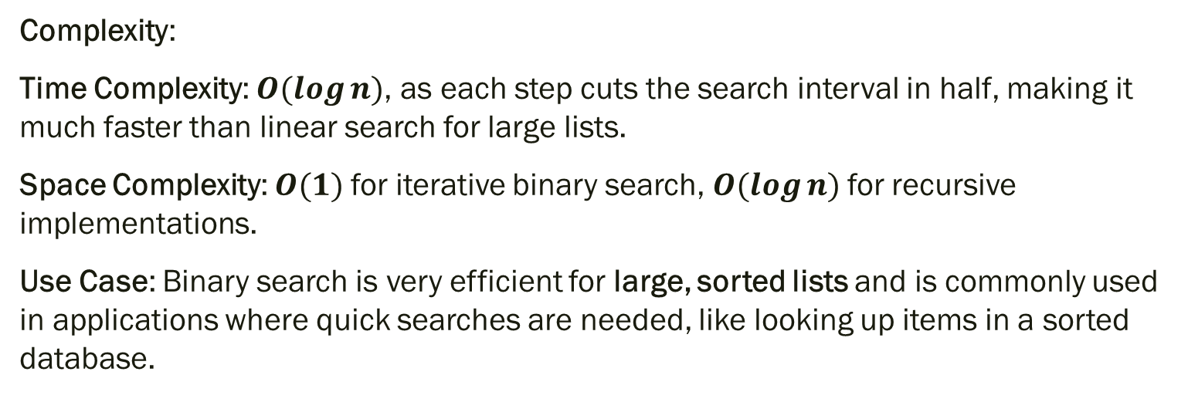
1. A stack ADT, a concrete data structure for a First In First out (FIFO) queue.
Trees: A hierarchical data structure consisting of nodes, useful for representing relationships and hierarchies.
Binary Search
Complexity:
Time Complexity: $O(log⁡n)$, as each step cuts the search interval in half, making it much faster than linear search for large lists.
Space Complexity: $O(1)$for iterative binary search, $O(log⁡n)$for recursive implementations.
Use Case: Binary search is very efficient for large, sorted lists and is commonly used in applications where quick searches are needed, like looking up items in a sorted database.

Slide 18
1. A stack ADT, a concrete data structure for a First In First out (FIFO) queue.
Trees: A hierarchical data structure consisting of nodes, useful for representing relationships and hierarchies.
Linear Search
Definition: Linear search is a simple algorithm that checks each element in a list or array sequentially until it finds the target element or reaches the end of the list.

Slide 19
1. A stack ADT, a concrete data structure for a First In First out (FIFO) queue.
Trees: A hierarchical data structure consisting of nodes, useful for representing relationships and hierarchies.
Linear Search
Steps:
Start from the beginning of the list.
Compare each element with the target element.
If a match is found, return the index of that element.
If no match is found by the end of the list, return an indication that the element is not present (e.g., -1).

Slide 20
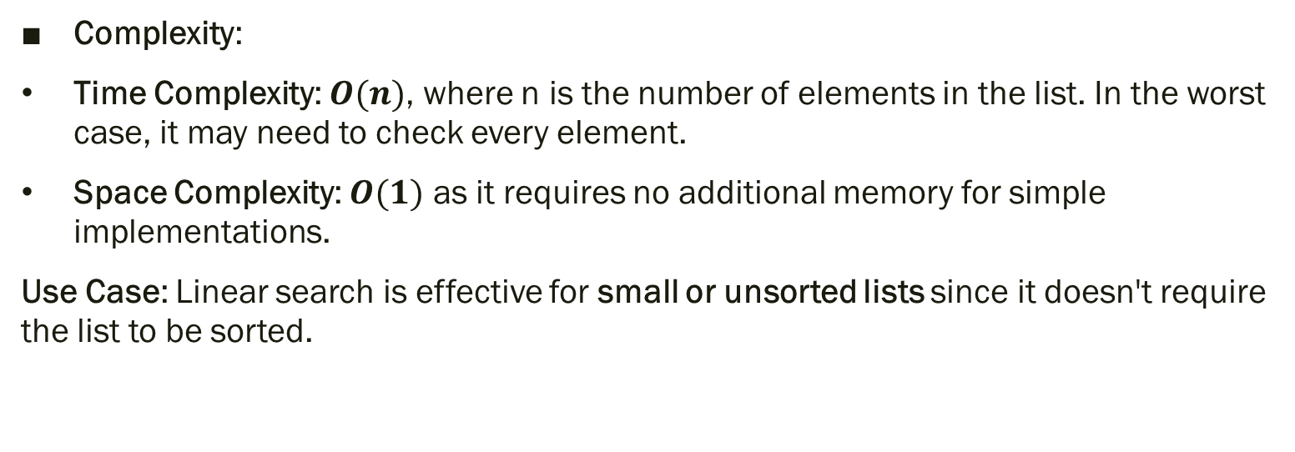
1. A stack ADT, a concrete data structure for a First In First out (FIFO) queue.
Trees: A hierarchical data structure consisting of nodes, useful for representing relationships and hierarchies.
Linear Search
Complexity:
Time Complexity: $O(n)$, where n is the number of elements in the list. In the worst case, it may need to check every element.
Space Complexity: $O(1)$ as it requires no additional memory for simple implementations.
Use Case: Linear search is effective for small or unsorted lists since it doesn't require the list to be sorted.

Slide 21
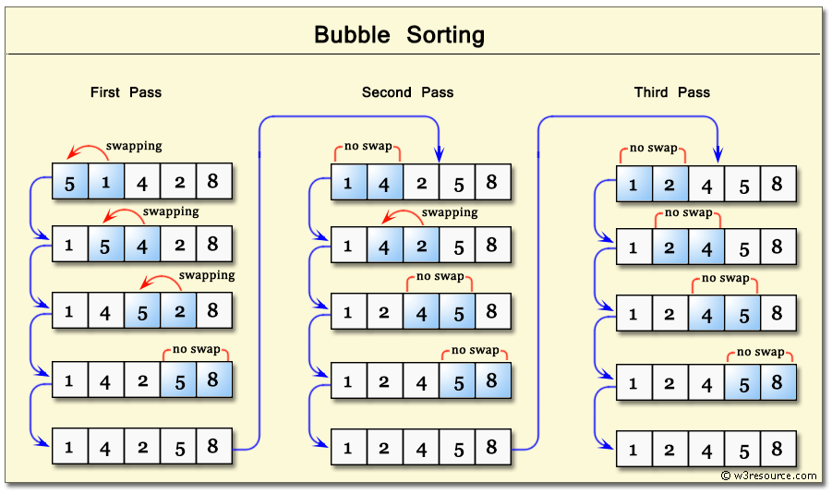
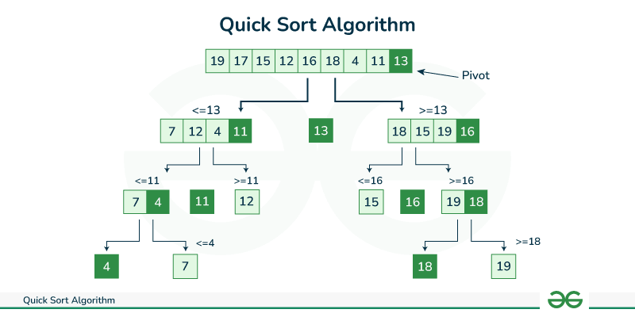
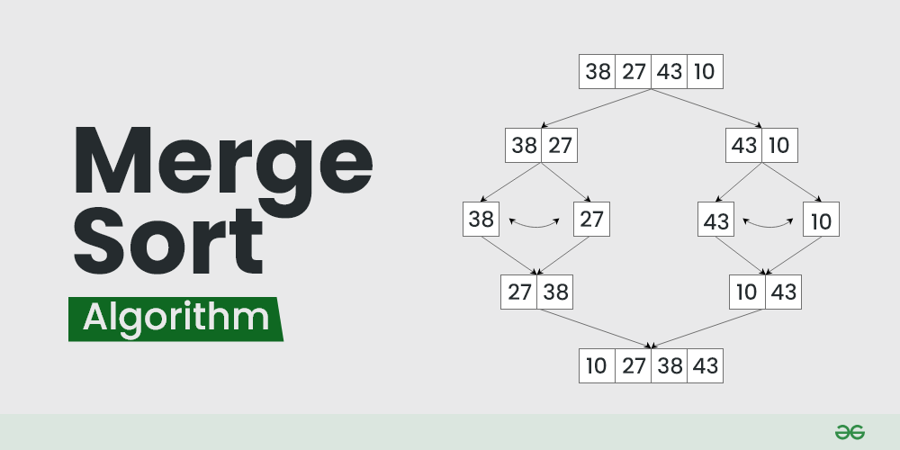
1. A stack ADT, a concrete data structure for a First In First out (FIFO) queue.
Trees: A hierarchical data structure consisting of nodes, useful for representing relationships and hierarchies.
Examples: Some commonly used Sorting Algorithms include:
Sorting Algorithms: Like quicksort, mergesort, and bubble sort, used to arrange elements in a particular order.

Slide 22
1. A stack ADT, a concrete data structure for a First In First out (FIFO) queue.
Trees: A hierarchical data structure consisting of nodes, useful for representing relationships and hierarchies.
Quicksort
Definition: Quicksort is a divide-and-conquer algorithm that sorts an array by selecting a "pivot" element and partitioning the other elements into two sub-arrays according to whether they are less than or greater than the pivot. The sub-arrays are then recursively sorted.

Slide 23
1. A stack ADT, a concrete data structure for a First In First out (FIFO) queue.
Trees: A hierarchical data structure consisting of nodes, useful for representing relationships and hierarchies.
Steps:
Select a pivot element from the array. This can be the first, last, middle, or a random element.
Partition the array so that elements less than the pivot go to its left, and elements greater than the pivot go to its right.
Recursively apply the same process to the left and right sub-arrays.
Combine the results from the sorted sub-arrays and pivot to form the sorted array.

Slide 24
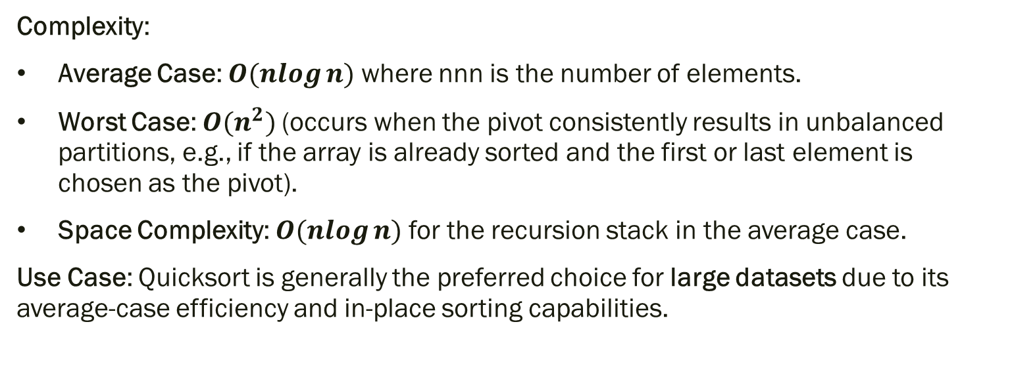
1. A stack ADT, a concrete data structure for a First In First out (FIFO) queue.
Trees: A hierarchical data structure consisting of nodes, useful for representing relationships and hierarchies.
Complexity:
Average Case: $O(nlog⁡n)$where nnn is the number of elements.
Worst Case: $O(n^{2})$(occurs when the pivot consistently results in unbalanced partitions, e.g., if the array is already sorted and the first or last element is chosen as the pivot).
Space Complexity: $O(nlog⁡n)$for the recursion stack in the average case.
Use Case: Quicksort is generally the preferred choice for large datasets due to its average-case efficiency and in-place sorting capabilities.

Slide 25
1. A stack ADT, a concrete data structure for a First In First out (FIFO) queue.
Trees: A hierarchical data structure consisting of nodes, useful for representing relationships and hierarchies.
Mergesort
Definition: Mergesort is another divide-and-conquer algorithm that splits the array into two halves, recursively sorts each half, and then merges the sorted halves back together.

Slide 26
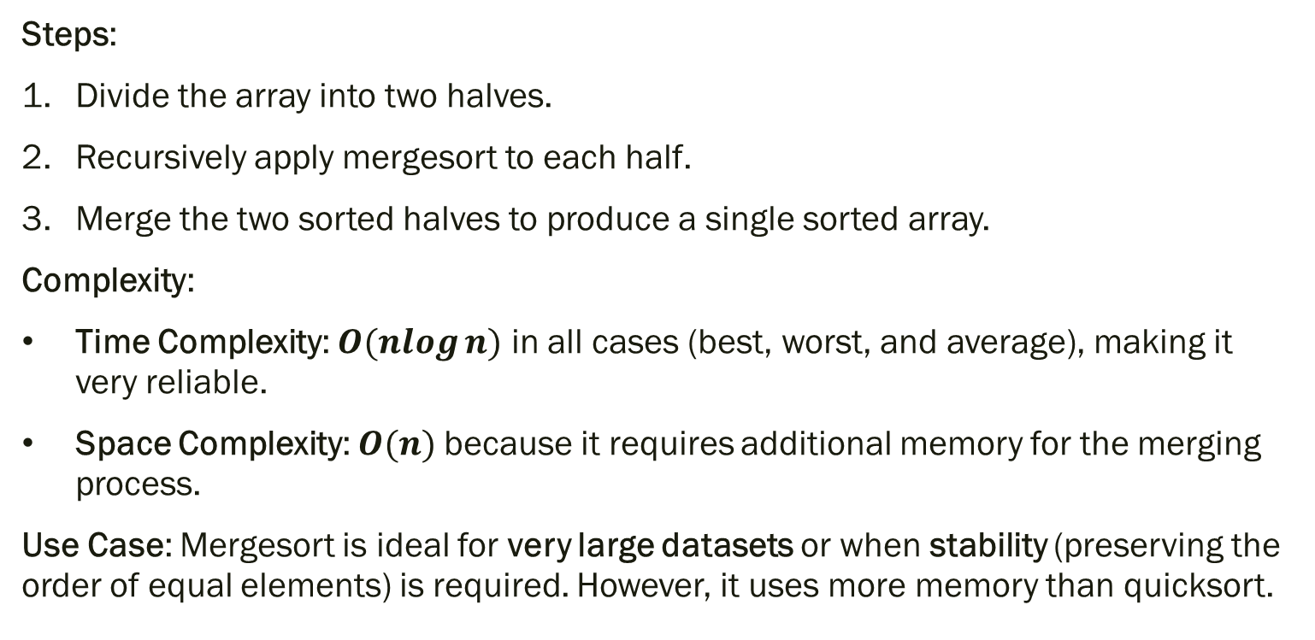
1. A stack ADT, a concrete data structure for a First In First out (FIFO) queue.
Trees: A hierarchical data structure consisting of nodes, useful for representing relationships and hierarchies.
Steps:
Divide the array into two halves.
Recursively apply mergesort to each half.
Merge the two sorted halves to produce a single sorted array.
Complexity:
Time Complexity: $O(nlog⁡n)$ in all cases (best, worst, and average), making it very reliable.
Space Complexity: $O(n)$because it requires additional memory for the merging process.
Use Case: Mergesort is ideal for very large datasets or when stability (preserving the order of equal elements) is required. However, it uses more memory than quicksort.

Slide 27
1. A stack ADT, a concrete data structure for a First In First out (FIFO) queue.
Trees: A hierarchical data structure consisting of nodes, useful for representing relationships and hierarchies.
Bubble Sort
Definition: Bubble Sort is a simple comparison-based algorithm that repeatedly steps through the list, compares adjacent pairs, and swaps them if they are in the wrong order. This process repeats until the list is sorted.

Slide 28
1. A stack ADT, a concrete data structure for a First In First out (FIFO) queue.
Trees: A hierarchical data structure consisting of nodes, useful for representing relationships and hierarchies.
Steps:
Start from the beginning of the list.
Compare each pair of adjacent elements. If they are in the wrong order, swap them.
Repeat this process, moving through the list multiple times, until no more swaps are needed.
Complexity:
Time Complexity: O(n2)O(n^2)O(n2) in the average and worst cases due to repeated comparisons and swaps.
Best Case: O(n)O(n)O(n) if the list is already sorted (with an optimized version that stops if no swaps are made in a pass).
Space Complexity: O(1)O(1)O(1), since it sorts the array in-place.
Use Case: Bubble sort is rarely used in practice for large datasets due to its inefficiency but can be useful in teaching sorting algorithms or for small datasets where simplicity is more important than speed.

Slide 29
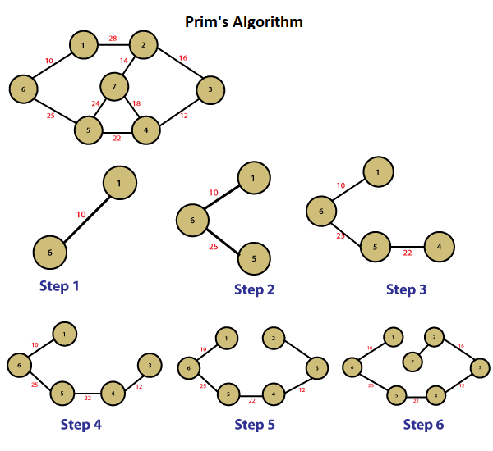
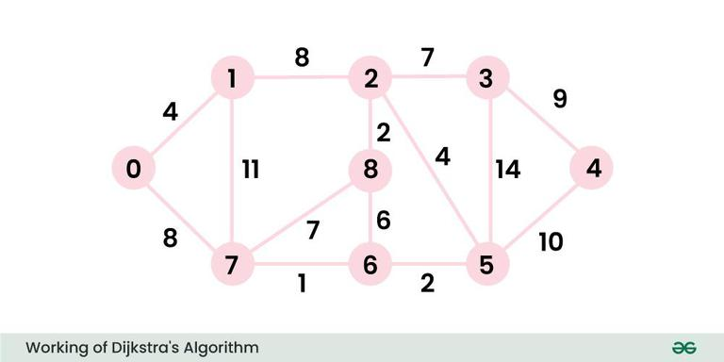
1. A stack ADT, a concrete data structure for a First In First out (FIFO) queue.
Trees: A hierarchical data structure consisting of nodes, useful for representing relationships and hierarchies.
Examples: Some commonly used Graph Algorithms include:
Graph Algorithms: Like Dijkstra's and Prim’s algorithms, used to find shortest paths or minimum spanning trees in graphs.

Slide 30
1. A stack ADT, a concrete data structure for a First In First out (FIFO) queue.
Trees: A hierarchical data structure consisting of nodes, useful for representing relationships and hierarchies.
Dijkstra's Algorithm
Purpose: Dijkstra’s algorithm is used to find the shortest path from a single source node to all other nodes in a weighted, directed or undirected graph where weights (or distances) are non-negative.

Slide 31
1. A stack ADT, a concrete data structure for a First In First out (FIFO) queue.
Trees: A hierarchical data structure consisting of nodes, useful for representing relationships and hierarchies.
Steps:
Initialize Distances: Start by setting the distance from the source node to itself as 0 and all other nodes as infinity.
Set Up a Priority Queue: Use a priority queue (often implemented with a min-heap) to keep track of nodes to explore, ordered by their current shortest known distance from the source.
Update Neighbors: For each node, update the distances to its neighboring nodes if a shorter path is found.
Mark as Visited: Once a node’s shortest distance is determined (when it’s dequeued from the priority queue), mark it as visited and no longer update it.
Repeat: Continue the process for all nodes until all have been visited or until the queue is empty.

Slide 32
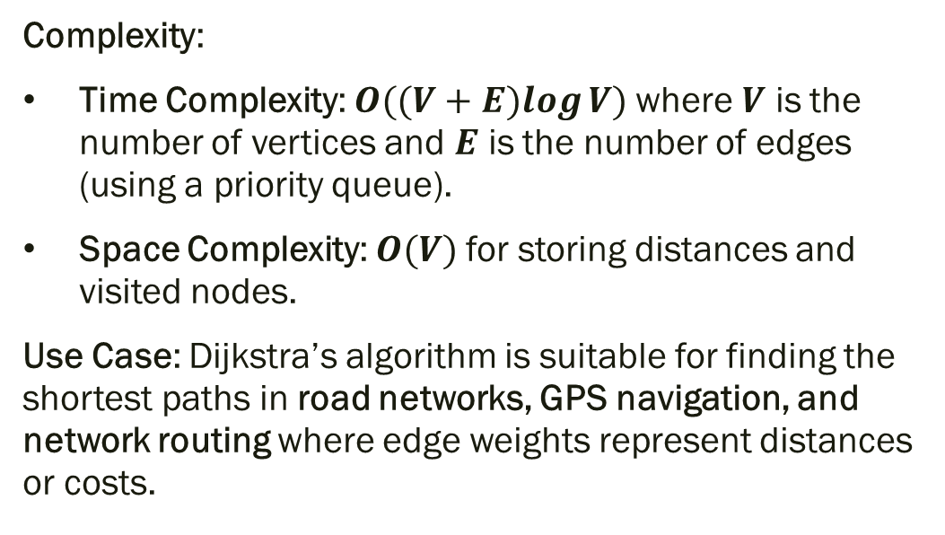
1. A stack ADT, a concrete data structure for a First In First out (FIFO) queue.
Trees: A hierarchical data structure consisting of nodes, useful for representing relationships and hierarchies.
Complexity:
Time Complexity: $O((V+E)log⁡V)$where $V$ is the number of vertices and $E$ is the number of edges (using a priority queue).
Space Complexity: $O(V)$for storing distances and visited nodes.
Use Case: Dijkstra’s algorithm is suitable for finding the shortest paths in road networks, GPS navigation, and network routing where edge weights represent distances or costs.

Slide 33
1. A stack ADT, a concrete data structure for a First In First out (FIFO) queue.
Trees: A hierarchical data structure consisting of nodes, useful for representing relationships and hierarchies.
Prim’s Algorithm
Purpose: Prim's algorithm is used to find the Minimum Spanning Tree (MST) of a weighted, undirected graph. The MST is a subset of edges that connect all nodes with the minimum possible total edge weight and no cycles.

Slide 34
1. A stack ADT, a concrete data structure for a First In First out (FIFO) queue.
Trees: A hierarchical data structure consisting of nodes, useful for representing relationships and hierarchies.
Steps:
Start with a Random Node: Pick any node as the starting point and add it to the MST.
Initialize Edge List: Track all edges connected to the growing MST.
Select the Minimum Edge: From the edges that connect nodes in the MST to nodes outside it, select the edge with the smallest weight.
Add Node and Edge to MST: Add the connected node to the MST and mark it as visited.
Repeat: Continue selecting the minimum weight edge that connects a node in the MST to a node outside it until all nodes are included.

Slide 35
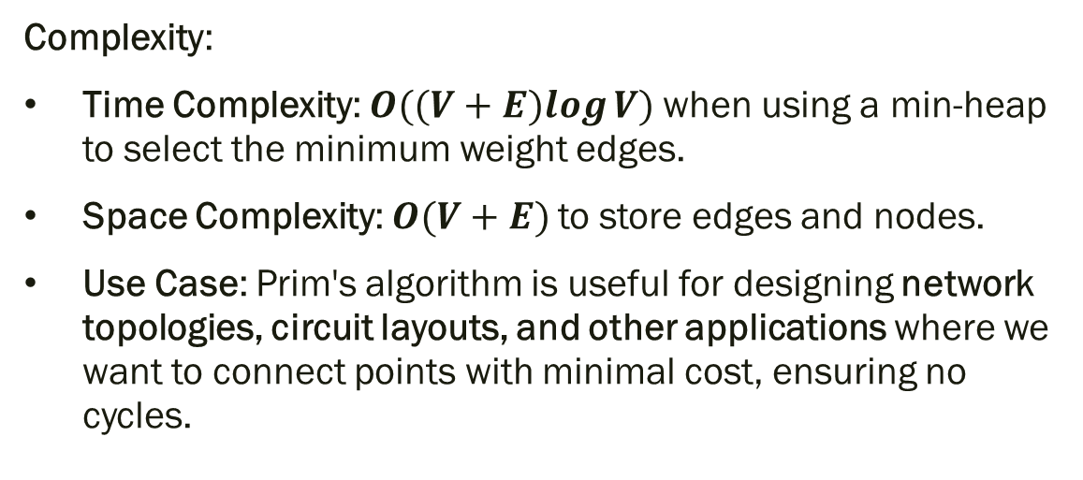
1. A stack ADT, a concrete data structure for a First In First out (FIFO) queue.
Trees: A hierarchical data structure consisting of nodes, useful for representing relationships and hierarchies.
Complexity:
Time Complexity: $O((V+E)log⁡V)$when using a min-heap to select the minimum weight edges.
Space Complexity: $O(V+E)$to store edges and nodes.
Use Case: Prim's algorithm is useful for designing network topologies, circuit layouts, and other applications where we want to connect points with minimal cost, ensuring no cycles.

Slide 36
1. A stack ADT, a concrete data structure for a First In First out (FIFO) queue.
What is ADT?

Slide 37
1. A stack ADT, a concrete data structure for a First In First out (FIFO) queue.
An Abstract Data Type (ADT) is a mathematical model or concept that defines a data structure purely by its behavior and the operations it supports, without specifying its internal implementation. In essence, an ADT describes what operations can be performed on the data and how they behave from a user’s perspective, rather than how these operations are executed.
Key Aspects of ADT
Encapsulation of Data and Operations: An ADT focuses on the operations (functions or methods) that can be performed on the data, while hiding the internal details (like data storage) from the user.
Defined Operations: The ADT specifies a set of operations and their expected behavior (input/output) without detailing how these operations are implemented.
Implementation Independence: The internal implementation can vary, allowing flexibility. For example, a stack can be implemented using an array or a linked list, but its operations (push, pop, etc.) will behave the same from the user's point of view.

Slide 38
1. A stack ADT, a concrete data structure for a First In First out (FIFO) queue.
Examples of ADTs
Some common ADTs include:
Stack: Defines operations like push (add an element), pop (remove the top element), and peek (view the top element). It follows Last In First Out (LIFO) behavior.
Queue: Defines operations like enqueue (add an element) and dequeue (remove the oldest element). It follows First In First Out (FIFO) behavior.
List: Defines operations like add, remove, and get elements by position.
Tree: Defines operations for hierarchical data organization, such as adding and traversing nodes.
Dictionary (Map): Defines operations for storing key-value pairs and retrieving values based on their keys.

Slide 39
1. A stack ADT, a concrete data structure for a First In First out (FIFO) queue.
Why ADTs Are Useful
ADTs provide a clear, abstract layer that helps programmers understand and utilize data structures without needing to know their specific implementation. This abstraction:
Simplifies program design by focusing on what operations are available, rather than how they are done.
Encourages modularity and reusability, as different implementations can be used interchangeably.
Improves maintainability, as the underlying data structure can be changed without affecting the code that uses it, as long as the ADT operations remain consistent.

Slide 40
1. A stack ADT, a concrete data structure for a First In First out (FIFO) queue.
Example: Stack ADT
The Stack ADT includes the following:
push(item): Adds item to the top of the stack.
pop(): Removes and returns the item from the top of the stack.
peek(): Returns the item at the top of the stack without removing it.
is_empty(): Checks if the stack is empty.

Slide 41
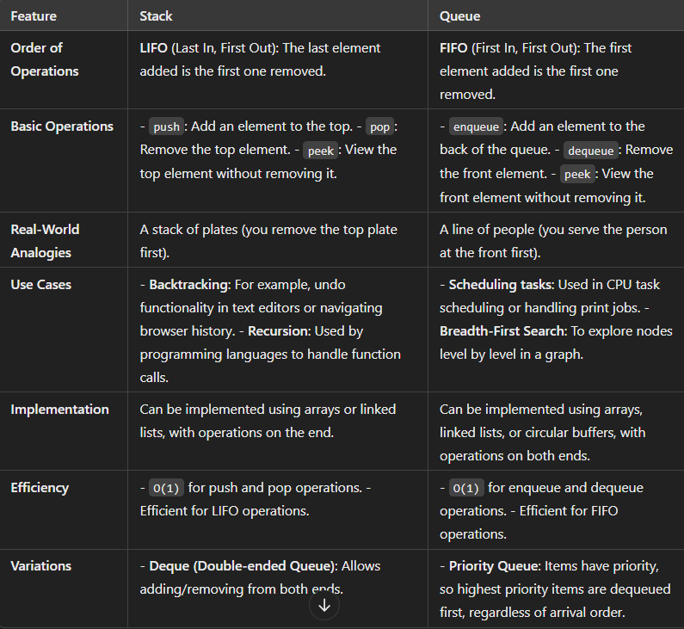
1. A stack ADT, a concrete data structure for a First In First out (FIFO) queue.
Compare different between Stack and Queue

Slide 42
1. A stack ADT, a concrete data structure for a First In First out (FIFO) queue.
Stack Implementations in Java
Using java.util.Stack Class:
Java provides a built-in Stack class in the java.util package.
It is a subclass of Vector, meaning it’s synchronized and thread-safe.
Operations: Provides standard stack operations (push, pop, peek, isEmpty).
Drawback: Since Stack is synchronized, it can be slower in single-threaded applications.
Stack<Integer> stack = new Stack<>();
stack.push(1);
stack.push(2);
int top = stack.pop();

Slide 43
1. A stack ADT, a concrete data structure for a First In First out (FIFO) queue.
Using java.util.Deque (ArrayDeque or LinkedList):
The Deque interface (short for "double-ended queue") provides addFirst and removeFirst methods, which allow it to act like a stack.
Both ArrayDeque and LinkedList implement Deque.
Advantage: ArrayDeque is faster than Stack in single-threaded contexts and is non-synchronized.
Deque<Integer> stack = new ArrayDeque<>();
stack.push(1);
stack.push(2);
int top = stack.pop();

Slide 44
1. A stack ADT, a concrete data structure for a First In First out (FIFO) queue.
class Node {
int data;
Node next;
Node(int data) { this.data = data; }
}
class Stack {
private Node head;
public void push(int data) {
Node newNode = new Node(data);
newNode.next = head;
head = newNode;
}
public int pop() {
if (head == null) throw new EmptyStackException();
int data = head.data;
head = head.next;
return data;
}
}
Using a Linked List:
Implement a custom stack using a singly linked list where push adds a node at the head and pop removes the head.
Advantage: More control over implementation; can manage memory more directly.

Slide 45
1. A stack ADT, a concrete data structure for a First In First out (FIFO) queue.
class Stack {
private int[] stack;
private int top;
public Stack(int capacity) {
stack = new int[capacity];
top = -1;
}
public void push(int data) {
if (top == stack.length - 1) throw new StackOverflowError();
stack[++top] = data;
}
public int pop() {
if (top == -1) throw new EmptyStackException();
return stack[top--];
}
}
Using an Array:
Implement a custom stack with an array and an index pointer for the top.
Advantage: Efficient if the maximum size of the stack is known; less memory overhead than a linked list.

Slide 46
1. A stack ADT, a concrete data structure for a First In First out (FIFO) queue.
Queue Implementations in Java
Using java.util.Queue (LinkedList or PriorityQueue):
Java’s Queue interface is implemented by classes like LinkedList and PriorityQueue.
LinkedList can be used for a standard queue, where elements are added to the tail and removed from the head.
PriorityQueue is useful for queues where elements are removed based on priority rather than order of insertion.
Queue<Integer> queue = new LinkedList<>();
queue.add(1);
queue.add(2);
int front = queue.remove();

Slide 47
1. A stack ADT, a concrete data structure for a First In First out (FIFO) queue.
class CircularQueue {
private int[] queue;
private int front, rear, size;
public CircularQueue(int capacity) {
queue = new int[capacity];
front = 0;
rear = -1;
size = 0;
}
public void enqueue(int data) {
if (size == queue.length) throw new IllegalStateException("Queue is full");
rear = (rear + 1) % queue.length;
queue[rear] = data;
size++;
}
public int dequeue() {
if (size == 0) throw new NoSuchElementException("Queue is empty");
int data = queue[front];
front = (front + 1) % queue.length;
size--;
return data;
}
}
Using a Circular Array:
Implement a custom queue using a circular array with two pointers: front and rear.
Advantage: Fixed-size, efficient in terms of memory and operations.

Slide 48
1. A stack ADT, a concrete data structure for a First In First out (FIFO) queue.
class Node {
int data;
Node next;
Node(int data) { this.data = data; }
}
class Queue {
private Node front, rear;
public void enqueue(int data) {
Node newNode = new Node(data);
if (rear != null) rear.next = newNode;
rear = newNode;
if (front == null) front = rear;
}
public int dequeue() {
if (front == null) throw new NoSuchElementException("Queue is empty");
int data = front.data;
front = front.next;
if (front == null) rear = null;
return data;
}
}
Using a Linked List:
Implement a custom queue using a linked list, where elements are added at the tail and removed from the head.
Advantage: Flexible size; no predefined limit as in an array

Slide 49
Two sorting algorithms.

Slide 50
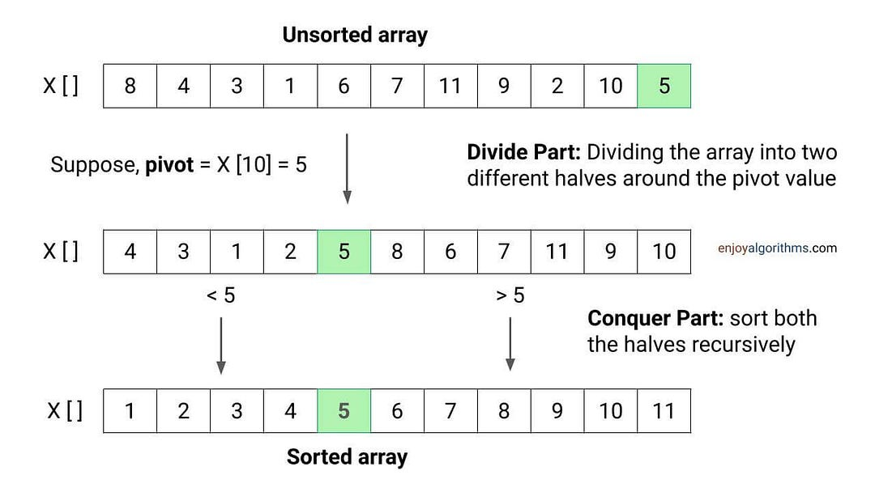
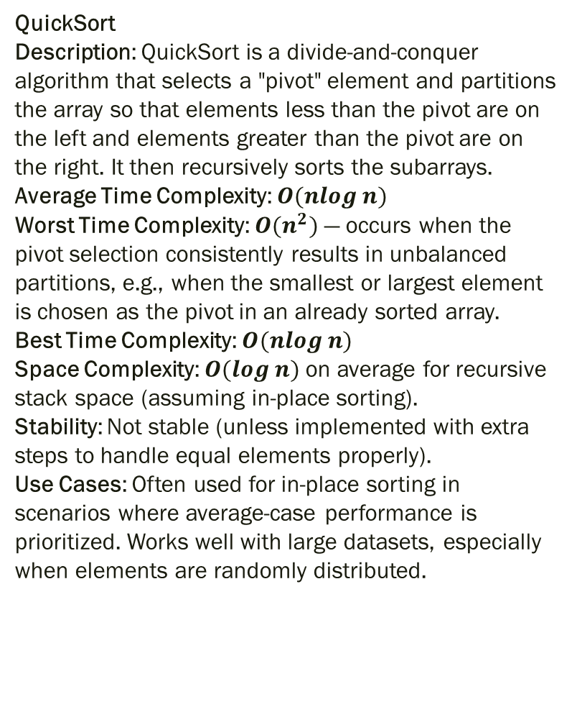
QuickSort Description: QuickSort is a divide-and-conquer algorithm that selects a "pivot" element and partitions the array so that elements less than the pivot are on the left and elements greater than the pivot are on the right. It then recursively sorts the subarrays. Average Time Complexity: $O(nlog⁡n)$ Worst Time Complexity: $O(n^{2})$— occurs when the pivot selection consistently results in unbalanced partitions, e.g., when the smallest or largest element is chosen as the pivot in an already sorted array. Best Time Complexity: $O(nlog⁡n)$ Space Complexity: $O(log⁡n)$on average for recursive stack space (assuming in-place sorting). Stability: Not stable (unless implemented with extra steps to handle equal elements properly). Use Cases: Often used for in-place sorting in scenarios where average-case performance is prioritized. Works well with large datasets, especially when elements are randomly distributed.

Slide 51
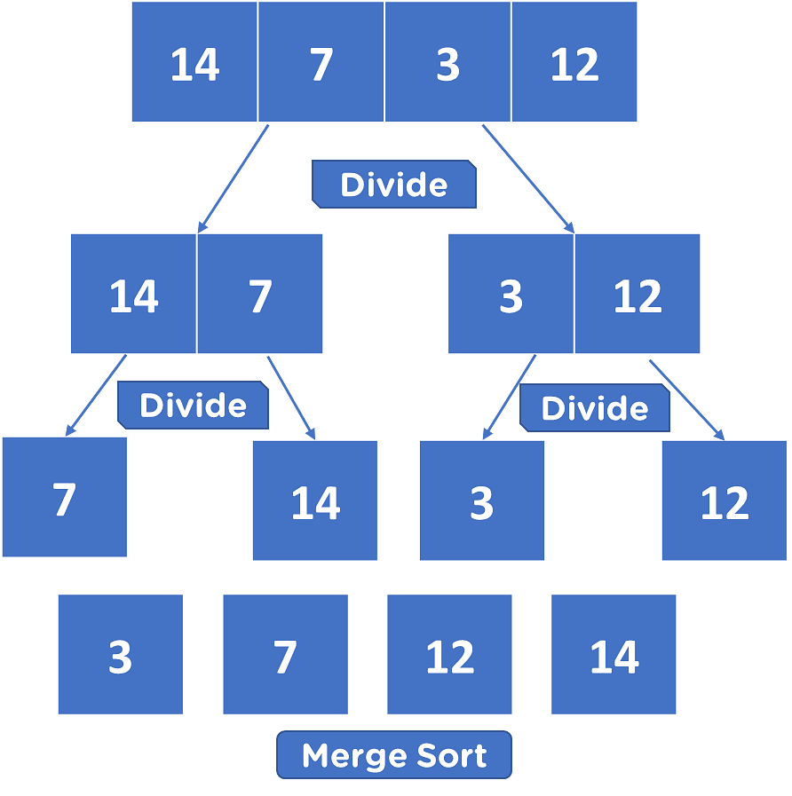
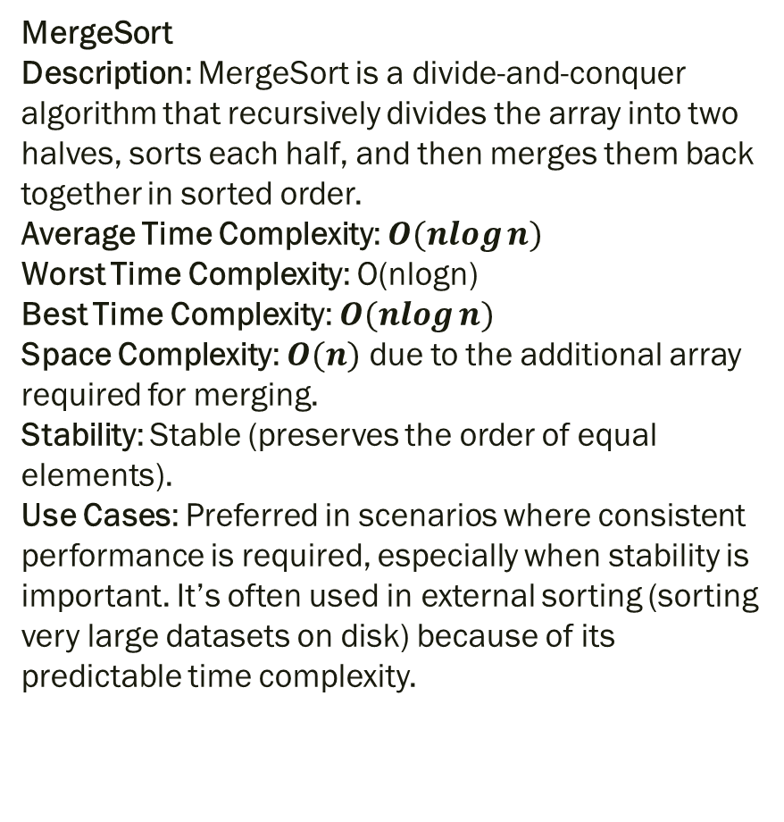
MergeSort Description: MergeSort is a divide-and-conquer algorithm that recursively divides the array into two halves, sorts each half, and then merges them back together in sorted order. Average Time Complexity: $O(nlog⁡n)$ Worst Time Complexity: O(nlog⁡n) Best Time Complexity: $O(nlog⁡n)$ Space Complexity: $O(n)$ due to the additional array required for merging. Stability: Stable (preserves the order of equal elements). Use Cases: Preferred in scenarios where consistent performance is required, especially when stability is important. It’s often used in external sorting (sorting very large datasets on disk) because of its predictable time complexity.

Slide 52
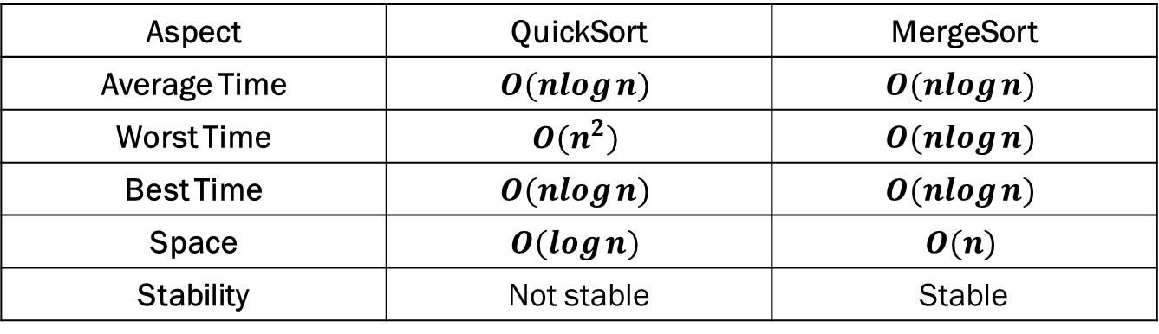
Complexity Comparison
Aspect | QuickSort | MergeSort
Average Time | $$O(nlog⁡n)$$ | $$O(nlog⁡n)$$
Worst Time | $$O(n^{2})$$ | $$O(nlog⁡n)$$
Best Time | $$O(nlog⁡n)$$ | $$O(nlog⁡n)$$
Space | $$O(log⁡n)$$ | $$O(n)$$
Stability | Not stable | Stable

Slide 53
Summary QuickSort is generally faster on average in practical applications, especially with large datasets, but it has a worst-case complexity of O(n2)O(n^2)O(n2). MergeSort offers guaranteed O(nlog⁡n)O(n \log n)O(nlogn) time complexity for all cases, making it reliable and consistent, though it requires additional space. Choosing between QuickSort and MergeSort depends on the use case: Use QuickSort for in-place, fast average-case performance, especially when memory usage is a concern. Use MergeSort when stability and guaranteed O(nlog⁡n)O(n \log n)O(nlogn) time complexity are more critical, especially in scenarios that involve large datasets or linked lists.

Slide 54
Summary QuickSort is generally faster on average in practical applications, especially with large datasets, but it has a worst-case complexity of O(n2)O(n^2)O(n2). MergeSort offers guaranteed O(nlog⁡n)O(n \log n)O(nlogn) time complexity for all cases, making it reliable and consistent, though it requires additional space. Choosing between QuickSort and MergeSort depends on the use case: Use QuickSort for in-place, fast average-case performance, especially when memory usage is a concern. Use MergeSort when stability and guaranteed O(nlog⁡n)O(n \log n)O(nlogn) time complexity are more critical, especially in scenarios that involve large datasets or linked lists.

Slide 55
Two network shortest path algorithms.

Slide 56
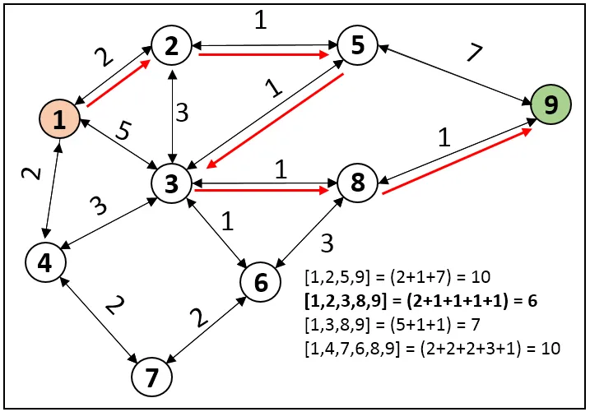
1. Dijkstra's Algorithm
Purpose: Dijkstra's algorithm finds the shortest path from a single source vertex to all other vertices in a weighted graph with non-negative edge weights.
Use Case: Ideal for finding the shortest route in road networks, like Google Maps or GPS navigation, where edge weights represent distances or travel times.
How It Works:
Initialize the distance to the source vertex as 0 and all other vertices as infinity.
Mark all vertices as unvisited and set the source vertex as the current node.
For the current node, calculate the tentative distances to each of its neighbors and update their distances if the new calculated distance is smaller.
Once all neighbors of the current node are evaluated, mark it as visited (meaning it won't be checked again).
Move to the unvisited vertex with the smallest tentative distance and repeat steps 3-4 until all vertices have been visited.

Slide 57
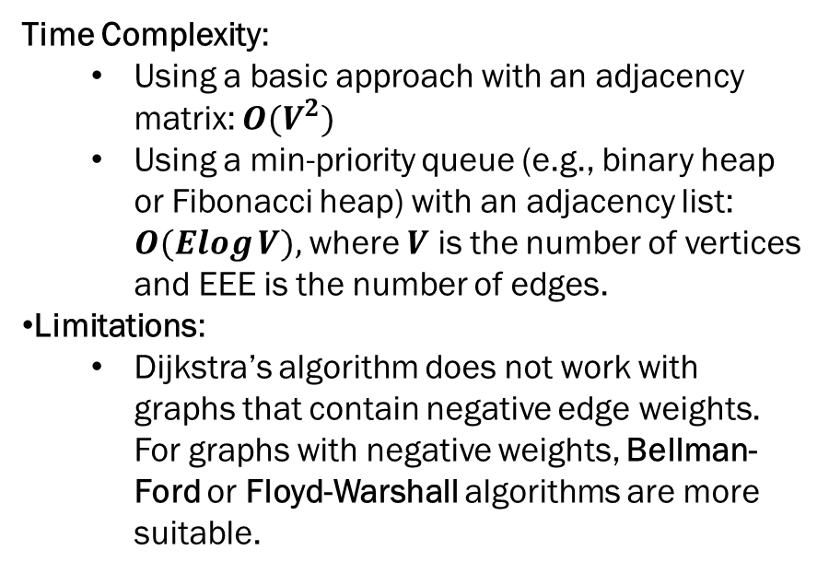
Time Complexity:
Using a basic approach with an adjacency matrix: $O(V^{2})$
Using a min-priority queue (e.g., binary heap or Fibonacci heap) with an adjacency list: $O(Elog⁡V),$where $V$ is the number of vertices and EEE is the number of edges.
Limitations:
Dijkstra’s algorithm does not work with graphs that contain negative edge weights. For graphs with negative weights, Bellman-Ford or Floyd-Warshall algorithms are more suitable.

Slide 58
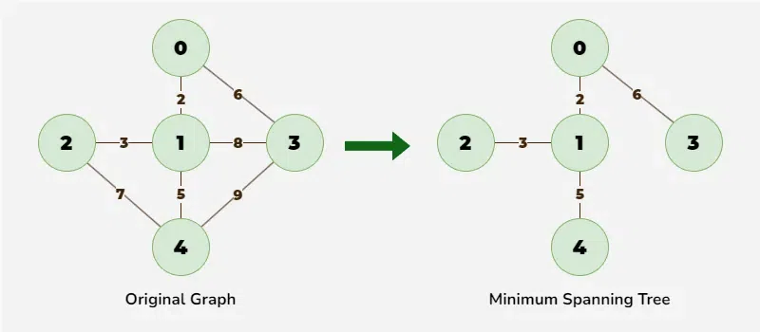
2. Prim’s Algorithm
Purpose: Prim's algorithm is designed to find a minimum spanning tree (MST) for a weighted, connected graph. It minimizes the total weight of edges required to connect all vertices in the graph, without cycles.
Use Case: Useful in network design, such as designing a telecommunication or electrical grid network, where you want to connect all nodes with minimal wiring or cabling cost.
How It Works:
Start from an arbitrary vertex and mark it as part of the MST.
Select the smallest-weight edge that connects a vertex in the MST to a vertex outside the MST.
Add this vertex and edge to the MST.
Repeat steps 2-3 until all vertices are included in the MST.

Slide 59
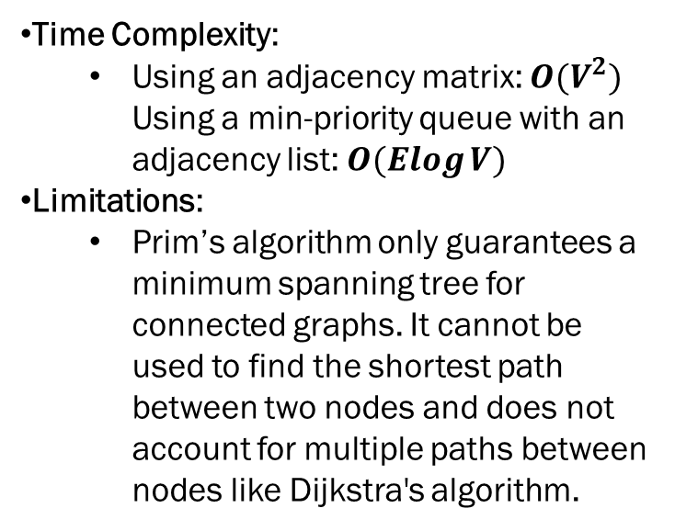
Time Complexity:
Using an adjacency matrix: $O(V^{2})$ Using a min-priority queue with an adjacency list: $O(Elog⁡V)$
Limitations:
Prim’s algorithm only guarantees a minimum spanning tree for connected graphs. It cannot be used to find the shortest path between two nodes and does not account for multiple paths between nodes like Dijkstra's algorithm.

Slide 60
Comparison of Dijkstra's and Prim’s Algorithms
Feature | Dijkstra’s Algorithm | Prim’s Algorithm
Goal | Finds the shortest path from a source vertex to all other vertices in a weighted graph. | Finds the minimum spanning tree for a weighted graph.
Graph Type | Works on directed or undirected graphs with non-negative weights. | Works on undirected, connected graphs with weights.
Output | Shortest path from source to each vertex. | Minimum spanning tree connecting all vertices.
Algorithm Type | Greedy | Greedy
Time Complexity | O(Elog⁡V)O(E \log V)O(ElogV) with priority queue | O(Elog⁡V)O(E \log V)O(ElogV) with priority queue
Best Use Case | Shortest route/navigation | Network design (minimal connection cost)
Negative Weights | Not supported | Not applicable

