Slide 1
Meta-GLIS robot

Slide 2
Autoencoder dataset

Slide 3
Experiments settings
Create the dataset to train the autoencoder (5000 experiments)
Nominal robot’s joints masses:
[1, 0, 3, 0, 5, 0, 2.5]
Each joint mass is randomized -+ 1, except last mass -1, +3 for each experiment
300 BO iterations for each experiment with 10 random starting points to generate a optimal parameters for each experiment

Slide 4
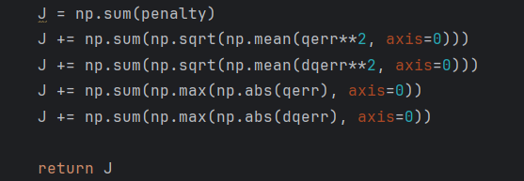
Objective function
Simulate the robot trajectory given the input parameters
Minimize joint position error, and velocity error
Since BO is a maximization, wrap objective function as
- Log(J)

Slide 5
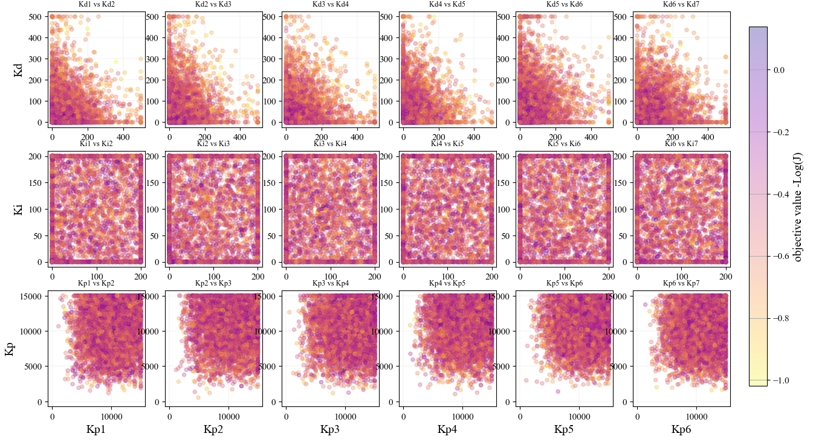
Optimal BO parameters manifold

Slide 6
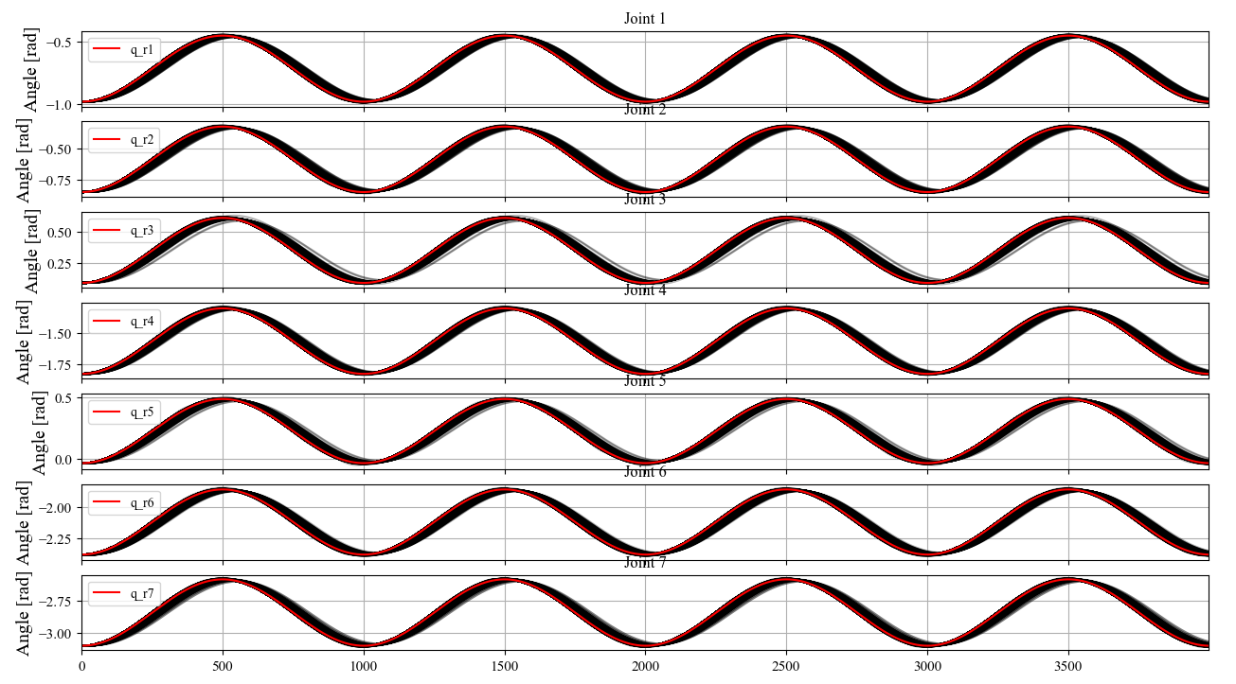
Optimal BO parameters trajectories

Slide 7
Autoencoder training

Slide 8
Training settings
Use 4250 out of the 5000 optimal parameters as training set
The remaining 750 are the test set
Training performed for 5, 10, and 21 latent dimension

Slide 9
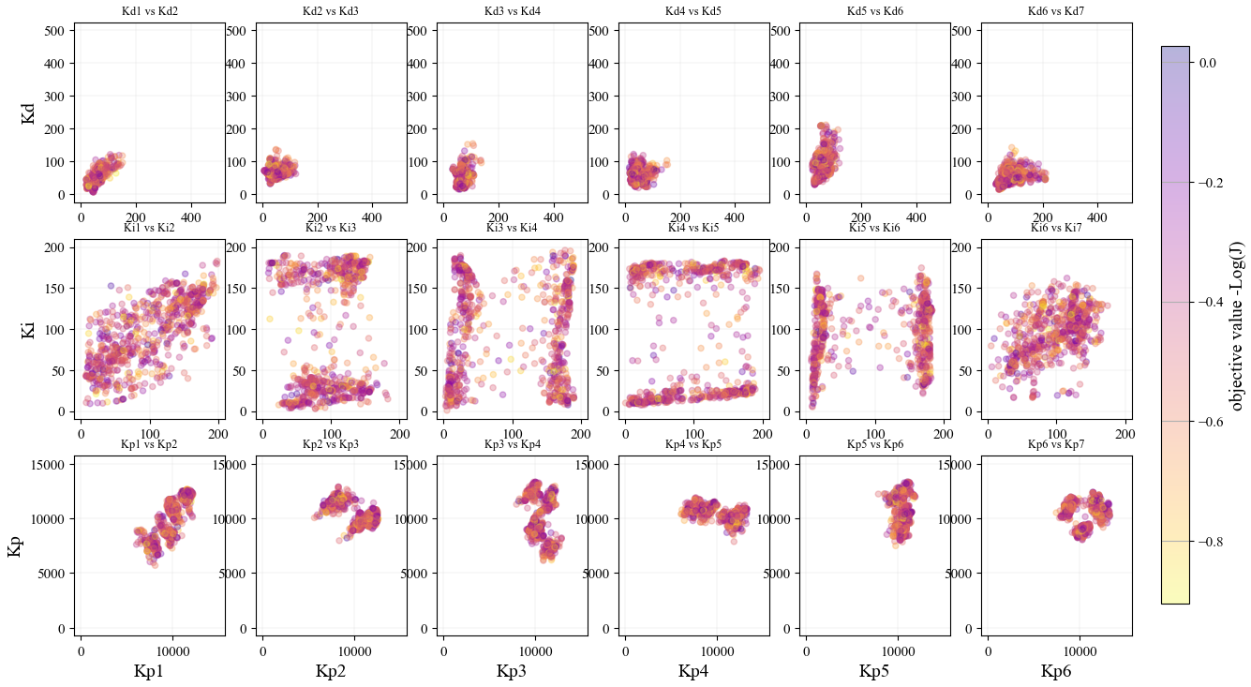
Test set recreation

Slide 10
Comparison of latent dimension 10

Slide 11
Experiments settings
Create small datasets (100 experiments) for comparison
Nominal robot’s joints masses:
[1, 0, 3, 0, 5, 0, 2.5]
Each joint mass is randomized -+ 1, except last mass -1, +3 for each experiment
300 BO iterations with 1 starting point (optimal parameters of nominal robot)

Slide 12
Latent dimensionality
Starting
parameters
BO optimization is now performed over 10 parameters instead of 21
Convert the parameters between dimensions through the pre-trained encoder/decoder
The search space of the latent dimension is limited to the optimum parameters observed from the train dataset
Compare dataset created through latent dimension BO with the normal one (same seed)
Encoder
BO
Decoder
Objective function
- Log(J)
Decoder
Outputs

Slide 13
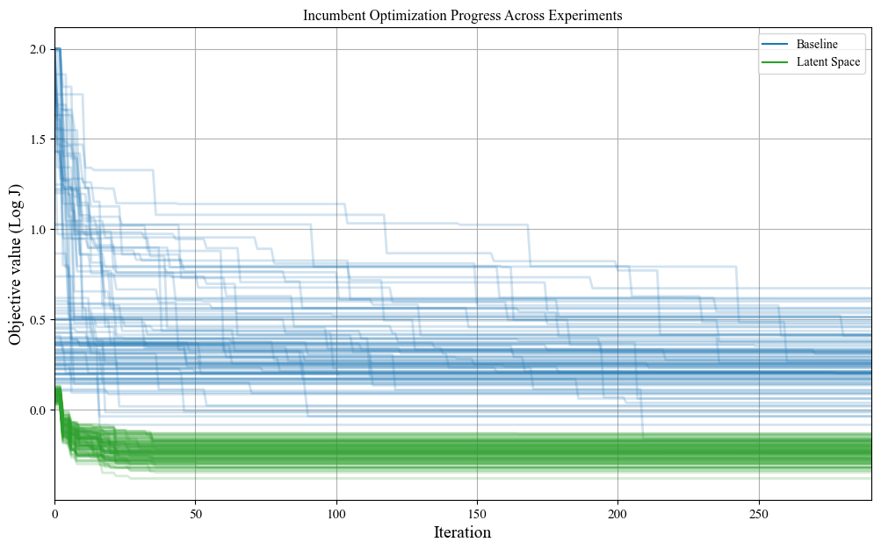
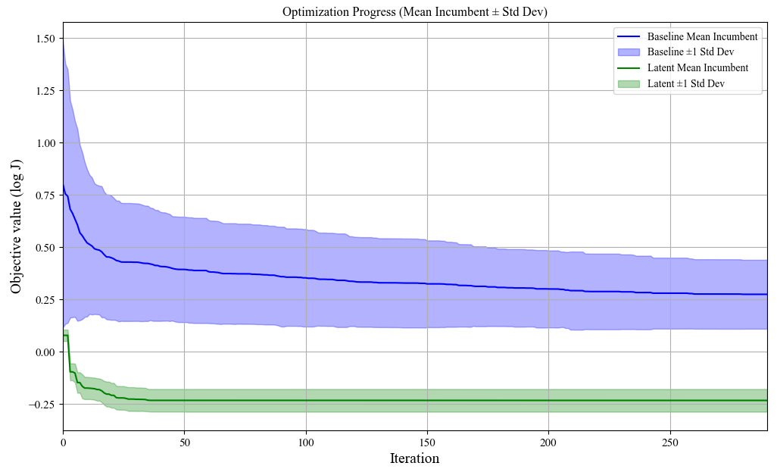
Resulting comparison

Slide 14
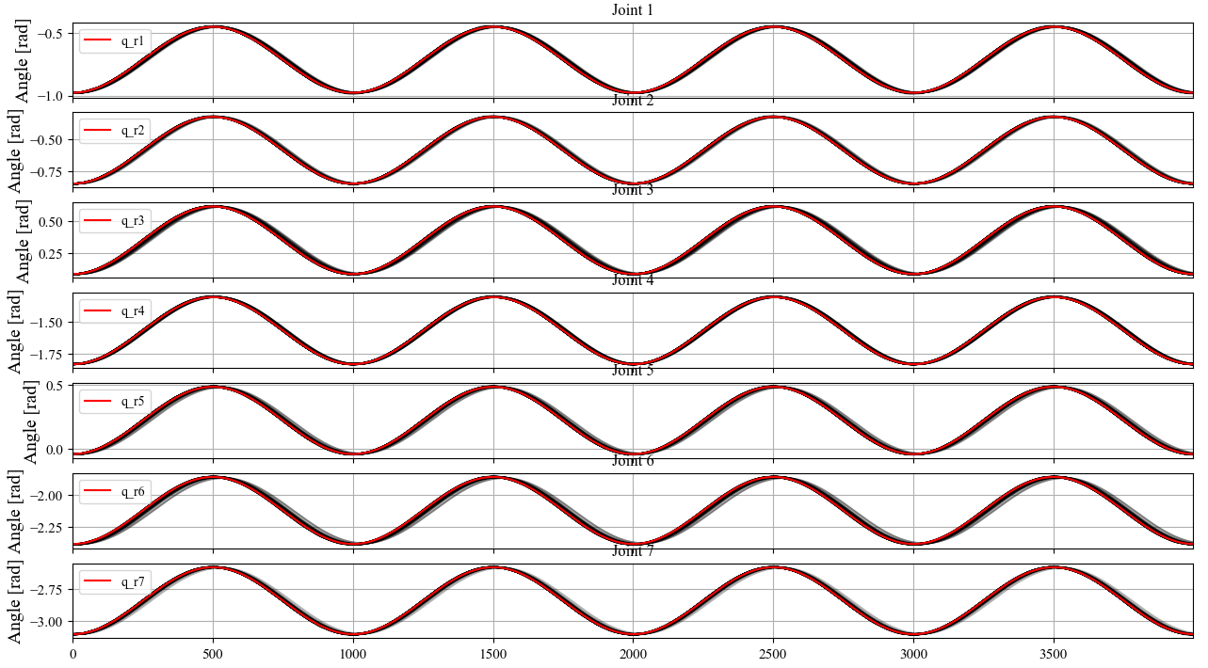
Baseline optimal trajectories

Slide 15
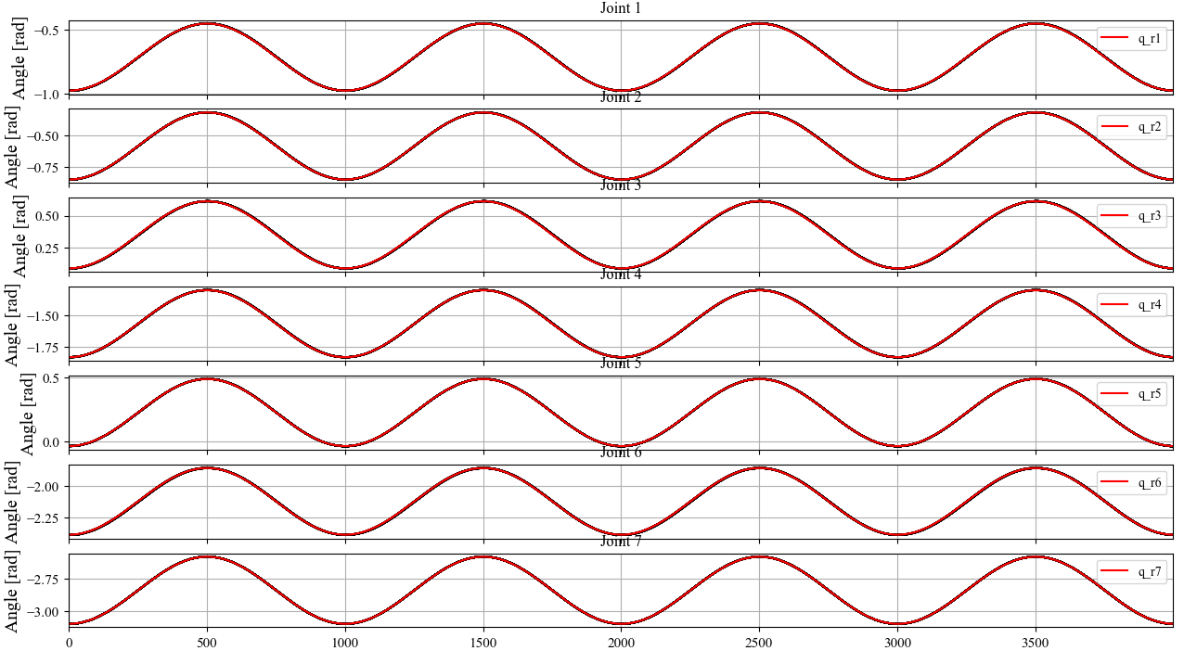
Latent space optimal trajectories

Slide 16
Resulting comparison
The latent space optimization yields better results
The optimum is also reached with less iterations

