Slide 1


Artificial Intelligence and Machine Learning
Heart Disease Prediction
BY G-30 PURAB VATS (2210990692) PRANAV KUMAR(2210990667) PRITAM KUMAR(2210990683)
ARYAN(2210990174) Supervisor Mr. Tushar Khitoliya Institute of Engineering & Technology Department of computer Science and Engineering Chitkara University, Punjab, India.

Slide 2
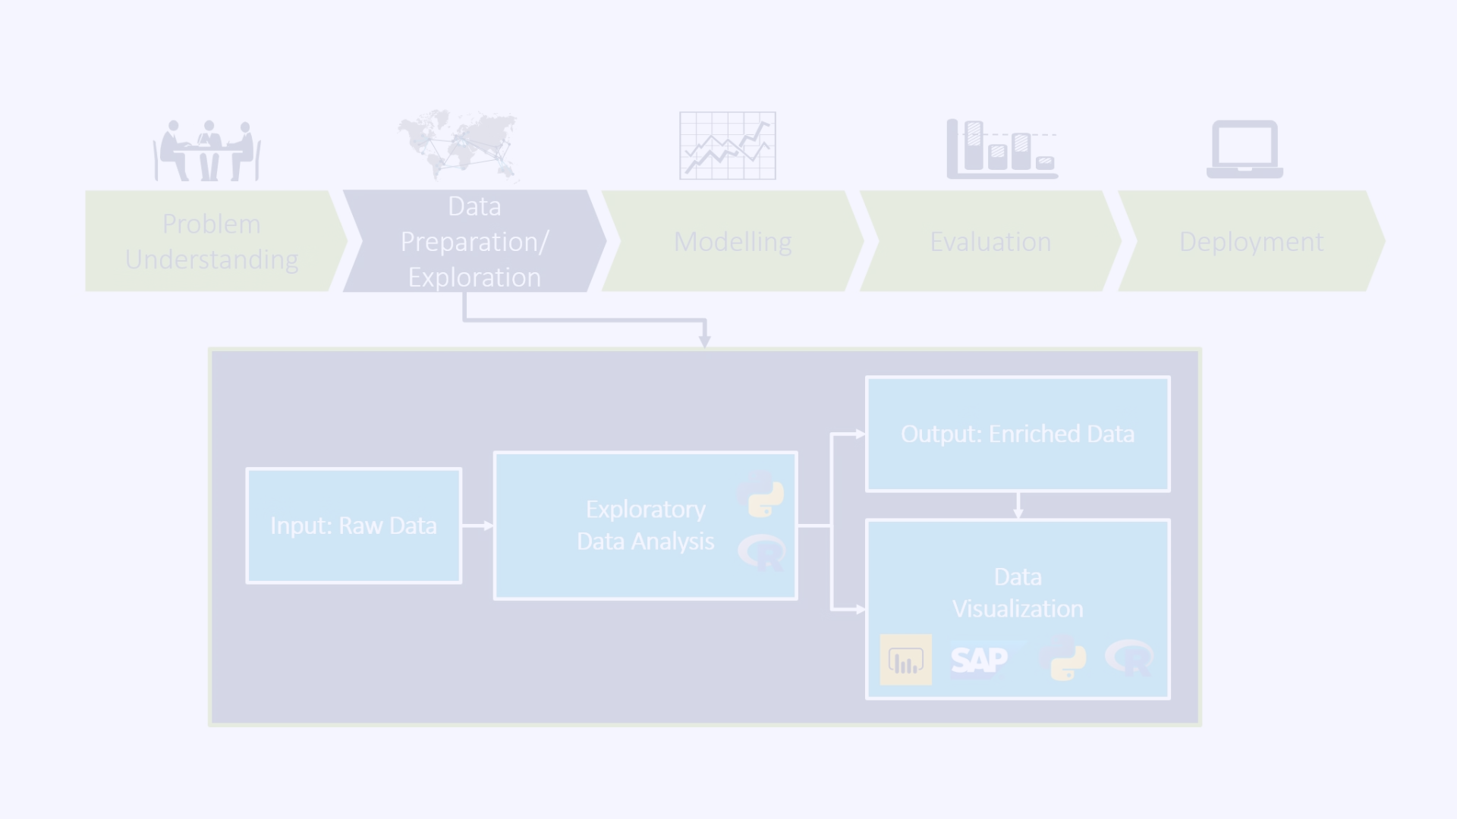
Data Collection and Exploration
The project began with the collection of a comprehensive dataset containing health metrics such as age, sex, cholesterol levels, blood pressure, and presence of diabetes, along with a label indicating whether the person has heart disease or not. The dataset was sourced from reputable sources like Kaggle or UCI Machine Learning Repository. Exploratory data analysis was then conducted using pandas to load and explore the dataset, check for missing values, and visualize the distributions of features using matplotlib and seaborn.
Data Collection
Data Preprocessing
Gathered a diverse dataset containing health metrics and heart disease labels.
Handled missing data, encoded categorical variables, and normalized features as needed.
1
2
3
Exploratory Data Analysis
Loaded the dataset, checked for missing values, and visualized feature distributions.

Slide 3
Model Building and Evaluation
The project then implemented a range of machine learning algorithms, including Logistic Regression, Support Vector Machines (SVM), Decision Trees, and Random Forest Classifiers, using the scikit-learn library. Each model was trained on the preprocessed training data, and their performance was evaluated using metrics such as accuracy, precision, recall, and F1-score. Confusion matrices were plotted to visualize the models' performance, and the results were compared to identify the most effective approach for predicting heart disease.
Logistic Regression
Support Vector Machines (SVM)
Decision Trees and Random Forest
Implemented a Logistic Regression model to predict heart disease based on the input features.
Utilized SVM, a powerful algorithm for classification tasks, to identify individuals at risk of heart disease.
Explored Decision Trees and Random Forest Classifiers to capture complex relationships in the data and make accurate predictions.

Slide 4
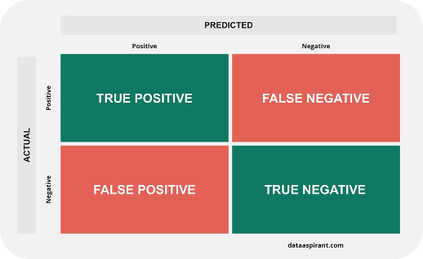
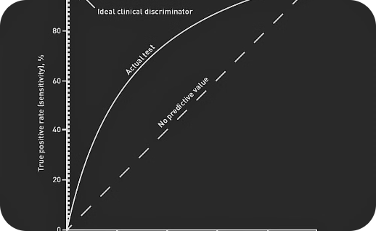
Results Visualization
The project culminated in the visualization of the machine learning models' performance, leveraging tools like matplotlib and seaborn. This included plotting confusion matrices to assess the models' accuracy, precision, recall, and F1-score. Additionally, the team generated ROC (Receiver Operating Characteristic) curves and calculated the AUC (Area Under the Curve) scores to provide a comprehensive evaluation of the models' ability to distinguish between individuals with and without heart disease.
Confusion Matrix
ROC Curve and AUC
Visualized the models' accuracy, precision, recall, and F1-score using confusion matrices.
Plotted ROC curves and calculated AUC scores to evaluate the models' ability to distinguish heart disease cases.

Slide 5
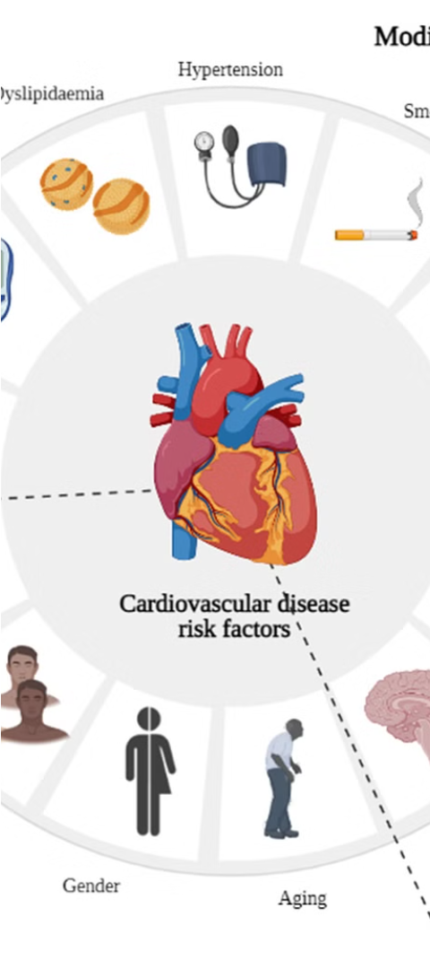
Insights and Implications
The heart disease prediction project not only developed accurate machine learning models but also provided valuable insights into the key factors contributing to the onset of heart disease. By analyzing the feature importance and the relationships between various health metrics and heart disease, the team was able to identify the most influential variables, such as age, cholesterol levels, and the presence of diabetes. These insights can inform healthcare professionals and policymakers in developing targeted prevention and intervention strategies, ultimately leading to improved patient outcomes and a reduction in the global burden of heart disease.
Age
Cholesterol Levels
Older age was identified as a significant risk factor for heart disease, highlighting the importance of targeted screening and preventive measures for the elderly population.
High cholesterol levels were found to be a strong predictor of heart disease, emphasizing the need for regular cholesterol monitoring and management.
Diabetes
The presence of diabetes was a strong indicator of increased heart disease risk, underscoring the importance of comprehensive diabetes management and its impact on cardiovascular health.

Slide 6



Potential Applications and Future Directions
The heart disease prediction project holds immense potential for real-world applications in the healthcare sector. The developed machine learning models can be integrated into clinical decision support systems, enabling healthcare professionals to quickly and accurately identify individuals at risk of heart disease. This early detection can lead to timely interventions, such as lifestyle modifications, medication management, or referrals to specialists, ultimately improving patient outcomes and reducing the burden on healthcare systems.
Clinical Decision Support
Early Intervention
Healthcare System Efficiency
Enable timely interventions, such as lifestyle modifications or medication management, to mitigate the risk of heart disease.
Integrate the predictive models into clinical decision support systems to aid healthcare professionals in identifying high-risk individuals.
Improve the overall efficiency of healthcare systems by optimizing resource allocation and reducing the burden of heart disease.

Slide 7
Conclusion
In conclusion, the heart disease prediction project has demonstrated the immense potential of artificial intelligence and machine learning in the field of healthcare. By developing accurate predictive models and gaining valuable insights into the key risk factors for heart disease, this endeavor has laid the foundation for a more proactive and personalized approach to cardiovascular health management. The project's findings can empower healthcare professionals, policymakers, and individuals to take informed actions, ultimately leading to improved patient outcomes and a reduction in the global burden of heart disease. As the field of AI and machine learning continues to evolve, the team remains committed to exploring new frontiers and pushing the boundaries of what is possible in the pursuit of a healthier and more resilient future.

