Slide 1
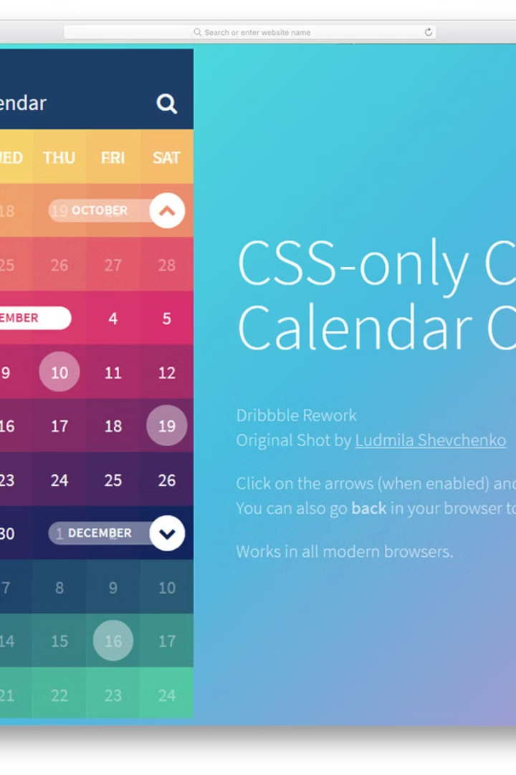

Introduction to the code
Program to display a calendar by defining a function called display_calendar.
Purab Vats
2210990692

Slide 2

Purpose of the code
1
Efficient Time Management
2
Enhance Productivity
3
User-Friendly Interface
Assist in organizing schedules and important dates efficiently.
Help increase productivity by better planning and scheduling.
Aim to provide an easy-to-use calendar display for various needs.

Slide 3
Function definition: display_calendar(year, month)
1
Simple Parameters
Function takes year and month as input parameters.
2
Basic Logic
Utilizes simple algorithms to generate the calendar output.
3
Output Format
Returns a visually appealing calendar display to the user.

Slide 4
Explanation of the code logic
Algorithmic Approach
Data Structure Handling
Utilizes an algorithm to map days to respective date cells.
Manages data using arrays or dictionaries for robust storage.
Applies conditional logic for leap year calculations.
Effective handling of different month lengths.

Slide 5
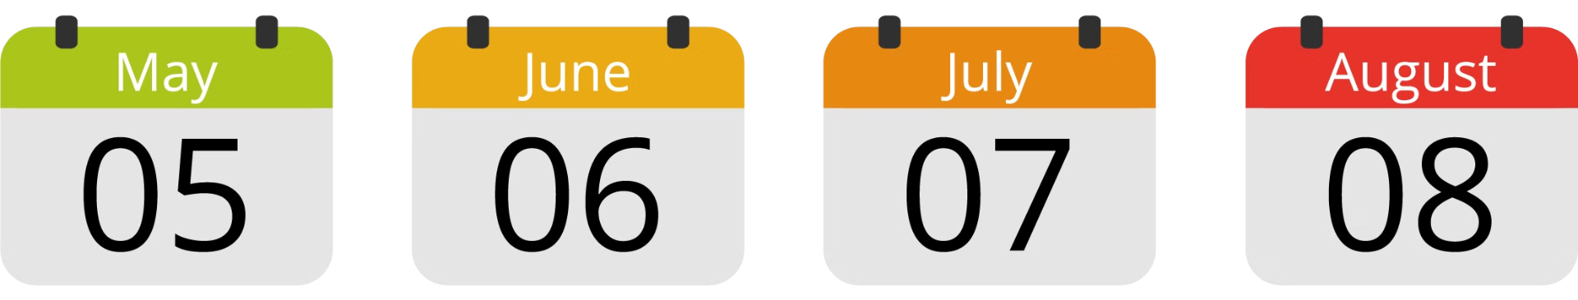
Input parameters: year, month
1
Year
2
Month
Accepts a 4-digit integer representing the year.
Takes an integer between 1 and 12 to specify the month.

Slide 6

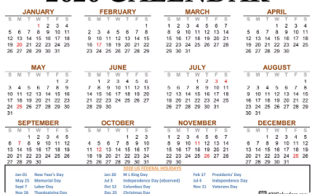

Output: Calendar display
Visual Appeal
Yearly Display
Monthly Representation
Generates an aesthetically pleasing presentation of dates and days.
Capable of showcasing the entire year's calendar in a single view.
Provides a clear and structured view of the chosen month.

Slide 7
Example usage of the code
Virtual Calendars
Web Development
Applicable in digital calendars for various applications and tools.
Usage in creating calendar displays on web pages and applications.
Data Analysis
Assistance in scheduling and analyzing time-bound data.

Slide 8



Conclusion and key takeaways
Enhanced Planning
Efficient Resource Utilization
User-Centric Design
Improved scheduling and structured planning for users.
Focus on providing a seamless and intuitive user experience.
Optimizes time allocation and resource management.

