Slide 1
Project Presentation of COOP
On
Smart Study Planner
Taranpreet Singh 2210992454
Purab Vats 2210990692
Tanish Singla 2210992438
Shalesh Thakur 2210992283
Supervised By: Dr. Shikha Tuteja
Department of Computer Science and Engineering,
Chitkara University, Punjab

Slide 2
Introduction
2.1 Background
Lack of structured shipment allocation system
Students often struggle with unstructured study planning
Difficulty in identifying which topics to prioritize
No awareness of overload or burnout risk
2.2 Problem Statement
Develop an AI-powered smart study planning system
Automatically prioritize topics based on importance and dependencies
Generate optimized daily study schedule
Detect overload situations and suggest recovery strategies
Provide progress tracking and productivity insights
Enable social learning through leaderboard and collaboration
2

Slide 3
Software and Hardware Requirement Specification
3.1 Methodology :-
The development of Smart Study Planner follows the Agile methodology Focus on iterative development, testing, and continuous improvement Application is built in modular sprints, including:
User Authentication System
Subject & Topic Management
AI-based Scheduling Engine
Overload Detection & Recovery System
Social & Leaderboard Features
Continuous testing ensures:
Scalability
Reliability
Performance optimization
3.2 Programming / Working Environment
Frontend: React (Vite)
Backend: Node.js with Express.js
Database: MongoDB Atlas (Cloud Database)
Authentication: JWT + Email OTP Verification
AI Integration: Google Gemini API (for topic analysis & prioritization)
Communication: REST APIs (client-server interaction)
Architecture: Client-Server Architecture Model

Slide 4
Software and Hardware Requirement Specification (1/2)
3.3 Requirements to Run the Application
Hardware Requirements :-
Operating System: Windows / Linux / macOS
RAM: Minimum 8 GB
Processor: Intel i5 or equivalent
Software Requirements :-
Node.js & npm installed
MongoDB Atlas configured
Gemini API Key setup
Email Service (Nodemailer) configured for OTP
Browser: Latest version of Chrome / Firefox / Safari

Slide 5
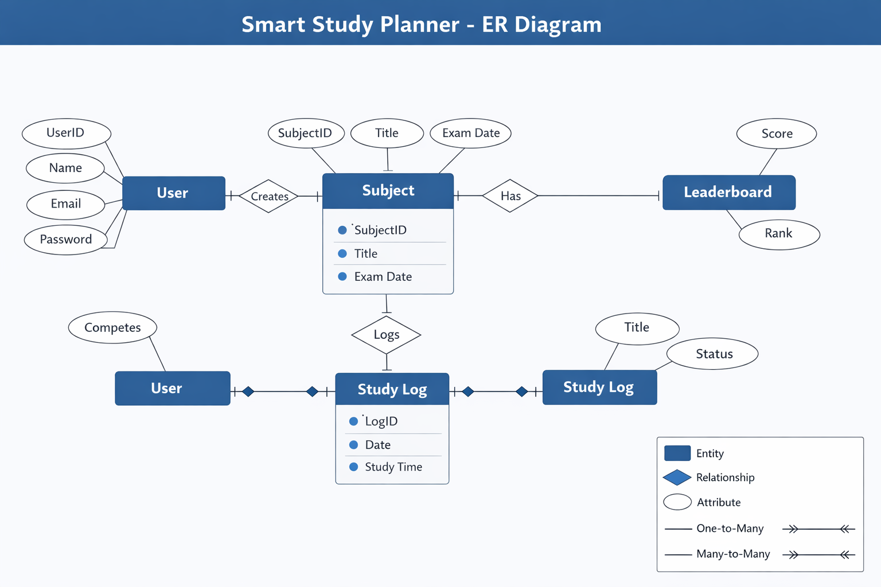
ER Diagram

Slide 6
TECHNOLOGIES AND TOOLS
Smart Study Planner uses modern technologies to ensure scalability, performance, and intelligent functionality.
React.js (with Vite):Used to build a fast, responsive, and dynamic user interface. Enables smooth navigation between dashboard, subjects, and social features.
Node.js & Express.js : Provides a scalable server environment to handle APIs, business logic, and scheduling operations efficiently.
MongoDB Atlas: Cloud-based NoSQL database used to store user data, subjects, topics, tasks, and analytics securely.
JWT & Email OTP Verification: Ensures secure user authentication, session management, and email validation for account safety.
Google Gemini API: Used for intelligent topic analysis, prioritization, and dependency detection to enhance study planning.

Slide 7
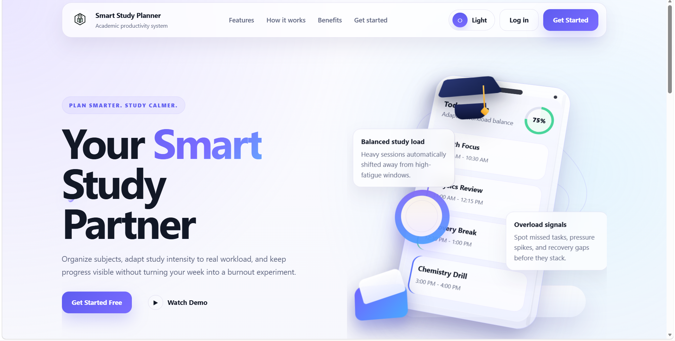
VISUAL REPRESENTATION

Slide 8
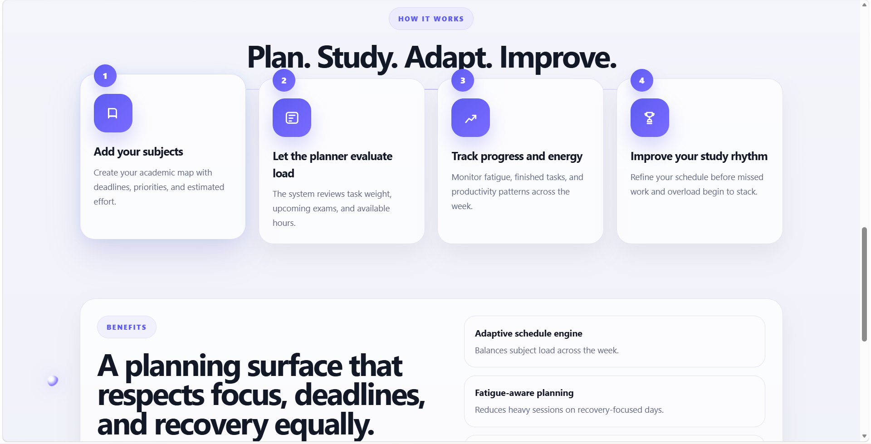
VISUAL REPRESENTATION

Slide 9
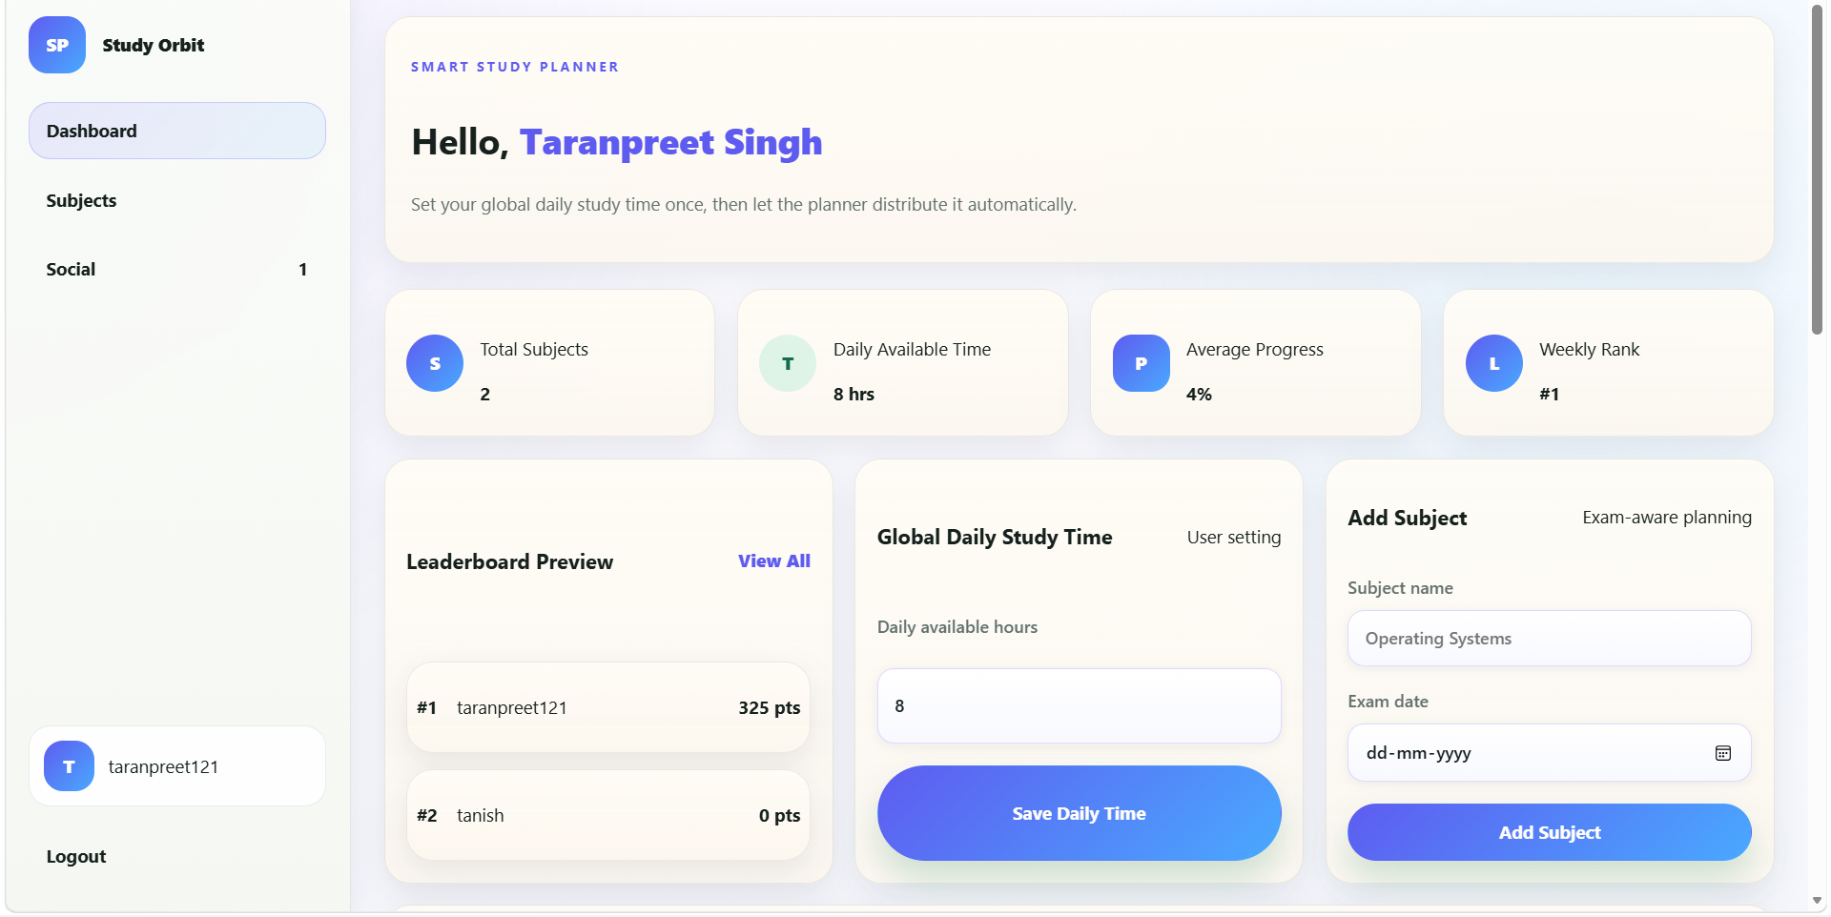
VISUAL REPRESENTATION

Slide 10
Future Scope
Advanced AI Personalization: Improve AI to adapt study plans based on user performance, learning speed, and behavior patterns.
Mobile Application Development: Develop Android/iOS apps for better accessibility and on-the-go study management.
Integration with Learning Platforms: Connect with platforms like YouTube, Coursera, or NPTEL for direct learning resources within the app.
Smart Revision System: Implement spaced repetition and automatic revision scheduling before exams
Real-Time Collaboration: Enable group study features, shared schedules, and peer discussions.
Enhanced Burnout Detection: Use advanced analytics to predict stress levels and suggest optimal breaks.
Gamification Features: Introduce badges, streaks, and rewards to increase user engagement.

Slide 11
Conclusion
The Smart Study Planner presents an intelligent and efficient solution for managing academic workloads. By leveraging AI-based prioritization and dependency analysis, the system helps students understand not only what to study but also the correct order in which topics should be covered. It optimizes time utilization through dynamic scheduling while adapting to different subjects, deadlines, and individual study capacities. The inclusion of features such as overload detection and recovery mode ensures that students can avoid excessive stress and maintain a balanced and sustainable study routine. Additionally, progress tracking, performance insights, and social learning elements enhance motivation, accountability, and overall engagement. The system also promotes consistency by guiding users with structured daily goals and actionable recommendations. Overall, the application transforms traditional study practices into a structured, data-driven, and highly personalized learning experience, ultimately helping students improve productivity, manage time effectively, and achieve better academic outcomes.
Furthermore, the Smart Study Planner demonstrates how modern technology and artificial intelligence can be effectively utilized in the field of education to address real-world challenges faced by students. The system not only simplifies study planning but also empowers users to make informed decisions about their learning process. Its flexible and scalable design allows it to be extended with advanced features such as personalized recommendations, mobile accessibility, and deeper analytics in the future. By combining automation with user-centric design, the application creates a more efficient, adaptive, and engaging study environment, making it a valuable tool for students aiming to enhance both their academic performance and overall learning experience.

Slide 12
References
React (Official Documentation): Meta. React – A JavaScript Library for Building User Interfaces. https://react.dev
Vite (Official Documentation); Evan You. Vite – Next Generation Frontend Tooling. https://vitejs.dev
Node.js (Official Documentation): OpenJS Foundation. Node.js – JavaScript Runtime Environment. https://nodejs.org
Express.js (Official Documentation): OpenJS Foundation. Express – Fast, Unopinionated Web Framework for Node.js. https://expressjs.com
MongoDB Atlas (Official Documentation): MongoDB Inc. MongoDB Atlas – Cloud Database Service. https://www.mongodb.com/atlas
Mongoose (ODM Library): Mongoose Team. Mongoose – MongoDB Object Modeling for Node.js. https://mongoosejs.com
Google Gemini API: Google. Gemini – Generative AI API Documentation. https://ai.google.dev

Slide 13
Thank You
13

