Slide 1
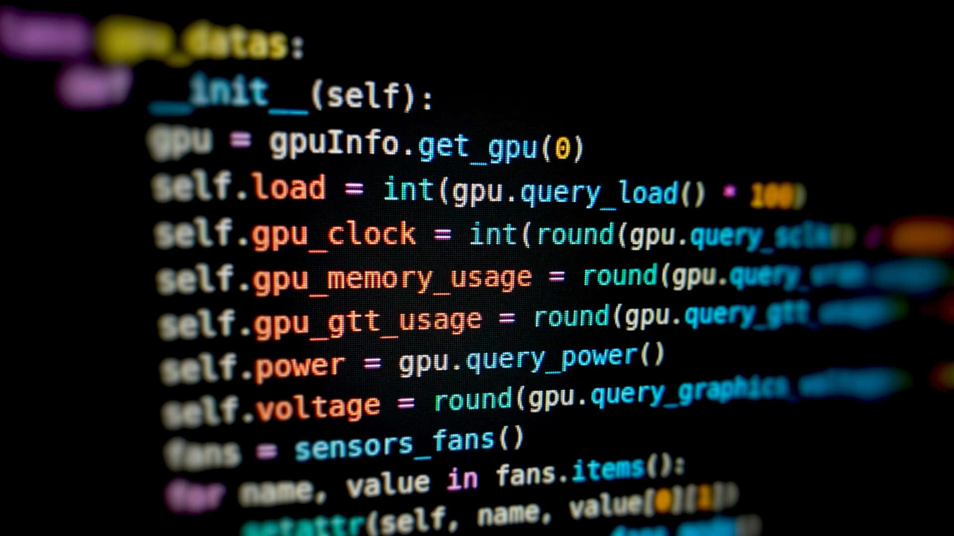
PAYPAL
Full-Stack App with MongoDB, Mongoose, Node.js & Angular
Course: COMP 2068 – JavaScript Frameworks
Team Members : Manan, Vishva, Dev, Neel, Purab, Parth

Slide 2
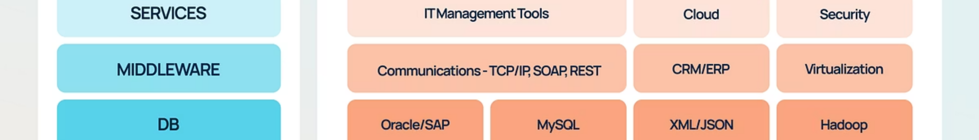
Why This Stack Matters
Today, our group will walk you through how to build a real, full-stack web application using modern JavaScript technologies that are transforming the industry.
Industry Relevance
Beginner-Friendly Power
This stack is powering thousands of production applications worldwide, making it one of the most sought-after skillsets in web development today.
MongoDB, Express, and Angular form a powerful yet accessible ecosystem that lets you build real applications from day one.
01
02
MongoDB Data Storage
Mongoose Connection Layer
Learn how document databases store and retrieve data efficiently
Understand how to structure and validate your data models
03
04
Frontend-Backend Communication
Cloud Deployment
Master HTTP requests and REST APIs
Deploy your full application to production using Render and Atlas

Slide 3
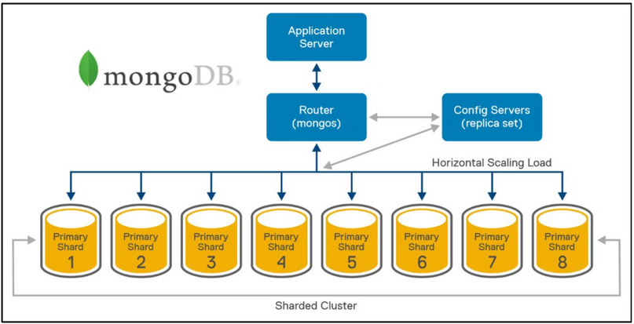



What is MongoDB?
MongoDB is a NoSQL document database that revolutionises how we think about data storage in modern applications.
JSON-Like Documents
Schema Flexibility
Stores data as flexible BSON documents, making it natural for JavaScript developers
No rigid schemas required—adapt your data structure as your app evolves
Cloud-Ready
Seamlessly integrates with MongoDB Atlas for production-ready deployments
Why We Chose MongoDB
Intuitive for JavaScript developers—everything feels like working with objects
Perfect for rapid prototyping and iterative development
Scales effortlessly from learning projects to production applications
Notes:
3

Slide 4
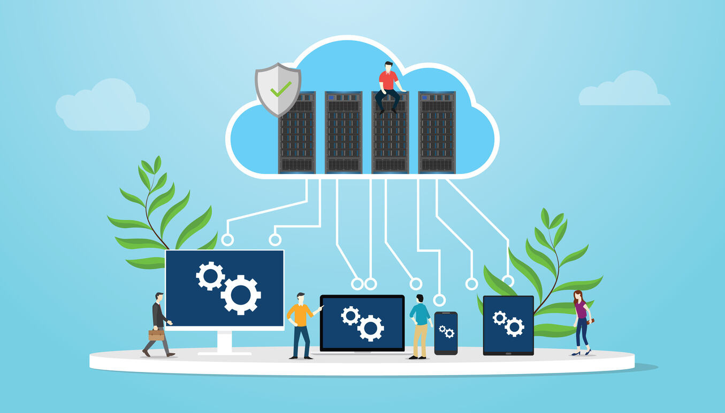





MongoDB Atlas: Your Cloud Database
MongoDB Atlas is the fully managed cloud version of MongoDB, providing enterprise-grade database capabilities without the operational overhead.
Create Your Cluster
Set up a free-tier cluster in minutes with just a few clicks
Configure Database Users
Create secure credentials for your application to connect
Whitelist IP Addresses
Configure network access to allow Render to connect securely
Connect with URI
Use the connection string to link your backend to Atlas
Free Tier Benefits
Production Ready
512 MB storage, shared RAM, perfect for learning and small projects
Built-in security, automated backups, and monitoring capabilities
Global Deployment
Deploy across multiple cloud regions for optimal performance
Notes:
4

Slide 5
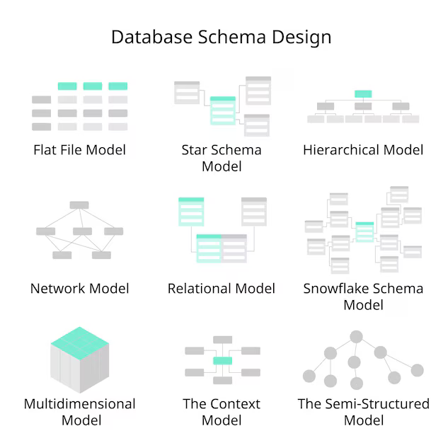
Mongoose: Your Data Modelling Partner
Mongoose is an ODM (Object Data Modelling) library that bridges MongoDB and Node.js, providing structure and validation to your database operations.
How Mongoose Helps
Schemas
Define the structure of your documents with clear field types and requirements
Validation
Built-in validators ensure data integrity before saving to the database
Query Simplification
Intuitive methods for creating, reading, updating, and deleting documents
Beginner-Friendly
Clear error messages and straightforward syntax make learning easier
Our Transaction Model
const transactionSchema = new Schema({ payer: { type: String, required: true }, payee: { type: String, required: true }, amount: { type: Number, required: true }, status: { type: String, enum: ['pending', 'completed'] }});
Notes:
5

Slide 6




Building the Backend with Node.js & Express
Our backend serves as the intelligent bridge between the Angular frontend and MongoDB database, handling all business logic, validation, and data operations.
API Routes
Data Validation
RESTful endpoints for GET, POST, PUT, and DELETE operations
Ensures incoming requests meet required formats and constraints
Database Bridge
Response Handling
Communicates with MongoDB to persist and retrieve data
Sends formatted JSON responses back to the frontend
Key Backend Routes
Backend Responsibilities
GET /api/transactions — Retrieve all transactions
The Express backend controls all business logic, ensures data integrity through validation, and provides a secure interface between the database and client.
POST /api/transactions — Create new transaction
PUT /api/transactions/:id — Update existing transaction
DELETE /api/transactions/:id — Remove transaction

Slide 7
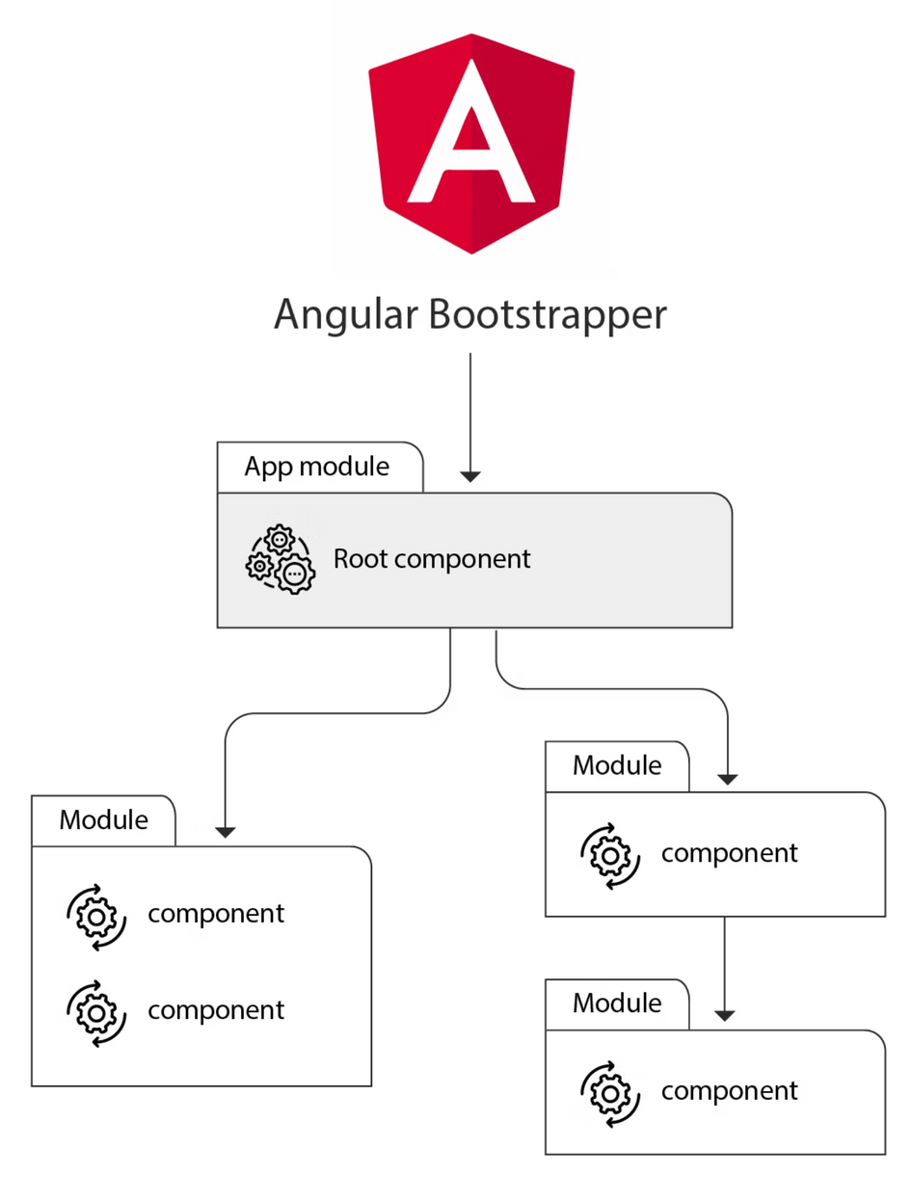
Angular Frontend: Dynamic User Interface
Our Angular frontend provides a responsive, dynamic interface that communicates seamlessly with the backend API to deliver real-time updates.
Why Angular?
Course Alignment: Directly relevant to COMP 2068 curriculum
Component Architecture: Modular structure makes large apps manageable
Two-Way Data Binding: UI and data stay synchronized automatically
Production-Ready: Built by Google for enterprise applications

Slide 8
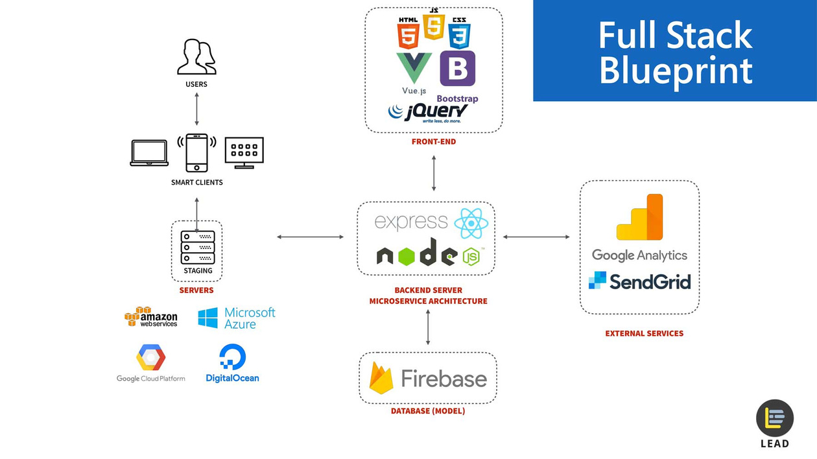




Full-Stack Architecture
Understanding how all the pieces work together is crucial for full-stack development. Here's how our application components communicate:
Client Browser
User interacts with Angular application
Angular Frontend
Sends HTTP requests to backend API endpoints
Express Backend API
Processes requests, validates data, queries database
MongoDB Atlas
Stores and retrieves data from cloud cluster
Frontend Deployment
Backend Deployment
Static site hosted on Render for fast global delivery
Node.js web service running continuously on Render
Database Hosting
MongoDB Atlas cluster providing managed cloud storage

Slide 9



Live Demo: PayPal Transactions Manager
We've built a fully functional PayPal Transactions Manager that demonstrates all the concepts we've covered, deployed and running in production.
1
2
Add Transaction
Edit Transaction
Create new payment records with payer, payee, amount, and status
Modify existing transaction details with real-time updates
3
4
Delete Transaction
View All Transactions
Remove transactions with confirmation and immediate database sync
Browse complete transaction history with filtering options
Access Our Live Application
Feel free to explore the application, test the functionality, and review the source code. The backend API endpoint will show available routes when accessed directly.

Slide 10






In-Class Exercise: Build Your First Full-Stack Application
To help you learn this stack hands-on, we've created a simple guided exercise that walks you through building a complete full-stack application from start to finish.
Clone Starter Project
Run Minimal Backend
Get the foundation code and set up your development environment with all necessary dependencies.
Launch a Node.js server with Express to handle API requests and responses.
Connect MongoDB
Modify Schema
Establish connection to a test database and verify your data persistence layer.
Add custom fields like "notes" to your Mongoose model and understand data structure.
Create Angular Input
Test POST Request
Build a new form field in your frontend to capture user data effectively.
Send data to your API and verify the complete data flow from frontend to database.
What You'll Gain
Confidence with full-stack development workflow
Hands-on experience building and consuming real APIs
Deep understanding of Mongoose models and schemas
Practical Angular data-binding and form handling skills

Slide 11
Common Challenges & Solutions
We've prepared comprehensive troubleshooting guidance in the README to help you overcome common hurdles. Don't worry—these issues are normal and we'll help you through them!
CORS Errors
API URL Mismatches
Angular Build Errors
Issue: Browser blocks requests between different origins
Issue: Frontend can't find backend endpoints
Issue: Compilation fails with cryptic messages
Solution: Double-check your environment variables and ensure API base URLs match between frontend and backend
Solution: Verify all imports, check for typos in component selectors, and ensure dependencies are installed correctly
Solution: Configure CORS middleware properly in Express to allow cross-origin requests from your Angular app
MongoDB Connection Timeouts
Render Deployment Issues
Issue: Database won't connect or takes too long
Issue: Application fails to deploy or run in production
Solution: Verify connection string, check network access settings in MongoDB Atlas, and ensure IP whitelist is configured
Solution: Check environment variables, build scripts, and ensure all dependencies are listed in package.json
💡 Remember: We'll be available during class to help if you get stuck. Debugging is a crucial skill—don't hesitate to ask questions!
Notes:
11

Slide 12

Essential VS Code Extensions for Your Workflow
These powerful extensions will make your development experience smoother, faster, and more enjoyable during the exercise and beyond.
ESLint
MongoDB for VS Code
Angular Language Service
Postman
Automatically catches errors and enforces consistent coding standards. Improves code quality by highlighting potential bugs and style issues in real-time.
Connect directly to MongoDB Atlas from your editor. Browse collections, run queries, and manage your database without leaving VS Code.
Provides intelligent code completion, error checking, and navigation for Angular templates. Makes working with components and directives much easier.
Test your API routes easily with a user-friendly interface. Send requests, inspect responses, and debug your backend endpoints efficiently.
Why These Tools Matter
Professional developers rely on extensions to boost productivity and reduce errors. Installing these tools now will help you:
Write cleaner, more maintainable code
Debug issues faster and more effectively
Understand best practices through real-time feedback
Build confidence in your development workflow
Notes:
12

Slide 13
Questions & Next Steps
Thank You for Your Attention!
Feel Free to Ask Questions
We're excited to walk you through the hands-on exercise now. This is where theory meets practice, and you'll see how all the pieces of the MEAN/MERN stack come together beautifully.
No question is too small or too basic. We're here to help you succeed, whether you need clarification on concepts, debugging assistance, or guidance on best practices.
Remember, learning to code is a journey. Every error message is a learning opportunity, and every successfully running application is a milestone worth celebrating.
"The only way to learn a new programming language is by writing programs in it." — Dennis Ritchie
🚀 Ready to Code
💪 Hands-On Learning
🎉 Celebrate Progress
Clone the repository and start building your first full-stack application
Apply everything you've learned through practical implementation
Every line of code you write brings you closer to becoming a full-stack developer
Let's begin the exercise together! 🎯
Notes:
13

