Slide 1
Content-Based AI Movie Recommendation System
CRT Mini Project
Student Name : T. Reddy Purandareswar
Roll No. : 23AK1A3365
Branch : AIML
College : Annamacharya Institute Of Technology and Sciences, Tirupati.

Slide 2
Problem Statement
Users face difficulty discovering relevant movies from large collections. The system recommends similar movies automatically using machine learning.

Slide 3
Methodology / Approach
Dataset (5000+ Movies)
→ Data Cleaning
→ Count-Vectorizer
→ Cosine Similarity
→ Recommendations
→ Stream-lit Interface

Slide 4


Technologies
Technologies: Python, Pandas, Scikit-Learn, Stream-lit.

Slide 5
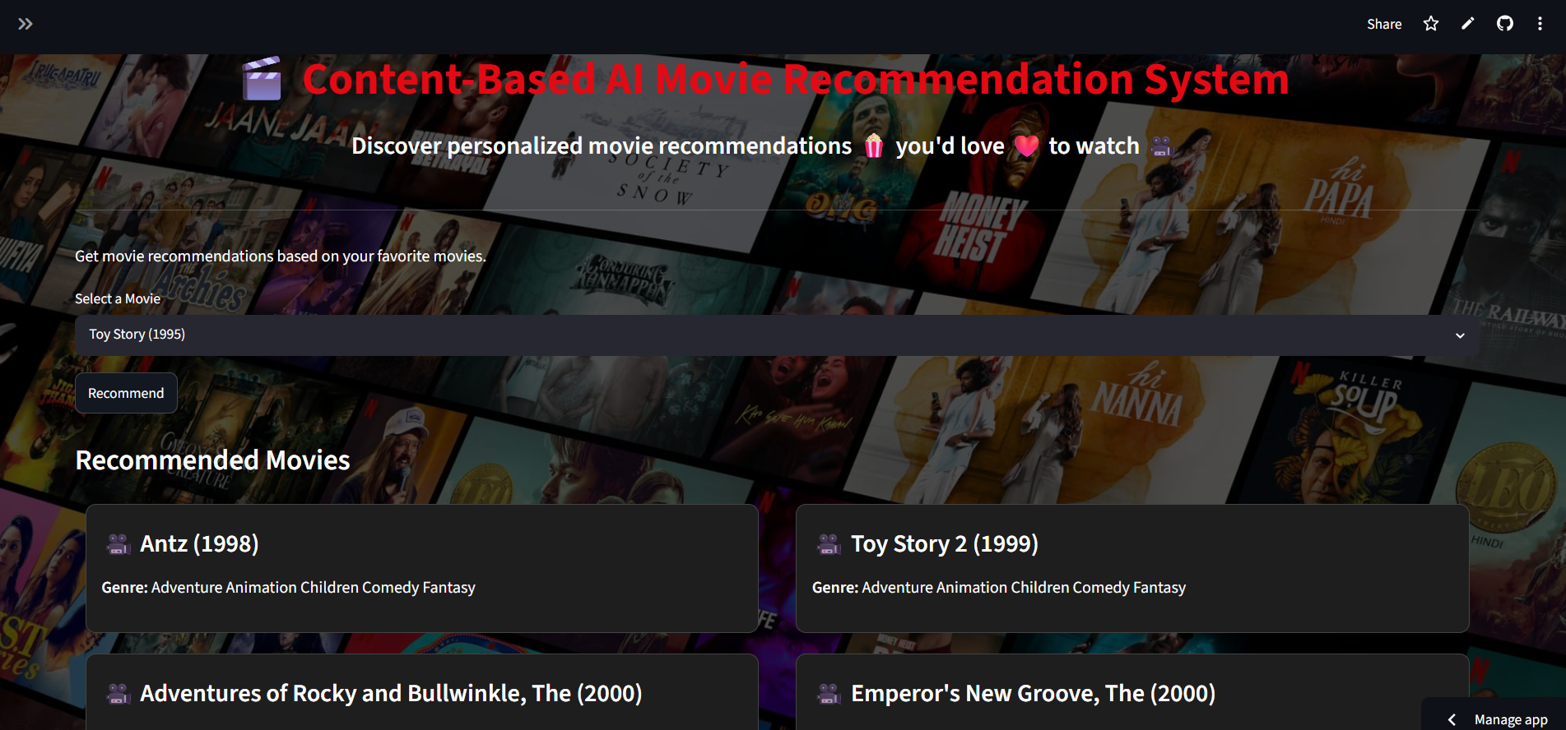
Results
Interactive recommendation system with genre-based movie suggestions and clickable search links.

Slide 6
Conclusion & Future Scope
The project successfully demonstrates Content-Based Filtering.
Future Enhancements: Posters, Ratings, User Profiles, Hybrid Recommendations.

