Slide 1
Sales Data Analysis & Business Insights
Apex Planet Internship - Task 4
By: T. Reddy Purandareswar

Slide 2
Objective
To analyze sales data across regions and identify key business insights to improve performance and decision-making.

Slide 3
Dataset Overview
Sales dataset
Includes Region, Category, Sales, and Profit.
Visualized using Power BI.

Slide 4
Sales by Region
East region shows the highest sales.
South region as the lowest performance.

Slide 5
Key Insights
East region is the top-performing region.
South region has lower sales performance.
Central region shows negative profit.

Slide 6
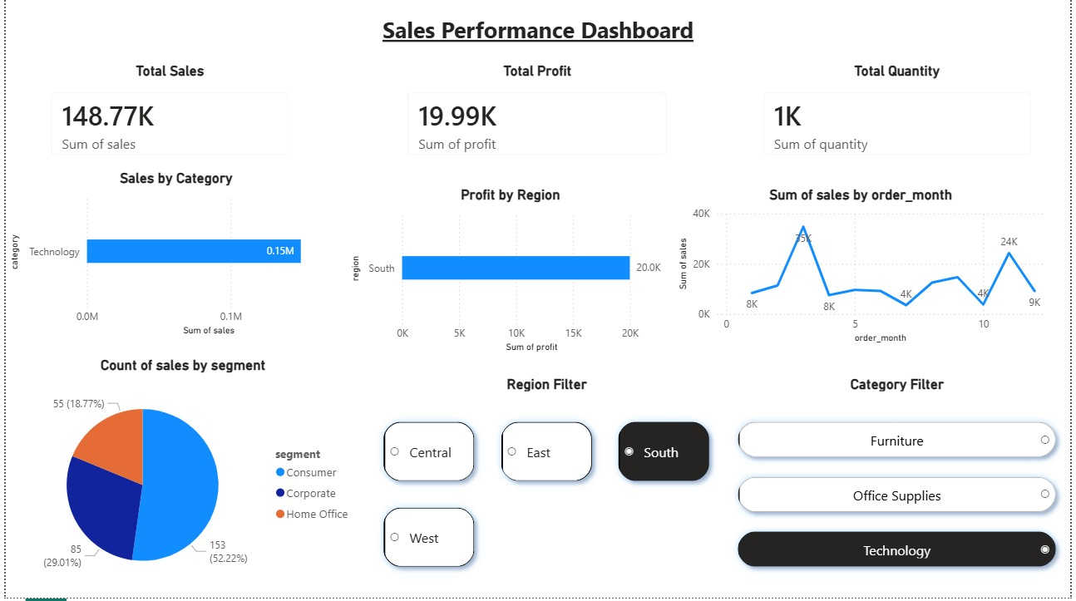
Dashboard Overview

Slide 7
Hypothesis Testing
H0: No difference in sales between East and South
H1: Significant difference exists
Test Used: T-Test
Result: p-value < 0.05
Conclusion:
There is a statistically significant difference in sales.
East region outperforms South region.

Slide 8
Business Recommendations
- Focus on improving sales in South region
- Maintain strong performance in East
- Improve profit strategy in Central region

Slide 9
Conclusion
Data-driven insights help improve business performance and support better decision-making.

