Slide 1
BTI CE Title - M1 Presentation A.Y. 2025-2026 Project Title - DYSCOVER: AI-Powered Early Dyslexia Screening Tool
Presented by:
Under the guidance of: Dr. Pravin Shrinath
Roll No. | Name
C006 | Manya Gor
C011 | Arushi Sangle
C033 | Purav Shah

Slide 2
Index
Introduction
Motivation
Problem Statement
Proposed Tech Stack
Literature Survey
Dataset
Flowchart (pipeline)
Output
Conclusion

Slide 3
Introduction
Dyscover is an AI-powered tool for screening Dyslexia early in children aged 3–12.
Tasks: a short questionnaire, phoneme awareness, decoding via nonsense words, reading fluency and so on.
Children respond orally; system records answers and scores them automatically.
Uses speech recognition (Whisper-medium fine-tuned for Indian voices) + ML model for risk detection.
Outcome: Classify children into Low, Moderate, or High risk of Dyslexia.

Slide 4
Motivation
Early reading problems often go undetected in schools, especially in India.
Manual tests are slow, costly, and dependent on experts.
Late detection → widening learning gaps & low confidence.
Advances in speech-to-text and ML enable a scalable, low-cost assessment.
Helps ensure equal access to early support in both urban and rural schools.

Slide 5
Problem Statement
“Many children with dyslexia are not identified early because current tests are slow, need experts, and are not easily available in schools. There is a need for a quick, easy, and affordable AI tool that can help spot early signs of dyslexia in children aged 3–12, so they can get help on time and improve their learning.”

Slide 6
Proposed Tech Stack
Backend
Language/Frameworks: Python 3.11, Flask 2.3, Flask-CORS
ASR Runtime: openai-whisper (Whisper-medium, fine-tuned), PyTorch 2.x, torchaudio
Audio Processing: ffmpeg 6.x
TTS: pytts3, Azure Cognitive Services Speech SDK
Env & Utilities: python-dotenv, requests, logging
Storage: Local file storage (audio/sessions/results)
Package Manager: pip + virtualenv

Slide 7
Proposed Tech Stack
Frontend
Frameworks: Next.js 15 (App Router), React 19
Styling/UX: Tailwind CSS 4, Radix UI Primitives, Framer Motion 11
Notifications: React Hot Toast
Audio Capture: Web Audio API (getUserMedia, MediaRecorder, AudioContext)
Data Transfer: Fetch API (multipart/form-data uploads)
Build/Runtime: Node.js 20 LTS, npm 10

Slide 8
Proposed Tech Stack
AI/ML
Speech Recognition: Whisper-medium via openai-whisper + torchaudio
ML Frameworks: PyTorch 2, scikit-learn 1.5, LightGBM 4.x
Models: Logistic Regression (baseline), Gradient Boosting (risk classification, calibrated)
Optimization: Gradient Descent (lbfgs/saga)
Metrics: CER/WER, confidence thresholds
Libraries: NumPy, SciPy (signal processing)

Slide 9
Proposed Tech Stack
1. Audio I/O
Input: WebM/Opus, 16 kHz mono
Server: WAV PCM16 normalized
Silence trimming: client-side + lightweight server
2. TTS Prompts: WAV PCM, cached locally
3. APIs
POST /api/transcribe (webm/wav); /api/score (JSON transcript + metadata)
GET /api/results/:sessionId (aggregates)
4. Security
CORS restricted to Next.js origin; Env config via .env (keys, paths)
File validation: MIME/type checks, duration caps

Slide 10
Literature Survey - Prior Work in the Domain
Early Screening Tools: Tests like Dyslexia Early Screening Test help detect risk but need trained professionals and are not scalable.
Eye-Tracking Based Research: Adolescents with dyslexia show longer fixations, regressions, and irregular saccades. ML on eye-movement data achieves high prediction accuracy.
Phonological Awareness Assessments: Tasks like segmentation, blending, and manipulation are reliable predictors of dyslexia risk.
ASR-Based Screening Attempts: Models like Kaldi, Vosk, wav2vec explored, but weak on short utterances and child speech.
Clinical Perspectives: Pediatric studies stress early detection (ages 3–12) to prevent learning gaps and support timely interventions.

Slide 11
Literature Survey - Architectural & Technical Approaches
Speech Recognition Models: Whisper-medium handles short sounds and Indian accents better than smaller Whisper models; large models impractical in schools.
Machine Learning Classifiers: Logistic Regression, Random Forest, Gradient Boosting widely used; boosting models offer high accuracy and interpretability.
Feature Engineering: Combining accuracy, error patterns, timing, and error types improves classification.
Data Augmentation: Adding background noise (classroom/home) enhances robustness in real-world settings.
Assessment Modalities: Eye-tracking and rapid naming tasks highlight timing + error metrics as critical signals—parallels Dyscover’s speech-based features.

Slide 12
Literature Survey - Gaps in Existing Solutions
Lack of ASR + ML integration for dyslexia risk prediction in Indian children.
Over-reliance on text-only or eye-tracking methods; speech-based assessments underexplored.
ASR systems often fail on short phonemes and nonsense words → lower accuracy for early readers.
Few screening tools provide detailed per-task diagnostic reports; most only give a single score.
Limited focus on privacy, fairness, and scalability; many cloud-only solutions raise cost and safety concerns.

Slide 13
Literature Survey – Dyscover’s Contribution
Unified Screening System: Combines phoneme awareness, nonsense word decoding, reading fluency, and questionnaire.
Fine-Tuned Whisper-Medium: Adapted for Indian child speech (short sounds, CV/CVC, noisy classrooms).
Risk Classification Model: Gradient Boosting + calibrated thresholds → interpretable and reliable detection of Low, Moderate, High risk.
Detailed Reporting: Provides task-wise scores, error highlights, and improvement suggestions for teachers/parents.
Fairness & Privacy: Secure, consent-driven processing; fairness checks across dialect, gender, background.
Scalability: Lightweight enough for schools/clinics; expandable with more accents, data, and fluency/prosody features.

Slide 14
Dataset
Speech Data: Indian English with diverse regional accents, including children.
Noise Augmentation: Classroom/home sounds added for realism.
Tasks Covered: Phoneme awareness, nonsense words, reading passages, questionnaire.
Evaluation: Compared ASR outputs with human raters → measured CER/WER + inter-rater reliability.

Slide 15
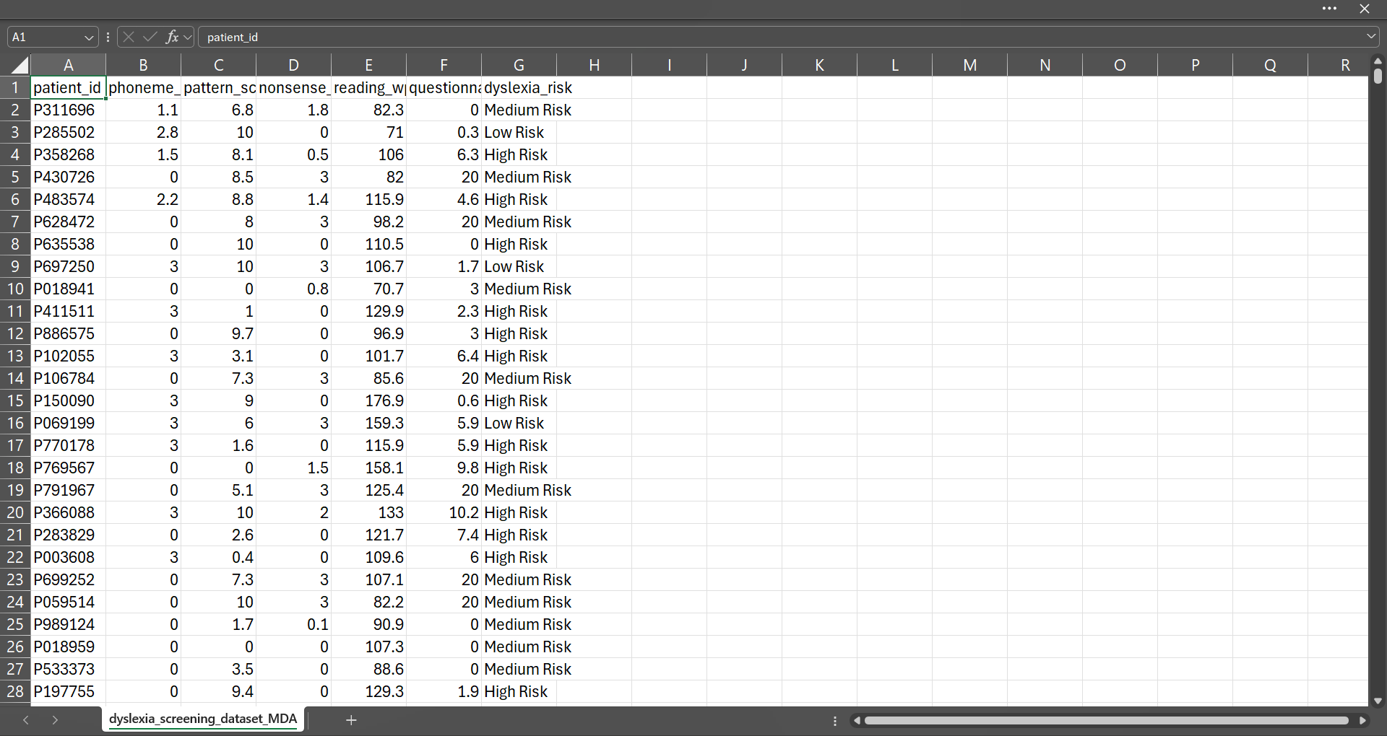
Dataset

Slide 16
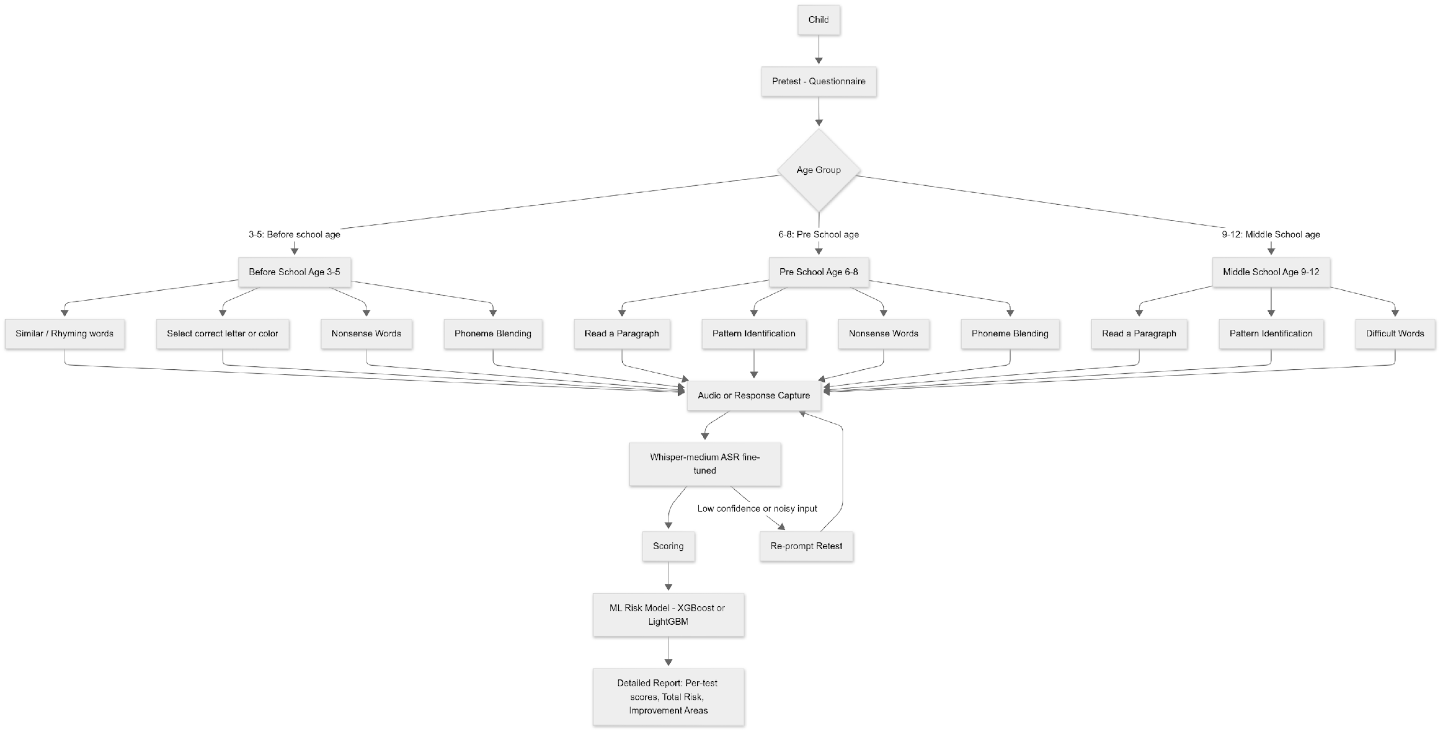
DYSCOVER: Project Flow

Slide 17
Output
Per-task scores: accuracy, error patterns, and timing for phoneme awareness, nonsense words, and reading.
Total risk classification: Low / Moderate / High (based on combined performance + ML model).
Detailed final report: Shows scores per task and overall risk level. Clearly highlights areas where the child needs improvement (e.g., segmentation, decoding, fluency). Provides recommendations for retest or extra support.
Teacher/Parent view: simple, structured summary for easy interpretation.
Explainability: system highlights which errors influenced the child’s risk score (e.g., frequent sound substitutions, skipped words).

Slide 18
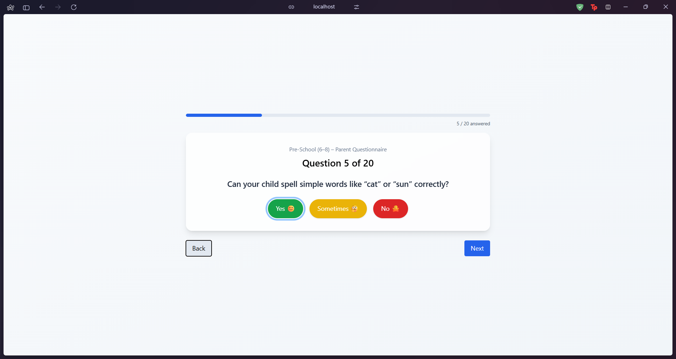
Output (Questionnaire)

Slide 19
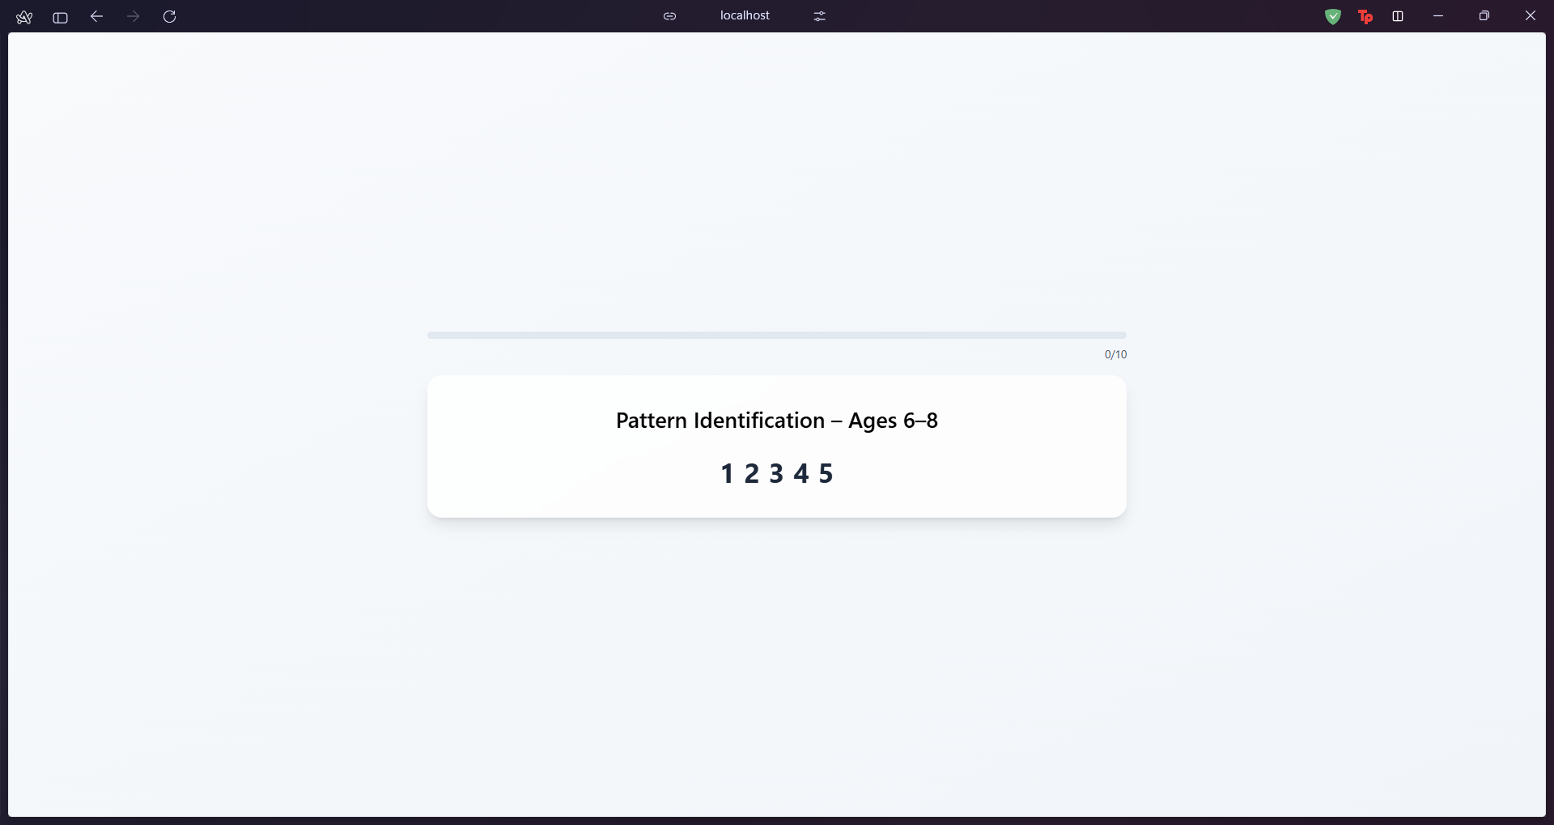
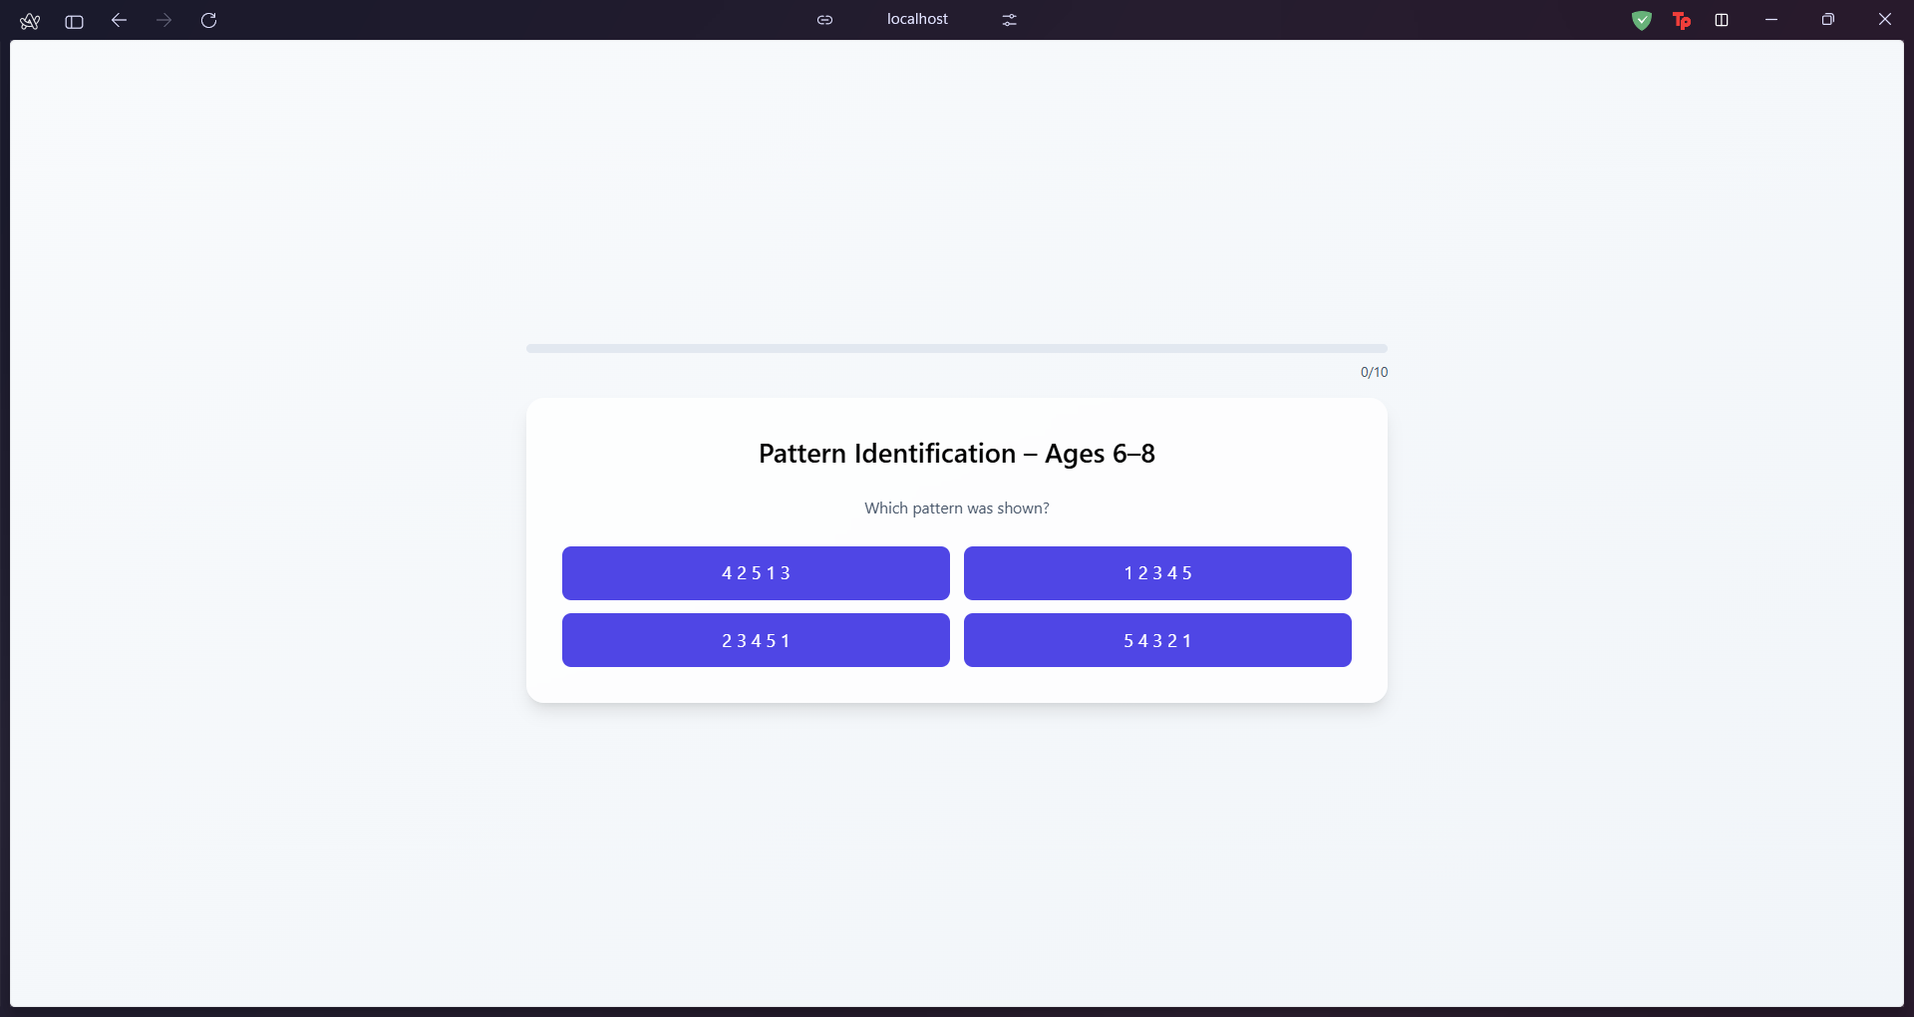
Output (Phonological Tests)

Slide 20
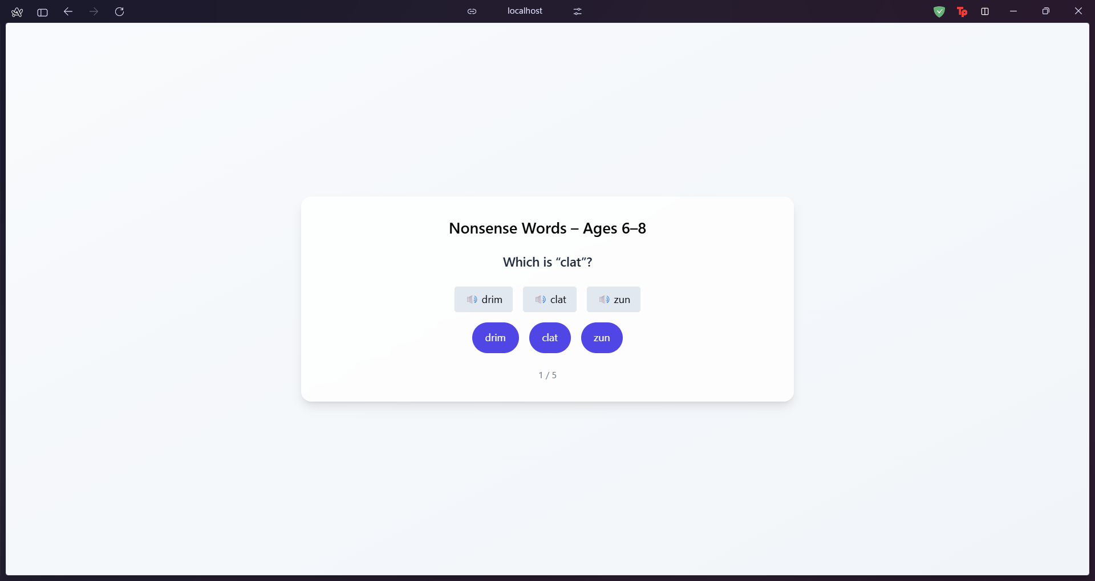
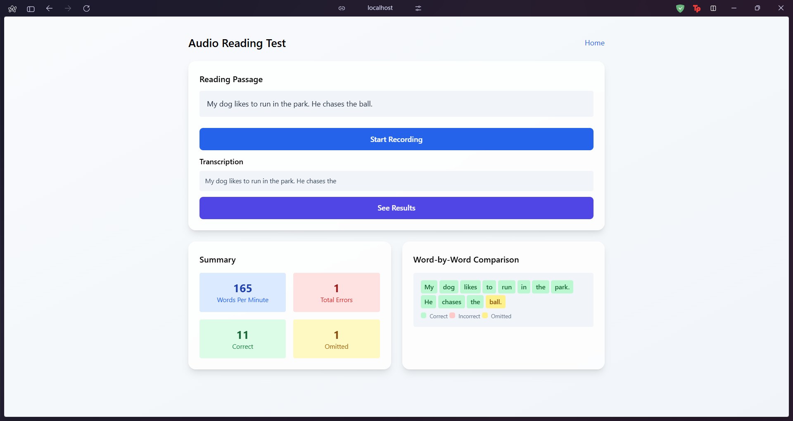
Output (Phonological Tests)

Slide 21
Conclusion
Developed Dyscover, a speech-based, AI-powered tool to assess reading skills in children.
Whisper-medium (fine-tuned) improves recognition of Indian child speech.
ML model combines task performance + ASR confidence to deliver reliable risk levels.
Ensures privacy, fairness, and scalability.
Next Steps: Add more regional accents, refine phoneme alignment, and enable longitudinal progress tracking.

