Slide 1
Student Tracking System
By: Haozhen Yang, Keqing Guan, Hang Zong, Jiazhen Yu, Mufeng Xie, Tianxiang Chu

Slide 2
Introduction
Goal: Develop a tracking system for graduate students
Stakeholders: Graduate advisors of CSCE Department of Texas A&M

Slide 3
User story 1
As an advisor
So that I can load the information of the students from google sheets easily
I want to have the information as a chart

Slide 4
Google Sheet
Chart on Our Webpage

Slide 5
User Story 2
As an advisor
So I can click on the name of the students
I want to be able to see more information when clicking on the names

Slide 6
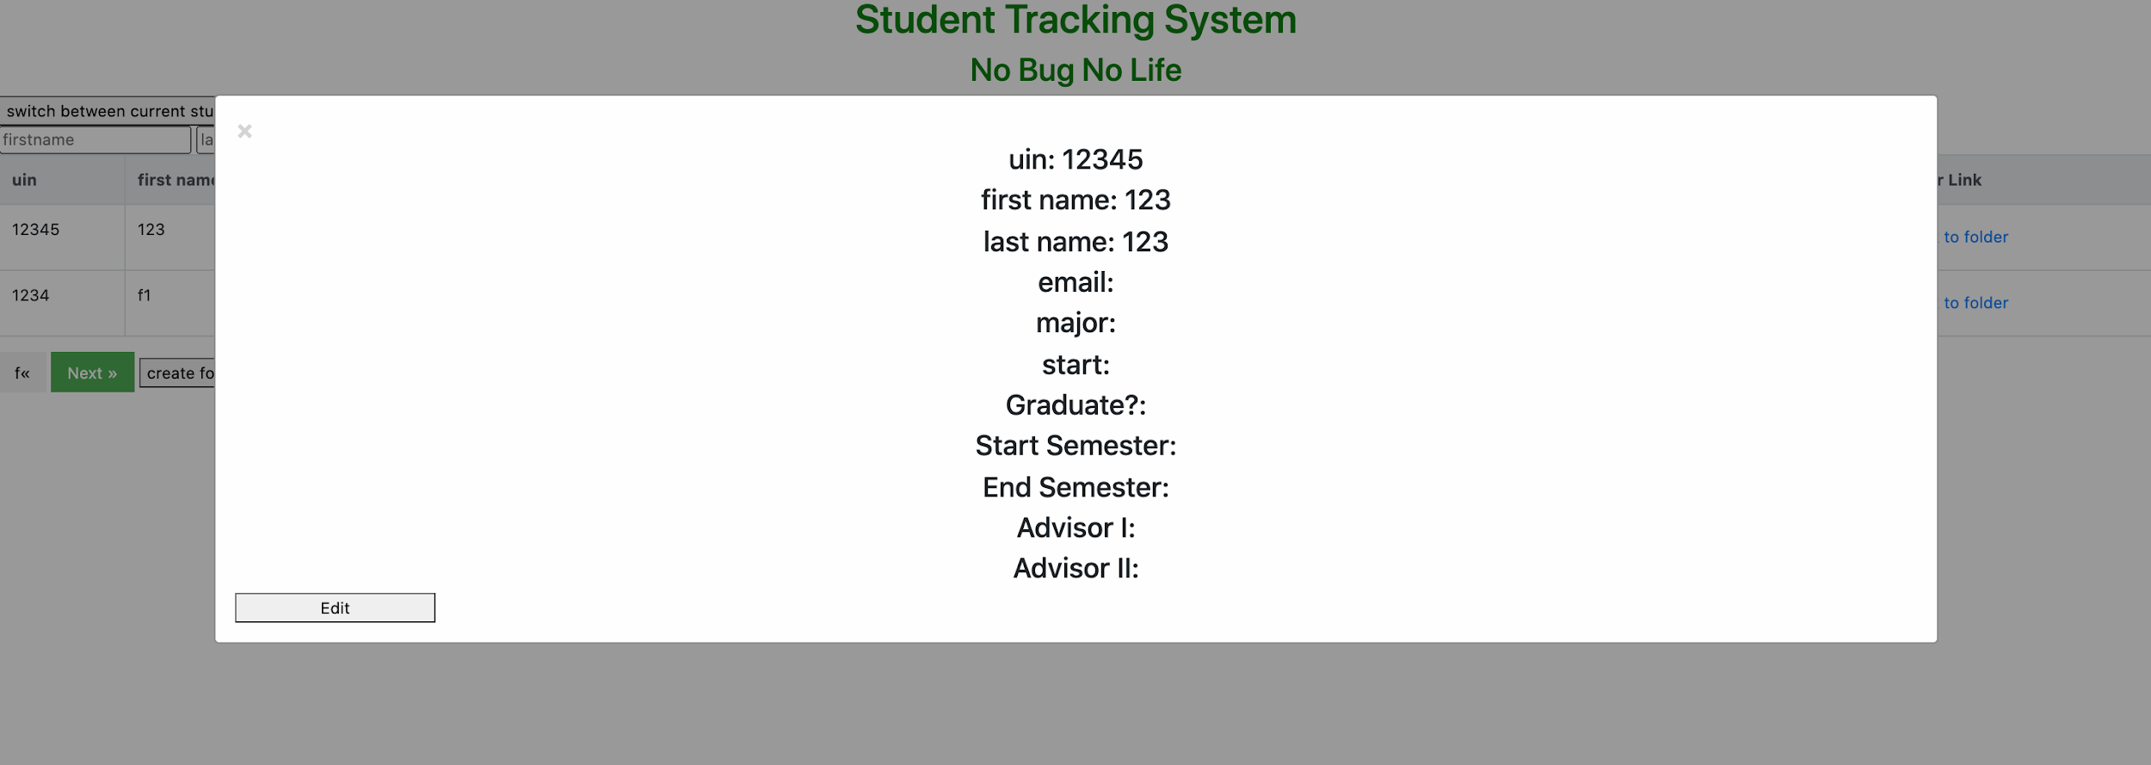
Pop-up dialog

Slide 7
User Story 3
As an advisor
So that I can search for students’ information
i want to find a student by his/her UIN or name

Slide 8
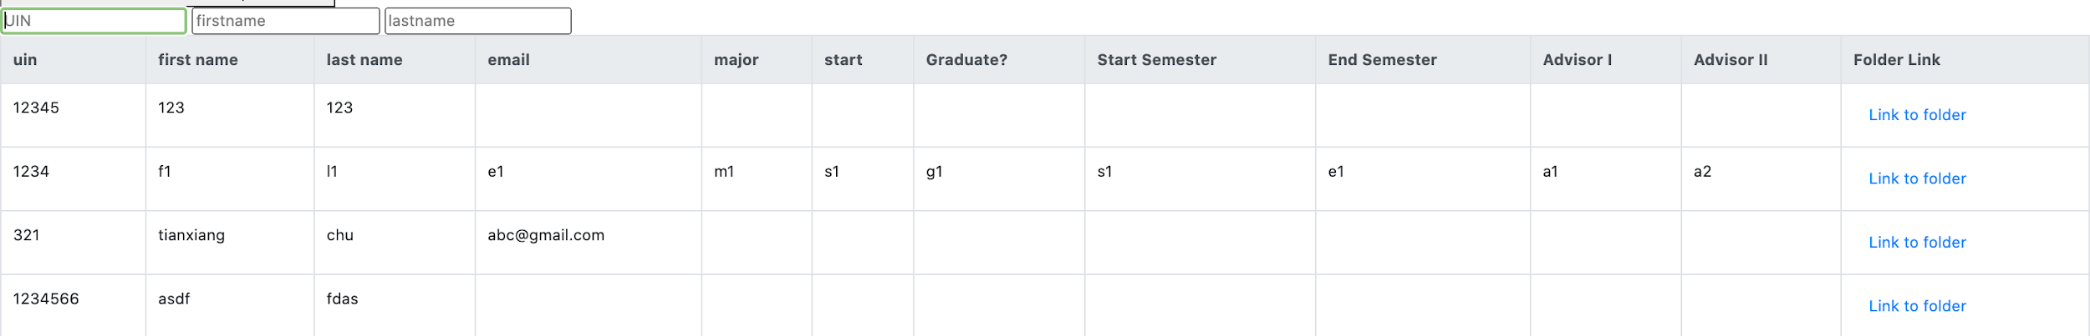
Before Search
After Search

Slide 9
User Story 4
As an Advisor
So that I can give each student a folder in google drive
i want to save all the files of the students in the google drive

Slide 10
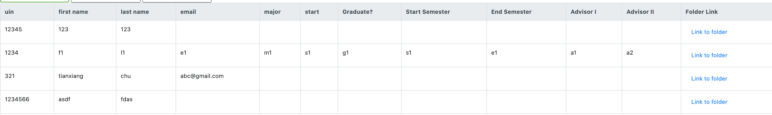
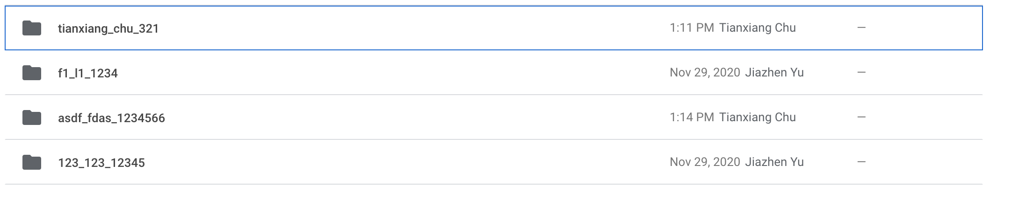
Chart on the Webpage
Folders in the Google Drive

Slide 11
User Story 5
As an advisor
So that I can change the loaded google sheet
I want to add students that are not on the google sheet

Slide 12
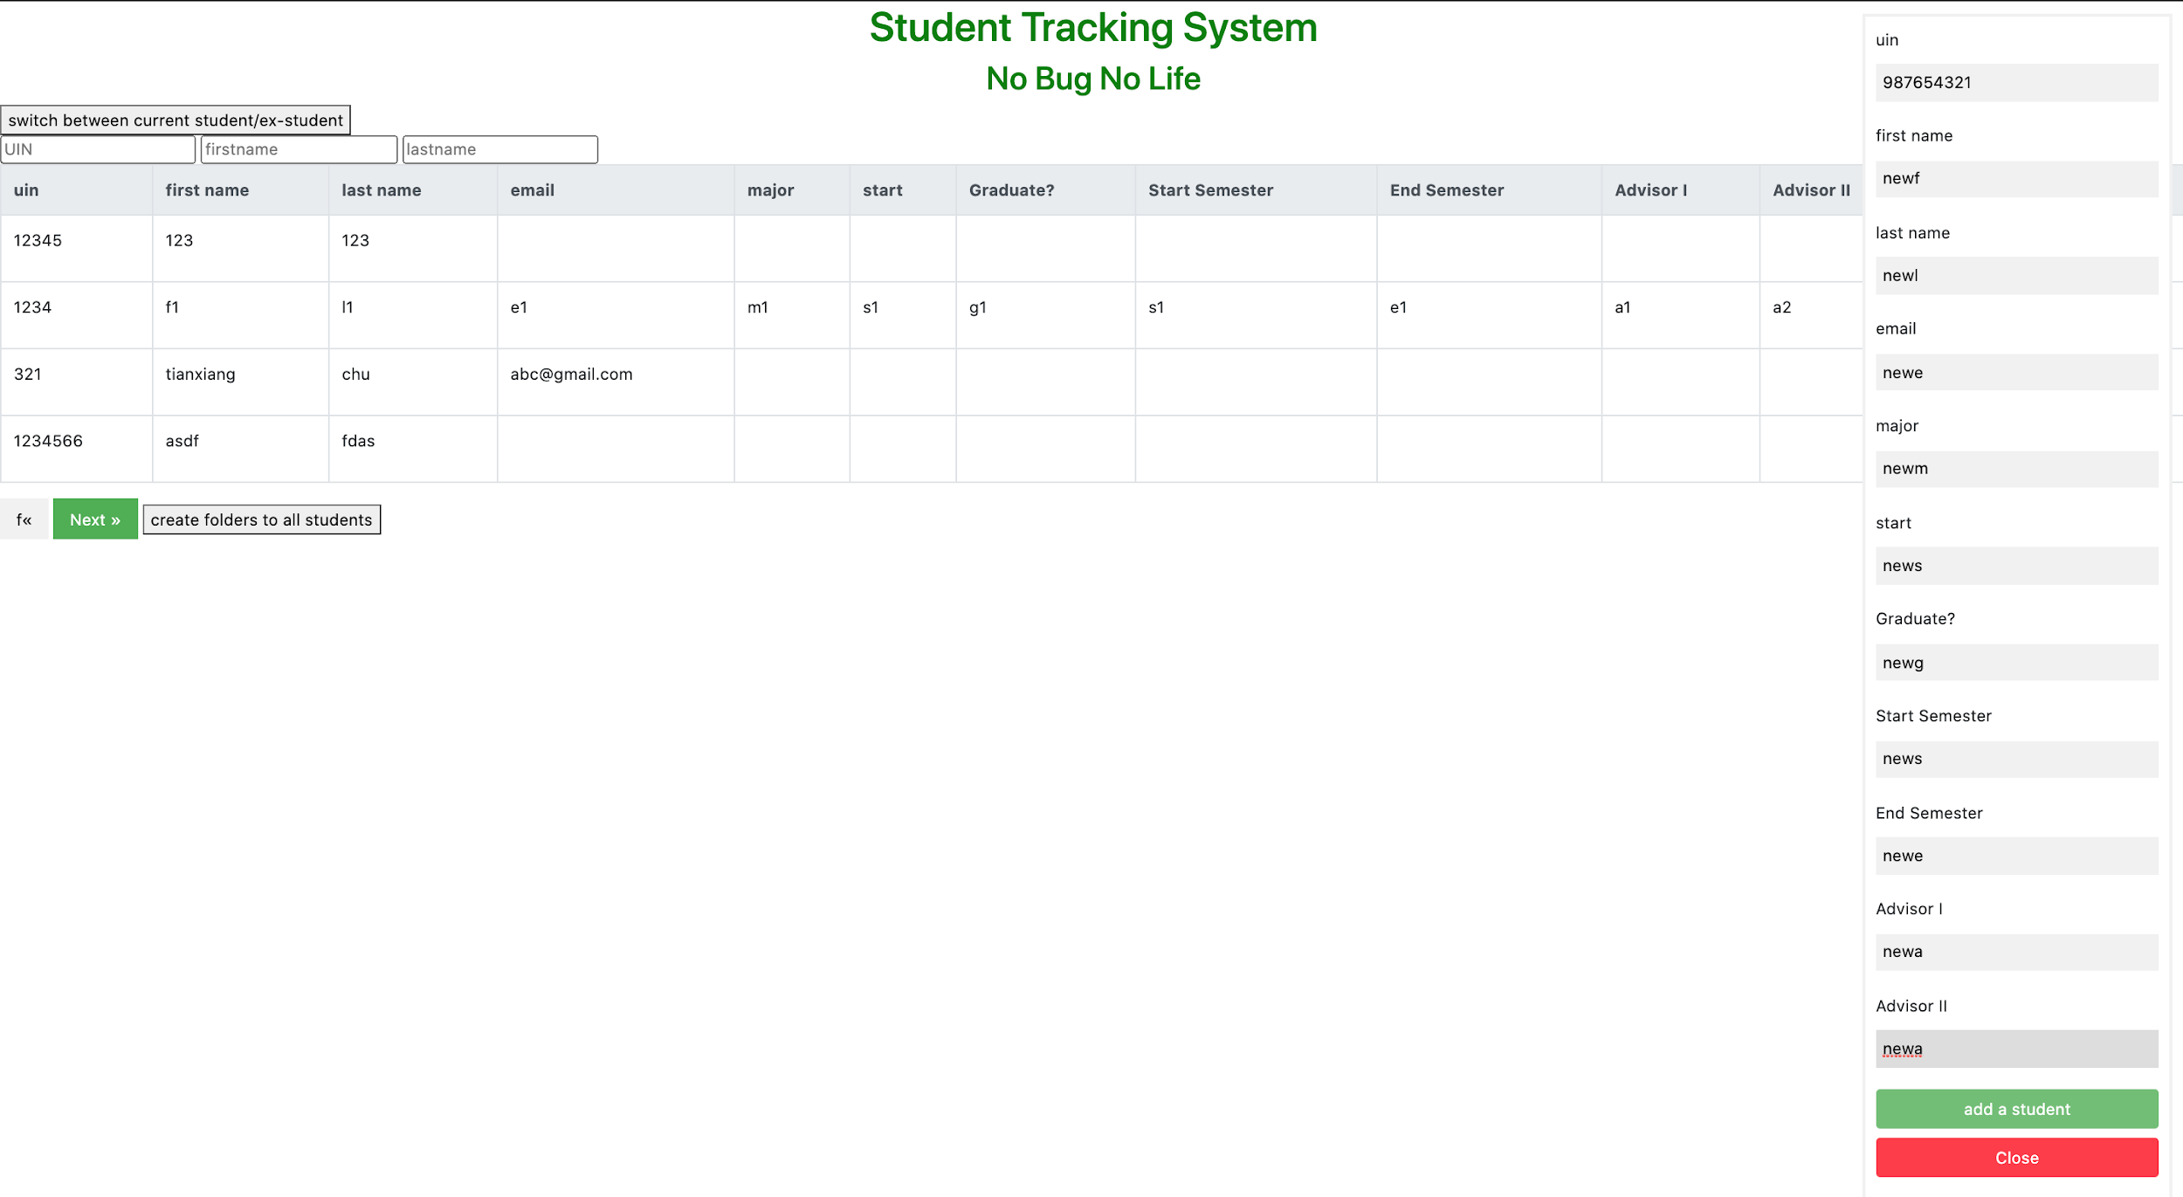
Before

Slide 13
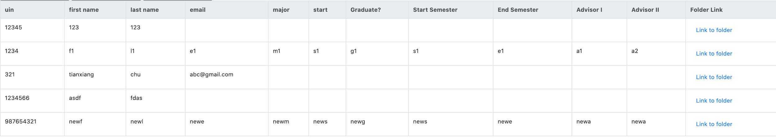
After

Slide 14
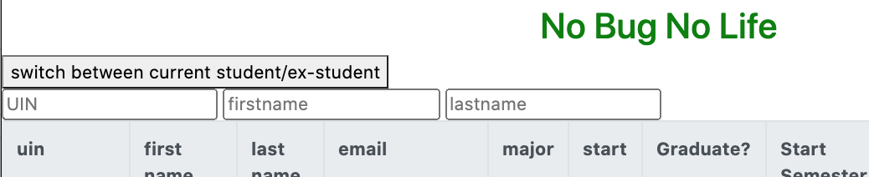
User Story 6
As an advisor
So that I can manage the current students and the former students separately
I want to be able to switch between the current student chart and the former student chart

Slide 15
User Story 7
As an advisor
So that I can change the information of the students
I want to edit the information of the students

Slide 16
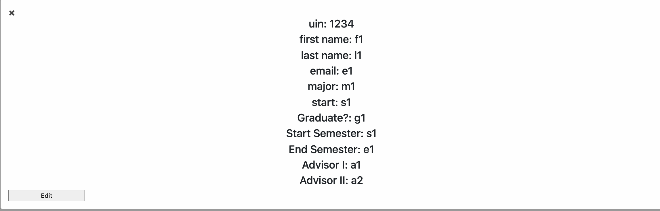
Before Edit

Slide 17
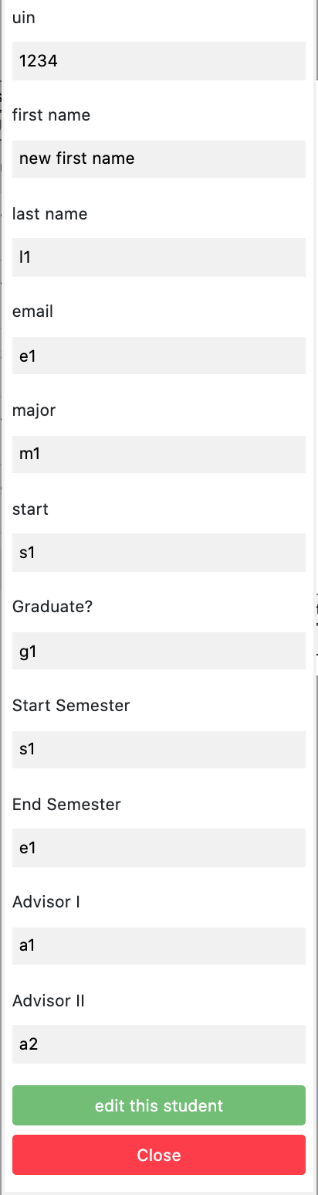
Edit page

Slide 18
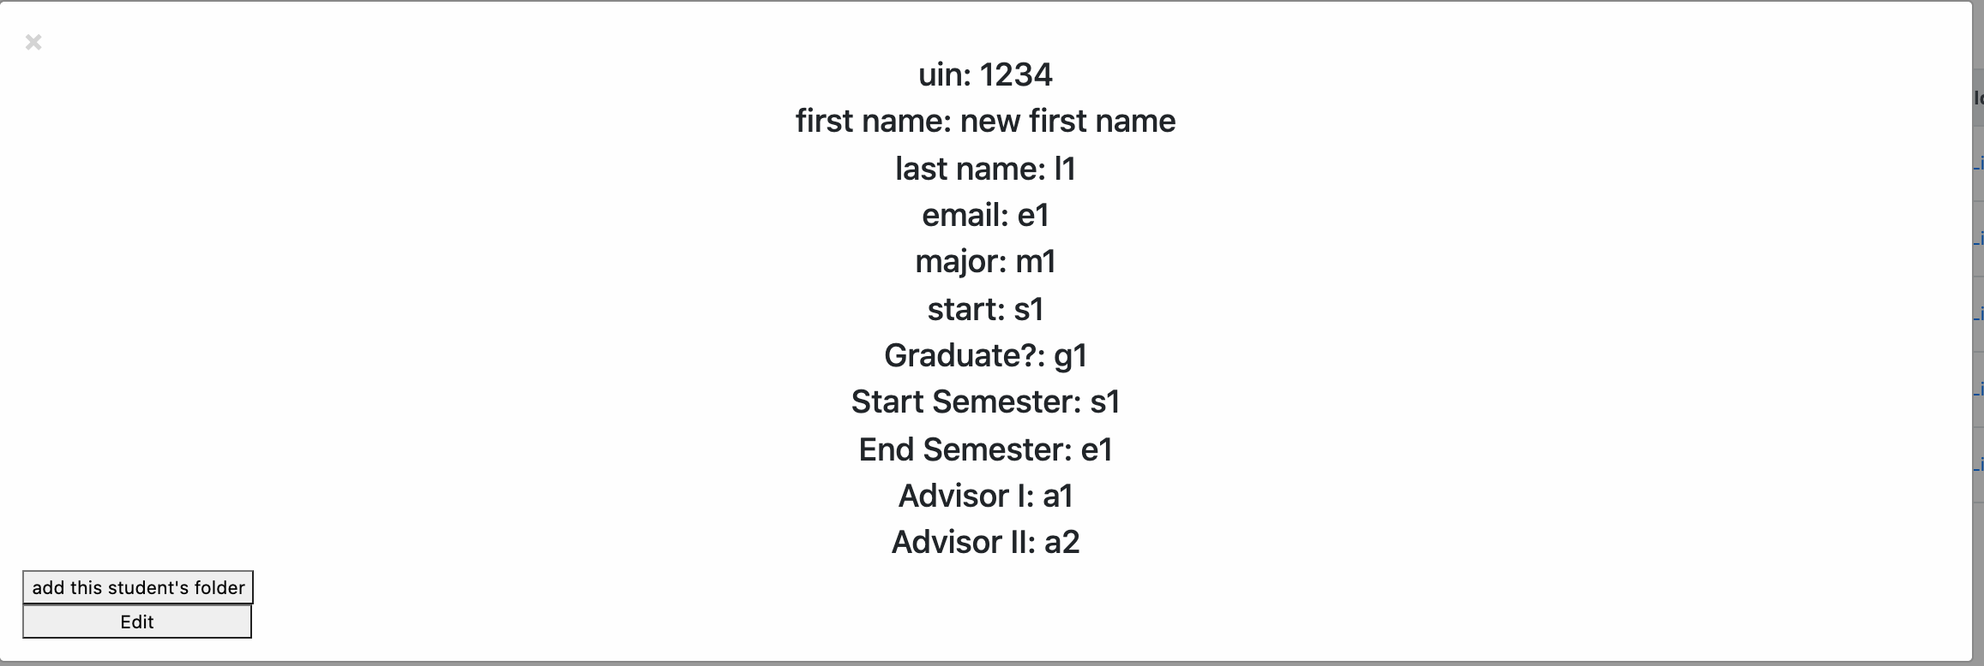
After Edit

Slide 19
User Story 8
As an advisor
So that i can manage the files of the students
I want to upload files to the system
Since we give each student a folder, the user can simply click on the folder link and upload any file to the folder. Therefore, we did not implement this user story.

