Slide 1
B.Tech Integrated Mid-Term Presentation
A.Y. 2021-2022 Project Title: Disease Detection System using Machine Learning
Presented by: Vaibhav Raheja (C056)
Viraj Shah (C064)
Mayank Shetty (C075)
Purav Patel (C098)
Under The Guidance of: Prof. Manisha Tiwari

Slide 2
Roadmap
Introduction
Literature Review
Proposed System
Proposed Algorithm
Architecture Diagram
Plan of Action for the rest of the Project
References

Slide 3

Machine Learning in Disease Detection
Machine learning (ML) is the study of computer algorithms that improve automatically through experience and by the use of data.
It is seen as a part of Artificial Intelligence (AI).
Machine learning algorithms build a model based on sample data, to make decisions without any explicit programming.

Slide 4
Literature Review
Link for Literature Review

Slide 5
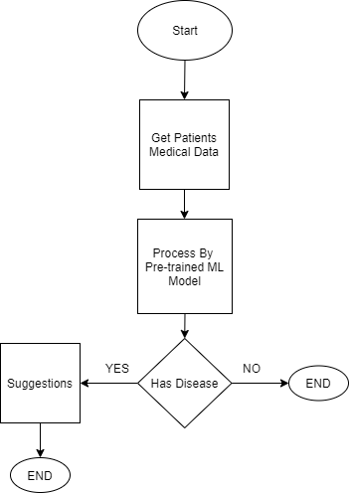
Proposed System

Slide 6
Proposed Algorithm
Algorithm for machine learning for Chronic Kidney Disease Detection
Logistic Regression
Random Forest
Algorithm for machine learning for Diabetes Detection:
K-Nearest Neighbour
Logistic Regression

Slide 7
Proposed Algorithm
Algorithm for machine learning for Heart Disease Detection
Decision Tree
Random Forest Regression
Algorithm for machine learning for Pneumonia
Convolutional Neural Network
Support Vector Machine (SVM)
Notes:
For detection of Pneumonia ,
We have selected CNN and SVM as potential algorithms. The core concept of CNN is to use convolution of image and filters to generate invariant features which are passed onto the next layer.
As for SVM, it is a supervised machine learning model that uses classification algorithms for two-group classification problems. Both models provide high-accuracy and high-performance, which is perfect for our system.
Both these models can also be combined to form an Integrated Model, which has been implemented in one of our references, where it offered a higher pneumonia detection accuracy than both the models individually.

Slide 8
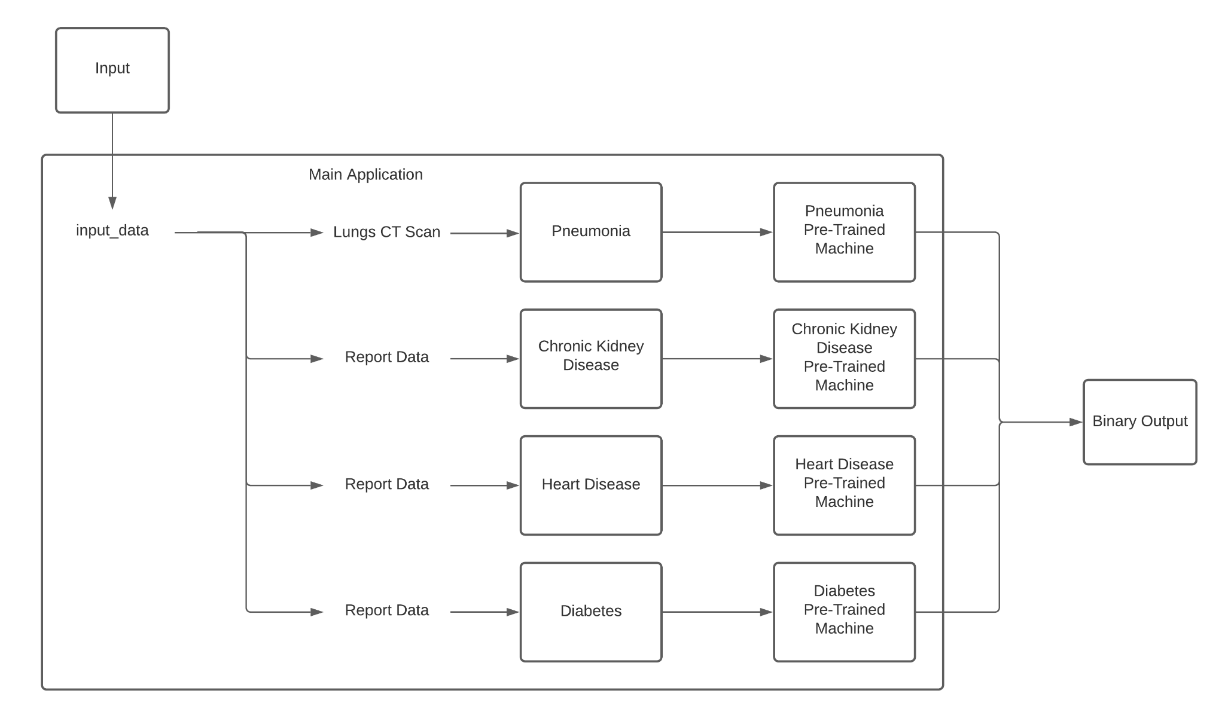
Architecture Diagram

Slide 9
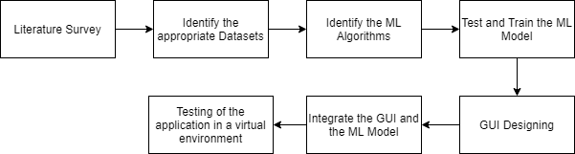
Plan of Action

Slide 10
References
[1] J. J. Khanam, S. Y. Foo, “A comparison of machine learning algorithms for diabetes prediction”, ICT Express (Feb. 2021), 2021, doi: 10.1016/J.ICTE.2021.02.004.
[2] F. G. Woldemichael and S. Menaria, "Prediction of Diabetes Using Data Mining Techniques," 2018 2nd International Conference on Trends in Electronics and Informatics (ICOEI), 2018, pp. 414-418, doi: 10.1109/ICOEI.2018.8553959.
[3] A. Mujumdar, V. Vaidehi, “Diabetes Prediction using Machine Learning Algorithms”, Procedia Computer Science, Volume 165, 2019, pp. 292-299, doi: 10.1016/J.PROCS.2020.01.047.
[4] S. K. Dey, A. Hossain and M. M. Rahman, "Implementation of a Web Application to Predict Diabetes Disease: An Approach Using Machine Learning Algorithm," 2018 21st International Conference of Computer and Information Technology (ICCIT), 2018, pp. 1-5, doi: 10.1109/ICCITECHN.2018.8631968.
[5] M. Kavitha, G. Gnaneswar, R. Dinesh, Y. R. Sai and R. S. Suraj, "Heart Disease Prediction using Hybrid Machine Learning Model," 2021 6th International Conference on Inventive Computation Technologies (ICICT), 2021, pp. 1329-1333, doi: 10.1109/ICICT50816.2021.9358597.
[6] F. Alotaibi, “Implementation of Machine Learning Model to Predict Heart Failure Disease”, International Journal of Advanced Computer Science and Applications (IJACSA), 10(6), 2019, doi: 10.14569/IJACSA.2019.0100637.
[7] J. Qin, L. Chen, Y. Liu, C. Liu, C. Feng and B. Chen, "A Machine Learning Methodology for Diagnosing Chronic Kidney Disease," in IEEE Access, vol. 8, pp. 20991-21002, 2020, doi: 10.1109/ACCESS.2019.2963053.
[8] R. Gupta, N. Koli, N. Mahor and N. Tejashri, "Performance Analysis of Machine Learning Classifier for Predicting Chronic Kidney Disease," 2020 International Conference for Emerging Technology (INCET), 2020, pp. 1-4, doi: 10.1109/INCET49848.2020.9154147.
[9] F. M. Javed Mehedi Shamrat, P. Ghosh, M. H. Sadek, M. A. Kazi and S. Shultana, "Implementation of Machine Learning Algorithms to Detect the Prognosis Rate of Kidney Disease," 2020 IEEE International Conference for Innovation in Technology (INOCON), 2020, pp. 1-7, doi: 10.1109/INOCON50539.2020.9298026.
[10] T. Ozturk, M. Talo, E. Yildirim, U. Baloglu, O. Yildirim, U. Acharya, “Automated detection of COVID-19 cases using deep neural networks with X-ray images.”, Computers in biology and medicine vol. 121 (2020), 2020, doi: 10.1016/j.compbiomed.2020.103792.
[11] A. Sharma, M. Negi, A. Goyal, R. Jain and P. Nagrath, “Detection of Pneumonia using ML & DL in Python.”, IOP Conference Series: Materials Science and Engineering 1022, 2021, doi: 10.1088/1757-899X/1022/1/012066.

