Slide 1
Test-Time Adaptive Anomaly Detection for Sensor-Based Time-Series Monitoring Under Distribution Shift
Group No : 2
Guided By : Dr. Arpita Mandal
Phase 1 recap and Phase 2 progress

Slide 2
Team Members
Sl.No | PRN | Name
1 | SCFU424005 | Tanishka Mahindrakar
2 | SCFU424023 | Unnati Patro
3 | SCFU424012 | Purav Patil

Slide 3
Agenda
Problem statement
Objectives
Problem Description
Proposed Solution
Dataset
Training/ Pre-requisites
Timeline/Milestones
References

Slide 4
Domain and Problem Statement
Develop a test-time adaptation module for an unsupervised time-series anomaly detector on the Yahoo Webscope dataset to adapt to changes in normal time-series behavior during testing, reduce false alarms caused by distribution shifts, and improve detection performance measured using F1 score and AUROC compared with a static (non-adaptive) baseline detector.

Slide 5
Objectives
Implement an EMA-based trend estimation and detrending module for changing data behavior.
Implement test-time model adaptation using samples predicted as normal.
Compare the adaptive model with a static baseline using F1, AUROC and AUPRC.

Slide 6
Dataset
There are 9 Datasets in the Paper
We have chose Yahoo Webscope S5 dataset

Slide 7
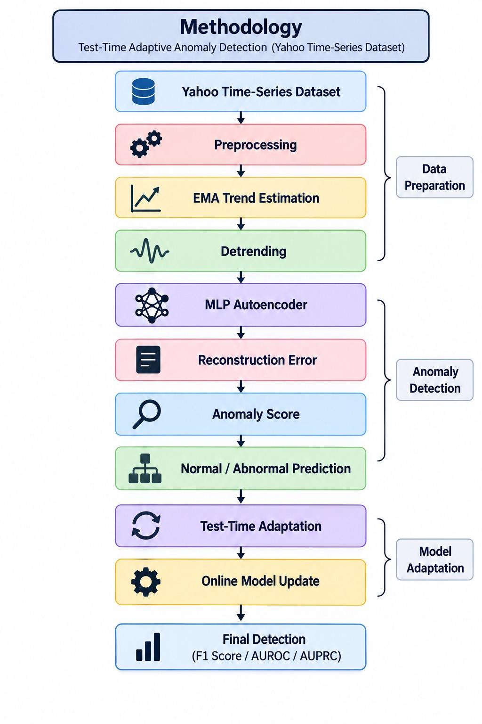
Methods & Proposed Solution
The proposed method uses the Yahoo time-series dataset, followed by preprocessing and EMA-based trend estimation to remove changing trends.
The detrended data is passed through an MLP Autoencoder to calculate reconstruction error and anomaly scores.
During testing, the model adapts online using samples predicted as normal, followed by final anomaly detection and evaluation using F1 Score, AUROC, and AUPRC.
Proposed Solution:
An adaptive anomaly detection framework that combines EMA-based detrending with an MLP Autoencoder and test-time model adaptation.
Evaluation: F1 Score | AUROC | AUPRC

Slide 8
Why EMA for Trend Estimation?
1)Cheap & fast: EMA is just one simple formula — no extra training, no heavy computation. Perfect for real-time systems where data keeps streaming in.
2)No memory needed: It only needs the previous trend value + current window average — doesn't need to store a long history. Matches their goal of "process and evict" (lightweight, real-time-friendly).
3)Naturally adapts: EMA automatically shifts toward new patterns while still being stable against noise — exactly what's needed to track a "moving normal.”
4)Proven & simple: It's a well-established statistical technique (from Muth, 1960) — reliable, not experimental.

Slide 9
Why MLP Autoencoder model?
1)Their method is model-agnostic: The paper's real contribution is the adaptation strategy (trend + online update), not a new architecture. So they picked a simple, well-known baseline (MLP autoencoder) to prove their strategy works — even on a basic model.
2)If it works on a simple model, it's a strong result: Showing improvement on a "plain" MLP proves the gain comes from their trend/adaptation idea — not from a fancy, complicated model doing the heavy lifting.
3)Reconstruction-based fits naturally: Autoencoders are built to reconstruct normal data well and struggle with anomalies — this fits perfectly with their loss function (Eq. 4), which is based on reconstruction error.
4)Easy to plug their method into: Their normalize → model → denormalize pipeline (Fig. 3) is architecture-agnostic — it just needed some reconstruction model to demonstrate the idea, and MLP is the simplest choice.

Slide 10
Outcomes
Our project mainly focuses on:
  Adapting anomaly detection models to changing normal time-series behavior.
  Reducing false alarms caused by distribution shift during deployment.
  Improving anomaly detection performance using test-time adaptation.
  Comparing the adaptive model with a static baseline using F1 Score, AUROC, and AUPRC.

Slide 11
Progress at Phase 1
Project Topic Finalised
Dataset Identified
Literature Study Initiated
GitHub Repo Created
Implementation Yet to Begin
Gap analysis

Slide 12
Limitation
1. Threshold Problem
Ideally, you'd pick the "anomaly cutoff" (threshold) by testing all possible values on the test data and choosing whichever works best.
Problem: You can't do that in real life — you don't have test data with answers ahead of time.
Their fix: They didn't use that "cheat" — instead, they set the threshold using only training data stats, and reported AUROC (a threshold-free performance score) to be fair.
Limitation: Performance could be even better with a smarter threshold-picking method — they admit this is still an open problem.
2. Inconsistent Labeling (What counts as "anomaly" is unclear)
Different situations define "anomaly" differently — there's no universal rule.
Problem: When test data looks very different from training data, you can't always tell — is this a real anomaly, or just a legitimate "new normal" (distribution shift)?
Their fix: They assume most test data is still normal, and use trend estimation + the model's own predictions to guess what's normal.
Limitation: This is a workaround, not a real solution. A better fix could be active learning — having a human occasionally label a few test samples to guide the model, but they didn't do this; they just suggest it as future work.
* Future Direction (mentioned, not implemented): Use active learning — have humans label a small subset of test data to reduce the ambiguity between "anomaly" vs. "new normal.”

Slide 13
Phase 2: Progress Update

Slide 14
Phase 2 Evaluation Agenda
1. High-Level Design
2. Model Development and Integration
3. Model Version, Metadata and Metrics
4. Git and GitHub
5. Folder and File Structure
6. Results and Next Steps

Slide 15
1. High-Level Design
How the system works, step by step
1. Server data
SMD: 38 sensors per machine
2. Windows
Cut the stream into short pieces
3. Normalise
Remove slow drift (EMA)
4. MLP autoencoder
Learns what normal looks like
5. Anomaly score
Copy error: big = unusual
6. Threshold
Above cut-off = alarm
7. Evaluate
F1, AUPRC, AUROC
Before deployment
The model learns from normal history only. No anomaly labels needed.
Test-time adaptation
While running, windows judged normal update the model.
Every model gets the same data, the same metrics and the same random seeds.
Notes:
Walk left to right. Data is cut into windows, normalised, passed through the autoencoder, scored and thresholded. The orange box is the test-time adaptation loop.

Slide 16
High-Level Design: Models Compared
Model | How it works | What it updates
Pretrained baseline | Trained once on normal data, then frozen | Nothing
M2N2 (AAAI 2024) | EMA detrending + update on windows judged normal | Whole MLP
CANDI (AAAI 2026) | Picks safe windows to learn from; trains a small add-on (SANA) | SANA add-on only
All three use the same MLP autoencoder, so differences come from the adaptation strategy.

Slide 17
High-Level Design: Architecture
Inputs
• SMD data
• Config files (YAML)
Evaluation harness
• Methods: M2N2, CANDI, baseline
• Thresholds: fixed, streaming
• Normalisation: EMA, RevIN
• Backbone: MLP (swappable)
Outputs
• Raw scores and alarms
• Metrics (12 per run)
• Run settings
• Comparison tables
Every method has the same two functions: fit() and score().
Thresholds and metrics are separate from the models, so all models are graded the same way.

Slide 18
2. Model Development: What Is Built
Component | Status
MLP autoencoder | ✓ Done
Pretrained baseline (static) | ✓ Done
M2N2 (adaptive method 1) | ✓ Done
CANDI (adaptive method 2) | ✓ Done
Metrics and tests | ✓ Done
Streaming threshold | Coded, results next
RevIN normalisation | Coded, results next
Other backbones and latency | Planned
Done = built and run end to end on SMD data.

Slide 19
Model Integration
One config file drives the whole run.
Steps: load data, train, stream the test data and adapt, apply threshold, compute metrics, save.
Docker packages the environment, so it runs the same on any machine.
54 full runs (6 machines x 3 models x 3 seeds) and 6 quick runs completed.
22+ automated tests cover metrics, thresholds, windows and normalisation.
Run it
docker compose run --rm data | quick | smd | compare

Slide 20
3. Model Version and Metadata
Model | Config file | Window | Test-time update | Parameters
Pretrained | configs/methods/pretrained.yaml | 10 | None (frozen) | ≈ 102 K
M2N2 | configs/methods/m2n2.yaml | 5 | SGD, 1 step per window | ≈ 53 K
CANDI | configs/methods/candi.yaml | 10 | SGD on selected windows | ≈ 102 K + 2.1 M
Saved automatically with every run
• run.json: settings, dataset, seed, Git commit, threshold, number of updates
• metrics.json: all 12 metric values
• scores.npy and preds.npy: raw score and alarm for every time step

Slide 21
Metrics Used
Metric | Meaning in simple words
F1 score | Balance of real alarms and caught anomalies (needs a threshold)
AUPRC | How well the scores rank the rare anomalies (no threshold needed)
AUROC | Chance an anomaly scores higher than normal data (no threshold needed)
PA%K, F1-PA | Credit for detecting part of an anomaly period (reference only)

Slide 22
Results: Our M2N2 vs Published Paper (AUPRC)
Reading the chart
• Machines 1-4 and 2-1 (tuned in the paper): we match or beat it. AUROC 0.897 vs 0.845 and 0.797 vs 0.764.
• Machines 1-8 and 2-4: close.
• Machines 1-7 and 3-2: gap. We used default settings there.
Notes:
AUPRC measures how well the scores rank anomalies. Paper values: machine 1-4 from the M2N2 paper, the others from the CANDI paper's table. Be honest about the gap on 1-7 and 3-2: the paper gives no settings for those machines, so we used defaults.

Slide 23
Results: Static vs Adaptive Models (AUROC)
Mean AUROC
Static baseline: 0.695
M2N2: 0.726
CANDI: 0.700
M2N2 beats the static baseline on 4 of 6 machines. CANDI's gain is small so far; tuning it is our next step.
Notes:
AUROC averaged over 3 seeds. M2N2 improves on 4 of 6 machines (largest gain on 1-4). It is worse on 1-7 and 3-2 where settings are untuned. CANDI's gain in our reproduction is smaller than the paper reports.

Slide 24
4. Git and GitHub
Repository: github.com/PuravPatil/test-time-adaptation-tsad1
Branch per person (name/topic), merged by pull request with one review.
Automated tests run on every pull request (GitHub Actions).
Original paper code is never edited; our changes live in our own adapters.
Data and run outputs are kept out of Git.

Slide 25
5. Folder and File Structure
Folder | Purpose
configs/ | All settings: datasets, methods, experiments
src/audit/data, backbones | SMD loader, windowing, MLP autoencoder
src/audit/methods | M2N2 and CANDI behind one interface
src/audit/normalization, thresholds | EMA / RevIN; fixed / streaming threshold
src/audit/evaluation | Metrics, harness, latency timer
scripts/ | Download, preprocess, run, compare with paper
tests/ | Automated tests
results/, data/ | Run outputs and summary tables; datasets
docs/, README.md, Dockerfile | Notes, how to run, container setup

Slide 26
Next Steps
Weeks 4-6: three extension studies on the same harness.
  Tanishka: RevIN vs EMA normalisation
  Purav: streaming threshold vs fixed threshold
  Unnati: other backbones and per-step latency
Tuning: adjust M2N2 and CANDI settings to move closer to the papers.
Weeks 7-8: live demo dashboard.

Slide 27
Thank you

