Slide 1



AAKASH ARVIND PARMAR : 1791226 GROUP NUMBER: 11 PURAV UDAY DESAI : 1791005 GUIDE: KRISHNA BHATT JAY BHAVESH THADESHWAR : 1791048
AAKASH ARVIND PARMAR : 1791226 GROUP NUMBER: 11 PURAV UDAY DESAI : 1791005 GUIDE: KRISHNA BHATT JAY BHAVESH THADESHWAR : 1791048

Slide 2

Consultancy and Logistic Industry offering Project

Slide 3

Introduction and Purpose of Project

Slide 4

Technology Stack

Slide 5




Slide 6

Software Architecture

Slide 7
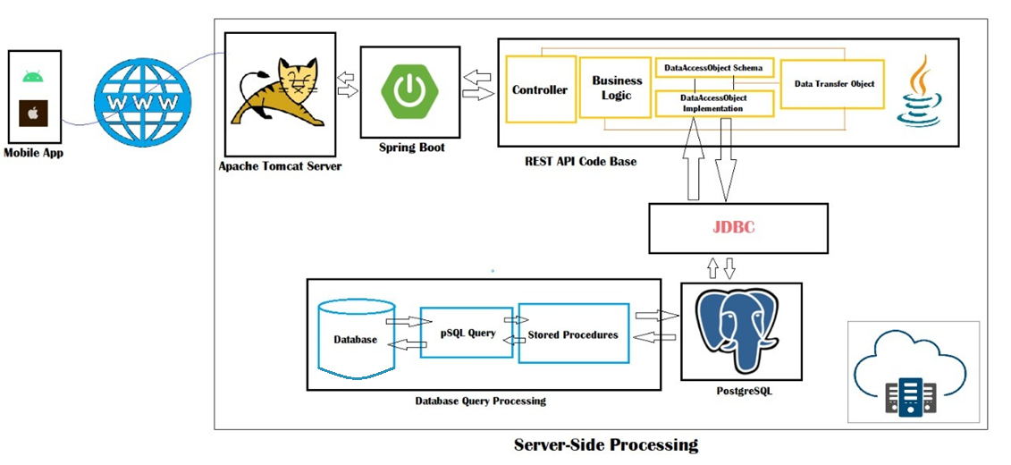
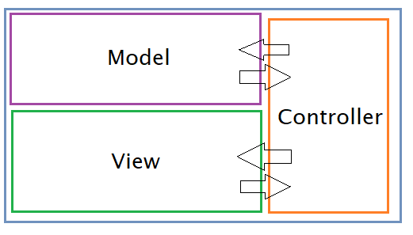

Slide 8
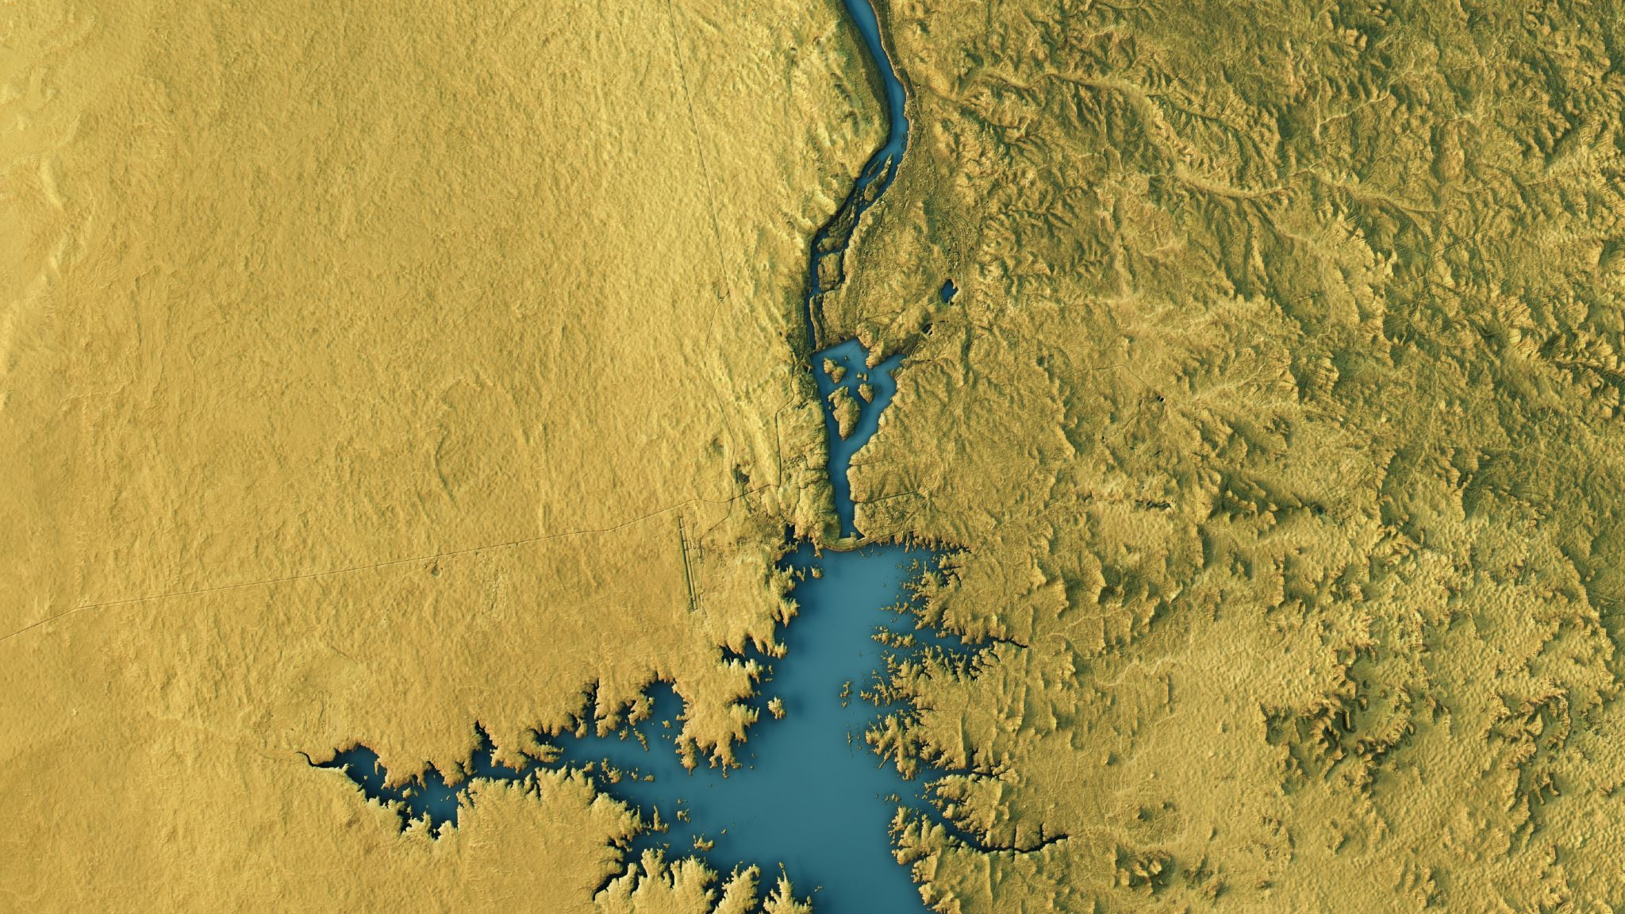
Features

Slide 9
Email Marketing
Logging Mechanism
JWT Token
Enriched Documentation using Swagger
Scheduling job processes
Exception handling mechanism
Encryption using Blowfish Cipher
Google Contacts
Graph Reports
On-Time Notifications
Extensive and offline search and filter support
Geolocating on map
Sharable PDF Reports
Call Recording
Cross-platform Implementation
Dark Mode

Slide 10

Modules

Slide 11
Company Executive
Generating enquiry & tickets
Adding new clients
Recording calls
Notifications
Extensive search and filter support
Dashboard
Owner
Login and Signup process
Reports for performance tracking
Geolocating on map
Adding new executives
Adding new areas and cities
Adding new status for enquiry
Creating new company and company branch
Creating new positions for executive
Listening recorded call for quality control
Dashboard

Slide 12

Demo

Slide 13

Merits and Demerits

Slide 14

Future Scope

Slide 15

Thank You

