Slide 1
St. Francis Institute of Technology Information Technology Python Mini Project (ITM 401)
Classroom Management System SEITA_BATCH -A1
Himanshu Chaurasiya-17
Vikas Chaurasiya-18
Parth Dali-19
Pranav Dalvi-20

Slide 2
OVERVIEW
Introduction
Problem Statement
Background Study
Proposed features for the Project
System Module
System Design (Block Diagram/Flow Diagram)
System Requirements
References

Slide 3
INTRODUCTION
Classroom Management System deals with the maintenance of student and teachers information with in the institute.
It is an automation system, which is used to store the student’s information, course-track, assignment, notice-updates.
It is a Student-Teacher Portal where teachers and student can sign up and teachers can add students in the class.
Teachers can analyze classroom tasks in precise detail determined the procedures and expectations required for students to be successful.
The project overcomes all the manual approach of maintaining class information on paper by automating. As the system is fully automated, it does not require human efforts in calculating student’s grade.
Thus, considering above functionalities, this system is useful in managing the class more efficiently.

Slide 4
PROBLEM STATEMENT
To create a Classroom Management System using Python and Django. It is an integrated web application that handles various academic and non academic activities of a College/ Academic Institute which can be accessed by student/faculty through internet connected devices with the aid of one’s user name and password to prevent the possibilities of malicious activities. Through links that displays in the home page, the user can access different options of the website assigned to them. It will have a friendly user interface and would help maintain records of each students.

Slide 5
Background Study
The idea behind classroom management in school is not to put across a single point of view about the definition but to bring together contrasting opinion and attitude so that the readers can be given the ground work on which to base his own conclusion of management. In the classroom and school premises and the development of good relationship. Manus (1989) sensibly pointed out four rules of classroom management and these four roles can be applied in the classroom / they are;
Rule one:- Get them in; the process of getting them in can be seen to involve three phase i.e. greeting, seating and starting
Rule two:- Get them out; here the teacher needs to consider how phases of concluding a lesson on and dismissing a class.
Rule three:- Get on with it; this referred to the main part of the lesson. The nature of its content and the manner of its presentation.
Rule four:- Get on with them; here the teachers develop good personal relationship with their pupils by fostering mutual, trust and respect to do this effectively the teachers need to be aware of each child as an individual and be sensitive to the mood of the class as a whole. He also went further to say that classroom management is the ability of the teacher to coordinate effective teaching and learning in the classroom, in other words classroom management is the ability for teacher to manage both men and material.

Slide 6
Proposed features for the Project
Updating Students Marks.
Teachers can upload assignments which will be sent to all students in their class and students can download the assignments.
Students can also submit their assignment but once submitted can't be changed later.
Teachers can also see all the mark given by them to a student through their marks profile and can edit them if necessary and Students can view the marks given to them by teachers in marks section.
User’s can see their profile through profile option and can edit their profile through edit profile.
User’s can also change their password if necessary.

Slide 7
SYSTEM MODULE
Teacher Login: Teacher has an account in the system from where he can administer all the information and different student accounts. He can upload assignment, grade them and view submissions. Teacher can also prompt the students for a new notice. He can view entire student list and a list of students in a particular class. Teacher can edit his profile username, password.
Student Login: The system contains a student account where he can join the class to which access is provided by the teacher. He can view his marks, upcoming assignments and any class notices. Student can download the assignments and access it, then can submit it under the assigned section. Student can also edit his profile and password too.

Slide 8
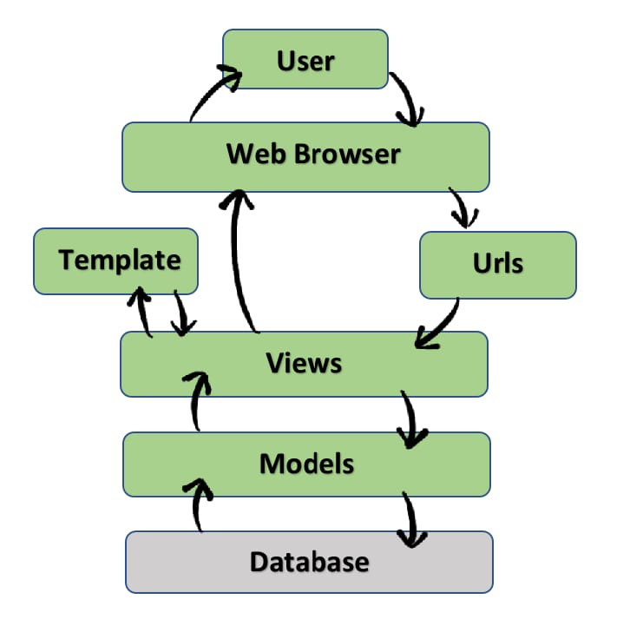
SYSTEM DESIGN

Slide 9
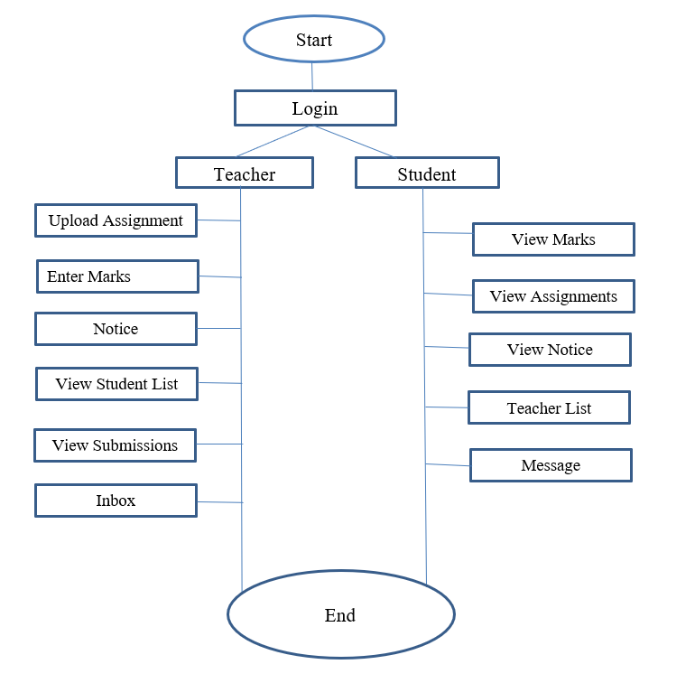
Flowchart

Slide 10
SYSTEM REQUIREMENTS
HARDWARE REQUIREMENTS –
Processor : Dual Core or higher
Hard Drive: 500 GB or higher
RAM: 2GB or higher
Internet Connection: Preferred 1Mbps or higher
SOFTWARE REQUIREMENTS –
Front-End : HTML, CSS
Back-End : Python , PostgreSQL, Django
Operating System: Windows 7 or higher
Editor Tools: Visual Studio Code/ Atom
Web Browser: Google Chrome

Slide 11
REFERENCE
https://www.upgrad.com/blog/python-projects-ideas-topics-beginners/
www.w3schools.com
https://realpython.com/django-setup/
https://www.djangoproject.com/start/
https://resources.owllabs.com/blog/virtual-classroom

