Slide 1
Interim Project Overview
Query Queens ASAP
Amirah
Sama
Agathe
Purbasha
Notes:
For this project, our Query Queens ASAP Team intends to take a structured, step-by-step approach to analyse the Adventure Works 2022 demo database and extract meaningful insights based on the scenario or questions provided. Our approach will combine SQL, Python, and data analytics techniques to ensure that the analysis is both accurate and actionable.

Slide 2
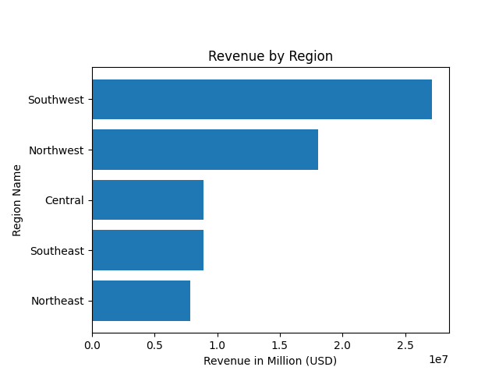
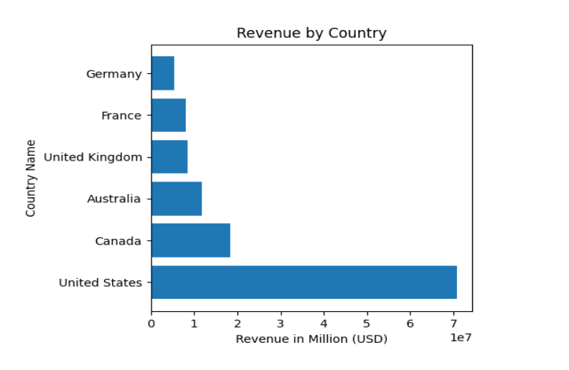
What are the regional sales in the best performing country?
Notes:
We have analysed the data and the bar chart shows that USA is the best performing country for this company, and a deeper analysis shows that the Southwest regions is performing the best, with around 2.7 millions in revenue.

Slide 3
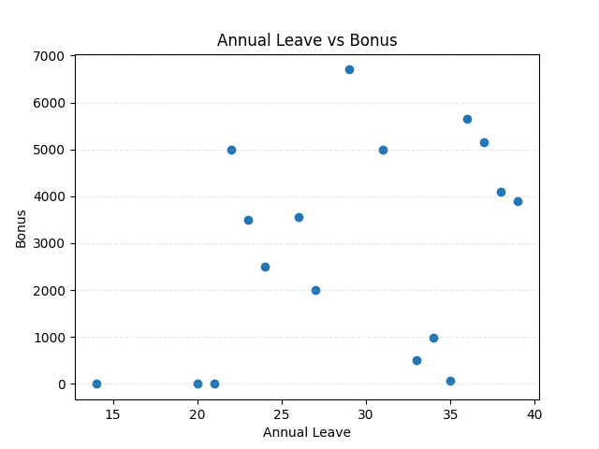
What is the relationship between annual leave taken and bonus?
Notes:
The scatter plot shows that the points are widely scattered with no visible upward or downward trend, showing that there is no correlation between the attribution of a bonus and the amount of Annual Leave days taken. In our view, the bonuses are then likely influenced by performance, sales achievements, or
Commissions, rather than Annual Leave taken.

Slide 4
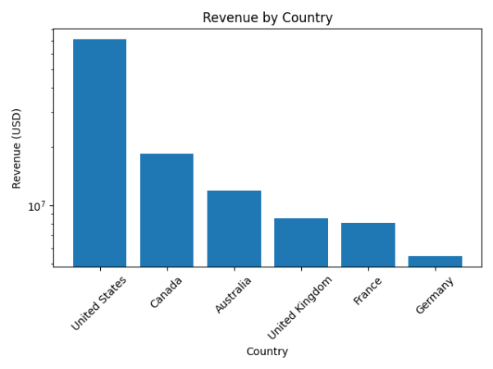
What is the relationship between Country and Revenue?
Notes:
After converting all currencies to USD, we observe that some countries contribute substantially more revenue than others: North America is ahead with USA and Canada, which indicates that the company’s sales performance is not evenly distributed geographically. Countries with larger or more active sales territories generate the highest revenue, while others show much lower totals. Overall, the relationship demonstrates that a country is an important factor in revenue generation, with certain markets driving most of the company's income.

Slide 5
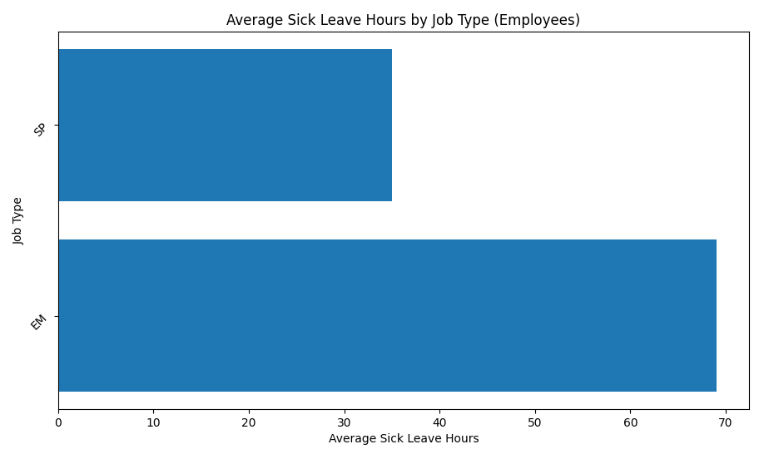
What is the relationship between sick leave and Job Title (PersonType)?
SP: Sales Persons
EM: Employees
Notes:
We found that only individuals with PersonType ‘EM’ (Employee) and ‘SP’ (Sales Person) appear in the HumanResources.Employee table, meaning they are the only ones with real job titles and recorded sick-leave hours. All other PersonTypes do not represent internal staff, which is why they were excluded.
The bar chat shows is a significant discrepancy in the amount of sick leave taken by people of PersonType ‘EM’ and ‘SP’, with people of PersonType ‘EM’ registering almost twice the amount of sick hours than people of PersonType ‘SP’.

Slide 6
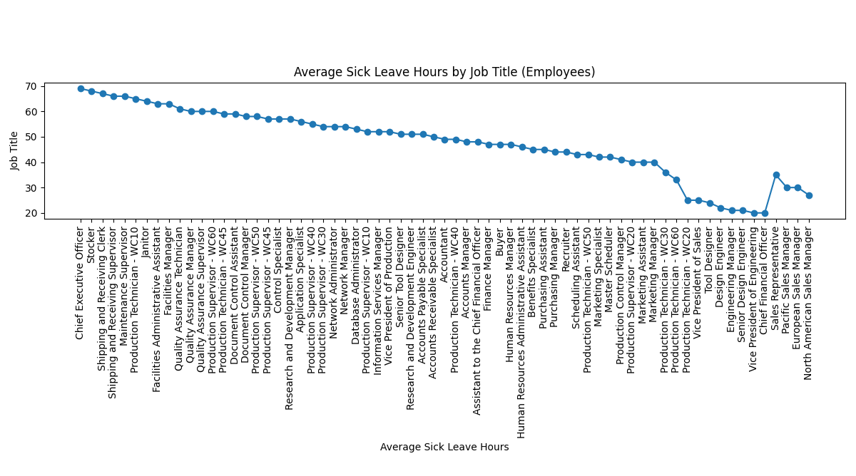
What is the relationship between sick leave and Job Title (PersonType)?
Notes:
In this chart showing the average sick leave hours by job title, we can see a clear pattern: senior leaders consistently take the most sick leave, while mid-level administrative and technical roles fall in the middle. Production and operational roles have the lowest sick leave levels, possibly due to stricter attendance requirements or less flexibility. Overall, the results suggest that sick leave varies significantly by job type and responsibility level.

Slide 7
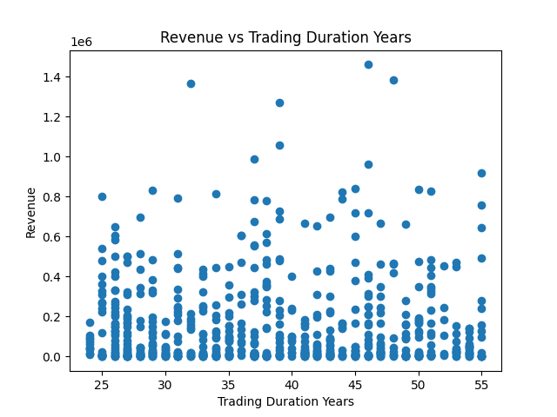
What is the relationship between store trading duration and revenue?
Notes:
For this analysis, we have converted all currencies to USD in order to provide a fair comparison between the stores.
The data displayed in this scatter plot shows that there is no clear relationship between how long a store has been trading and the amount of revenue it generates. Stores with both short and long trading histories are spread across the full range of revenue levels, with no visible trend upward or downward. This suggests that factors other than trading duration— such as store size, location, or staffing—are likely driving revenue performance, rather than simply how long the store has been open.

Slide 8
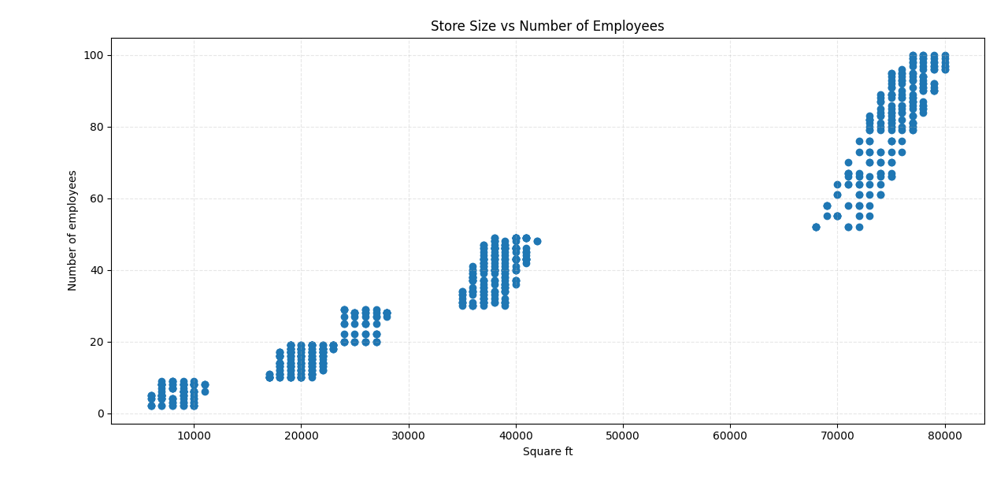
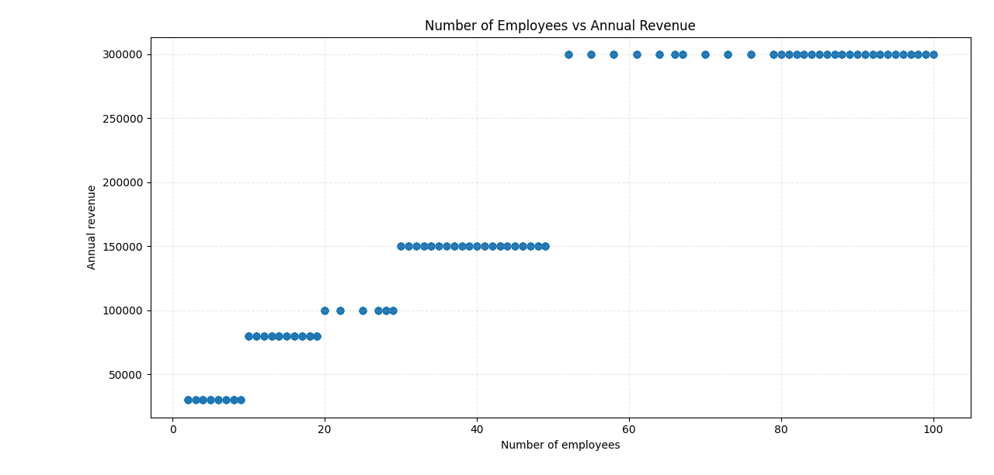
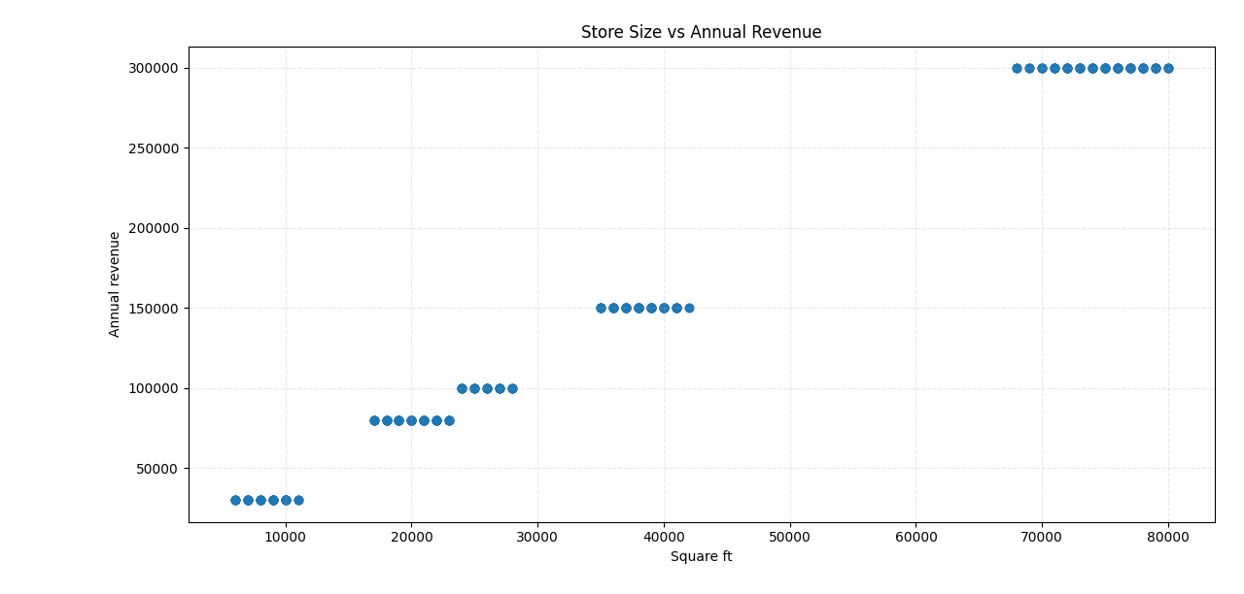
What is the relationship between the size of the stores, number of employees and revenue?
Notes:
The analysis shows a clear positive relationship between store size, number of employees, and annual revenue. Larger stores employ more staff and consistently generate higher revenue. Likewise, stores with more employees tend to earn more. Overall, bigger stores with larger teams deliver stronger financial performance.

