Slide 1
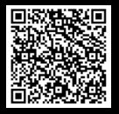
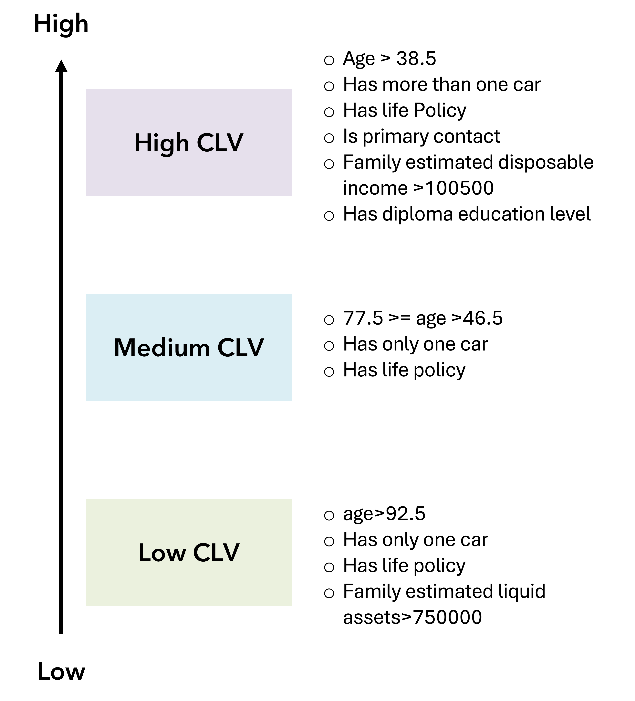
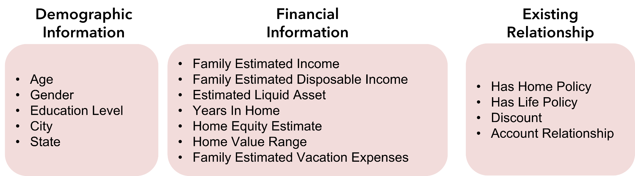
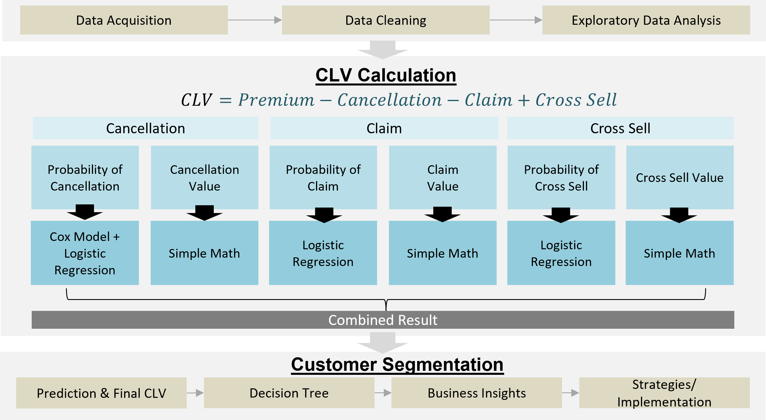

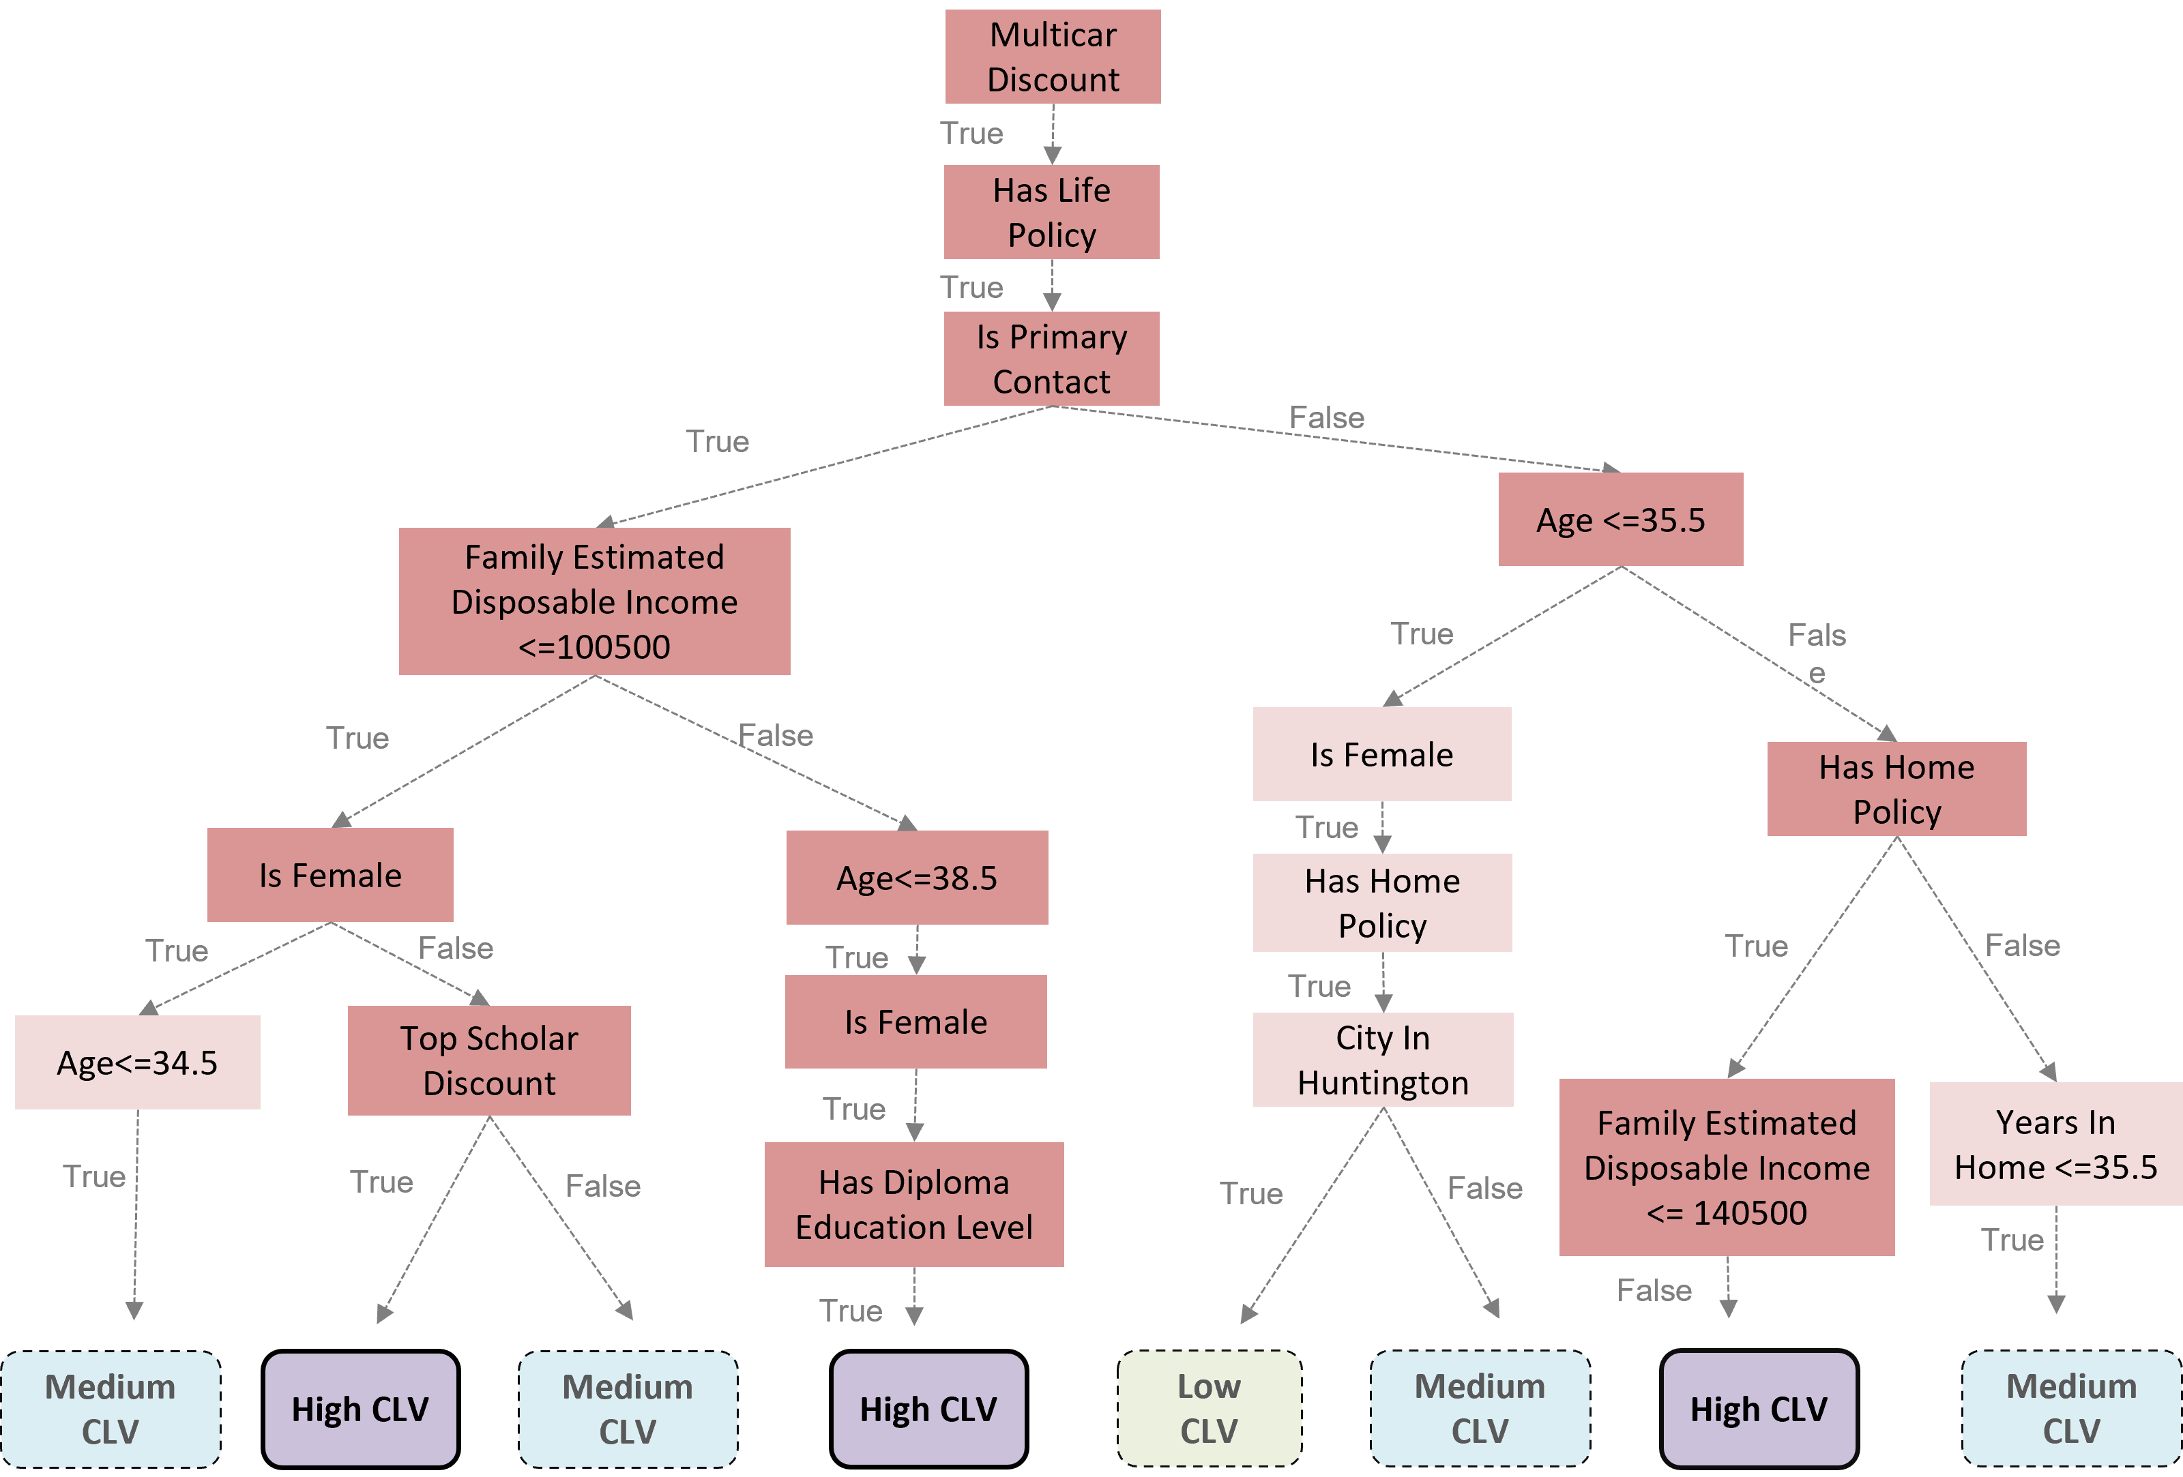
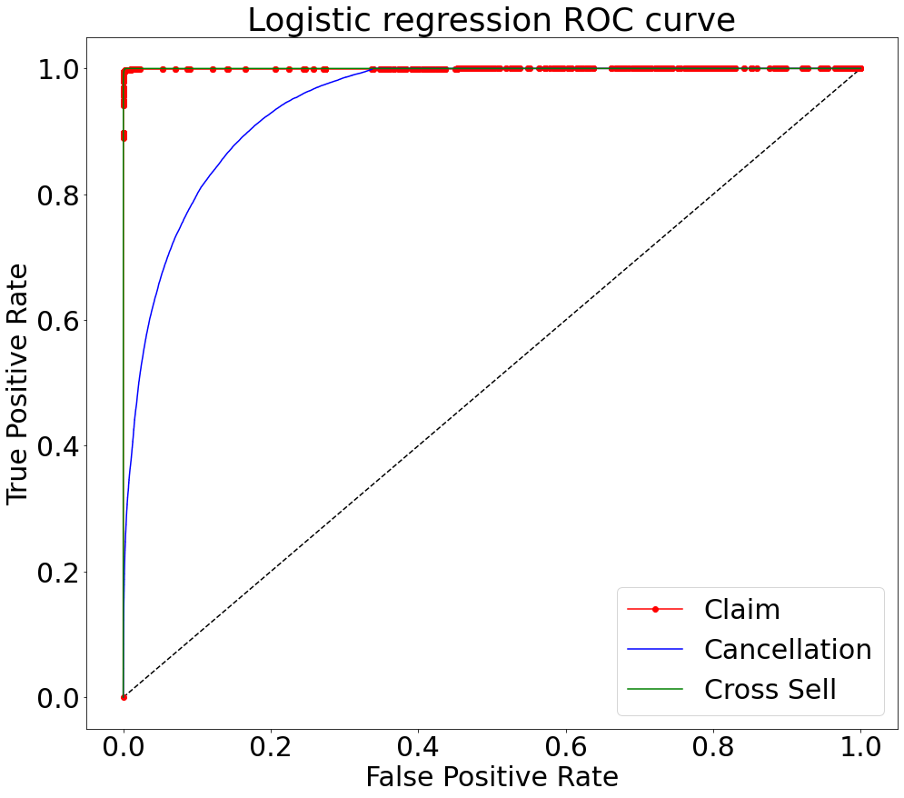
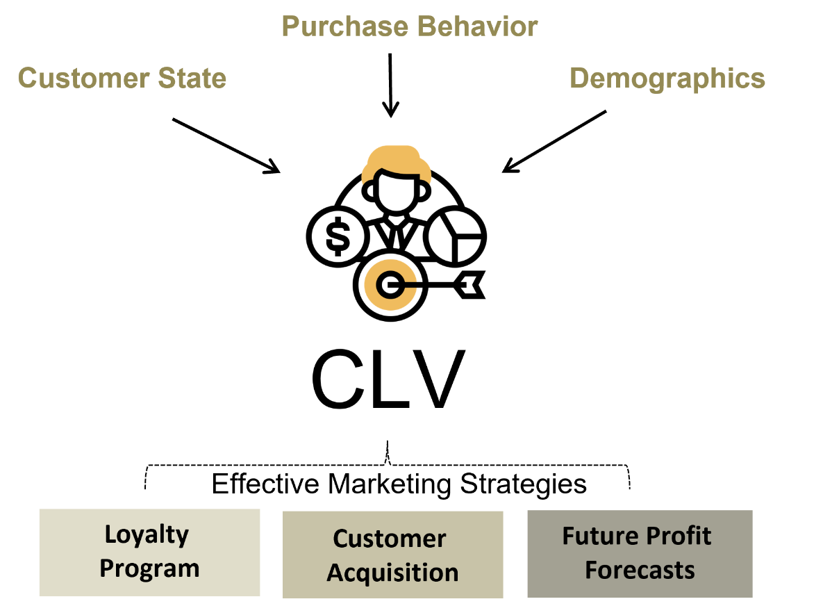
Estimating Customer Lifetime Value in Insurance
Yi-Chen Chiou, Rohan Das, Udayan Kate, Sanjana Santhanakrishnan, Jiayu Zhang, Yang Wang
Purdue University, Krannert School of Management
ychiou@purdue.edu; das172@purdue.edu; ukate@purdue.edu; santhans@purdue.edu; zhan4358@purdue.edu; yangwang@purdue.edu
RESEARCH QUESTIONS
STATISTICAL RESULTS – CUSTOMER SEGMENTATION
EXPECTED IMPACT
What is the best way to develop a predictive model to calculate CLV for customers in insurance industry ?
What are the key features for determining CLV ?
What is the effective mechanism to categorize customers based on CLV?
After CLV is calculated, we divided customers into three brackets and applied a decision tree to extract the key features of each customer group based on their CLV.
Understand the overall value of a particular customer:​
Features of customers having a high CLV score can be analyzed to optimize budget for customer acquisition by prioritizing potential customers with similar features. Key features of the customer determining the segments based on the model are as follows:​
METHODOLOGY
Training Accuracy: 86.273%
Testing Accuracy: 86.278%
ABSTRACT
Customer Lifetime Value is an important metric, using which companies can focus on growing or maintaining their revenue streams from their customer base. This metric can help organizations provide a direction to focus the marketing expenditures and efforts by helping identify customers who have high potential in terms of longevity of association and identify the possibility of selling additional products (cross-selling). The metric can also help identify those customers who probably do not have high potential in these terms, further aiding in optimizing the expenses and effort on marketing the products. This research explores the possible methods of calculating customer lifetime value in the insurance industry and develops a model which can help predict the customer lifetime value for new customers.
Keywords: Customer Lifetime Value, Insurance, Logistic Regression, Survival Analysis, Cross-Selling, Decision Tree
Fig 4.Key Features
Design Better Marketing and Customer Acquisition Strategies:
The CLV value of existing customers will assist in developing targeted marketing strategies in the form of discounts or better customer service to those customers with a high cross-selling value.
Segments | Strategy type | Business Strategy
High CLV | Engage & Enhance | Design customized loyalty program and offer rewards such as premium discount to valuable customers
Med CLV | Enhance & Engage | Provide up-selling rewards and cross-selling discounts
Low CLV | Service Engagement | Reduce marketing investment Explore the types of products preferred by customers
INTRODUCTION
With increasing market competition and rivalry, building long-term relationships with customers is how an insurance company can keep and grow its market share. Assessing an CLV of customers is a method by which insurance firms can identify customers who would potentially stay longer with them than others. This is especially useful considering the low switching costs for customers in this sector and the myriad of options available. It can also help these firms discover strategies to acquire and retain customers while increasing profitability. Using CLV, insurance companies can identify customers with a high probability of cross-buying other insurance products as well. Marketing strategies can therefore focus their efforts on retaining/acquiring these high CLV, high net profit customers rather than the less valuable customers. Further, classifying customers based on CLV can help determine characteristics of profitable customers and these factors would be beneficial in determining what segment of customers to focus the marketing campaigns on.
Fig 2.Customer Segments
CONCLUSION
Our study has helped us develop models to accurately identify the potential of customers to file claims, cancel an ongoing policy or participate in cross selling. Further using these models, we have calculated an annual value the customer may bring as either a revenue or as a cost to the insurance company. This annual value of the customer can be extrapolated as the customer’s lifetime value based on which we have been able to assess features of customers who have a high value of CLV or a low value.
This identification has led us to suggest data and analytics driven strategies for marketing campaigns to retain an existing customer or acquire new customers by intelligently targeting specific market segments.
STATISTICAL RESULTS – CLV CALCULATION
Prediction of: | Model used | Accuracy
Claims Probability | Logistic Regression | 99.92%
Cancellation Probability | Cox Proportional Hazard Model (Variable Selection) + Logistic Regression | 88.3%
Cross Selling Probability | Logistic Regression | 65.2%
Actual Revenue
476,500,000
Calculated Revenue
414,801,173
Fig 5.Using our calculated CLV, we were closely able to estimate the actual revenue ($)
ACKNOWLEDGEMENTS
Fig 3.Subset of the Decision Tree
We would like to thank Professor Yang Wang, Matthew Lanham, and our industry partner for this opportunity, their guidance and support on this project.
Fig 1. Customer Lifetime Value(CLV)

