Slide 1


Transferable Neural WAN TE
for Changing Topologies
Abd AlRhman AlQiam¹, Yuanjun Yao², Zhaodong Wang², Satyajeet Singh Ahuja², Ying Zhang², Sanjay G. Rao¹, Bruno Ribeiro¹, Mohit Tawarmalani¹
1
2

Slide 2
Traditional Traffic Engineering Pipeline
45%
Input TMs
Capacities + Tunnels
4
C1
C1
Centralized
SDN Controller
1
C2
2
C2
3
Route traffic
C3
EBB Controller
SWAN, B4,
C3
5
Has a global view of the network
optimizes a network-wide objective (e.g., minimize link utilization)
It employs linear programming to route traffic
55%

Slide 3
Traditional Traffic Engineering Pipeline
45%
Input TMs
Capacities + Tunnels
4
C1
C1
LP Solver
1
C2
2
C2
3
Route traffic
C3
C3
Issues with this approach:
Input TMs don't fully capture actual TM (e.g., prediction error)
LP solvers can’t cope with prediction inaccuracies
Resulting in suboptimal routing
LP solvers do not scale to large topologies
5
55%

Slide 4

Traditional Traffic Engineering Pipeline
Why ML-based TE?
45%
Input TMs
Capacities + Tunnels
4
$$⨉$$
C1
C1
LP Solver
Neural Model
1
C2
2
C2
3
Route traffic
C3
DOTE, NSDI 23
TEAL, SIGCOMM 23
C3
Issues with this approach:
Input TMs don't fully capture actual TM (e.g., prediction error)
LP solvers can’t cope with prediction inaccuracies
Resulting in suboptimal routing
LP solvers do not scale to large topologies
5
55%

Slide 5
Why ML-based TE?
45%
30%
Input TMs
Capacities + Tunnels
4
C1
C1
LP Solver
Neural Model
1
C2
2
C2
3
Route traffic
C3
DOTE, NSDI 23
TEAL, SIGCOMM 23
C3
5
Can compensate for prediction error
Results in a better routing
Faster
Scale to large topologies
55%
70%

Slide 6
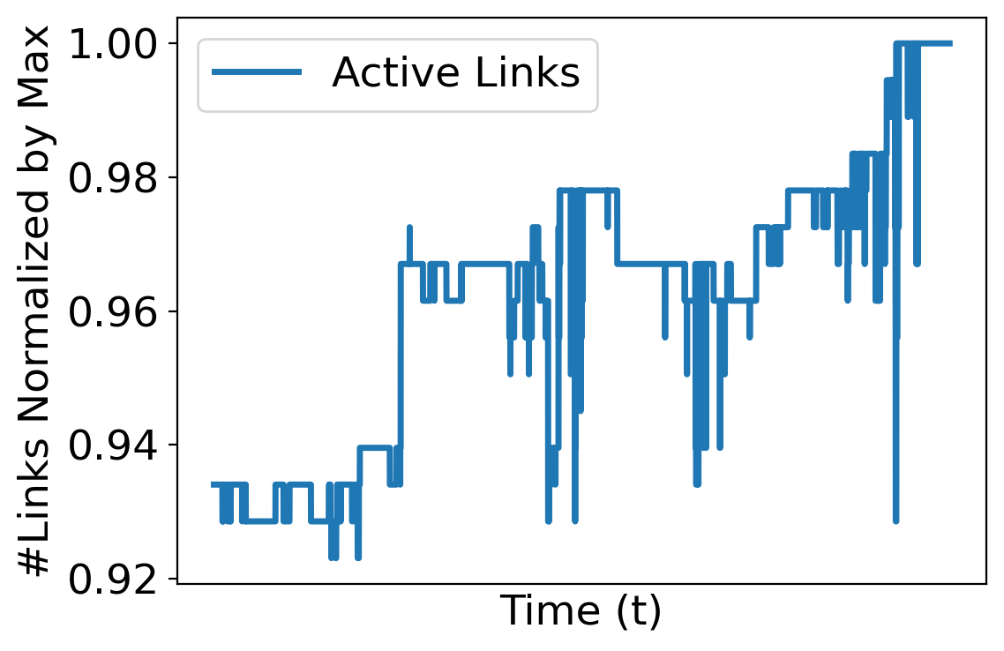
Challenges for ML-based TE
Networks evolve continuously
Organic growth
Maintenance
Failures
Existing neural TE schemes
Focus on fixed topologies and fixed set of tunnels
Do not generalize to topologies outside training set

Slide 7
Contributions
HARP: First neural TE scheme that can handle changing topologies
HARP is transferable across topologies
Preserves key invariances to natural inputs transformations (e.g., reordering tunnels)
Neural architecture is aligned to the optimization model
HARP outperforms classical LP solvers:
5-13% lower average Maximum Link Utilization (MLU) based on traffic matrix predictor
100x faster on large topologies
HARP performs well even with topologies/failures outside training data
Close to optimal MLU in all cases
34% lower MLU than DOTE and TEAL on average

Slide 8
Why explicitly modeling topology is important?
DOTE (NSDI 23)
Fully connected neural network
Does not model capacities, tunnels..
Model cannot distinguish two scenarios where tunnels and capacities vary
For the same input TMs, DOTE generates the same routing regardless of tunnels and capacities
C3 > C1 > C2
30%
4
30%
4
C1
DOTE
Routing on fixed set of tunnels
C1
C1
C1
Fixed
size TMs
70%
1
C2
2
C2
3
1
C2
2
C2
3
C3
C3
C3
C3
5
5
70%

Slide 9
Why preserving invariances is important?
Identical topologies except tunnel relabeling
Existing neural models do not guarantee identical routing in the two scenarios
Prerequisite to generalize to topologies unseen in training
4
30%
4
30%
#1
C1
#2
C1
C1
C1
1
C2
2
C2
3
1
C2
2
C2
3
C3
C3
C3
C3
5
5
#2
70%
#1
70%

Slide 10
HARP Design Principles
Principle 1: Ensure invariances to input transformations
Node relabeling
Tunnel relabeling
Traffic matrix transpose
Principle 2: Aligning neural architecture to optimization model
Mimics the iterative nature of optimization algorithms
An example of the power of neural algorithmic reasoning*
Allow HARP to generalize to topologies beyond training.
* Beatrice Bevilacqua, Kyriacos Nikiforou, Borja Ibarz, Ioana Bica, Michela Paganini, Charles Blundell, Jovana Mitrovic, and Petar Veličković. Neural algorithmic reasoning with causal regularisation. ICML, 2023

Slide 11
HARP Overview
HARP Design
Tunnels described as sets of edges
Set
Transformer
Topology
and
Capacities
GNN
Tunnel Embeddings
Modeling tunnels as sets of edges introduces an invariance to traffic matrix transpose
1) Model Topology
And
Capacities
2) Model Tunnels
3) Initial Routing Predictor
4) Iteratively improve the routing

Slide 12
HARP Design
Tunnel Embeddings
1) Model Topology
And
Capacities
2) Model Tunnels
3) Initial Routing Predictor

Slide 13
HARP Design
Input TMs
Network-wide MLU
Tunnel Embeddings
MLP
Initial Routing
RAU
RAU
Final
Routing
Highest link utilization in a tunnel
RAU: Recurrent Adjustment Unit, applied K times
1) Model Topology
And
Capacities
2) Model Tunnels
3) Initial Routing Predictor
4) Iteratively improve the routing

Slide 14
Experimental Setup
Datasets:
AnonNet: Data collected from real cloud WAN
GEANT: Public dataset
Abilene: Public dataset
KDL: Synthetic TMs
Baselines:
DOTE
TEAL
Gurobi (widely-used LP solver)
Schemes evaluated using ground-truth matrix unless otherwise mentioned

Slide 15
Topology changes in real-world cloud WAN
Topology and TM at 1 min intervals over a 4-week period.
Partitioned into 78 clusters
Within a cluster:
Tunnels fixed
Link capacities change (partial/full link failures)
250 unique link capacity configurations in some clusters
Across clusters:
Tunnels change
E.g., node/link addition
20% of the last cluster’s tunnels not present in the first cluster
Cluster 1
Cluster 2
Cluster 78
Time
Past work has only evaluated on static topologies

Slide 16
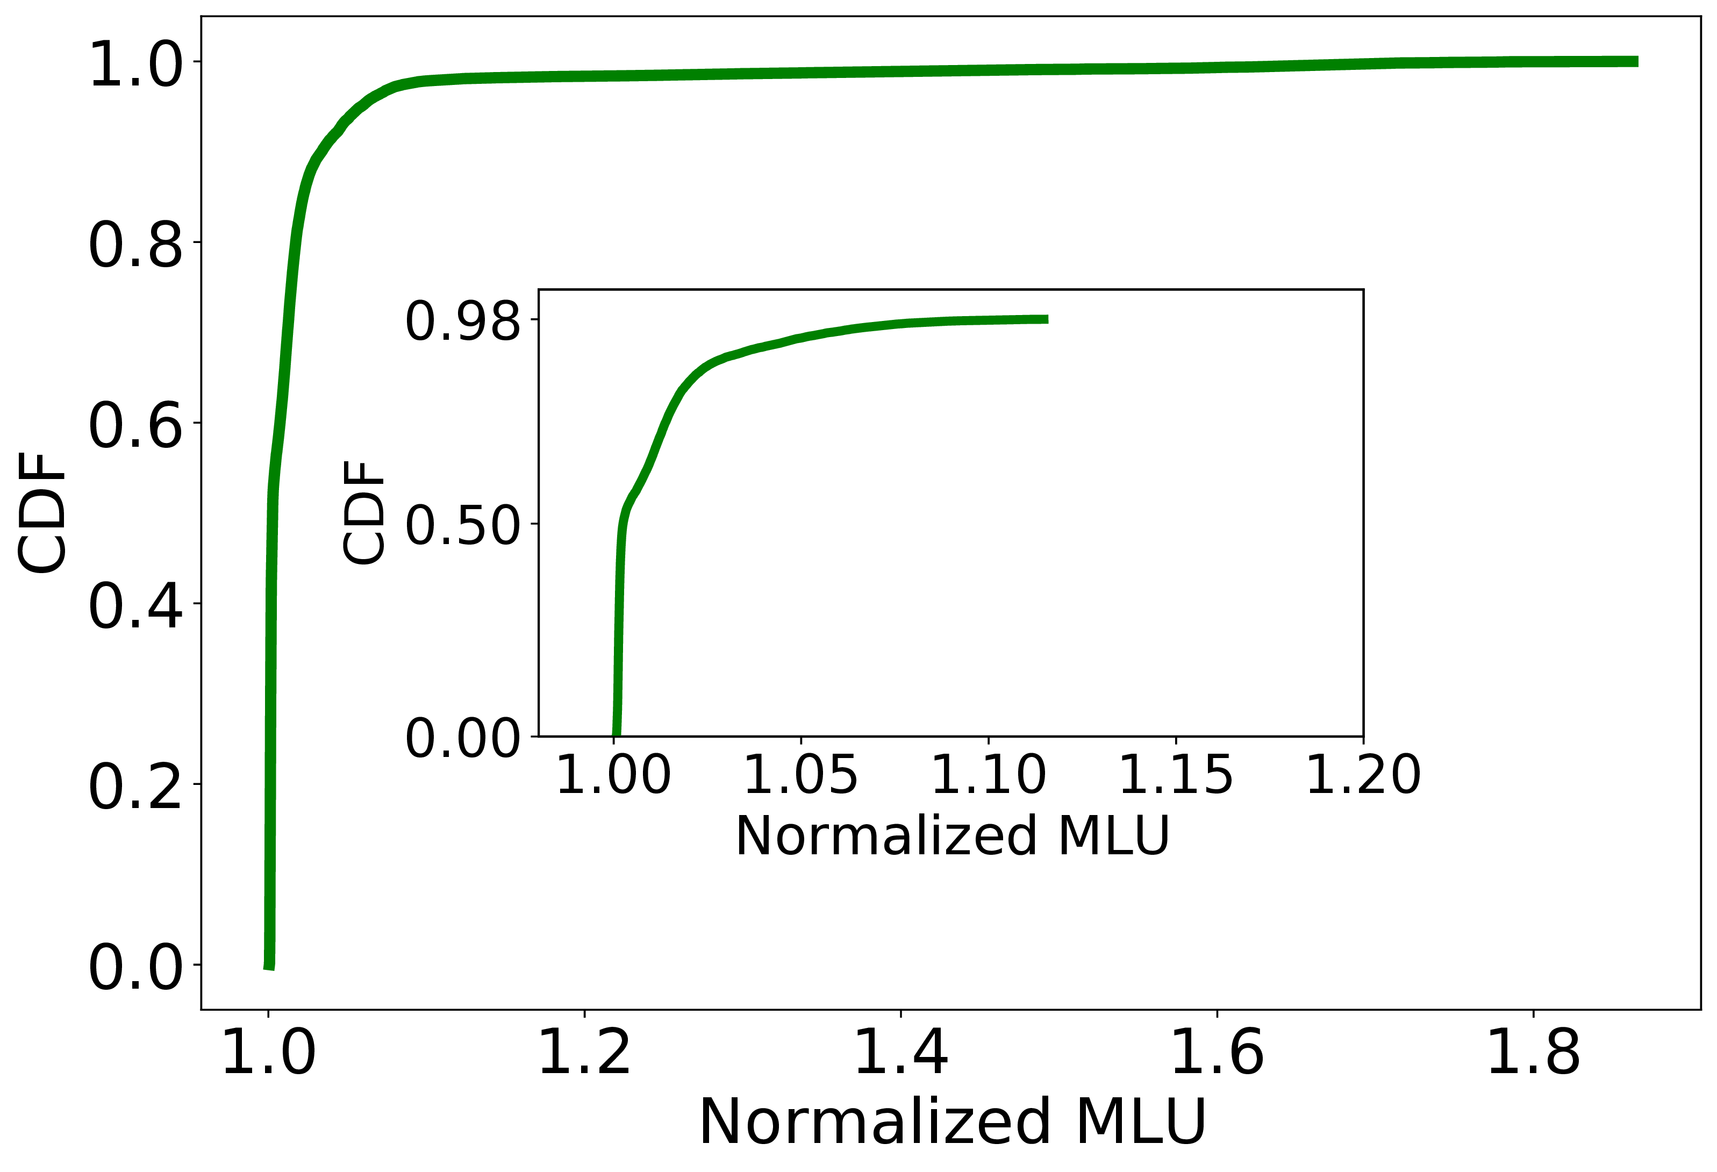
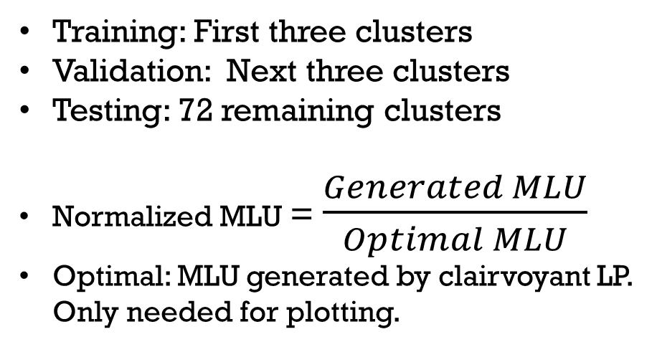
Can HARP work in dynamic environments?
Training: First three clusters
Validation: Next three clusters
Testing: 72 remaining clusters
Normalized MLU = $\frac{Generated MLU}{Optimal MLU}$
Optimal: MLU generated by clairvoyant LP. Only needed for plotting.
Better
HARP is within 12% of optimality 98% of the time despite
significant tunnel and topology changes outside training set

Slide 17
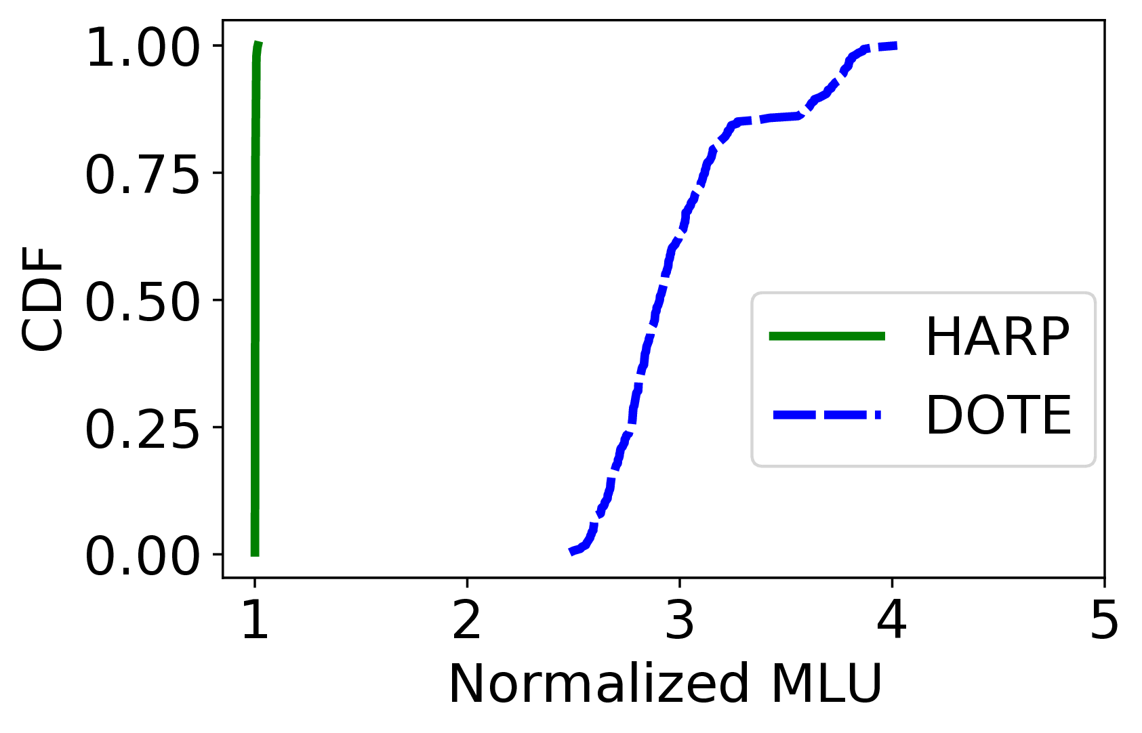
HARP vs DOTE
Train and test on same cluster
On average, HARP’s MLU is 3x lower
DOTE assumes static link capacities
Cannot handle partial/full link failures
Across clusters even more challenging

Slide 18
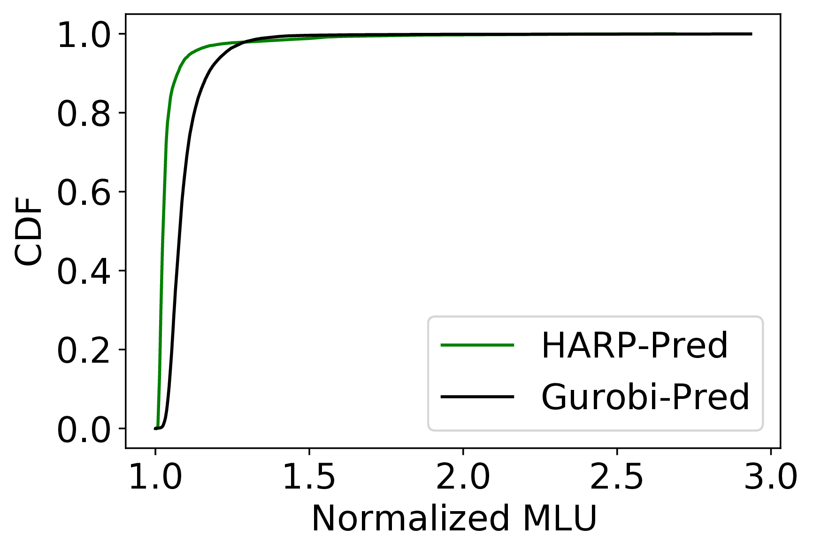
Can HARP work with inaccurate predictors?
When the predicted matrix is used, HARP outperforms LP solvers by 9% on the 80% percentile.
Benefits with other predictors are even higher. See paper.
HARP learns to be robust to prediction errors.

Slide 19
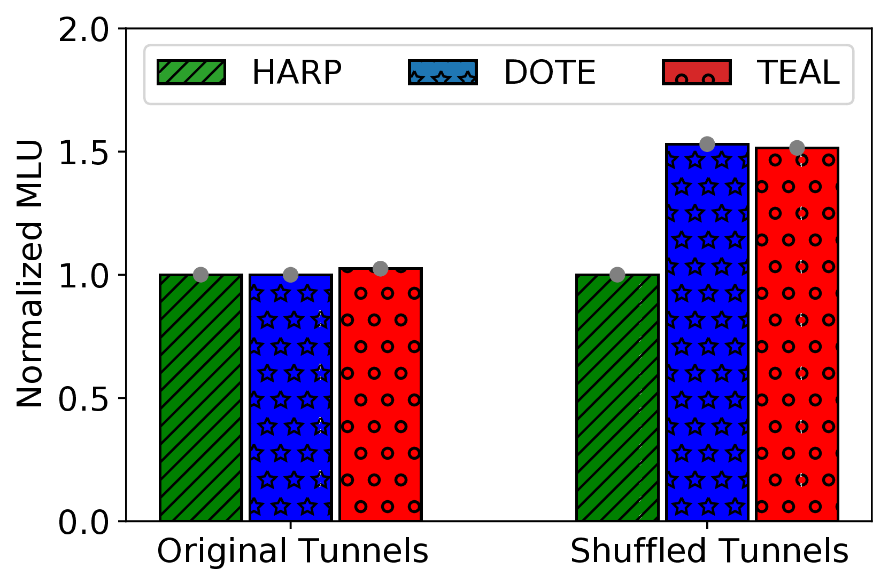
Preserving invariances with HARP
When tunnels in testing are shuffled relative to training:
HARP retains its performance
DOTE and TEAL generate 1.5x MLU
Better
Unshuffled Tunnels
Shuffled Tunnels
Tested on

Slide 20
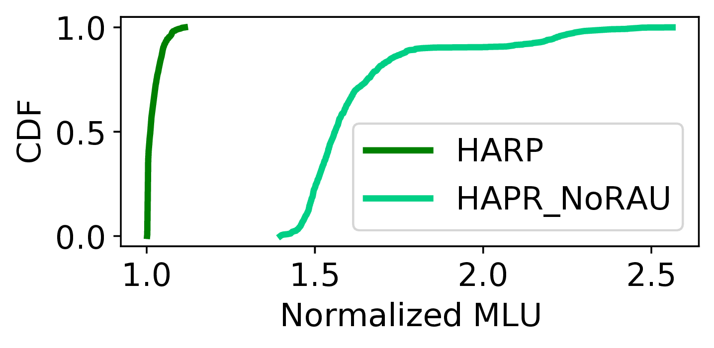
Importance of the aligned architecture
On average, HARP’s MLU is 1.6x lower than that of HARP_NoRAU

Slide 21
Other Experiments
HARP’s ability to handle failures outside training set
Full-link failures
Partial-link failures
Computation times

Slide 22
Conclusion
HARP: First neural TE scheme that can handle changing topologies
HARP is transferable across topologies
Preserves key invariances to natural inputs transformations (e.g., reordering tunnels)
Neural architecture is aligned to the optimization model
HARP outperforms classical LP solvers:
5-13% lower average MLU based on traffic matrix predictor
100x faster on large topologies
HARP performs well even with topologies/failures outside training data
Close to optimal MLU in all cases
34% lower MLU than DOTE and TEAL on average
We released HARP’s source code
https://github.com/Purdue-ISL/HARP

