Slide 1

Dealer: Application-aware Request Splitting for Interactive Cloud Applications
Mohammad Hajjat
Purdue University
Joint work with:
Shankar P N (Purdue), David Maltz (Microsoft), Sanjay Rao (Purdue) and Kunwadee Sripanidkulchai (NECTEC Thailand)

Slide 2






Performance of Interactive Applications
=
Interactive apps → stringent requirements on user response time
Amazon: every 100ms latency cost
1% in sales
Google: 0.5 sec’s delay increase → traffic
and revenue drop by 20%
Tail importance: SLA’s defined on 90%ile and higher response time
Notes:
I’m sure all of us get frustrated whenever you wanna open your facebook page or wanna buy something online and the page keeps loading for “few seconds”.
We became very impatient that we just close the browser tab and leave if the page takes more than expected.

Slide 3

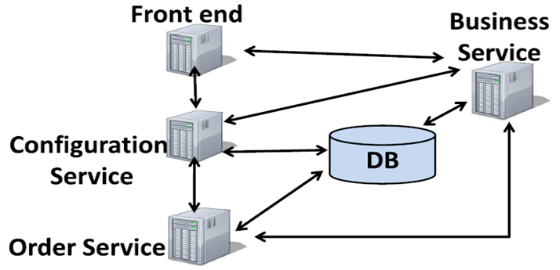
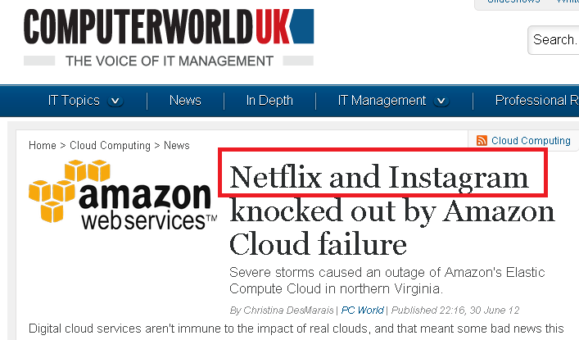
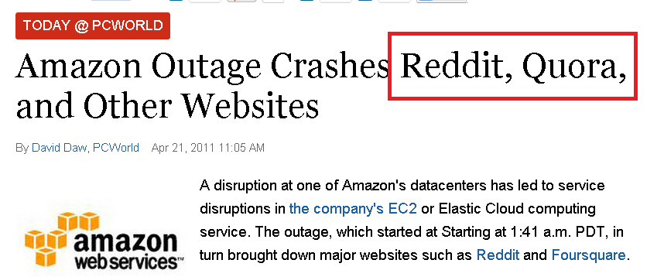
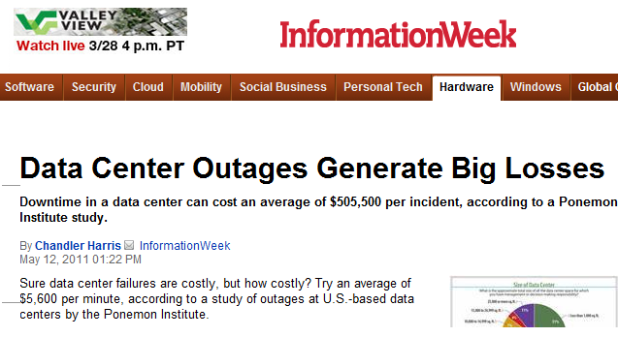
Cloud Computing: Benefits and Challenges
Benefits:
Elasticity
Cost-savings
Geo-distribution:
Service resilience, disaster recovery, better user experience, etc.
Challenges:
Performance is variable: [Ballani’11], [ Wang’10], [Li’10], [Mangot’09], etc.
Even worse, data-centers fail
Average of $5,600 per minute!

Slide 4




Approaches for Handling Cloud Performance Variability
Autoscaling?
Can’t tackle storage problems, network congestion, etc.
Slow: tens of mins in public clouds
DNS-based and Server-based Redirection?
Overload remote DC
Waste local resources
DNS-based schemes may take hours to react

Slide 5

Contributions
Introduce Dealer to help interactive multi-tier applications respond to transient variability in performance in cloud
Split requests at component granularity (rather entire DC) → Pick best combination of component replicas (potentially across multiple DC’s) to serve each individual request
Benefits over naïve approaches:
Wide range of variability in cloud (performance problems, network congestion, workload spikes, failures, etc.)
Short time scale adaptation (tens of seconds to few minutes)
Performance tail (90th percentile and higher):
Under natural cloud dynamics > 6x
Redirection schemes: e.g., DNS-based load-balancers > 3x

Slide 6
Outline
Introduction
Measurement and Observations
System Design
Evaluation
Notes:
We now discuss our measurements and observations that lead to our design of dealer.

Slide 7
Performance Variability in Multi-tier Interactive Applications
Thumbnail Application
FE
Queue
Role
ebRole
IIS
Web
Role
WorkerRole
IIS
orkerRole
Load
Balancer
IIS
Worker
Role
BL₁
blob
blob
BE
BL₂
WorkerRole
orkerRole
Worker
Role
Queue
Multi-tier apps may consist of hundreds of components
Deploy each app on 2 DC’s simultaneously

Slide 8


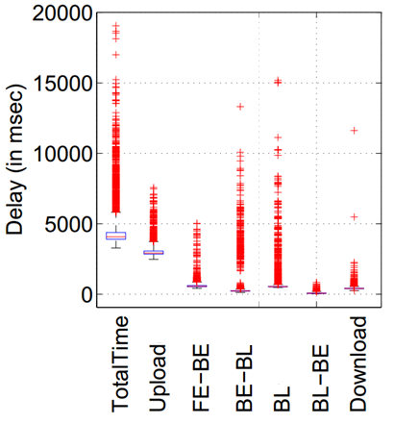

Performance Variability in Multi-tier Interactive Applications
Outliers
FE
BL₁
BL₂
BE
75th
median
25th

Slide 9
Observations
Replicas of a component are uncorrelated
Few components show poor performance at any time
Performance problems are short-lived; 90% < 4 mins
FE
BL₁
BL₂
BE
FE
BL₁
BL₂
BE

Slide 10
Outline
Introduction
Measurement and Observations
System Design
Evaluation
Notes:
We now describe the design of our system that makes use of these observation to solve performance problems in the cloud.

Slide 11
Dealer Approach: Per-Component Re-routing
C₁
C₂
C₃
C₄
C_{n}
GTM
C₁
C₂
C₃
C₄
C_{n}
Split req’s at each component dynamically
Serve each req using a combination of replicas across multiple DC’s

Slide 12


Dealer System Overview
C₁
C₂
C₃
C_{n}
GTM
C₁
C₂
C₃
C_{n}
Dealer
C₁
C₂
C₃
C_{n}

Slide 13
Dealer High Level Design
Determine Delays
Compute Split-Ratios
Application
Stability
Dynamic Capacity Estimation

Slide 14
Determining Delays
Monitoring:
Instrument apps to record:
Component processing time
Inter-component delay
Use X-Trace for instrumentation, uses global ID
Automate integration using Aspect Oriented Programming (AOP)
Push logs asynchronously to reduce overhead
Active Probing:
Send req’s along lightly used links and comps
Use workload generators (e.g., Grinder)
Heuristics for faster recovery by biasing towards better paths
Determine Delays
Compute Split-Ratios
Application
Stability
Dynamic Capacity Estimation

Slide 15
Determining Delays
Monitoring
Probing
Combine Estimates
Stability & Smoothing
Delay matrix D[,]: component processing and inter-component communication delay
Transaction matrix T[,]: transactions rate between components

Slide 16
Calculating Split Ratios
C₄₁
C₁₁
C₂₁
C₃₁
FE
C₅₁
BL₁
Determine Delays
Compute Split-Ratios
Application
BL1
C4
user
FE
BE
C1
C2
C3
BL₂
C₄₂
BL2
C5
Stability
C₁₂
C₂₂
BE
C₃₂
Dynamic Capacity Estimation
C₅₂

Slide 17
Calculating Split Ratios
C₄₁
C₁₁
C₂₁
C₃₁
C₅₁
C₄₂
C₁₂
C₂₂
C₃₂
C₅₂
Given:
Delay matrix D[im, jn]
Transaction matrix T[i,j]
Capacity matrix C[i,m] (capacity of component i in data-center m)
Goal:
Find Split-ratios TF[im, jn]: # of transactions between each pair of components C_{im} and C_{jn} s.t. overall delay is minimized
Algorithm: greedy algorithm that assigns requests to the best performing combination of replicas (across DC’s)

Slide 18
Other Design Aspects
Dynamic Capacity Estimation:
Develop algorithm to dynamically capture capacities of comps
Prevent comps getting overloaded by re-routed traffic
Stability: multiple levels:
Smooth matrices with Weighted Moving Average (WMA)
Damp Split-Ratios by a factor to avoid abrupt shifts
Integration with Apps:
Can be integrated with any app (stateful; e.g., StockTrader)
Provide generic pull/push API’s
Determine Delays
Compute Split-Ratios
Application
Stability
Stability
Dynamic Capacity Estimation
Dynamic Capacity Estimation

Slide 19
Outline
Introduction
Measurement and Observations
System Design
Evaluation
Notes:
Now we end up our talk with few evaluations that show the benefit and importance of dealer

Slide 20
Evaluation
Real multi-tier, interactive apps:
Thumbnails: photo processing, data-intensive
Stocktrader: stock trading, delay-sensitive, stateful
2 Azure datacenters in US
Workload:
Real workload trace from big campus ERP app
DaCapo benchmark
Comparison with existing schemes:
DNS-based redirection
Server-based redirection
Performance variability scenarios (single fault domain failure, storage latency, transaction mix change, etc.)

Slide 21
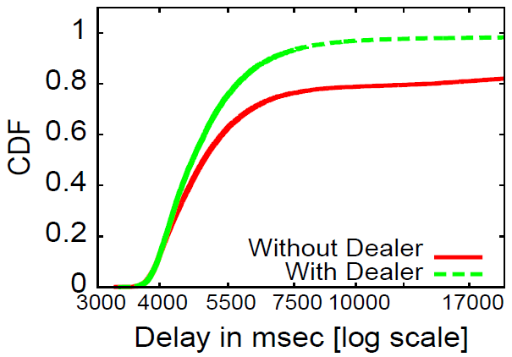
Running In the Wild
Evaluate Dealer under natural cloud dynamics
Explore inherent performance variability in cloud environments
More than 6x difference
Notes:
In this first experiment, we wanted to evaluate the effectiveness of Dealer in
responding to the natural dynamics of real cloud deployments.
We watned to explore the inherent performance variability in cloud environments and evaluate Dealer’s ability to cope with them.
This fig shows a CDF of perofmrnace with and without running Dealer which we run for 2 days.
→ The figure shows that …

Slide 22
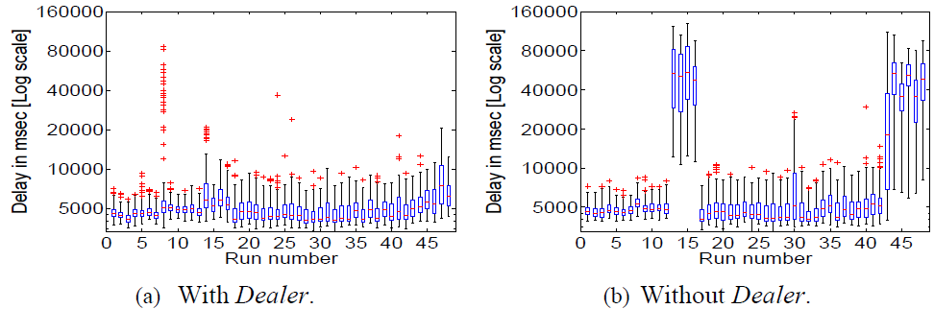
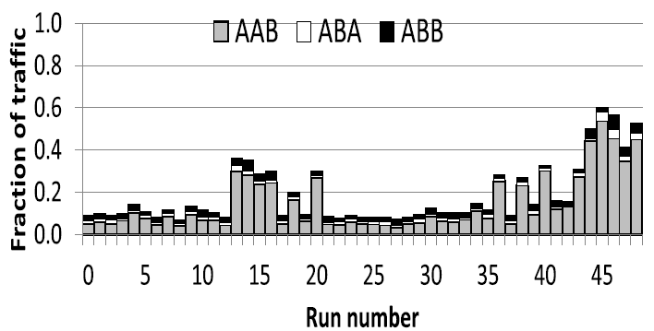

Running In the Wild
FE
BE
BL
A
B
FE
BE
BL
BL
Notes:
To understand why Dealer performs better we dig in deeper to see how the performance changes for each.
During the 2 days of the experiment, we split each hour into into two halfhour
runs; one without activating Dealer, and another with it.
The figure shows a box-plot of total response time for each
run of the experiment. The X-axis shows the run number
and the Y-axis shows the total response time.
As you can see, the response time without Dealer was ok for most of the run except for these shaded areas. We did a further investigation to see why this happened and turned out that these high delays were caused by the BL instances in A DC, which had lower capacity to absorb requests during those periods. Such a sudden dip in capacity is an example of the kind of things that may occur in the cloud
On the other hand, Dealer mitigated the problem by tapping into the available capacity of that component in B DC
→ This graph shows the fraction of requests directed to one or more components in B by Dealer. It shows that dealer sent more traffic remotely during these episodes of bad performance, and it did this inteligently by serving requests in A dc but using the BL replica in the other DC instead, so that it overides the problematic component in A.

Slide 23
Dealer vs. GTM
Global Traffic Managers (GTM’s) use DNS to route user IP’s to closest DC
Best performing DC ≠ closest DC (measured by RTT)
Results: more than 3x improvement for 90th percentile and higher
Notes:
We also compare our Dealer system against GTM’s

Slide 24
Dealer vs. Server-level Redirection
Re-route entire request, granularity of DC’s
HTTP 302
DC_{A}
DC_{B}
Notes:
We also compare against server-level redirection which takes app performance into account. This scheme redirects entire user requests at the granularity of individual DC.
So the req is either processed by Dca or DCb.
Here, for eg, if DCA shows poor performance, this scheme sends an http302 message back to the client redirecting it to the other DC.

Slide 25
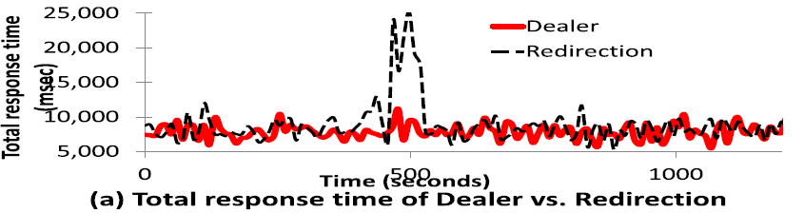
Evaluating Against Server-level Redirection
BL₁
FE
BE
BL₂
BL₁
FE
BE
BL₂

Slide 26
Conclusions
Dealer: novel technique to handle cloud variability in multi-tier interactive apps
Per-component re-routing: dynamically split user req’s across replicas in multiple DC’s at component granularity
Transient cloud variability: performance problems in cloud services, workload spikes, failures, etc.
Short time scale adaptation: tens of seconds to few mins
Performance tail improvement:
Natural cloud dynamics > 6x
Coarse-grain Redirection: e.g., DNS-based GTM > 3x

Slide 27

Questions?

