Slide 1



Everywhere: Impact of Device and Infrastructure Synergies on User Experience
Alessandro Finamore
Marco Mellia
Maurizio Munafò
Sanjay Rao
Ruben Torres
IMC 2011
Cost TMA – Figaro - NSF

Slide 2
YouTube primer and scenario

Slide 3






Motivations
YouTube is the most popular video download system on the Internet (*)
13 million hours of video uploaded during 2010
It is a big share of the mobile traffic
more than 500 tweets per minute containing a YouTube link
Questions:
How the system handle PC or Mobile requests?
What about the performance?
YouTube CDN
ISP1
ISP2
Data Center
(*) www.youtube.com/t/press_statistics

Slide 4


Which devices?
We separate the devices in two categories:
PC-player:
Regular PC / Laptop / nettop having a web browser with the Adobe Flash plugin or that is HTML5 compliant
Mobile-player:
A smarthphone, an Internet Tablet or a set-top-box using a custom application to access to YouTube
No distinction/difference among the different operating systems

Slide 5
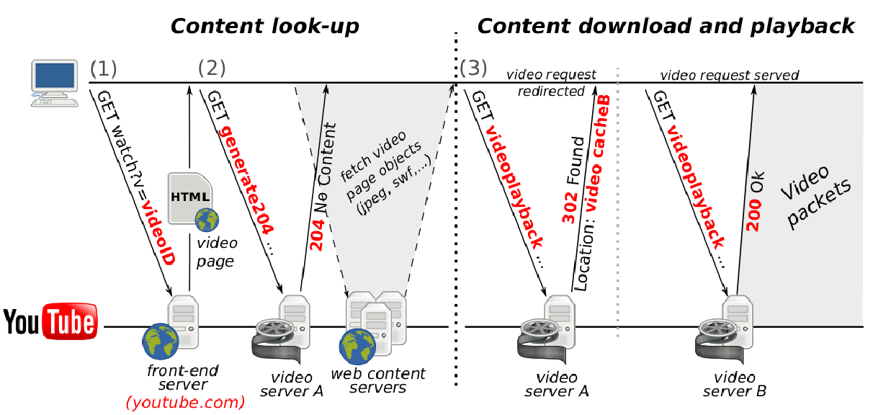
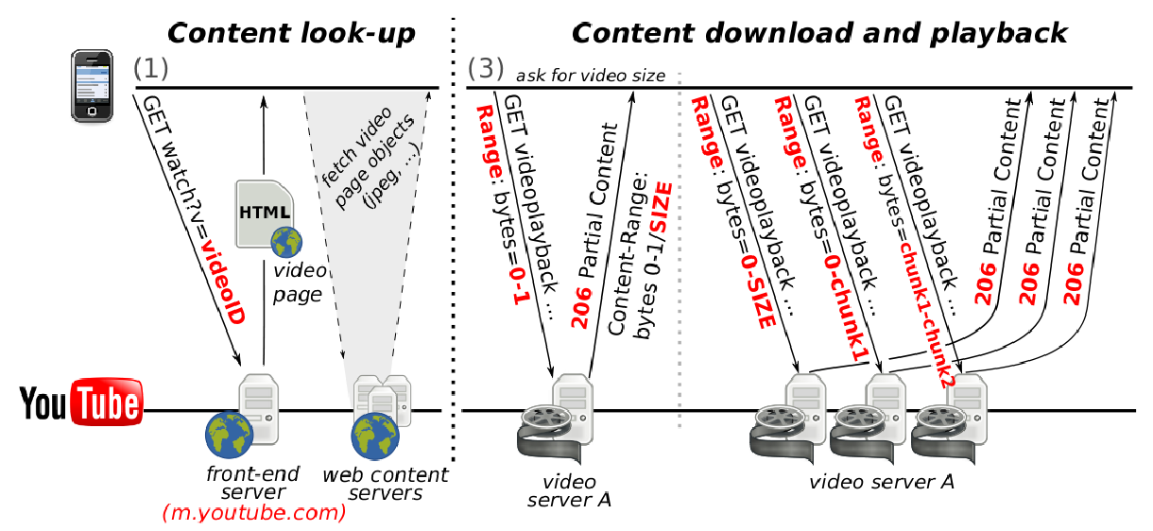
YouTube primer
The scenario
is complex
PC-player
Download
Mobile-player
Download

Slide 6

Collection Tool
^{(*)}
Traffic classification using
L4 (TCP) statistics
Per-connection statistics (#bytes, #pkts, ...)
L7 DPI to inspect the HTTP messages
Classify the type of content and device
Identify the “control” messages
Per-video statistics (video duration, resolution, codec, ...)
(*) http://tstat.polito.it

Slide 7
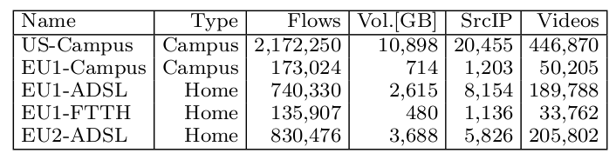
Data sets
Week-long collections on Sep. 2010
5 vantage points in Europe and US
4 access technologies - ADSL, Fiber-To-The-Home, Ethernet, WiFi
Both Residential ISPs and Campus networks
Mobile-player access YouTube via WiFi
No 3G/4G in our data sets

Slide 8
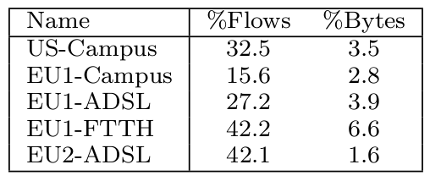

How much traffic is due to Mobile-player?
Mobile traffic corresponds to a
small fraction of bytes
very high number of flows (?!?!?)

Slide 9

Example of video download
Let’s download the same video X using different type
of device
PC
Give me video X
Mobile
Give me video X
What are the similarities/differences in
the evolution of the download?

Slide 10
YouTube primer
PC-player
Download
Mobile-player
Download

Slide 11
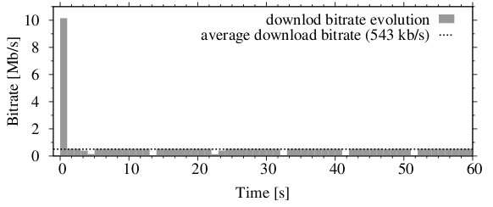
PC-player video download
1
Fast start: the player is buffering
a portion of the video
2
The download bandwidth is throttled as to reach the video average download rate
The download rate is controlled by the video server
(the client is passive)

Slide 12
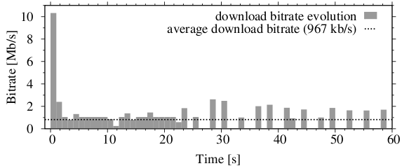
Mobile-player video download
1
Fast start: the player is buffering a
a portion of the video
3
3
Chunks of video: the player asks for portion of the video using separate flows
2
The client abruptly aborts the TCP connection (playout buffer is possibly full)

Slide 13

Download scheme comparison
PC-player
Download controlled by the video server
1 video session = 1 TCP connection
Mobile-player
Download controlled by the client
1 video session = N TCP connections
N is 10 – 100 connections!
Intuition: buffering at Mobile-players is critical
(No guarantee to store the content on the file system)
We group into a VIDEO SESSION all the TCP connections
That have the same source IP and videoID
Are concurrent in time

Slide 14
Some simple characterization
Which type of content different users retrieve?
Does it change using different devices?
What are the available video formats?

Slide 15
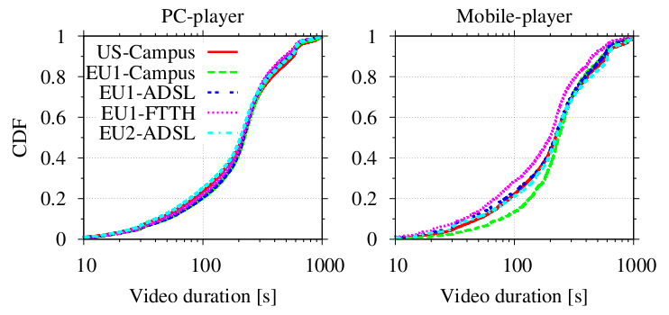
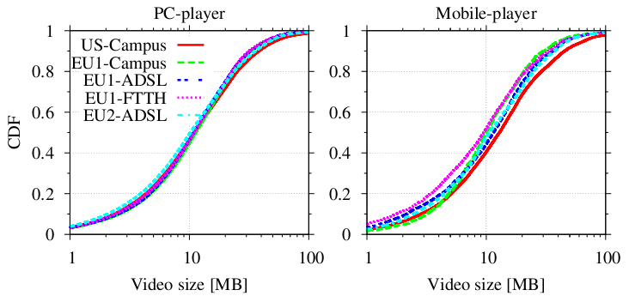
Comparing video duration & size
Users access to (find) the
same content from any
device from everywhere

Slide 16
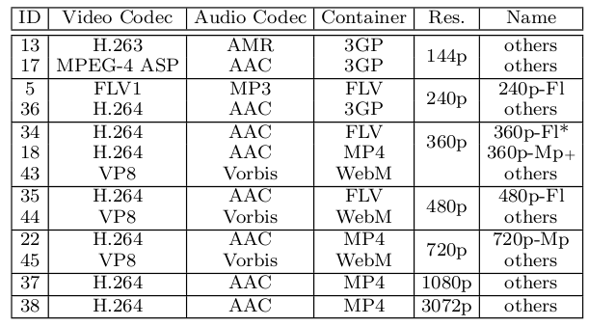
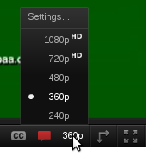
YouTube video formats
default
PC-player
default
Mobile-player
Several formats supported
Hidden to the user
Mainly used FLV and MP4

Slide 17
How content is retrieved?
Do users change resolution?
Do users go into full-screen mode?
How much of the video is actually played?
…. and how much is downloaded?

Slide 18
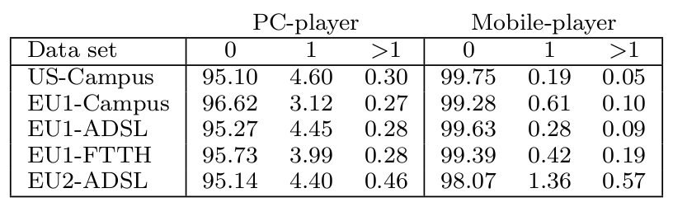
Probability of resolution switch
Resolution switch:
The user starts to download in RES1 (e.g. 360p)
and then jump to RES2 (e.g. 720p)
Let’s focus on this
Users stick to the default playback parameters!
Why so? Intuition is that
users are not aware of this possibility
it is “difficult” to change resolution
inertia

Slide 19
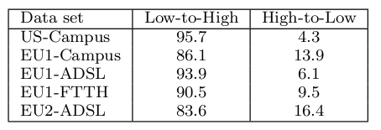
Probability of resolution switch
5% of PC-player sessions face a resolution switch.
Question: Are those jumping to an higher or lower resolution?
Low-to-High is the most common
>95% are 360Fl → 480Fl
this is triggered AUTOMATICALLY when going fullscreen
>50% happens in the first 10s of download
High-to-Low is more common if there are performance issues

Slide 20
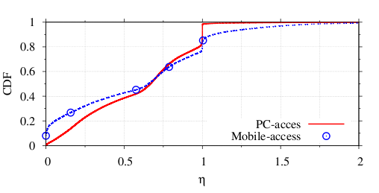
Fraction of video downloaded
For each video session we compute:
Downloaded bytes
η
Fraction of video
downloaded
=
=
Full video bytes
Download only a
portion of the video
Download more than
the entire video ??!?!?

Slide 21
Fraction of video downloaded
Downloaded bytes
η
Fraction of video
downloaded
=
=
Full video bytes
Download only a
portion of the video

Slide 22
Fraction of video downloaded (η<1)
80% of sessions were
early aborted by users
It happens even more on Mobile
Why so?
Possible mismatch between video expectation and actual content
What are the implications for the network?

Slide 23


Fraction of video downloaded (η<1) Amount of wasted bytes
Can we estimate the amount of played bytes?
If user stops downloading at time T=3s, he could have only played NO MORE than T=3s of video
Given the nominal video bitrate R, the amount of video actually consumed is TxR = played bytes
downloaded bytes
<
fraction of
wasted bytes
played bytes
Note: this is a lower bound of the real waste
since we are not considering the initial
buffering at the player

Slide 24
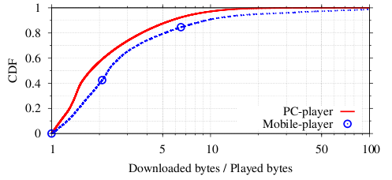
Fraction of video downloaded (η<1) Amount of wasted bytes
Mobile devices waste more traffic
>20% of aborted sessions downloaded more than 5 times what could be played!
This is due to aggressive buffering policies at the player

Slide 25
Fraction of video downloaded
Downloaded bytes
η
Fraction of video
downloaded
=
=
Full video bytes
Download more than
the entire video ??!?!?

Slide 26
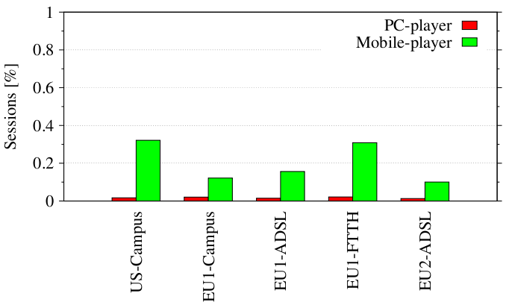
Fraction of video downloaded (η>1)
Fract of Sessions
There should NOT be session with η>1, but:
>5% of mobile sessions download 25% more of the video

Slide 27
Why so much waste for mobile?
Recall: No guarantee to store the content on the file system
One possible cause: not optimized control of the playout buffer
video
Initial condition
Playout buffer
β
sent
Each chunk of video is delivered
in a separate flow until the playout
buffer do not have β bytes.
At this time, the playout can starts
video
1
2
Playout buffer
1
2
β
played
sent
If there isn’t enough space in the buffer
Data already sent are wasted
Need to retransmit the data
video
1
2
3
4
5
6
?!?!
Playout buffer
3
4
5
β

Slide 28
Why so much waste for mobile?
Recall: No guarantee to store the content on the file system
One possible cause: not optimized control of the playout buffer
video
Initial condition
Playout buffer
The client keeps downloading
content ignoring that the buffer is full
No correct handling of flow control
Possible bug in the player framework?
β
sent
Each chunkf of video is delivered
in a separate flow (HTTP Range)
Until the delivery of β bytes
the playback do not starts
video
1
2
Playout buffer
1
2
β
played
sent
If there isn’t enough space in the buffer
Data already sent are wasted
Need to retransmit the data
video
1
2
3
4
5
6
Playout buffer
3
4
5
β

Slide 29
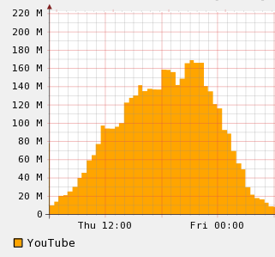
Overall waste of bandwidth
Overall the wasted amount of data during peak hours
for PC-player, 39%
for Mobile-player, 47%
160Mb/s of YouTube
@ peak hours
67Mb/s of
traffic wasted!!!
Bitrate [Mb/s]

Slide 30
Some performance
How much has the user to wait for the video playback to start?
How fast the download is?

Slide 31
Perfomance indexes
Startup latency: time elapsed between the video request and the first data packet
Lower bound of what the user experience
(not consider the initial buffering)
Bitrate ratio:
Avg. video session bitrate
Bitrate ratio =
Avg. video encoding bitrate

Slide 32
YouTube primer Startup latency
redirections
PC-player
Download
Mobile-player
Download

Slide 33
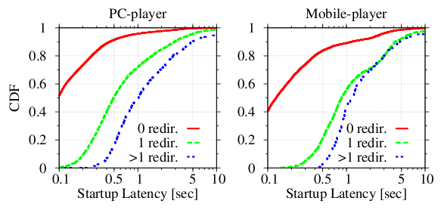
Startup latency
More than 10% of the requests are redirected
Redirects can be due to “cache miss” at the server
Redirect are 10% more likely for Mobile-player

Slide 34
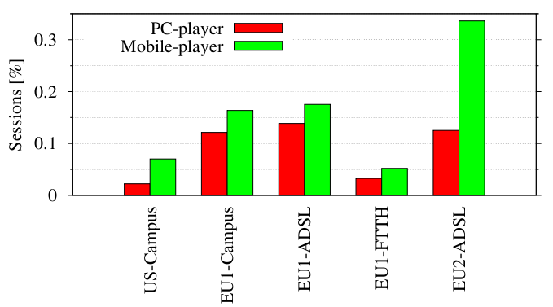
Bitrate ratio < 1
Fract of Sessions
Bottlenecked download are more likely for Mobile-Player
The content is fetched from “far away” servers

Slide 35
Conclusions
The type of device do not affect the type of content accessed (video lenght and duration)
Different default video codecs
Users watch just a portion of the video and stick to the default configuration
They use only fullscreen
The download mechanism is related to the type of video with aggressive buffering policies
Mobile-player download even more than what is needed!
Lower performance for Mobile-players

Slide 36
Future work
Space for improvements
Caching policies with respect to
Video popularity: Mobile video are “less popular”...
Video format: MP4 is “less popular” than FLV...
Real mobile dataset in 3G/4G networks
Preliminary analysis confirm the results
Compare other video streaming services
Preliminary analysis confirm the waste of traffic

Slide 37
?? || ##

