Slide 1
Veritas
Answering Causal Queries from Video Streaming Traces
Chandan Bothra*, Jianfei Gao*, Sanjay Rao, Bruno Ribeiro Purdue University
*equal contribution

Slide 2
Let’s stream some videos :)
YouFlix
Notes:
YouFlix, What if Qs in N/W design?

Slide 3
Let’s stream some videos :)
Network conditions
YouFlix
Quality
Notes:
YouFlix, What if Qs in N/W design?

Slide 4

What if Qs in a video streaming system
Network conditions
YouFlix
Quality
What if?

Slide 5
What if Qs in a video streaming system
Network conditions
YouFlix
Quality
Use different ABR algorithm?
Stream higher quality 4K videos?
Reduce the buffer size?
What if?

Slide 6
What happens today?
Notes:
What happens today? * Trace driven simulations: using collected data from past sessions. [directly use past data.] * Suffer from biases due to hidden confounder. * RCTs: * Biases due Why do they fall short? Can;t answer questions What this paper is about? * Answering what-if Qs accurately without using RCTs.
*

Slide 7
What happens today?
Trace driven simulations
Use data collected from past sessions.
Suffers from biases due to hidden confounders.
Notes:
What happens today? * Trace driven simulations: using collected data from past sessions. [directly use past data.] * Suffer from biases due to hidden confounder. * RCTs: * Biases due Why do they fall short? Can;t answer questions What this paper is about? * Answering what-if Qs accurately without using RCTs.
*

Slide 8
What happens today?
Trace driven simulations
Use data collected from past sessions.
Suffers from biases due to hidden confounders.
Randomized Control Trials (RCTs)
Gold standard to answer what-if Qs.
Affects performance of live users.
Notes:
What happens today? * Trace driven simulations: using collected data from past sessions. [directly use past data.] * Suffer from biases due to hidden confounder. * RCTs: * Biases due Why do they fall short? Can;t answer questions What this paper is about? * Answering what-if Qs accurately without using RCTs.
*

Slide 9
Our contributions
Notes:
Why is it interpretable? Traces to run emulation, model HMM ...

Slide 10
Our contributions
Veritas: Accurately answering what-if questions without RCTs
Focus on video streaming
Notes:
Why is it interpretable? Traces to run emulation, model HMM ...

Slide 11
Our contributions
Veritas: Accurately answering what-if questions without RCTs
Focus on video streaming.
Principled framework that tackles causal reasoning
Reasoning about interventions (changes) to the system.
Simplify complex task leveraging domain specific insights.
Notes:
Why is it interpretable? Traces to run emulation, model HMM ...

Slide 12
Our contributions
Veritas: Accurately answering what-if questions without RCTs
Focus on video streaming
Principled framework that tackles causal reasoning
Reasoning about interventions (changes) to the system.
Simplify complex task leveraging domain specific insights.
Veritas achieves lower error (0.022%) than Baseline and CausalSim (3-4%)
Baseline: Widely used approach for trace-driven simulation.
CausalSim [NSDI 23]: Recent causal inference approach that needs RCT training data.
Notes:
Why is it interpretable? Traces to run emulation, model HMM ...

Slide 13
What are the challenges in video streaming?

Slide 14
Challenge #1: Network Bandwidth is a confounder
Notes:
Not monotonic relationship.

Slide 15
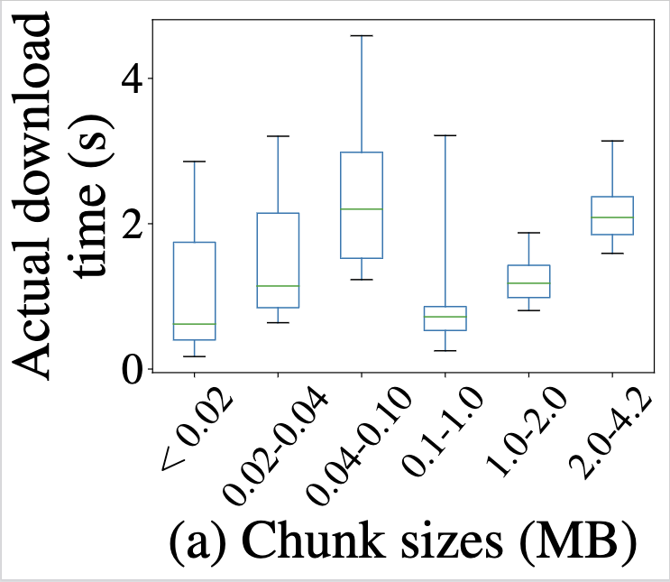
Challenge #1: Network Bandwidth is a confounder
Larger chunk sizes may have smaller download times in observed data.
Adaptive bitrate (ABR) algorithms pick higher qualities when network conditions better.
Notes:
Not monotonic relationship.

Slide 16
Challenge #2: TCP state is a confounder
Notes:
Look up TCP version… Property of RTT factor…

Slide 17
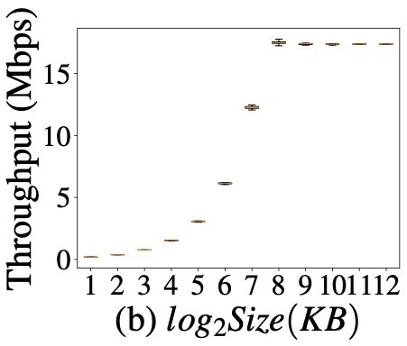
Challenge #2: TCP state is a confounder
Observed throughput may not reflect intrinsic network bandwidth (INB)
Depends on
Size
TCP State
Notes:
Look up TCP version… Property of RTT factor…

Slide 18
Challenge #3: Cascading effects in video streaming…
Deployment
What if?
Notes:
Remove low and high; observed in deployment; what if Q?

Slide 19
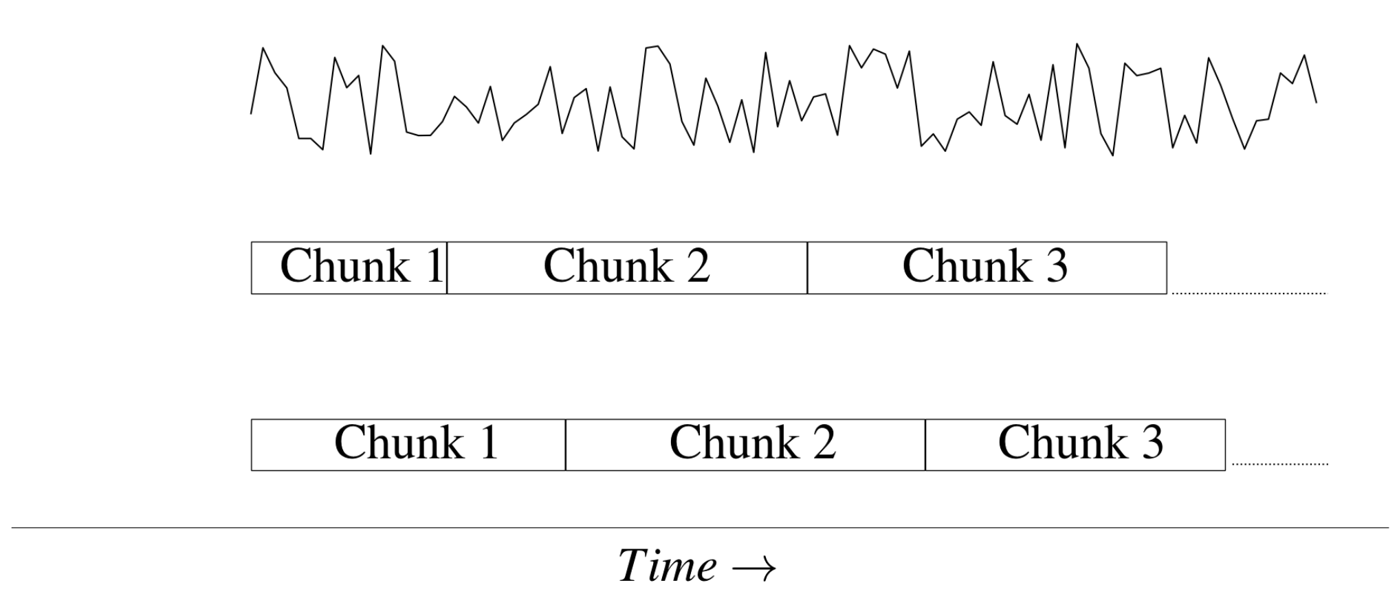
Challenge #3: Cascading effects in video streaming…
Intrinsic Network Bandwidth (INB)
Deployment
What if?
Notes:
Remove low and high; observed in deployment; what if Q?

Slide 20
Challenge #3: Cascading effects in video streaming…
Intrinsic Network Bandwidth (INB)
Deployment
What if?
Notes:
Remove low and high; observed in deployment; what if Q?

Slide 21
Challenge #3: Cascading effects in video streaming…
Intrinsic Network Bandwidth (INB)
Deployment
What if?
Change in quality of single chunk affects the properties of all succeeding chunks.
Notes:
Remove low and high; observed in deployment; what if Q?

Slide 22
Modeling video streaming…

Slide 23
Modeling video streaming…
Buffer (B_{e} )
Buffer (B_{s} )
n
n
Chunk Size (S_{n})
Download time (D_{n})
Observed variables for n^{th} chunk
Observed throughput (Y_{n})

Slide 24
Modeling video streaming…
Buffer (B_{e} )
Buffer (B_{s} )
Buffer (B_{e} )
n
n
n
Chunk Size (S_{n})
……
Download time (D_{n})
Download time (D_{n-1})
Chunk ‘n’
Observed variables for the preceding chunks…
Observed throughput (Y_{n})
Observed throughput (Y_{n-1})

Slide 25
Goal: Infer Intrinsic Network Bandwidth (Hidden)
INB, C_{e}
INB, C_{s}
INB, C_{e}
n
n
n-1
Buffer (B_{e} )
Buffer (B_{s} )
Buffer (B_{e} )
n
n
n-1
Chunk Size (S_{n})
Download time (D_{n})
Download time (D_{n-1})
Shaded: Observed
Unshaded: Hidden
Observed throughput (Y_{n})
Observed throughput (Y_{n-1})

Slide 26
Complex dependency graph makes inference hard.
INB, C_{e}
INB, C_{s}
INB, C_{e}
n
n
n-1
Buffer (B_{e} )
Buffer (B_{e} )
Buffer (B_{s} )
n-1
n
n
Chunk Size (S_{n})
TCP state (W_{s} )
TCP state (W_{e} )
Download time (D_{n})
n
n-1
Download time (D_{n-1})
TCP state (W_{e} )
n
Shaded: Observed
Unshaded: Hidden
Observed throughput (Y_{n})
Observed throughput (Y_{n-1})
Notes:
Add arrows from TCP states… Causal graph: inference hard. Crucial decision to observe TCP state variables at start of each chunk…

Slide 27
Key insight: observing TCP state simplifies inference
INB, C_{e}
INB, C_{s}
INB, C_{e}
n
n
n-1
Buffer (B_{e} )
Buffer (B_{e} )
Buffer (B_{s} )
n-1
n
n
Chunk Size (S_{n})
TCP state (W_{s} )
TCP state (W_{e} )
Download time (D_{n})
n
n-1
Download time (D_{n-1})
TCP state (W_{e} )
n
Shaded: Observed
Unshaded: Hidden
Observed throughput (Y_{n})
Observed throughput (Y_{n-1})
*TCP state and buffer size at end of chunk download can be logged but Veritas does not log it.
Notes:
Add arrows from TCP states… Causal graph: inference hard. Crucial decision to observe TCP state variables at start of each chunk…

Slide 28
Why is observing TCP state useful?
INB, C_{e}
INB, C_{s}
INB, C_{e}
n
n
n-1
Buffer (B_{e} )
Buffer (B_{e} )
Buffer (B_{s} )
n-1
n
n
Chunk Size (S_{n})
TCP state (W_{s} )
TCP state (W_{e} )
Download time (D_{n})
n
n-1
Download time (D_{n-1})
TCP state (W_{e} )
n
Shaded: Observed
Unshaded: Hidden
d-separates past and future
Observed throughput (Y_{n})
Observed throughput (Y_{n-1})
Notes:
Add arrows from TCP states… Causal graph: inference hard. Crucial decision to observe TCP state variables at start of each chunk…
Resulting graph satisfies d-separation property which simplifies the causal task.

Slide 29
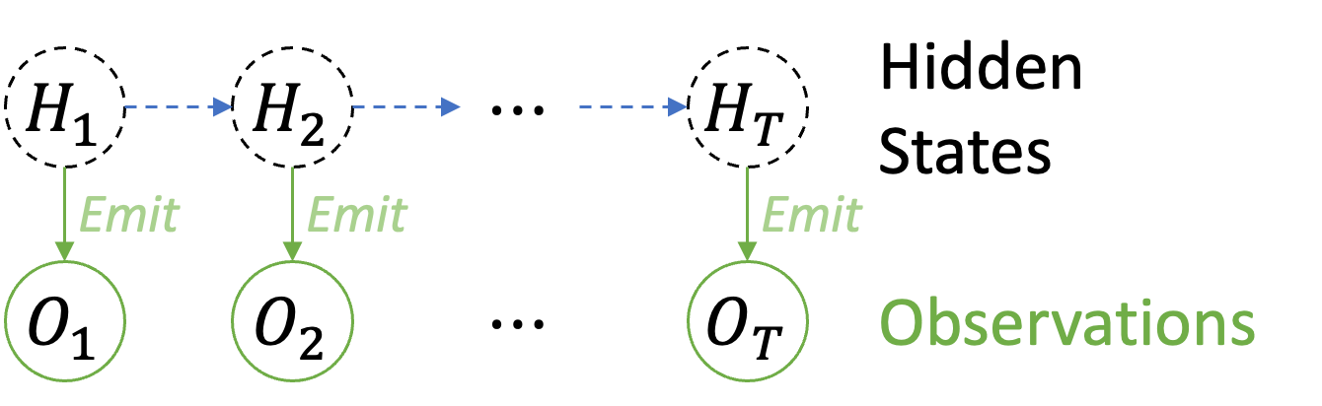
Veritas: Design Details
Hidden states: INB time series across chunks
Partially observed hidden states: Chunks sizes, TCP states, etc.
Observed variable: observed throughput.
Domain specific emission model relates the Capacity, chunk size, TCP state to the observed throughput.
Notes:
Design details: a traditional variant of HMM..,

Slide 30
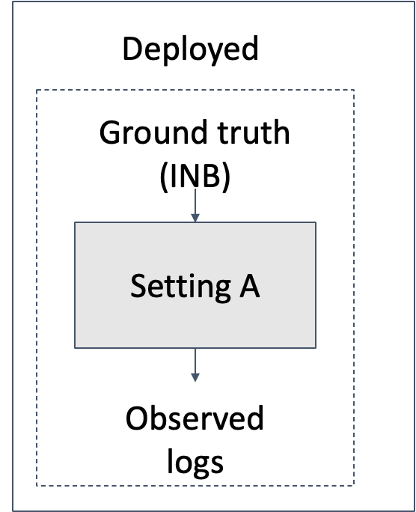
Veritas: Answering causal queries

Slide 31
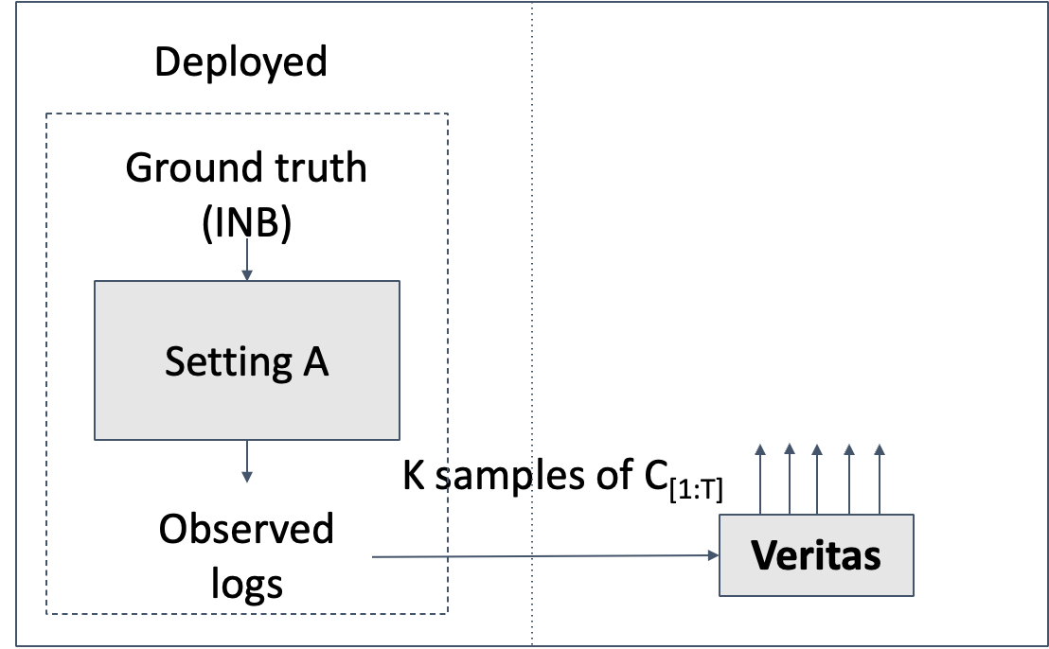
Veritas: Answering causal queries

Slide 32
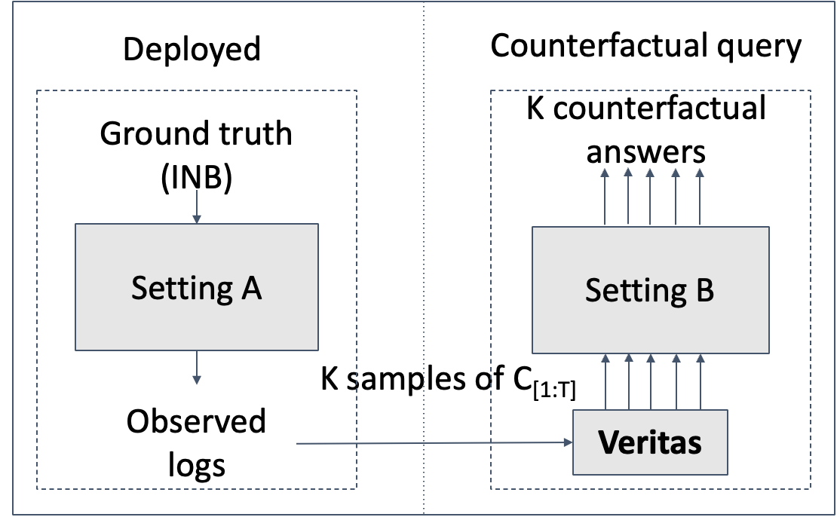
Veritas: Answering causal queries
Notes:
WHy not CS2p?

Slide 33
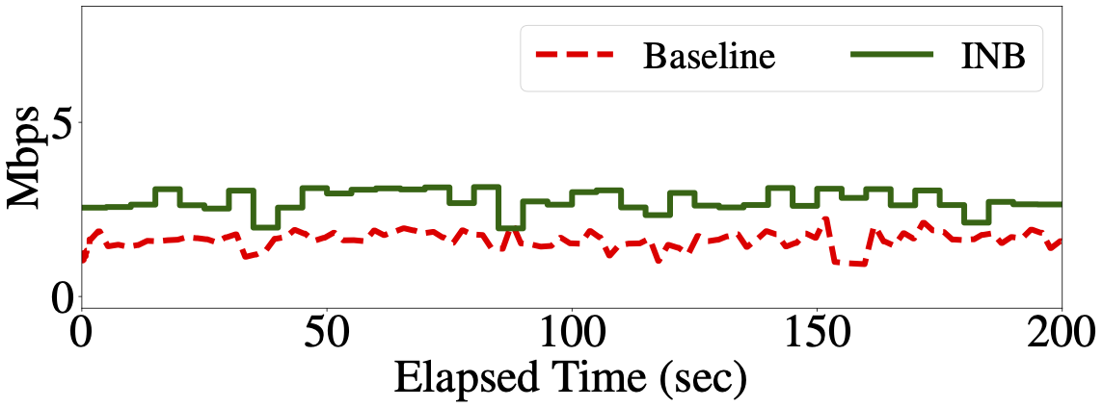
Illustrating Veritas in action
Intrinsic Network Bandwidth (INB): FCC trace emulated using Mahimahi.
Baseline: Widely used trace driven approach using observed throughput of chunks.

Slide 34
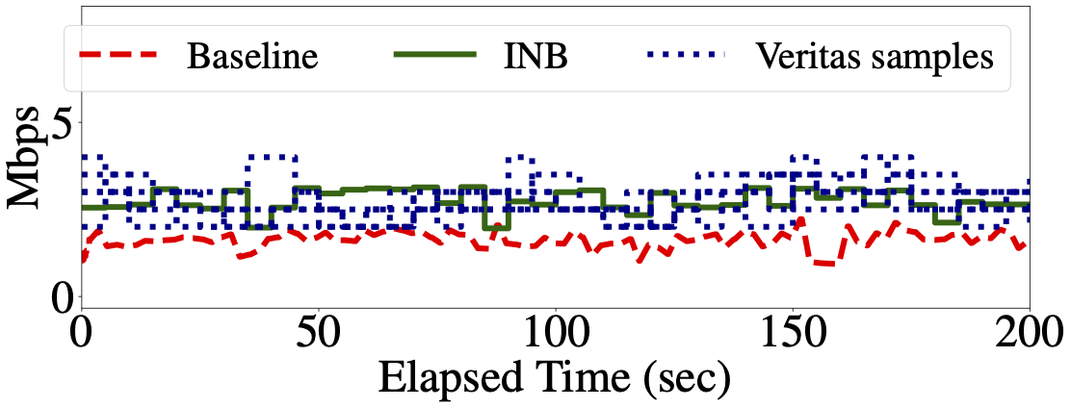
Illustrating Veritas in action
Veritas: Multiple samples account for uncertainty in inference.
Notes:
Uncertainty of model or network?

Slide 35
What if Q: change from low quality to high quality?

Slide 36
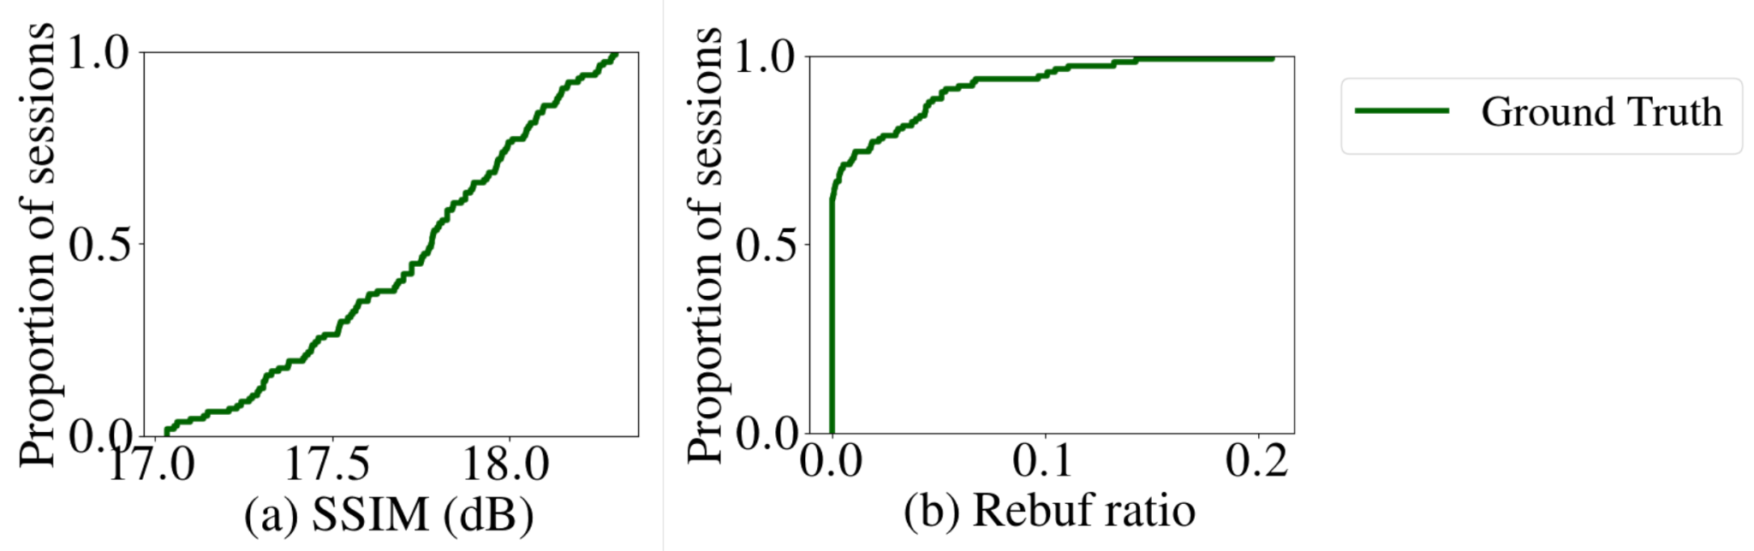
What if Q: change from low quality to high quality?
Ground Truth: Emulate true Intrinsic Network Bandwidth (INB) trace.

Slide 37
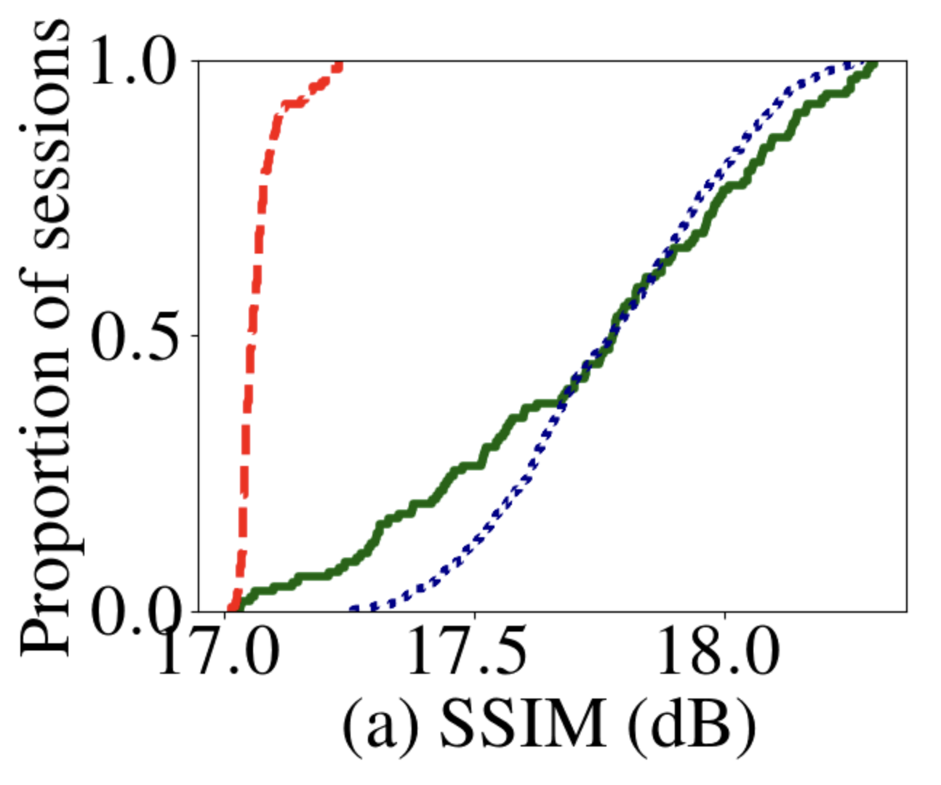
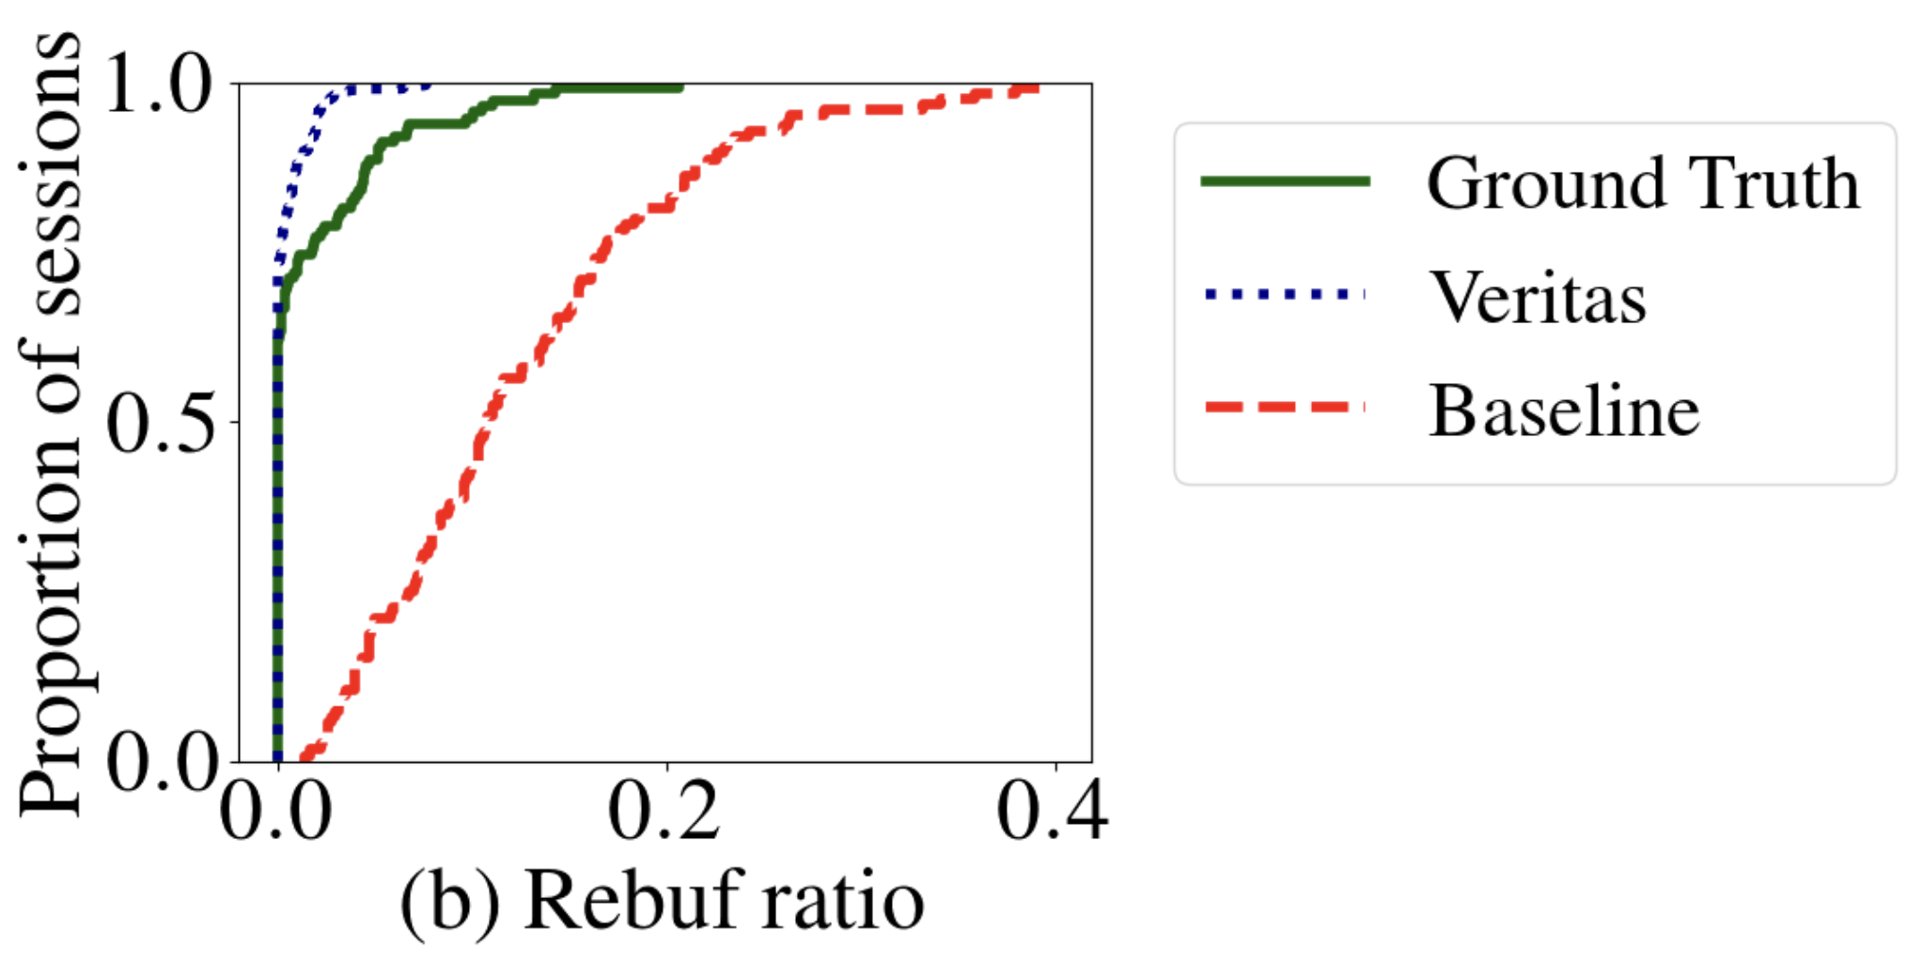
What if Q: change from low quality to high quality?
Ground Truth: Emulate true Intrinsic Network Bandwidth (INB) trace.
Veritas (0.022% error) much closer to ground truth than Baseline (~3% error).

Slide 38
Veritas vs. CausalSim (NSDI 2023)

Slide 39
Veritas vs. CausalSim (NSDI 2023)
CausalSim
Requires RCT training data.
Veritas
Does not require RCT training data.

Slide 40
Veritas vs. CausalSim (NSDI 2023)
CausalSim
Requires RCT training data
Given RCT data from 2 ABR algorithms can answer questions about third.
Veritas
Does not require RCT training data.
Only needs data from one ABR algorithm.

Slide 41
Veritas vs. CausalSim (NSDI 2023)
CausalSim
Requires RCT training data
Given RCT data from 2 ABR algorithms can answer questions about third.
Cannot answer questions outside the scope of the RCT.
Veritas
Does not require RCT training data.
Only needs data from one ABR algorithm
Can answer wider range of what-if questions. E.g.:
Change of buffer size.
Change of video quality.

Slide 42
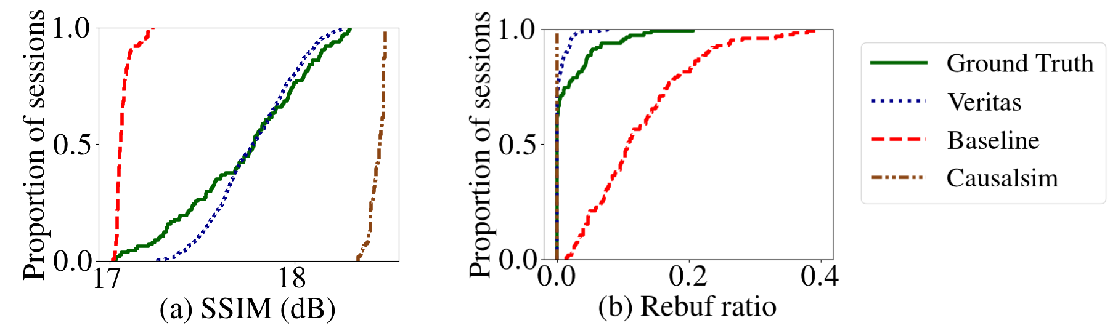
What if Q: change from low quality to high quality?
Veritas (0.022% error) much closer to ground truth than CausalSim (~4% error).

Slide 43
Conclusion
Novel framework for causal inference without using RCT data.
Simply causal inference by observing TCP state.

Slide 44
Conclusion
Novel framework for causal inference without using RCT data.
Simply causal inference by observing TCP state.
Veritas answers wide range of causal queries:
Change of ABR, change of qualities, change of buffer size, etc.
Veritas median error < 0.022% compared to 3-4% error for Baseline and CausalSim.
Real world validations on Puffer testbed (details in paper).

Slide 45
Conclusion
Novel framework for causal inference without using RCT data.
Simply causal inference by observing TCP state.
Veritas answers wide range of causal queries:
Change of ABR, change of qualities, change of buffer size, etc.
Veritas median error < 0.022% compared to 3-4% error for Baseline and CausalSim.
Real world validations on Puffer testbed (details in paper).
Artifact available at: https://github.com/Purdue-ISL/Veritas

Slide 46
Thank you!
Contact: cbothra@purdue.edu

Slide 47
Back-up slides
Q/A

Slide 48
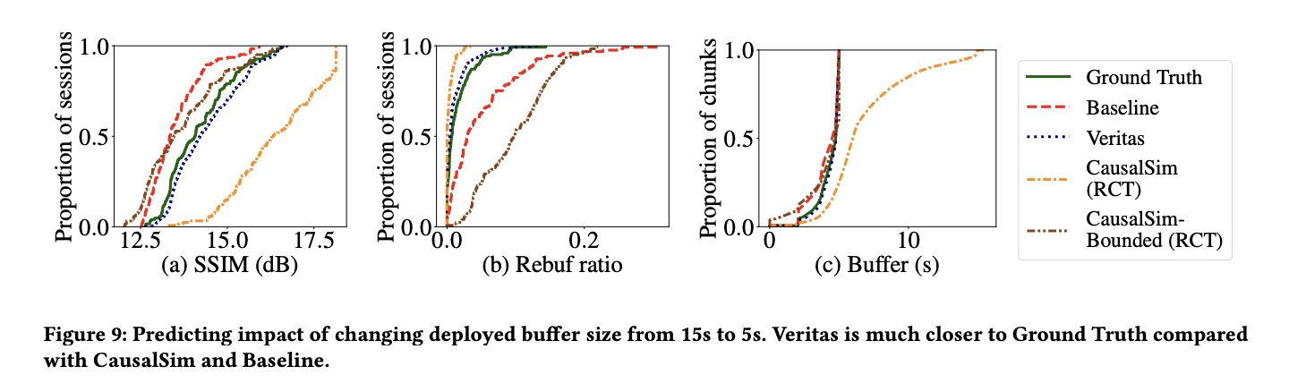
What if: change buffer from 15s to 5s?

Slide 49
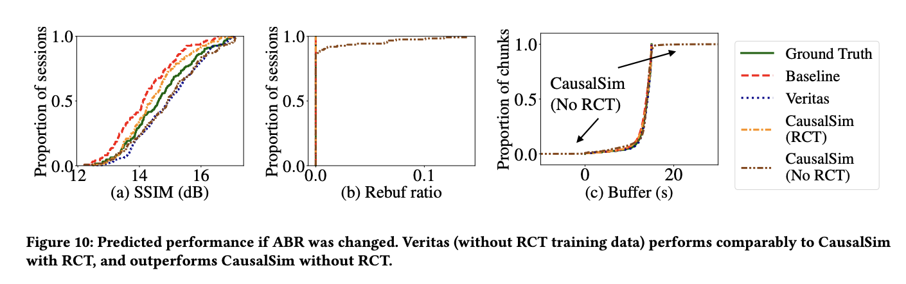
What if change ABR?

Slide 50
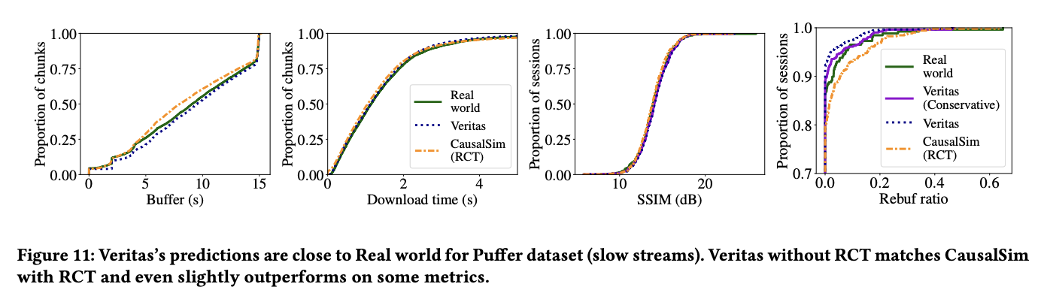
What if: Puffer?

