Slide 1
Closer to the Cloud - A Case for Emulating Cloud Dynamics by Controlling the Environment
Ashiwan Sivakumar
Shankaranarayanan P N
Sanjay Rao
School of Electrical and Computer Engineering
Purdue University

Slide 2




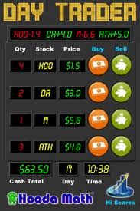
Latency-Sensitive Applications on the Cloud
Complex
Multi-tiered
SOA
Stringent SLA
$$$ savings
Geo-redundancy
Elasticity
Scalability
Test beds

Slide 3
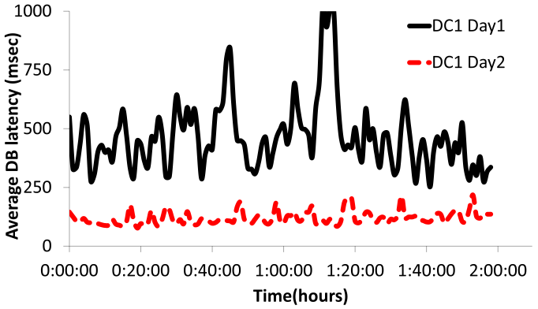
Performance Fluctuations in Microsoft Azure
Short-term and long-term variation in DB latency
DB performs 100% worse on Day 1 than on Day 2
Variation in RTT of TCP streams observed in Amazon EC2
Our study confirms - hotcloud10 (CloudCmp), SoCC10 (YCSB)

Slide 4

Control over the Environment : A Technique
Experiments in the wild – cloud provider 1
Trace collection and analysis
Data model to emulate on GENI
Experiments in the wild – cloud provider 2
Performance prediction and redesign
Application/research prototype under development
Commercial clouds ?
No control over the environment and shared infrastructure
Cloud test beds like Open Cirrus, Eucalyptus?
Can emulate cloud dynamics and federated, but no control over the environment

Slide 5

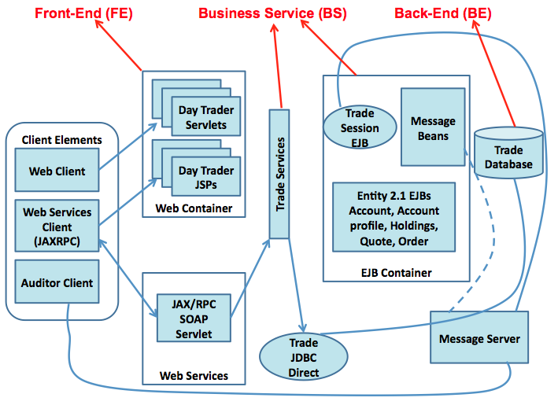
Sample Enterprise Application Day Trader

Slide 6
Single Data Center Deployment on GENI
Delay node
2 ms
2 ms
2 ms
Users
FE1
BS1
BE
*.emulab.net
(Utah)
Test bed
User workload generator (grinder) running in Purdue
Workload from DaCapo benchmark for Enterprise apps
Application instances running on nodes from Utah
Delay node between BS1 and BE

Slide 7
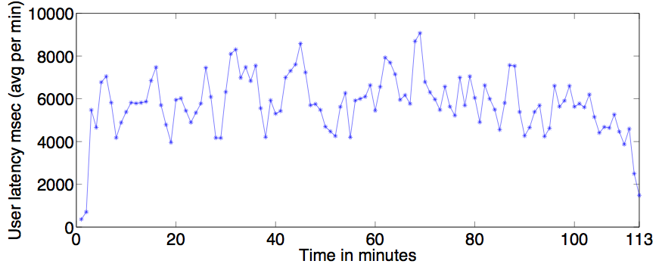
Predicting Performance of Applications by Replaying Trace
DB latency trace from Azure (slide 3) replayed between BS and BE
Total application response time for each user request plotted
More or less follows network delay between BS and BE
Also measured error percentage – always within 1 %

Slide 8
Multi Data Center Deployment on GENI
2 ms
Delay node
2 ms
FE1
BS1
2 ms
*.emulab.net
(Utah)
41.2 ms
41.2 ms
BE
Users
*.uky.emulab.net
(Kentucky)
41.2 ms
0.5 ms
FE2
BS2
Test bed
User workload generator in Purdue
Two instances of the application components
One deployment in Utah and another in Kentucky
Delay node between FE1 and BS1 in Utah

Slide 9
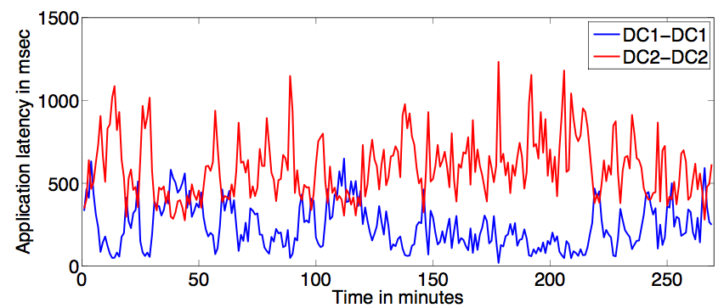
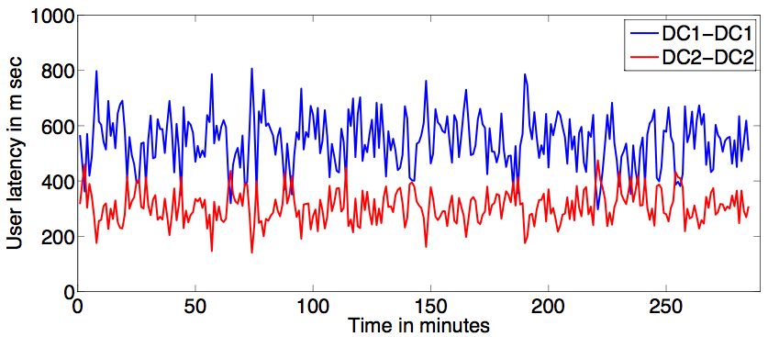
What –if Analyses on Application
No delay : DC2 slower than DC1
Delay 250 ms : DC1 slower than DC2
DC1 – DC1 : FE1 – BS1 in Utah & DC2 – DC2 : FE2 – BS2 in Kentucky

Slide 10
An Adaptive System - Dealer
Cloud environment is highly dynamic
Problem isolated to one component in a DC
Current redirection mechanisms
Abandon entire deployment
Dealer : Adapts to cloud dynamics
Components deployed on multiple DCs
Fine-grained component level redirection
Optimally suggests path based on latencies

Slide 11
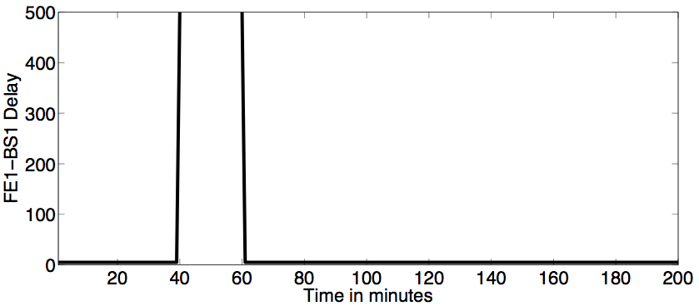
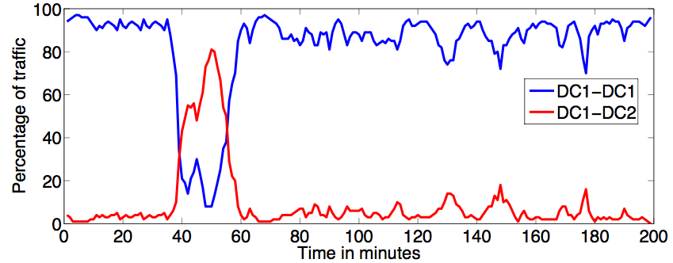
Evaluation of the Adaptive System
Control Input : Step
Output : Dealer path change
DC1 – DC1 : FE1 – BS1 & DC1 – DC2 : FE1 – BS2

Slide 12
Conclusions
To open up new avenues in cloud research
Control over test bed environment – critical
Can be used as a technique by developers and researchers for
emulating real cloud dynamics to
predict application performance
compare cloud providers
what-if analyses on application
develop solutions for performance problems

Slide 13
Q & A

Slide 14
Back up slides

Slide 15
Future Directions
Dynamically change the delay
Multi data-center deployment like Emulab
Emulating cloud data stores
Blobs, Queues, Big-Table provided as service
Installing and running Cassandra on GENI

Slide 16
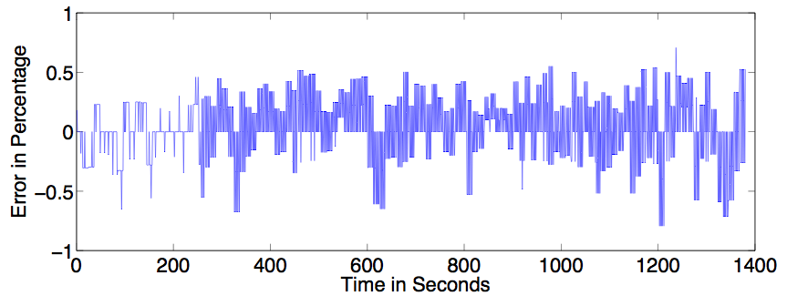
Accuracy and Repeatability Requirements
Error percentage :
(observed latency – expected latency)/expected latency in %
observed – ping , expected – delay applied
always within +- 1% error bound
Require such high degree of accuracy and repeatability

Slide 17
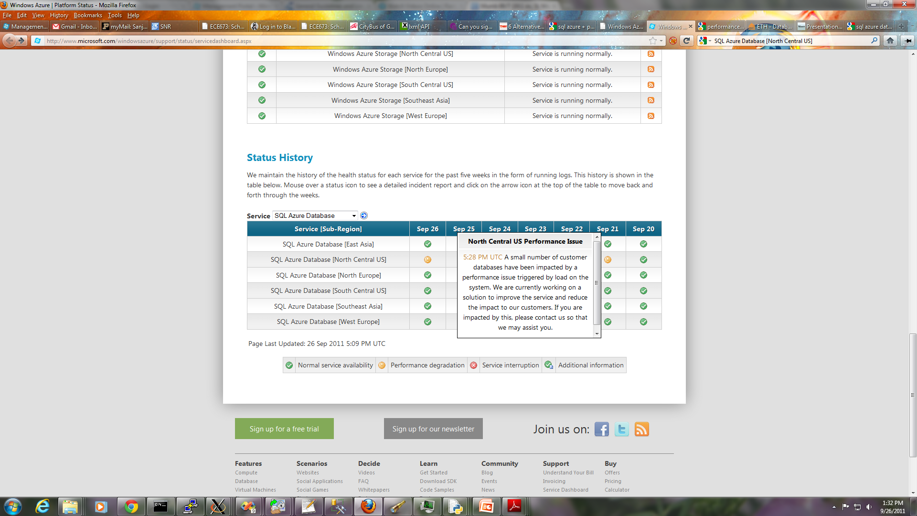
SQL Azure Performance Issue Snapshot (6 Days)

Slide 18
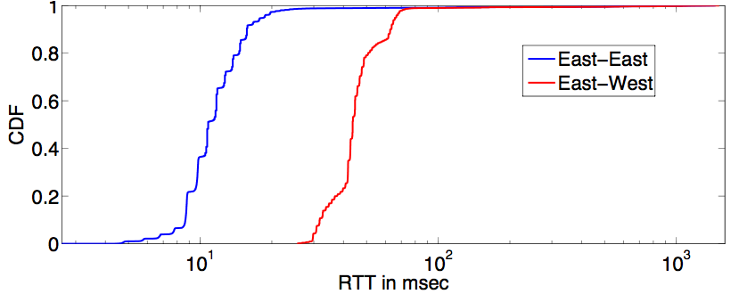
Performance Fluctuations in Amazon EC2
Simple Experiment
RTT measured for a TCP stream
Both inter and intra DC show variation

Slide 19
Day Trader Communication Pattern
FE
BS
BE
HTTP Request
SOAP – new HTTP Request
MySQL Queries
1
2
3
4
5
7
6
Users
8
9
11
10
13
12
HTTP Response
SOAP Response
MySQLReplies
Response time = component latency + communication latency
Multiple calls between components for a given user request

