Slide 1


Cloudward Bound: Planning for Beneficial Migration of Enterprise Applications to the Cloud
Mohammad Hajjat , Xin Sun, Yu-Wei Sung (Purdue University)
David Maltz (Microsoft Research),
Sanjay Rao (Purdue University),
Kunwadee Sripanidkulchai (IBM T.J. Watson)
Mohit Tawarmalani (Purdue University)

Slide 2
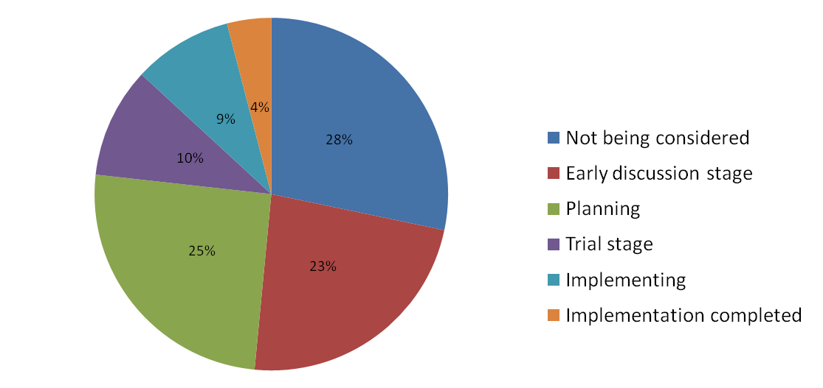
Cloud Computing
“Most influential management ideas of the millenium”
Harvard Business Review
Early successes (e.g., indexing NYTimes Archive)
Much interest in migrating enterprises to the public cloud

Slide 3
Concerns with cloud computing
Data privacy
National Privacy Laws
Industry-specific privacy laws (e.g., Health Care)
SLA Requirements
Application response time
Availability

Slide 4




Hybrid Cloud Architectures
“And there are some things they might not want to put in the cloud for security and reliability reasons….So, you've got
to have these kinds of hybrid solutions.”
Steve Ballmer, Microsoft CEO
Cloud
back-end
frontend
an ACL
“We think it's a combination of putting applications in your own data center, and then use the cloud to take out peaks, or you could put specific things in the cloud.”
Joe Tucci, EMC CEO
Internet
front- end
back-end
(sensitive
databases)
“Virtually every enterprise will adopt a hybrid format”
Russ Daniels, CTO of cloud computing, HP
Local Data Center

Slide 5


Our focus #1 : Planning hybrid cloud layouts
Cost savings, Application response times, Bandwidth costs
Scale and complexity of enterprises applications
Cloud
back- end
back-end
frontend
an ACL
Internet
front- end
back end
Local Data Center
front- end
back end
Local Data Center

Slide 6
Our focus #2: migrating security policies
Security most important initiative for 83% of surveyed operators
Security policies often realized using Access Control Lists (ACLs)
Typical to see hundreds of firewall contexts, ACLs with hundreds
of rules
Cloud
back- end
back-end
?
frontend
an ACL
permit frontend→backend port 8000 deny any→backend
Internet
front- end
back end
Local Data Center
front- end
back
end
Local Data Center

Slide 7
Contributions of this paper
Highlight complexity of enterprise applications, data-center policies
Framing and providing first-cut solutions for two key challenges in migrating enterprises to hybrid cloud
Models for planning hybrid cloud deployments
Abstractions and algorithms for assurable migration of security policies
Validations using real enterprise applications, Azure-based cloud deployments

Slide 8
Talk Outline
Enterprise Applications
Models for planning hybrid cloud deployments
Assurable migration of security policies
Evaluation and Results
Related Work and Conclusion

Slide 9
Enterprise Applications
E.g., Payroll, travel and expense reimbursement, customer relationship management etc.
FE1
Front End
(FE)
FE
FE2
BL1
BL2
Business Logic
(BL)
BL4
BL5
BL
BL3
BL1
BL2
BL3
BL4
BL5
Back End
(BE)
BE
3-tier Application Structure

Slide 10







Enterprise Applications
E.g., Payroll, travel and expense reimbursement, customer relationship management etc.
FE
BL
BE

Slide 11
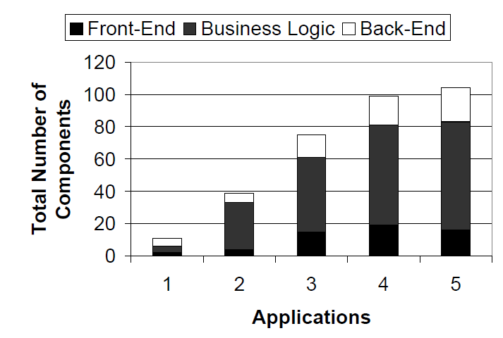
Scale of enterprise applications

Slide 12
Abstracting the planning problem
E
External
I
Internal
Ci
N_{i} = number of servers in component C_{i}
C₀
C₁
T_{ij}= number of transactions per second along (i,j)
S_{ij}= average size of transactions along (i,j)
C₂
C_{i}
Enterprise
C₃
C₄
C_{j}
Cj
To determine:
m_{i}= number of servers of component C_{i} to migrate to the cloud (m_{i} ≤ N_{i})
C_{k}
C₅
App1
App2

Slide 13
Formulating the planning problem
Objective: Maximize cost savings on migration
Benefits due to hosting servers in the cloud
Cost increase/savings related to wide area Internet communication
Constraints:
Policy constraints
Bounds on increase in transaction delay
Future work:
Application availability
Cloud
back-end
frontend
front- end
back-end
(sensitive
databases)
Local Data Center

Slide 14
Partitioning requests after migration
T’_{iR,jR}
C_{iR}
C_{jR}
T_{i,j}
Cloud
Migrate
T’_{iR,jL}
C_{i}
C_{j}
T’_{iL,jR}
C_{iL}
C_{jL}
Local DC
T’_{iL,jL}
Local DC
(1) Location sensitive routing
(2) Location Independent routing
Split in proportion to the number of servers in C_{jL} and C_{jR}
Introduces non-linearity in constraints.

Slide 15
Modeling Approach
Model complexity Vs. Practicality of data collection
Fine-grained models:
Potentially more accurate
Model parameters harder to collect
Our Approach:
Use easily available information (e.g., computation times of components and communication times on links)
Empirical experience to drive iterative model refinements

Slide 16
Modeling user response times
Ideally, desirable to bound increase in:
Mean response time
Response time variations (e.g., 95%ile response times).
Bounding changes to mean delay relatively easier
Linearity of expectations
Bounding delay variations harder
Feasible to bound changes to variance of response times
By conditioning on path taken by transactions
Independence assumptions
Can be extended to applications with non path-like transactions
Conservative bounds on changes to delay percentiles feasible

Slide 17
Benefits/costs on migration
Benefits due to hosting servers in the cloud
Economies of scale, lowered operational expenses
Estimates from Armbrust et al (Berkeley TR, 2009)
Benefits dependent on compute or storage servers
Future extension: savings due to using cloud for peaks
Focus on recurring costs associated with migration
Modeling costs related to Internet communication
Linear cost model
Matches charging model of EC2, Azure etc.

Slide 18
Talk Outline
Enterprise Applications
Models for planning hybrid cloud deployments
Assurable migration of security policies
Evaluation and Results
Related Work and Conclusion

Slide 19

Migration algorithm overview
Reachability Matrix (R)
Transform R
Cloud
fe₁
t(a₂)
Entities:
 | fe₁ | fe₂ | BE₁ | BE₂ | INT
fe₁
fe₂ |  |  | t(a₃) | t(a₃)
BE₁ | t(a₂) | t(a₂) |  | t(a₃)
BE₂ | t(a₂) | t(a₂) | t(a₃)
INT |  | t(a₁)∩ t(a₂) | t(a₁)∩ t(a₃) | t(a₁)∩ t(a₃)
 | fe₁ | fe₂ | BE₁ | BE₂ | INT
fe₁
fe₂ |  |  | a₃ | a₃
BE₁ | a₂ | a₂ |  | a₃
BE₂ | a₂ | a₂ | a₃
INT |  | a₁∩ a₂ | a₁∩ a₃ | a₁∩ a₃
 | fe₁ | fe₂ | BE₁ | BE₂ | INT
fe₁
fe₂
BE₁
BE₂
INT
 | fe₁ | fe₂ | BE₁ | BE₂ | INT
fe₁
fe₂
BE₁
BE₂
INT | a₁∩ a₂ | a₁∩ a₂
Internet (INT)
 | fe₁ | fe₂ | BE₁ | BE₂ | INT
fe₁
fe₂ |  |  | t(a₃) | t(a₃)
BE₁ | t(a₂) | t(a₂) |  | t(a₃)
BE₂ | t(a₂) | t(a₂) | t(a₃)
INT | t(a₁)∩ t(a₂) | t(a₁)∩ t(a₂) | t(a₁)∩ t(a₃) | t(a₁)∩ t(a₃)
Internet (INT)
a₁
migrate
a₁
t(a₃)
a₃
t(a₃)
R
a₃
t(a₂)
R
a₂
R
a₂
R
R
R
R
a₂
a₃
a₃
R
R
R
FE
FE
BE₁
BE₂
fe₁
fe₂
fe₂
BE₁
BE₂
BR = Border Router, AR = Access Router
t(a₁)∩ t(a₂)
a₁∩ a₂
Local Data Center
Local Data Center
Extract common ACLs and place them in new setting.
Edge-cut-set between source and destination entities.
Avoid unnecessary wide-area communication
Symbolic representation for scalability

Slide 20
Evaluation
Evaluation Goals:
Are there scenarios where a hybrid approach makes sense?
Is it feasible to achieve cost savings with the cloud while meeting performance targets and policy constraints?
How effective are our planning models?
Case Studies:
Windows Azure SDK application
Campus Enterprise Resource Planning (ERP) application

Slide 21
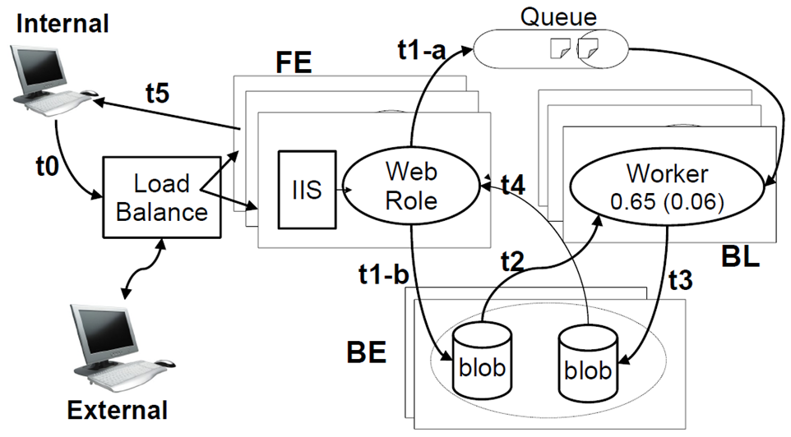
Experiments on cloud test-bed
Thumbnail example application
Two Azure data centers (DCs), represent local/remote
Internal users: hosts in campus close to internal DC
External users: Planetlab
Reengineer application for hybrid cloud deployment

Slide 22
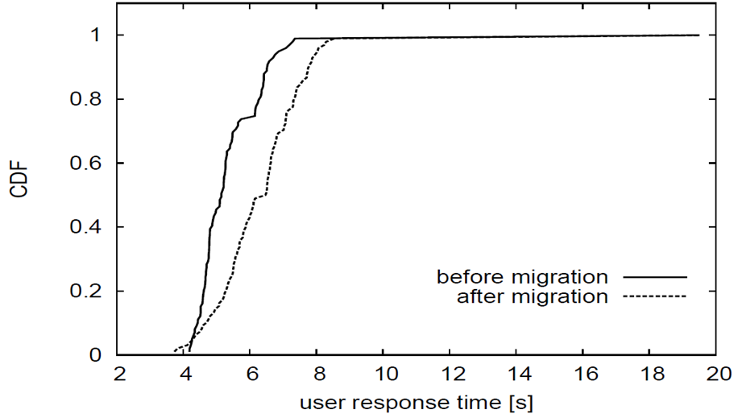
Results
Plan requirements: increase in mean delay less than 10%, increase in variance less than 50%
Algorithm Recommendation: Migrate 1 FE , 3 BL servers
Observed: 17% increase in mean, 12% increase in variance

Slide 23
Campus ERP application architecture
users
78% Internal 22% external
30%
30%
20%
FE₁
FE
10%
FE₂
5%
(3)
5%
(2)
30%
1%
20%
BL₁
BL₂
BL₃
BL₄
BL₅
BL
(7)
(3)
1%
(2)
(2)
(2)
59%
9%
22%
5%
5%
BE₁
BE₂
BE₃
BE₄
BE₅
BE
(1)
(1)
(1)
(1)
(1)
500GB
300GB
700GB
50GB
50GB

Slide 24
Recommendations from planned migration approach
 |  | Recommended components to migrate
Bound on increase in mean delay | Yearly Savings | FE | BL | BE
30% | $58K | migrate all components in full
15% | $38K | FE1(1),FE2 | BL1(1),BL2,BL3,BL4,BL5 | BE2,BE3,BE4,BE5
15% w/ policy | $14K | FE1(1) | BL1(2),BL2,BL4,BL5 | …
Hybrid clouds can achieve cost savings while meeting enterprise policies and delay bounds
See paper for sensitivity studies to benefit ratios

Slide 25

Migrating security policies: Evaluation
users
FE₁
FE₂
BL₂
BL₃
BL₄
BL₅
BL₁
BE₃
BE
BE₁
BE₂
BE₄
BE₅
Internet (INT)
a₁
a₁
R
R
Campus Core Network
R
R
a₂
R
a₂
R
a₃
R
a₃
R
a₄
R
a₅
R
a₇
R
FE₁
FE₂
BL₁
BL₂
BL₃
BL₄
BL₅
BE
Local Data Center

Slide 26
Migration scenario
a₁
Internet (INT)
a₁
R
R
Campus Core Network
R
R
a₂
R
a₂
R
R
R
R
R
R
a₃
a₃
a₄
a₅
a₇
FE₁
FE₂
BL₁
BL₂
BL₃
BL₄
BL₅
BE
Local Data Center

Slide 27




New ACL placement generated by our algorithms
Cloud
BL₁
BL₂
BL₄
r₁₂
r₁₃
BL₅
r₇
FE₁
r₁₀
r₉
r₁₁
r₈
R
r₁
Internet (INT)
r₁
r₂
r₂
Local Data
Center
R
Campus Core Network
R
R
R
R
R
R
R
R
r₃
r₃
r₄
r₄
r₅
r₆
FE₁
FE₂
BL₁
BL₃
BE
Other Evaluations:
Ensuring unauthorized traffic does not traverse the Internet
Scalability to large networks

Slide 28
Related Work
Recent works on partial application migration:
Teregowda et al, HotCloud 2010
Clouds for disaster recovery alone: Wood et al, HotCloud 2010
Economics of using clouds:
Armbrust et al, Berkeley Technical Report, 2009
Comparisons across providers: Li et al, HotCloud 2010
Security policies on migration to the cloud
Li et al, LADIS 2010
Other challenges with migrating enterprises
Wood et al, HotCloud 2009, …
Work from cloud provider perspective
E.g., Shieh et al (HotCloud2010), Lam et al (UCSD TR, 2010),..
Analytical models of multi-tier applications
Urgaonkar et al, Sigmetrics 2005

Slide 29
Conclusions
Hybrid cloud models often make sense
Enable cost savings, while meeting enterprise policies and
application response time requirements
Planned approach to migration important and feasible
Algorithms for hybrid cloud layouts
Algorithms for correct reconfiguration of security policies
Future Work
Exploring model complexity and performance inaccuracy
Wider range of application case studies
Take workload and network dynamics into account

