Slide 1


Transferable Neural WAN TE
for Changing Topologies
Abd AlRhman AlQiam¹, Yuanjun Yao², Zhaodong Wang², Satyajeet Singh Ahuja², Ying Zhang², Sanjay G. Rao¹, Bruno Ribeiro¹, Mohit Tawarmalani¹
1
2

Slide 2
Traditional Traffic Engineering Pipeline
45%
Input TMs
Capacities + Tunnels
4
C1
C1
Centralized
SDN Controller
1
C2
2
C2
3
Route traffic
C3
EBB Controller
SWAN, B4,
C3
5
Has a global view of the network
optimizes a network-wide objective (e.g., minimize link utilization)
It employs linear programming to route traffic
55%
Notes:
Traffic engineering pipeline takes as inputs a set of TMs (click), a set of capacities, and a set of predefined tunnels (click),
then those are fed to a centralized SDN controller. Common examples are (EBB controller, SWAN, and B4) (click).
This centralized controller has a global view of the network (click), optimizes a network-wide objective (something like minimize link utilization) (click) where it employs linear programming to route the traffic (click) (click).

Slide 3
Traditional Traffic Engineering Pipeline
45%
Input TMs
Capacities + Tunnels
4
C1
C1
LP Solver
1
C2
2
C2
3
Route traffic
C3
C3
Issues with this approach:
Input TMs don't fully capture actual TM (e.g., prediction error)
LP solvers can’t cope with prediction inaccuracies
Resulting in suboptimal routing
LP solvers do not scale to large topologies
5
55%
Notes:
(click) Using Linear Programming solvers in the SDN controller has two main drawbacks (click):
The first one is that input TMs don't fully capture actual TM due to prediction error, and
LP solvers can’t cope with prediction inaccuracies (click)
Eventually resulting in suboptimal routing (click)
2. The second problem is that LP solvers do not scale to large topologies (click)

Slide 4

Traditional Traffic Engineering Pipeline
Why ML-based TE?
45%
Input TMs
Capacities + Tunnels
4
$$⨉$$
C1
C1
LP Solver
Neural Model
1
C2
2
C2
3
Route traffic
C3
DOTE, NSDI 23
TEAL, SIGCOMM 23
C3
Issues with this approach:
Input TMs don't fully capture actual TM (e.g., prediction error)
LP solvers can’t cope with prediction inaccuracies
Resulting in suboptimal routing
LP solvers do not scale to large topologies
5
55%
Notes:
(click) (click)
So, recently, the community has shifted towards using neural models for routing.
For example, last year we saw DOTE and TEAL.
(click)

Slide 5
Why ML-based TE?
45%
30%
Input TMs
Capacities + Tunnels
4
C1
C1
LP Solver
Neural Model
1
C2
2
C2
3
Route traffic
C3
DOTE, NSDI 23
TEAL, SIGCOMM 23
C3
5
Can compensate for prediction error
Results in a better routing
Faster
Scale to large topologies
55%
70%
Notes:
Neural models can compensate for prediction errors yielding better routing (click) (click)
2. And they are also faster and can scale to large topologies.
(click)

Slide 6
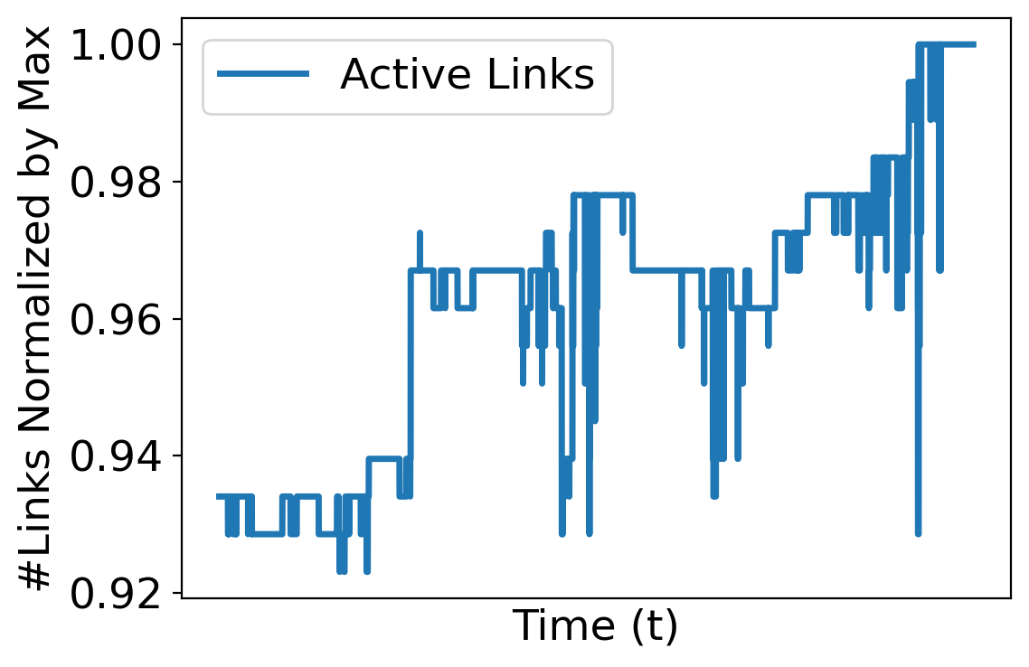
Challenges for ML-based TE
Networks evolve continuously
Organic growth
Maintenance
Failures
Existing neural TE schemes
Focus on fixed topologies and fixed set of tunnels
Do not generalize to topologies outside training set
Notes:
However, there are some challenges that neural models need to address.
(click)
For instance, networks evolve continuously due to multiple reasons including organic growth, planned maintenance, or unplanned failures… etc., (click)
For example, the figure on the right illustrates the variation in the number of links over time in a real cloud WAN network. It is evident that link failures and additions happen frequently. (click)
However, existing neural TE models focus on fixed topologies and fixed set of tunnels. (click)
Thus, they do not generalize to topologies outside training set. (click)

Slide 7
Contributions
HARP: First neural TE scheme that can handle changing topologies
HARP is transferable across topologies
Preserves key invariances to natural inputs transformations (e.g., reordering tunnels)
Neural architecture is aligned to the optimization model
HARP outperforms classical LP solvers:
5-13% lower average Maximum Link Utilization (MLU) based on traffic matrix predictor
100x faster on large topologies
HARP performs well even with topologies/failures outside training data
Close to optimal MLU in all cases
34% lower MLU than DOTE and TEAL on average
Notes:
For this, we propose HARP (click)
LP: Depending on traffic matrix predictor, HARP generates 5-13% lower MAXIMUM LINK UTILIZATION (MLU) on average.
HARP is 100x faster than Gurobi on large topologies
Neural: HARP performs well even with topologies/failures outside training data, it achieves close-to-optimal MLU in all cases.
Also, On average, it results in 34% lower MLU than state-of-the-art neural TE models like DOTE and TEAL

Slide 8
Why explicitly modeling topology is important?
DOTE (NSDI 23)
Fully connected neural network
Does not model capacities, tunnels..
Model cannot distinguish two scenarios where tunnels and capacities vary
For the same input TMs, DOTE generates the same routing regardless of tunnels and capacities
C3 > C1 > C2
30%
4
30%
4
C1
DOTE
Routing on fixed set of tunnels
C1
C1
C1
Fixed
size TMs
70%
1
C2
2
C2
3
1
C2
2
C2
3
C3
C3
C3
C3
5
5
70%
Notes:
To motivate the design of HARP and explain where existing neural models fall short, let us consider Why explicitly modeling topology is important? (click) And to answer this, let’s examine DOTE. (click)
DOTE is basically a fully connected NN that does not model capacities, tunnels, or topology. To be concrete, (click) it takes a fixed-size TMs as input, and generate routing on fixed set of tunnels. (click)
However, when tunnels or capacities change (click), routing generated by DOTE does not change. On the topology to the right, the upper tunnel should carry more traffic since C1 is greater than C2 (click). However, DOTE is not able to distinguish these two scenarios despite the change in tunnels and capacities. (click)
To be precise: For the same input TMs, DOTE generates the same routing regardless of tunnels and capacities used.
I refer to our paper to know more reasons why existing neural TE schemes fall short
(click)

Slide 9
Why preserving invariances is important?
Identical topologies except tunnel relabeling
Existing neural models do not guarantee identical routing in the two scenarios
Prerequisite to generalize to topologies unseen in training
4
30%
4
30%
#1
C1
#2
C1
C1
C1
1
C2
2
C2
3
1
C2
2
C2
3
C3
C3
C3
C3
5
5
#2
70%
#1
70%
Notes:
Another issue to consider is: why preserving invariances is important? (click)
If we look at these two topologies, we find them identical except that the tunnels are relabeled (click).
This relabeling has no effect on the routing. However, (click) existing neural models like DOTE and TEAL do not guarantee identical routing in the two scenarios. Please refer to our paper to know why.
(click) In fact, Preserving invariances is a prerequisite to generalize to topologies unseen in training. (click)

Slide 10
HARP Design Principles
Principle 1: Ensure invariances to input transformations
Node relabeling
Tunnel relabeling
Traffic matrix transpose
Principle 2: Aligning neural architecture to optimization model
Mimics the iterative nature of optimization algorithms
An example of the power of neural algorithmic reasoning*
Allow HARP to generalize to topologies beyond training.
* Beatrice Bevilacqua, Kyriacos Nikiforou, Borja Ibarz, Ioana Bica, Michela Paganini, Charles Blundell, Jovana Mitrovic, and Petar Veličković. Neural algorithmic reasoning with causal regularisation. ICML, 2023
Notes:
While designing HARP, we had two principles in mind:
(click)
talk
(click)
Talk
(click)
These two principles allow HARP to generalize to topologies beyond training

Slide 11
HARP Overview
HARP Design
Tunnels described as sets of edges
Set
Transformer
Topology
and
Capacities
GNN
Tunnel Embeddings
Modeling tunnels as sets of edges introduces an invariance to traffic matrix transpose
1) Model Topology
And
Capacities
2) Model Tunnels
3) Initial Routing Predictor
4) Iteratively improve the routing

Slide 12
HARP Design
Tunnel Embeddings
1) Model Topology
And
Capacities
2) Model Tunnels
3) Initial Routing Predictor
Notes:
initial routing prediction takes these tunnel embeddings and the input traffic matrices then feed them to a multi-layer perceptron

Slide 13
HARP Design
Input TMs
Network-wide MLU
Tunnel Embeddings
MLP
Initial Routing
RAU
RAU
Final
Routing
Highest link utilization in a tunnel
RAU: Recurrent Adjustment Unit, applied K times
1) Model Topology
And
Capacities
2) Model Tunnels
3) Initial Routing Predictor
4) Iteratively improve the routing

Slide 14
Experimental Setup
Datasets:
AnonNet: Data collected from real cloud WAN
GEANT: Public dataset
Abilene: Public dataset
KDL: Synthetic TMs
Baselines:
DOTE
TEAL
Gurobi (widely-used LP solver)
Schemes evaluated using ground-truth matrix unless otherwise mentioned
Notes:
We conducted experiments using four datasets.
HARP was compared to three baselines.
We note that schemes are evaluated………..

Slide 15
Topology changes in real-world cloud WAN
Topology and TM at 1 min intervals over a 4-week period.
Partitioned into 78 clusters
Within a cluster:
Tunnels fixed
Link capacities change (partial/full link failures)
250 unique link capacity configurations in some clusters
Across clusters:
Tunnels change
E.g., node/link addition
20% of the last cluster’s tunnels not present in the first cluster
Cluster 1
Cluster 2
Cluster 78
Time
Past work has only evaluated on static topologies
Notes:
But before we delve into the results and evaluation, it is essential to provide more details and characteristics of the AnonNet dataset.
AnonNet is collected over a 4-week period at 1 min interval where every snapshot has a topology and a traffic matrix. (click)
We partitioned the dataset into 78 clusters. (click)
TALK
(click)
TALK
(CLICK)
I emphasize that past work has only evaluated on static topologies

Slide 16
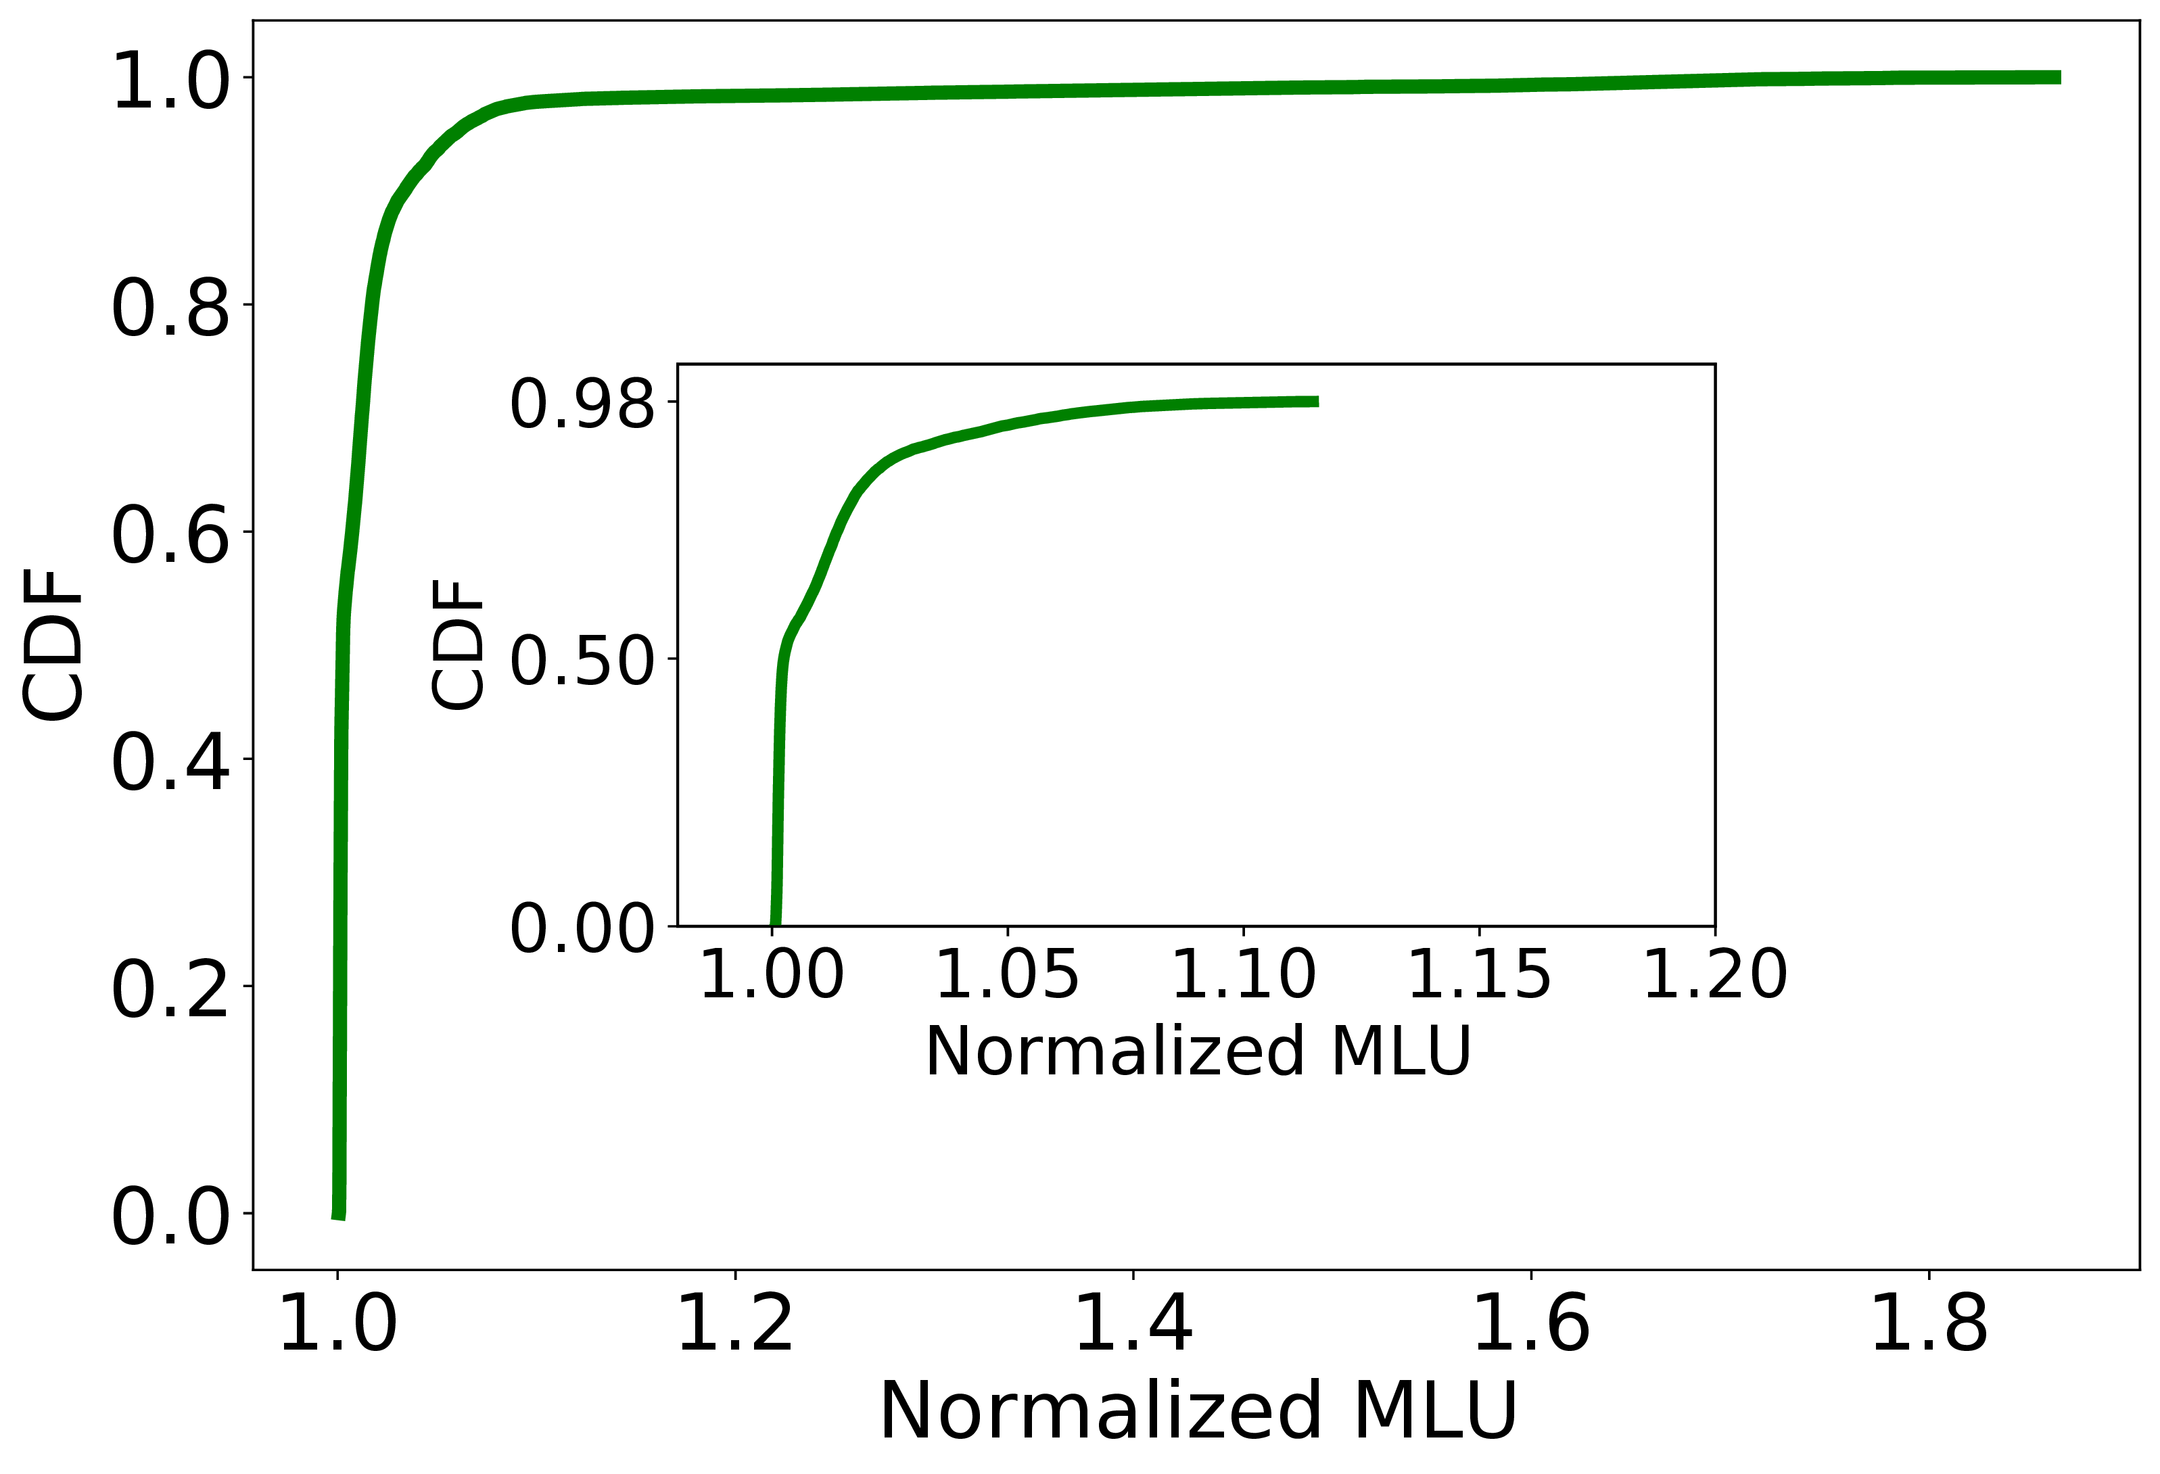
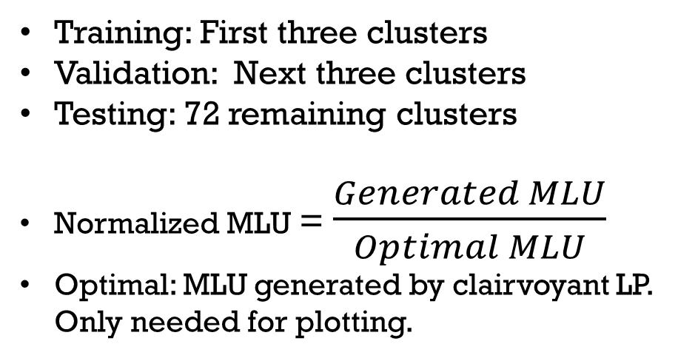
Can HARP work in dynamic environments?
Training: First three clusters
Validation: Next three clusters
Testing: 72 remaining clusters
Normalized MLU = $\frac{Generated MLU}{Optimal MLU}$
Optimal: MLU generated by clairvoyant LP. Only needed for plotting.
Better
HARP is within 12% of optimality 98% of the time despite
significant tunnel and topology changes outside training set
Notes:
To evaluate the ability of HARP to perform well in such dynamic conditions, we trained it on …………….
By Normalized MLU we mean generated/optimal, where optimal is only needed for plotting.

Slide 17
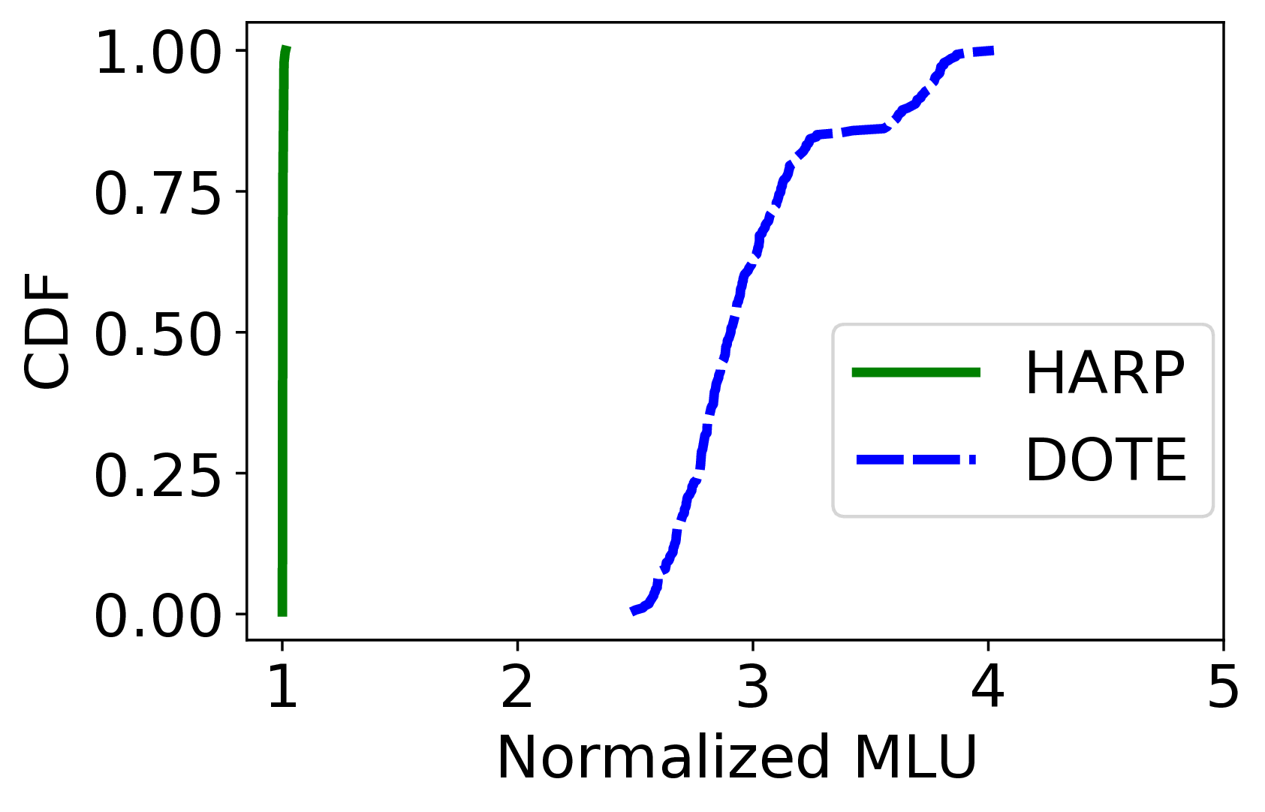
HARP vs DOTE
Train and test on same cluster
On average, HARP’s MLU is 3x lower
DOTE assumes static link capacities
Cannot handle partial/full link failures
Across clusters even more challenging
Notes:
Then, (click) we compare HARP to DOTE where we train and test on the same cluster.
We see that HARP generates significantly lower MLU than DOTE. (click)
On average, HARP’s MLU is 3 times lower than that of DOTE, and this is mainly because DOTE assumes …………………
Working with DOTE across clusters will be even more challenging.

Slide 18
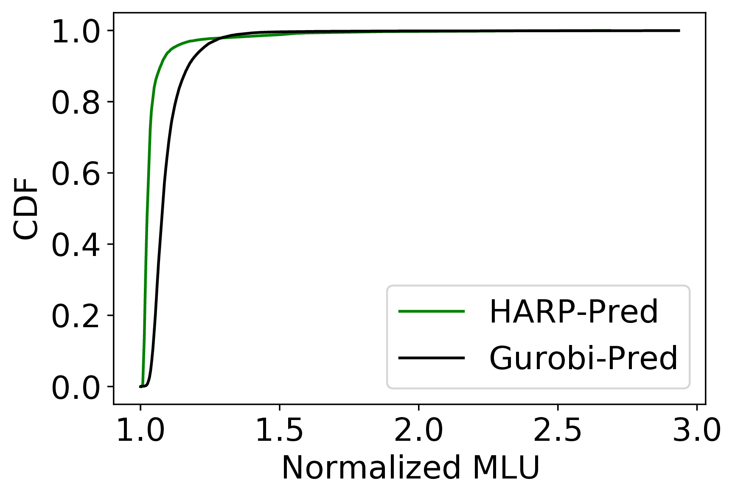
Can HARP work with inaccurate predictors?
When the predicted matrix is used, HARP outperforms LP solvers by 9% on the 80% percentile.
Benefits with other predictors are even higher. See paper.
HARP learns to be robust to prediction errors.
Notes:
After that, we examine the ability of HARP to compensate for prediction errors. We compare HARP to Gurobi on the predicted matrix. (click)
HARP outperforms Gurobi (click) by 9% on the 80%th percentile.
(click) Benefits are even higher with other predictors as we show in our paper. (click)
We hypothesize that HARP learns to be robust to prediction errors.

Slide 19
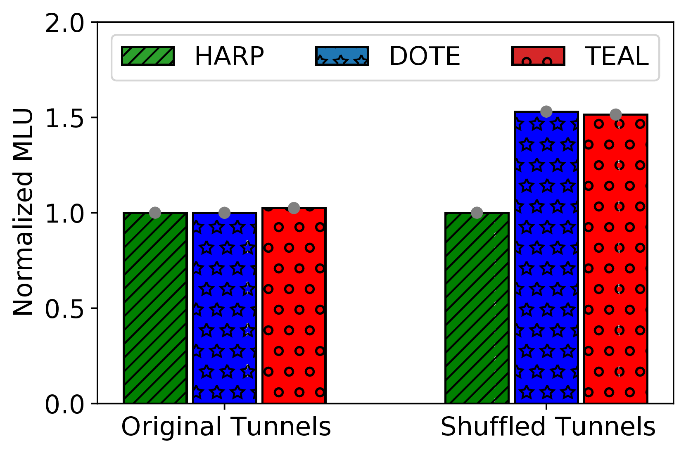
Preserving invariances with HARP
When tunnels in testing are shuffled relative to training:
HARP retains its performance
DOTE and TEAL generate 1.5x MLU
Better
Unshuffled Tunnels
Shuffled Tunnels
Tested on
Notes:
We then demonstrate one of HARP’s invariances to input transformations.
HARP, DOTE and TEAL were trained on a given set of tunnels, then two experiments were conducted in testing-mode.
In the first experiment, we used the same tunnels in the same order (click) and as we see, all models perform well
In the second experiment, we used the same training tunnels but in different order (click) Ideally, this reordering, should not make a difference. However, only HARP retains its performance (click), while DOTE and TEAL generate 1.5 times higher MLU.

Slide 20
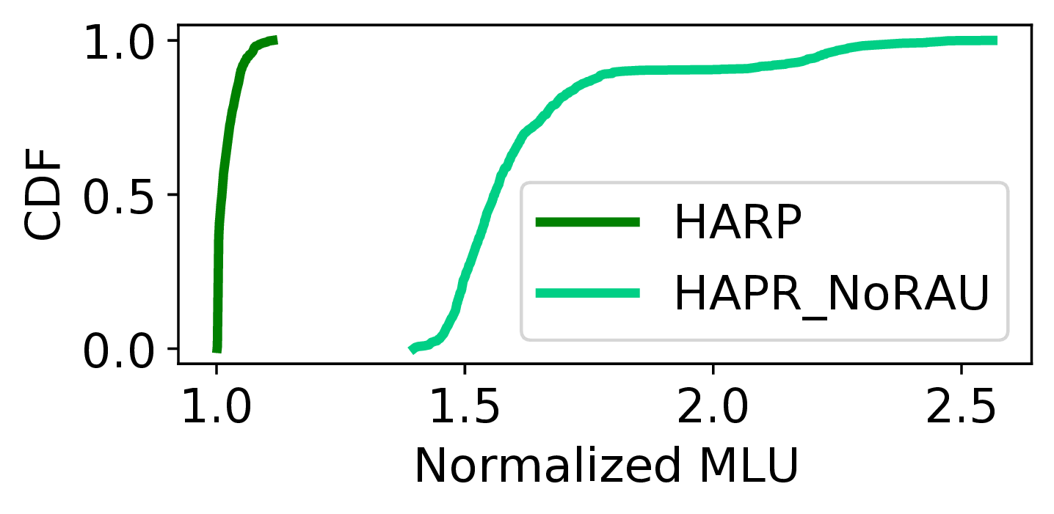
Importance of the aligned architecture
On average, HARP’s MLU is 1.6x lower than that of HARP_NoRAU
Notes:
Finally, we compare HARP to another version without the recurrent unit to showcase the importance of aligning the architecture to the optimization algorithms.
As we see, HARP make significant improvement due to the presence of the recurrent adjustment unit. (click)
On average, ………………………….

Slide 21
Other Experiments
HARP’s ability to handle failures outside training set
Full-link failures
Partial-link failures
Computation times
Notes:
Please refer to our paper to see different set of experiments where we show HARP’s ability to handle failures outside training set. We conducted experiments with full-link failures and partial-link failures.
We also presented computation times.

Slide 22
Conclusion
HARP: First neural TE scheme that can handle changing topologies
HARP is transferable across topologies
Preserves key invariances to natural inputs transformations (e.g., reordering tunnels)
Neural architecture is aligned to the optimization model
HARP outperforms classical LP solvers:
5-13% lower average MLU based on traffic matrix predictor
100x faster on large topologies
HARP performs well even with topologies/failures outside training data
Close to optimal MLU in all cases
34% lower MLU than DOTE and TEAL on average
We released HARP’s source code
https://github.com/Purdue-ISL/HARP

Slide 25
HARP Design
Network-wide MLU
RAU
Highest link utilization in a tunnel
Network-wide MLU == Highest link utilization in a tunnel ?
Reduce traffic allocation for this path
Increase traffic allocation for this path
Yes?
No?

Slide 26
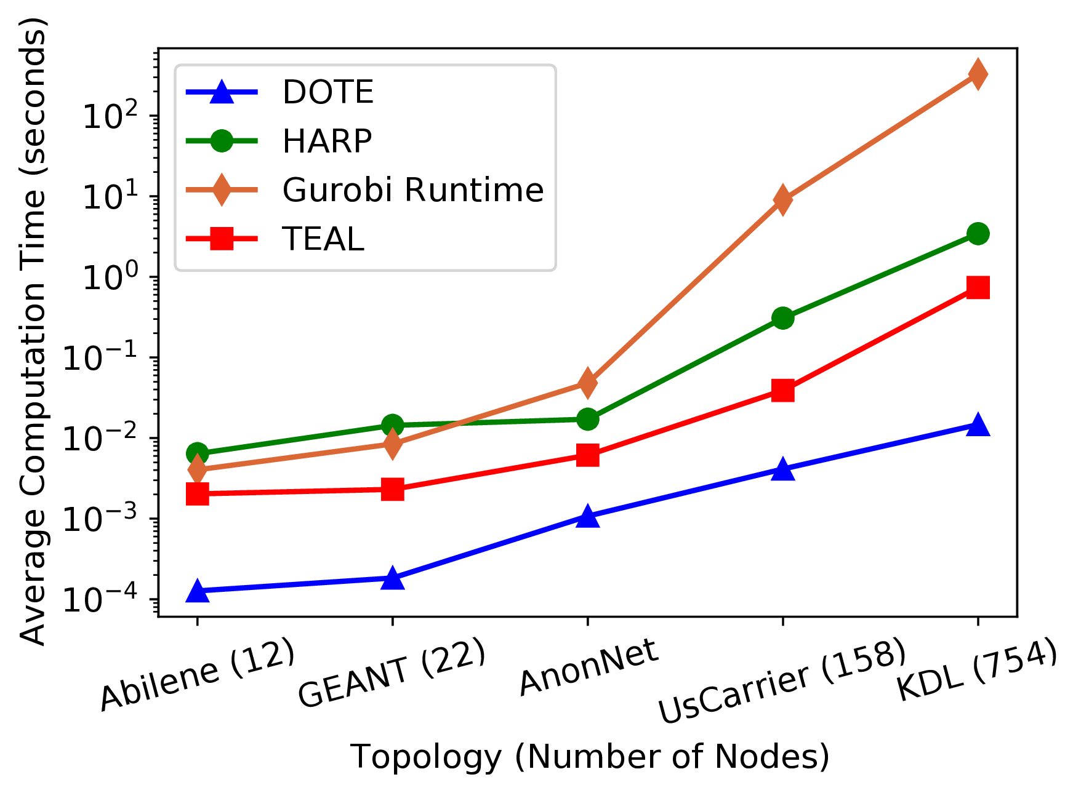
Evaluation: Computation Times

Slide 27
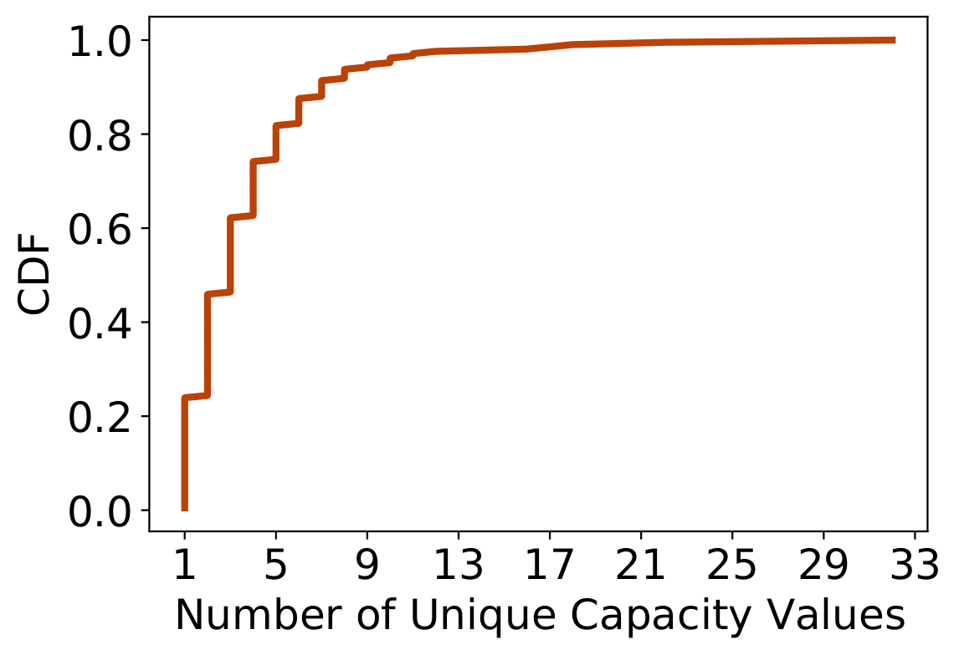
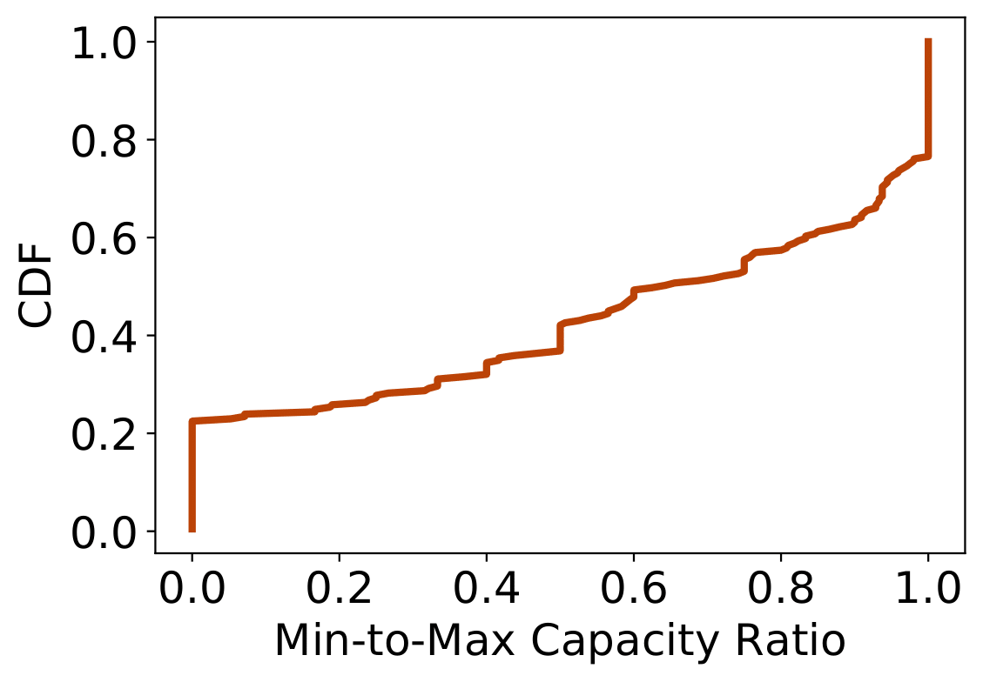
Do Topologies Change Across Time? Real-world case
What about link capacities? Do they witness any changes across time?
Notes:
- Across the entire dataset, around 60% of links witness 4 different unique capacity values or more.
- Across the entire dataset, around 60% of links witness a min-to-max ratio of 0.8 or less.
- F: Too detailed. If needed, you can view it.

Slide 28
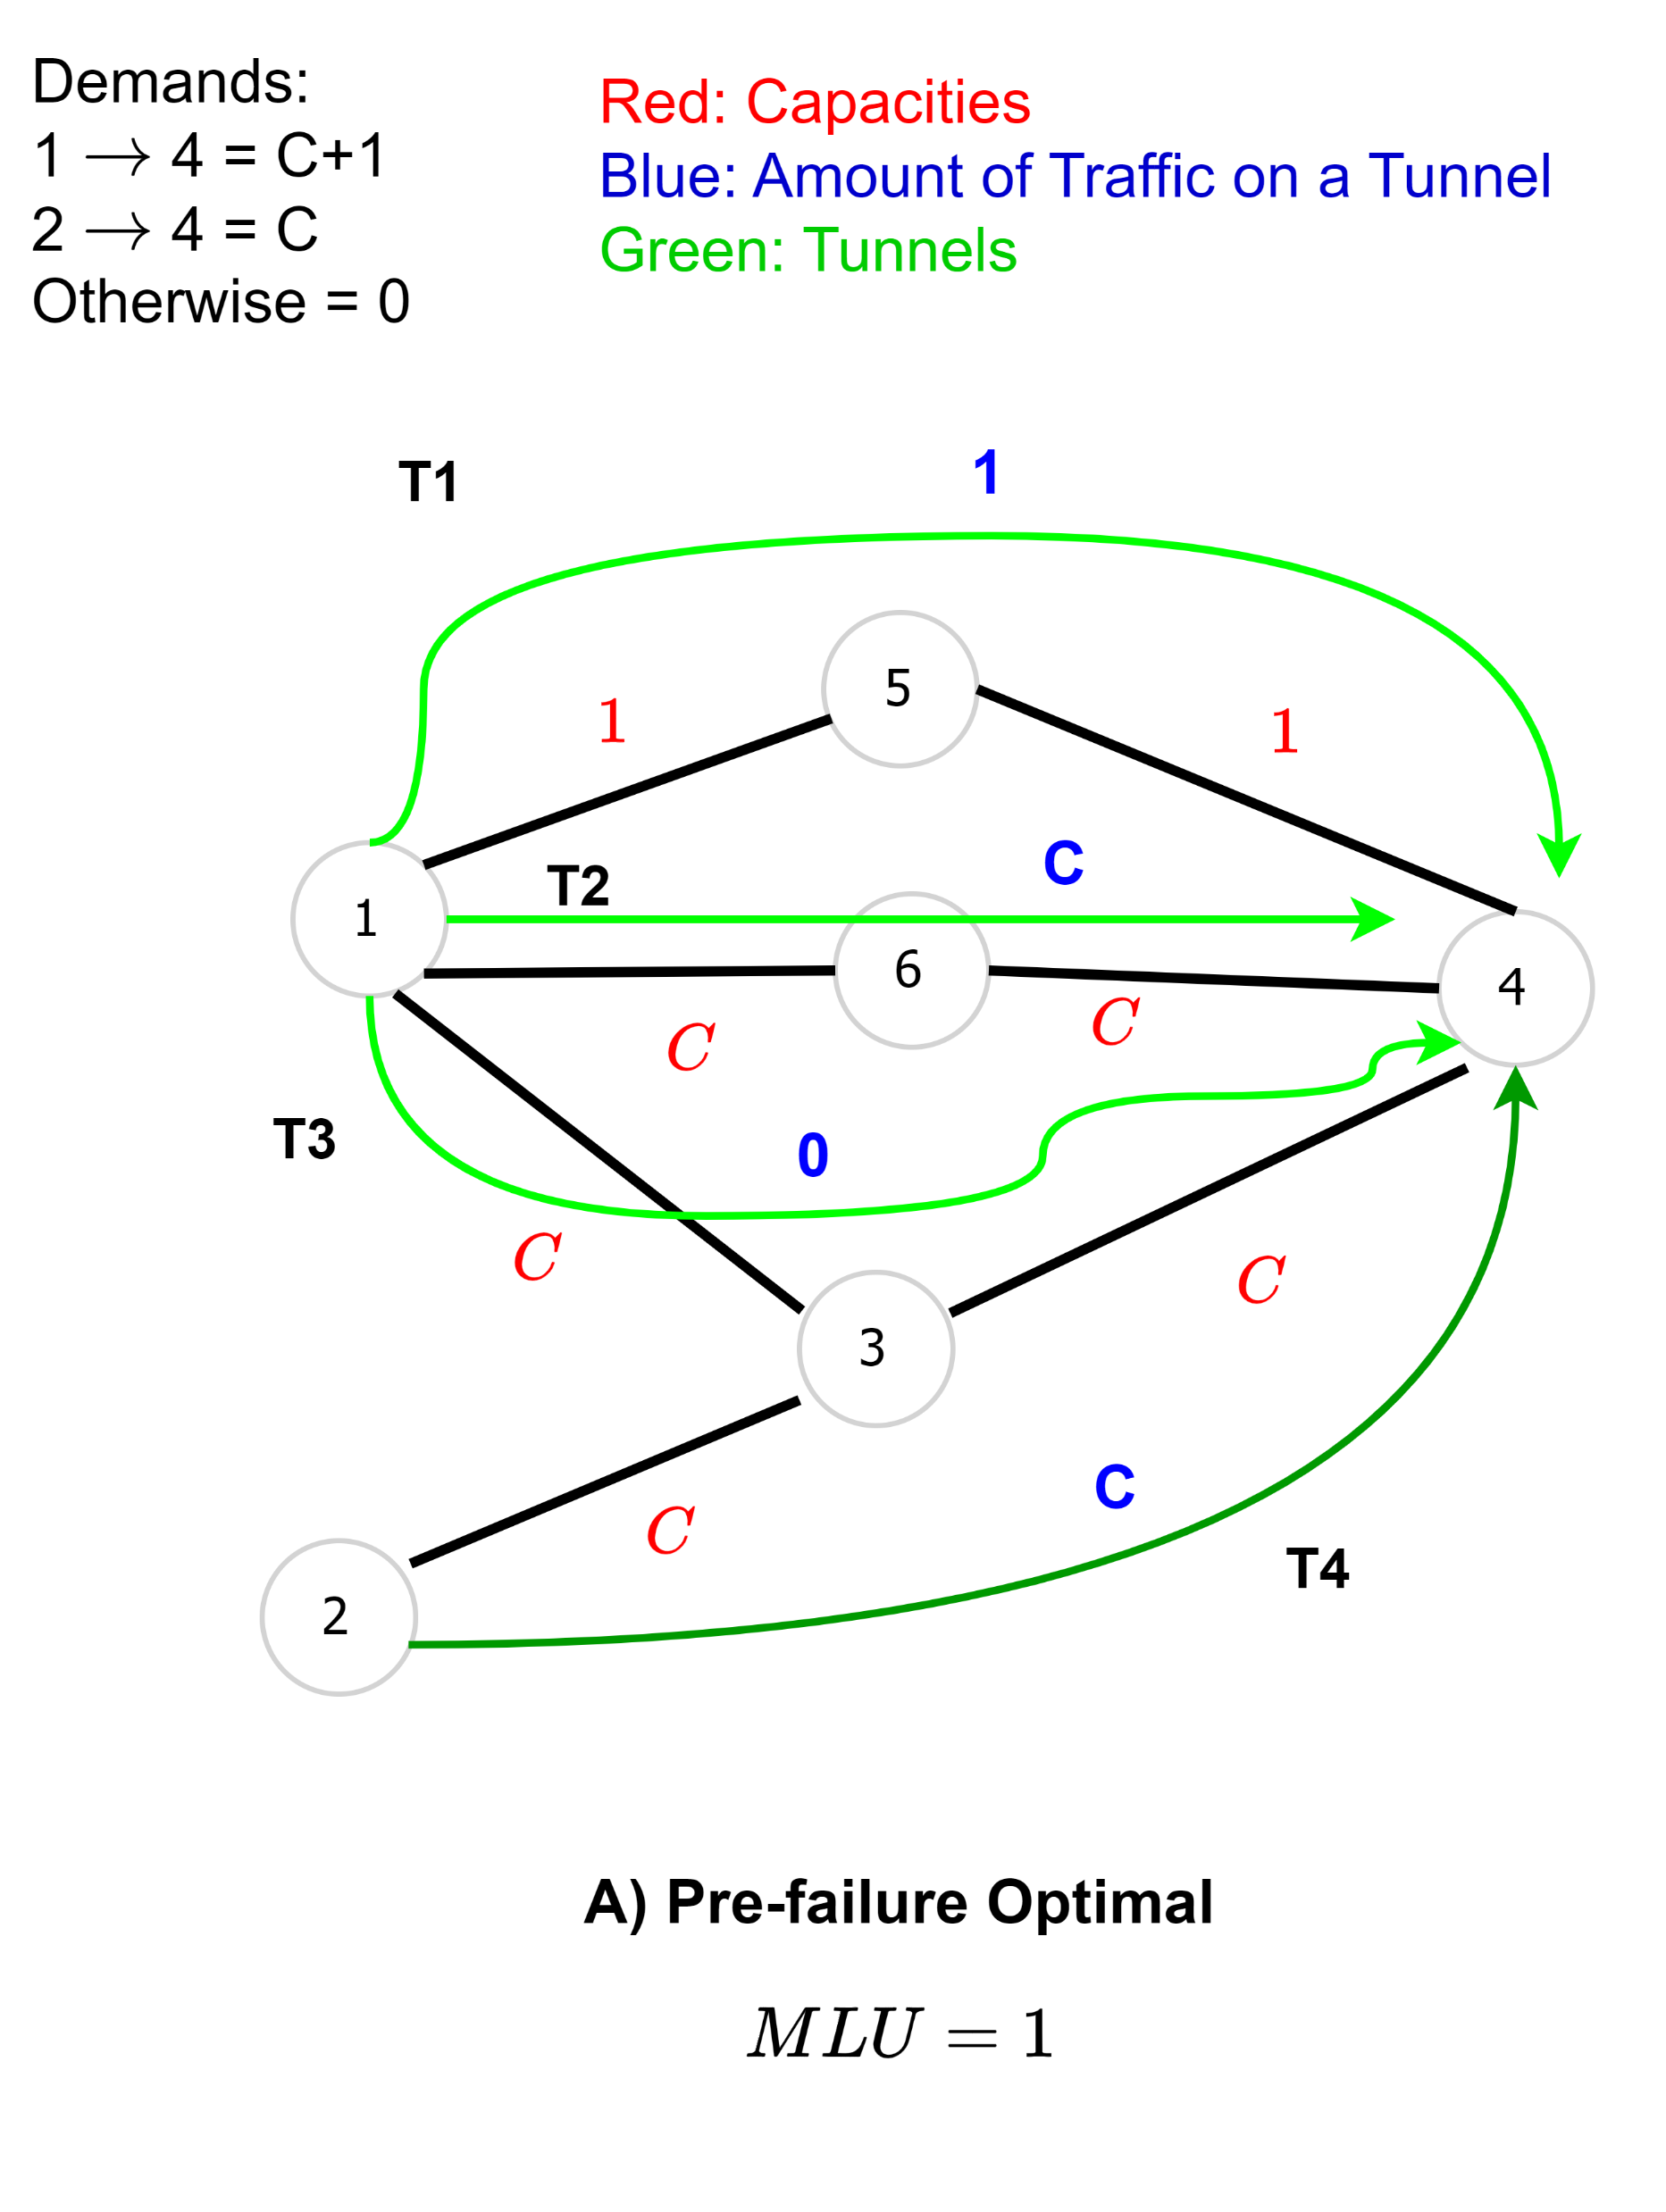
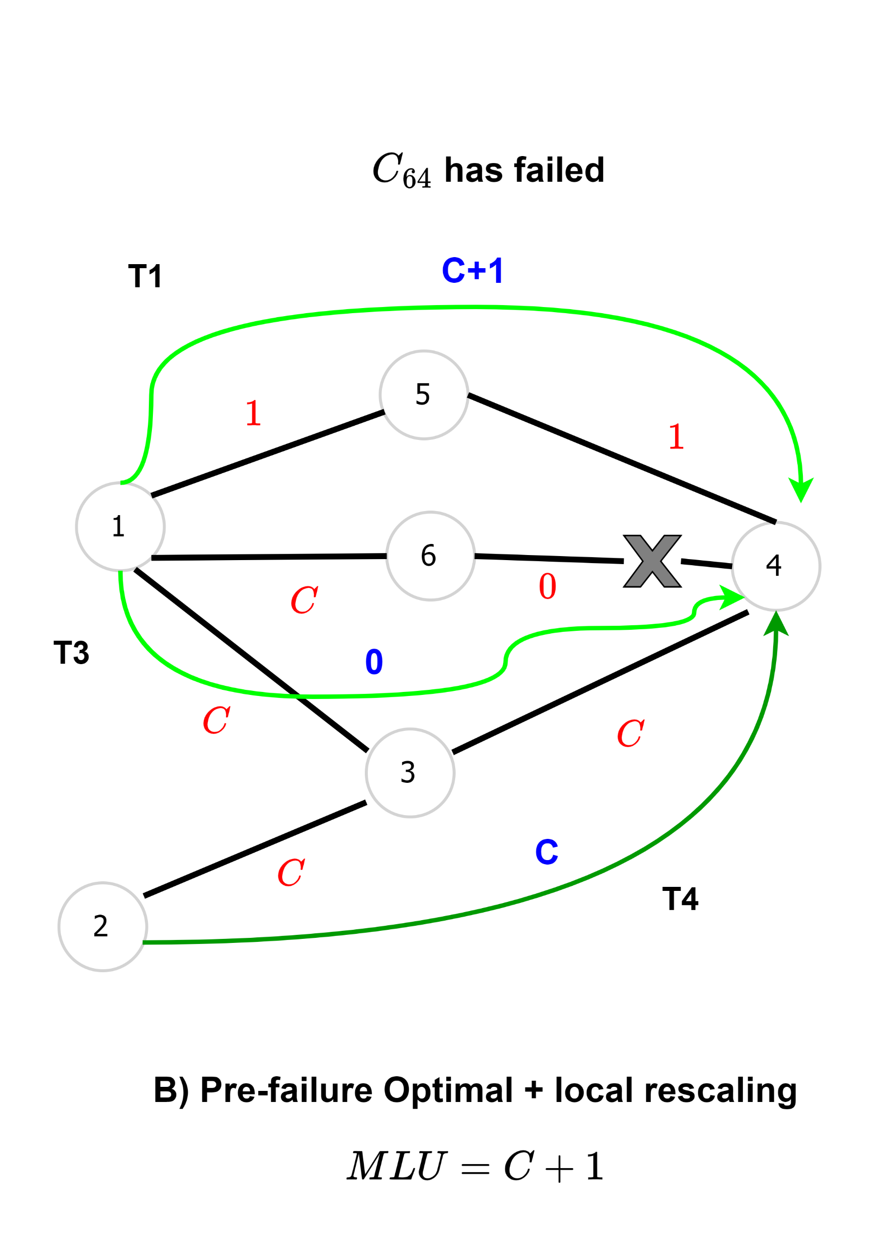
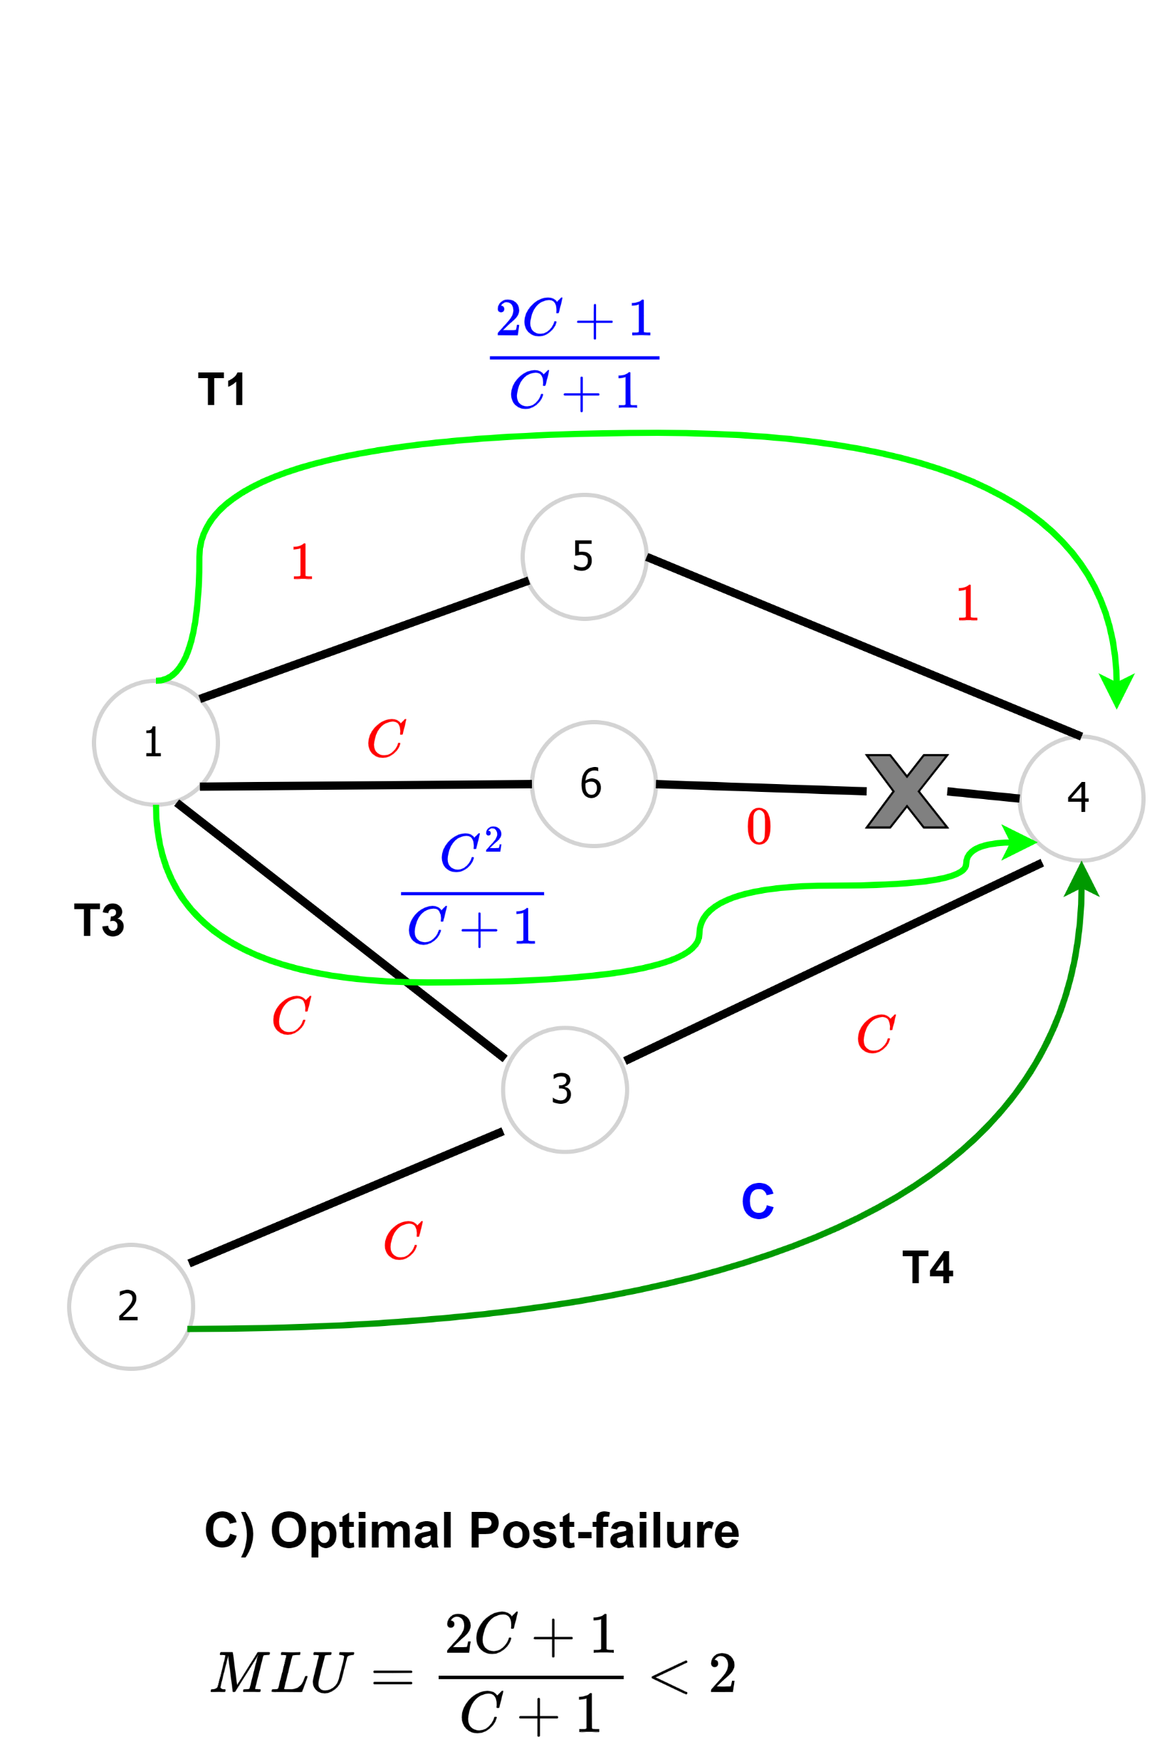
Neural TE Solutions: A Very simple topology perturbation

