Slide 1

Enabling Confidentiality of Data Delivery in an Overlay Broadcasting System
Ruben Torres, Xin Sun, Aaron Walters, Cristina Nita-Rotaru and Sanjay Rao
Notes:
Good Afternoon, my name is Ruben Torres and I will be presenting this work, done in collaboration with XS, AW, CNT and SR at Purdue University

Slide 2
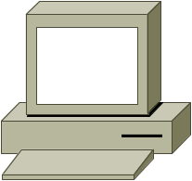
Introduction
Overlay multicast, replacement for IP multicast
  Real deployments: Tmesh, CoolStreaming, ESM
  Commercial systems: PPLive, TVU
Multicast group: source (A) and members (B,C,D)
A
C
A
C
R1
R2
R1
R2
B
D
B
D
IP multicast
Overlay multicast
Notes:
In recent years, overlay multicast has emerge as a mature replacement for IP Multicast.
The difference between IP multicast and overlay multicast is that IP multicast requires special support from routers but Overlay multicast does not.
Applications like peer to peer video streaming have matured through real deployments and Commercial Systems.

Slide 3
Data Confidentiality in Overlays
Further usage of overlays requires integrating security mechanisms for data confidentiality
Security mechanisms efficiently provided with symmetric encryption
  Group key shared by all members to encrypt data
  Group key management protocols to establish and manage the group key.
Notes:
Now that Overlay multicast architectures have been validated, new features can be incorporated such as security mechanisms. In particular, achieving confidentiality and integrity of data.
Security mechanisms can be efficiently provided by symmetric encryption, which requires a group key to be shared by all members of the group and used to encrypt the data. This group key is managed by group key management protocols.

Slide 4
New Opportunities in Overlays
Group key management extensively studied with IP multicast
New opportunities and challenges for group key management with overlay networks
  Richer design space on constructing structures for data and keys delivery
    Coupling data and keys delivery in one overlay
    Decoupling data and keys delivery using two overlays
  Opportunities to simplify resilient key delivery
Notes:
Group key management has been widely studied in the context of IP Multicast.
We focus in new challenges and opportunities using overlays.
- In IP Multicast, there is a native multicast medium to distribute data and keys. In contrast overlay multicast offers a richer space to distribute data and keys. For example, we could have coupled structures where data and keys are disseminated over the same overlay, or we could have decoupled architectures, where data ad keys go through distinct overlays.
- Also, as we will show later, overlay multicast offers new opportunities to simplify resilient key delivery.

Slide 5
Key Contributions of this Paper
One of the first studies on key dissemination using overlays
Show overlays can simplify resilient key dissemination
  Per-hop reliability is effective in achieving end to end resiliency
Show decoupled out-performs coupled approaches
  Decoupled: data and keys delivered in separate overlays
  Good application performance and low overhead
Distinguished work in evaluation under real Internet environments and real workloads

Slide 6

System Model and Assumptions
Single source
Tree based delivery
Bandwidth intensive applications
Access bandwidth limitation
  DSL ~ Kbps
  Ethernet ~ Mbps
Outsider attack
A/V signal
S
source
Group members
A
Ethernet
D
B
DSL
C
DSL
E
F
Data delivery tree
Notes:
We focus on single source applications
Group members form a tree optimized for efficient data distribution, with parent-child relationships between nodes.
Parent forward data to children and children receive data from parents.
We concentrate on Bandwidth intensive applications with source rate in the order of hundreds of kbps.
We node maintains a bandwidth limitation depending on the access bandwidth of the node, that will define how many children a node can sustain in the tree.
We consider outsider attacks. Members of the group are trusted.

Slide 7
Background
Group key shared by all members to encrypt data and restrict access only to authorized users
  Key changes with joins and leaves in the group
Two approaches to change keys
  Every event (join or leave)
  Batching events, better performance
This paper employs LKH [Wong00] and batching
  LKH is pioneering work and widely studied
Notes:
Secret key allows access to data and when nodes leave the group, the key needs to be change.
We change the key because the key is the one restricts the access only to authorized users. Once the group changes, the key have to be change.
There are two ways to do it, one is doing it per event or for better performance batch the events.
LKH is a protocol that efficiently manages manage the group key.
Use variant of LKH that employs batching. Key changes periodically instead of every join/leave

Slide 8
Considerations on Keys Delivery
Key messages are sensitive to loss
  Losing data packets: tolerable
  Losing keys: dramatic impact in application performance
Key traffic can be bursty
  High key traffic at rekey event could compete with data traffic for large groups
Keys messages needed by subset of members
  Group key management artifact
Notes:
Important considerations on keys dissemination that will drive our evaluation are:
- Key messages are more sensitive than data messages. Losing a key message can be more harmful than loosing a couple of data packets.
- Key traffic can be bursty at the rekey event. Depending on the number of changes in the group, keys traffic could increase to compete with data traffic.

Slide 9
Resilient Key Dissemination Schemes
Extensively studied with IP Multicast (hard problem)
Unique opportunity in overlays
  Use per-hop reliable protocols (e.g. TCP)
  Explore effectiveness of per-hop reliability in end to end reliability:
    Real join/leave patterns
    Real workloads
TCP
TCP
end to end
TCP
TCP
Data delivery tree
Notes:
Extensively study in the context of IP Multicast. Reliability in IP multicast has proven to be a difficult problem.
Overlays offer a unique opportunity of per hop reliability, by using reliable protocols such as TCP, on the communication link between two nodes in the data delivery tree. This does not guarantee end to end reliability since nodes in the middle could leave the group or fail before forwarding the keys.
But we will evaluate the effectiveness of per-hop reliability in real internet environments.

Slide 10
Architectures for Key Dissemination
Data and keys traffic have different properties
Explore design space to distribute data and keys:
  Coupled Data Optimized – One overlay optimized for data delivery
  Coupled Key Optimized – One overlay optimized for key delivery [Zhang05]
  Decoupled – Two overlays, one for data and one for keys
Notes:
From the system perspective, data and keys have different properties. Therefore, we explore three different ways to disseminate data and keys.
As mentioned before, key traffic can be bursty. To study overhead reduction schemes, we evaluate three ways to disseminate data and keys.
- Coupled Data Optimized, where one overlay optimized for data delivery, is used for data and keys. This is the simplest solution since we assume there is a data delivery overlay already in place.
- Coupled Key optimized, where one overlay optimized for key delivery, is used for data and keys. This approach was proposed by Zhang et al.
- Finally, we will explore the decoupled approach, where data and keys are sent through two different overlays

Slide 11

Coupled Data Optimized
Keys needed by subset of nodes
+ Simple
+ Good application performance
- Can incur high unnecessary overheads
s
s
u1
kA
u3
u4
u1
u4
u2
u3
u2
u1
u2
u3
kB
u4
Coupled Data Optimized
Coupled Key Optimized [Zhang05]
Notes:
In coupled data optimized, one overlay optimized for data delivery is used to deliver keys. This is the simplest design since the overlay structure for data delivery is already in place. It can achieve good application performance. The drawback is that it does not exploit the fact that certain keys are only needed by a subset of the nodes. Then, all nodes in the group will receive all key messages weather they need them or not, incurring in high unnecessary overhead. In this example, users u1 and u2 need kA and users u3 and u4 need kB, but all nodes get all keys.
On the other hand, in Coupled key optimized, the delivery tree is carefully constructed to take advantage of this fact. This same tree is then used to deliver data. Therefore the overhead due to key traffic is kept low. In this example, users u1 and u2 are in same subtree and will only receive key kA.

Slide 12
Coupled Key Optimized
Not feasible in heterogeneous scenarios (Ethernet, DSL)
Keys needed by subset of nodes
s
u1
DSL
kA
DSL
u2
u3
u1
u3
Ethernet
u2
u4
kB
disconnected
u4
Ethernet
Coupled Key Optimized [Zhang05]
Notes:
But we claim that Coupled key optimized for data delivery is not feasible under real internet environments where nodes have different bandwidth capabilities. Consider the following example where users u1 and u2 are behind a DSL connection and u3 and u4 are behind an Ethernet connections. Further assume that DSL nodes can support cero children and Ethernet nodes can support many children. In the tree constructed with coupled key optimized for the previous example, u2 will be disconnected from the tree.

Slide 13
Decoupled
+ Good application performance
+ Reduce key dissemination overhead
- Two structures have to be maintained
Compare:
  Cost of maintaining two structures in Decoupled
  Benefit of reducing key dissemination overhead
Notes:
Now we want to explore a scheme that can have good application performance and low overhead. In decoupled, we will use two overlays one for data and one for keys delivery. The drawback is that there are two overlay structures to be maintained.
Therefore, we want to evaluate if the overhead of maintaining two structures out-weights the keys overhead in Coupled Data Optimized.

Slide 14
Evaluation Methodology
Evaluation conducted with ESM broadcasting system [Chu04]
Planetlab experiments
Streaming video rate of 420Kbps [Chu04]
Traces from operational deployments to represent group dynamics
Event | Degree 0 or 1 | Degree 6 | Peak Group Size | Joins | Leaves
Rally | 37% | 12% | 252 | 148 | 149
Competition | 54% | 7% | 116 | 110 | 75
Portal | 65% | 35% | 107 | 184 | 179
Conference1 | 33% | 67% | 42 | 8 | 9
Conference2 | 62% | 38% | 62 | 71 | 63
Notes:
Observe in all the traces, significant heterogeneity (this two columns show distribution) and this two columns show join/leave in 20 minutes segment and this can have significant churn.

Slide 15
Evaluation Goals
Resilient key dissemination:
  Effectiveness of per-hop TCP in end to end reliability
    Real join/leave patterns
    Real workloads
Comparison of architectures:
  Coupled Data Optimized
  Coupled Key Optimized
  Decoupled

Slide 16

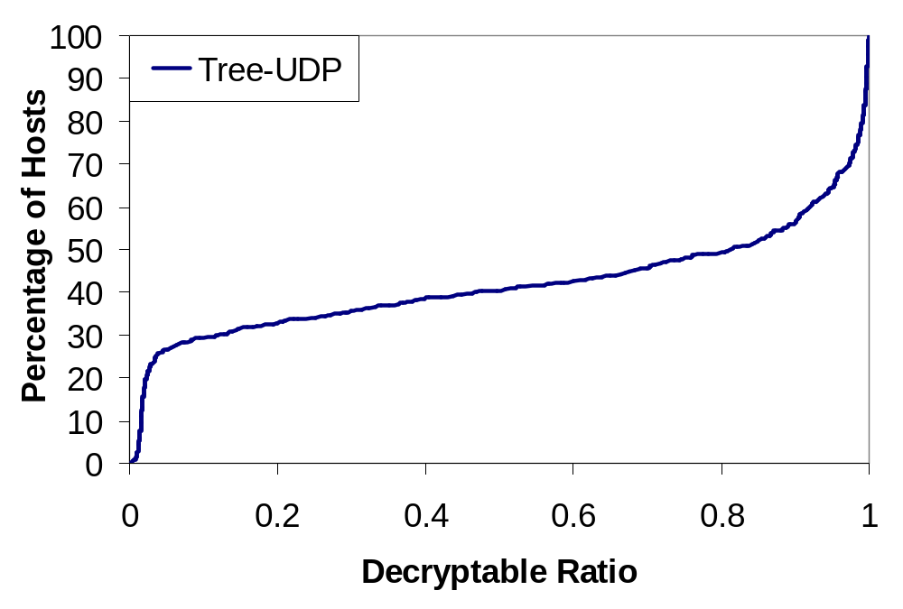
Decryptable Ratio
Coupled Data Optimized
better
Notes:
We measure performance with the Decryptable Ratio. This is the ratio of data received that can be decrypted by the total data received. A DR of 1 for a node means that the node was able to decrypt all data it received. This graph is a cumulative distribution of hosts and DR. In the X axis we have DR and Y axis percentage of hosts. The more close the curve is to the bottom right of the graph, the better. We take a point x,y in this example, means 50% of the hosts can decrypt at most 80% of the data. In this case we us UDP (which is an unreliable transport protocol) as the transport protocol for keys, for comparison.

Slide 17
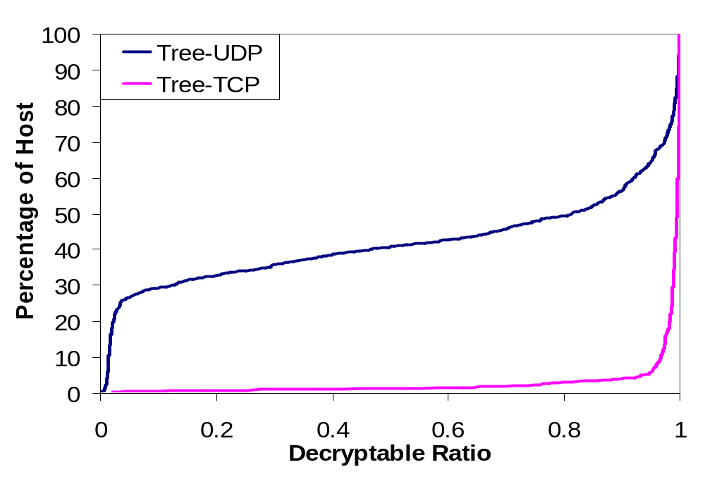
Per-hop TCP
better
Tail
Expected: per-hop reliability improves performance
Surprising: it is close to perfect

Slide 18
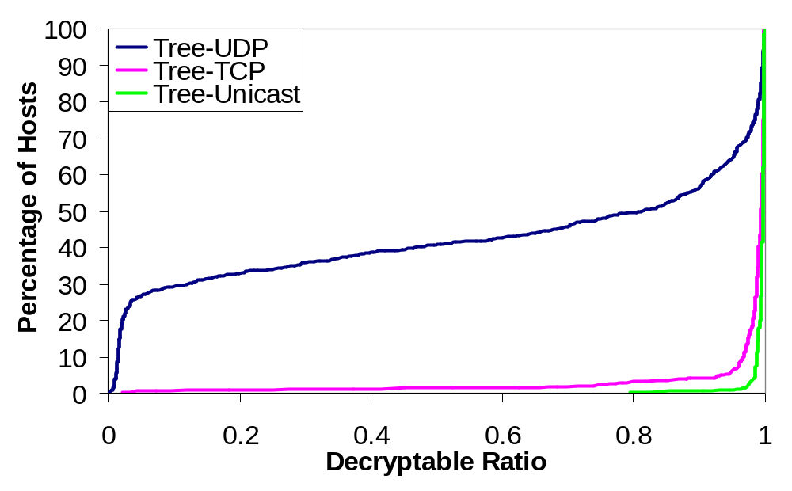
Tree-Unicast
Proposed in our paper
Considers overlay convergence
tail

Slide 19
Coupled Data Optimized in Various Regimes
Similar results obtained in different scenarios:
  Sensitivity to various real traces
  Burst departures
  Ungraceful departures
  Sensitivity to overlay node bandwidth limitation
  Synthetic traces for join-leave dynamics
Notes:
We exercised this scheme in a variety of scenarios obtaining good results in all of them. One possible scenario where this scheme could be affected is insider attack, where member of the group could drop keys arbitrarily.
One potential limitation is insiders attack, where insiders may drop keys.

Slide 20
Comparison of Architectures
Scheme | Performance | Key dissemination overhead | Overlay maintenance overhead
Coupled Data Optimized | Good | ? Data optimized | ? One structure
Coupled Key Optimized [Zhang05] | Infeasible | --- | ---
Decoupled | Good | ? Key optimized | ? Two structures

Slide 21
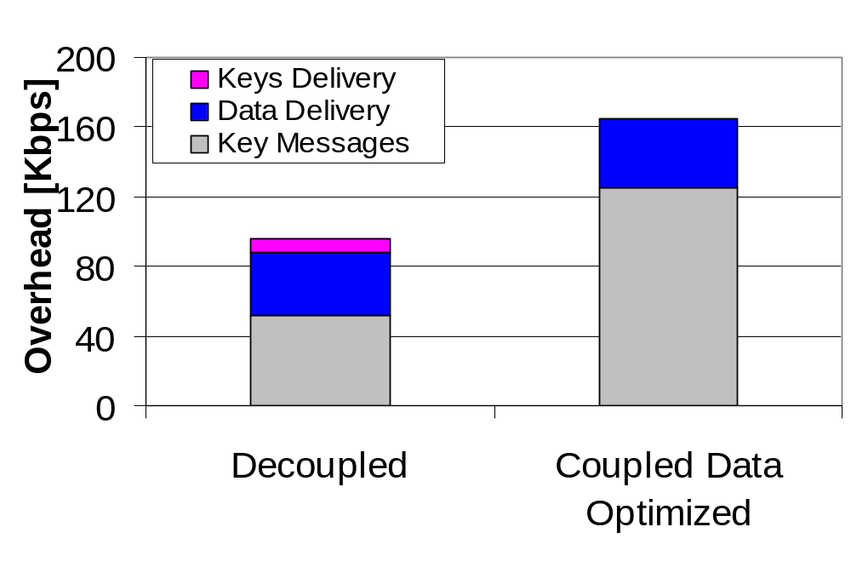
Peak Overheads
better
Overall peak overhead reduced
Overhead of maintaining two structures is low
Notes:
We now evaluate the decoupled approach. Here we compare peak overhead for decoupled against the peak overhead for Coupled Data Optimized. The grey section of the bars is the overhead due to key messages. The blue section is the overhead due to maintaining the data delivery structure and the Pink section is the overhead due to maintaining the key delivery structure. Two observations are that the overall peak overhead is reduced by reducing the number of key messages that need to be distributed. And the Overhead of maintaining two structures is low. So it is worthwhile to do decoupled.

Slide 22
Summary
One of the first studies on key dissemination using overlays
Show overlays can simplify resilient key dissemination
  Per-hop reliability is effective in achieving end to end resiliency
Show decoupled out-performs coupled approaches
  Data and keys delivered in separate overlays
  Good application performance and low overhead
Distinguished work in evaluation under real Internet environments and real workloads

Slide 23
Thanks! Questions?
rtorresg@purdue.edu

Slide 24
Backup Slides

Slide 25
Applicable to Mesh or Multi-tree
Overhead
  Independent of using multi-tree, mesh or tree
  Could create a structure specialized for key distribution on top of the mesh
Performance
  Better since mesh and multi-trees are more redundant structures

Slide 26
Rekey period 60 seconds
Batching scheme more useful if changes in the group are small.
If rekey period is too small, higher avg. overhead
If too long, large portion of group changes, which can degrade batching scheme

Slide 27
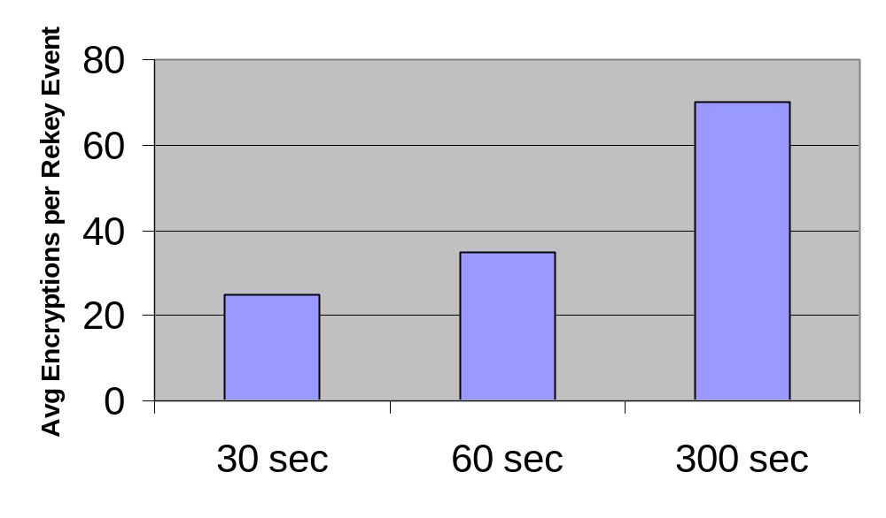
Why 60 seconds? - Computation Overhead
Marking performs better for small rekey intervals.
For larger rekey intervals, the number of encryptions increase by group dynamics

Slide 28
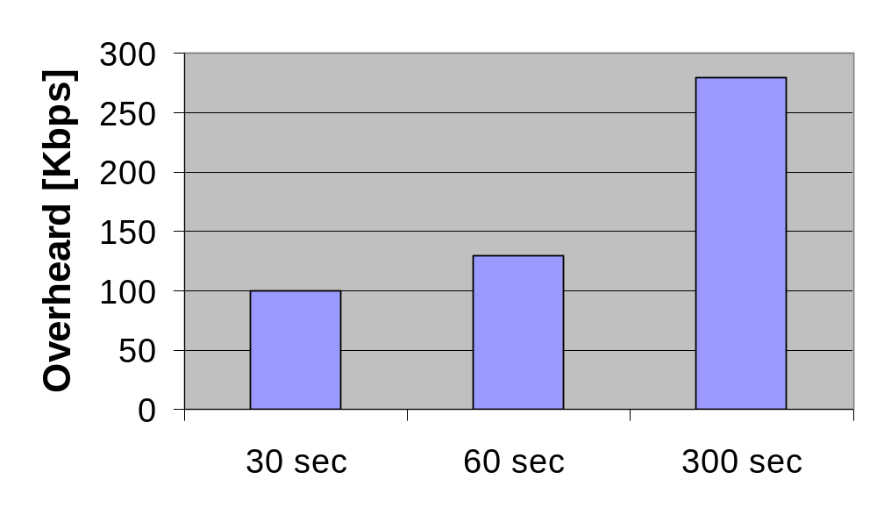
Why 60 seconds? - Peak Overheads
On average, overhead is low, but there are peaks
These overheads are not sustained. They only occur at the rekey event, which take less than one second

Slide 29
Why Per-hop Reliability so Effective?
Performed wide number of experiments changing degree, leave model, join/leave pattern
Much of these workloads don't seem to expose problems.
Factors that mitigate this:
  A failure very close to the rekey event (60 seconds rekey period). The odds of this happening are small.
  The node that leaves must have children
  There is still a tail where certain nodes show some impact.
we think simple heuristic could improve scheme further

Slide 30
Churn
Trace | Stay Time – Median (minutes)
Conference1 | 11
Conference2 | 2
Portal | 3
We also used several synthetic traces to experiment with higher churns
  Tree-Unicast performed well under such scenarios

Slide 31
Scaling
There are two aspects with scaling
  Application performance won't be affected
  For overhead, the benefits of decoupled might become more significant.
That said, enabling confidentiality itself can cause higher overhead.

Slide 32
Tree-Unicast - details
Join account for larger fraction of the cases and it is easy to handle.
For leaves, a similar heuristic can be done.
  More involved solution (node leaving could have children)

Slide 33
Is DR good but raw data degrades when nodes die?
Impact in transient performance
overall average performance remains good
  Time a node takes to reconnect is short (5secs)
It could show up if:
  Departure happen just before rekey period,
  Node cannot reconnect before the next rekey event
  Node have children
A few of this events occurred and account for the tail.
Further improvements with simple heuristics (caching)

Slide 34
Node 001 leaves
msg1 = { {group_key}₀, {0}₀₀, {0}₀₁, {0}₀₂, {00}₀₀₀, {00}₀₀₂ } | forward_level = 1
msg2 = { {group_key}₁} | forward_level = 1
msg3 = { {group_key}₂} | forward_level = 1
Msg4 = { {group_key}₀,{0}₀₁} | forward_level = 2
Msg5 = { {group_key}₀,{0}₀₂} | forward_level = 2
Msg6 = { {group_key}₀, {0}₀₀, {00}₀₀₂} | forward_level = 3
[ ]
[ ]
msg1
msg2
msg3
000
100
200
[0]
msg4
msg5
011
020
[00]
[01]
[02]
Keys Tree
msg6
Multicast Tree
000
001
002
001
002

