Slide 1



Dragonfly: Higher Perceptual Quality For Continuous 360° Video Playback
Ehab Ghabashneh‡ Chandan Bothra‡ Ramesh Govindan✶
Antonio Ortega ✶ Sanjay Rao ‡
‡
✶
Notes:
✶

Slide 2
Introduction
Video traffic is dominating the internet traffic
1

Slide 3
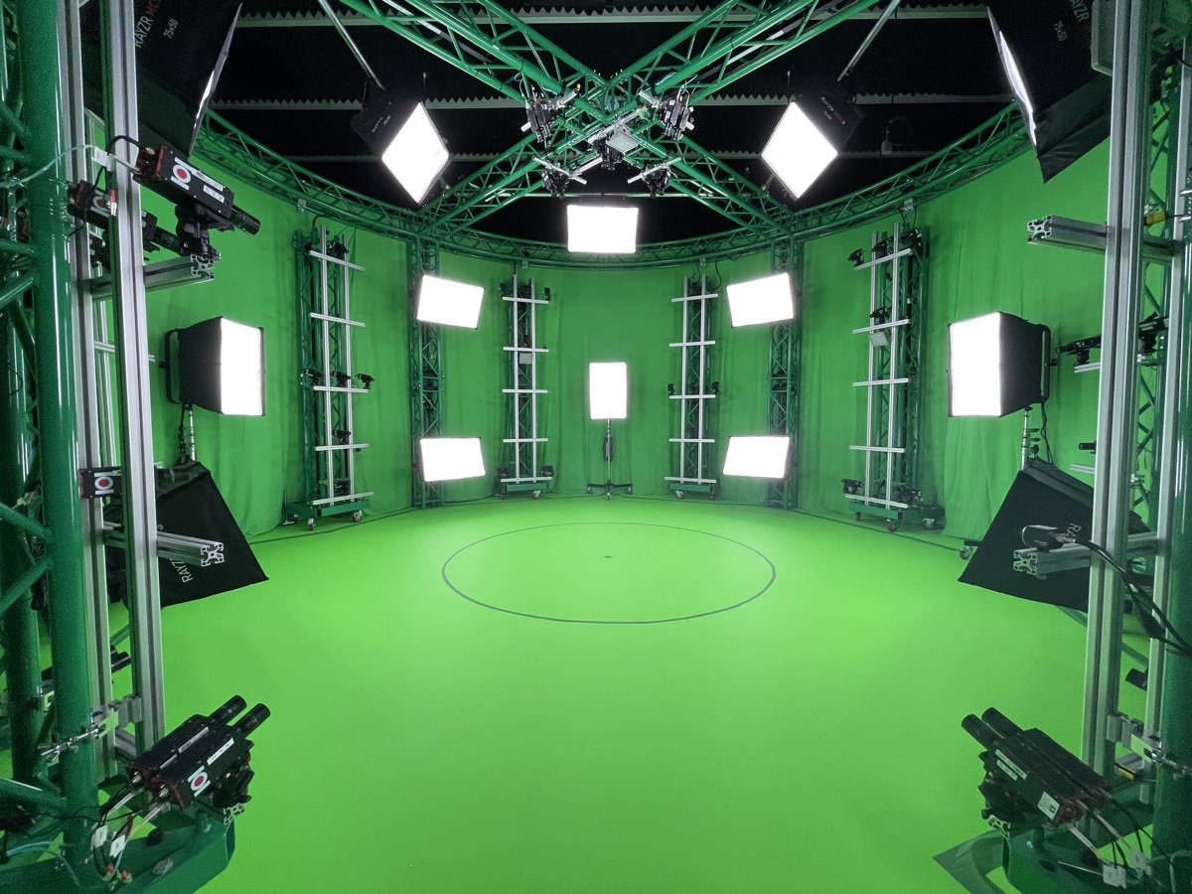
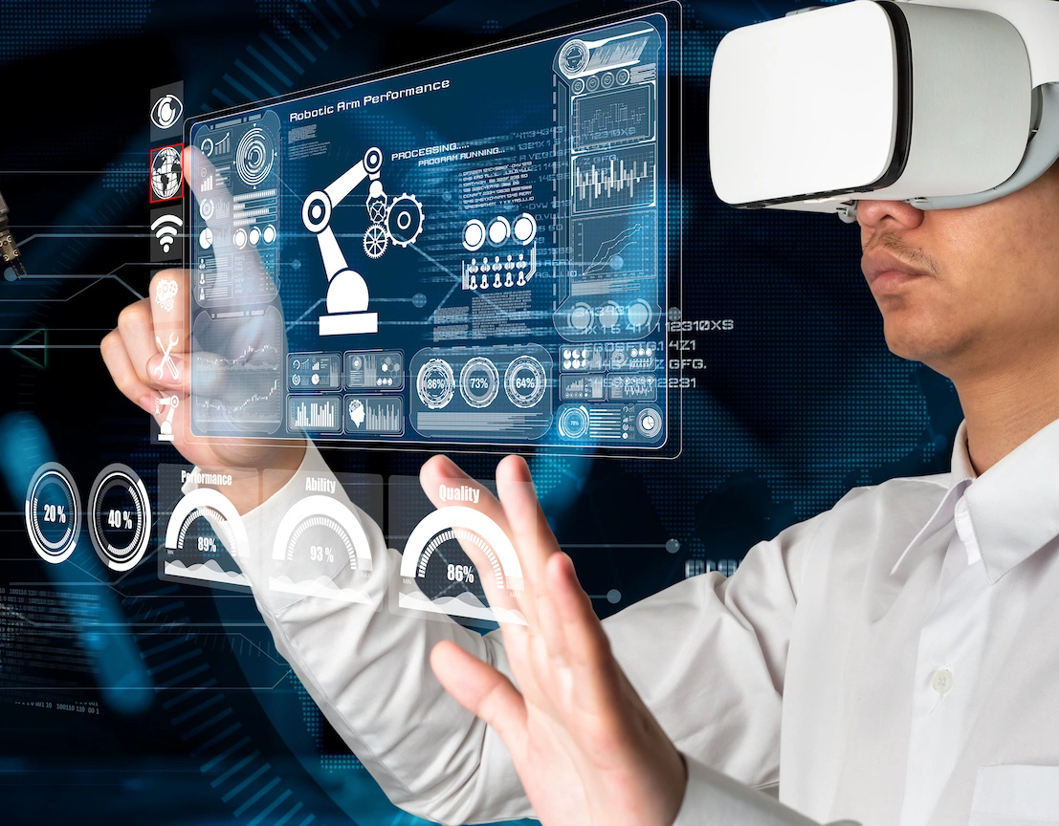



Introduction
Video traffic is dominating the internet traffic
New forms of video content emerged
Volumetric Videos
VR/AR Videos
360˚ Videos
6D View
1

Slide 4

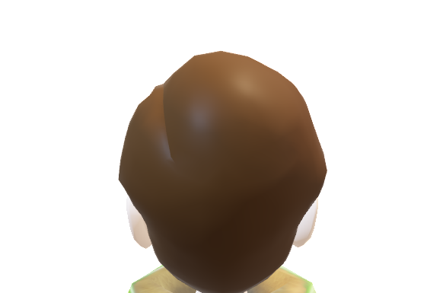
Traditional video versus 360° video
Passively consuming content
2

Slide 5
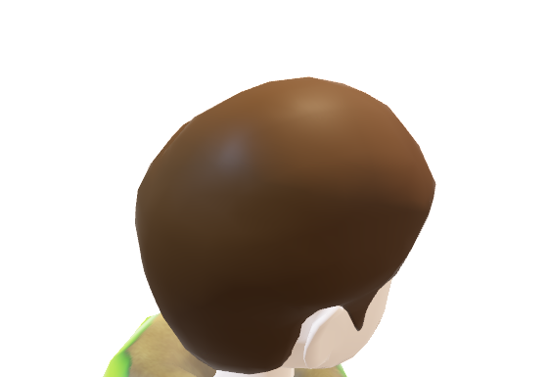
Traditional video versus 360° video
Passively consuming content
2

Slide 6
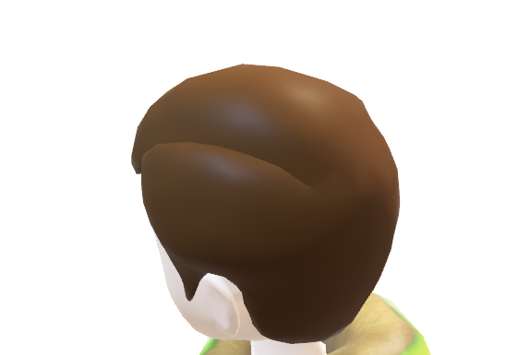
Traditional video versus 360° video
Passively consuming content
Actively engaging with content
2

Slide 7
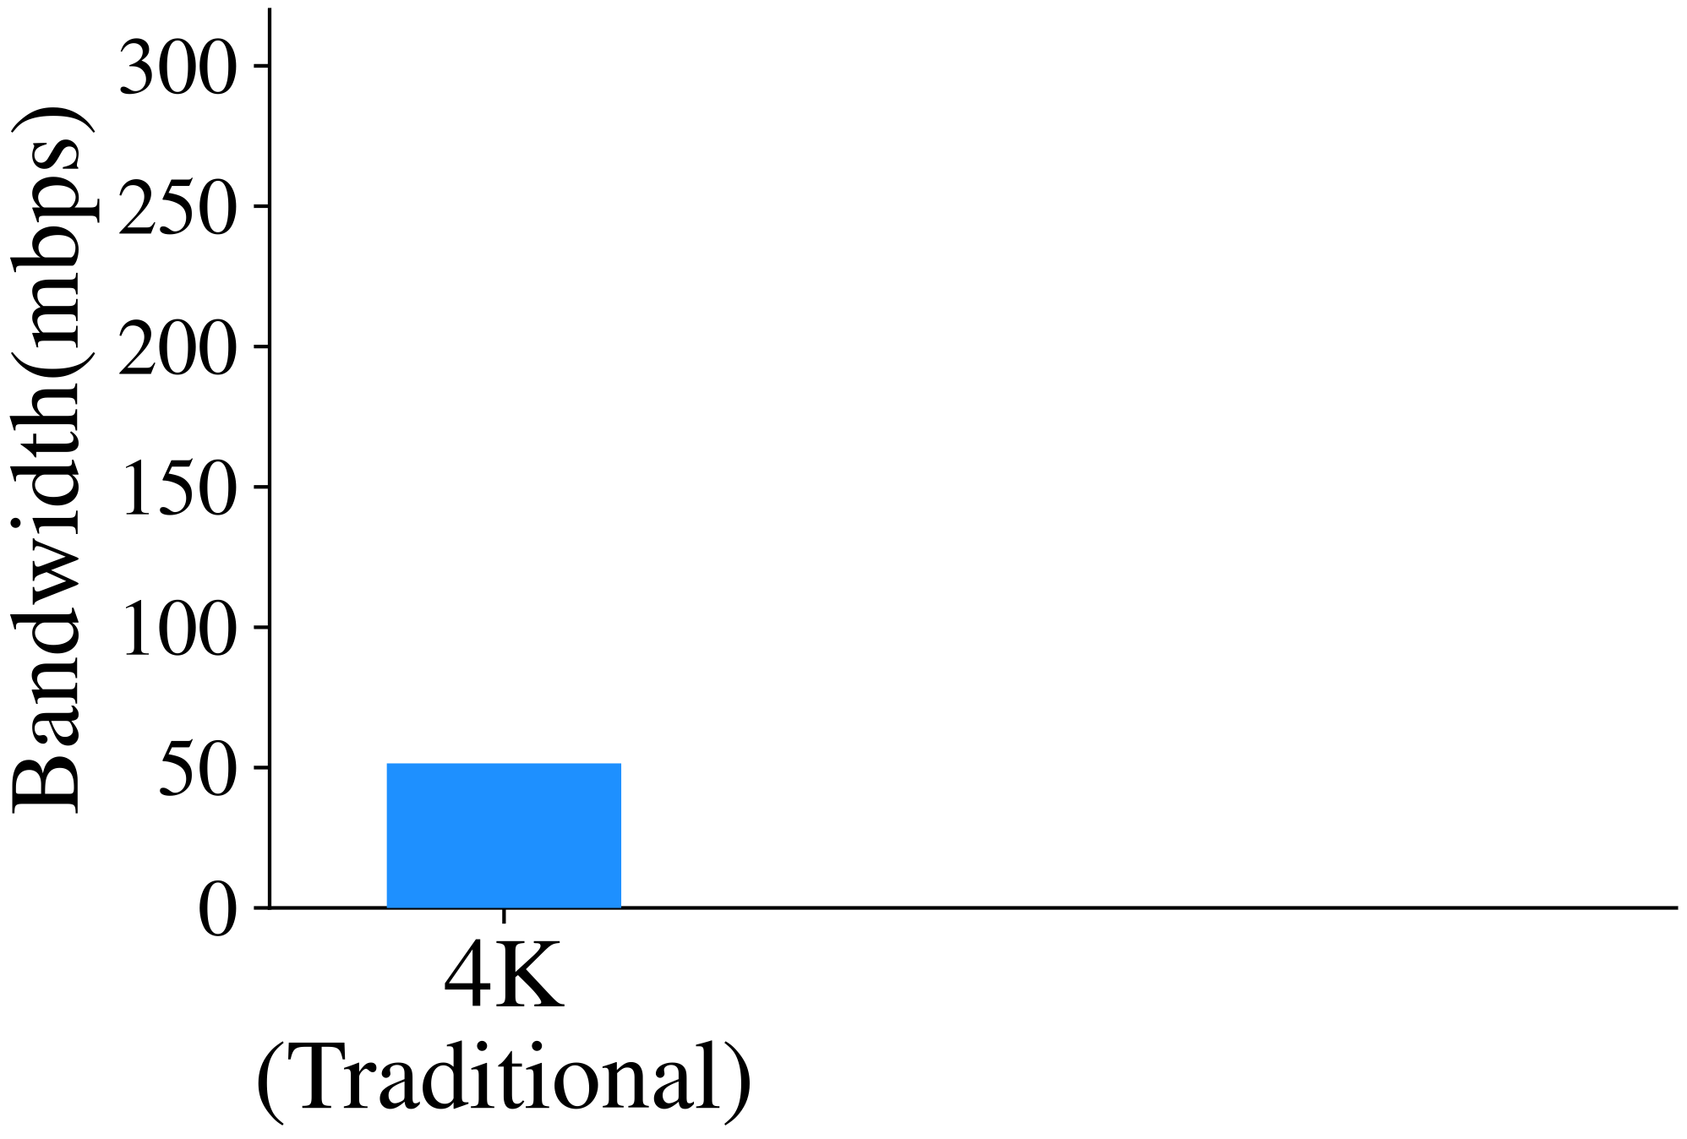
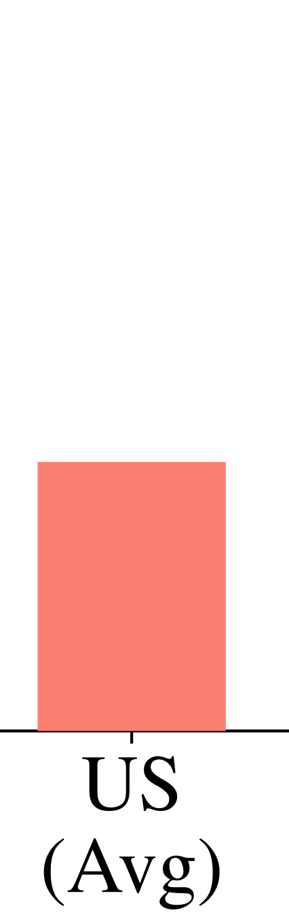
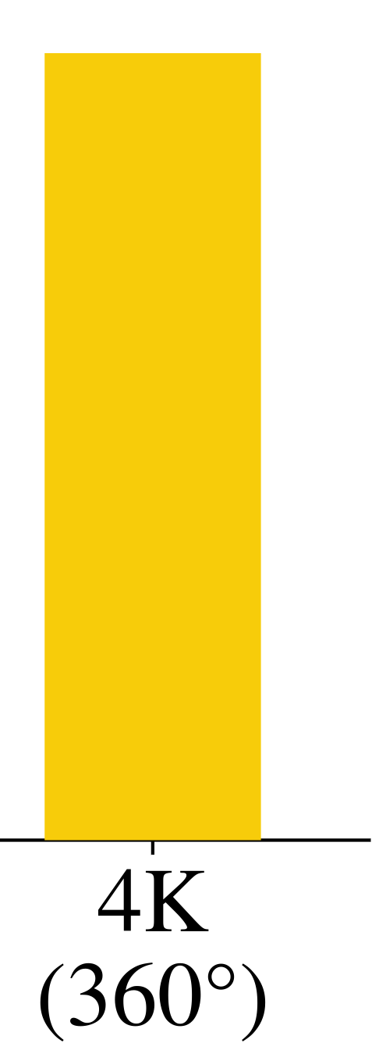
Traditional streaming approach
Approach #1. Simply stream full 360 video following traditional streaming methodology
  360 video is ~5X traditional video
3

Slide 8
Traditional streaming approach
Approach #1. Simply stream full 360 video following traditional streaming methodology
  360 video is ~5X traditional video
  Far exceed avg US broadband bandwidth
3

Slide 9
Traditional streaming approach
Approach #1. Simply stream full 360 video following traditional streaming methodology
  360 video is ~5X traditional video
  Far exceed avg US broadband bandwidth
Traditional approach cannot support
high quality video experience
3

Slide 10
Tile-based rebuffering approach
Approach #2. Predict user motion and stream the relevant video portion in a higher quality
      e.g., Rubiks (MobiSys ’18), Flare (MobiCom ‘18), Pano (SIGCOMM ‘19)
4

Slide 11

Video tiling
5

Slide 12

Video tiling
Spatially segmented
5

Slide 13
Video tiling
Spatially segmented
5

Slide 14
Video tiling
Spatially segmented
5

Slide 15
Video tiling
Spatially segmented
Temporally segmented
Tile
5

Slide 16
Tile-based rebuffering approach
Approach #2. Predict user motion and stream the relevant video portion in a higher quality
      e.g., Rubiks (MobiSys ’18), Flare (MobiCom ‘18), Pano (SIGCOMM ‘19)
  Limitation. Treat as conventional ABR ➔ Optimizing the quality of relevant tiles
                Minimizing stalls (stall if a relevant tile is missing)
6

Slide 17
Tile-based rebuffering approach
Approach #2. Predict user motion and stream the relevant video portion in a higher quality
      e.g., Rubiks (MobiSys ’18), Flare (MobiCom ‘18), Pano (SIGCOMM ‘19)
  Limitation. Treat as conventional ABR ➔ Optimizing the quality of relevant tiles
                Minimizing stalls (stall if a relevant tile is missing)
Median prediction accuracy is 25% for 3sec lookahead
lookahead
playback (t°)
t° + 3 sec
Motion uncertainty → rebuffering and optimizing the quality of irrelevant tiles
6

Slide 18
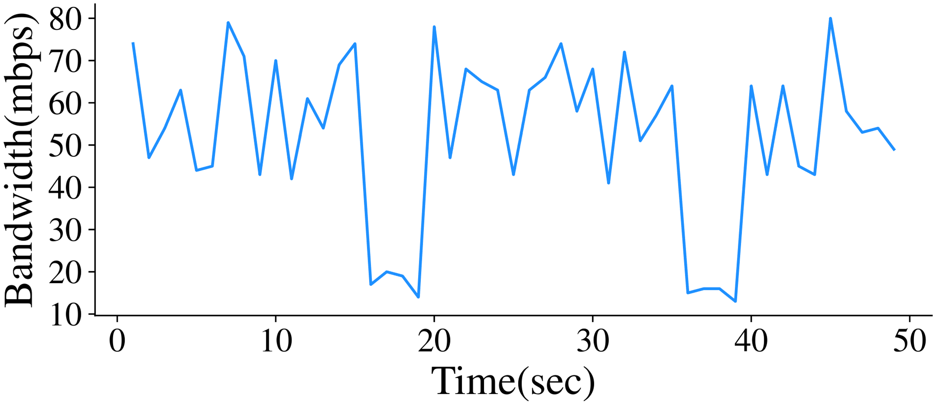
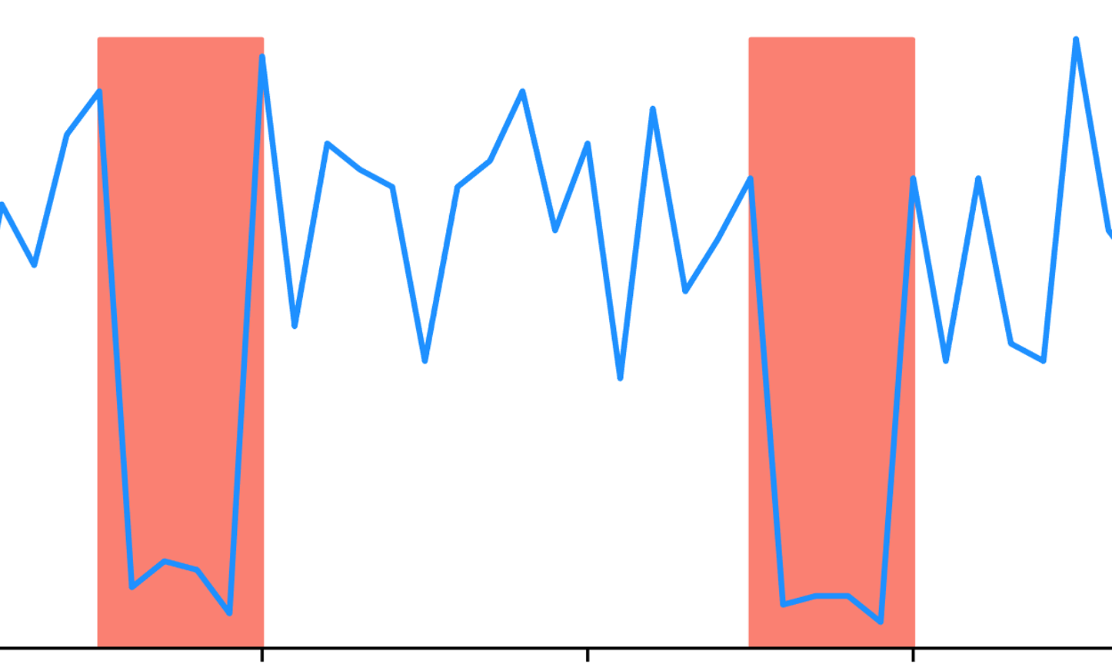

Tile-based rebuffering approach
Approach #2. Predict user motion and stream the relevant video portion in a higher quality
      e.g., Rubiks (MobiSys ’18), Flare (MobiCom ‘18), Pano (SIGCOMM ‘19)
  Limitation. Treat as conventional ABR ➔ Optimizing the quality of relevant tiles
                Minimizing stalls (stall if a relevant tile is missing)
Median prediction accuracy is 25% for 3sec lookahead
lookahead
playback (t°)
t° + 3 sec
Motion uncertainty → rebuffering and optimizing the quality of irrelevant tiles
Bandwidth uncertainty → rebuffering
6

Slide 19
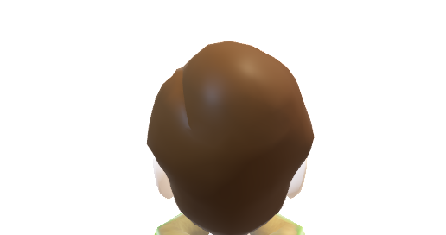
Rebuffering model: limitation
7

Slide 20
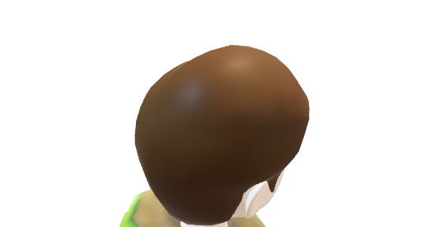
Rebuffering model: limitation
7

Slide 21
Rebuffering model: limitation
7

Slide 22
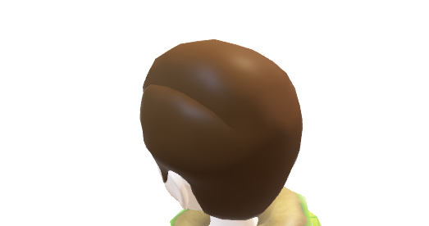
Rebuffering model: limitation
User might move during rebuffering
7

Slide 23
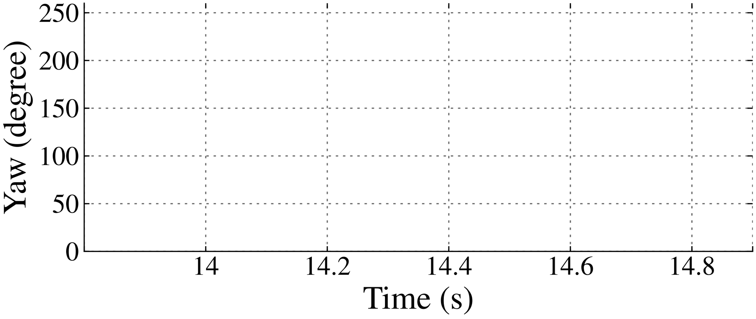
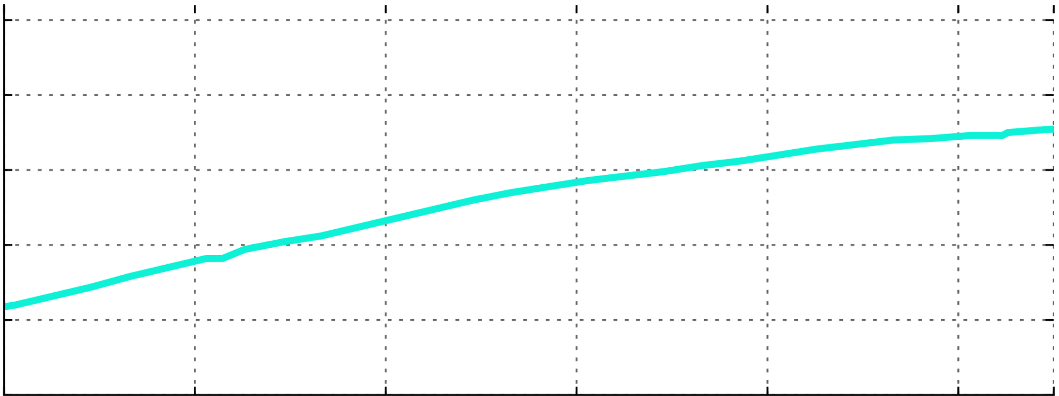
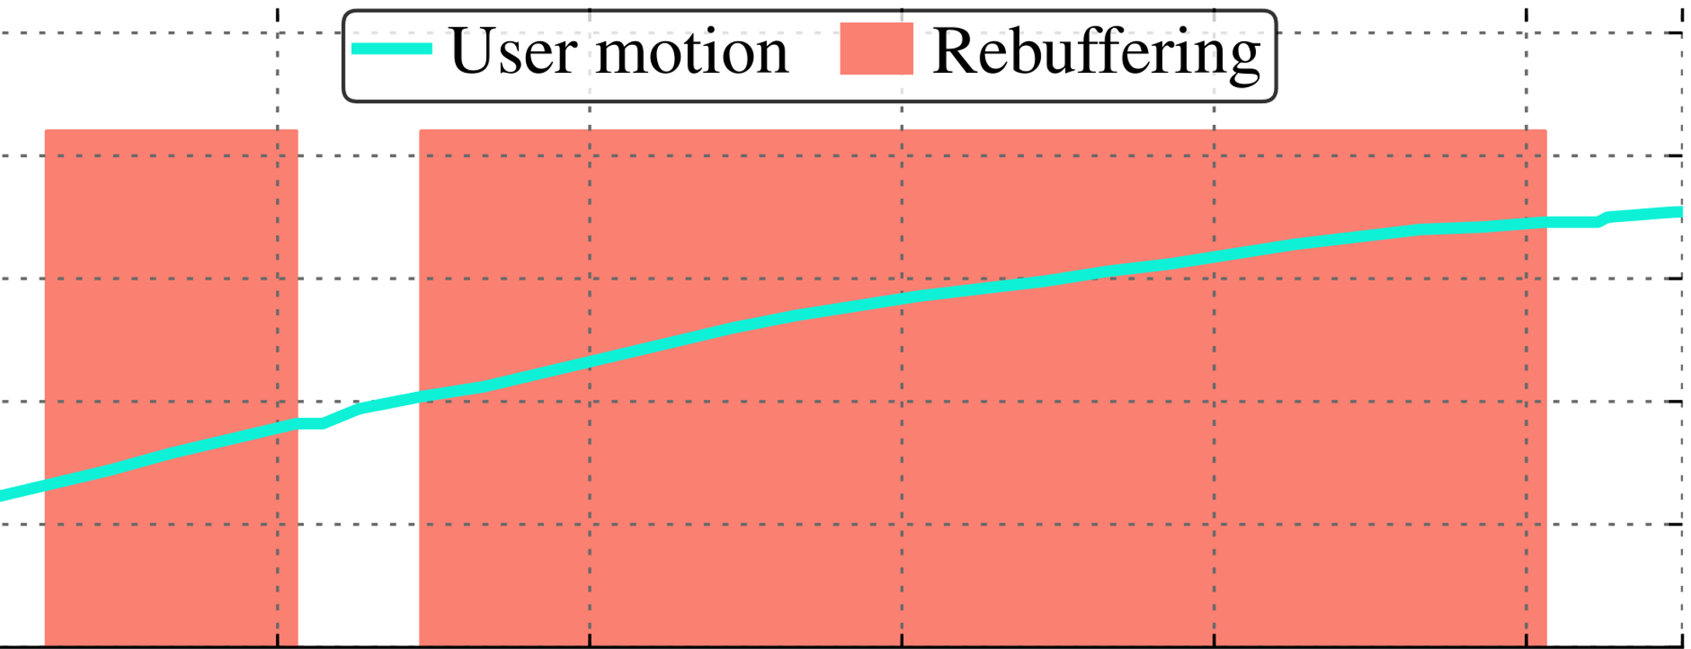
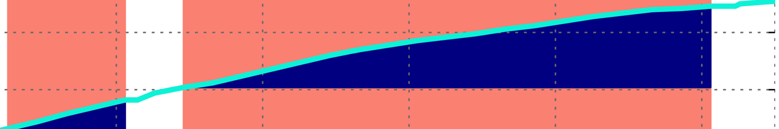
Rebuffering model: limitation
Rebuffering in 360° can lead to cascading stalls ➔ Badly hurts interactivity
User might move during rebuffering
7

Slide 24
How to stream 360˚ videos ?
Tile-based
Rebuffering model
Poor interactive experience
Can we stream 360 video without stall ?!
8

Slide 25
How to stream 360˚ videos ?
Tile-based
Rebuffering model
Naïve skip model
Poor interactive experience
Poor perceptual quality
Can we stream 360 video without stall ?!
8

Slide 26
How to stream 360˚ videos ?
Tile-based
Rebuffering model
Proactive skip model
(our work)
Naïve skip model
Poor interactive experience
Poor perceptual quality
Can we stream 360 video without stall ?!
8

Slide 27
Contributions
Demonstrate proactive skipping leads to better user experience than classical rebuffering model
9

Slide 28
Contributions
Demonstrate proactive skipping leads to better user experience than classical rebuffering model
Dragonfly, a system that proactively skip tiles for interactivity
  Ensures continuous playback without stalls
  Uses utility-driven model to determine which tiles to fetch, at what quality, and in what order
9

Slide 29
Contributions
Demonstrate proactive skipping leads to better user experience than classical rebuffering model
Dragonfly, a system that proactively skip tiles for interactivity
  Ensures continuous playback without stalls
  Uses utility-driven model to determine which tiles to fetch, at what quality, and in what order
Dragonfly outperforms state of the art (Flare/Pano)
  Users rated 65% of Dragonfly sessions as good/excellent rather than 13%-16% for Flare/Pano
  Emulation: Dragonfly improved median PSNR is higher by 1.25x-2.8x (without stalling!)
9

Slide 30
Proactive skipping with Dragonfly
playback (t°)
Chunk
boundary
10

Slide 31
Proactive skipping with Dragonfly
Fetch
playback (t°)
Chunk
boundary
10

Slide 32
Proactive skipping with Dragonfly
Passed render deadline
Fetch
Fetch later
playback (t°)
Chunk
boundary
10

Slide 33
Proactive skipping with Dragonfly
Passed render deadline
Cascade skipped tiles
Fetch
Fetch later
playback (t°)
Chunk
boundary
10

Slide 34
Proactive skipping with Dragonfly
playback (t°)
Chunk
boundary
10

Slide 35
Proactive skipping with Dragonfly
Do not fetch
Fetch
playback (t°)
Chunk
boundary
10

Slide 36
Proactive skipping with Dragonfly
Do not fetch
Fetch
playback (t°)
Chunk
boundary
10

Slide 37
Proactive skipping with Dragonfly
Do not fetch
Fetch
playback (t°)
Chunk
boundary
High perceptual quality
and interactive user experience
10

Slide 38
Utility-driven model
Tile(i)
Frame(f)
11

Slide 39
Utility-driven model
Relevant
Tile(i)
Frame(f)
11

Slide 40
Utility-driven model
How many frames the tile benefits ?
Relevant
Tile(i)
Frame(f)
11

Slide 41


Utility-driven model
Center
Periphery
How central relative to the viewport ?
How many frames the tile benefits ?
Relevant
Tile(i)
Frame(f)
11

Slide 42
Utility-driven model
Center
Periphery
How central relative to the viewport ?
How many frames the tile benefits ?
∑
Relevant
Tile(i)
Frame(f)
What is the value of tile if fetched by time (t) ?
11

Slide 43
Tile scheduling problem
Given the tiles utilities and a bandwidth estimate over the look-ahead window,
  Which tiles to fetch ?
  In what qualities?
  In what order ?
Goal: total utility of all tiles is maximized
Optimal solution → Integer programming problem
We use greedy heuristic algorithm
12

Slide 44
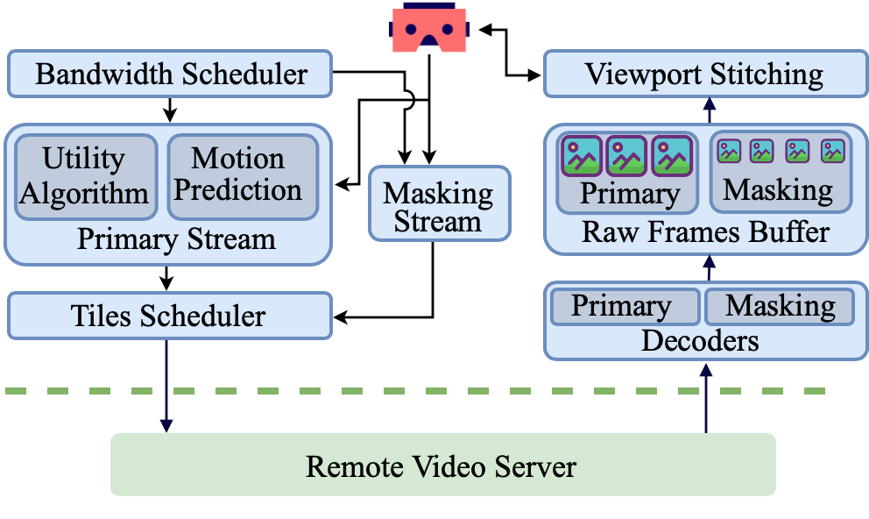
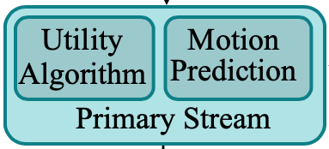
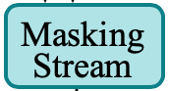
Dragonfly overview
12

Slide 45
Evaluation
Compare Dragonfly with
  Pano, Flare, and TwoTier
  Several Dragonfly variants (ablation study)
Methodology
  User study: participants moved freely when viewing video with a given algorithm
  Emulations: several 360 videos, bandwidth traces, user movement traces
    Metrics
  Subjective: (i) Opinion Score (ii) Qualitative Feedback
  Objective: (i) PSNR (ii) PSPNR (iii) Rebuffering Ratio (iv) Incomplete Viewports (v) Bandwidth Wastage
13

Slide 46
Evaluation
Compare Dragonfly with
  Pano, Flare, and TwoTier
  Several Dragonfly variants (ablation study)
Methodology
  User study: participants moved freely when viewing video with a given algorithm
  Emulations: several 360 videos, bandwidth traces, user movement traces
    Metrics
  Subjective: (i) Opinion Score (ii) Qualitative Feedback
  Objective: (i) PSNR (ii) PSPNR (iii) Rebuffering Ratio (iv) Incomplete Viewports (v) Bandwidth Wastage
13

Slide 47
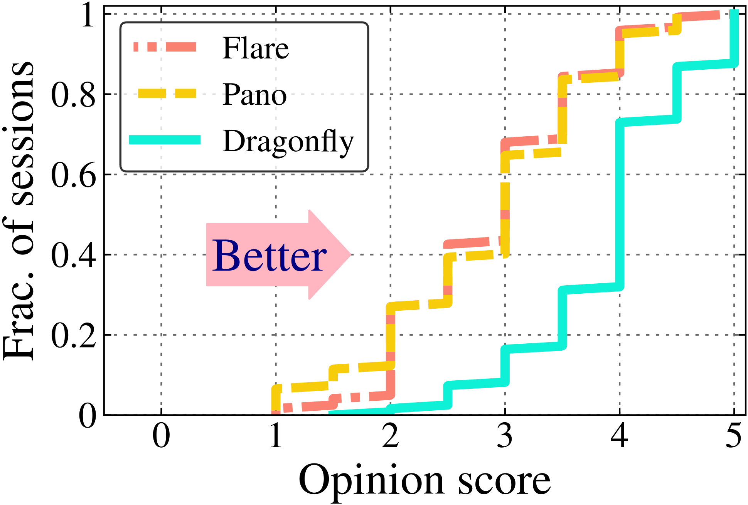
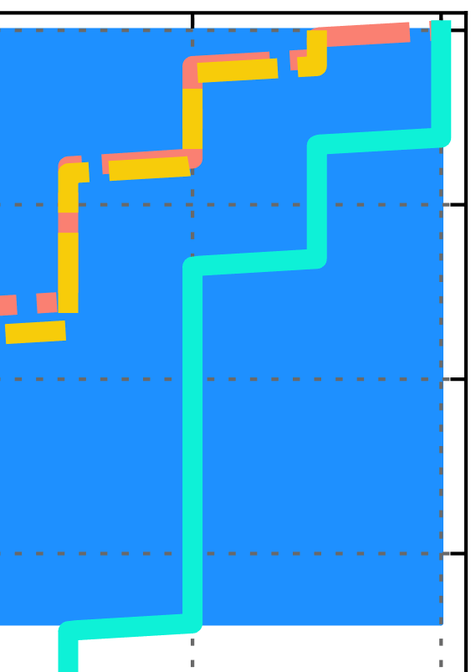
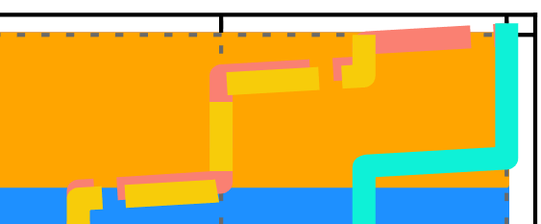
Evaluation: user study
We had 26 participants → 5 videos → 3 schemes: Dragonfly, Flare, and Pano
Majority of Dragonfly session having a rating >= 4
14

Slide 48
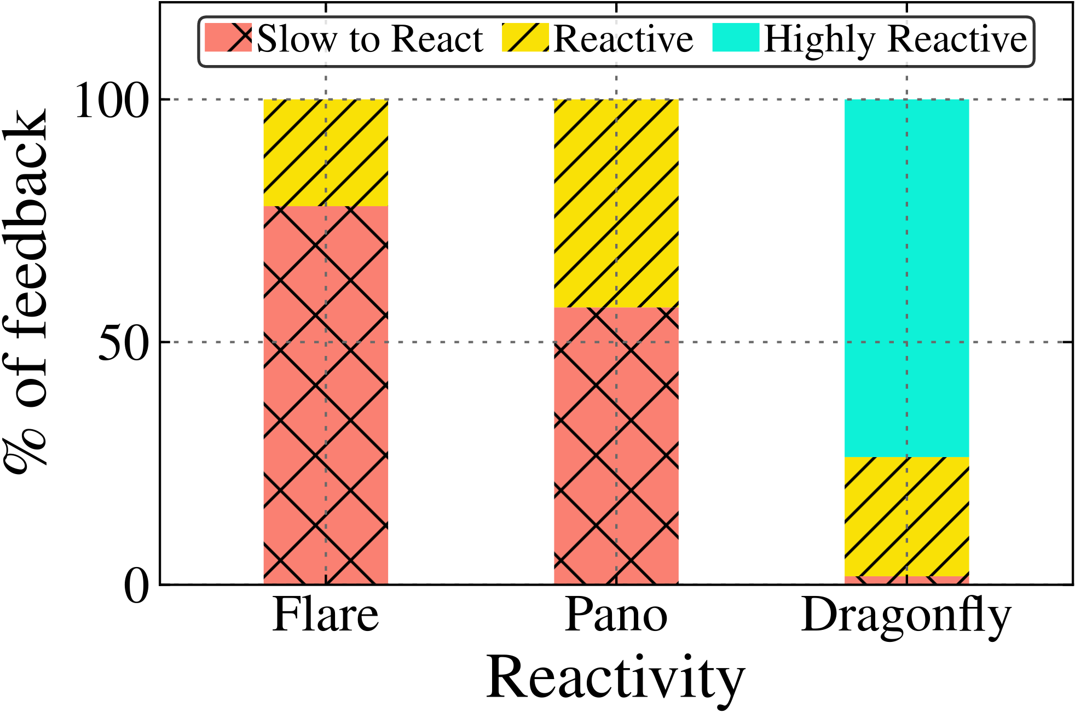
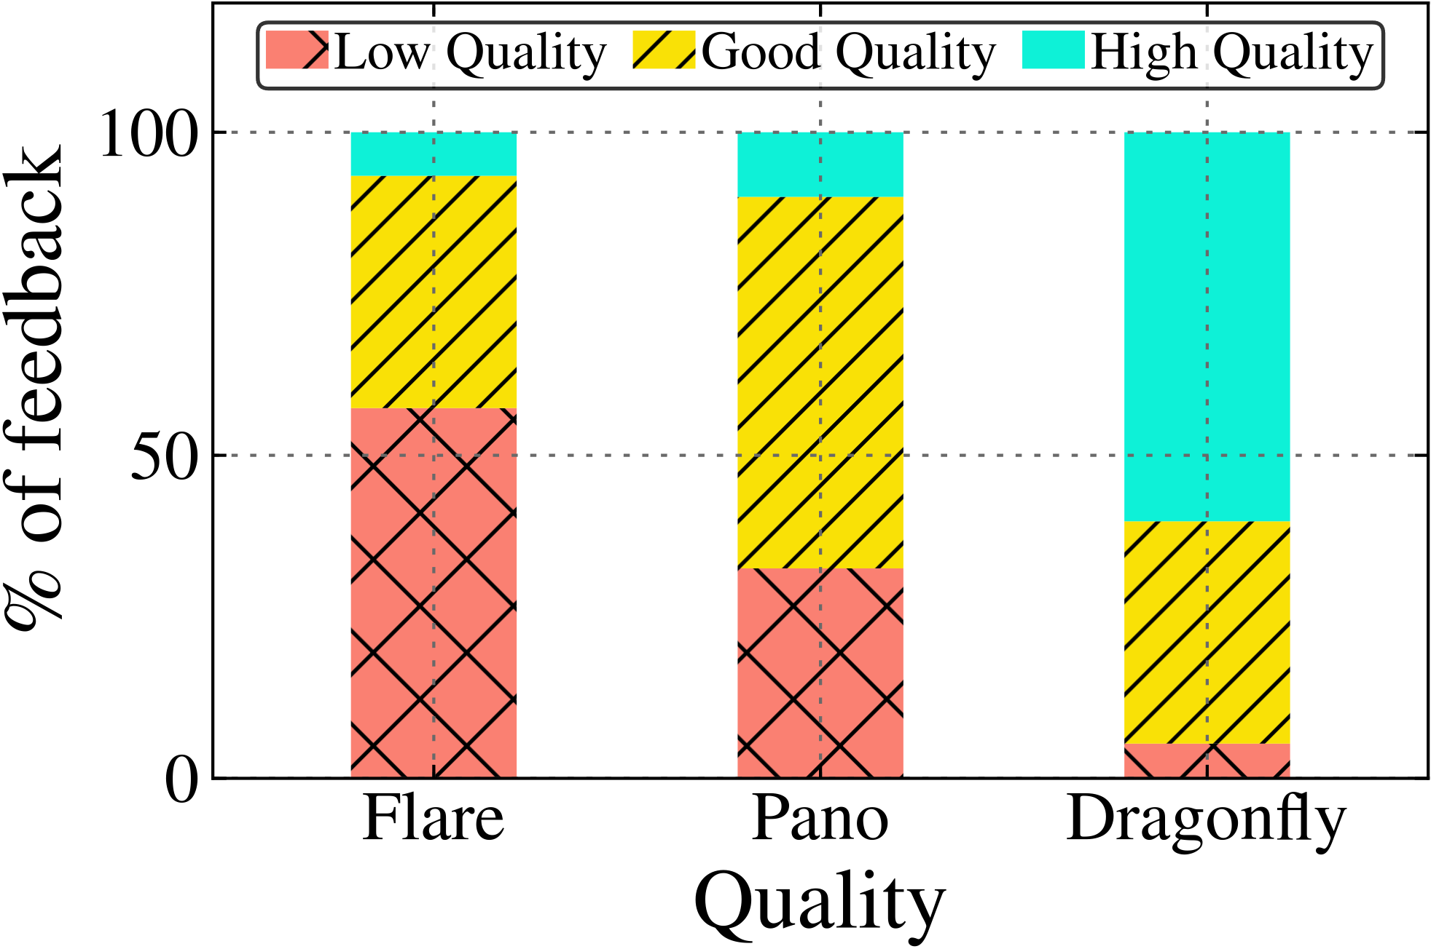
Evaluation: user study
For qualitive feedback, we summarize the key observations from 381 received comments
15

Slide 49
Evaluation: user study
For qualitive feedback, we summarize the key observations from 381 received comments
Dragonfly is highly reactive with higher quality
15

Slide 50
Conclusion
Proactive skip leads to better user experience than classical rebuffering
Dragonfly, a 360˚ system which proactively skips tiles to maintain interactivity
Dragonfly outperforms Flare/Pano
  Users rated 65% of Dragonfly sessions as good/excellent vs 13%-16% for Flare/Pano
  Reactivity feedback indicating Dragonfly is highly reactive, while Flare/Pano being slow to react
We released Dragonfly source code
https://github.com/Purdue-ISL/Dragonfly
16

