Slide 1


Hattrick: Solving Multi-Class TE using Neural Models
Abd AlRhman AlQiam¹, Zhuocong Li¹, Satyajeet Singh Ahuja², Zhaodong Wang² Ying Zhang², Sanjay G. Rao¹, Bruno Ribeiro¹, Mohit Tawarmalani¹
1
2

Slide 2
WANs must meet stringent Service Level Objectives
100X increase in WAN traffic in recent years [1]
Service Level Objectives (SLOs) more stringent.
SLO = Bandwidth must be met (99%-99.99%) of the time.
Multiple traffic classes help manage SLOs for diverse traffic.
Web search has high priority since it is delay-sensitive traffic.
Data replication across data centers has low priority since it is not delay-sensitive traffic.
[1] Chi-Yao Hong et al, B4 and after: Managing hierarchy, partitioning, and asymmetry for availability and scale in google’s software-defined wan. In Proceedings of the 2018 Conference of the ACM Special Interest Group on Data Communication, pages 74–87, 2018.

Slide 3
How is WAN traffic managed today? Traffic Engineering
45%
Input TMs
Capacities + Tunnels
4
C1
C1
Centralized
SDN Controller
LP Solver
1
C2
2
C2
3
Route traffic
C3
EBB, SWAN, B4
C3
5
Has a global view of the network
optimizes a network-wide objective (e.g., maximize fulfillment ratio (total carried flow)).
Linear Programming (LP) to route traffic.
55%

Slide 4
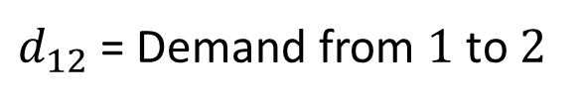
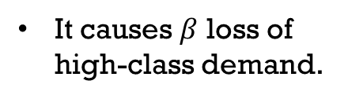




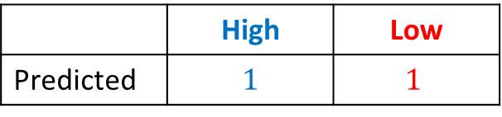

Challenge: Meeting SLOs under demand prediction errors
Assume link capacities are 1
$d_{12}$ = Demand from $1$ to $2$
 | High | Low
Predicted | $$1$$ | $$1$$
An optimal routing for the predicted matrix
$$send all high (one unit)$$
Actual | $$1+β$$ | $$1−β$$
1
2
$$send all low (one unit)$$
Applying the routing over actual
Optimal for predicted demand may not perform well on actual.
It causes $β$ loss of high-class demand.
$$1+β$$
1
2
$$1−β$$

Slide 5
Why ML-based TE?
45%
Input TMs
Capacities + Tunnels
4
C1
C1
LP Solver
Neural Model
1
C2
2
C2
3
Route traffic
C3
DOTE, NSDI 23
HARP, SIGCOMM 24
C3
5
55%
Learn to be resilient to prediction error
Results in a better routing

Slide 6
Hattrick vs State of the Art
Resilience to prediction error
DOTE (NSDI’23)
HARP (SIGCOMM’24)
Hattrick
ML-based TE
Supporting multiple traffic classes
SWAN, EBB, B4, Flexile
LP-based TE

Slide 7
Hattrick vs State of the Art
Hattrick, a first step towards optimizing metrics generated by a simulator
Simulator: Model network behavior under congestion caused by prediction error.
Example: Traffic prioritization at routers.
Unique untapped opportunity available to ML-based techniques.
DOTE (NSDI’23)
HARP (SIGCOMM’24)
Hattrick
Optimize metrics given by a simulator
Model-based
SWAN, EBB, B4, Flexile

Slide 8
Contributions
Hattrick: First ML-based TE scheme that can handle multi-class TE
Hattrick performs better
Improves 99% successfully delivered flow relative to Microsoft’s SWAN by 5.5% to 19.3% across traffic classes.
Improvements are up to 11% relative to an optimal LP-based strategy.
Hattrick reduces computation times.
Up to 280X faster than the optimal LP-based strategy
Up to 36X faster than SWAN.

Slide 9
Challenges for ML-based Multi-Class TE
Challenge: Ability to handle multi-class TE
Solution:
Align neural architecture to multi-class TE optimization.
Challenge: Respect priorities of different classes
Solution:
Precedence-aware learning
Challenge: Handling prediction error
Solution:
Learn with feedback from simulator
Introduce auxiliary metrics

Slide 10
Hattrick’s Architecture
Stage #2 can tune high-class routing to jointly optimize both classes.
Architecture is aligned to the optimal LP-based strategy.
Please refer to the paper for more details.
Predicted Low-class TM
Predicted High-class TM
Fine-tuned final routing for high-class TM
Stage#1
Stage#2
Initial routing for high TM
Final routing for Low-class TM

Slide 11
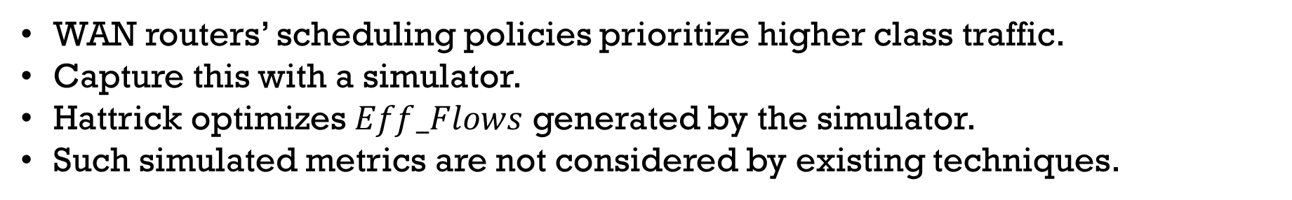


Hattrick’s Architecture
Actual Low-class TM
Actual High-class TM
Apply
Fine-tuned final routing for high-class TM
$$Eff_Flow^{H}$$
Network
Simulator
Final routing for Low-class TM
$$Eff_Flow^{L}$$
WAN routers’ scheduling policies prioritize higher class traffic.
Capture this with a simulator.
Hattrick optimizes $Eff_Flows$ generated by the simulator.
Such simulated metrics are not considered by existing techniques.

Slide 12





Example: Hattrick can learn how to mix traffic
$$send all high$$
1
$$High more than expected$$
2
1
2
$$send all low$$
Simulate using actual traffic.
Network drops high-class traffic.
Benefit of using simulated metrics
$$Mix traffic classes across links$$
$$High more than expected$$
1
2
1
2
Simulate using actual traffic.
Network drops low-class traffic.

Slide 13

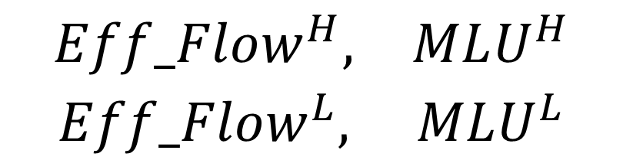
Why Hattrick uses auxiliary metrics?
Well-provisioned networks →
Introduce an auxiliary metric per class
MLU = Maximum Link Utilization
$$∇high=0$$
$$\begin{matrix}Eff_Flow^{H}, & MLU^{H} \\ Eff_Flow^{L}, & MLU^{L}\end{matrix}$$
More details in the paper.

Slide 14
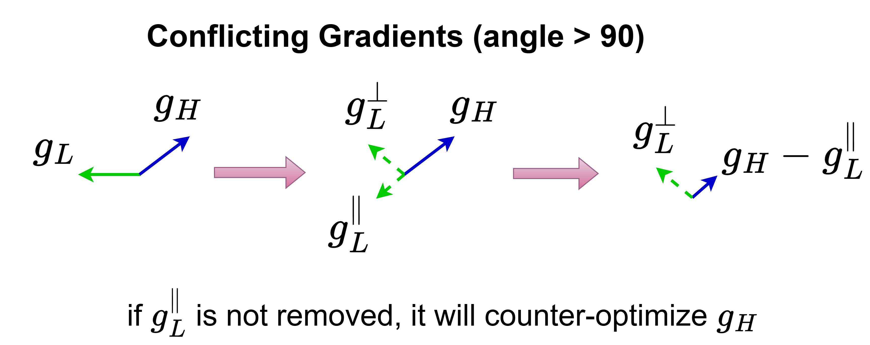
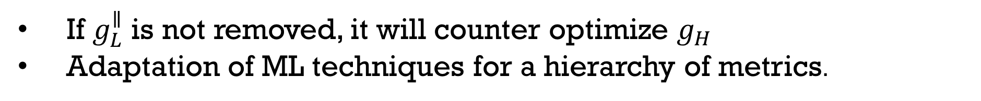
Precedence-Aware Learning for Hattrick
$$g^{H}:high traffic gradients, g^{L}:low traffic gradients$$
If $g_{L}^{∥}$ is not removed, it will counter optimize $g_{H}$
Adaptation of ML techniques for a hierarchy of metrics.

Slide 15
Experimental Setup (1)
Datasets:
PrivateWAN: Data collected from real cloud WAN that natively has three traffic classes
GEANT: Public dataset, split it into three classes using PrivateWAN traffic ratios
KDL: Synthetic TMs
UsCarrier: Synthetic TMs
Baselines:
Best_MC: optimal LP-based strategy (Flexile, CoNeXT’22)
Microsoft’s SWAN: LP-based TE, SIGCOMM’13
DOTE-MC: ML-based TE, NSDI’23
HARP-MC: ML-based TE, SIGCOMM’24
All experiments use three traffic classes.

Slide 16
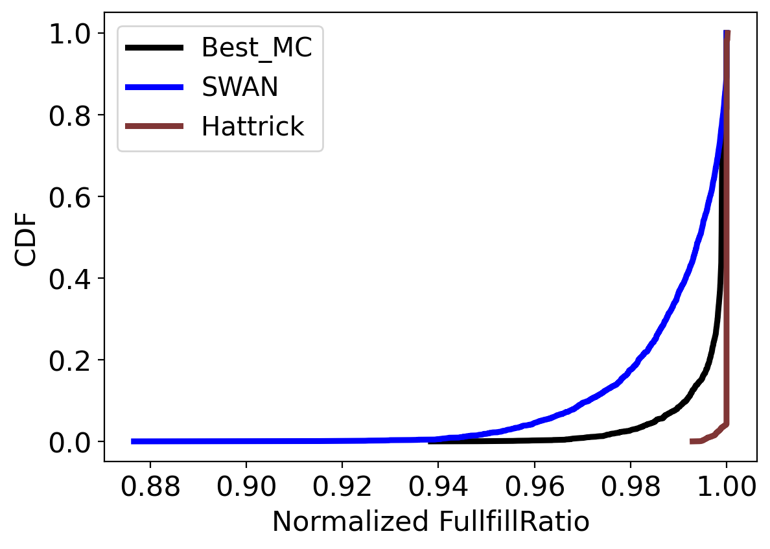
Hattrick vs LP-based Methods (1): GEANT
Hattrick outperforms Best_MC and SWAN.
Best_MC is sub-optimal due to prediction error, but optimal with accurate predictions.
NormFulFillRatio for high-class is always <= 1.
Better
High-class only
Normalized Fulfillment Ratio = $\frac{carried traffic of class C using a scheme}{carried traffic ofclass C using oracle Best_MC}$

Slide 17
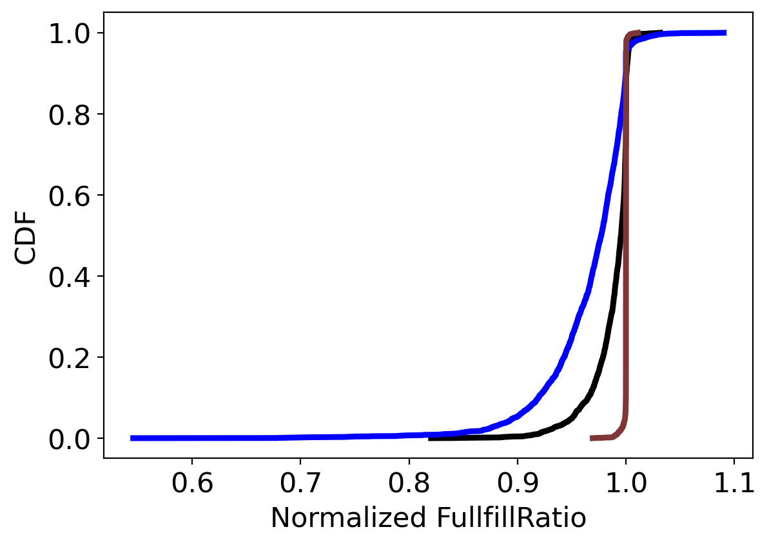
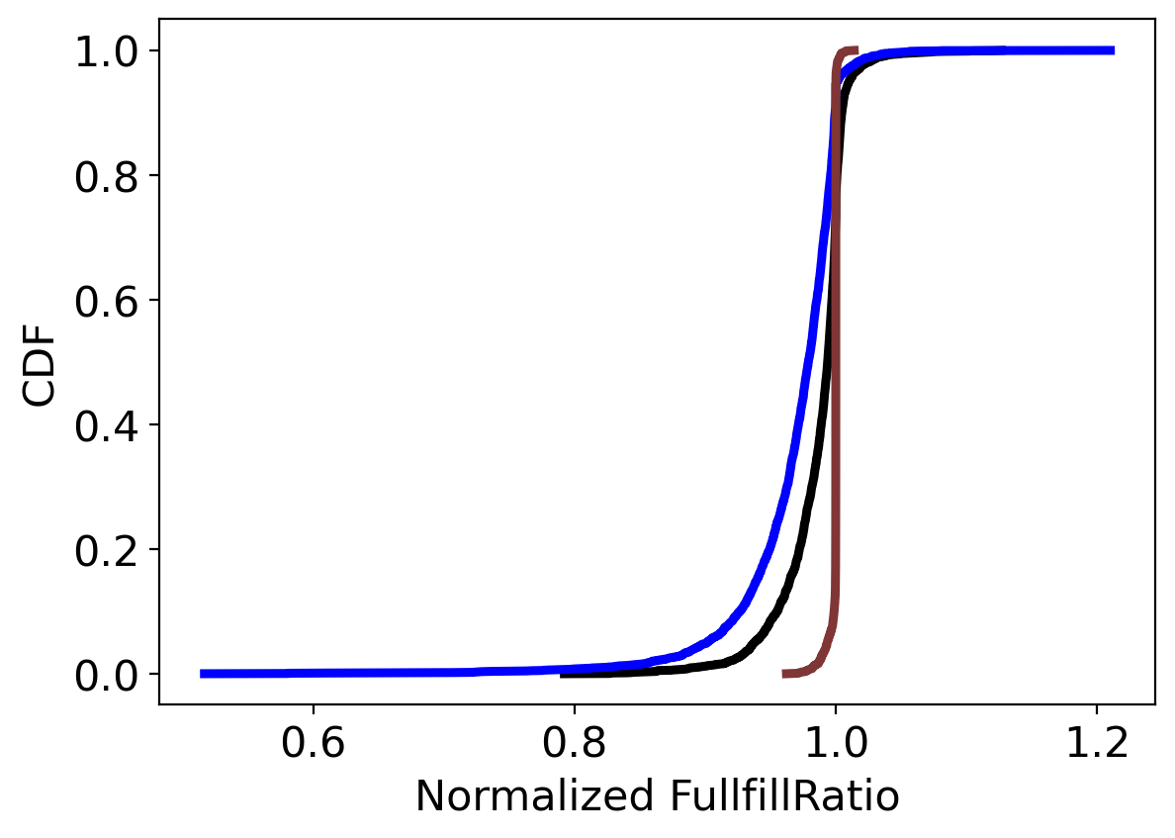
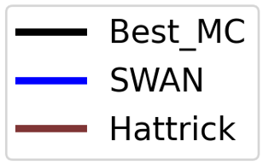
Hattrick vs LP-based Methods (2): GEANT
Better
High-class only
Med-class only
Low-class only
Clearer Hattrick wins for lower traffic classes.
NormFulFillRatio can be > 1 for lower classes indicating priority inversion.
The scheme served more of a less important traffic at the expense of a more important traffic.

Slide 18
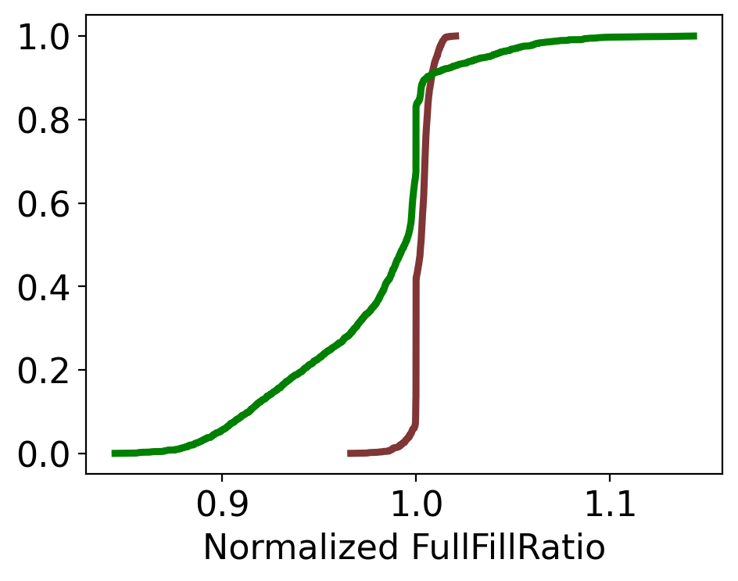
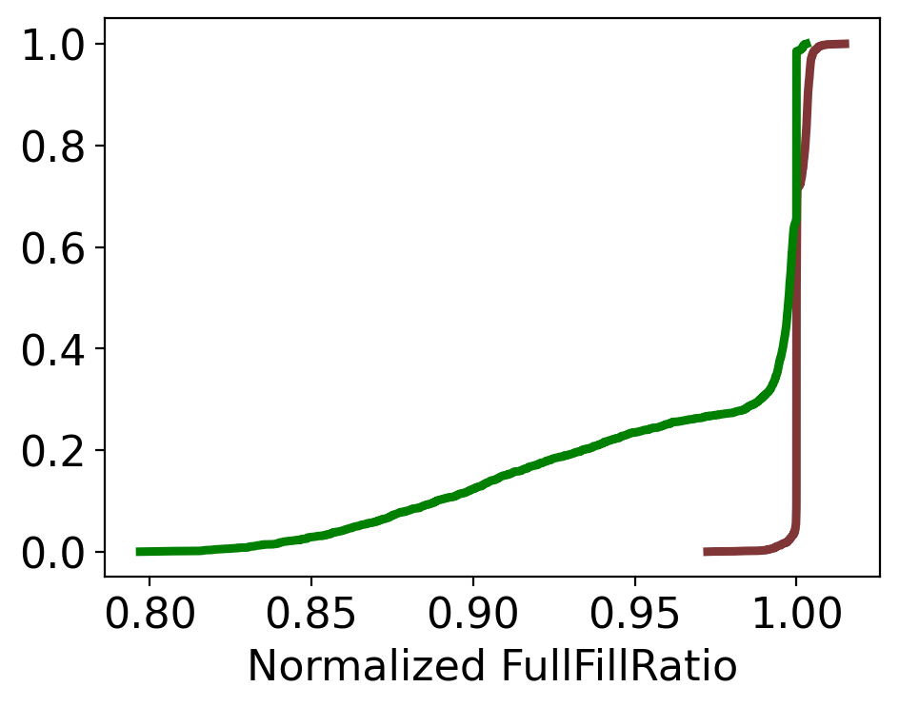
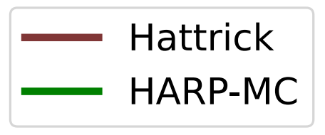
Hattrick vs ML-based TE Schemes
HARP (SIGCOMM’24) designed for a single-class TE.
Better
Med-class only
Low-class only
Significant win for Hattrick over HARP and DOTE (see paper) adapted to multi-class TE

Slide 19
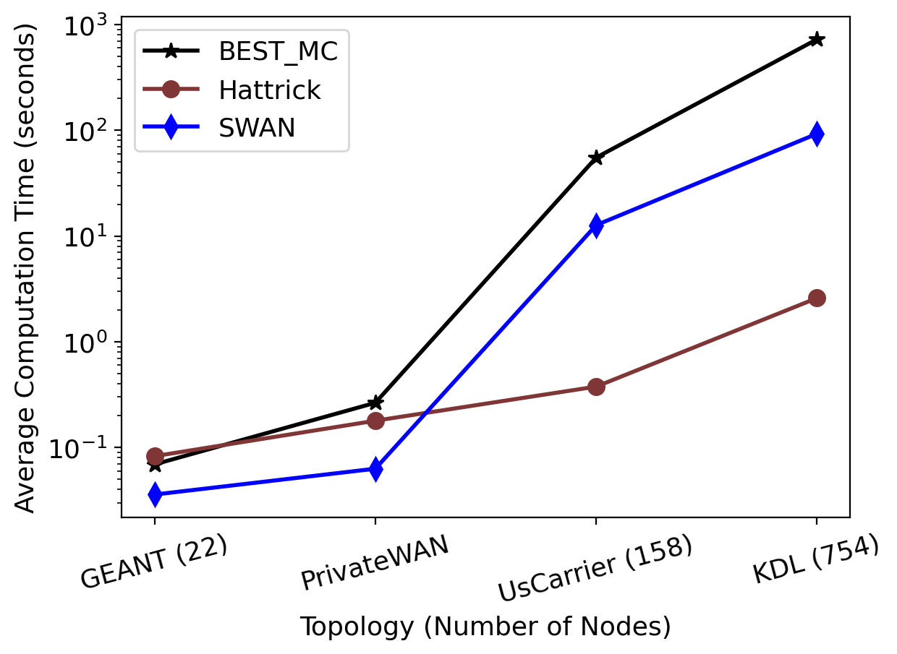
Scaling to larger topologies
On the KDL topology, Hattrick is:
280X faster than BEST_MC
36X faster than SWAN
Hattrick achieves higher NormFulFillRatio (see paper).
Better

Slide 20
Other Experiments
Hattrick outperforms other methods
on other datasets.
using different demand predictors.
Benefits of Hattrick’s design elements
Neural architecture aligned with multi-class TE helps.
Integrating simulated metrics helps Hattrick to carry more traffic.
Precedence-aware learning outperforms weighted additive loss

Slide 21
Conclusion
Hattrick: First neural TE scheme that can handle multi-class TE
Architecture is aligned to multi-class TE optimization techniques.
Resilient with prediction error.
Proposed a new precedence-aware multi-task learning method tailored for multi-class TE
Integrated a differentiable simulator into the training process of Hattrick to cope with prediction errors
Hattrick outperforms state-of-the-art multi-class TE
Hattrick reduces computation times
We released Hattrick’s source code
https://github.com/Purdue-ISL/Hattrick

