Slide 1


Beagle: Auto-tuning Performance Diagnosis for Live Video Streaming
Chandan Bothra*†, Leonardo Vilela Teixeira*†, Zahaib Akhtar‡, Sanjay G. Rao†, Bruno Ribeiro†
†Purdue University ‡Amazon Prime Video
* Equal contribution
IWQoS 2026 – Istanbul, Turkey

Slide 2
Live Video Streaming at Scale
Live video → millions of concurrent users
Performance impacted by many dimensions
CDNs, ISPs, protocols, devices, players
Poor experience for even a small subset is unacceptable
Real-time diagnosis needed → find root cause fast
Challenge: needle in a haystack
~10K+ flagged anomalies at any time step
Only 1 in hundreds is a true root cause
⚠ appears impaired
CDN_{A}
CDN_{A}
CDN_{B}
CDNs
ASN₁
ASN₂
ASN₂
ASN₃
ISPs
⚠ ASN₂ impaired impacts CDN_{A} & devices
📱 Smartphone
🖥️ Desktop
📱 Smartphone
🖥️ Desktop
📺 Smart TV
Devices
IWQoS 2026
2/13

Slide 3
Existing Approaches Fall Short
Rule-Based Systems
What they do:
Organize data in cuboid/hierarchical graph
Use thresholds to flag anomalous groups
Apply heuristics on parent-child precedence:
e.g., if all children impacted → flag parent
Limitations:
Static thresholds → false positives/negatives
Simple parent-child rules miss complex correlations
Requires extensive manual tuning
ML Approaches
Classical ML (GBDTs):
Independent model per dimension (CDN, ASN etc.)
Cannot make collective decisions across root causes
Misses graph/correlation structure entirely
Deep Neural Networks (Set Transformer):
Can learn correlations across inputs
Not interpretable (black box)
Requires large labeled datasets
Vulnerable to distribution shift
(training ≠ production data)
IWQoS 2026
3/13

Slide 4
Why Continuous Tuning is Essential
Production diagnosis systems require constant evolution
Rules drift over time
Thresholds set for one live event may not work for the next
User population shifts (new devices, new ISPs, new regions)
Precedence relationships change
New correlations emerge (e.g., new player tied to new device family)
Old correlations become stale as infrastructure evolves
Feedback is sparse and delayed
Ground truth only available for a tiny fraction of anomalies
Manual tuning cycles are slow (weeks) vs. problem evolution (days)
IWQoS 2026
4/13

Slide 5
Why Continuous Tuning is Essential
Production diagnosis systems require constant evolution
Rules drift over time
Thresholds set for one live event may not work for the next
User population shifts (new devices, new ISPs, new regions)
Precedence relationships change
New correlations emerge (e.g., new player tied to new device family)
Old correlations become stale as infrastructure evolves
Feedback is sparse and delayed
Ground truth only available for a tiny fraction of anomalies
Manual tuning cycles are slow (weeks) vs. problem evolution (days)
Need: automated, continuous adaptation from limited signals
IWQoS 2026
5/13

Slide 6
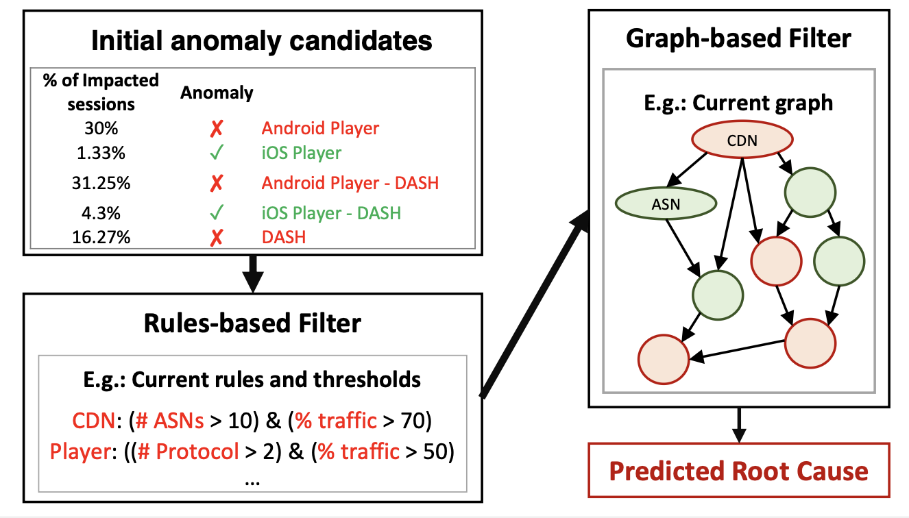
Beagle: Our Approach
Auto-tuning system for anomaly localization
Key idea: Learn rules & graph from limited feedback
Two cascaded filter stages:
① Rule-based filters (thresholds + logic)
② Graph-based filters (precedence DAG)
Design principles:
Interpretable (aligned with domain expert mechanisms)
Learns general rules from specific patterns
Works with very limited ground truth
IWQoS 2026
6/13

Slide 7
Design: Rule-Based Filters
Expert-configured rule (static thresholds)
Beagle: learns thresholds from feedback
Flag CDN as root cause if:
Impacted ASNs > 50% AND Impacted Traffic ≥ 70%
Same rule structure, learned thresholds:
Impacted ASNs > 40% AND Impacted Traffic ≥ 70%
Scenario: real issue with CDN_{A}
Same scenario → now correctly identified:
Impacted ASNs: 48% ✗ (below 50% threshold)
Impacted Traffic: 85% ✓ (above 70% threshold)
→ Rule says: NOT a root cause (missed!)
Impacted ASNs: 48% ✓ (above 40% threshold)
Impacted Traffic: 85% ✓ (above 70% threshold)
→ Correctly flagged as root cause ✓
Key properties:
• Same rule structure experts use → interpretable
• Thresholds tuned automatically from ground truth
Static thresholds are brittle — small misses cause false negatives
Smooth approximations of yes/no rules let us use standard ML optimization to find the best thresholds
IWQoS 2026
7/13

Slide 8
Design: Graph-Based Filters
Template Graph → Unrolled Graph
Template: generic dimensional relationships
Unrolled: specific values from observed data
Learned from Data
Edges as weights (relationship between dimensions)
Shared weights across all instances of the same type
Two types of graph rules:
ChildFiltersParent — "more specific wins”
ParentFiltersChild — "broad context validates specific"
Template Graph
Unrolled Graph
Learn one weight per relationship type
Shared weights applied to specific instances
CDN
CDN_{A}
CDN_{B}
w₁
ASN
ASN₁
ASN₂
ASN₃
w₂
Device
Desktop
Smart TV
ChildFiltersParent: ASN₂ is anomalous → suppress CDN_{A}
(more specific child is the true root cause)
Shared parameters: all CDN→ASN edges use w₁
Generalizes from specific examples to new instances
IWQoS 2026
8/13

Slide 9
Evaluation Setup
Datasets: Two large-scale live sports streaming datasets
> 1 million concurrent sessions
Multiple games over a season, each lasting hours
Hundreds of thousands of user groups
Baselines compared:
Expert: manually tuned production system
GBDT: Gradient Boosted Decision Trees (XGBoost)
Set Transformer: state-of-the-art deep neural network
Metrics: F1 Score, Mistake Rate
Mistake Rate = (FP + FN) / total samples
Split: 60% train / 20% validation / 20% test
IWQoS 2026
9/13

Slide 10
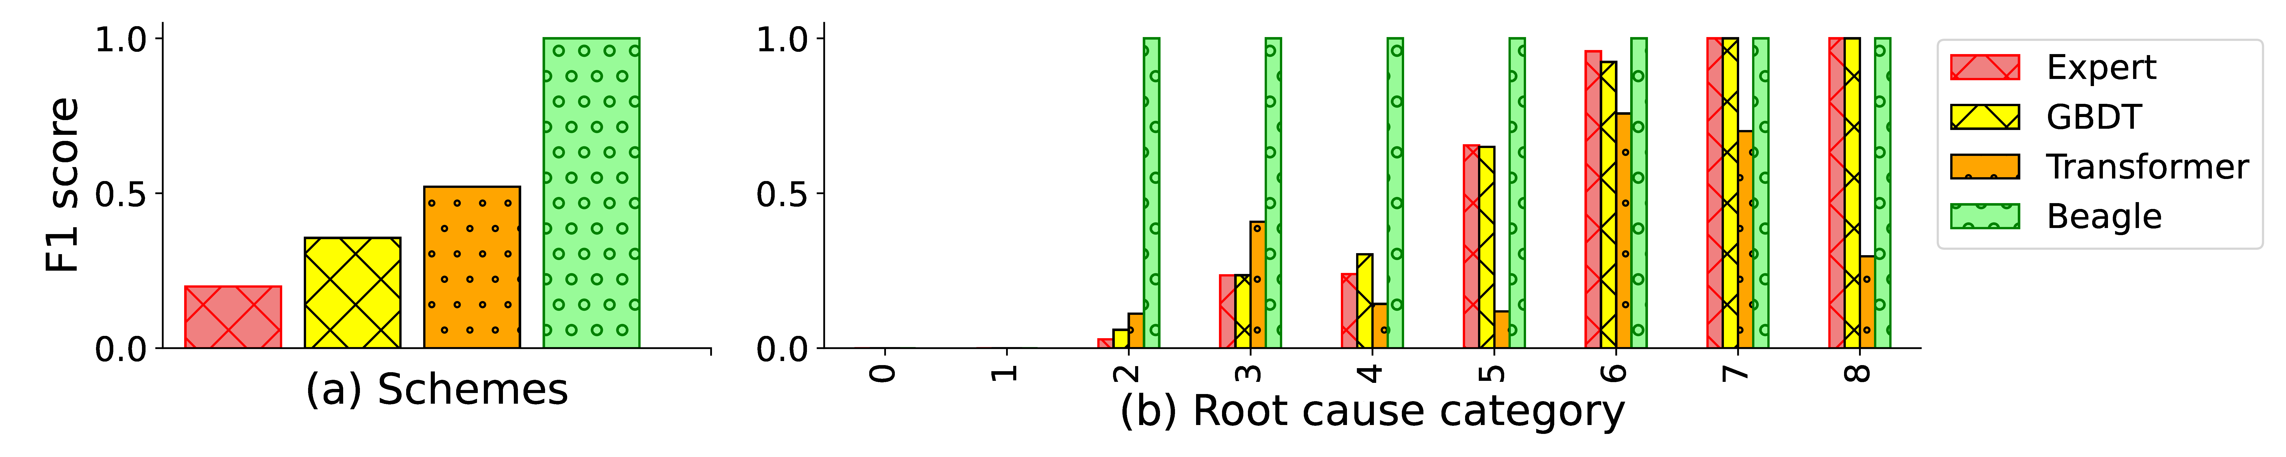
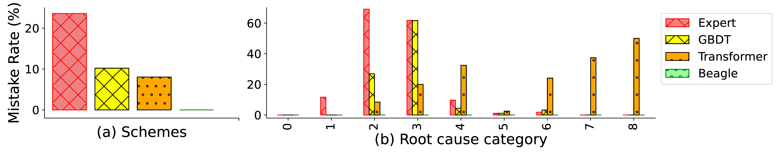
Results: Beagle vs. GBDT vs. Set Transformer
Beagle F1: 0.96+ | GBDT: 0.35 | Set Transformer: 0.52
GBDT fails on categories requiring graph relationships; Set Transformer hurt by distribution shift
IWQoS 2026
10/13

Slide 11
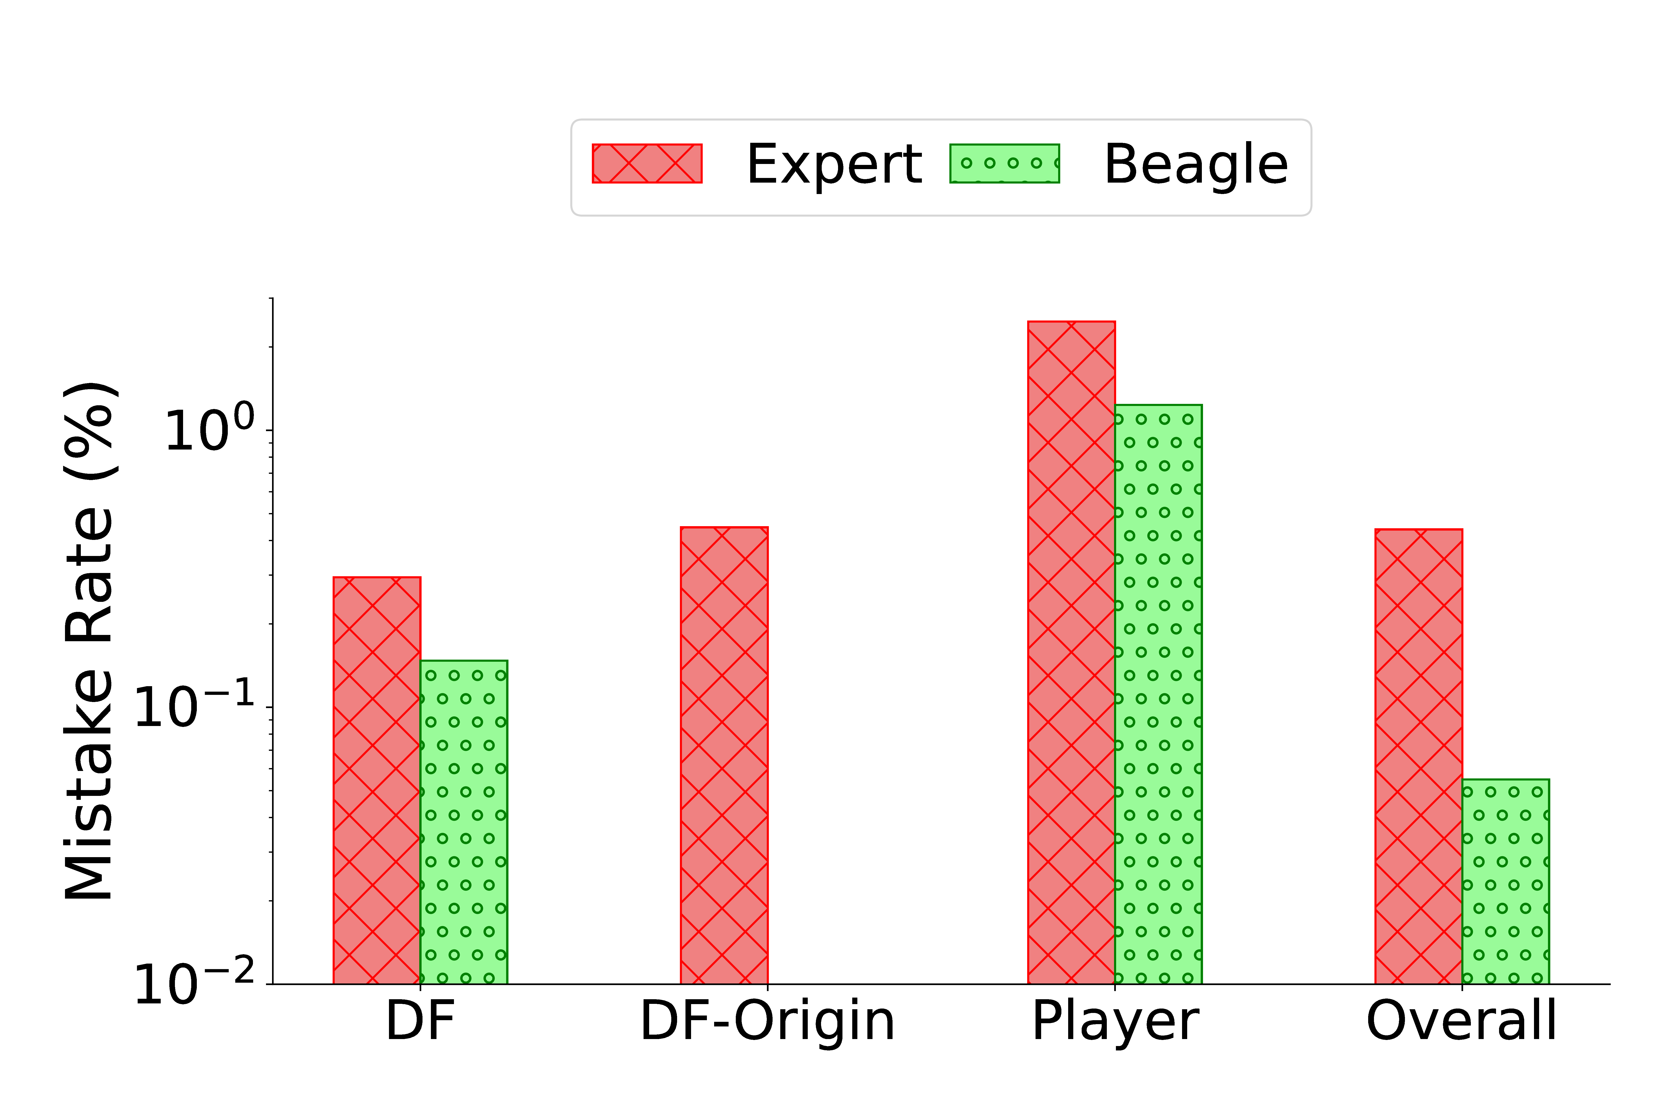
Results: Validation in the Wild
Primed with production expert system → Beagle reduces Mistake Rate from 0.43% to 0.05%
Nearly an order of magnitude improvement with only 1.13% labeled data
IWQoS 2026
11/13

Slide 12
Key Takeaways
Beagle: interpretable, auto-tuning root cause diagnosis for live streaming
Technical contributions:
Continuous relaxation of discrete rules → gradient-based threshold learning
Template graph with DAG constraint → learns general precedence relationships
Self-supervised pre-training + few-shot learning → works with <10 examples
Practical impact:
Reduces manual tuning effort for operational teams
Interpretable → experts can verify suggestions before deployment
Robust to distribution shift (unlike deep learning alternatives)
Nearly order-of-magnitude reduction in diagnosis errors in production
IWQoS 2026
12/13

Slide 13
Thank You!
Questions?

Slide 14
Backup: Challenges in Root Cause Diagnosis
1. Aggregation vs. Detail Tradeoff
High cardinality dimensions (10K+ ASNs, cities) → coarse views only
2. Dependence Between Dimensions
Single issue → anomalies across multiple user groups
Player P correlated with Device Families; Protocol Q with CDNs
3. Limited Feedback / Ground Truth
Only ~1.13% of data points have retrospective labels
Root causes are rare and imbalanced
4. Continuous Manual Tuning Required
Rules and precedence graphs need domain expertise
Long production cycles for each update
IWQoS 2026
B0/3

Slide 15
Backup: Design: Learning from Limited Feedback
Challenge: Only ~1% of data points have ground truth
Solution: Combination of techniques:
Self-supervised pre-training: match existing policy when no feedback
Few-shot learning: adapt from limited ground truth
Weighted loss function:
Higher weight for labeled data points
Lower weight for unlabeled (assume expert is correct)
Balance across root cause categories
Two-stage training:
Stage 1: Freeze graph, learn rule thresholds
Stage 2: Freeze rules, learn graph structure
IWQoS 2026
B1/3

Slide 16
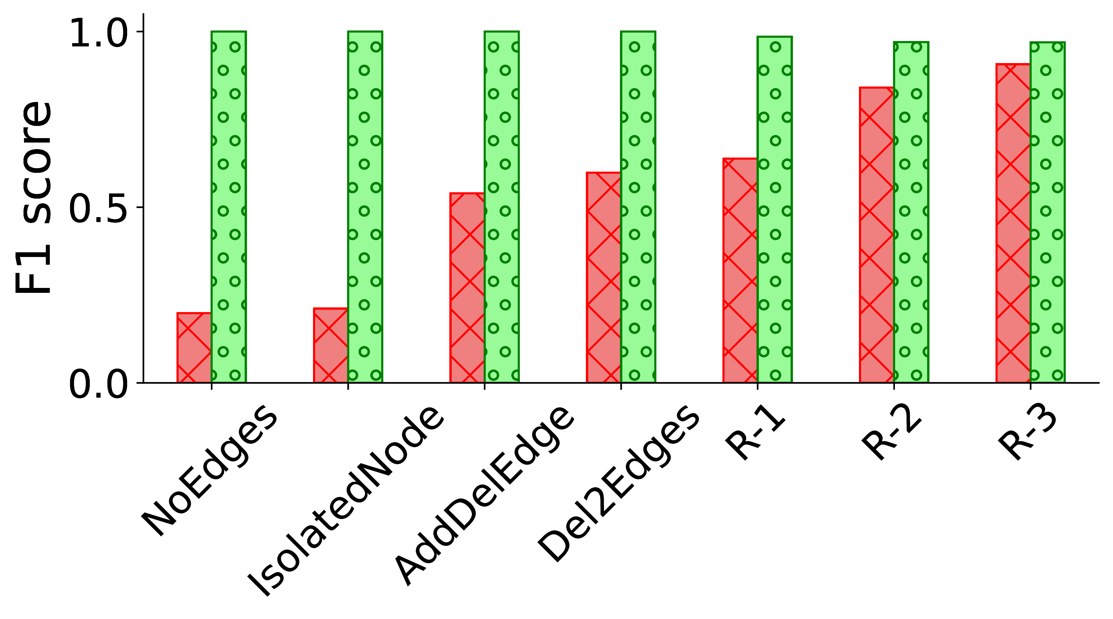
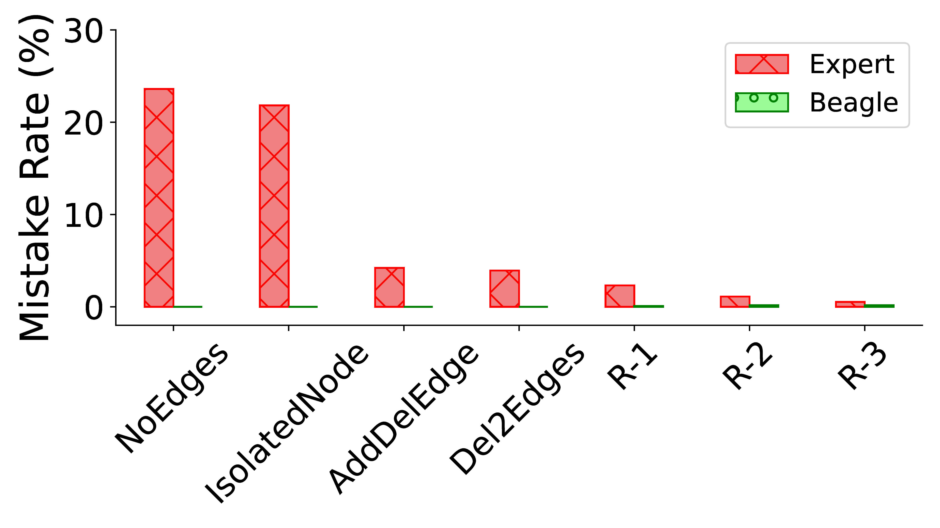
Backup: Results: Beagle's Auto-Tuning Ability
Beagle achieves F1 ≈ 1.0 across all test cases, even from weak starting points
Mistake Rate reduced by orders of magnitude vs. perturbed Expert models
IWQoS 2026
B2/3

Slide 17
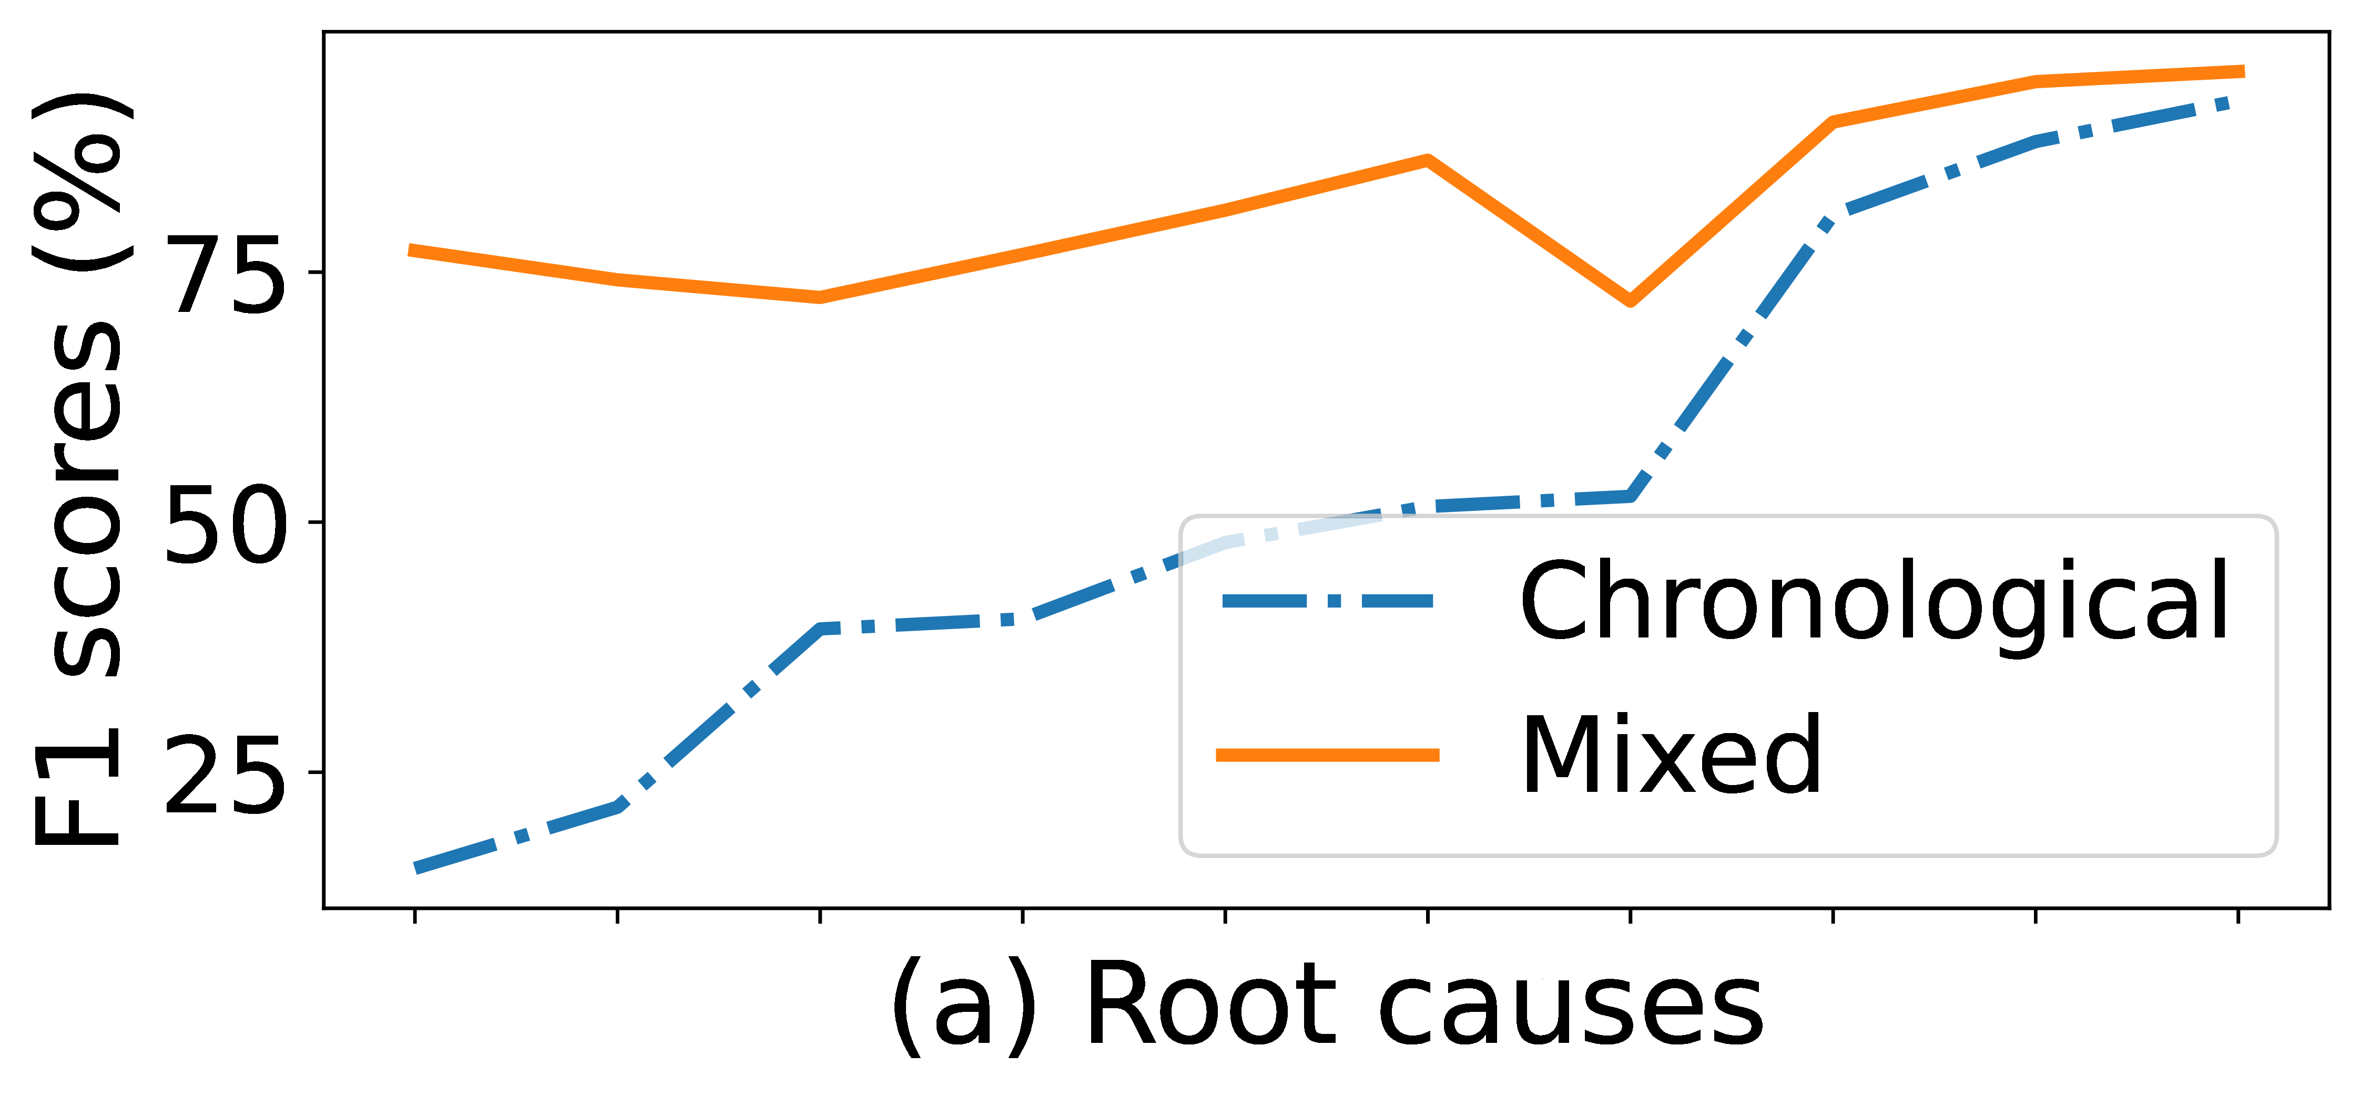
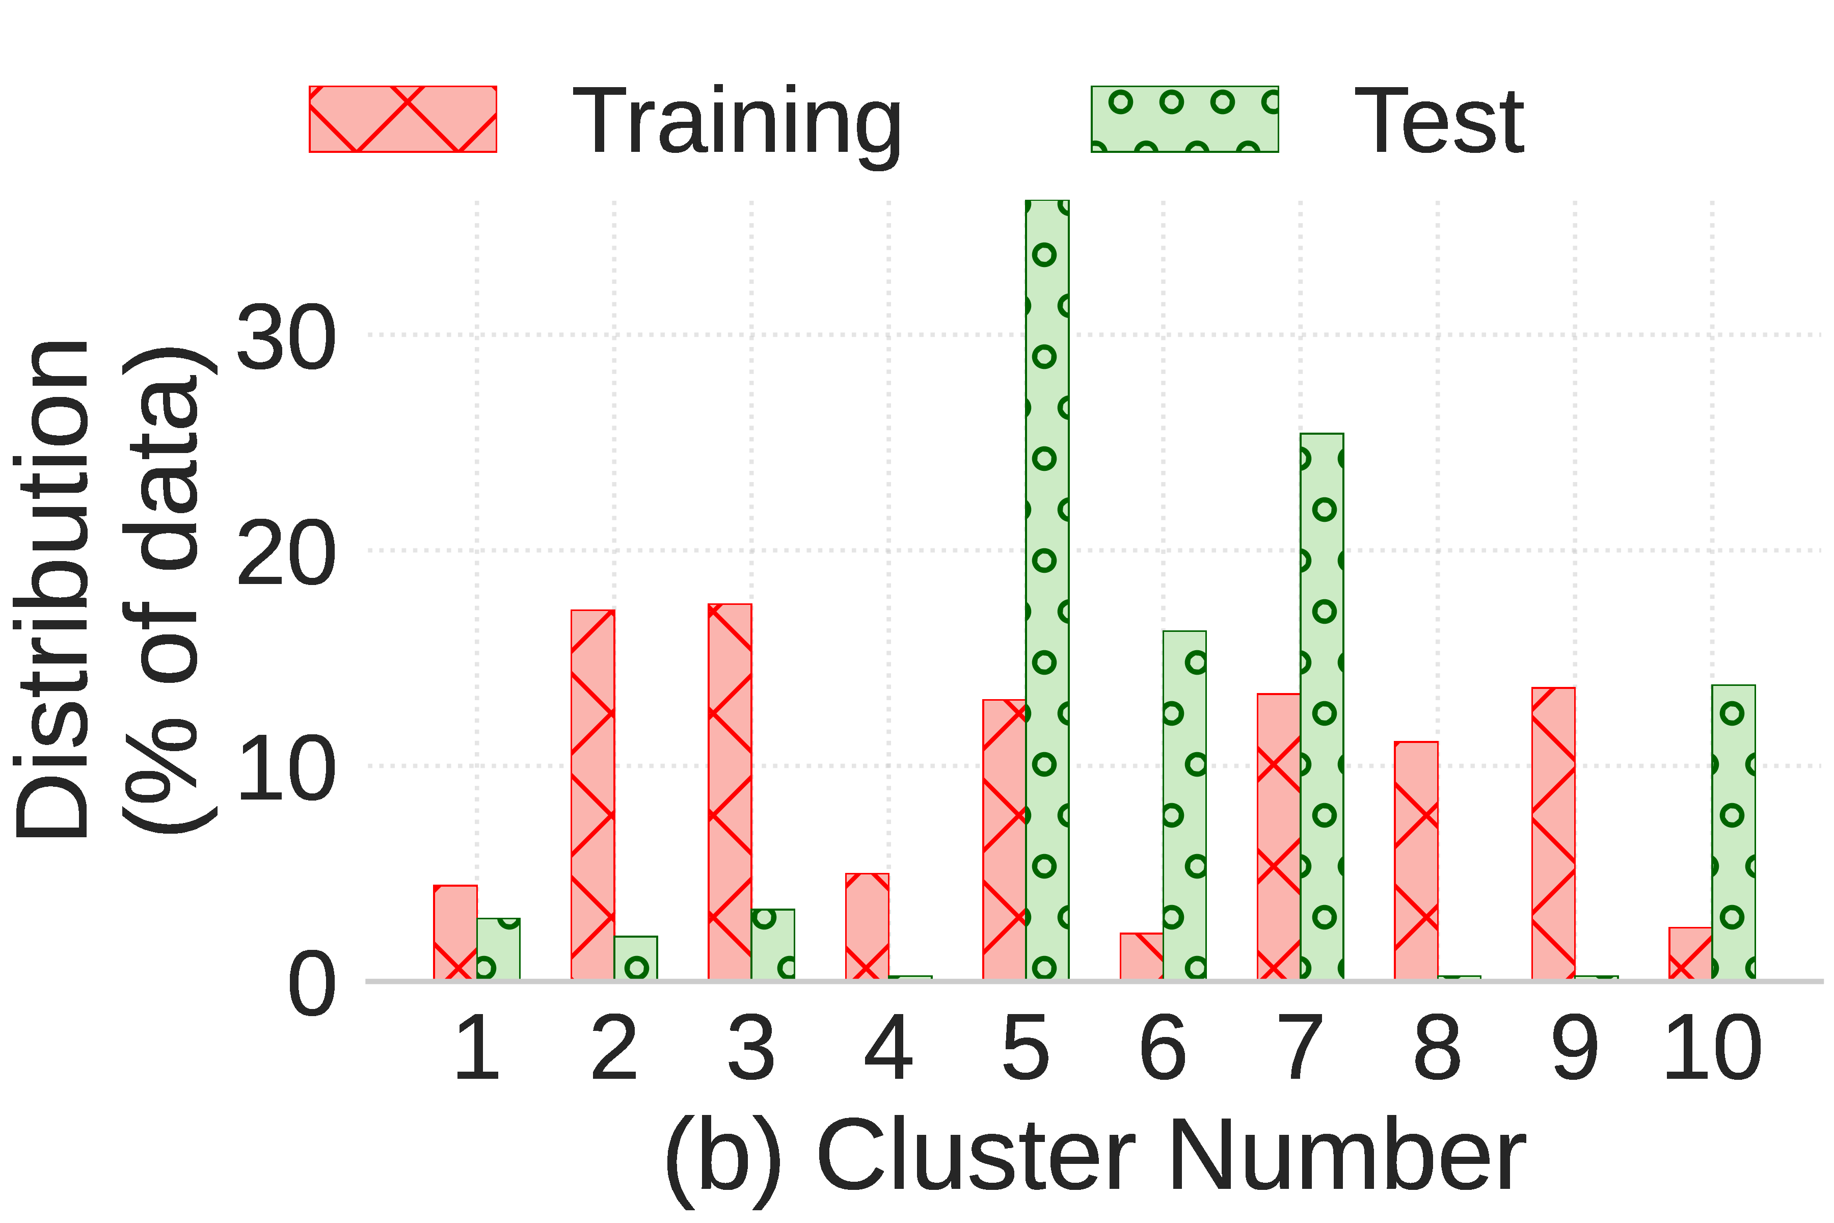
Backup: Why Does the Set Transformer Fall Short?
Distribution shift between training and test data
Mixed (past+future) training → 68% median F1 improvement over chronological
Beagle's inductive biases from domain knowledge make it robust to such shifts
IWQoS 2026
B3/3

