Slide 1

Enabling Contribution Awareness in an Overlay Broadcasting System
Yu-Wei (Eric) Sung
Michael Bishop, Sanjay Rao
School of ECE
SIGCOMM, Pisa, September 14, 2006

Slide 2




Video Broadcast using Overlay Multicast
Encoder
NYC
A/V Signal
E
Boston
D
E
Ethernet
Pisa
E
D
DSL
D
D
San Francisco
Tokyo
E
LA
Overlay Tree
Boston
NYC
Pisa
LA
San Francisco
Tokyo

Slide 3
State-of-Art in Overlay Multicast
Key successes already achieved
  Architecture Validation and Protocol Design
    Narada, Yoid, Overcast, NICE, SplitStream, ALMI, CoopNet, Bullet…
  Significant progress on scaling, resiliency
  Real Deployments
    Tmesh (Michigan), CoolStreaming (HK), ESM (CMU)
Much success to date:
  Homogeneous environments with abundant bandwidths
Can we go further? Is overlay multicast feasible in mainstream Internet environments?

Slide 4
Focus of This Paper
Heterogeneity in node upload/forwarding bandwidth:
  Upload access bandwidth varies widely
  Hosts may choose to forward differently
Resource-scarce
  E.g. 80% DSL/Cable modem, 20% Ethernet, Src Rate : 300Kbps
  Insufficient resources to provide full source rate to all receivers
Critical problem: not received enough attention
 | Download | Upload
DSL | 600-1200Kbps | 64-256Kbps
Cable | 1-6Mbps | 128-768Kbps
Ethernet | ≥ 10Mbps | ≥ 10Mbps
Bandwidth Resources

Slide 5
Key Contributions
Comprehensive solution to enable overlay broadcasting in resource-scarce, heterogeneous environments
Implementation on top of an operational broadcasting system
Internet study using traces from operational deployments

Slide 6
Talk Outline
Application Framework and System Design
  Distributed bandwidth allocation policy
  Multi-tree overlay structure
Experimental Methodology
Important Results
Summary

Slide 7
How to allocate bandwidth?
Host i “contributes/forwards” f_{i} :
  Bandwidth actually served to children in the broadcast
  May be less than access bandwidth
How much bandwidth r_{i} should host i receive?
Simple policy: bit-for-bit → r_{i} = f_{i} , inadequate since
  Resource-rich host can contribute more than src rate
  Resource-poor hosts are constrained by their upload bandwidth.

Slide 8
Our Approach
Provide support for bandwidth allocation policies
  More generic than bit-for-bit
  Amenable to distributed implementation
  Differential and Equitable Distribution
r_{i} = α × f_{i} + ( 1–α ) × ( avg f )
  Motivated by recent work on linear taxation
    [Sigcomm 04 PINS workshop]
∑ f_{j} / N
Entitled bandwidth
Contribution
_{j}
0 < α < 1

Slide 9
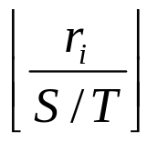
Multiple Overlay Trees [Coopnet,SplitStream]
With support from MDC, split into T-equally sized stripes
T trees, each distributes a single stripe of size S/T
Overall quality depends on the number of stripes received
Number of trees node i is entitled to =
S Kbps
Peer A
Peer C
Source
S/3
S/3
S/3
Tree 1
Tree 2
Tree 3

Slide 10
Entitled Bandwidth: Example
S=400Kbps, T=4, S/T=100Kbps, f_{E}=500Kbps, f_{D}=100Kbps, avg f =300Kbps,α=0.5
  r_{E}=0.5*500+0.5*300=400Kbps → entitled to 4 trees
  r_{D}=0.5*100+0.5*300=200Kbps → entitled to 2 trees
Source
100Kbps
100Kbps
100Kbps
100Kbps
E
D
E
E
D
E

Slide 11
Excess Bandwidth
Unused bandwidth may still exist after peers receive their entitled bandwidth
  When found: Excess Bandwidth
Peer D: entitled to 2 trees, excess in other trees
En. node
Source
100Kbps
100Kbps
100Kbps
100Kbps
E
D
D
E
E
D
E
D

Slide 12
Key Design Issues
Entitled Bandwidth Computation
  r_{i} = α × f_{i} + ( 1–α ) × ( avg f )
  Distributed global state sampling
  Smoothing entitled bandwidth
Excess Bandwidth Discovery
  Fair distribution while minimizing oscillation
  Achieved by active probes with Backoff, Prioritization

Slide 13
Evaluation Goals
How effective are these heuristics in providing incentives?
  Bandwidth
How stable is the resulting system?
  Time between tree reductions
  Reconnection time

Slide 14
Evaluation Methodology
Playback 20-min segments of real traces on Planetlab:
Use Slashdot to evaluate 2 systems:
  Cont-Agnostic: multi-tree broadcast system
  Cont-Aware: multi-tree + contribution-aware heuristics
S=400Kbps, T=4, stripe size S/T=100Kbps
  2 types of peers: Ethernet f_{max} ≤800Kbps, DSL f_{max} ≤100Kbps
  HC: 700-800Kbps, LC: 75-100Kbps
Broadcast Event | DSL (100Kbps) | Ethernet (10Mbps) | Peak Group Size
SIGCOMM2002 | 48% | 52% | 78
SOSP2003 | 48% | 52% | 54
Rally | 75% | 25% | 481
Slashdot | 73% | 27% | 158
GrandChallenge | 82% | 18% | 276
Conferences
Mainstream Internet

Slide 15
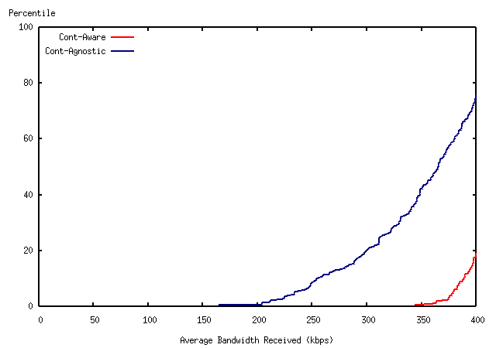
Performance: High Contributors
System | Mean | Std. Dev
Cont-Agnostic | 353 | 60.9
Cont-Aware | 415 | 24.6
Better
Cont-Aware gives HC better performance

Slide 16
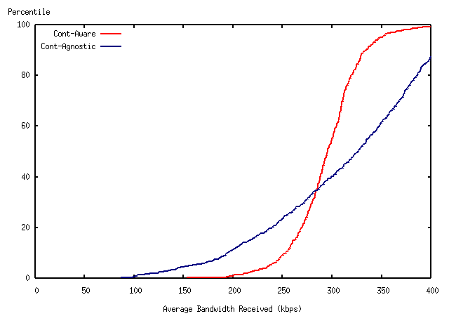
Performance: Low Contributors
Better
System | Mean | Std. Dev
Cont-Agnostic | 311 | 80.5
Cont-Aware | 295 | 34.8
Better
Similar performance among similar contributors

Slide 17
Stability
Time between Tree Reductions
  Cont-Aware performs slightly worse
  Reductions => slight dips in quality
    Not complete disconnection, 63.4% from 4→3, 34.1% from 3→2, only 2.5% from 2→1 and 1→0
Reconnection time (in sec)
 | Cont-Aware | Cont-Agnostic
HC | 7.1 | 80.82
LC | 53.42 | 65.26
Overall | 48.25 | 69.83

Slide 18
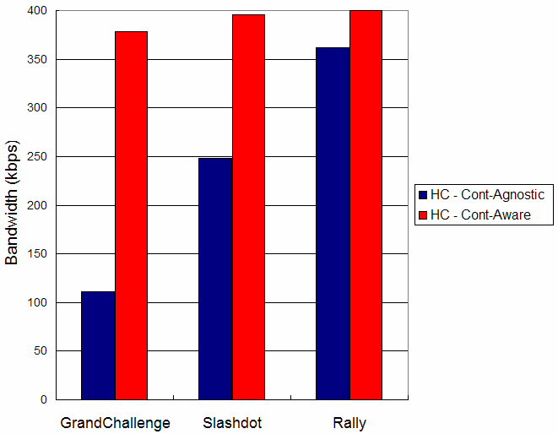
Performance across traces for high contributors

Slide 19
Summary
Focus: Video broadcasting in resource-scarce, heterogeneous environments
Comprehensive solution to address this challenge
  Leverages two key ideas: Multi-trees and Linear Taxation
  Implemented on top of an operational Broadcast System
  Internet study using traces from operational deployments
Key step to extend overlay broadcasting in mainstream Internet environments
Future work: exploration of resource allocation policies, cheating of nodes, detecting node capabilities.

Slide 20
Thank you!
Questions?

