Slide 1
Considering Priority in Overlay Multicast Protocols under Heterogeneous Environments
Michael Bishop, Sanjay Rao – Purdue University
Kunwadee Sripanidkulchai – National Electronics and Computer Technology Center, Thailand
Notes:
Number slides

Slide 2

Overlay Multicast
Purdue
NYC
Seattle-LAN
SF1
Seattle-LAN
SF2
Overlay Tree
NYC
Seattle-Modem
Purdue
SF1
SF2
Many system designs
  ESM, Bullet, Scribe, Splitstream, etc.
Many real deployment studies
  ESM, CoolStreaming, etc.
Notes:
Shrink graphics, cite systems here
Widely studied in community

Slide 3
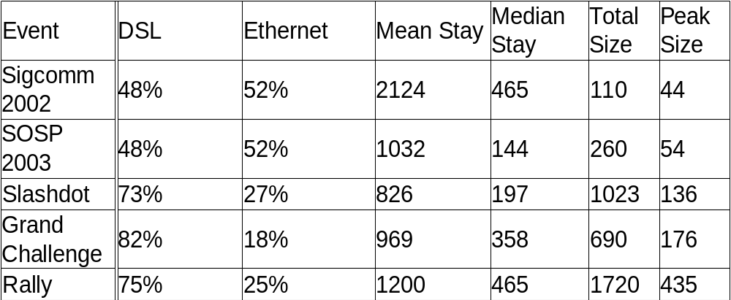
Motivation
Heterogeneous environments
  Outgoing bandwidth
  Session duration
  Not correlated! (Correlation coefficient of -0.01)
Data from ESM project (http://esm.cs.cmu.edu)
Notes:
Hit different environments – some 50/50, some more than 80% DSL
Use Slashdot to highlight, mention later

Slide 4
Our Contributions
Trace-based simulation study evaluating prioritization heuristics in heterogeneous environments
Formulate and study two key trade-offs of overlay multicast under heterogeneity
  Single-tree: Preference for node degree vs. node stability
  Multiple-tree: Overall performance vs. high-contributor performance
First systematic consideration of heterogeneity in multi-tree protocols
Notes:
Clarify HC as “important nodes”

Slide 5
Roadmap
Introduction & Motivation
Assumptions in Model
Single-Tree Protocols
Multiple-Tree Protocols
Conclusion

Slide 6
Protocol Model & Prioritization
Minimum-depth location eligible
A node is eligible if:
  the location is vacant
  the node has higher priority than the location's current occupant
  (Preemption)
Priority determined by algorithm used
High Priority
Low Priority
Notes:
Two colors – high and low

Slide 7
Metrics and Interpretation
Metrics
  Interval between ancestor changes
    Frequency of disconnections
  Stream loss rate
    Penalties assigned to disruptions
    Models average application performance
Caveat
  More details about assumptions in paper
Notes:
Have backup to discuss details of the two, leave vs. death, etc.

Slide 8
Factors Impacting Performance
Frequency of Disruptions
  Depth
  Ancestor Quality
    Network Dynamics
    Group Dynamics
Time to Reconnect
Notes:
Don't verbally justify neglecting network

Slide 9
Roadmap
Introduction & Motivation
Assumptions in Model
Single-Tree Protocols
Multiple-Tree Protocols
Conclusion

Slide 10
Minimizing Ancestor Impact
Number of Ancestors
  Improve by reducing tree depth
  Prioritize by node degree
Quality of Ancestors
  Improve by promoting nodes likely to remain in system
  Stay times unknown
  Age used as predictor of remaining stay time
Both at once?
  Trade-off between the two
    Prefer young high-degree to old low-degree?
Notes:
VERY, VERY SLOWLY.

Slide 11
Schemes Considered
No-Preemption used as baseline
Preempt-Degree
  Reduces tree depth
Preempt-Age
  Improves quality of ancestors
Family of Degree-Age Hybrids
  A has priority over B if:
  Evaluation goal: Which consideration is most effective for our real traces?
$\frac{D_{A}}{D_{B}}<{\left(\frac{A_{A}}{A_{B}}\right)}^{−p}$
D_{X} – degree of X
A_{X} – age of X
p - parameter
Notes:
Insert table defining elements in formula

Slide 12
Single Tree – Summary of Results
Preempt-Age
  Improves median time between ancestor changes from 2.5 minutes to 3.3 minutes
  Halves observed median loss rate if preemptions are cheap
Preempt-Degree
  Improves median time between ancestor changes to more than 8 minutes!
  Quarters observed median loss rate
Degree-Age hybrids
  Marginal improvement over Preempt-Degree
Notes:
Break back to two slides – schemes, then results
Have in backup – why Degree-Age doesn't improve? Use graph comparing traces under various D-A schemes to talk about composition. Also mention synthetic traces. Note this in talk as interesting.

Slide 13
Roadmap
Introduction & Motivation
Assumptions in Model
Single-Tree Protocols
Multiple-Tree Protocols
Conclusion

Slide 14
Multiple Tree Protocols
Source
Stripe 1
Stripe 2
Stripe 3
Internal nodes
Leaf nodes
Multiple Description Codec
  Divides content into k equally sized stripes
  Content quality depends of fraction of stripes received
SplitStream, CoopNet
Notes:
Add one slide for Uniform vs. ID, then put two ID schemes side-by-side.
Background – MDC (Cite CoopNet and SplitStream)
Uniform vs. ID (Bandwidth Allocation Policy) – only done under homogeneous! This is our contribution.
Questions of ID under Heterogeneity (additional complexity) w/ figures side-by-side

Slide 15
Bandwidth Allocation
Uniform (naïve)
  Same degree in each tree
Interior-Disjoint
  All contribution in one tree
  Used in SplitStream
  Never studied under heterogeneity!
Notes:
All nodes same size

Slide 16
Interior Disjoint Under Heterogeneity
Tree-optimized
Host-optimized
Ethernet
Contributor
Non-Contributor
DSL
Notes:
Show triangles for other trees

Slide 17
Loss in Multiple Trees
More complex under multi-tree
  At each sample, fraction of trees connected
    Connected in 3 of 4 trees: 0.25 loss
  Average across samples
Paper also considers other loss metrics for multi-tree scenarios
  Time disconnected from X or more trees

Slide 18
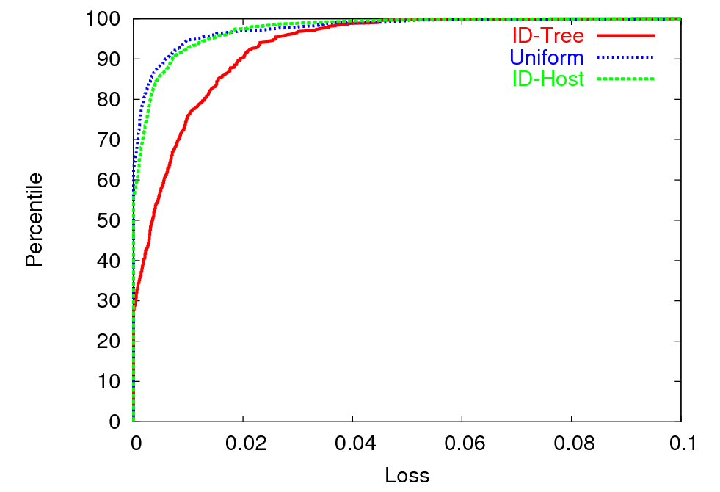
Loss Results for High Contributors
Higher is
better
ID-Tree does poorly for high-contributors
Uniform and ID-Host do well
Notes:
ID-Tree doesn't do well for high contributors – but how much does it cost to do better? Better than Uniform (naïve)
Best allocation and best prioritization don't do well together
Verbally state axes

Slide 19
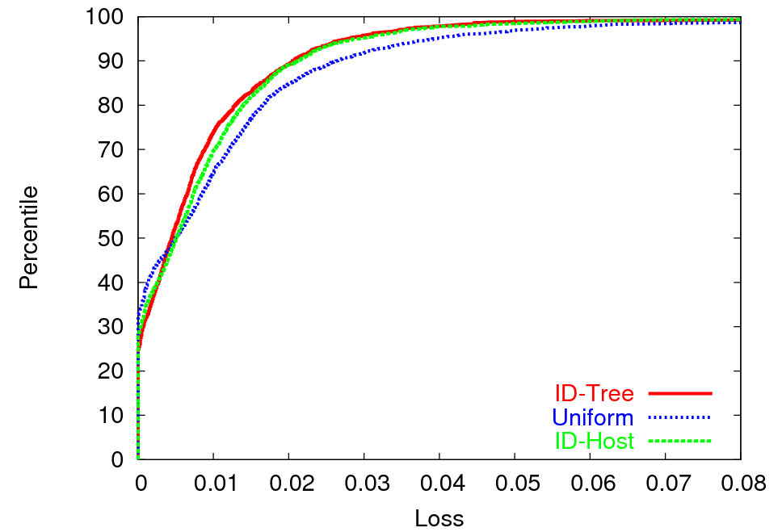
Loss Results for All Hosts
Higher is
better
Interior Disjoint policies better overall
Cost of ID-Host minimal
Notes:
Excitement – why is this interesting?

Slide 20
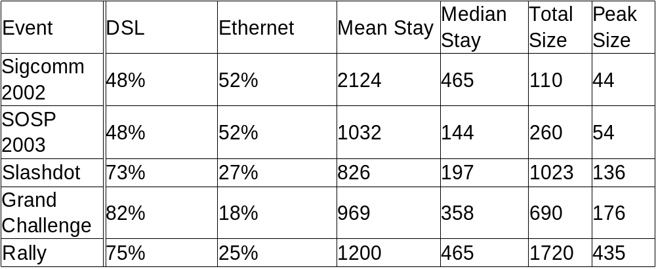
Sensitivity to Trace
Tried with several traces with varied characteristics
Slashdot moderately resource-scarce
From ESM deployment:
Notes:
Put conferences together

Slide 21
Sensitivity to Trace
(High Contributors)
Lower is
better
90th Percentile Loss
Notes:
Repeat table before this slide – briefly summarize
Label y-axis, order by RI if possible

Slide 22
Sensitivity Studies
Trace Used
  Study employing five real traces
Degree of hosts
  Using real trace, vary degrees of Ethernet and DSL nodes
Group scale
  Use synthetic trace to generate larger groups and vary average population
Number of Trees
  Using real trace, vary multi-tree parameters
Loss model
  Vary penalties for ancestor departure

Slide 23
Contributions and Conclusions
Study of trade-offs under heterogeneity
  Ancestor number vs. ancestor quality
    Favor reducing ancestor number (degree-based) over improving ancestor quality (age-based)
    Combining both offers minimal improvement over degree-based
  Overall performance vs. high-contributor performance in multi-tree
    Single-tree considerations insufficient
    Improving high-contributor performance has minimal cost to overall performance
First systematic study of multi-tree under heterogeneity
Notes:
Reiterate contributions here
First work to systematically study MT under hetero

Slide 24
Questions?

