Slide 1

Exploring the interplay between CDN caching and video streaming performance
Ehab Ghabashneh and Sanjay Rao

Slide 2
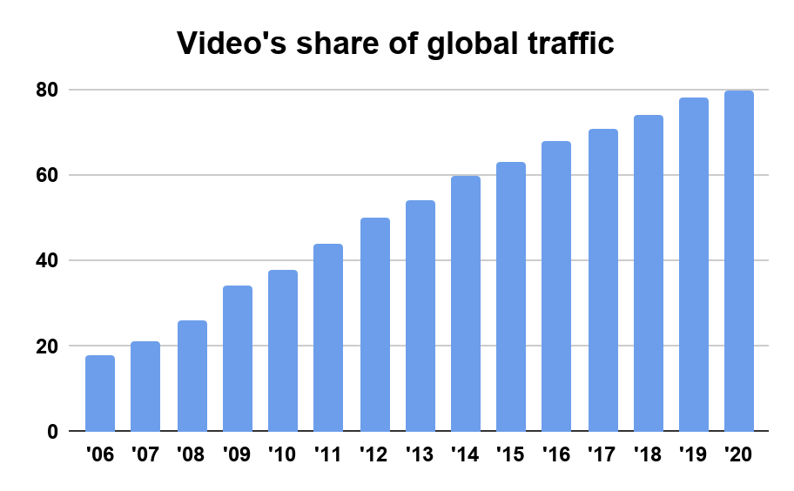




Internet Video Streaming Today
Video streaming: dominant form of network traffic
  Expected to account for 82% of all Internet traffic by 2022 [Cisco forecast].
Video streaming still a challenge
  Higher bit rate video (4K video => 50Mbps)
  Quality of experience (QoE) optimization issue.
Low quality
Rebuffering
1

Slide 3

Background: Adaptive Bitrate Streaming
Bitrates
Video
Time
A video clip is encoded
with multiple qualities (bitrates)
2

Slide 4
Background: Adaptive Bitrate Streaming
Bitrates
Bitrates
Video
Time
Time
Each bitrate is split into chunks
3

Slide 5


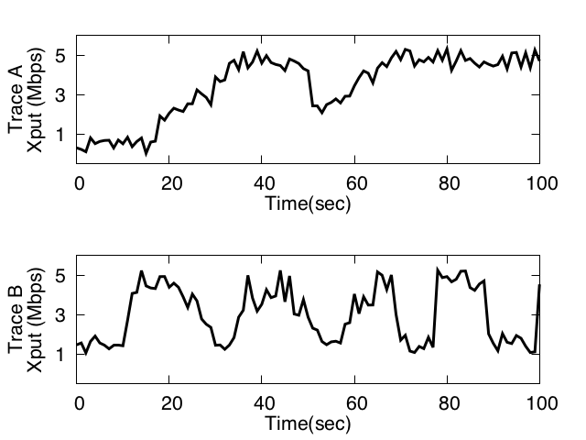
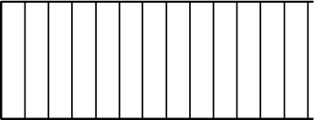
Background: Adaptive Bitrate Streaming
Bitrates
Time
Request nth chunk at bitrate r
Video Server
Video Client
Adaptive Bitrate Algorithms(ABR)
4
Notes:
This operation is periodically done for every chunks in the video using adaptive bitrate algorithms or ABR algorithms.

Slide 6
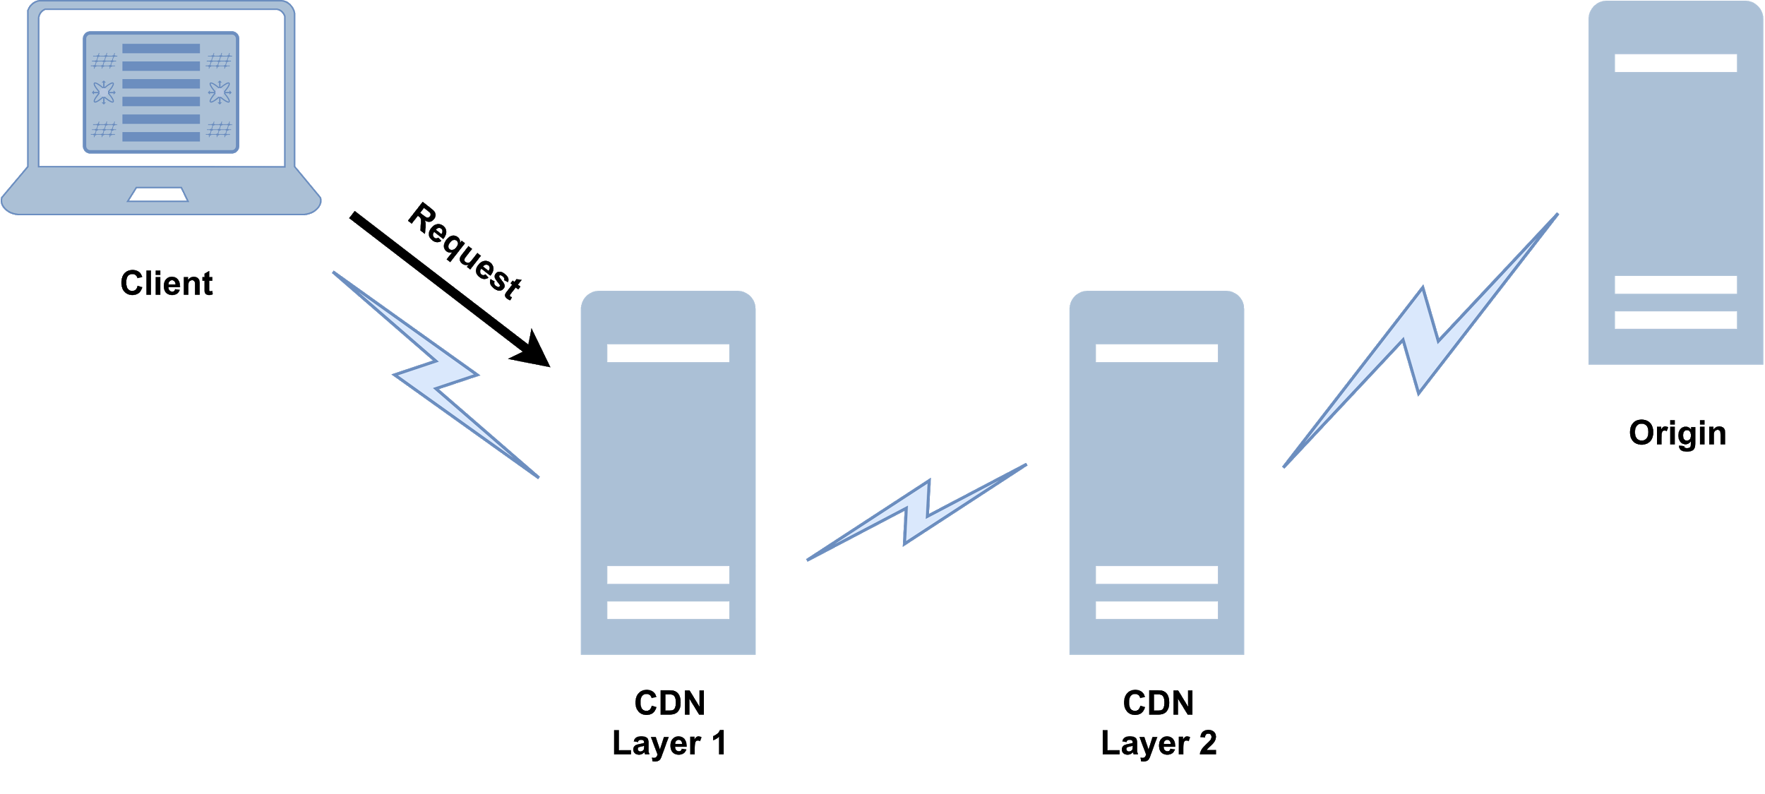
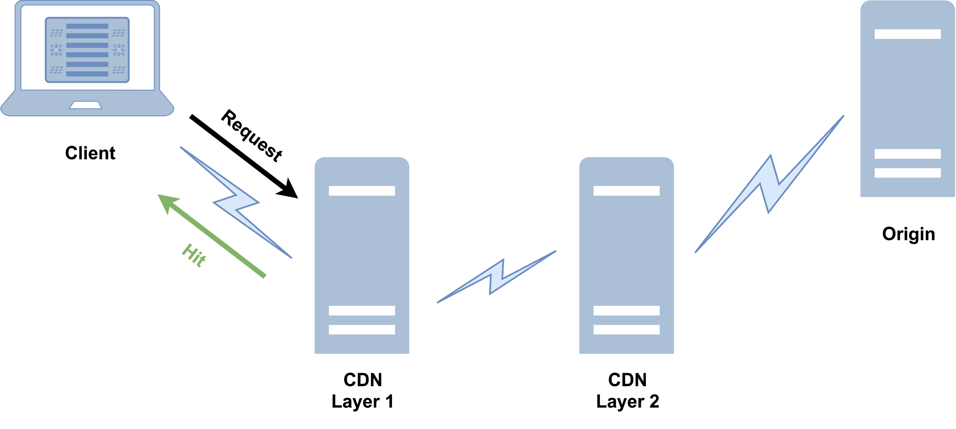
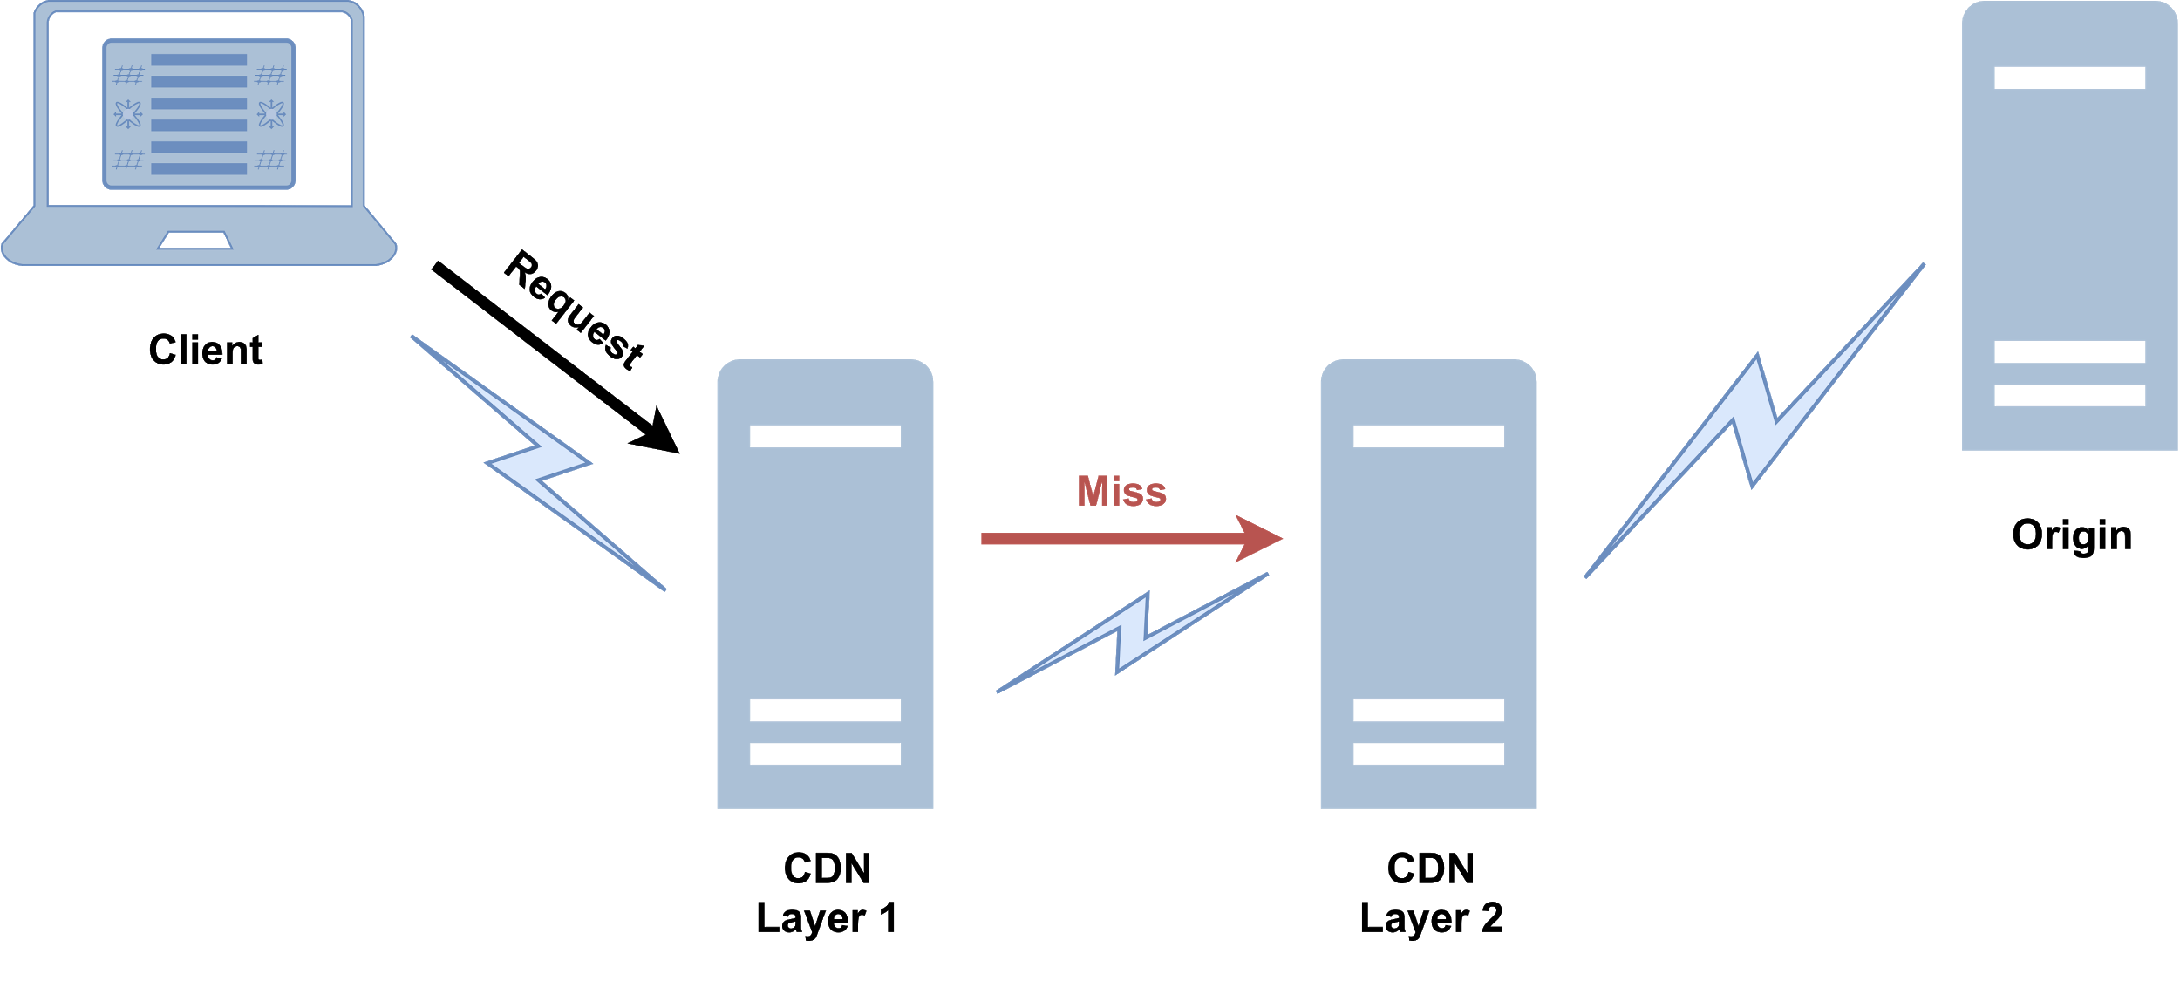

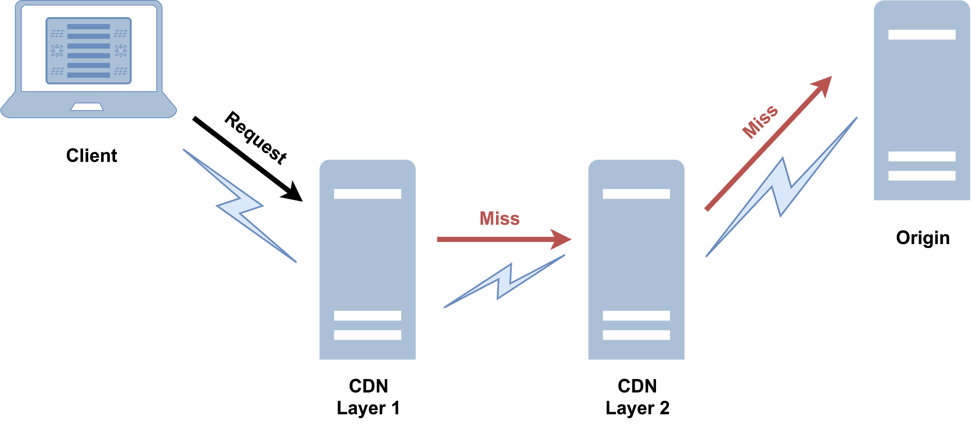

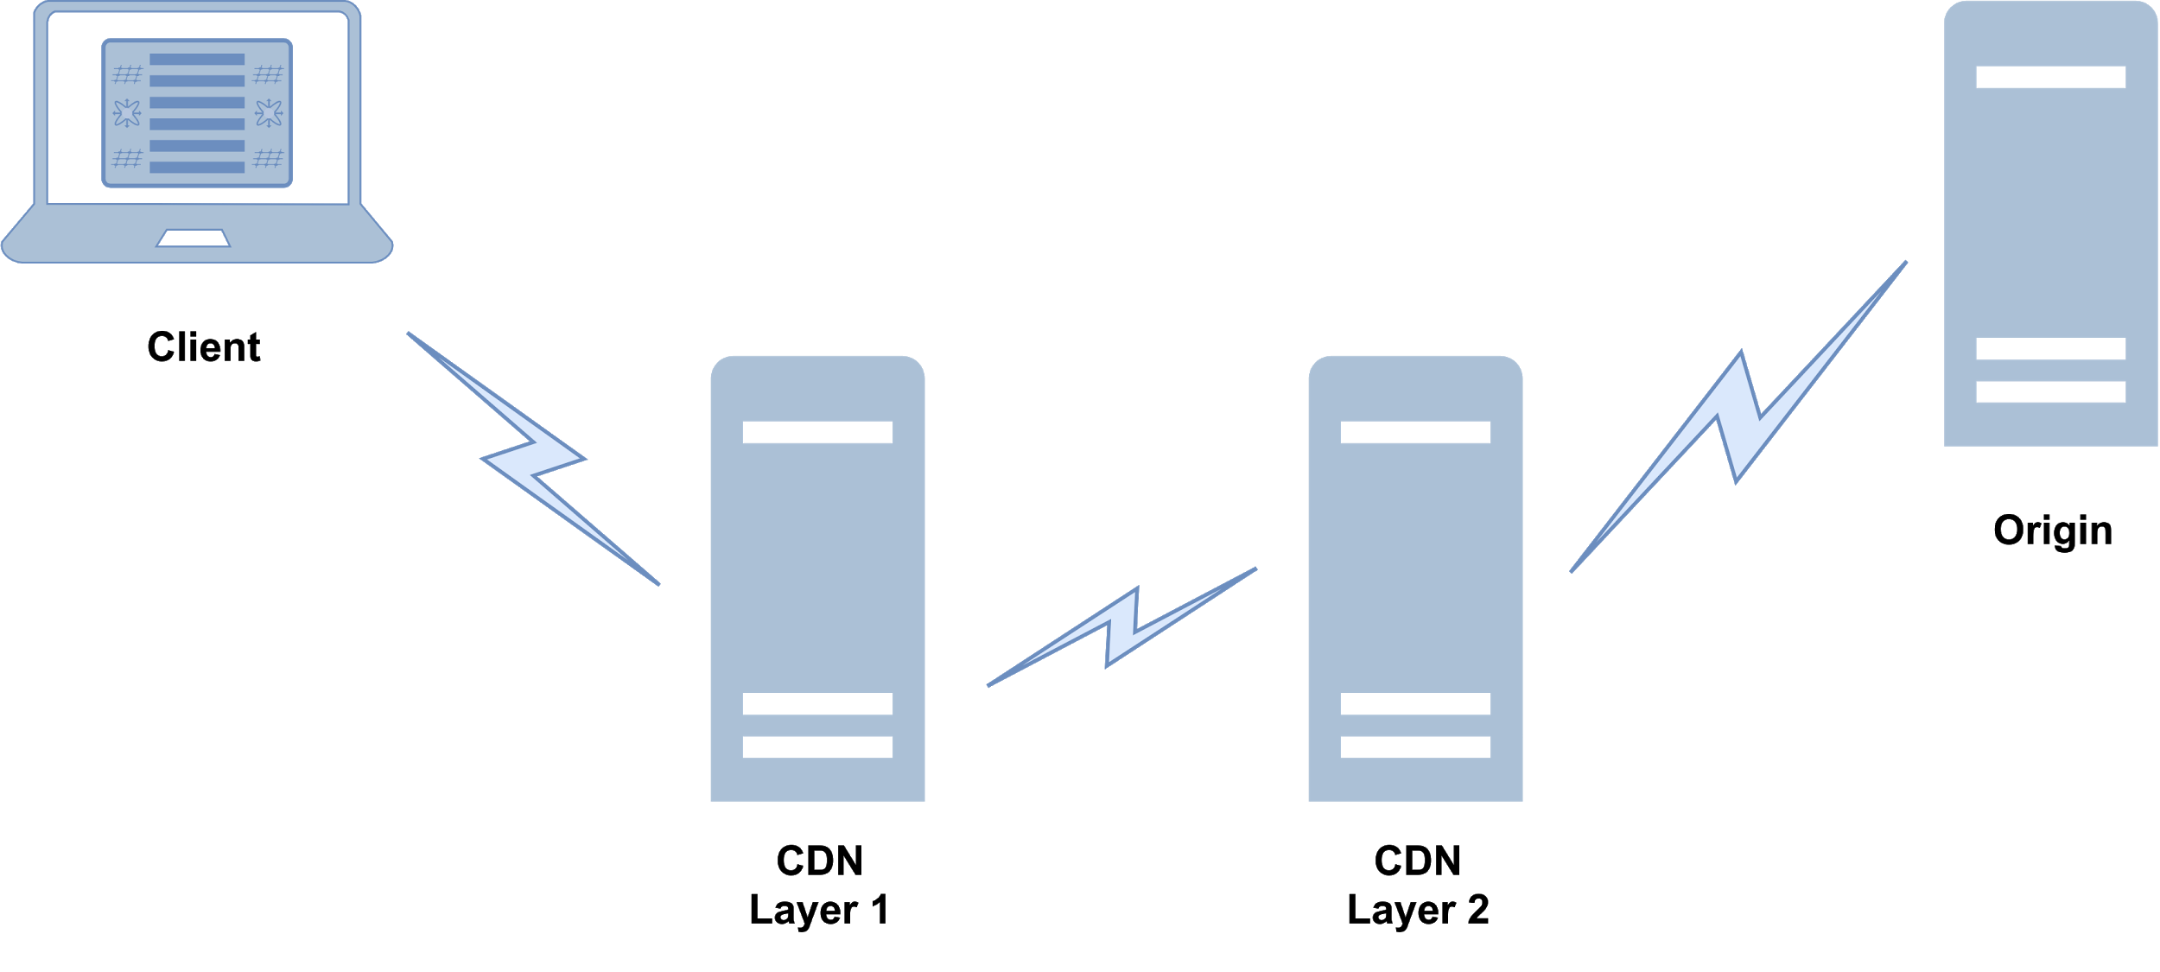
Background: Content Delivery Networks (CDNs)
5

Slide 7
Throughput prediction challenge
ABRs presume that video chunks through the session are served by one single server.
ABRs presume that video chunks through the session are served by one single server.
Reality: video chunks can be served by multiple servers through the same session.
Origin Video Server
miss!
ABR algorithms do not take CDN into account → HIGH prediction error.
Request nth chunk at bitrate r
Video Server
miss!
Video Client
. . . . .
CDN Video Server Layer 1
CDN Video Server Layer n
race A
Adaptive Bitrate Algorithms(ABR)
6

Slide 8
Contributions
Measurements to understand of the interplay between hierarchical CDN caching and Internet video performance.
Evaluate the benefit of exposing CDN information to ABR.
Findings:
  61-74% of sessions have chunks served from CDN and origin (mixed).
  Further, for many sessions, chunks may be served from multiple CDN layers.
  Throughput may vary based on serving layer.
Results: For sessions with significant mix of CDN and origin served chunks.
  ABR throughput prediction error reduced for 81.7% of sessions.
  QoE improved for 91.5% of sessions.
7

Slide 9



Classifying where objects are served from
We focus on Twitch and Vimeo because:
  They are popular (within Alexa top 100 US rank).
  They use CDNs that support special HTTP headers to identify which layer in the hierarchy a video chunk served from.
We picked videos that are popular/trending with video length ranges [5-15] minutes.
Dataset | Publisher | No. of sessions | Quality
ABR-set | Twitch | 104 | Auto (ABR)
 | Vimeo | 50 | Auto (ABR)
4K-set | Vimeo | 238 | 4K
8

Slide 10
Classifying where objects are served from
Challenge: How to infer serving location for each chunk?
Approach: Leverage CDN’s special HTTP headers.
One example, Akamai requires two pragma headers “akamai-x-cache-on” and “akamai-x-cache-remote-on”.
CDN | HTTP Response Header | Value | Server
Akamai | X-Cache X-Cache-Remote | TCP_HIT or TCP_MEM_HIT | Akamai L1/L2
 |  | TCP_MISS | Origin
Fastly | X-Cache | HIT, HIT | Edge
 |  | MISS, HIT
 |  | HIT | Shield
 |  | HIT,MISS
 |  | MISS | Origin
 |  | MISS,MISS
CloudFront | X-Cache | Hit from cloudfront | CloudFront
 |  | Miss from cloudfront | Origin
* more details in the paper.
9

Slide 11
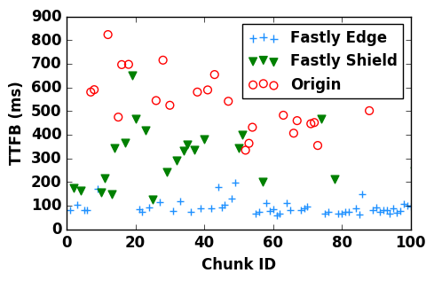
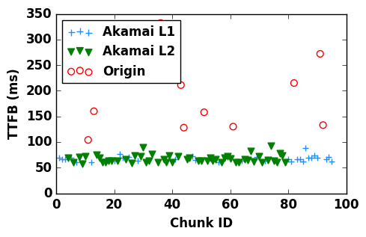
Classifying where objects are served from
Conclusion: chunks in the same video session are served by different points in the CDN hierarchy and Origin for multiple popular video publishers and multiple CDNs!
Time to first byte (TTFB): the time from when a HTTP request for a chunk is made till the first byte of response is received.
10

Slide 12
Why mixed sessions?
We found that 61% of Vimeo Akamai, 72% of Twitch sessions, 74% of Vimeo Fastly, and are mixed!
Insight 1: Chunks earlier in the session are more likely to be served from closer CDN location.
  Hypothesis: users tend to view first few seconds of video more.
  However, we also observe that both early and later in the session, chunks are served from a mix of locations.
Insight 2: Significant switching in serving location could occur from chunk to chunk → can hurt the ABR throughput prediction.
11
Notes:
Akamai Layer 1 is serving more chunks at the start of session ~20% in compare to the rest of the session ~2%. One possibility is to reduce the video start latency.

Slide 13
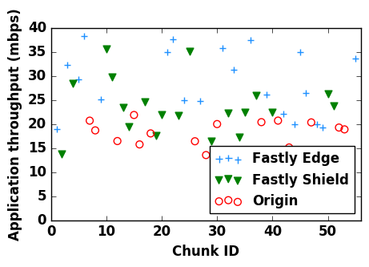

Impact on performance
Does serving location matter? Yes!
Performance metrics:
Time to first byte (TTFB): the time from when a HTTP request for a chunk is made till the first byte of response is received.
Receive Time: the time from when the first byte of a chunk is received till the last byte of it.
Application Throughput: the throughput perceived by the video player which is equal to
Conclusion: Application Throughput depends on where the chunk is served from!
* Results are sensitive to CDN, and Client location. More details in the paper.
12

Slide 14
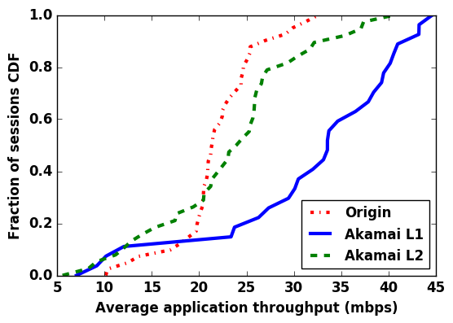
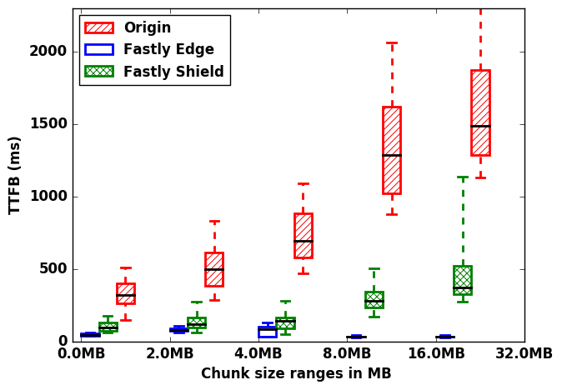
Is it TTFB or receive time?
Will the difference in application throughput hold even for bigger chunk sizes (e.g. 4K chunks) where receive time expected to be >> TTFB? Yes!
Special case: For Vimeo Fastly, TTFB grows with chunk size. [hypothesis is that it has a streaming miss feature which may be turned off].
13

Slide 15
ABR + CDN awareness
We have seen a difference in application throughput based on where the chunks are served from.
Evaluate the benefit of exposing CDN information to ABR algorithms.
14

Slide 16
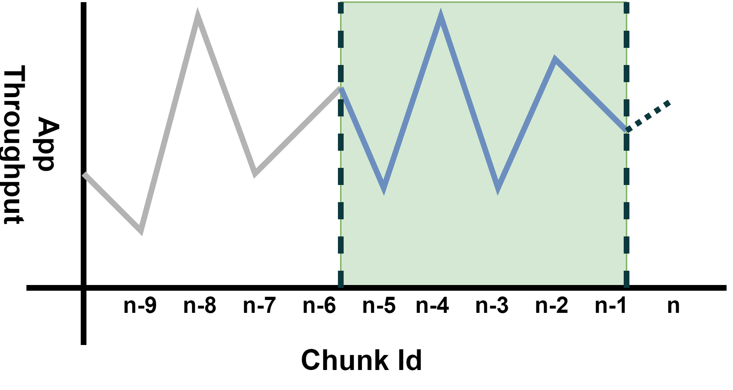
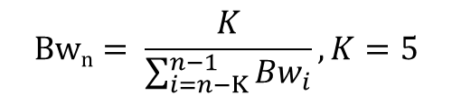
MPC^{[1]} ABR + CDN awareness
Origin Video Server
nth chunk bitrate
miss!
Video Client
. . . . .
CDN Video Server Layer 1
CDN Video Server Layer n
[1] Xiaoqi Yin, et al., SIGCOMM, 2015.
15

Slide 17
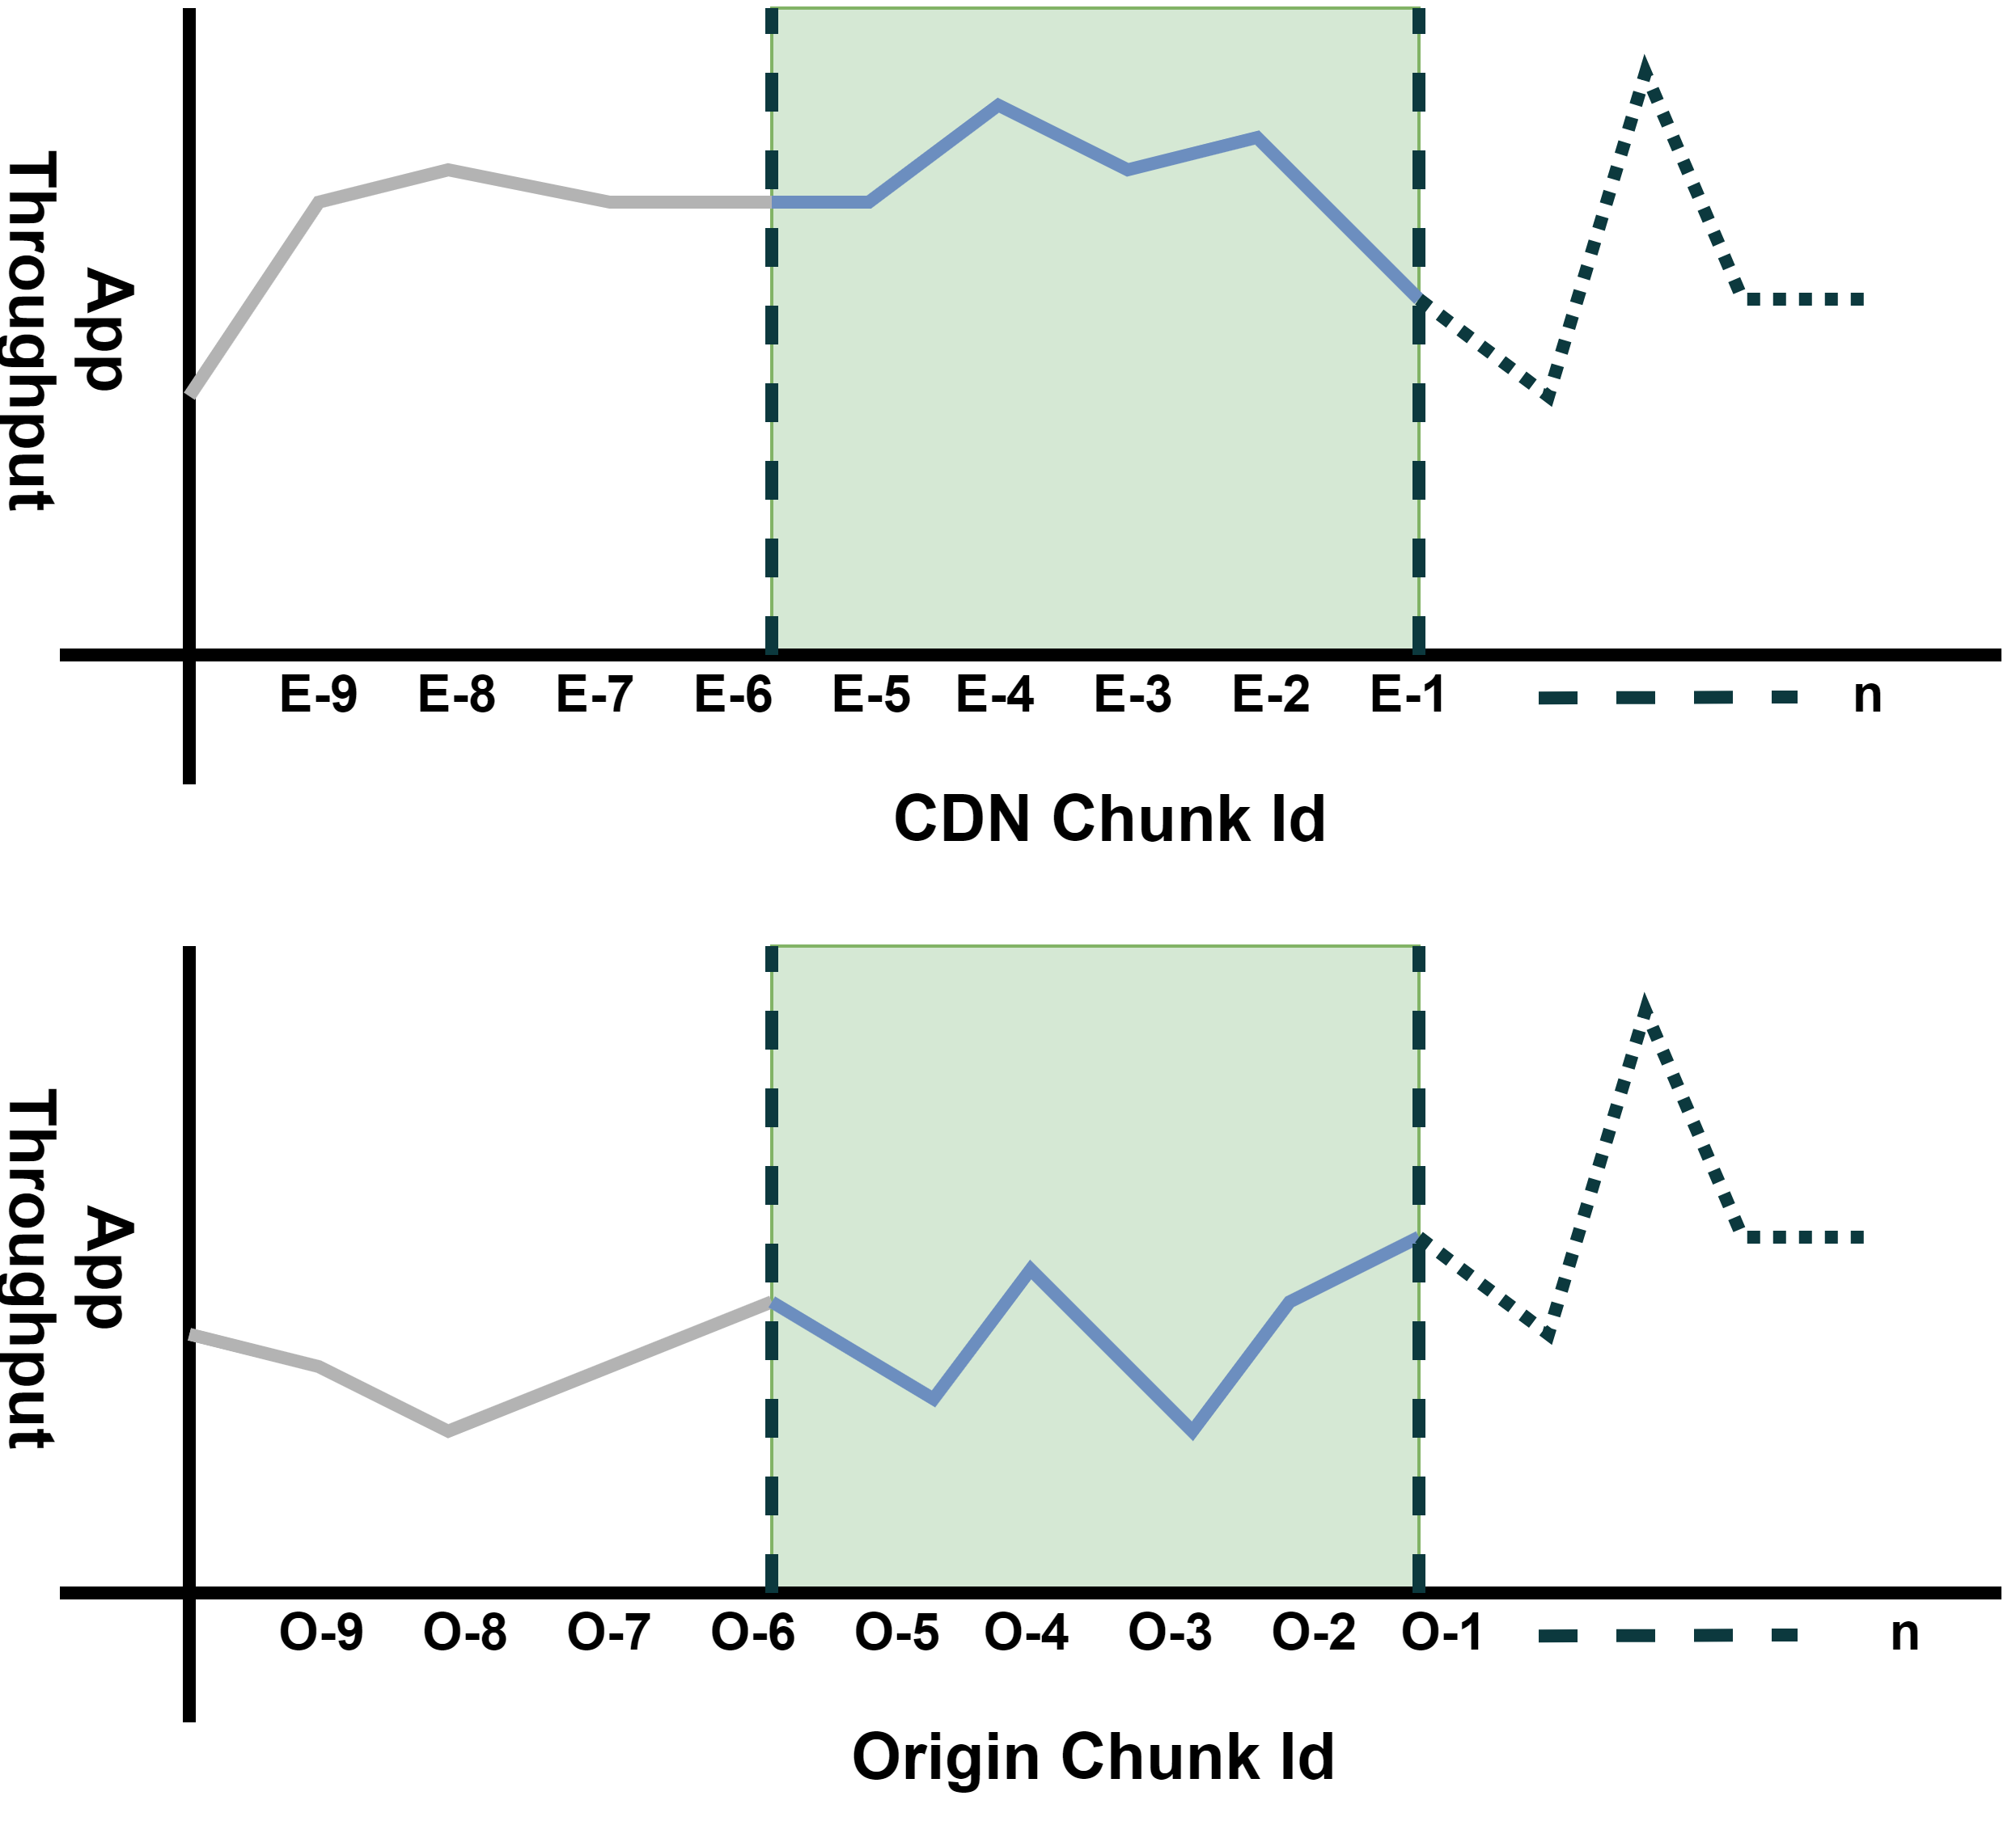
MPC ABR + CDN awareness
Origin Video Server
nth chunk bitrate
miss!
Video Client
. . . . .
CDN Video Server Layer 1
CDN Video Server Layer n
Expose to ABR where the next chunk resides. If next chunk is served by CDN, use CDNs’ throughput history. Otherwise, use the Origins’ history.
16

Slide 18
Evaluation methodology
Emulation setup:
  Video player → Dashjs
  Video client → Chromium browser
  Video server → npm http-server
  Network emulator → Mahimahi
Comparison
  MPC vs. MPC-CDN
QoE Metrics
  Average Bitrate
  Rebuffering Ratio
  Bitrate change magnitude
  QoE-lin (Linear combination of three metrics)^{[1]}
[1] Xiaoqi Yin, et al., SIGCOMM, 2015.
17

Slide 19
Results: the benefit of CDN hint
Evaluated sessions:
  Sessions with at least 20% chunks from CDN and 20% from origin
Throughput prediction error:
  Reduced the error for 81.7% of sessions
  20% of sessions have experienced reduction >= 35.7%
  Modest increase in the prediction error for the remaining sessions [<8.97% on avg]
QoE-linear:
  Improved for 91.5% of sessions
  20% of sessions have experienced improvement >= 10%
  Modest decrease in the QoE for the remaining sessions [<1% on avg]
Rebuffering Ratio:
  Reduced for 73.2% of sessions
  20% of sessions have experienced reduction >= 25.5%
  Modest increase in the rebuffering for the remaining sessions [<1.05% on avg]
18

Slide 20
Summary
61-74% of sessions are mixed (have chunks served from CDN and origin).
Further, for many sessions, chunks may be served from multiple CDN layers.
Application throughput can vary based on where chunk is served from.
For sessions with significant mix of CDN and origin-served chunks, exposing CDN information can
  Reduce ABR throughput prediction error for 81.7% of sessions.
  Improve QoE for 91.5% of sessions.
19

Slide 21
Thank you!
Questions? Please email..
Ehab Ghabashneh & Sanjay Rao
{eghabash,sanjay}@purdue.edu

