Slide 1


Predicting Apple Sweetness
Using Hybrid Machine Learning

Slide 2












Table of Contents
Team Members
Introduction of Study
Problem Statement
Objectives
Definition of Sweetness
Related Study
Research Method Overview
Progress of Research
Reference

Slide 3

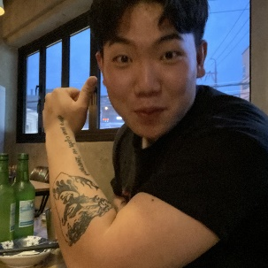
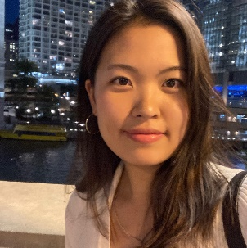
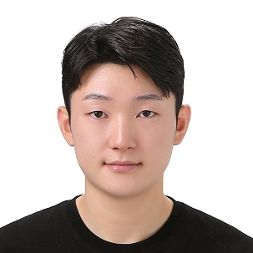
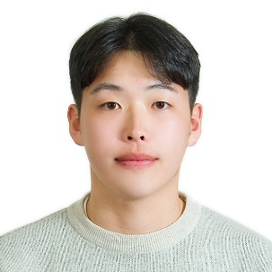
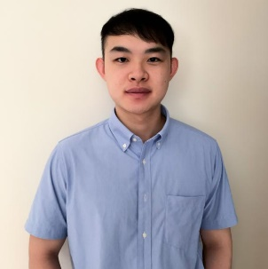
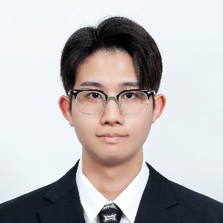
Introducing our Team Members
Heejun Park (YODA)
Yonsei Univ.
parkie0517@gmail.com
Taeyun Kim (KAMATE)
Jeju Nat’l Univ.
persimm0ncrack@gmail.com
Hanbi Kim (PHOENIX)
Chungbuk Nat’l Univ.
hanbikim20@g.cbnu.ac.kr
Seokhyeon Heo (EASY)
Jeju Nat’l Univ.
gj4535@gmail.com
Jeongho Ha (JAY)
Jeju Nat’l Univ.
hjh4212@naver.com
Jeffrey Tsai (GOKU)
Purdue Univ.
jeffrey051622@gmail.com
Kyungrock Kwon (ROCK)
Purdue Univ.
kyungrock99@gmail.com

Slide 4
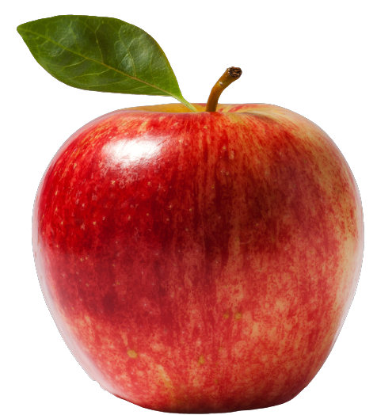
Introduction of Study
Production and Demand of Apples in the US
4,336,000 Tons

Slide 5
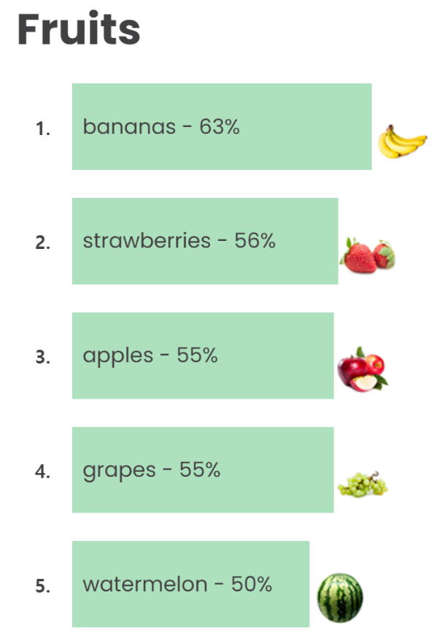
Introduction of Study
Ranked 3rd
in USA

Slide 6
Introduction of Study
Importance of Apple Sweetness
“Consumers”
“Farmers”
Various factors
Sweetness is related to flavor
Sweet apple is most preferred
Demand for sweet apple ⬆
Price ⬆
Economical benefits ⬆

Slide 7

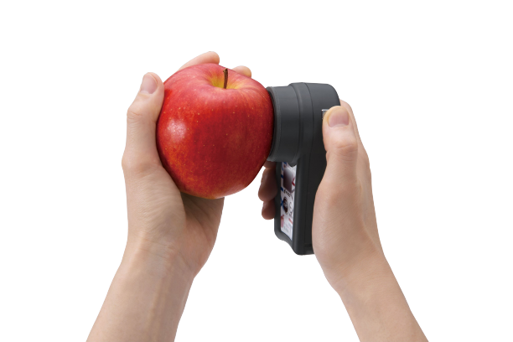
Problem Statement
Problem Consumers Encounter

Slide 8

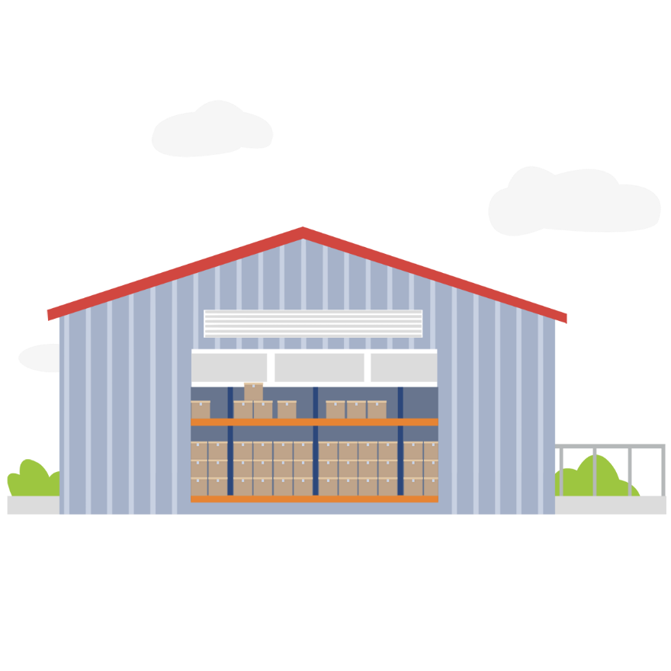
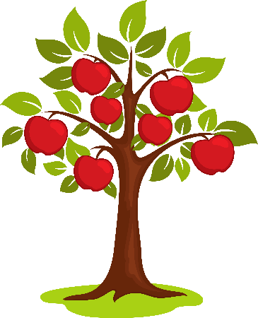
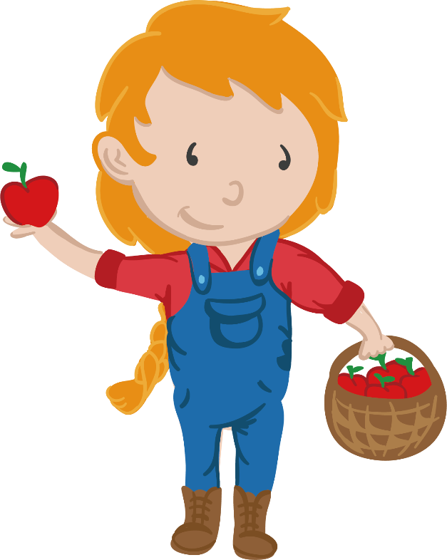
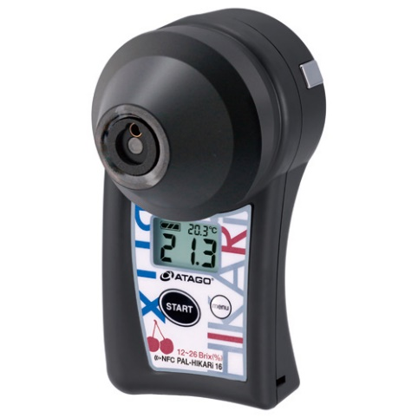
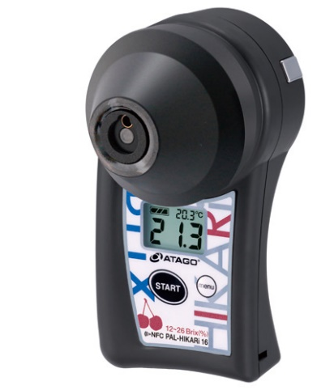
Problem Statement
Problem Farmers Encounter

Slide 9
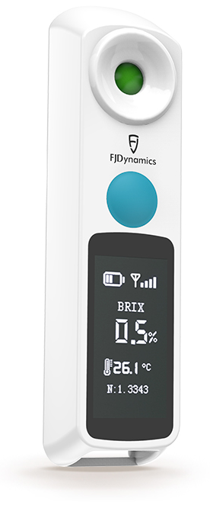
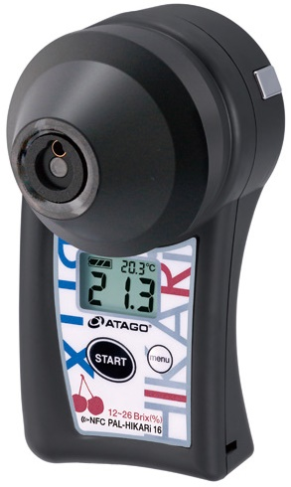
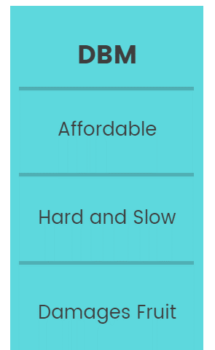
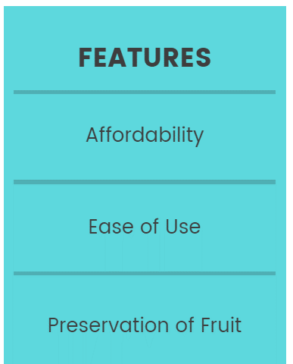
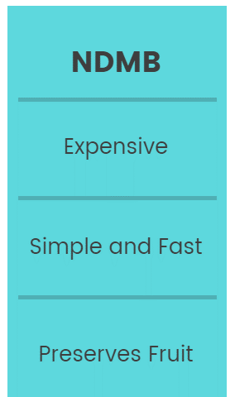
Problem Statement
Two Ways of Measuring Apple Sweetness
Destructive
Mehtod (DM)
Non-Destructive
Method (NDM)

Slide 10
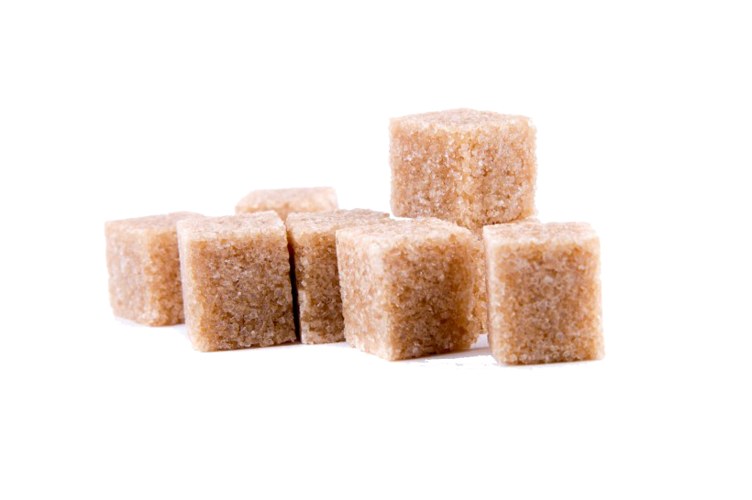





Objectives
What we aim to do in our Project
Preserves Apple
Preserves Apple
Simple and Fast
Simple and Fast
Affordable
Affordable
Non-Destructive Sugar Meter
Predicts Brix Value
Non-Destructive Sugar Meter
Predicts Brix Value
Brix: Degree used to measure sugar

Slide 11
Definition of Sweetness
Our own Definition of Apple Sweetness
Scope Name | Low | Fair | Good | Excellent
Brix Scope | Under 11 | 11~12 | 12~13 | Over 13
- Apple Maturity Guidelines of Michigan State University -
Scope Name | Low | Medium | High
Brix Scope | Under 12 | 12~13 | Over 13

Slide 12
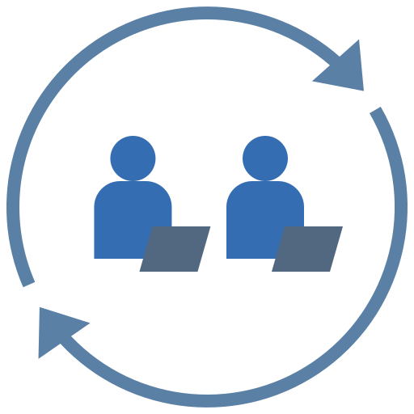

Related study
Analysis of Apple Colors and Sugar Contents Using Linear Regression
Predicting Fruit’s Sweetness Using Artificial Intelligence—Case Study: Orange
A Non-Invasive Method to Classify the Sweetness Levels of Apples
Apple Sweetness Measurement by image processing technique
Determination of Chokanan Mango Sweetness Using Non-Destructive Image Processing Technique
(a) Using hybrid machine
(b) Using only images

Slide 13
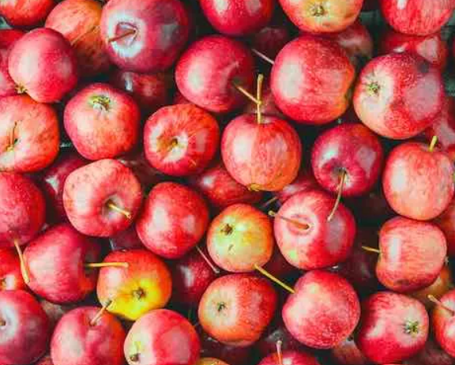
Research Method Overview
A. Sample Preparation
Pixie Crunch
- Botanical Name: Malus domestica 'Pixie Crunch' PP13871;
“Co-op33”
- Size : 2.5 inch
- Color : Medium red blooms
- Soil Requirements: Well-drained, Deep, Fertile soil.
- Growth Rate: 1/2 bushel or more by the third, fourth season.

Slide 14
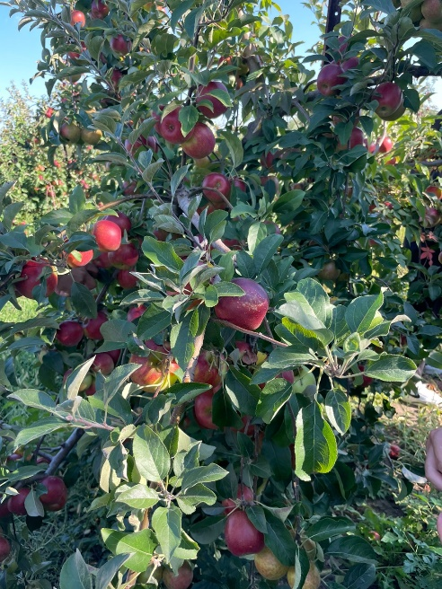
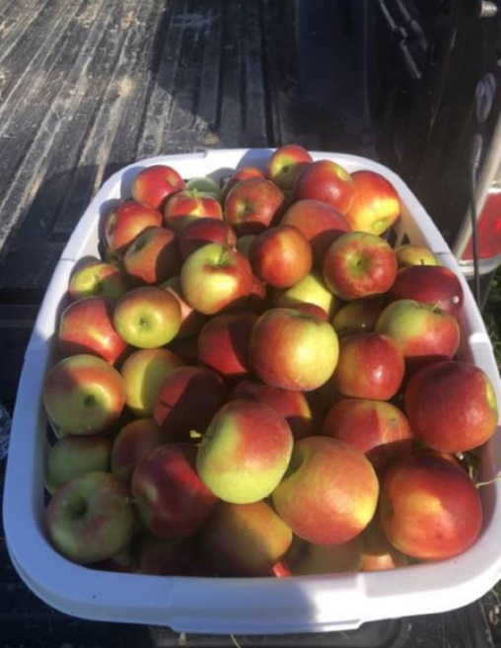
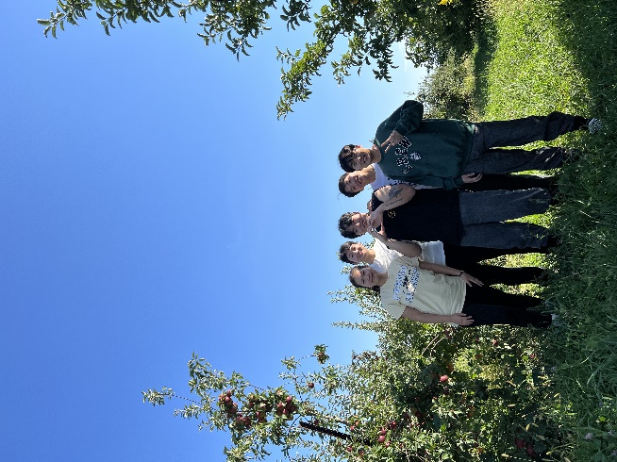
Research Method Overview
A. Sample Preparation

Slide 15
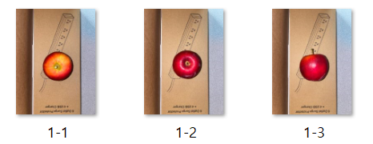
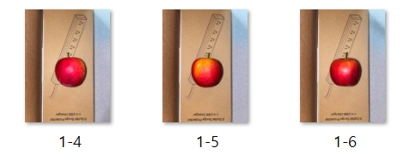
Research Method Overview
B. Data Collection
Visual data collection
18.5cm
(a)
18.5cm
26cm
(b)
3cm
3cm
38cm
Photo studio

Slide 16
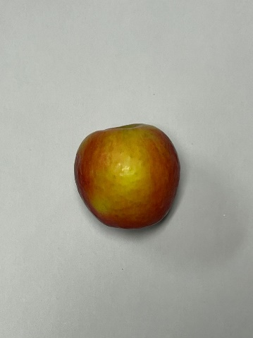
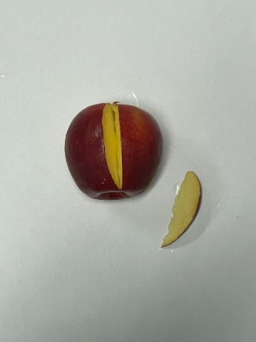
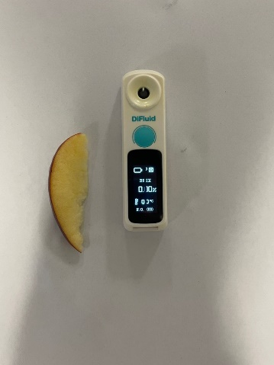
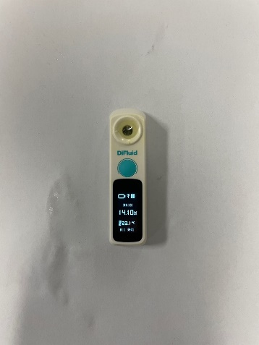
Research Method Overview
B. Data Collection
Measuring sugar levels
Range | Average
9.7 ~ 16.75 | 13.2
(a) finding the reddist
cross-section
(b) Cutting that part
of the apple
(c) Squeezing the juice
out of the slices on
the sample dish
(d) Measuring the
sugar level

Slide 17

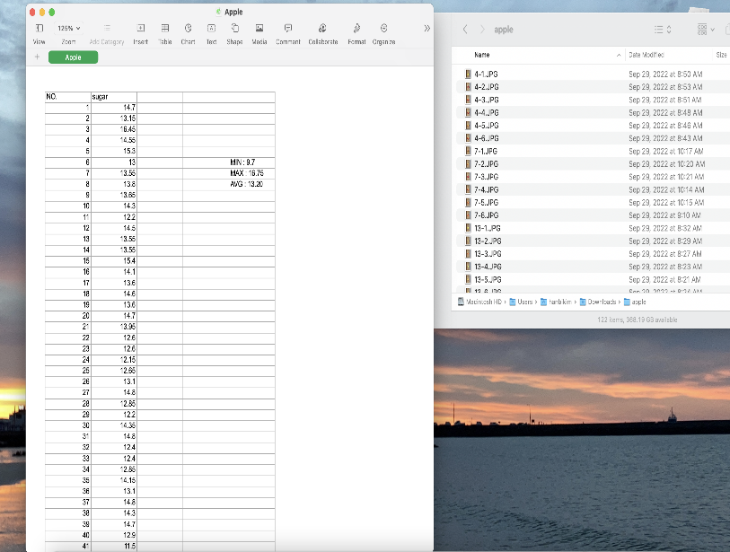
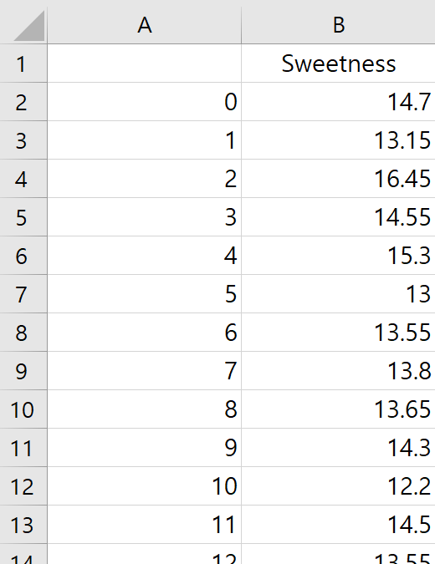
Research Method Overview
B. Data Collection
3) Recording the sugar levels
Brix meter
Sugar content recording
csv file

Slide 18
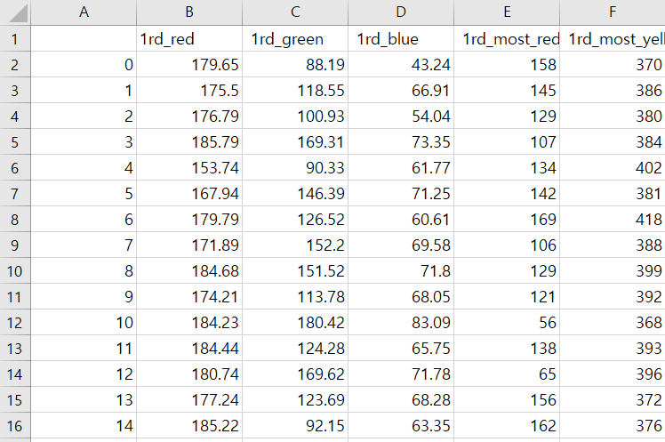
Research Method Overview
C. Data preprocessing - ML
Feature extraction
a. Apple’s RGB values
b. size
c. The Yellowest part
d. Ratio

Slide 19
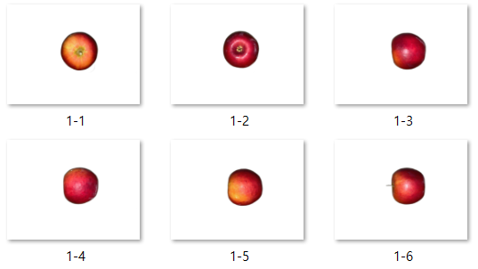
Research Method Overview
C. Data preprocessing - ML
2) The datafication method
a. Remove Background
b. Acquire RGB values for pixels
c. Acquire Size of apples
d. Combine features to optain other features
Remove background

Slide 20
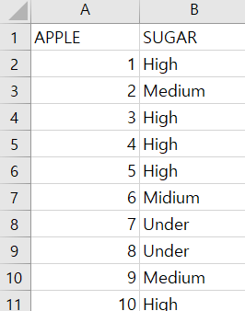
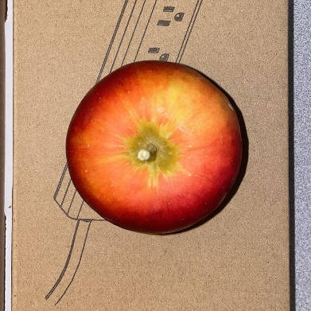
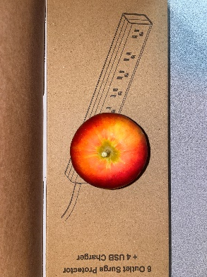
Research Method Overview
C. Data preprocessing - DL
1) Categorization sugar sweetness
- Low:Under 12, Medium:12~13, High: Over 13
2) Resizing the apple images
- Image size : 4032*3024 → 2000*2000

Slide 21
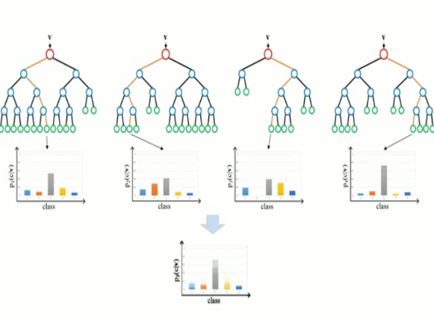
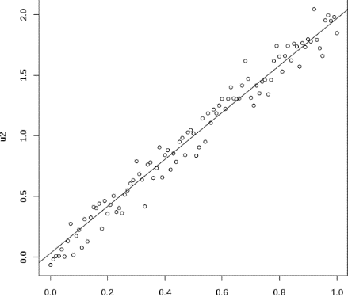
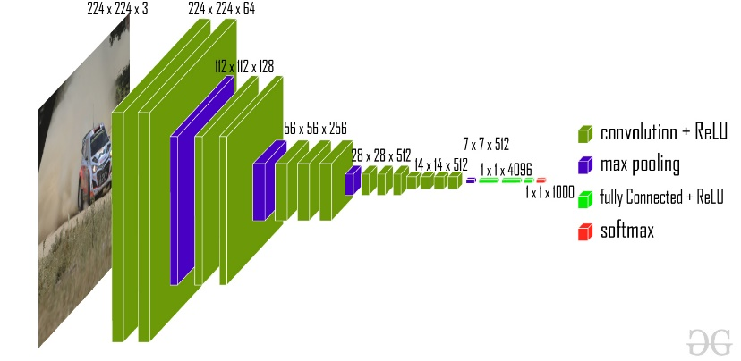
Research Method Overview
D. Research Models
1) Machine Learning
2) Deep Learning
(a) Linear Regression
(b) Random Forest
(a) VGG-16

Slide 22
Progress of Research and Plans
“Machine
Learning”
“Deep
Learning”
Machine Learning
- Accuracy : 60%
- Looking for new features
- Attempt to use classification models.
B. Deep Learning
- Accuracy : 35%
- Trying to develop other models
(Efficient Net, Tab Net)
- Attempt to make regression models.
=“Hybrid Machine”

Slide 23
Reference
[1] U.S. Department of Agriculture. World Production, Markets, and Trade Report (2022, Jun, 14), Fresh Apples, Grapes, and Pears: World Markets and Trade. [Online]. Available: https://apps.fas.usda.gov/psdonline/circulars/fruit.pdf
[2] Schwallier. P, “Checking apple maturity: What to look for,” Michigan State Univ. Extension, Aug. 28, 2012. Accessed: Oct. 6, 2022. [Online]. Available: https://www.canr.msu.edu/news/checking_apple_maturity_what_to_look_for
[3] Kim, Seon-Jong, “Analysis of Apple Colors and Sugar Contents Using Linear Regression,” in Proc. The Journal of the Convergence on Culture Technology (JCCT) Vol. 8, No. 1, pp. 201-207, Jan. 2022. [Online]. Available: https://koreascience.kr/article/JAKO202208148789847.view?orgId=anpor&hide=breadcrumb,journalinfo
[4] M. A. J. Al-Sammarraie et al., “Predicting Fruit’s Sweetness Using Artificial Intelligence—Case Study: Orange,” in Proc. Applied Sciences, vol. 12, no. 16, p. 8233, Aug. 2022, [Online]. Available: https://doi.org/10.3390/app12168233

Slide 24
Reference
[5] Chu-Hui Lee and Jhih-Chen Jhou. “A Non-Invasive Method to Classify the Sweetness Levels of Apples,” in Proc. 2021 Artificial Intelligence and Virtual Reality (AIVR) (AIVR 2021) Association for Computing Machinery pp. 128–134, July 2021. [Online]. Available: https://doi.org/10.1145/3480433.3480453
[6] T. Ittatirut et al., "Apple Sweetness Measurement by image processing technique", 2016 Fifth ICT Int’l Student Project Conf. (ICT-IS; PC), Thailand, pp. 182-185, May 2016, [Online]. Available: https://ieeexplore.ieee.org/document/7519266
[7] S. K. Bejo et al., "Determination of Chokanan Mango Sweetness (Mangifera indica) Using Non-Destructive Image Processing Technique," Australian Journal of Crop Science (AICS), Jan. 2014, 8. 475-480, [Online]. Available: http://www.cropj.com/bejo_8_4_2014_475_480.pdf
[8] “Top 20 Fruits and Vegetables Sold in the U.S.,” International Fresh Produce Association, 12-Nov-2021. [Online]. Available: https://www.freshproduce.com/resources/consumer-trends/top-20/. [Accessed: 25-Oct-2022].

Slide 25
Reference
[9] “Linear regression,” Wikipedia, 23-Oct-2022. [Online]. Available: https://en.wikipedia.org/wiki/Linear_regression. [Accessed: 26-Oct-2022].
[10] “scikit-learn random forest,” Naver blog GodGo. [Online]. Available: https://m.blog.naver.com/samsjang/220979751089. [Accessed: 26-Oct-2022].
[11] “VGG-16: CNN model,” GeeksforGeeks, 24-Aug-2022. [Online]. Available: https://www.geeksforgeeks.org/vgg-16-cnn-model/. [Accessed: 26-Oct-2022].

Slide 26

Thank You Any Questions?

