Slide 1
Probability Distributions for Continuous Random Variables
Chpt 4.1-4.2
Stat 511, Fall 2026

Slide 2
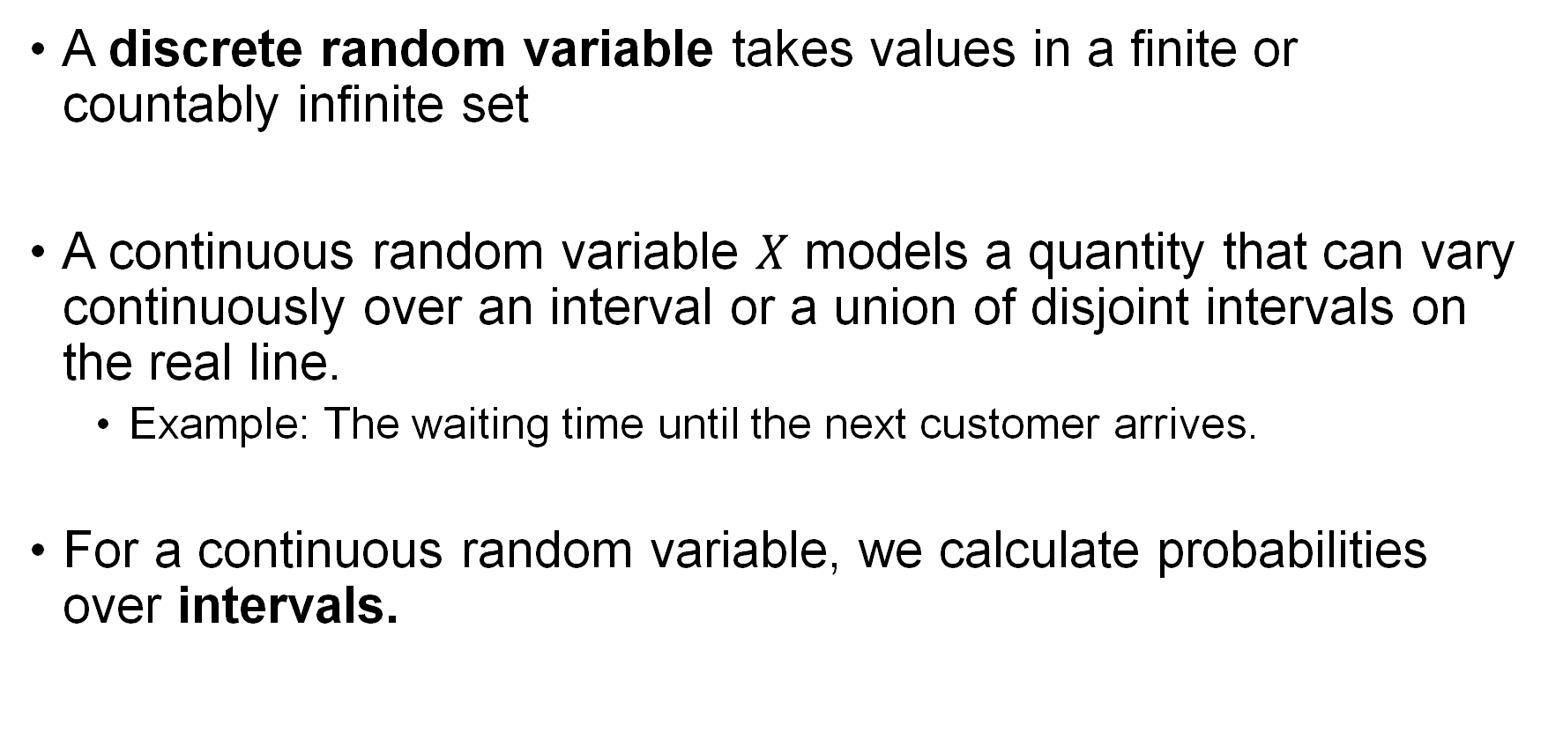
Continuous Random Variable
A discrete random variable takes values in a finite or countably infinite set
A continuous random variable $X$ models a quantity that can vary continuously over an interval or a union of disjoint intervals on the real line.
  Example: The waiting time until the next customer arrives.
For a continuous random variable, we calculate probabilities over intervals.

Slide 3
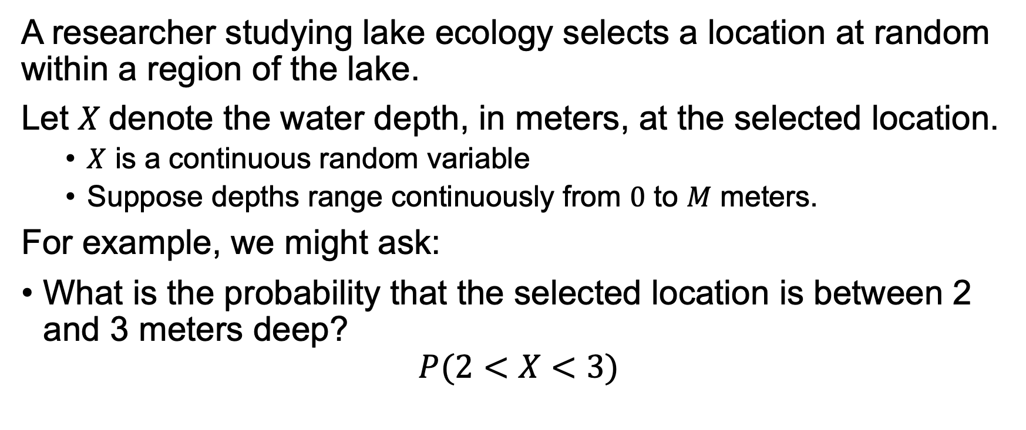
Example: Water Depth
A researcher studying lake ecology selects a location at random within a region of the lake.
Let $X$denote the water depth, in meters, at the selected location.
  $X$ is a continuous random variable
  Suppose depths range continuously from $0$ to $M$ meters.
For example, we might ask:
What is the probability that the selected location is between 2 and 3 meters deep?
$$P(2<X<3)$$

Slide 4
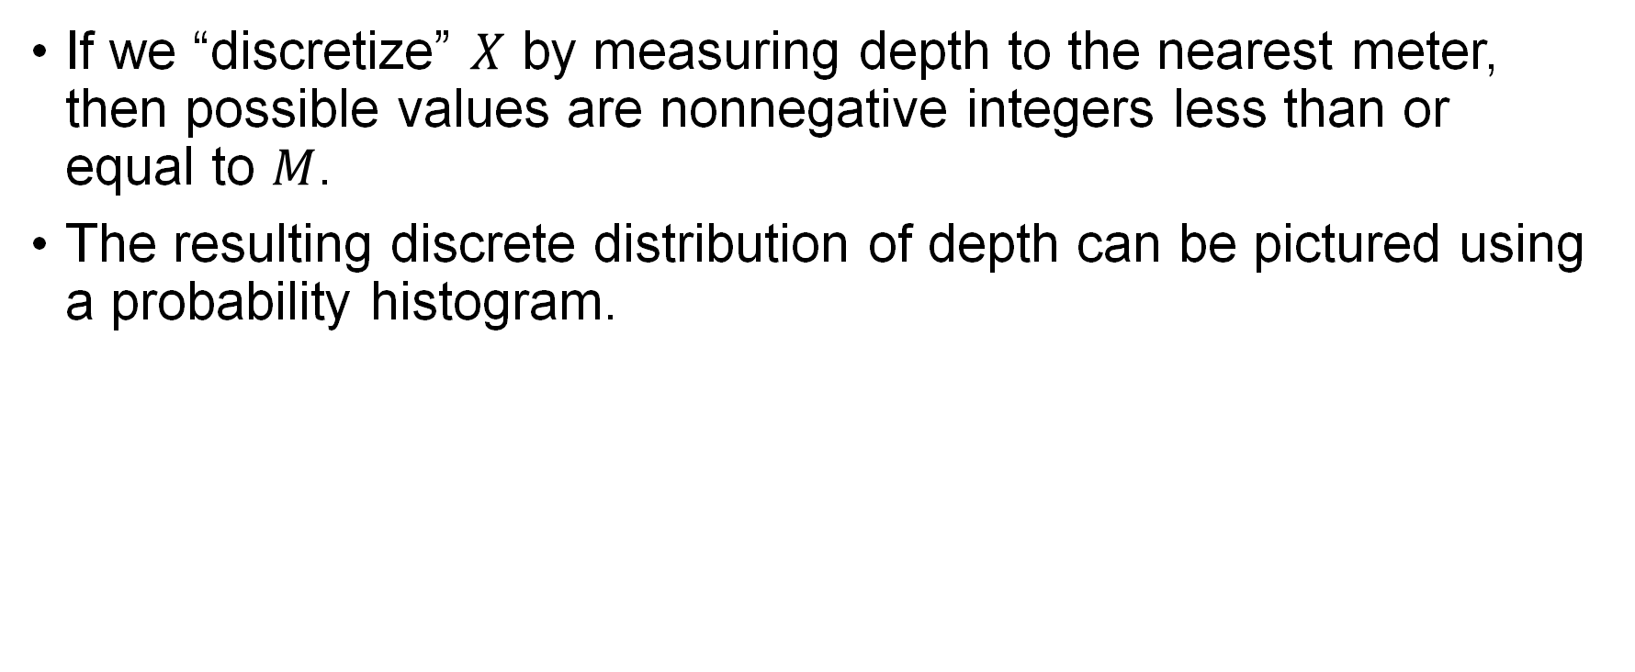
Example
If we “discretize” $X$ by measuring depth to the nearest meter, then possible values are nonnegative integers less than or equal to $M$.
The resulting discrete distribution of depth can be pictured using a probability histogram.

Slide 5
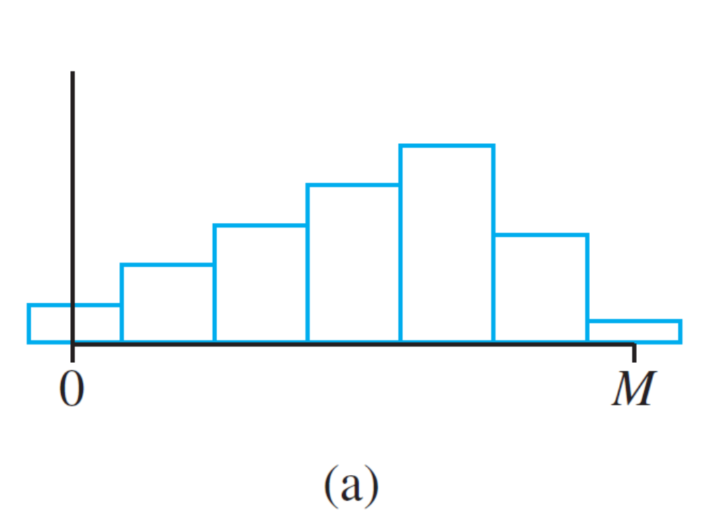
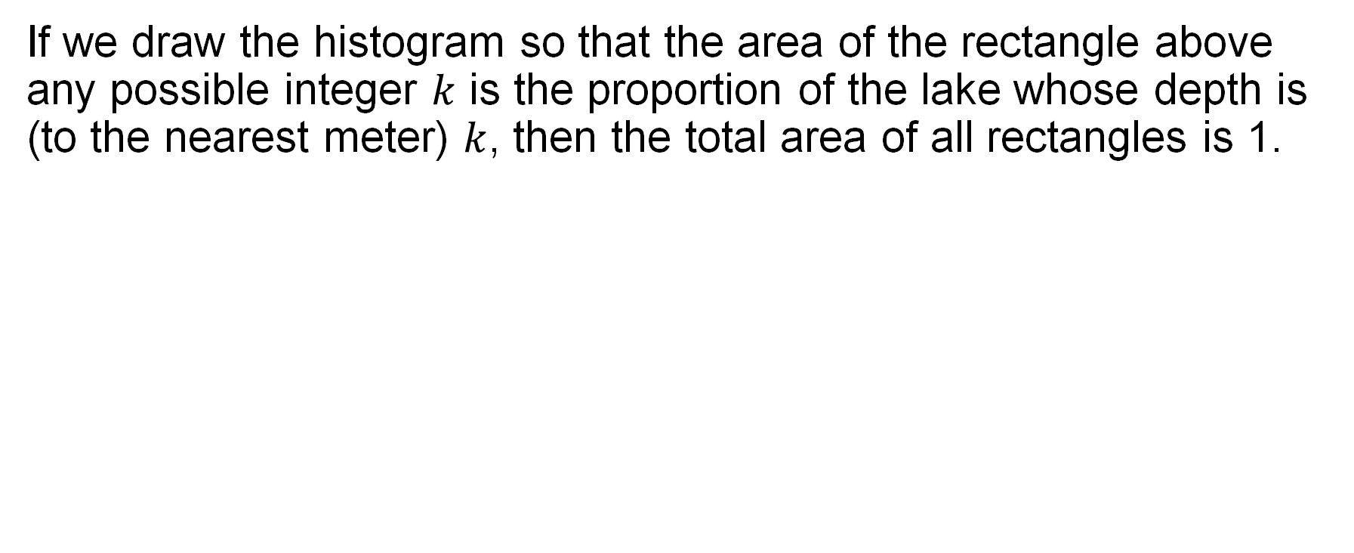
Histogram
If we draw the histogram so that the area of the rectangle above any possible integer $k$ is the proportion of the lake whose depth is (to the nearest meter) $k$, then the total area of all rectangles is 1.
Probability histogram of depth measured to the nearest meter

Slide 6
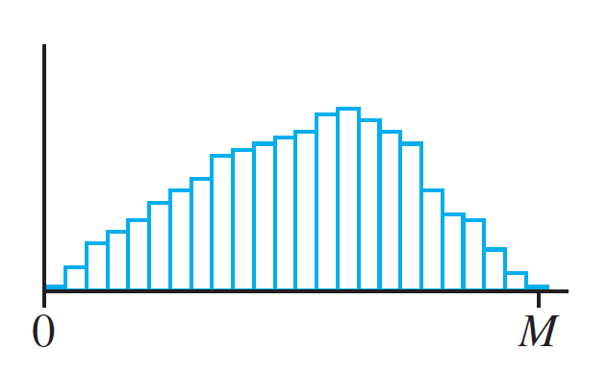
Histogram Cont.
If depth is measured much more accurately, each rectangle in the resulting probability histogram is much narrower, though the total area of all rectangles is still 1.
Probability histogram of depth measured to the nearest centimeter

Slide 7
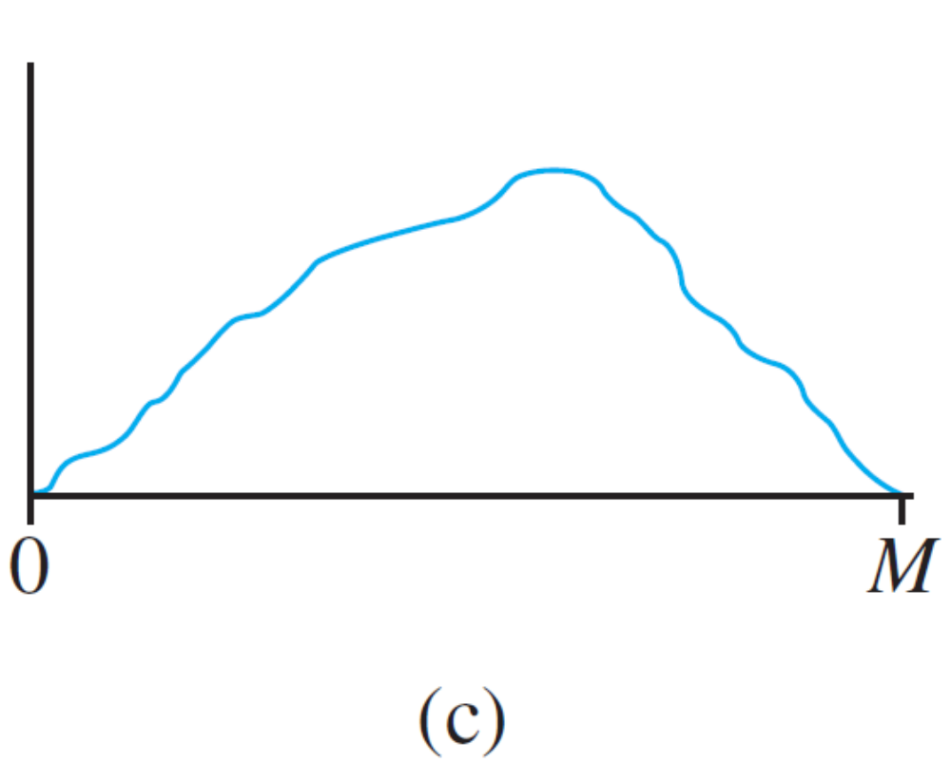
Histogram Cont.
If we continue in this way to measure depth more and more finely, the resulting sequence of histograms approaches a smooth curve
A limit of a sequence of discrete histograms

Slide 8
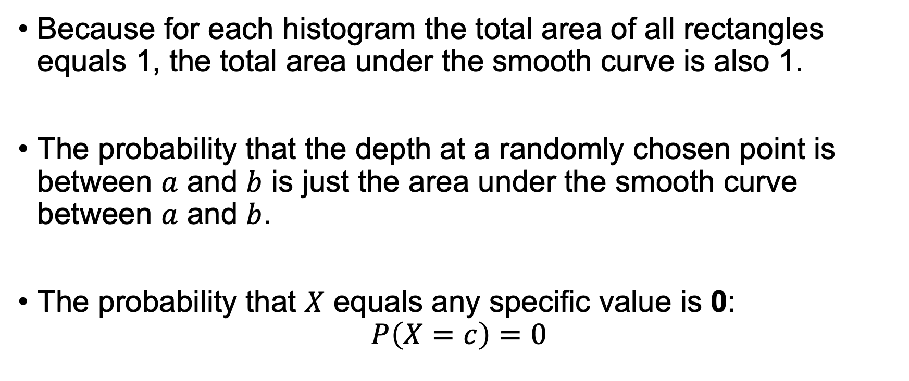
Probability Distributions for Continuous Variables
Because for each histogram the total area of all rectangles equals 1, the total area under the smooth curve is also 1.
The probability that the depth at a randomly chosen point is between $a$ and $b$ is just the area under the smooth curve between $a$ and $b$.
The probability that $X$ equals any specific value is 0:
$$P\left(X=c\right)=0$$

Slide 9
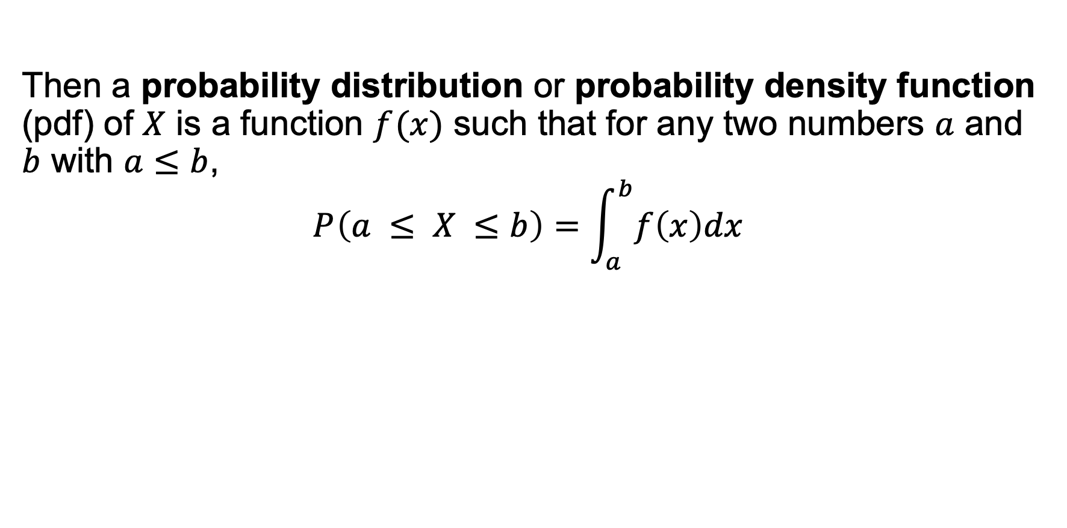
Probability Distributions for Continuous Variables
Then a probability distribution or probability density function (pdf) of $X$ is a function $f (x)$ such that for any two numbers $a$ and $b$ with $a≤b$,
$$P \left(a ≤ X ≤b\right)=\int_{a}^{b}{f\left(x\right)dx}$$

Slide 10
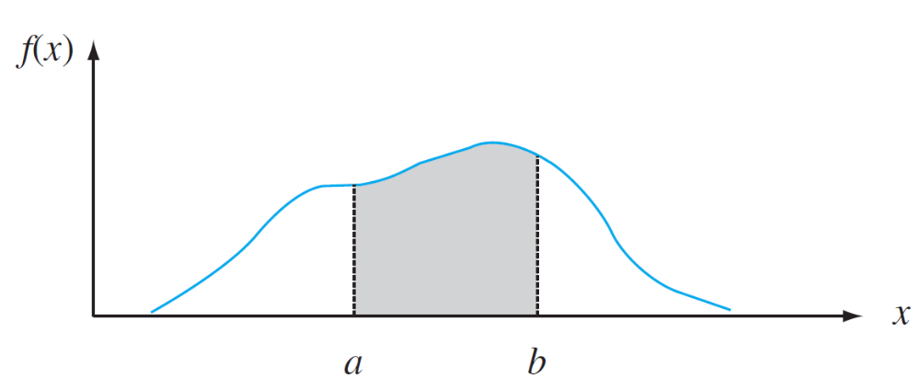
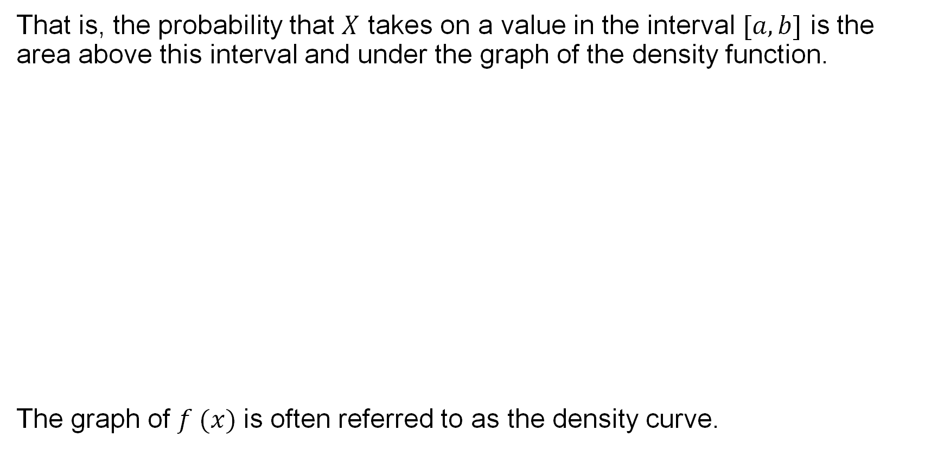
Probability Distributions for Continuous Variables
That is, the probability that $X$ takes on a value in the interval $[a, b]$ is the area above this interval and under the graph of the density function.
The graph of $f (x)$is often referred to as the density curve.
$P (a ≤X <b)$= the area under the density curve between $a and b$

Slide 11
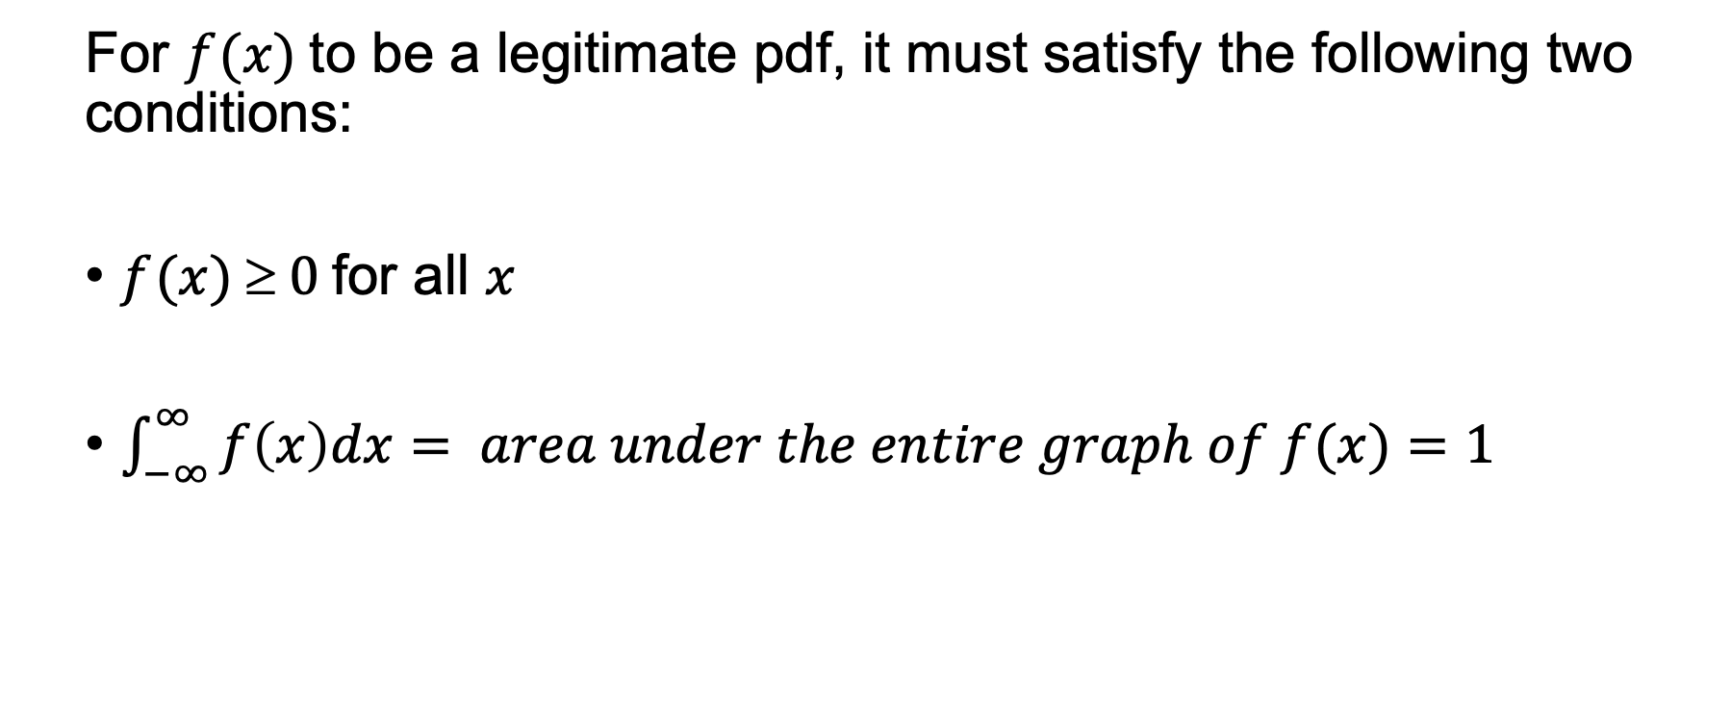
Property of PDF
For $f (x)$to be a legitimate pdf, it must satisfy the following two conditions:
$f (x)  0$for all $x$
$\int_{−∞}^{∞}{f\left(x\right)dx}= area under the entire graph of f(x)=1$

Slide 12
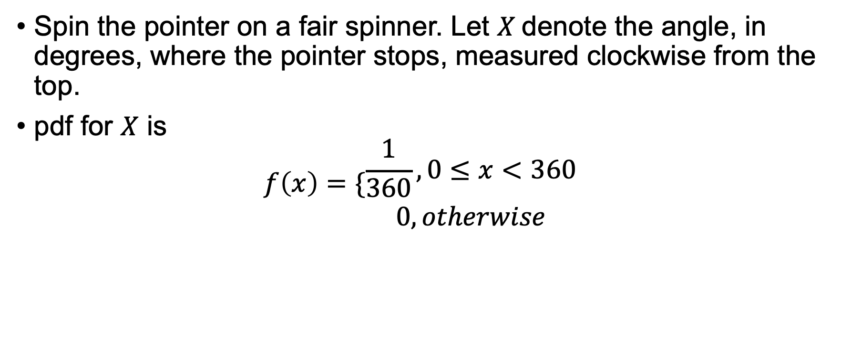
Example
Spin the pointer on a fair spinner. Let $X$denote the angle, in degrees, where the pointer stops, measured clockwise from the top.
pdf for $X$ is
$$f\left(x\right)=\{\begin{matrix}\frac{1}{360}, 0≤x<360 \\ 0, otherwise\end{matrix}$$

Slide 13
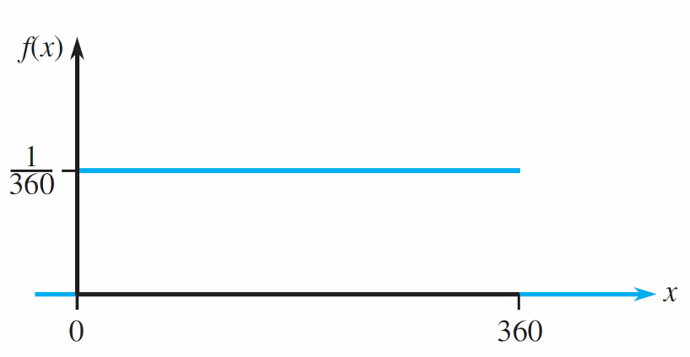
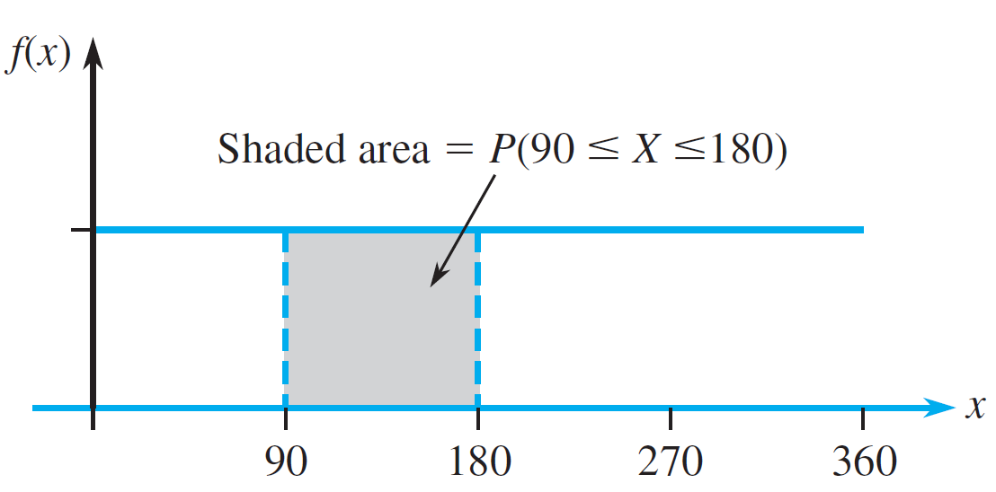
Example

Slide 14
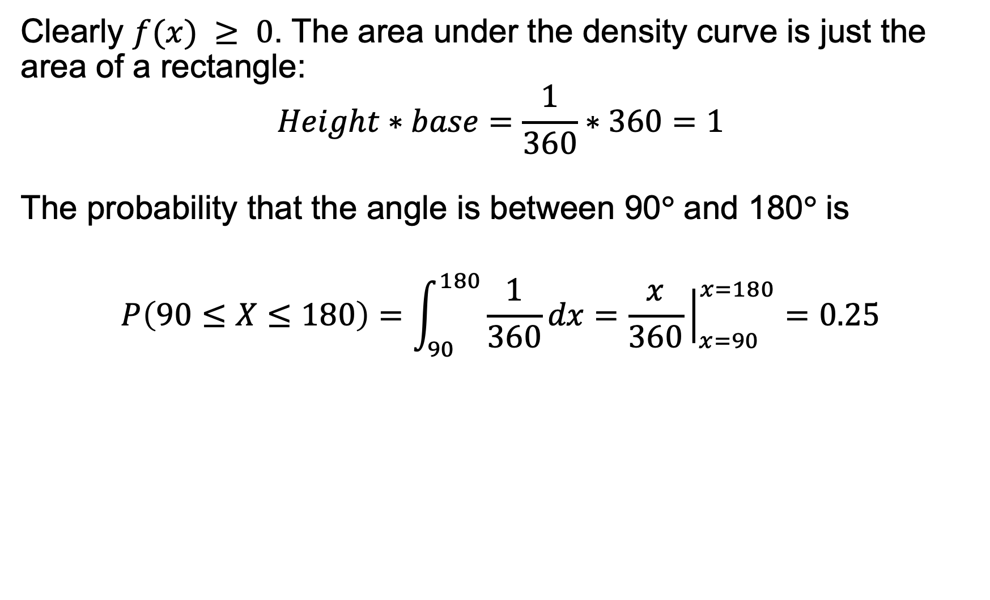
Example
Clearly $f(x) ≥ 0$. The area under the density curve is just the area of a rectangle:
$$Height∗base=\frac{1}{360}∗360=1$$
The probability that the angle is between 90° and 180° is
$$P\left(90≤X≤180\right)=\int_{90}^{180}{\frac{1}{360}}dx=\frac{x}{360}{\left.​\right|}_{x=90}^{x=180}=0.25$$

Slide 15
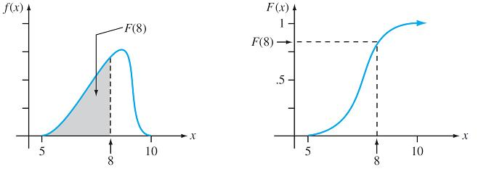
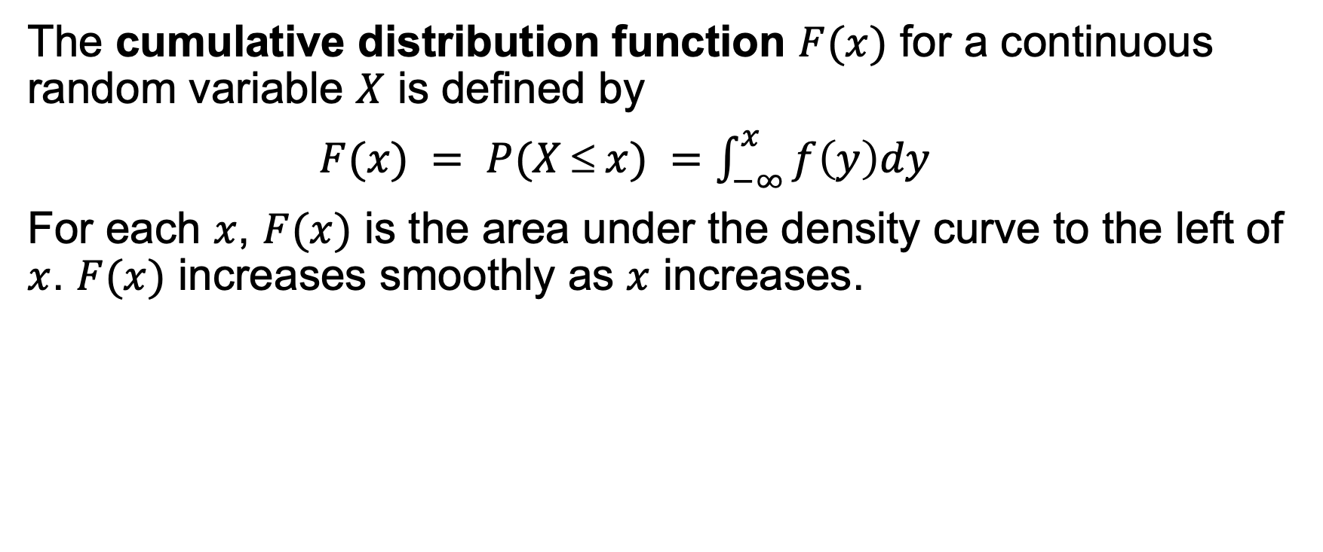
The Cumulative Distribution Function
The cumulative distribution function $F(x)$ for a continuous random variable $X$ is defined by
$F(x) = P(X ≤ x) =\int_{−∞}^{x}{f\left(y\right)dy}$
For each $x$, $F(x)$ is the area under the density curve to the left of $x$. $F(x)$ increases smoothly as $x$ increases.

Slide 16
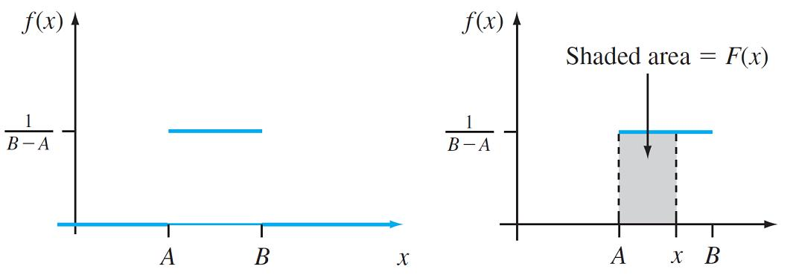
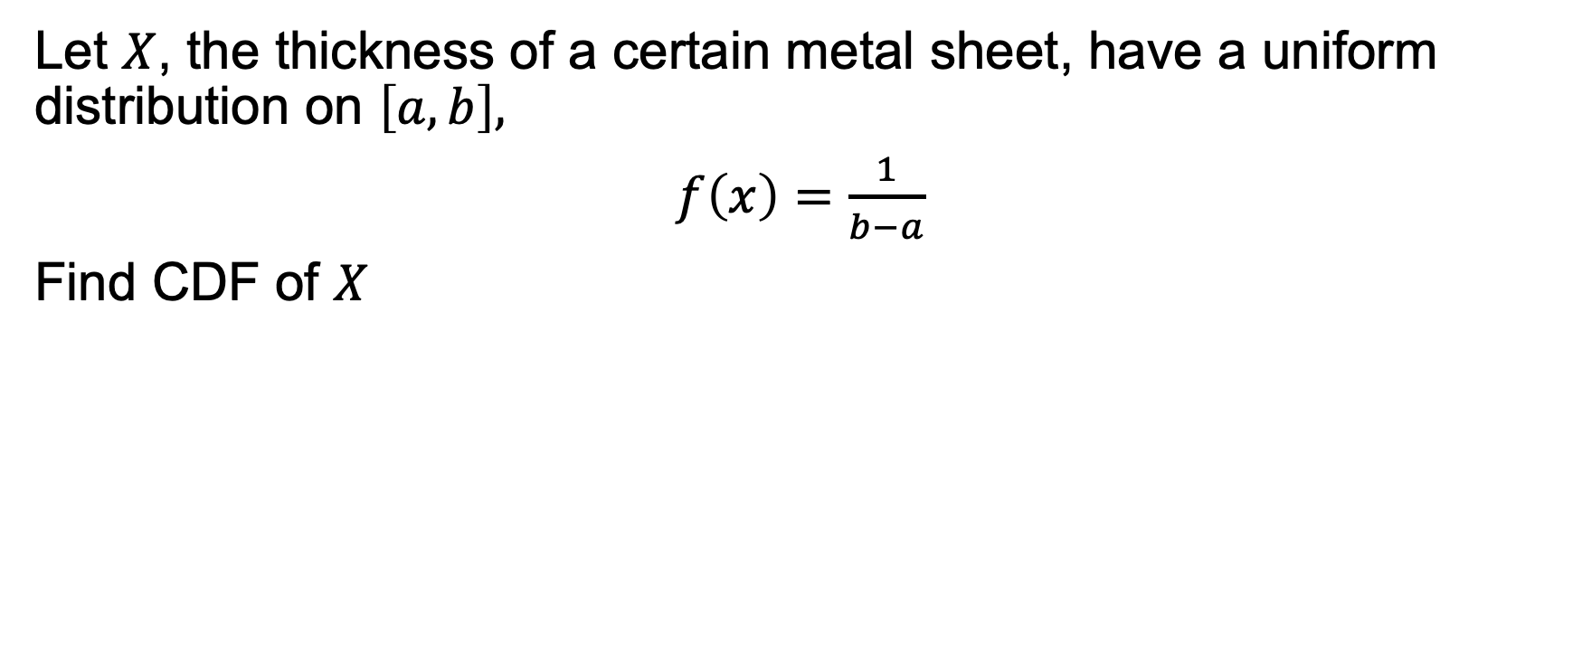
Example
Let $X$, the thickness of a certain metal sheet, have a uniform distribution on $\left[a, b\right],$
$f\left(x\right)=\frac{1}{b−a}$
Find CDF of $X$

Slide 17
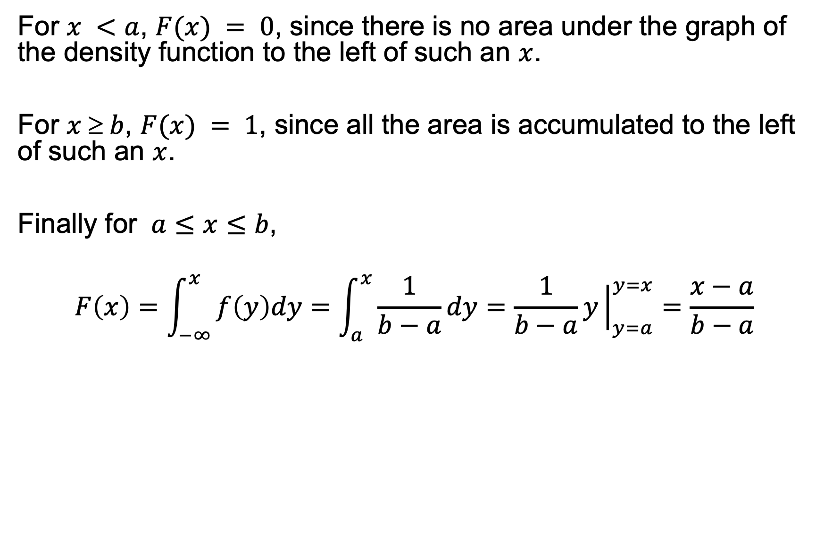
Example
For $x <a$, $F(x) = 0$, since there is no area under the graph of the density function to the left of such an $x$.
For $x  b$, $F(x) = 1$, since all the area is accumulated to the left of such an $x$.
Finally for $a≤x≤b$,
$$F\left(x\right)=\int_{−∞}^{x}{f\left(y\right)dy=\int_{a}^{x}{\frac{1}{b−a}dy=\frac{1}{b−a}y{\left.​\right|}_{y=a}^{y=x}=\frac{x−a}{b−a} }}$$

Slide 18
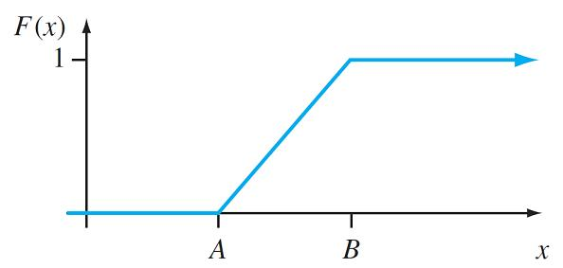
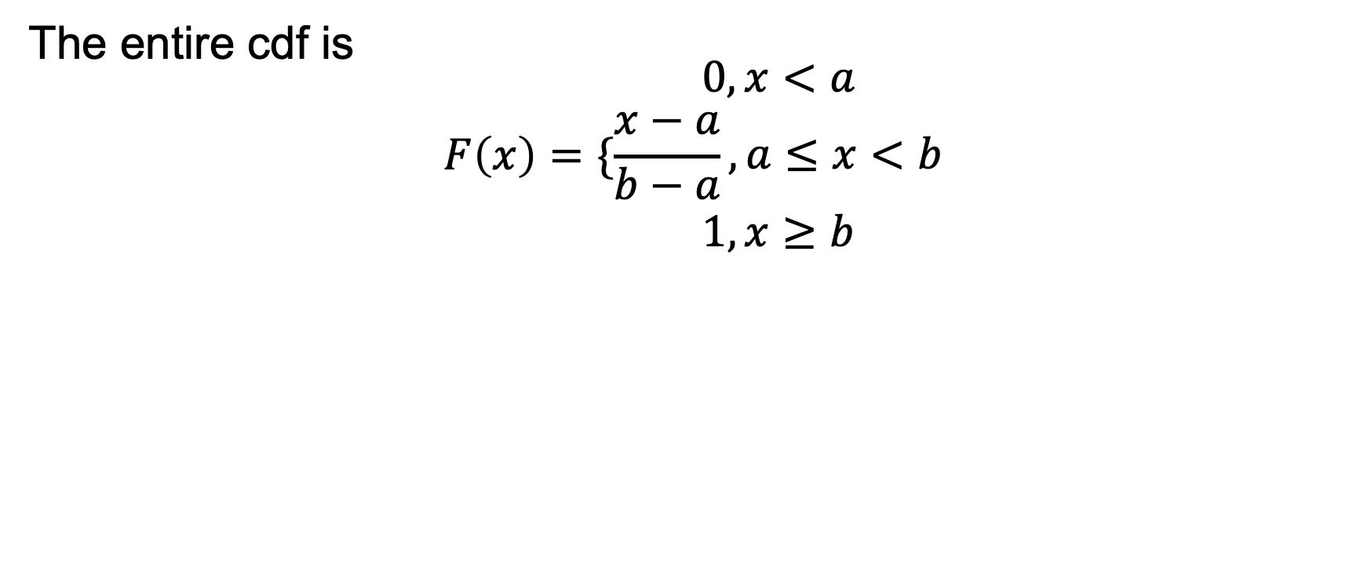
Example
The entire cdf is
$$F\left(x\right)=\{\begin{matrix}0, x<a \\ \frac{x−a}{b−a}, a≤x<b \\ 1,x≥b\end{matrix}$$

Slide 19
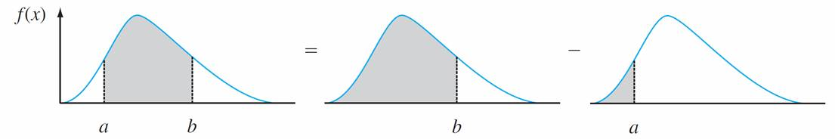
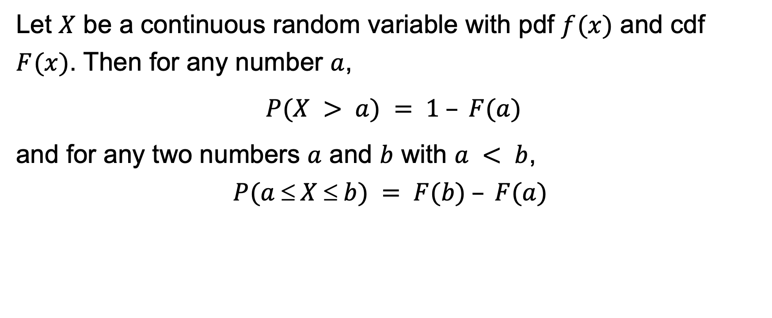

Using $F (x)$ to Compute Probabilities
Let $X$ be a continuous random variable with pdf $f (x)$ and cdf $F (x)$. Then for any number $a$,
$P(X > a) = 1 – F(a)$
and for any two numbers $a$ and $b$ with $a < b$,
$$P(a  X  b) = F(b) – F(a)$$

Slide 20
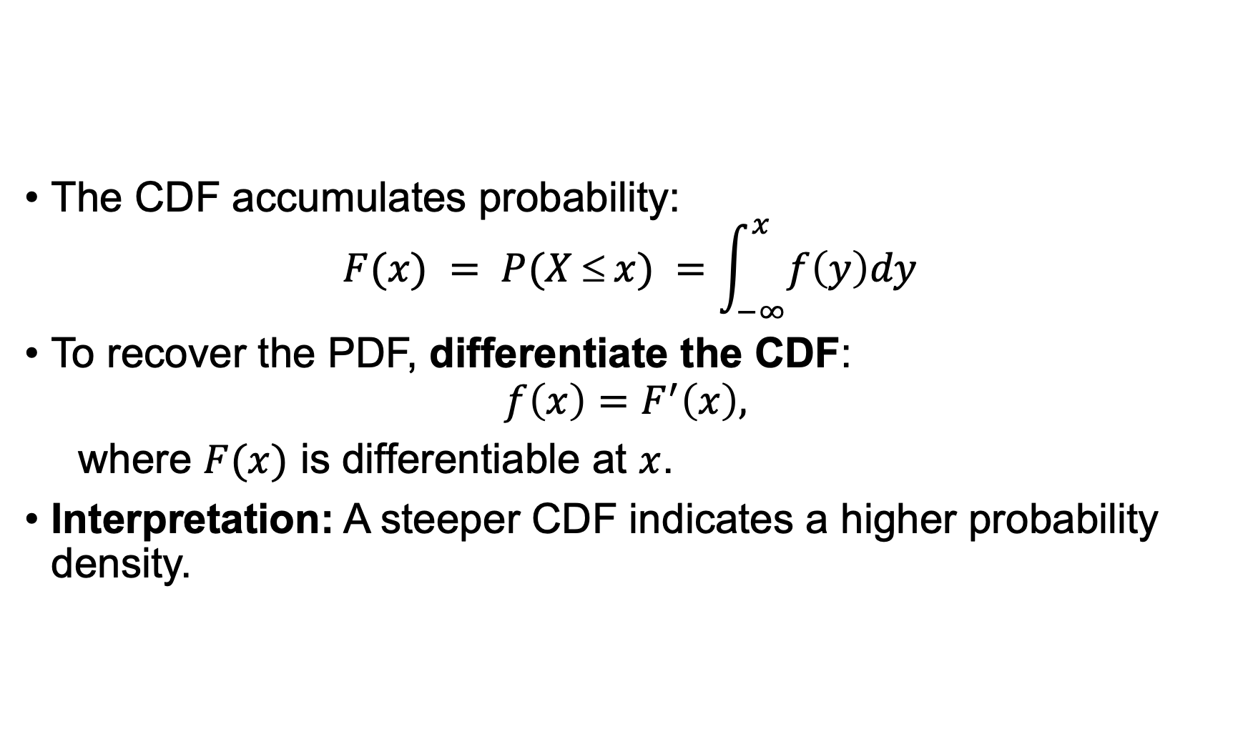
Obtaining the PDF from CDF
The CDF accumulates probability:
$$F(x) = P(X ≤ x) =\int_{−∞}^{x}{f\left(y\right)dy}$$
To recover the PDF, differentiate the CDF:
$$f\left(x\right)=F^{′}\left(x\right),$$
where $F(x)$ is differentiable at $x$.
Interpretation: A steeper CDF indicates a higher probability density.

Slide 21
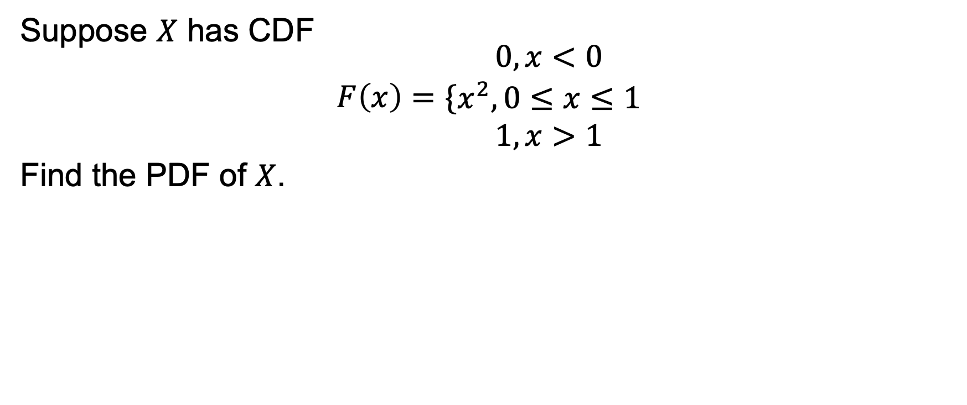
Example
Suppose $X$ has CDF
$$F\left(x\right)=\{\begin{matrix}0, x<0 \\ x^{2}, 0≤x≤1 \\ 1, x>1\end{matrix}$$
Find the PDF of $X$.

Slide 22
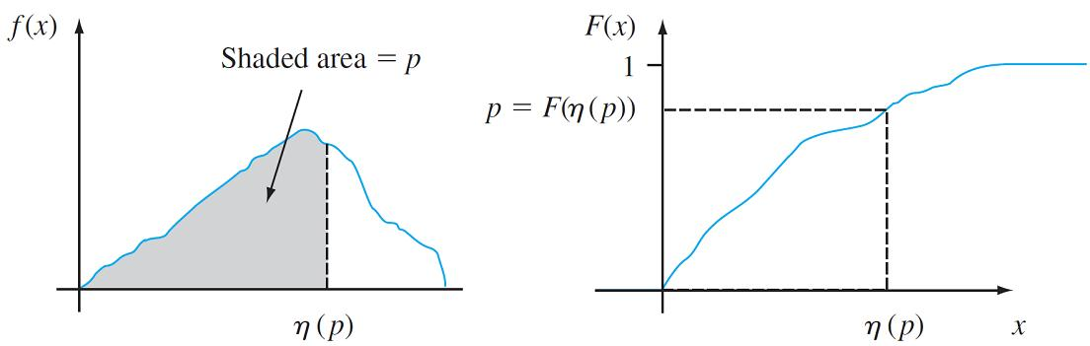
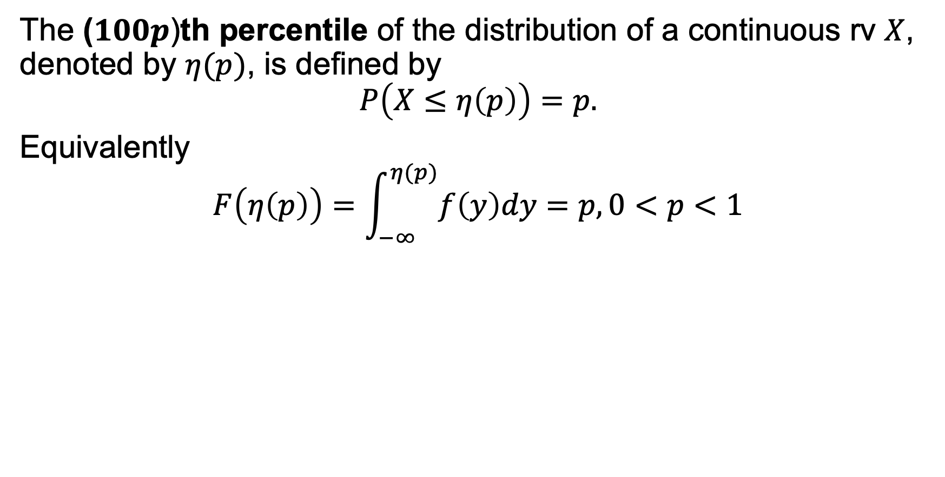
Percentiles of a Continuous Distribution
The ($100p$)th percentile of the distribution of a continuous rv $X$, denoted by $η(p)$, is defined by
$$P\left(X≤η\left(p\right)\right)=p.$$
Equivalently
$$F\left(η\left(p\right)\right)=\int_{−∞}^{η(p)}{f\left(y\right)dy}=p, 0<p<1$$

Slide 23
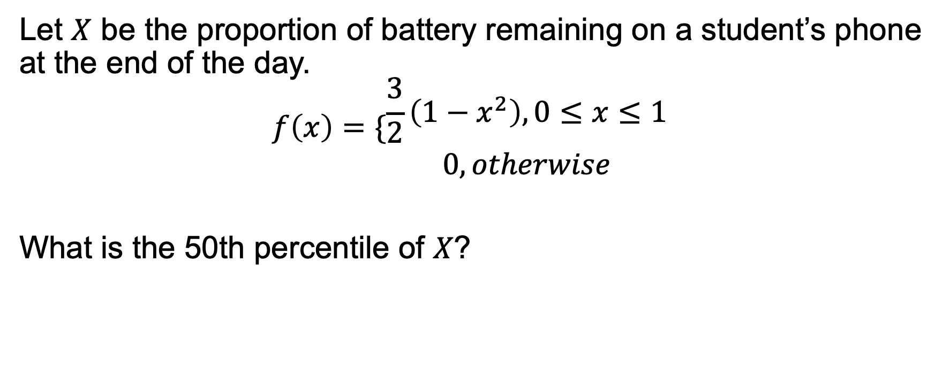
Example
Let $X$ be the proportion of battery remaining on a student’s phone at the end of the day.
$$f\left(x\right)=\{\begin{matrix}\frac{3}{2}\left(1−x^{2}\right), 0≤x≤1 \\ 0, otherwise\end{matrix}$$
What is the 50th percentile of $X$?

Slide 24
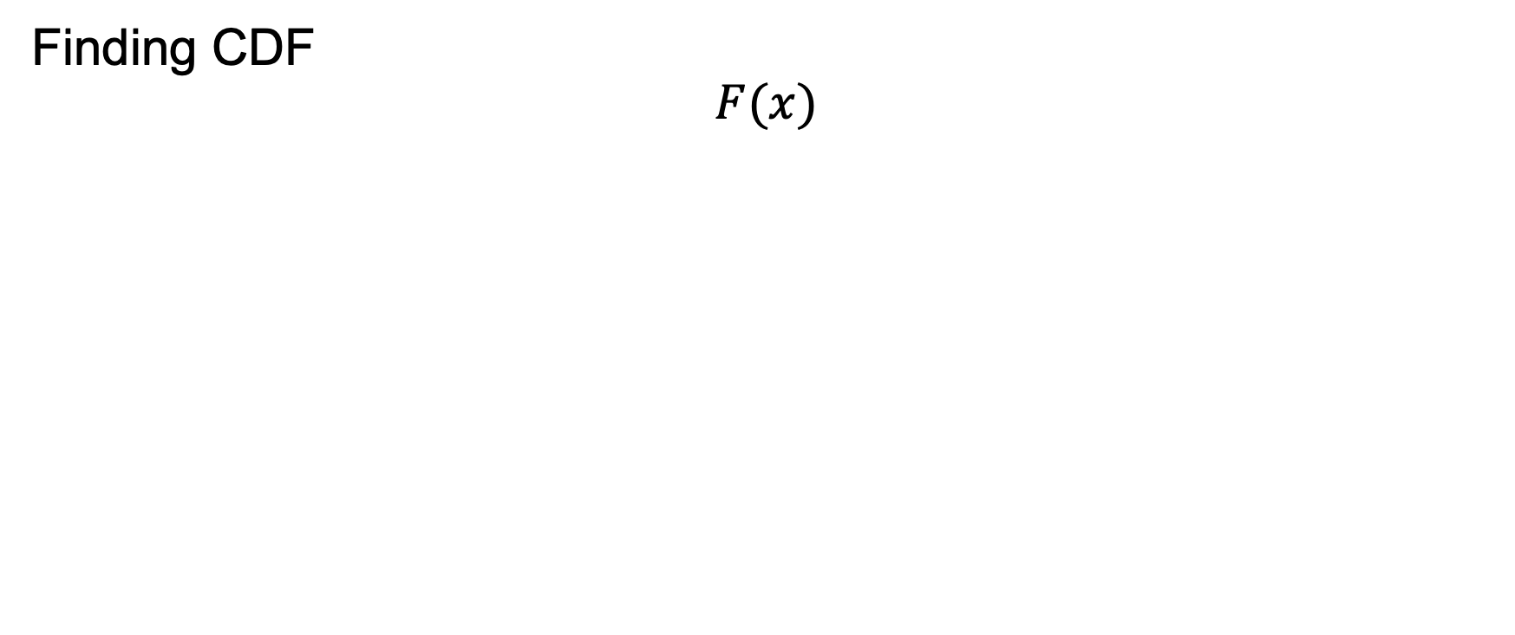
Example
Finding CDF
$$F(x)$$

Slide 25
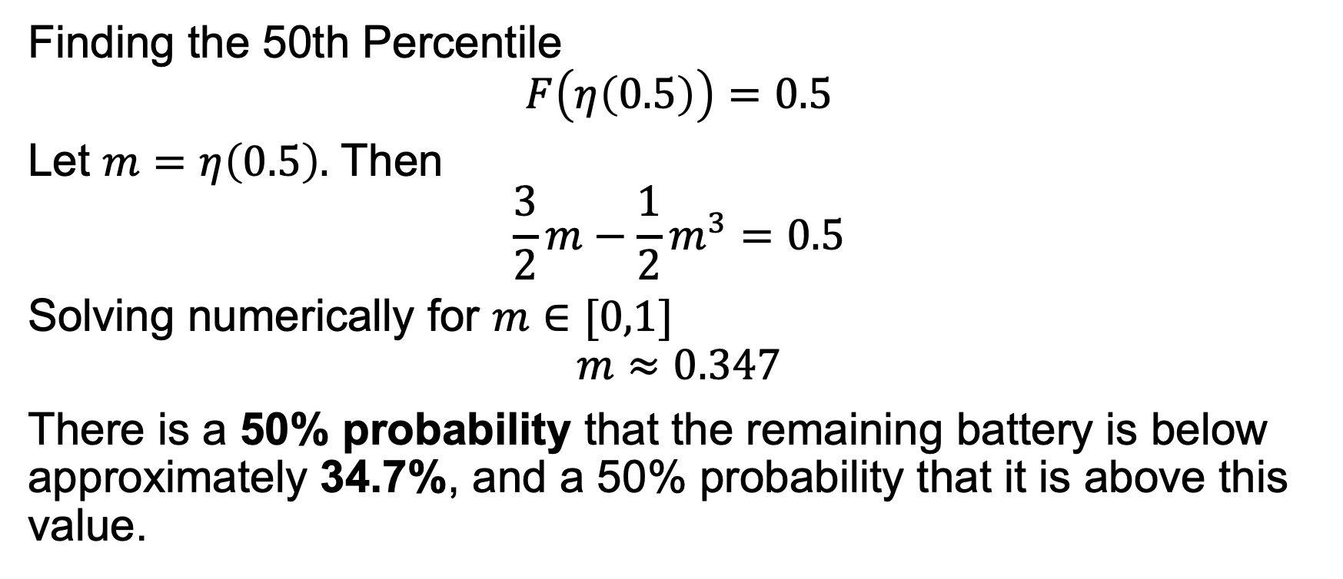
Example
Finding the 50th Percentile
$$F\left(η\left(0.5\right)\right)=0.5$$
Let $m=η\left(0.5\right).$ Then
$$\frac{3}{2}m−\frac{1}{2}m^{3}=0.5$$
Solving numerically for $m∈[0,1]$
$$m≈0.347$$
There is a 50% probability that the remaining battery is below approximately 34.7%, and a 50% probability that it is above this value.

Slide 26
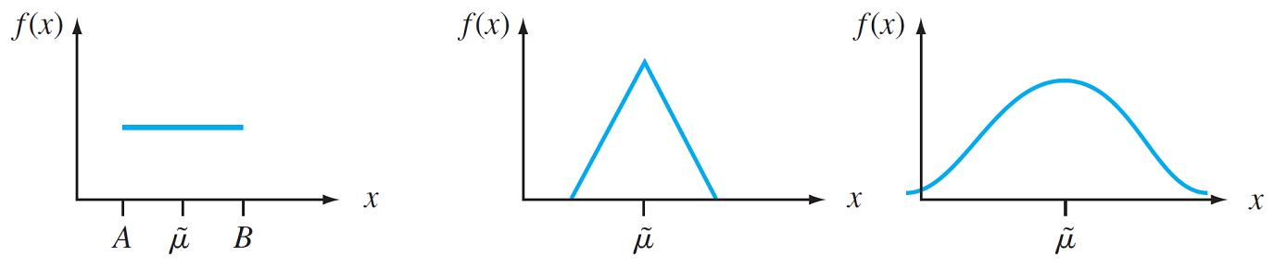
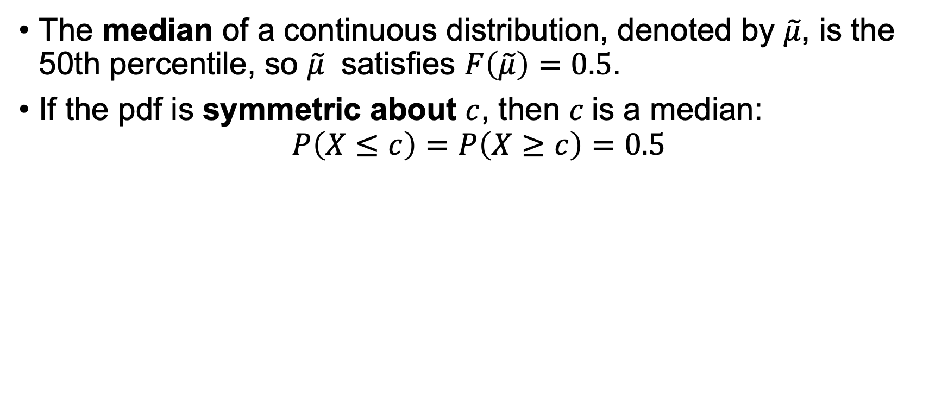
Median
The median of a continuous distribution, denoted by $\tilde{μ}$, is the 50th percentile, so $\tilde{μ}$ satisfies $F\left(\tilde{μ}\right)=0.5$.
If the pdf is symmetric about $c$, then $c$is a median:
$$P\left(X≤c\right)=P\left(X≥c\right)=0.5$$

Slide 27
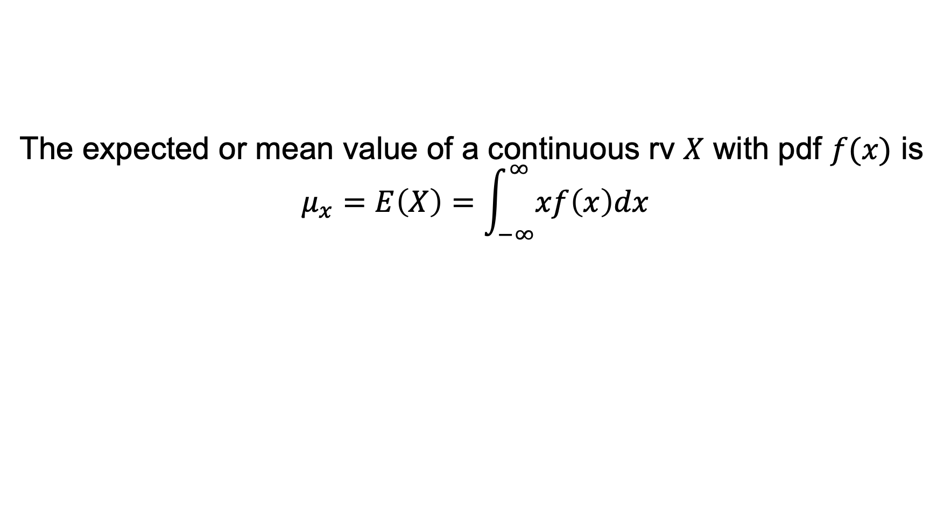
Expectation of Continuous RV
The expected or mean value of a continuous rv $X$ with pdf $f(x)$ is
$$μ_{x}=E\left(X\right)=\int_{−∞}^{∞}{xf\left(x\right)dx}$$

Slide 28
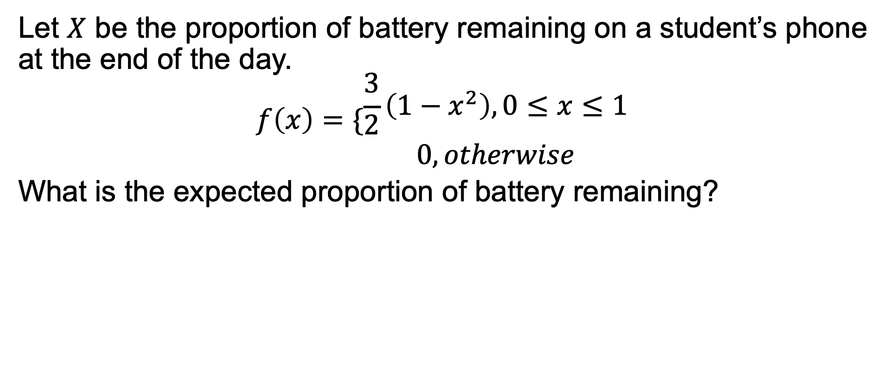
Example
Let $X$ be the proportion of battery remaining on a student’s phone at the end of the day.
$$f\left(x\right)=\{\begin{matrix}\frac{3}{2}\left(1−x^{2}\right), 0≤x≤1 \\ 0, otherwise\end{matrix}$$
What is the expected proportion of battery remaining?

Slide 29
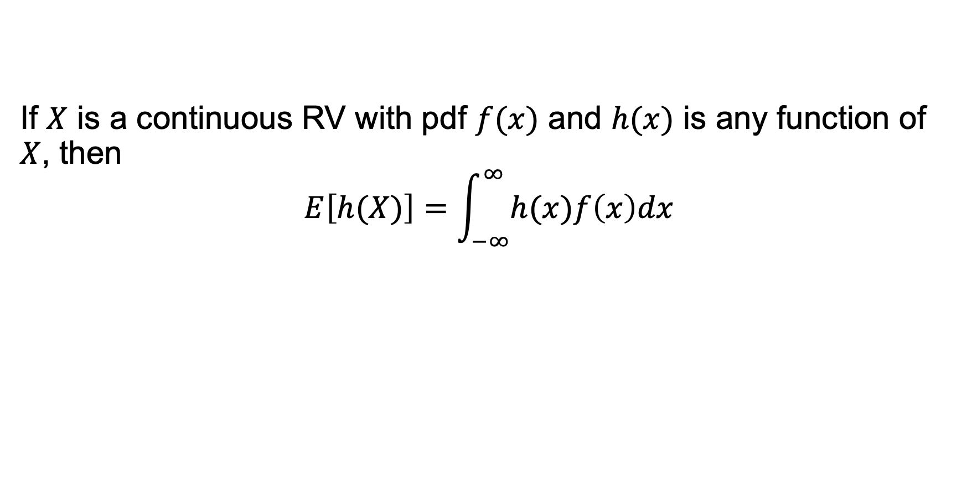
Expectation of Function of Continuous RV
If $X$ is a continuous RV with pdf $f(x)$ and $h(x)$ is any function of $X$, then
$$E\left[h(X)\right]=\int_{−∞}^{∞}{h(x)f\left(x\right)dx}$$

Slide 30
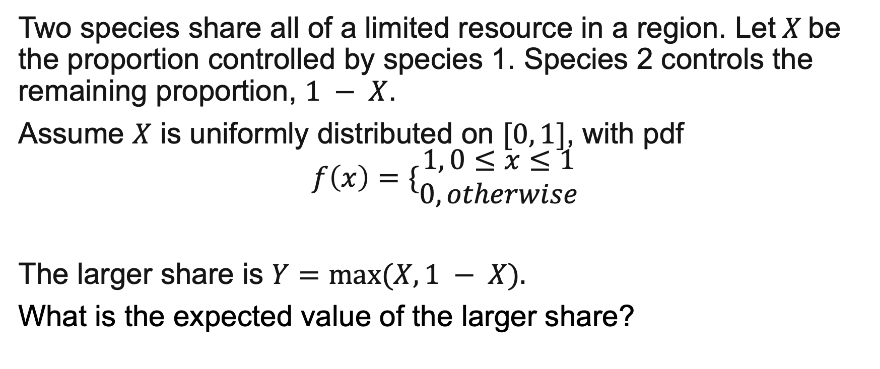
Example
Two species share all of a limited resource in a region. Let$X$be the proportion controlled by species 1. Species 2 controls the remaining proportion, $1 − X$.
Assume $X$ is uniformly distributed on $[0, 1]$, with pdf
$$f\left(x\right)=\{\begin{matrix}1, 0≤x≤1 \\ 0, otherwise\end{matrix}$$
The larger share is $Y=max⁡(X, 1 − X).$
What is the expected value of the larger share?

Slide 31
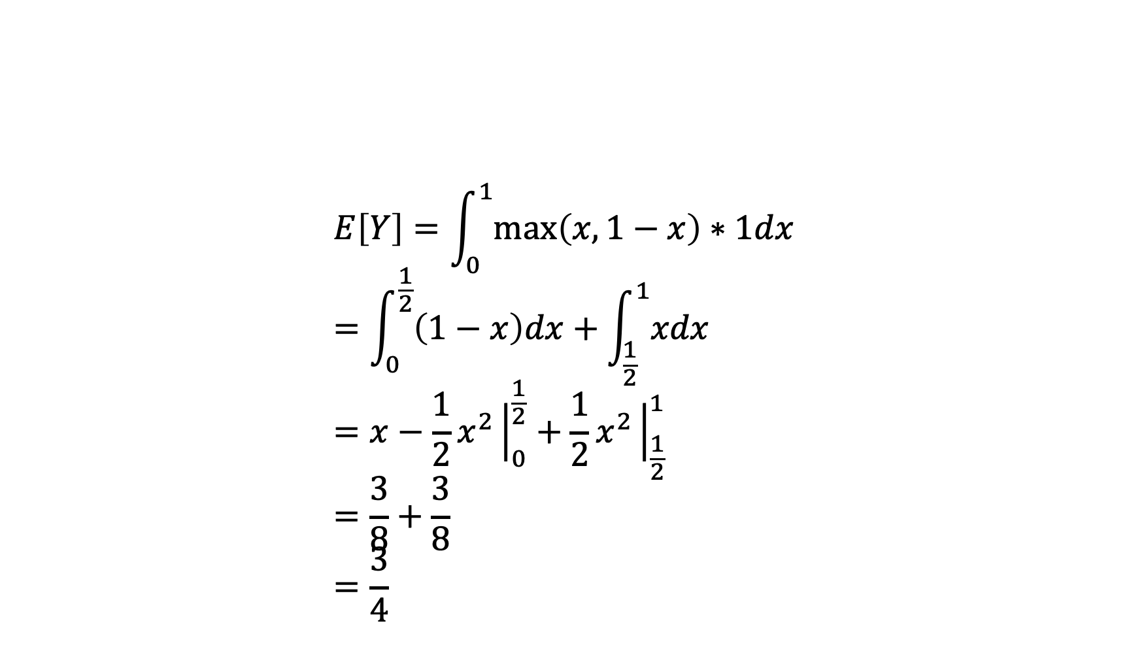
Example
$$E\left[Y\right]=\int_{0}^{1}{\max\left(x,1−x\right)∗1dx} \\ =\int_{0}^{\frac{1}{2}}{\left(1−x\right)dx}+\int_{\frac{1}{2}}^{1}{xdx} \\ =x−\frac{1}{2}x^{2}{\left.​\right|}_{0}^{\frac{1}{2}}+\frac{1}{2}x^{2}{\left.​\right|}_{\frac{1}{2}}^{1} \\ =\frac{3}{8}+\frac{3}{8} \\ =\frac{3}{4}$$

Slide 32
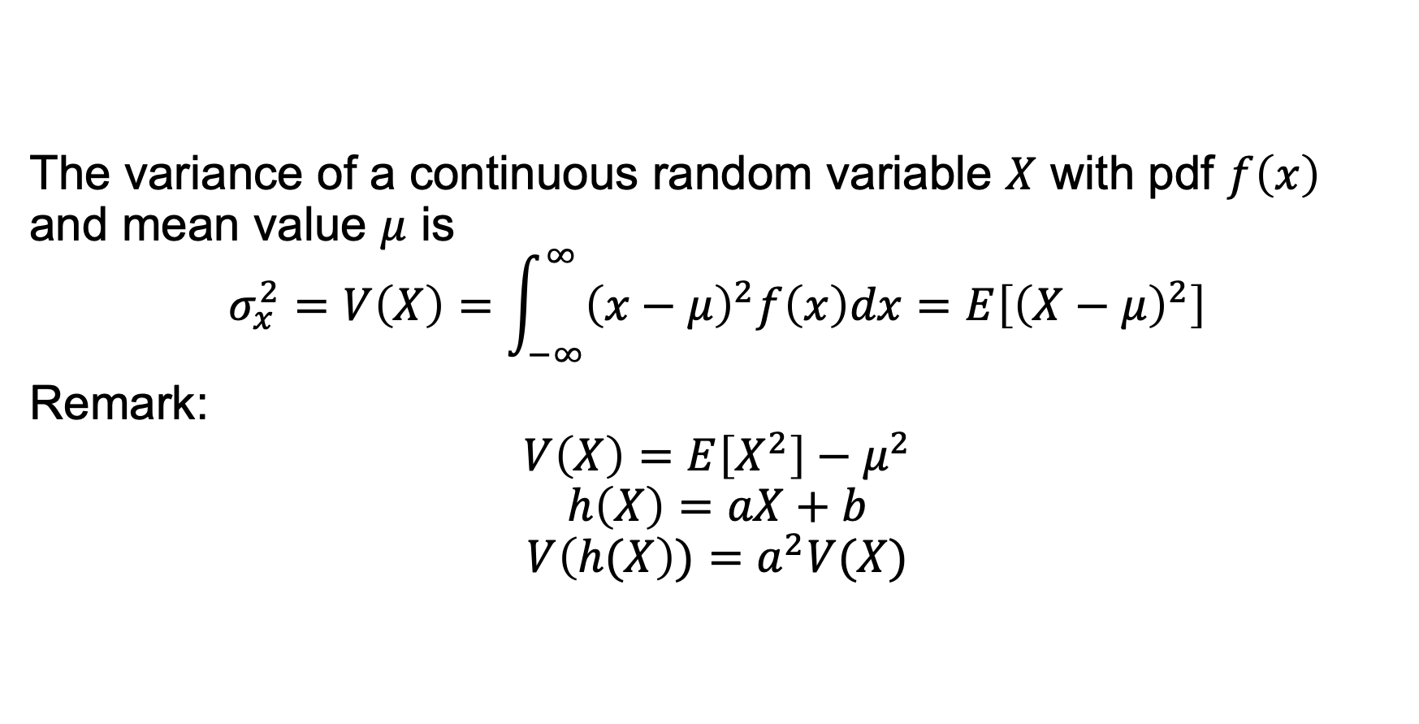
Variance of Continuous RV
The variance of a continuous random variable $X$ with pdf $f\left(x\right)$ and mean value $μ$ is
$$σ_{x}^{2}=V\left(X\right)=\int_{−∞}^{∞}{{\left(x−μ\right)}^{2}f\left(x\right)dx}=E\left[{\left(X−μ\right)}^{2}\right]$$
Remark:
$$V\left(X\right)=E\left[X^{2}\right]−μ^{2}$$
$$h\left(X\right)=aX+b$$
$$V\left(h(X\right))=a^{2}V(X)$$

Slide 33
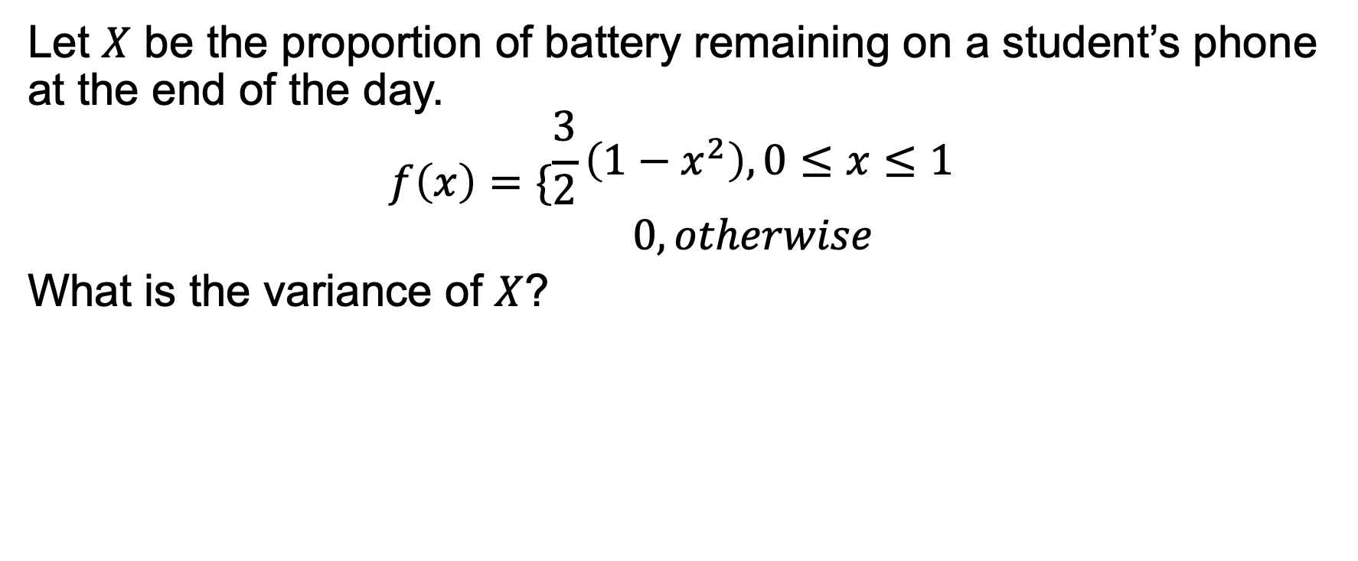
Example
Let $X$ be the proportion of battery remaining on a student’s phone at the end of the day.
$$f\left(x\right)=\{\begin{matrix}\frac{3}{2}\left(1−x^{2}\right), 0≤x≤1 \\ 0, otherwise\end{matrix}$$
What is the variance of $X$?

