Slide 1
The Normal Distribution
Chpt 4.3
Stat 511, Fall 2026

Slide 2
The Normal Distribution
The normal distribution is a continuous probability distribution with a symmetric, bell-shaped density curve.
It provides a useful model for measurements such as adult heights within a relatively homogeneous population and some types of measurement error.
It plays a central role in statistical inference.

Slide 3
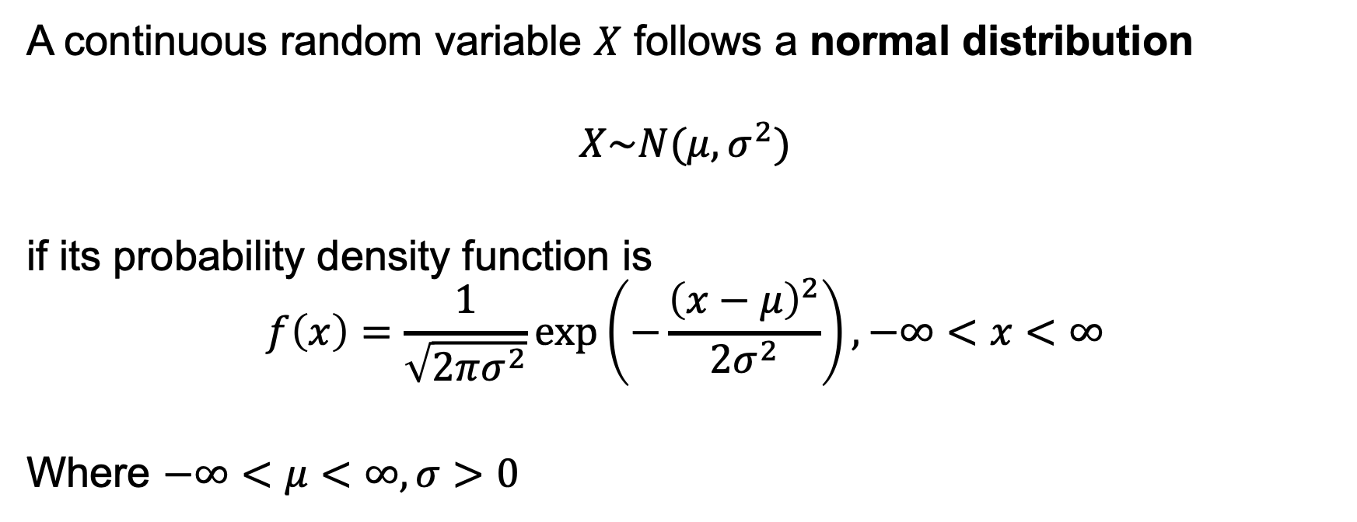
Definition and Notation
A continuous random variable $X$ follows a normal distribution
$$X\sim N(μ,σ^{2})$$
if its probability density function is
$$f\left(x\right)=\frac{1}{\sqrt{2πσ^{2}}}\exp\left(−\frac{{\left(x−μ\right)}^{2}}{2σ^{2}}\right),−∞<x<∞$$
Where $−∞<μ<∞,σ>0$
Notes:
The normal distribution is a family of distributions described by two parameters: the mean \(\mu\) and the variance \(\sigma^2\). Once we specify these two parameters, the entire distribution is determined.”
“We read this as ‘\(X\) follows a normal distribution with mean \(\mu\) and variance \(\sigma^2\).’ Notice that the second parameter is the variance. The standard deviation is \(\sigma\).”
This term measures the squared distance from the mean.
Values equally far above and below \(\mu\) have the same density, so the curve is symmetric about \(\mu\)
At x=u, the exponent is zero and the density is largest. As we move away from mu in either direction, the exponent becomes more negative, so the density decreases. This gives us the bell shape.

Slide 4

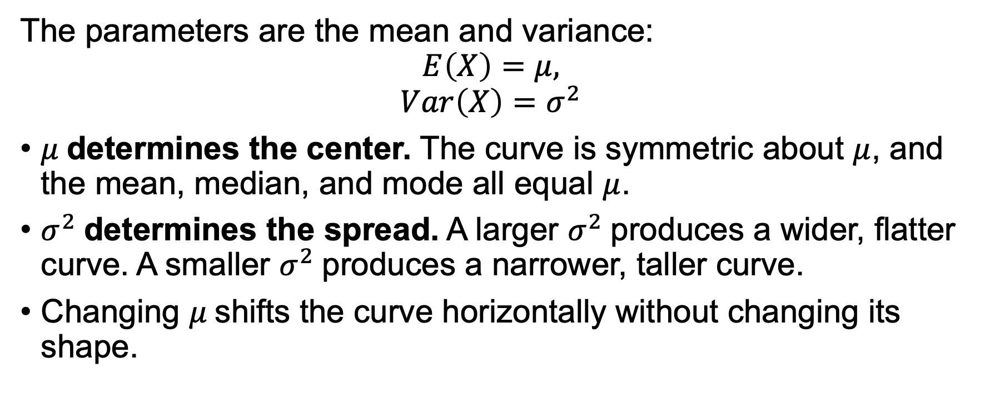
Interpreting $μ$and $σ^{2}$
The parameters are the mean and variance:
$$E\left(X\right)=μ,$$
$$Var\left(X\right)=σ^{2}$$
$μ$determines the center. The curve is symmetric about $μ$, and the mean, median, and mode all equal $μ$.
$σ^{2}$determines the spread. A larger $σ^{2}$produces a wider, flatter curve. A smaller $σ^{2}$produces a narrower, taller curve.
Changing $μ$shifts the curve horizontally without changing its shape.
Notes:
A normal distribution is completely determined by two parameters: its mean \(\mu\) and its variance \(\sigma^2\). We write \(X\sim N(\mu,\sigma^2)\). Notice that the second parameter is the variance, so the standard deviation is \(\sigma\)
The mean \(\mu\) locates the center. The curve is symmetric about \(\mu, the mean, median, and mode are all equal to \(\mu\)
The variance describes the spread. A larger variance means the distribution is more spread out. A smaller variance means it is more concentrated around the mean

Slide 5
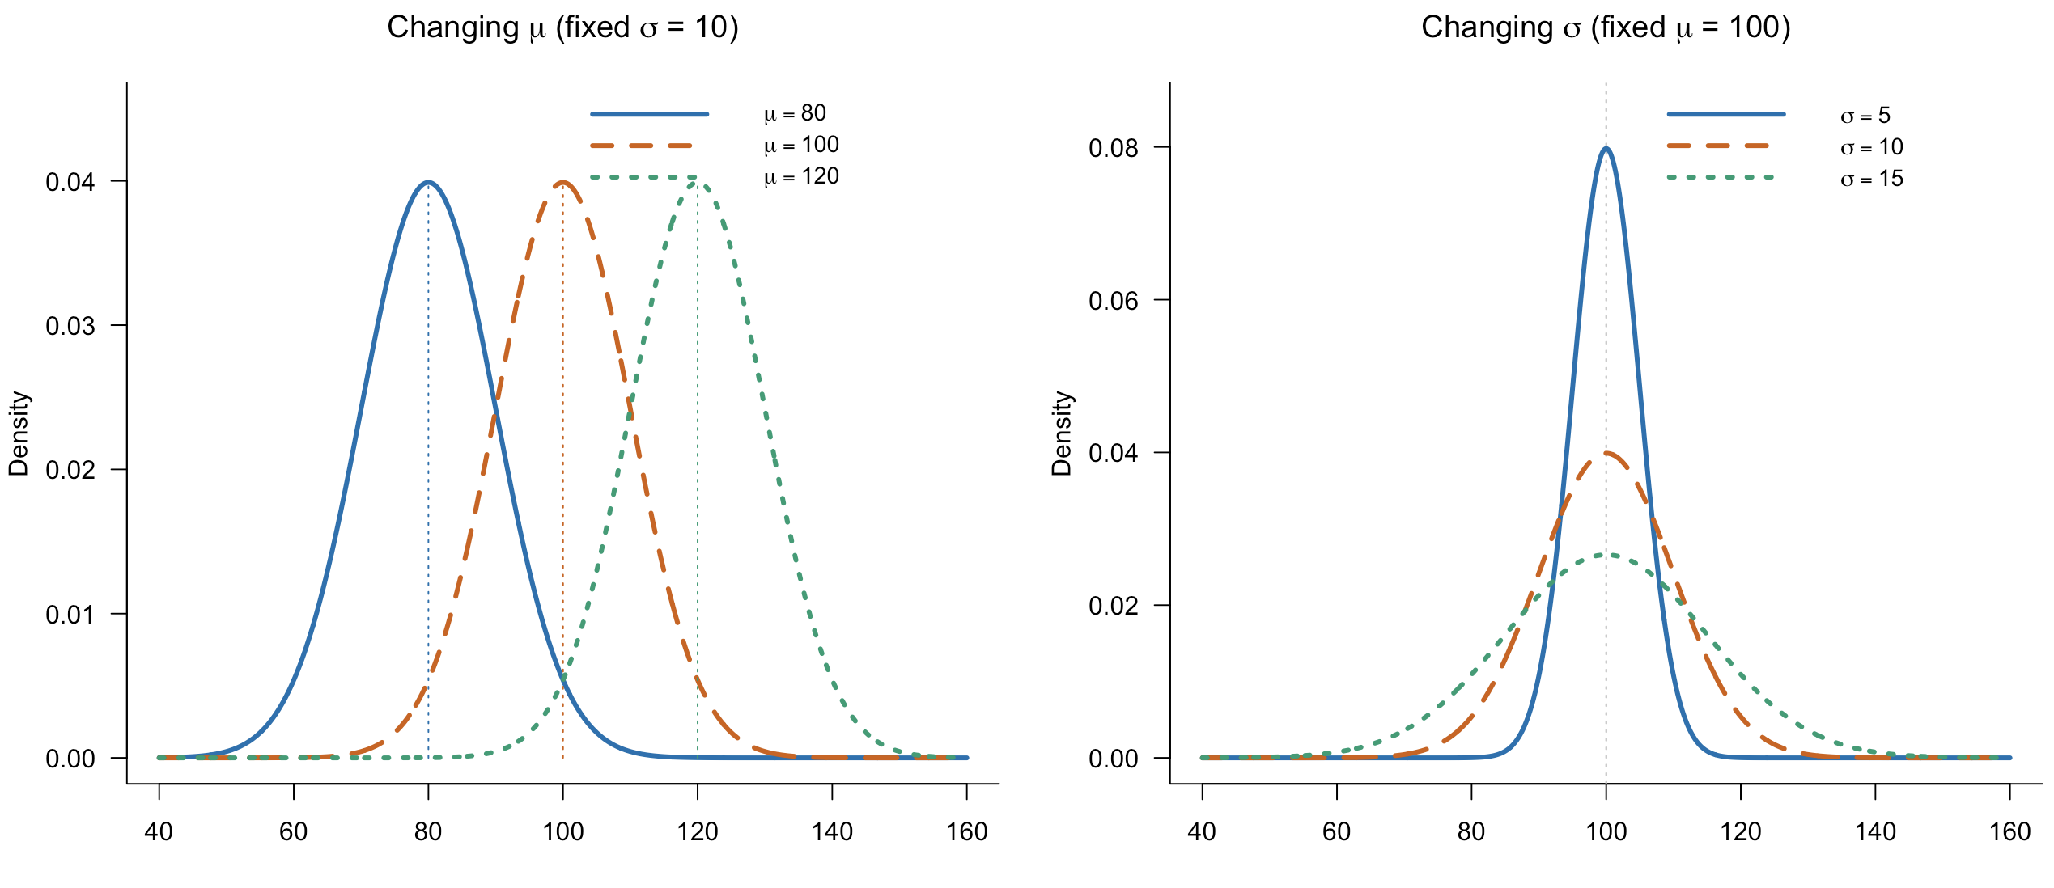
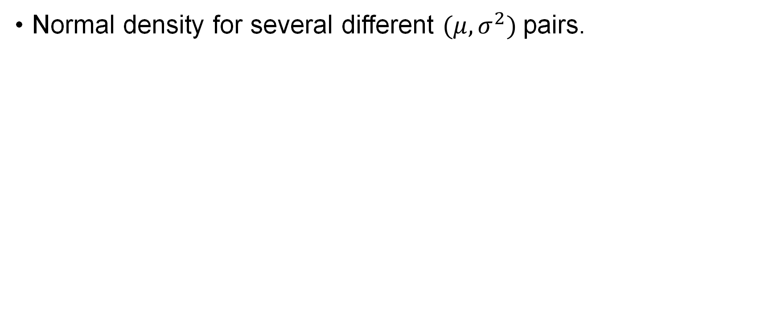
The Normal Distribution
Normal density for several different $(μ, σ^{2})$pairs.
Notes:
Here, all three distributions have the same standard deviation, \(10\), but different means. As the mean increases from \(80\) to \(120\), the curve moves to the right. Its shape and spread stay the same
Here, all three distributions have the same mean, \(100\), but different standard deviations. As the standard deviation increases, the curve becomes wider and its peak becomes lower.
Why does the wider curve have a lower peak? 1) Because the total area must remain one. Spreading the distribution over a wider range requires a lower peak.” 2)density

Slide 6
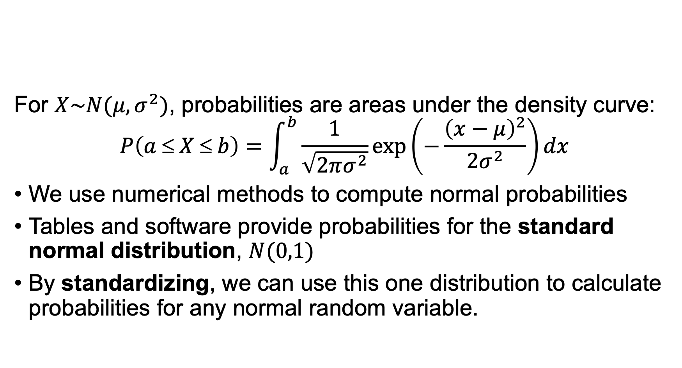
Computing Normal Probabilities
For $X\sim N(μ,σ^{2})$, probabilities are areas under the density curve:
$$P\left(a ≤ X ≤ b\right)=\int_{a}^{b}{\frac{1}{\sqrt{2πσ^{2}}}\exp\left(−\frac{{\left(x−μ\right)}^{2}}{2σ^{2}}\right)dx}$$
We use numerical methods to compute normal probabilities
Tables and software provide probabilities for the standard normal distribution, $N(0,1)$
By standardizing, we can use this one distribution to calculate probabilities for any normal random variable.

Slide 7
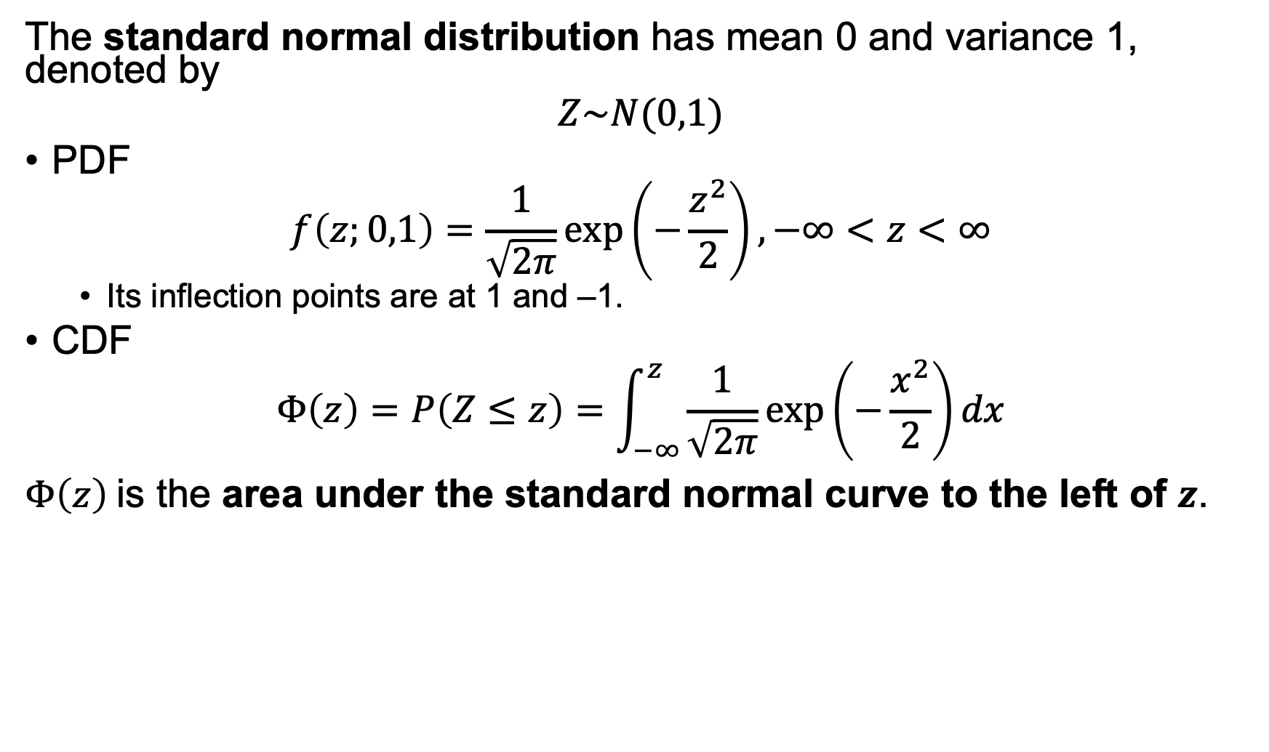
The Standard Normal Distribution
The standard normal distribution has mean 0 and variance 1, denoted by
$$Z\sim N(0,1)$$
PDF
$$f\left(z;0,1\right)=\frac{1}{\sqrt{2π}}\exp\left(−\frac{z^{2}}{2}\right), −∞<z<∞$$
  Its inflection points are at 1 and –1.
CDF
$$Φ\left(z\right)=P\left(Z≤z\right)=\int_{−∞}^{z}{\frac{1}{\sqrt{2π}}\exp\left(−\frac{x^{2}}{2}\right)dx}$$
$Φ\left(z\right)$is the area under the standard normal curve to the left of $z$.

Slide 8
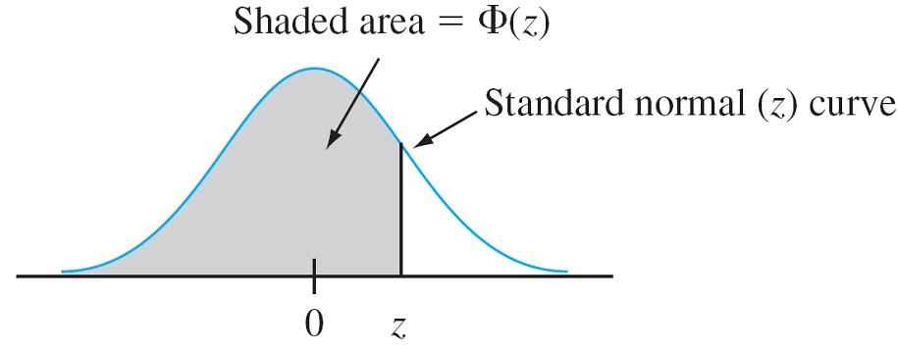
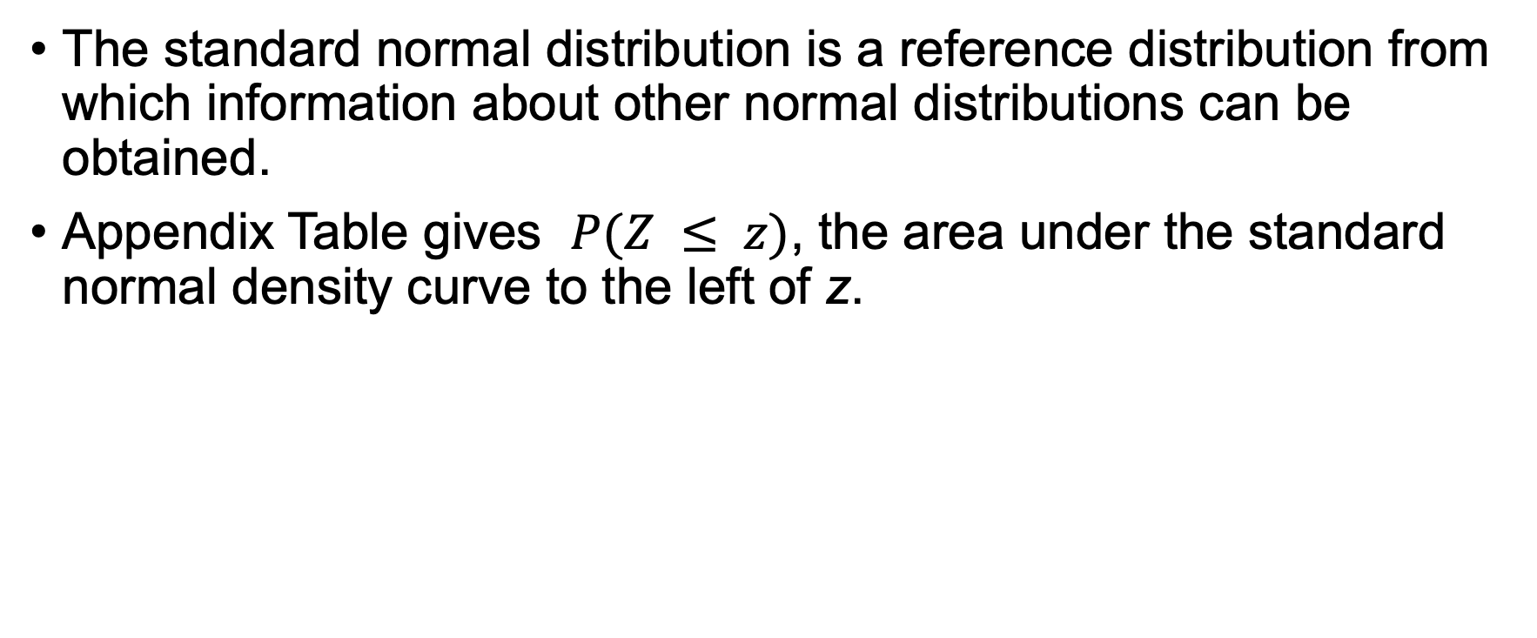
The Standard Normal Distribution
The standard normal distribution is a reference distribution from which information about other normal distributions can be obtained.
Appendix Table gives $P(Z ≤ z)$, the area under the standard normal density curve to the left of z.

Slide 9
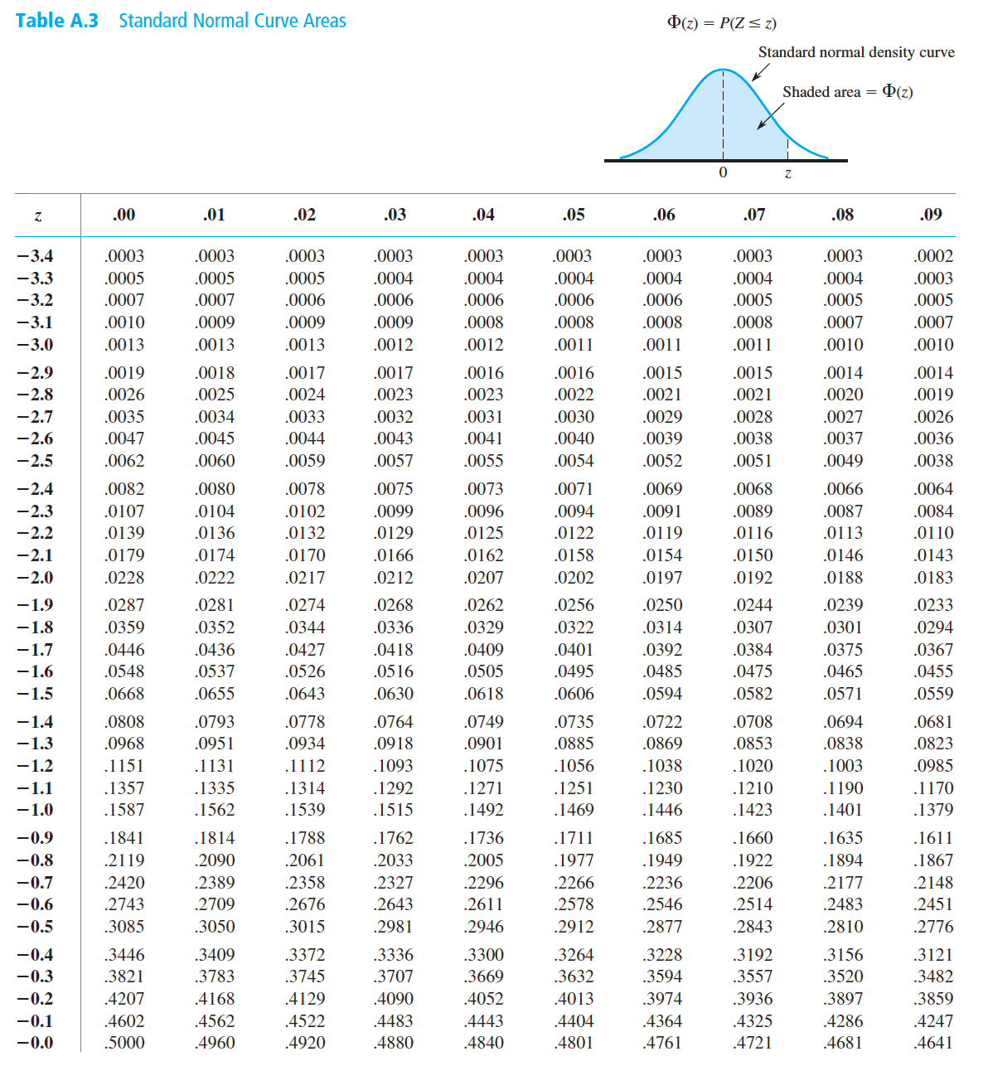
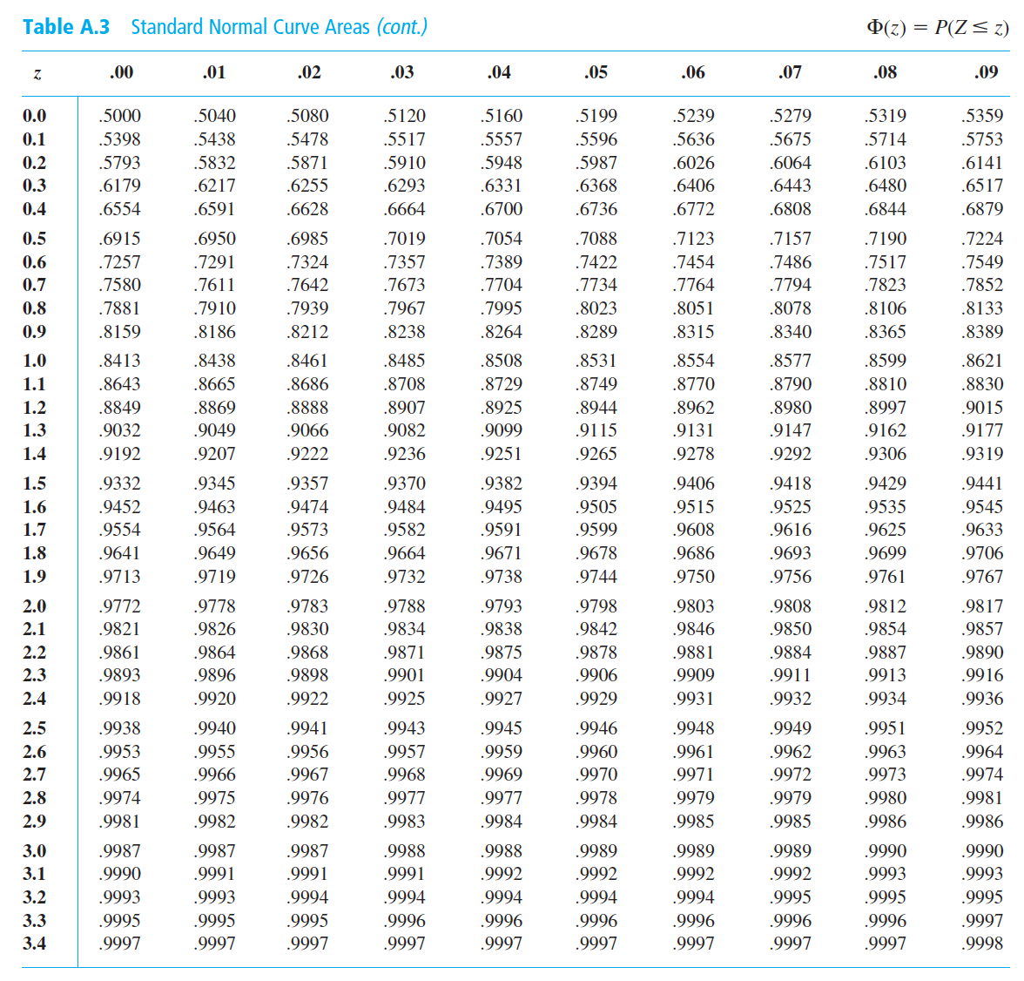
Appendix Table 3
Notes:
This table gives \(\Phi(z)=P(Z\le z)\), the area under the standard normal curve to the left of \(z\)
The row gives the ones and tenths digits. The column gives the hundredths digit. For \(z=1.23\), find row \(1.2\) and column \(.03\).

Slide 10
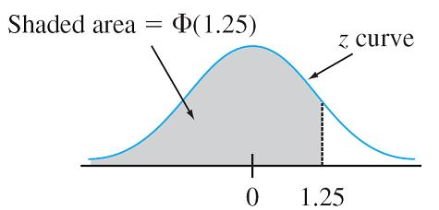
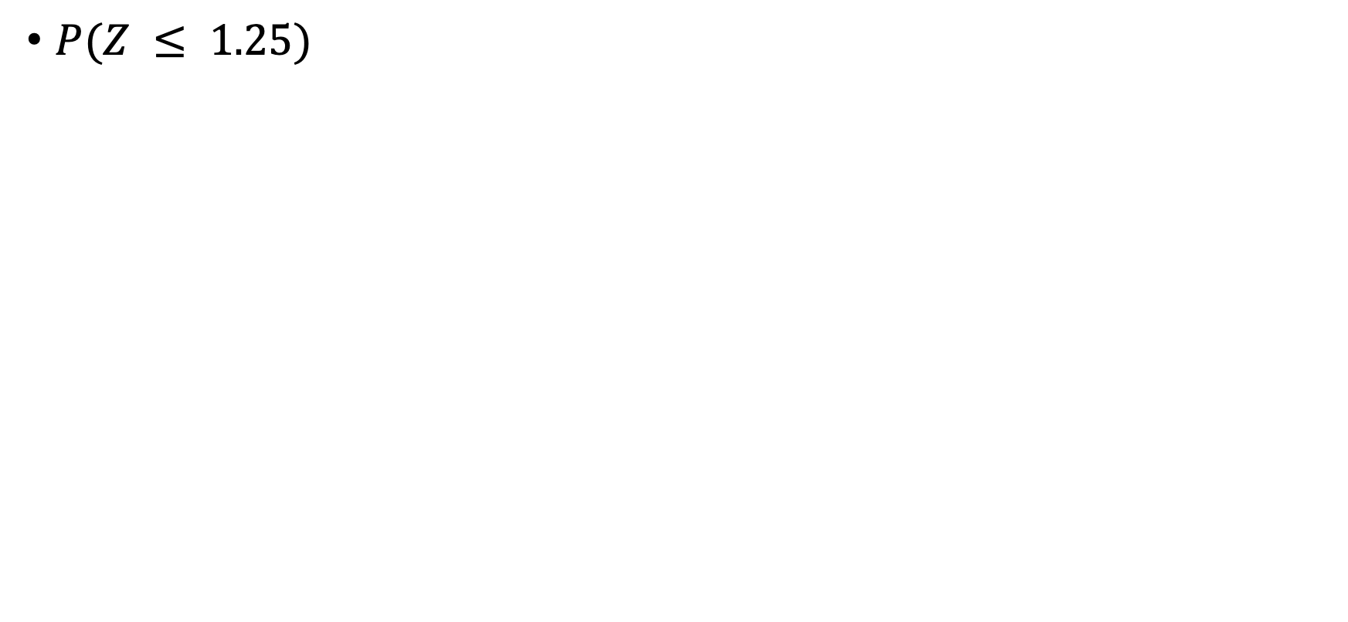
Determine Standard Normal Probabilities
$P(Z ≤ 1.25)$

Slide 11
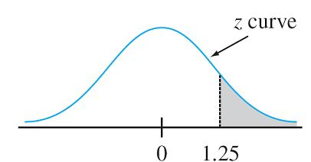
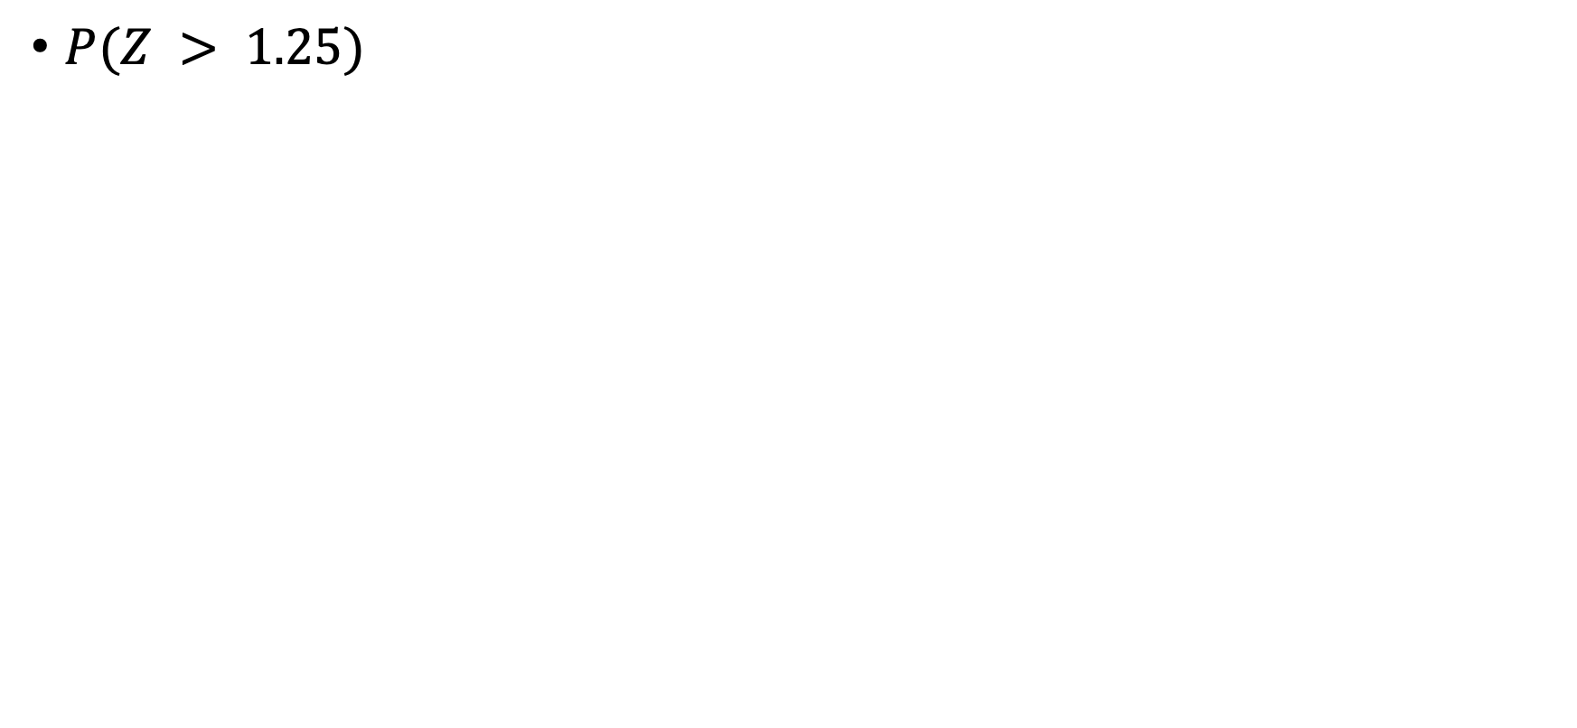
Determine Standard Normal Probabilities
$P(Z > 1.25)$

Slide 12
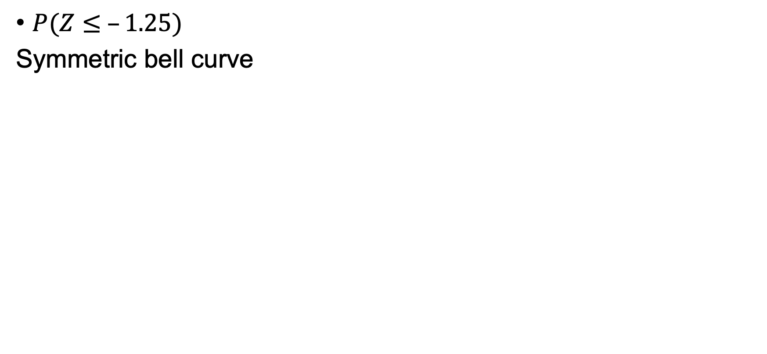
Determine Standard Normal Probabilities
$P(Z≤ –1.25)$
Symmetric bell curve

Slide 13
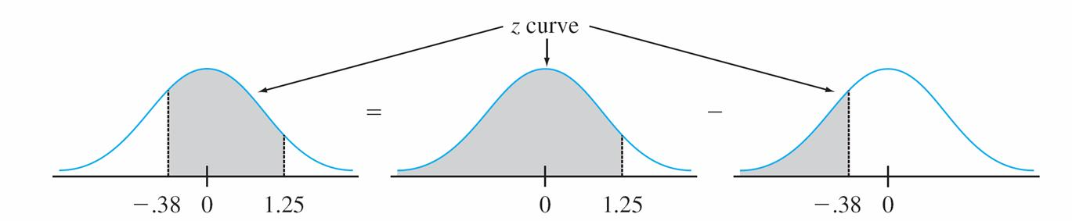
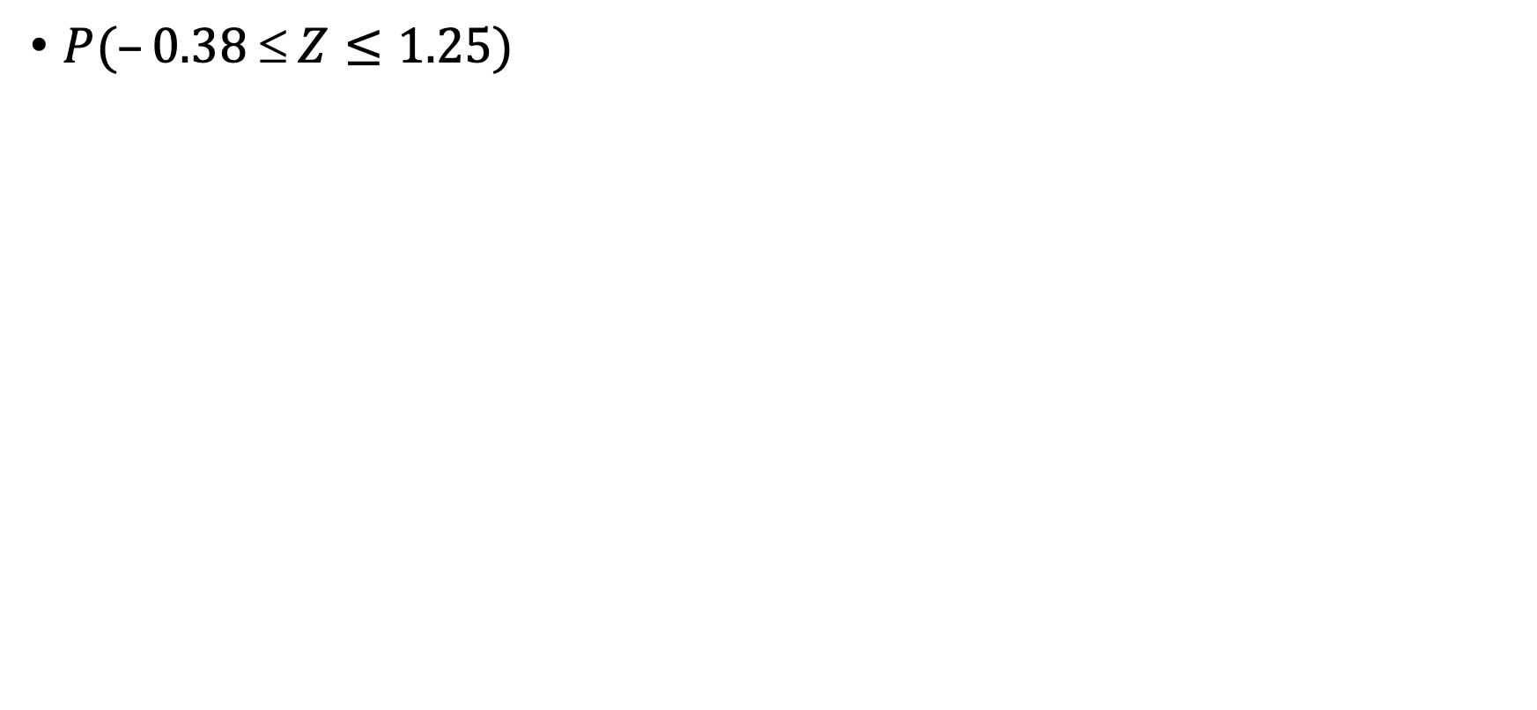
Determine Standard Normal Probabilities
$P(–0.38  Z≤1.25)$

Slide 14
Determine Standard Normal Probabilities
$P(–0.38  Z≤1.25)$

Slide 15
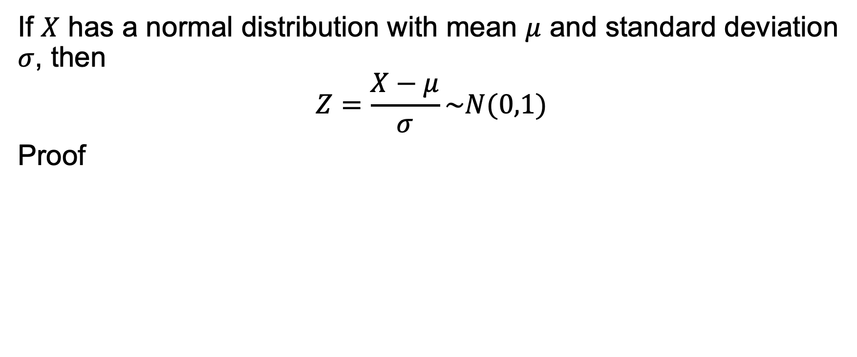
Nonstandard to Standard Normal Distribution
If $X$ has a normal distribution with mean $μ$ and standard deviation $σ$, then
$$Z=\frac{X−μ}{σ}\sim N(0,1)$$
Proof

Slide 16
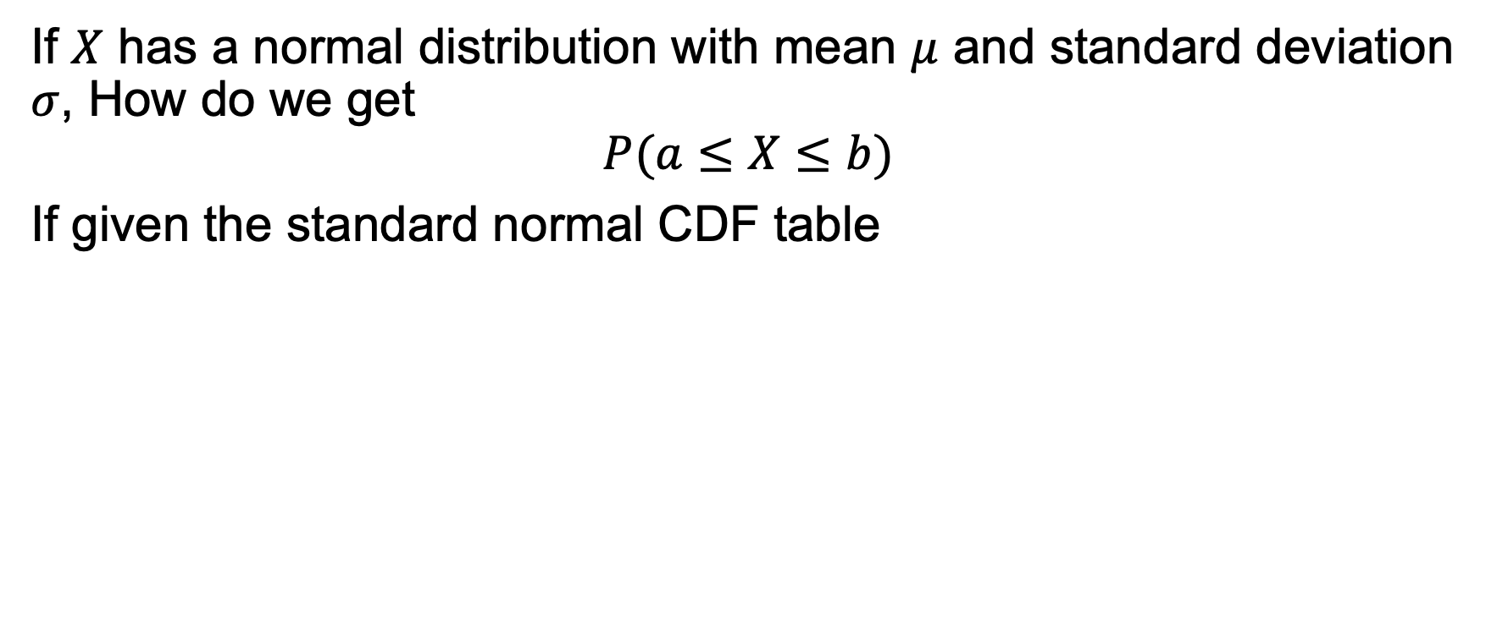
Nonstandard Normal Distribution
If $X$ has a normal distribution with mean $μ$ and standard deviation $σ$, How do we get
$$P(a≤X≤b)$$
If given the standard normal CDF table

Slide 17
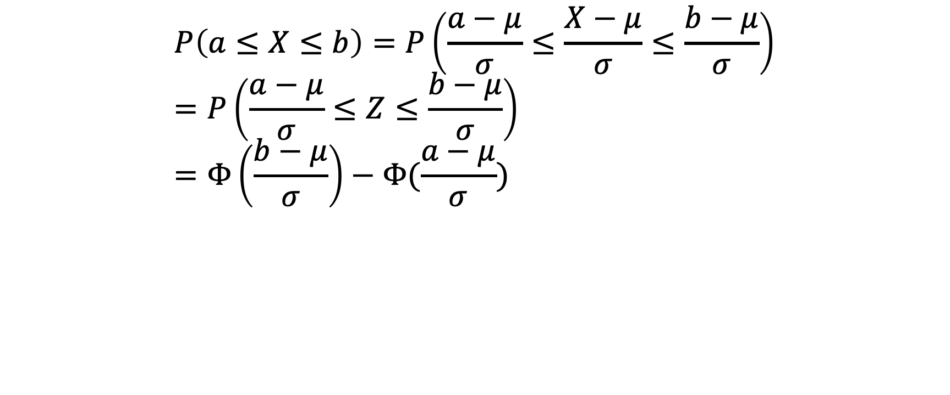
Nonstandard Normal Distribution
$$P\left(a≤X≤b\right)=P\left(\frac{a−μ}{σ}≤\frac{X−μ}{σ}≤\frac{b−μ}{σ}\right) \\ =P\left(\frac{a−μ}{σ}≤Z≤\frac{b−μ}{σ}\right) \\ =Φ\left(\frac{b−μ}{σ}\right)−Φ(\frac{a−μ}{σ})$$

Slide 18
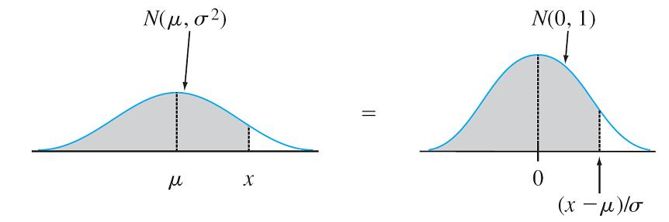
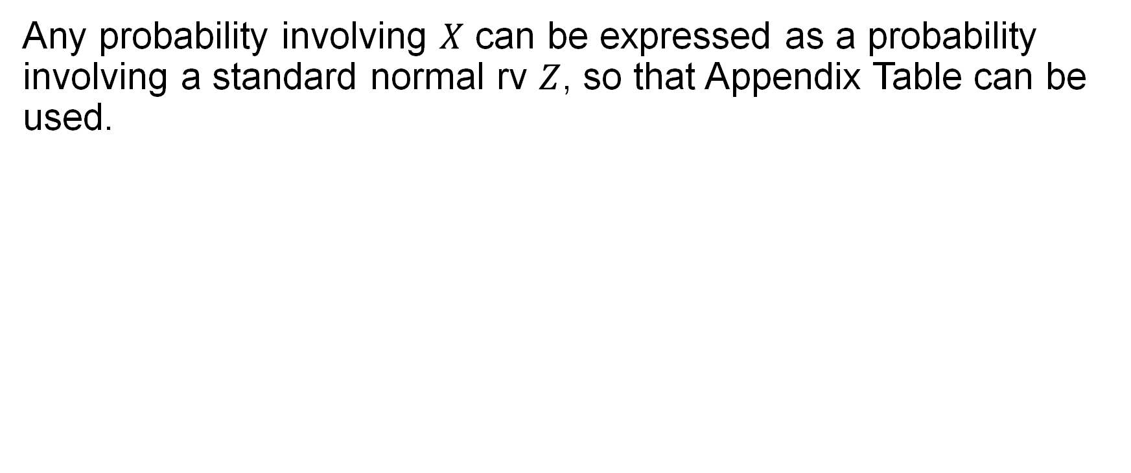
Nonstandard Normal Distribution
Any probability involving $X$ can be expressed as a probability involving a standard normal rv $Z$, so that Appendix Table can be used.

Slide 19
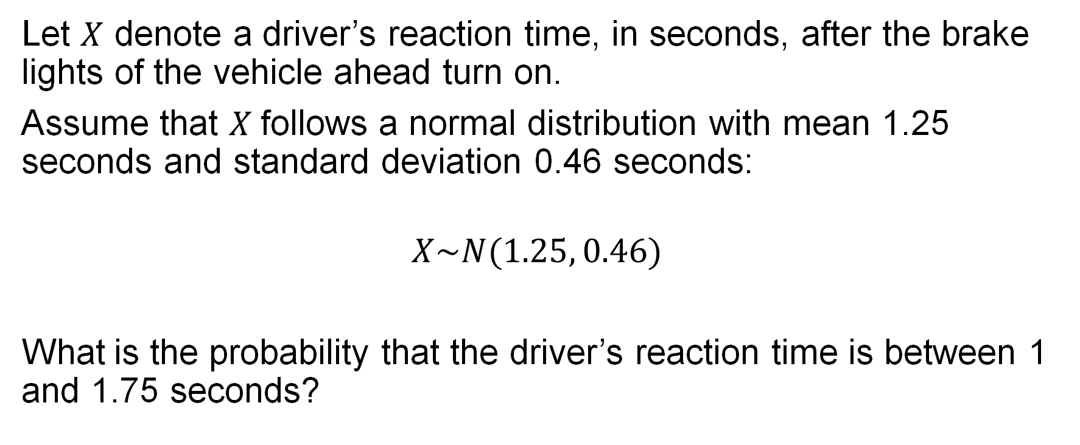
Example: Driver Reaction Time
Let $X$ denote a driver’s reaction time, in seconds, after the brake lights of the vehicle ahead turn on.
Assume that $X$follows a normal distribution with mean 1.25 seconds and standard deviation 0.46 seconds:
$$X\sim N(1.25, 0.46)$$
What is the probability that the driver’s reaction time is between 1 and 1.75 seconds?

Slide 20
Example: Driver Reaction Time

Slide 21
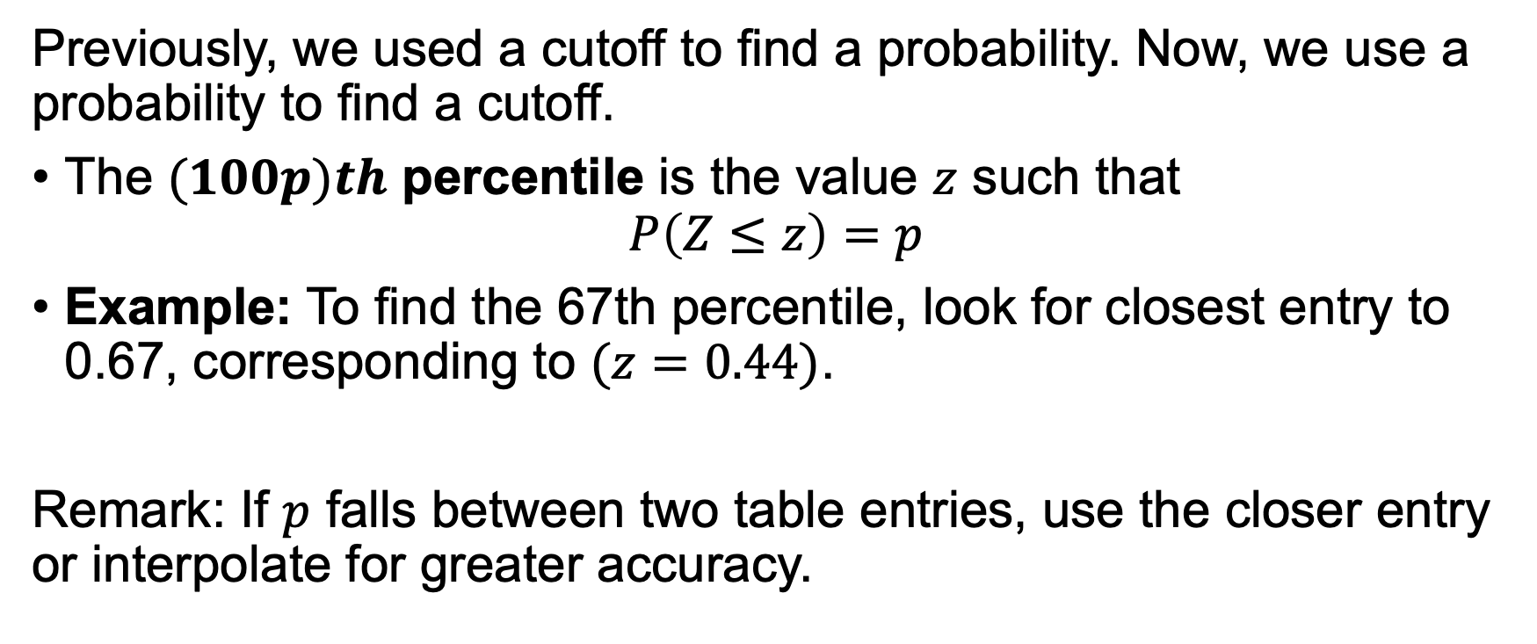
Percentiles of the Standard Normal Distribution
Previously, we used a cutoff to find a probability. Now, we use a probability to find a cutoff.
The $(100p)th$ percentile is the value $z$ such that
$$P\left(Z≤z\right)=p$$
Example: To find the 67th percentile, look for closest entry to 0.67, corresponding to $(z=0.44)$.
Remark: If $p$ falls between two table entries, use the closer entry or interpolate for greater accuracy.

Slide 22
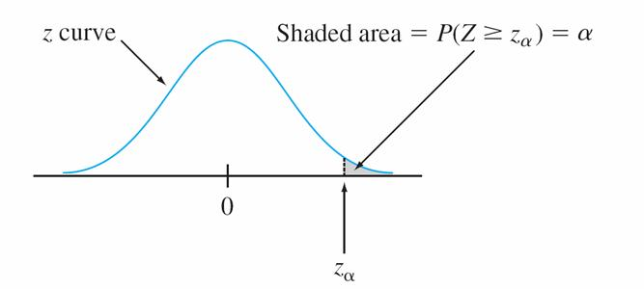
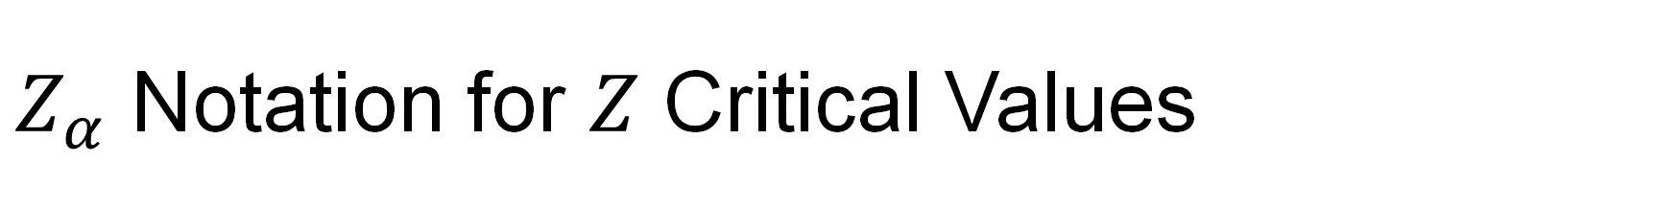
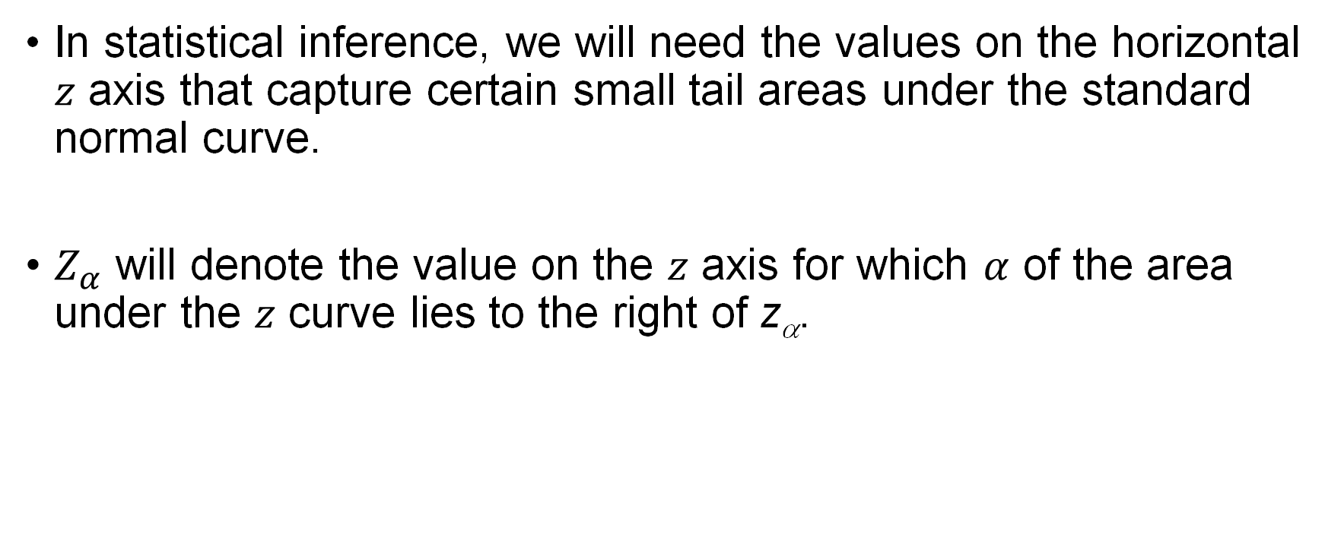
$Z_{α}$ Notation for $Z$ Critical Values
In statistical inference, we will need the values on the horizontal $z$ axis that capture certain small tail areas under the standard normal curve.
$Z_{α}$ will denote the value on the $z$ axis for which $α$ of the area under the $z$ curve lies to the right of z_{α}.
Notes:
This notation will be convenient later when we study confidence intervals and hypothesis tests.

Slide 23
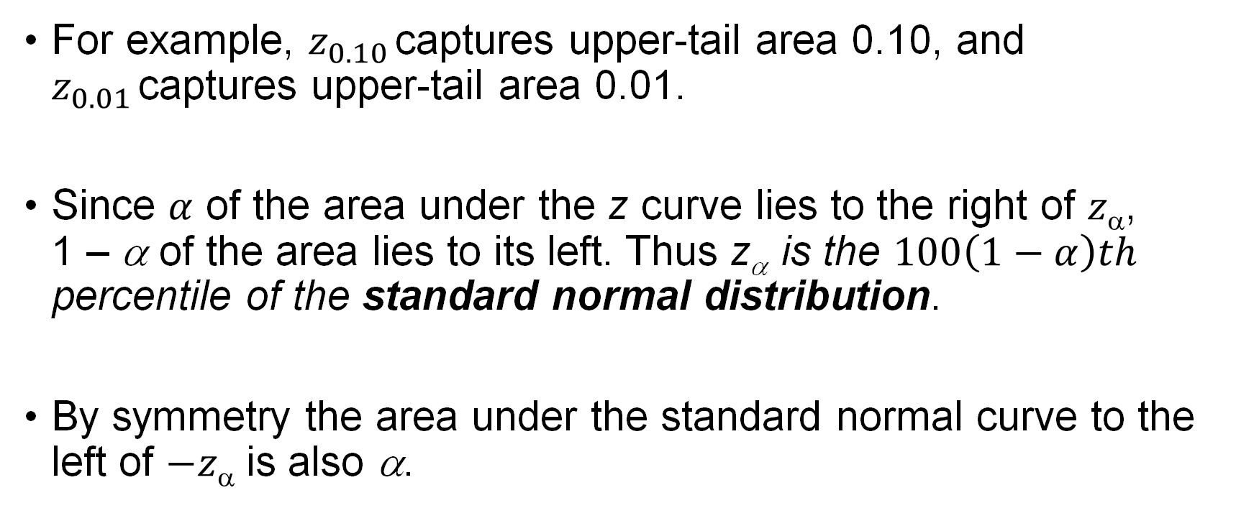
$Z_{α}$ Notation for $Z$ Critical Values
For example, $z_{0.10}$captures upper-tail area 0.10, and $z_{0.01}$captures upper-tail area 0.01.
Since $α$ of the area under the z curve lies to the right of $z$,
1 – α of the area lies to its left. Thus z_{α} is the $100\left(1−α\right)th$ percentile of the standard normal distribution.
By symmetry the area under the standard normal curve to the left of $−z$ is also α.

Slide 24
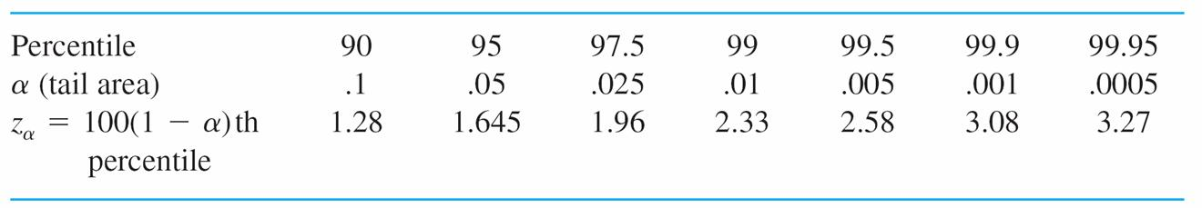
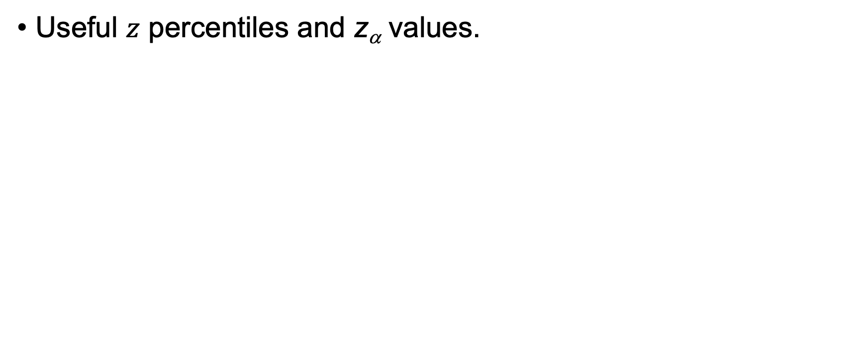
$Z_{α}$ Notation for $Z$ Critical Values
Useful $z$ percentiles and z_{α} values.
Standard Normal Percentiles and Critical Values

Slide 25
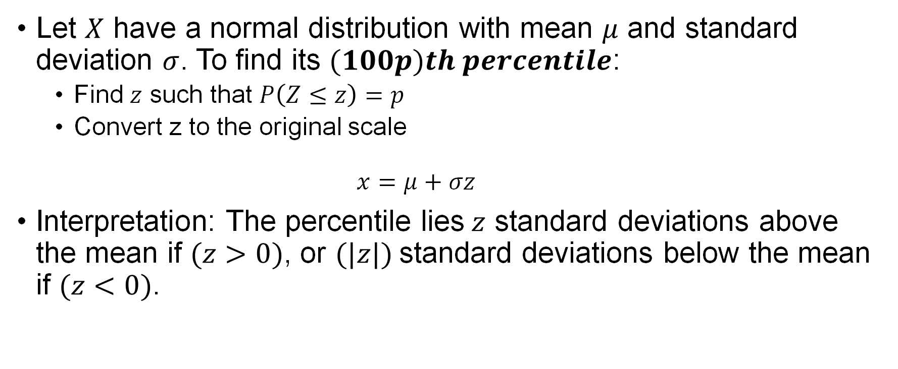
Percentiles of an Arbitrary Normal Distribution
Let $X$ have a normal distribution with mean $μ$ and standard deviation $σ$. To find its $(100p)th percentile$:
  Find $z$ such that $P\left(Z≤z\right)=p$
  Convert z to the original scale
  $x=μ+σz$
Interpretation: The percentile lies$z$ standard deviations above the mean if $(z>0)$, or $(|z|)$standard deviations below the mean if $(z<0)$.

Slide 26
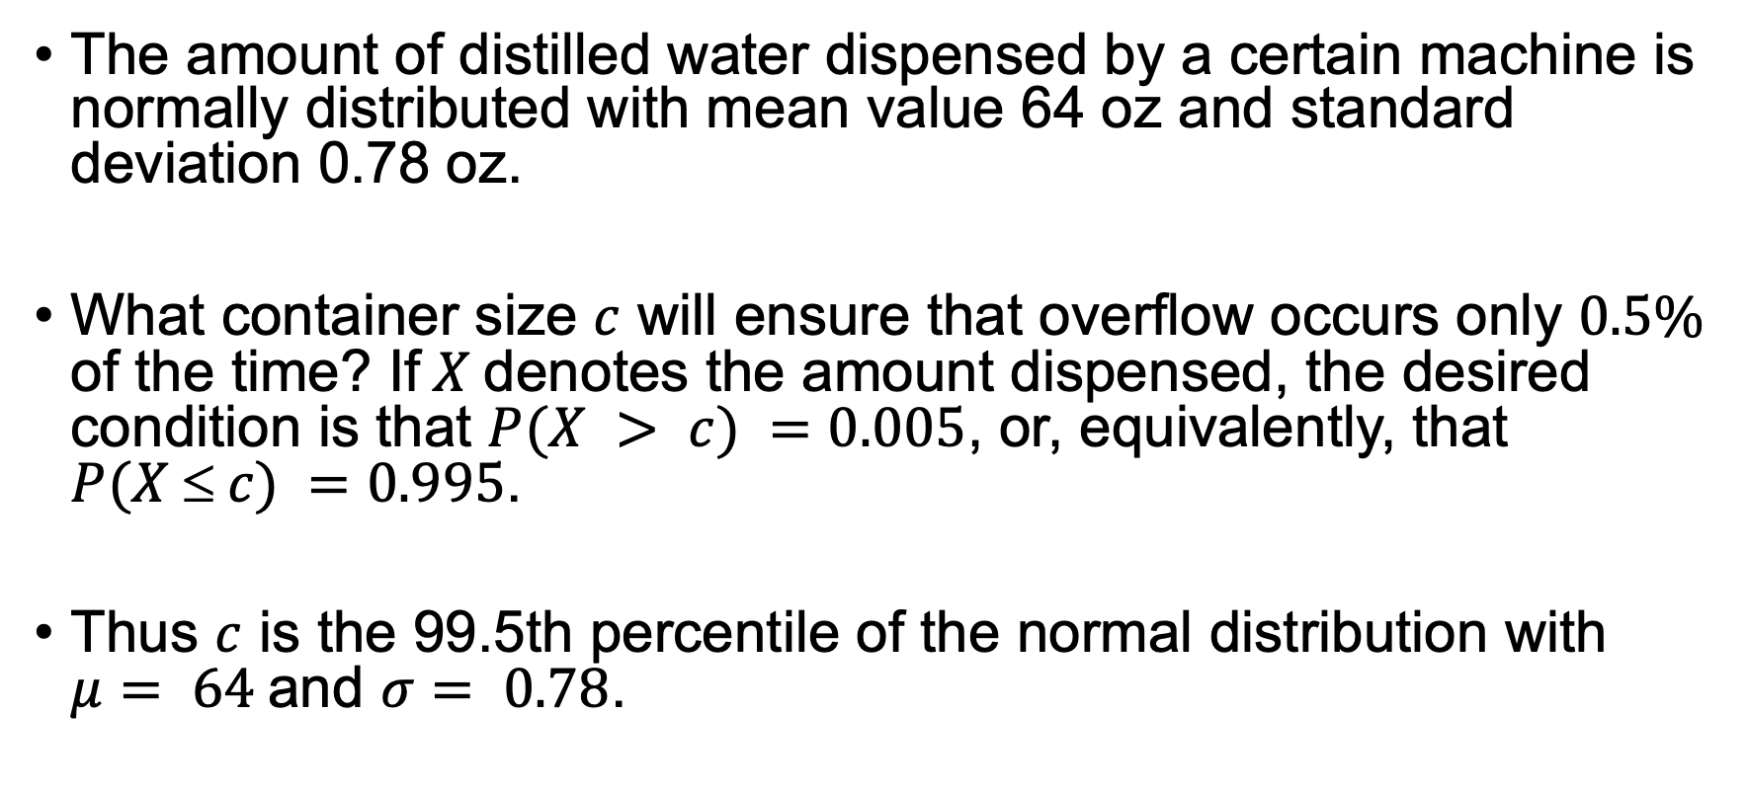
Example
The amount of distilled water dispensed by a certain machine is normally distributed with mean value 64 oz and standard deviation 0.78 oz.
What container size $c$ will ensure that overflow occurs only $0.5\%$ of the time? If$X$denotes the amount dispensed, the desired condition is that $P(X > c) =0.005$, or, equivalently, that $P(X  c) =0.995$.
Thus $c$ is the 99.5th percentile of the normal distribution with $μ= 64$and $σ= 0.78$.

Slide 27
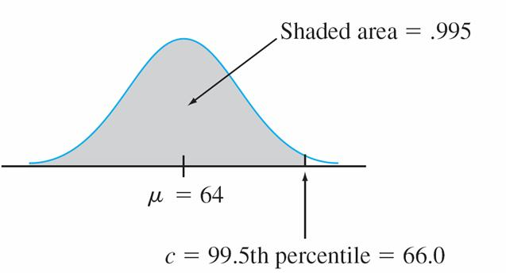
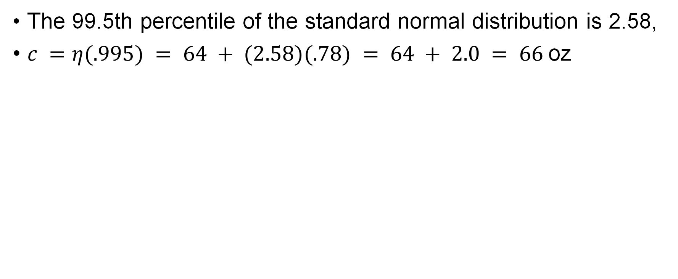
Example
The 99.5th percentile of the standard normal distribution is 2.58,
$c =η(.995) = 64 + (2.58)(.78) = 64 + 2.0 = 66$oz
Distribution of amount dispensed

Slide 28
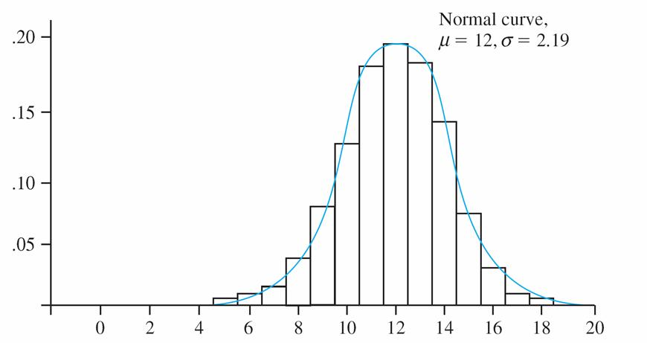
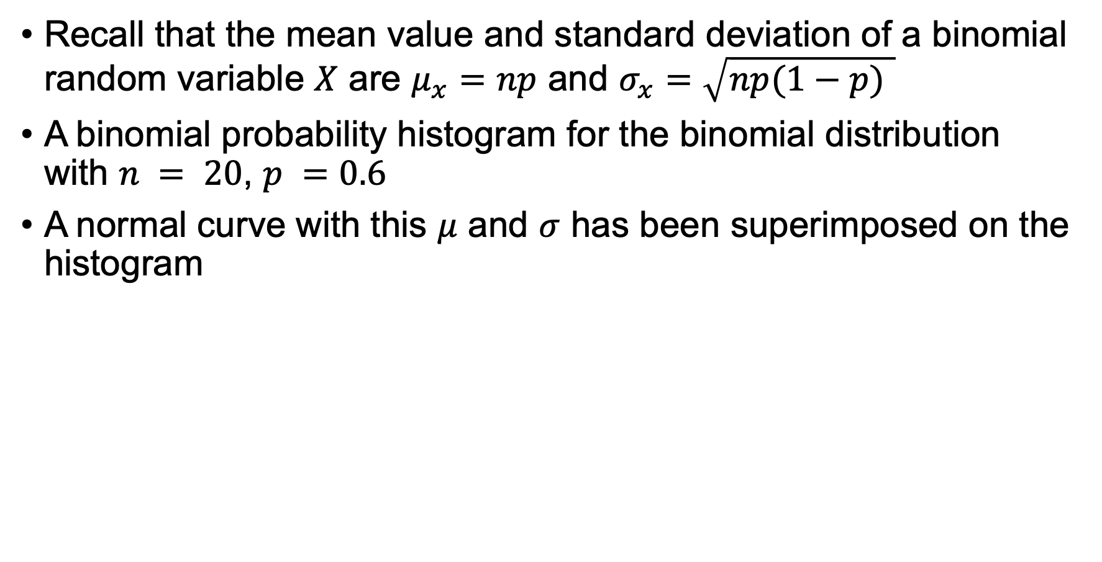
Normal Approximating the Binomial Distribution
Recall that the mean value and standard deviation of a binomial random variable $X$ are $μ_{x}=np$ and $σ_{x}=\sqrt{np(1−p) }$
A binomial probability histogram for the binomial distribution with $n = 20$, $p =0.6$
A normal curve with this $μ$ and $σ$ has been superimposed on the histogram

Slide 29
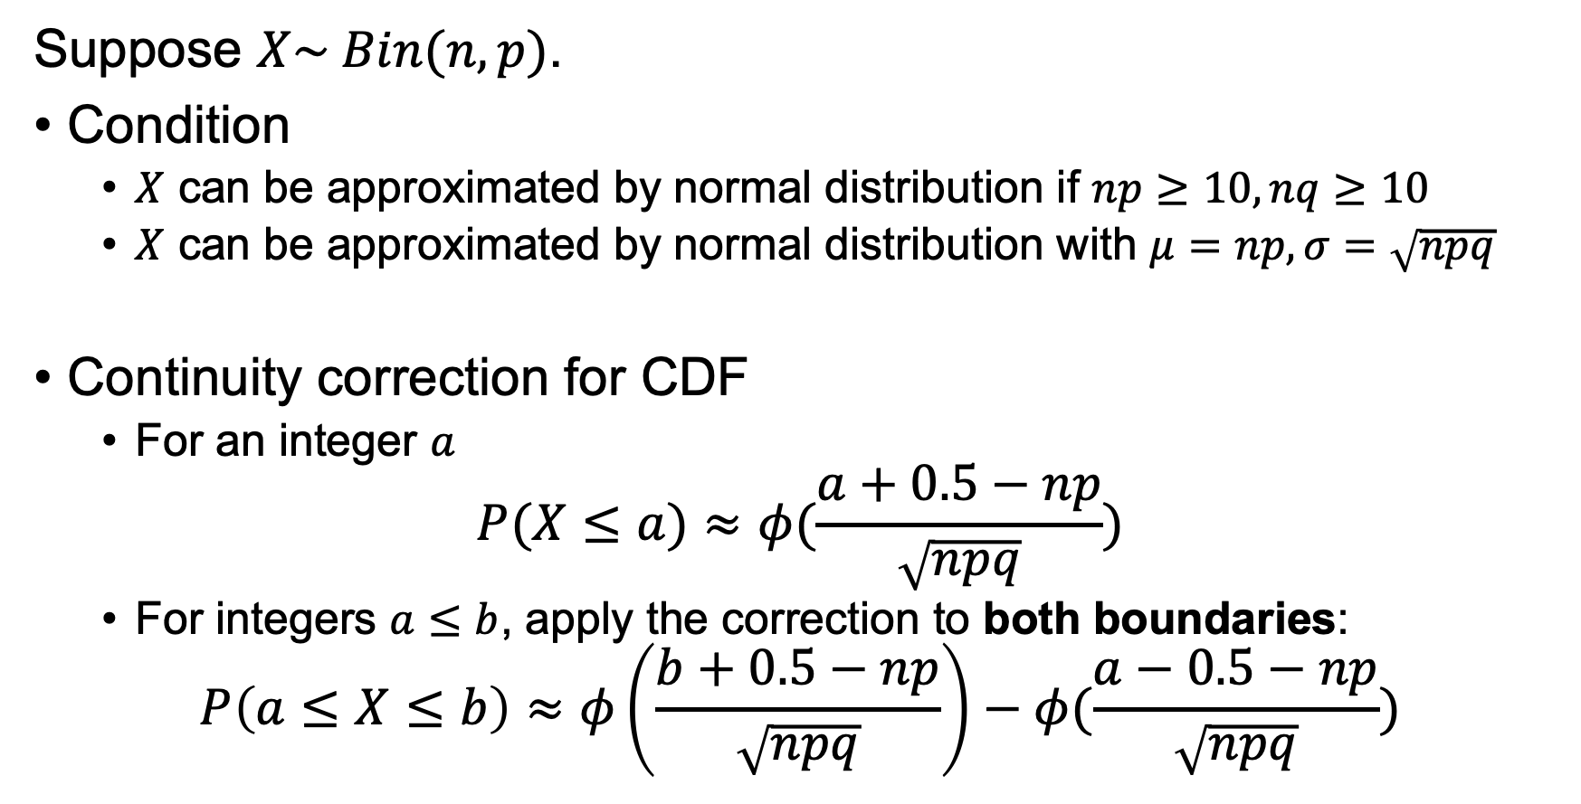
Approximating the Binomial Distribution
Suppose $X\sim Bin(n,p)$.
Condition
  $X$ can be approximated by normal distribution if $np≥10,nq≥10$
  $X$ can be approximated by normal distribution with $μ=np, σ=\sqrt{npq}$
Continuity correction for CDF
  For an integer $a$
$$P(X≤a)≈φ(\frac{a+0.5−np}{\sqrt{npq}})$$
  For integers $a≤b$, apply the correction to both boundaries:
$$P\left(a≤X≤b\right)≈φ\left(\frac{b+0.5−np}{\sqrt{npq}}\right)−φ(\frac{a−0.5−np}{\sqrt{npq}})$$

Slide 30
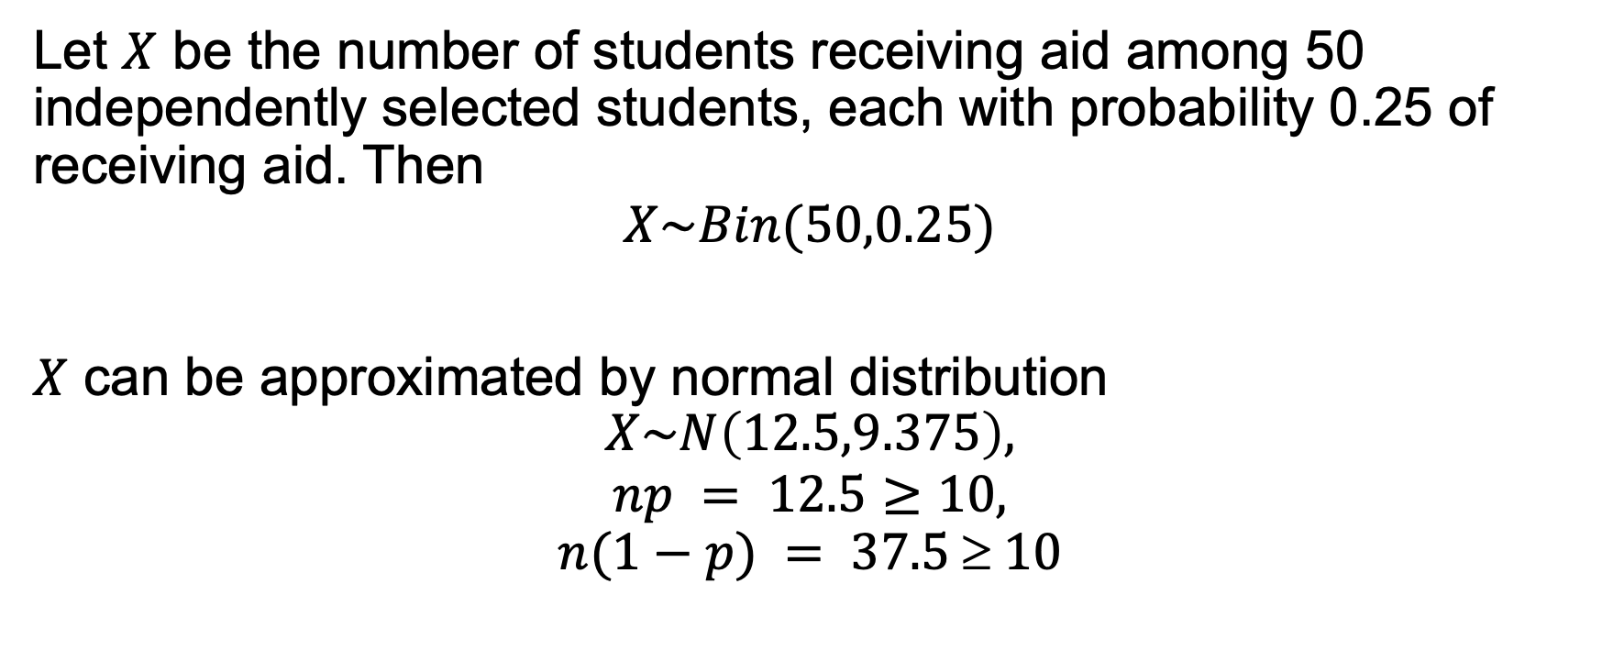
Example: Normal Approximation to the Binomial
Let $X$ be the number of students receiving aid among 50 independently selected students, each with probability 0.25 of receiving aid. Then
$$X\sim Bin(50,0.25)$$
$X$ can be approximated by normal distribution
$$X\sim N\left(12.5,9.375\right),$$
$$np = 12.5≥10,$$
$$n(1−p) = 37.5  10$$

Slide 31
Example
The probability that at most 10 students receive aid is
Between 5 and 15 (inclusive) of the selected students receive aid is

Slide 32
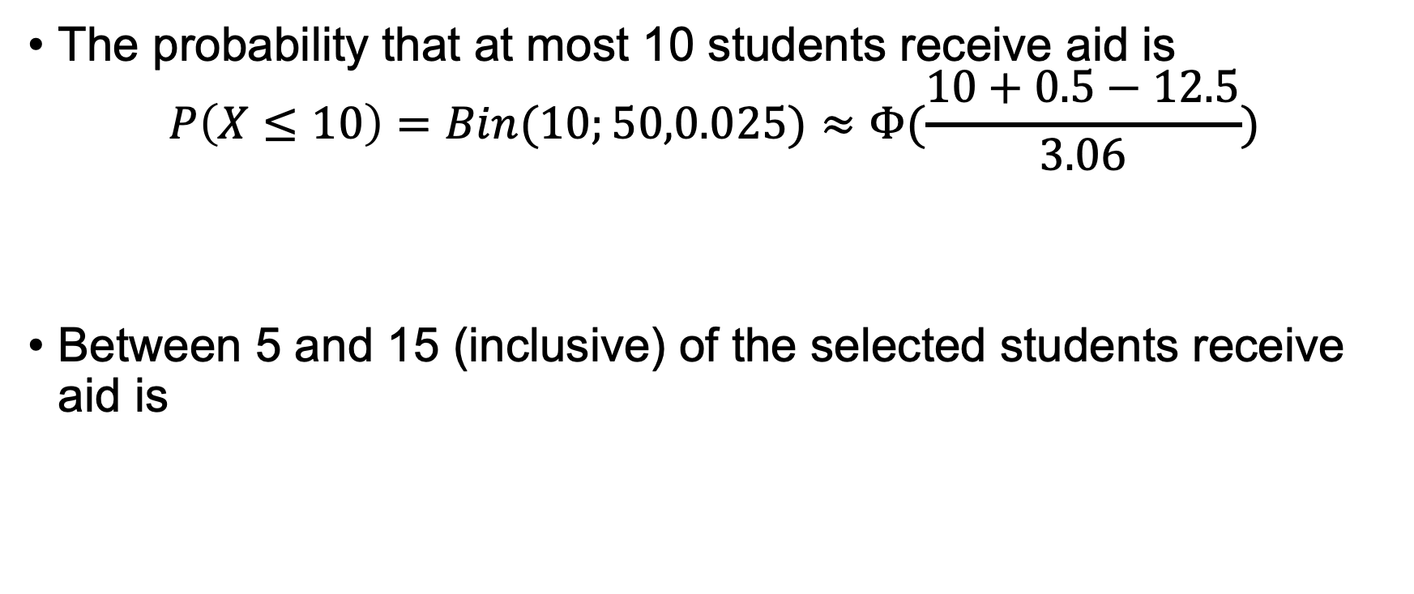
Example
The probability that at most 10 students receive aid is
$$P\left(X≤10\right)=Bin(10;50,0.025)≈Φ(\frac{10+0.5−12.5}{3.06})$$
Between 5 and 15 (inclusive) of the selected students receive aid is

Slide 33
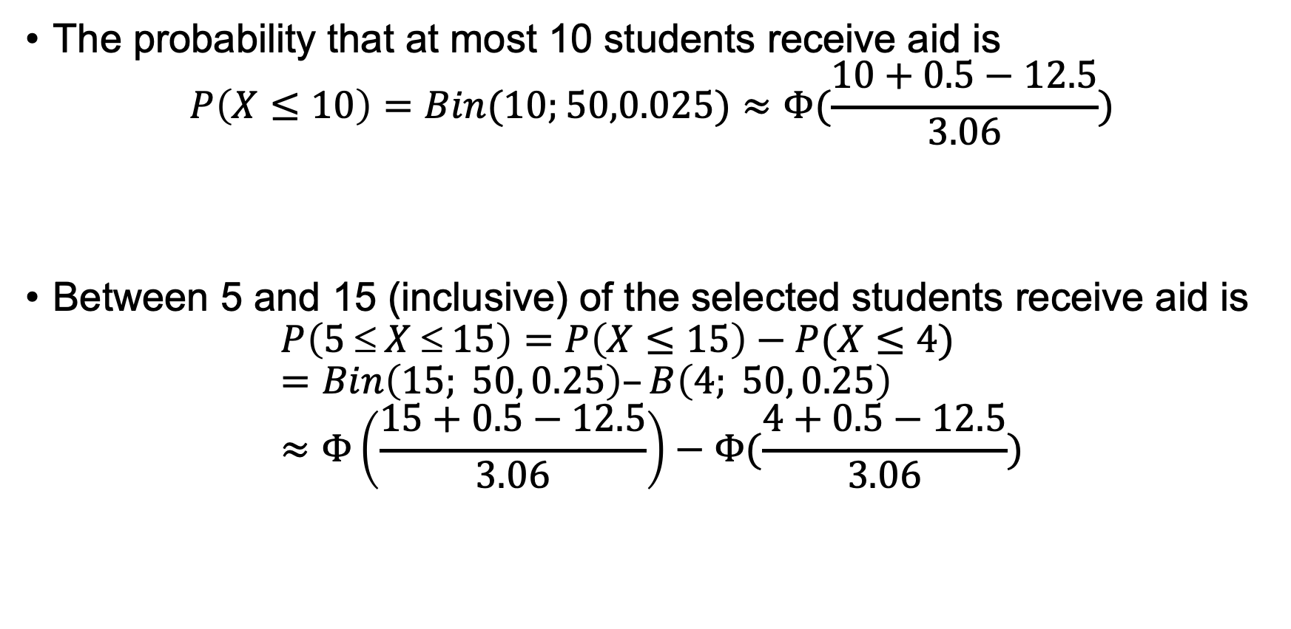
Example
The probability that at most 10 students receive aid is
$$P\left(X≤10\right)=Bin(10;50,0.025)≈Φ(\frac{10+0.5−12.5}{3.06})$$
Between 5 and 15 (inclusive) of the selected students receive aid is
$$P\left(5 ≤ X ≤ 15\right)=P\left(X≤15\right)−P(X≤4)=Bin\left(15; 50, 0.25\right)–B\left(4; 50, 0.25\right) \\ ≈Φ\left(\frac{15+0.5−12.5}{3.06}\right)−Φ(\frac{4+0.5−12.5}{3.06})$$

Slide 34
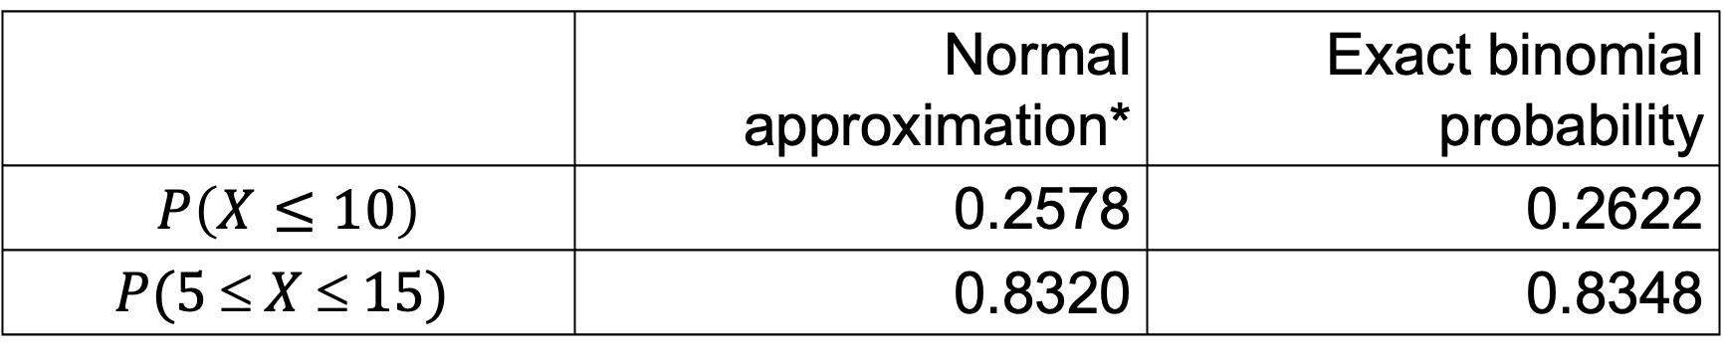
Example
 | Normal approximation* | Exact binomial probability
$$P\left(X≤10\right)$$ | 0.2578 | 0.2622
$$P(5  X  15)$$ | 0.8320 | 0.8348

