Slide 1

Intro to REACT.js Shayne Marques Presented by Web Dev Club
Notes:
PowerPoint from SlidesCarnival: https://www.slidescarnival.com/dumaine-free-presentation-template/1120#preview

Slide 2

What is React?
OPEN-SOURCE JAVASCRIPT LIBRARY
MAINTAINED BY FACEBOOK
FIRST DEPLOYED IN 2013
USED TO DEVELOP RESPONSIVE APPS

Slide 3
Why React?
JSX
Reusable components
Create large web applications
Change data without reloading the page
Fast
Great for user interfaces

Slide 4
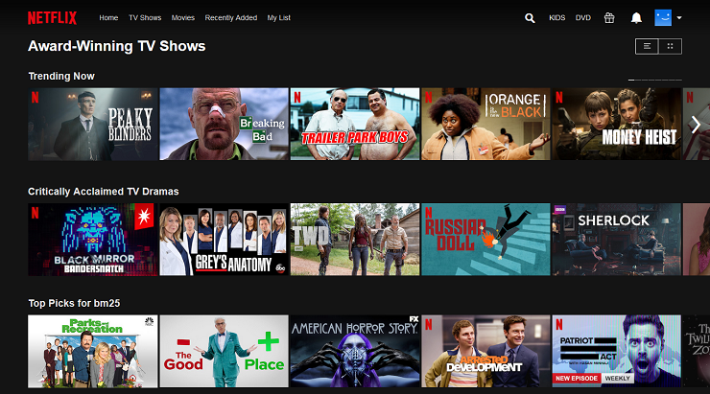
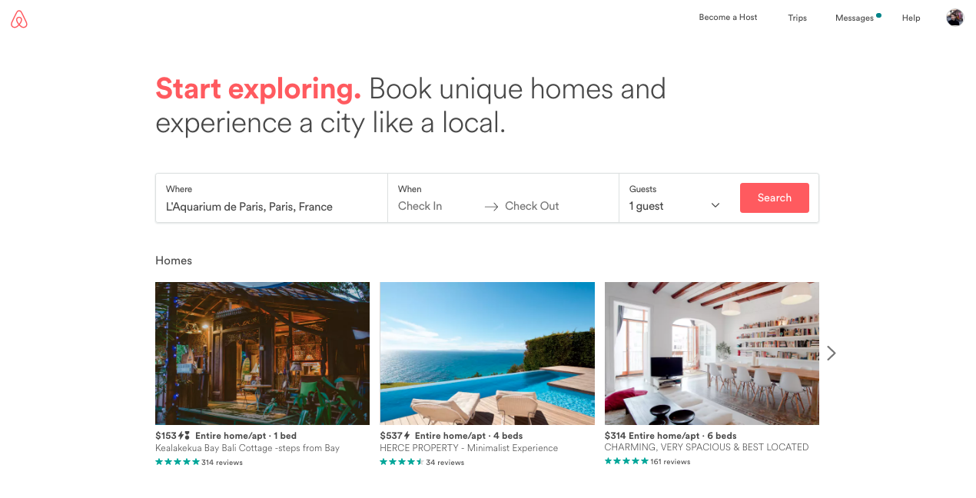
WEBSITES THAT USE REACT
Instagram
Netflix
Dropbox
Airbnb
PayPal
Reddit
KhanAcademy
UberEats

Slide 5

FEATURES
State
Props
Components
Virtual DOM

Slide 6

DEMO TIME

Slide 7

QUESTIONS?

