Slide 1
Metal
Purdue iOS Dev Club

Slide 2
Metal
Fastest Graphics library yet

Slide 3
Metal
Fastest Graphics library yet
Optimized for iOS Devices

Slide 4
Metal
Fastest Graphics library yet
Optimized for iOS Devices
A7+ chips

Slide 5
Metal
Fastest Graphics library yet
Optimized for iOS Devices
A7+ chips
Reduces the CPU overhead needed to perform GPU workloads

Slide 6
Problems of GPU programming
Lots of Rendering

Slide 7
Problems of GPU programming
Lots of Rendering
CPU overhead

Slide 8
Problems of GPU programming
Lots of Rendering
CPU overhead
Verification

Slide 9
Problems of GPU programming
Lots of Rendering
CPU overhead
Verification and Lookup
Locks & Unlocks

Slide 10
Metal
Lots of Rendering
CPU overhead
Verification and Lookup
Locks & Unlocks

Slide 11
Metal
Lots of Rendering
CPU overhead
Verification and Lookup
Locks & Unlocks
Great Performance

Slide 12
Metal
Lots of Rendering
CPU overhead
Verification and Lookup
Locks & Unlocks
Great Performance
Power efficient

Slide 13
Use Metal
Application Logics
Shadings

Slide 14
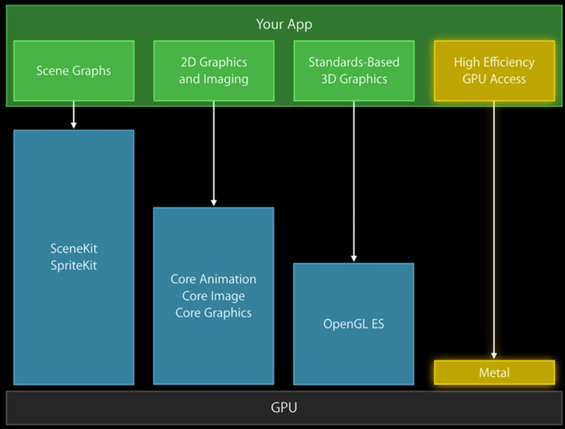

Slide 15
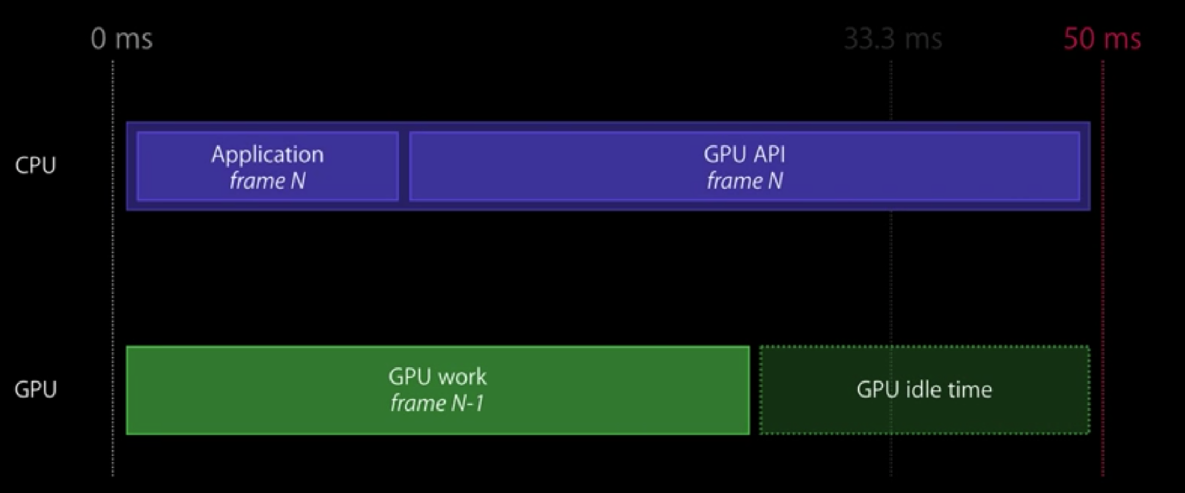

Slide 16
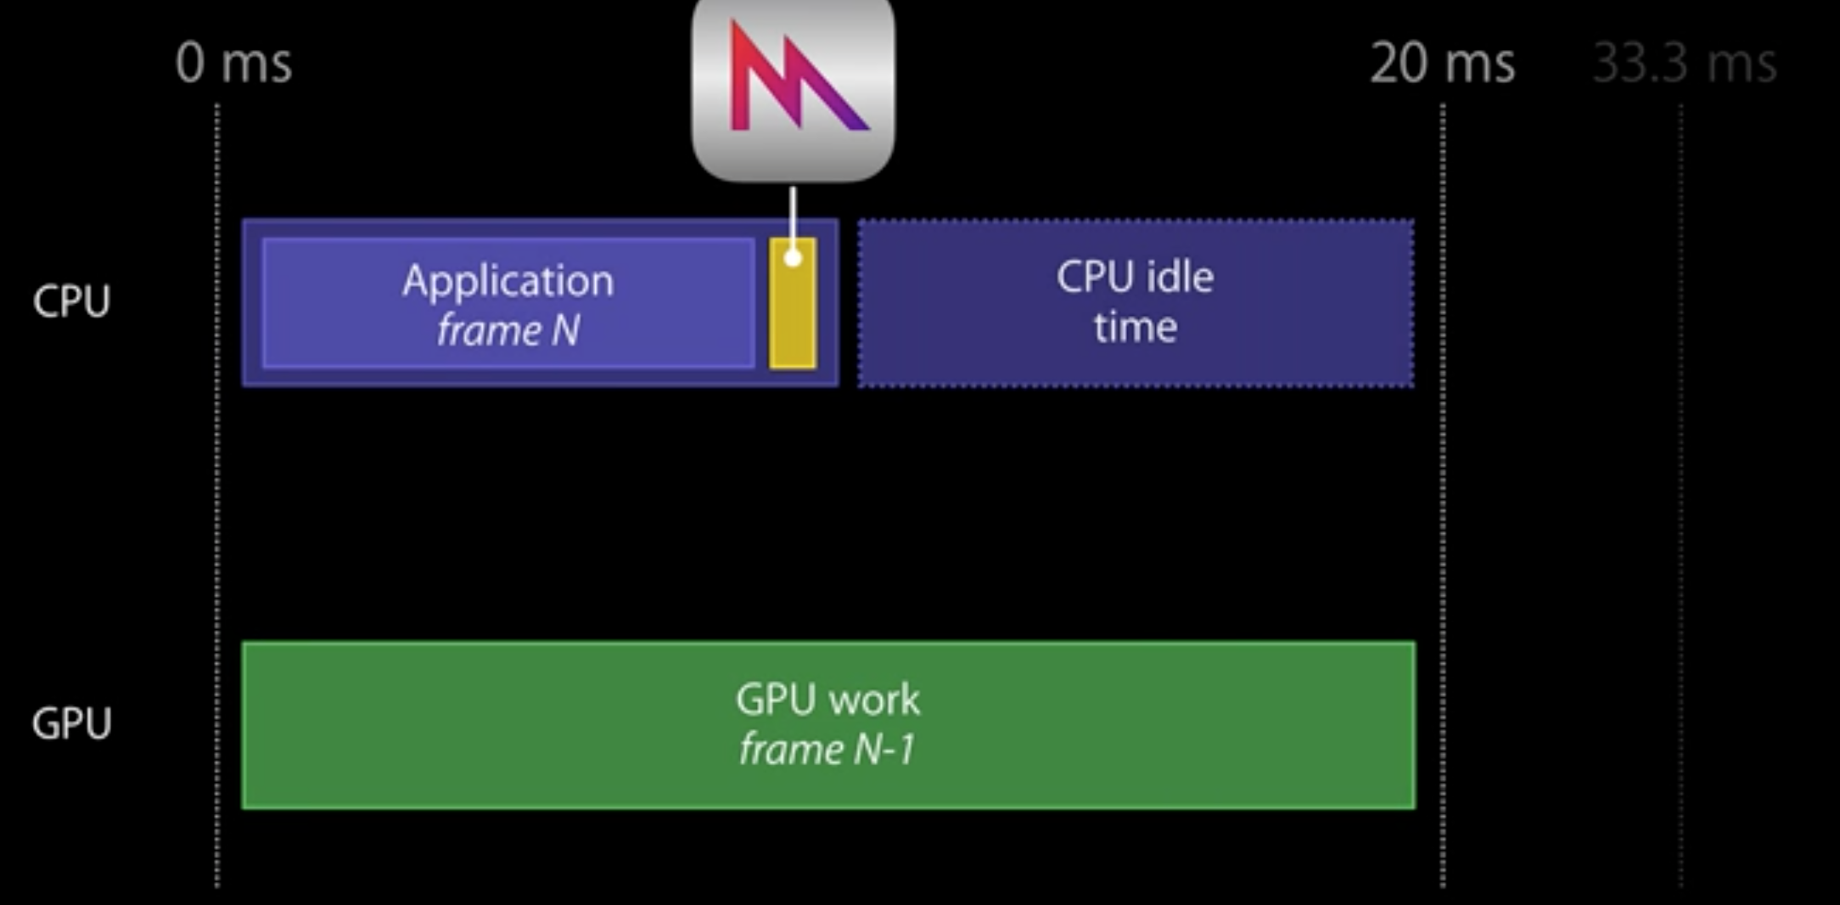

Slide 17
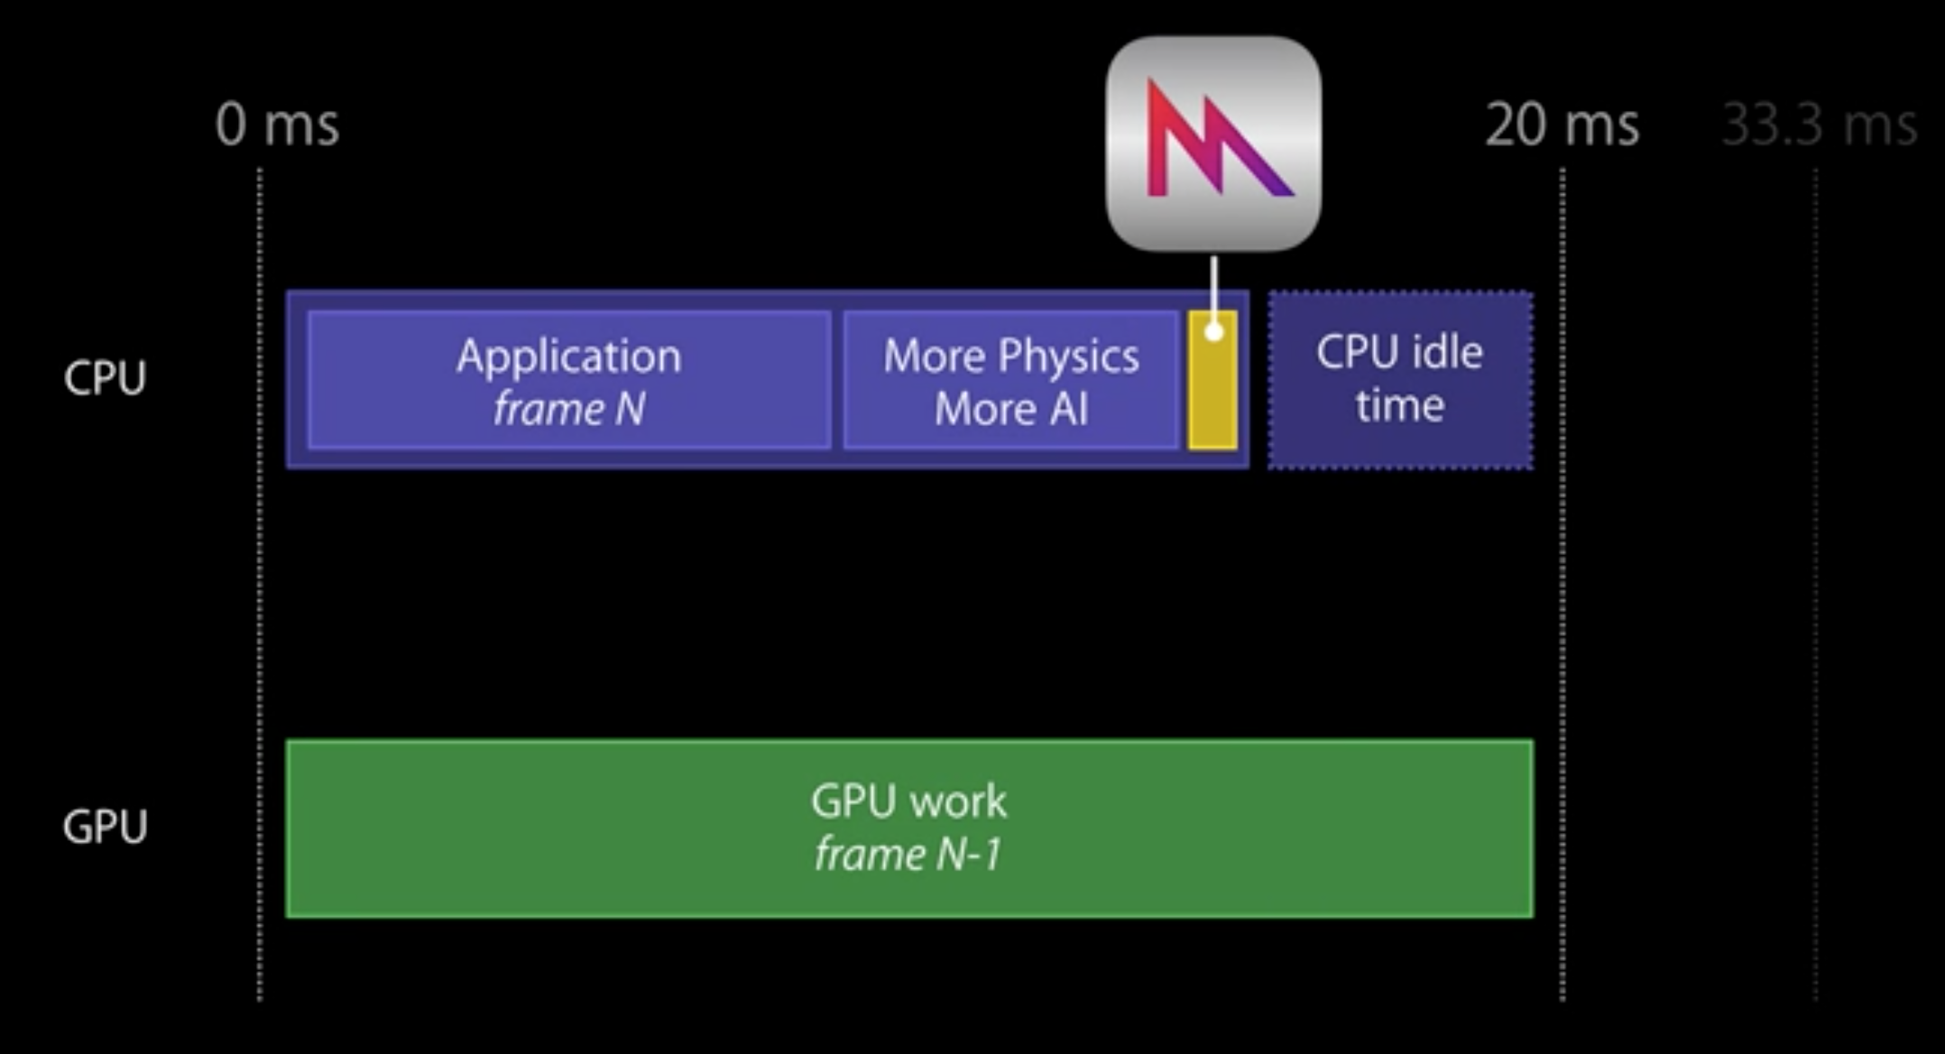

Slide 18
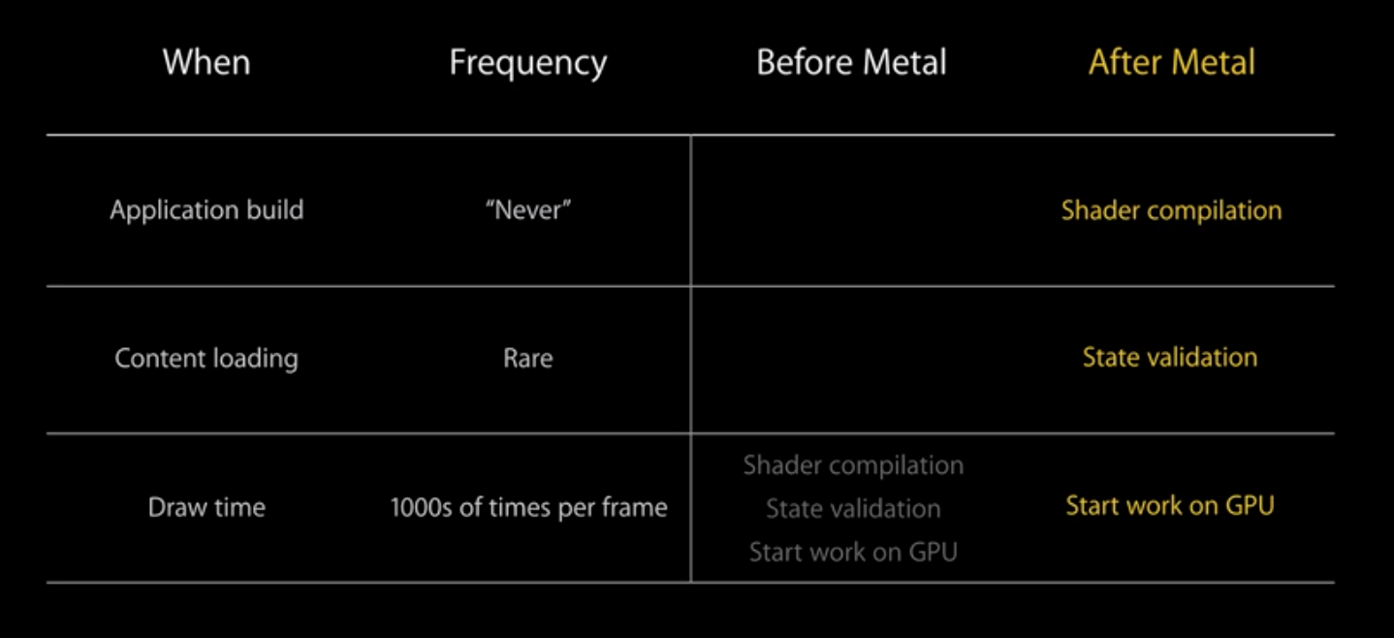

Slide 19
