Slide 1
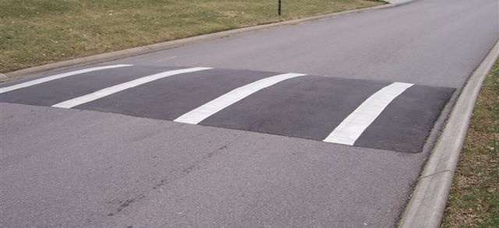
z
θ
x
y

Slide 3


One Neuron
x₀
w₀
x₁
w₁
$$s= b+\sum_{k=0}^{n−1}{xkwk}$$
$$f(s)$$
x_{n-1}
w_{n-1}

Slide 4
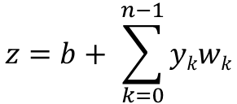
y₀
$$z=b+ \sum_{k=0}^{n−1}{ykwk}$$
y₁
σ(z)
aco:
actual output
w_{i}
Output Layer
y_{i}
y_{n-1}
Hidden Layer

Slide 5
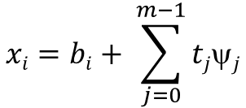
t_{j}
ψ_{j}
$$xi=bi+ \sum_{j=0}^{m−1}{tjψj}$$
Input Layer
σ(x_{i})
y_{i}
Hidden Layer

Slide 6
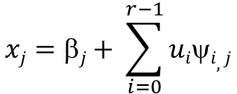
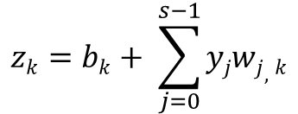
u_{i}
ψ_{i,j}
$$zk=bk+ \sum_{j=0}^{s−1}{yjwj,k}$$
σ(z_{k})
aco_{k}
$$xj=βj+ \sum_{i=0}^{r−1}{uiψi,j}$$
w_{j,k}
r Input Layer
0 ≤ i ≤ r
σ(x_{j})
y_{j}
t Output Layer
0 ≤ k ≤ t
s Hidden Layer
0 ≤ j ≤ s

