Slide 1
Create your own Platformer Fighter game
A SIGGD tutorial
By Andrew Lonsway
Updated by Clayton Detke

Slide 2
Step 1: Download this powerpoint
If you aren’t reading this on someone else’s screen, you got it.
Otherwise go tohttps://github.com/PurdueSIGGD/UnityTutorial, and find the file “PlatformerFighterInstructions.pptx”

Slide 3
Step 2: Install Unity
If you are using a personal computer
Install Unity Personal Edition [http://unity3d.com/get-unity/download]
When installing, uncheck “install visual studio”, it takes less time to install this way
Otherwise, Unity is installed on the lab computers.
Create a Unity Account, follow instructions on the launcher or go to https://id.unity.com/account/new
You may need to activate a new license to use Unity, if so just use Unity Personal, and we will not be using it in any professional capacity.

Slide 4
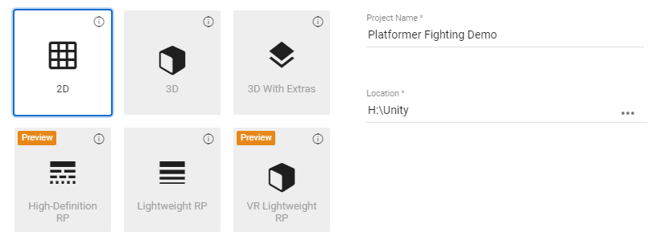
Step 2: New Project
Click the button
Name the project whatever you want, select 2D, and confirm where you want to store it
If you are on a lab computer, save it to your network drive (either H or W drive). Saving it on a desktop computer will wipe it once you log out

Slide 5
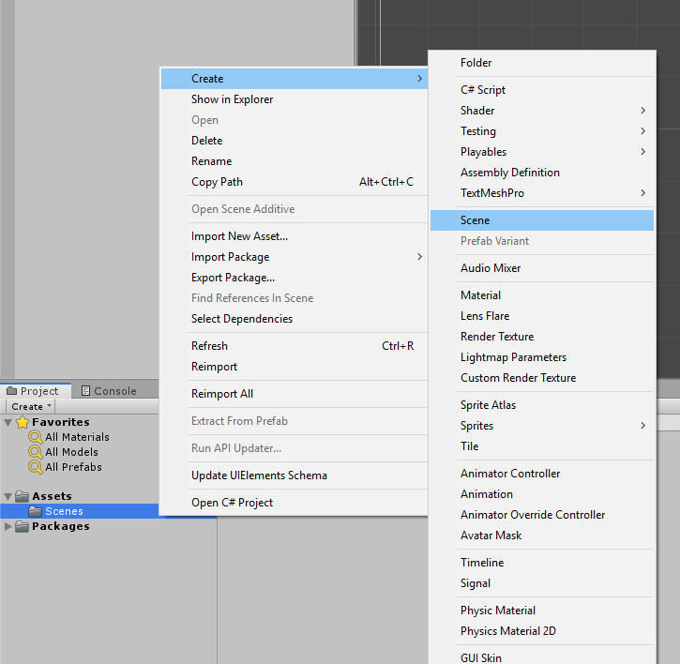
Step 3: Create a new scene
Right click Project menu
Create -> Scene

Slide 6
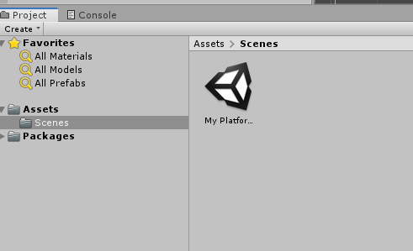
Step 3: Continued
Rename it to “My Platformer Demo”
Double click to enter the empty scene (should see no changes)
If you see a “Directional Light” in the left hierarchy pane, right click and delete it

Slide 7
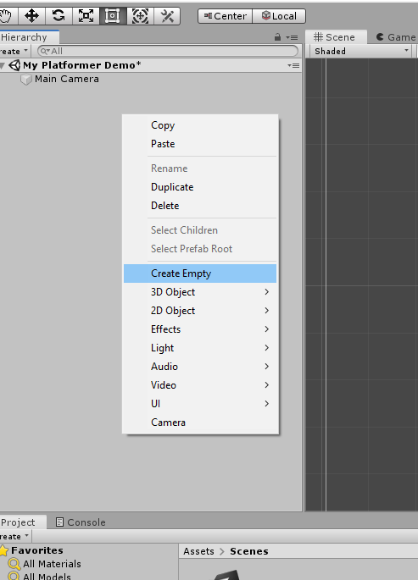
Step 4: Create your fighter
Once generated, ensure you are on the “Scene” tab, and right click on the tab labeled “Hierarchy”
Select “Create empty” (do not right click on the main camera gameobject)
You just created a new GameObject, the base structure of Unity. Rename it to anything you want!
If you see an arrow next to your new gameobject, click and drag it outside of the “Main Camera” object. This would cause problems later on.

Slide 8
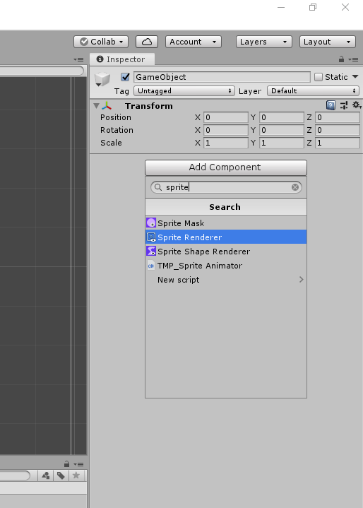
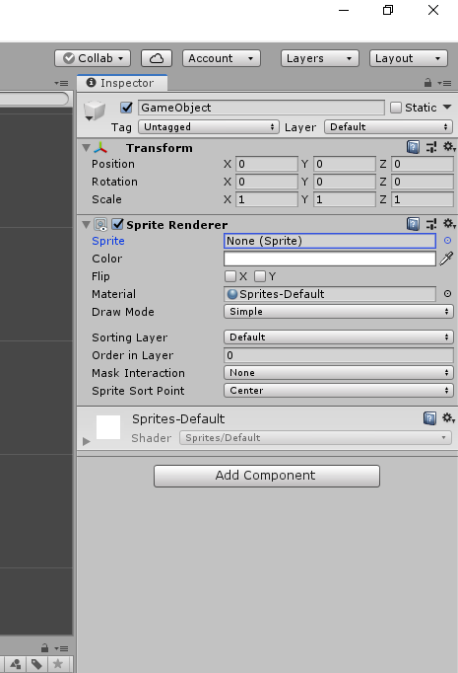
Step 5a: Give the GameObject some substance
Click “Add Component” on the right side, the inspector, and type “Sprite Renderer”, and select the first option that comes up.
This gives an icon to designate where your player is!
Select one of the default sprites in the “Sprite” selector by clicking the small circle
Since the sprite is very small, so press “r” to enable the scale tool. Click on the square in the middle and drag to scale it to the desired size.

Slide 9
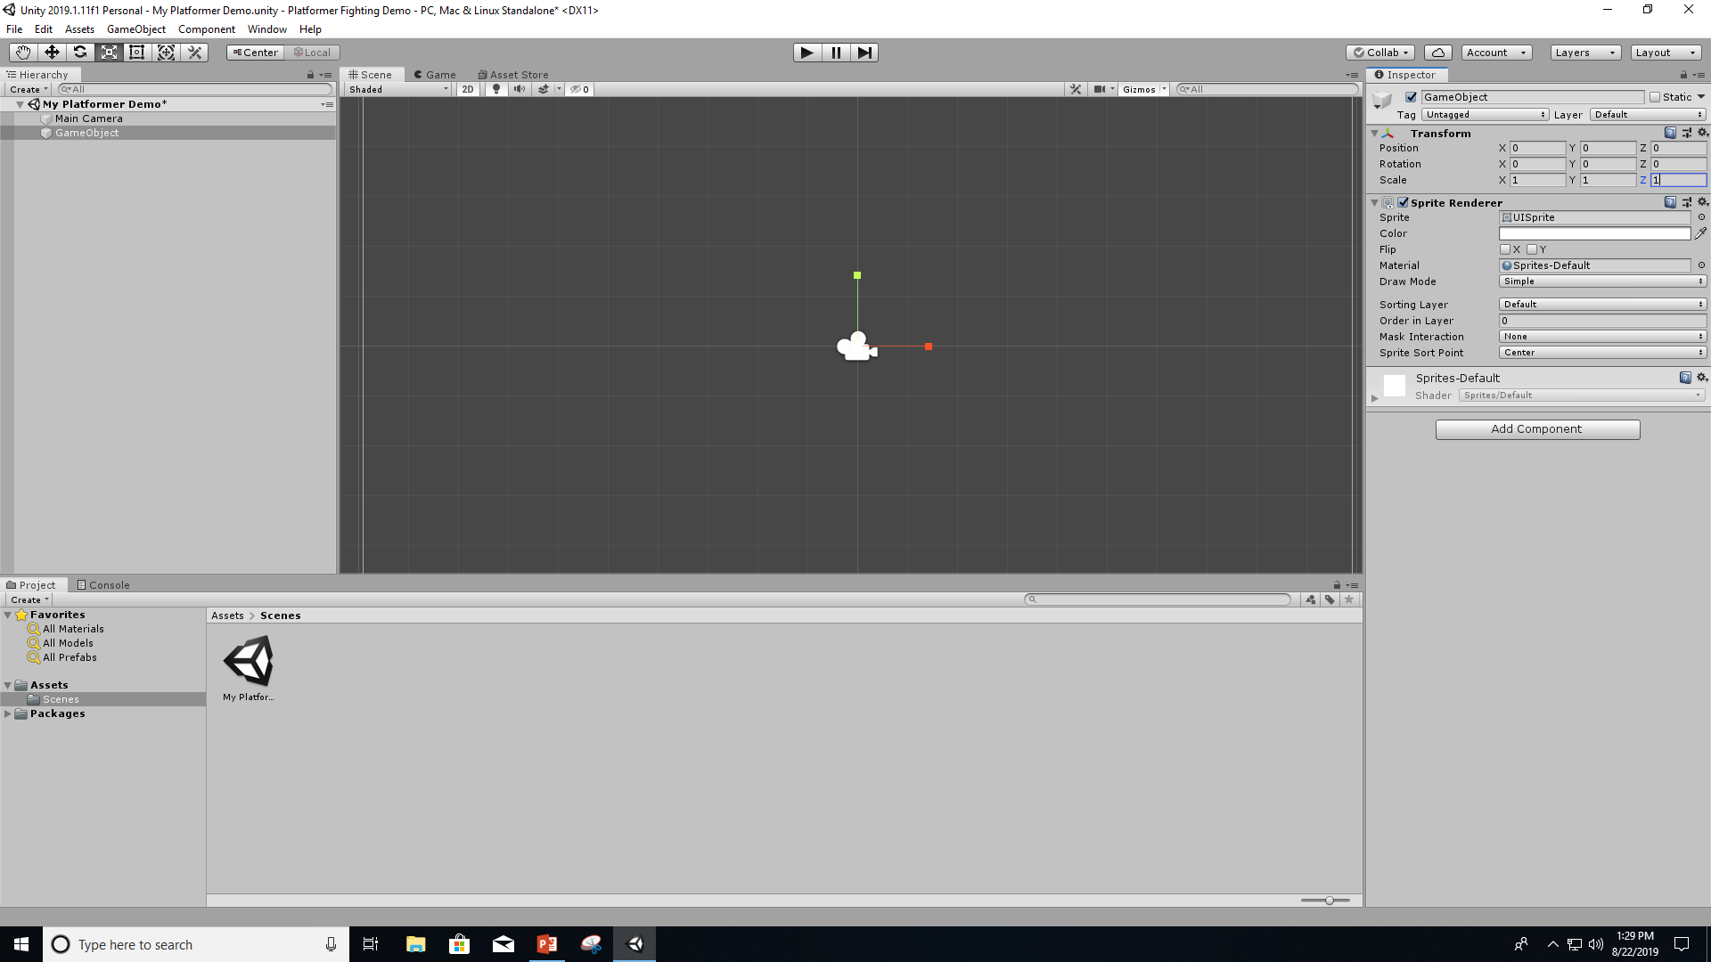
Step 5: Continued

Slide 10
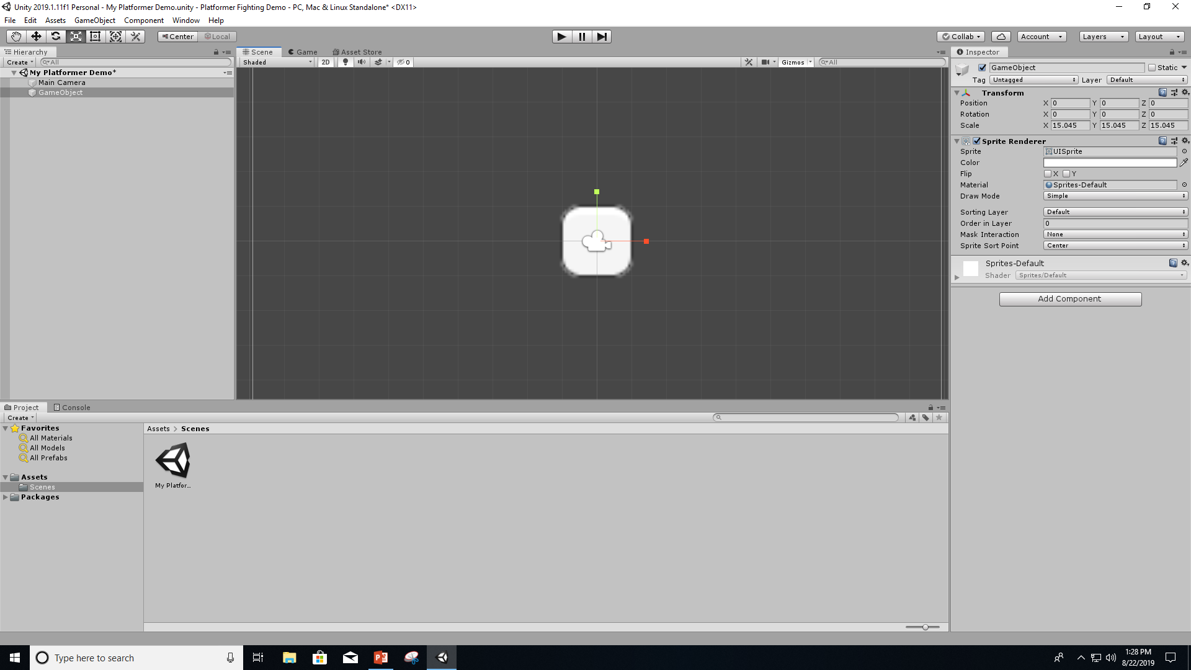
Step 5: Continued

Slide 11
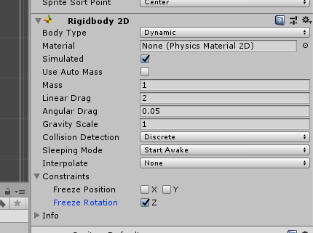
Step 5b: Give the gameobject mass
Add another component, this time being a “Rigidbody 2D”
This enables physics, allowing the object to be affected by gravity and other forces
Copy the values to the right, where Linear Drag is 2 and Rotation Z is frozen

Slide 12
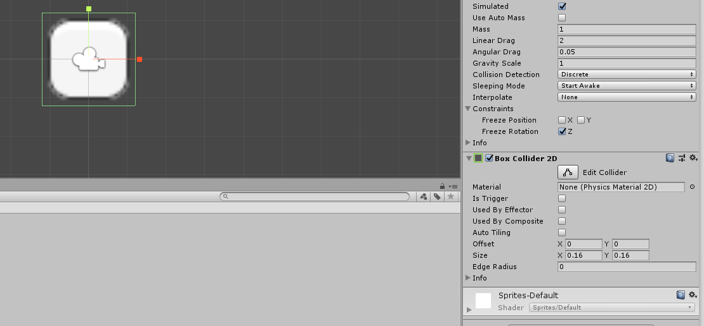
Step 5c: Give your box collision
Add another component, this named “Box collider 2D”
The green lines on your GameObject are the collision boxes. Click “Edit Collider” to click and drag where you want it to go.

Slide 13
Step 6: Make a platform
Create a new gameobject, add any sprite, and add a box collider.
Press “r” and scale the gameobject to be very wide
Do not give it a rigidbody 2D component, as the platform will fall. Platforms should not fall.
Pres “w” and drag the arrows to move the platform around, and put it wherever you want.

Slide 14
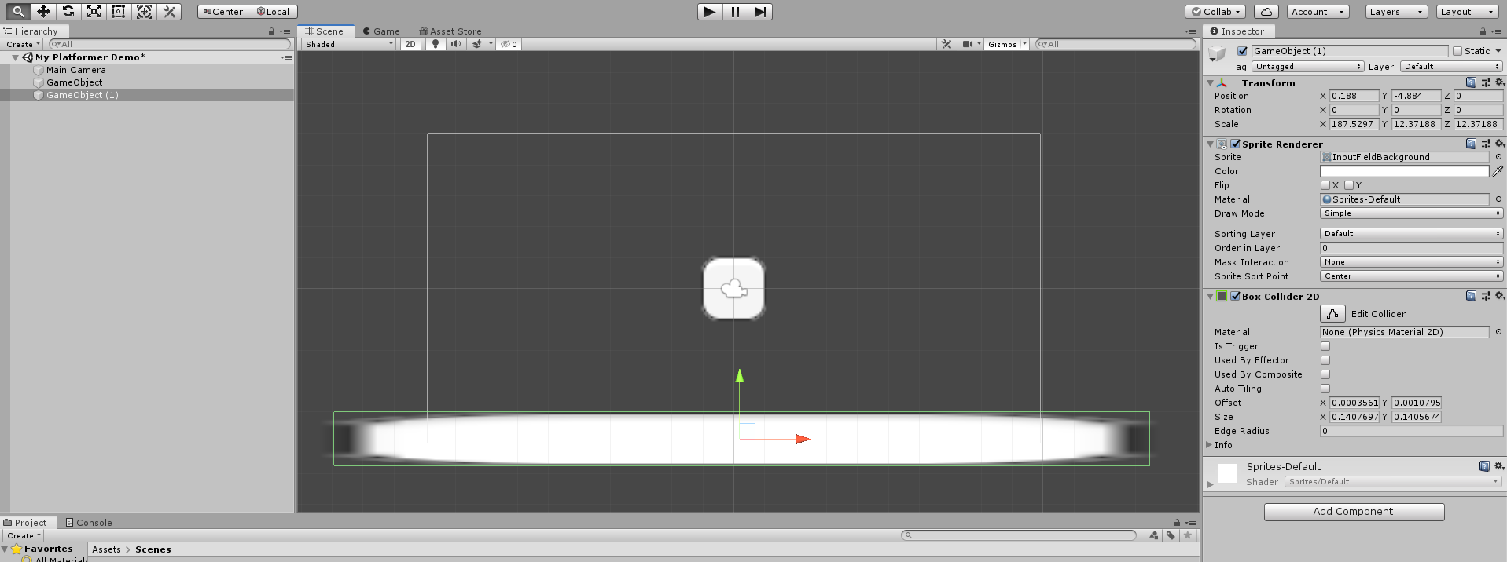
Step 6: Continued

Slide 15
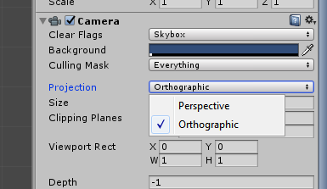
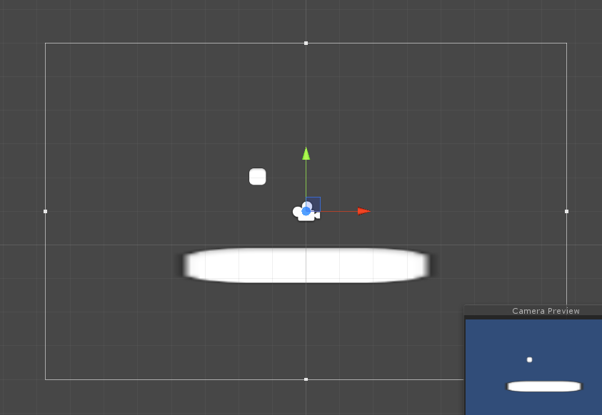
Step 7a: Make your camera view the player
Your scene should have been created with a game object named “Main Camera”. If not, right click on the hierarchy and click “Camera”.
Click on the camera object, change the “Projection” value to “Orthographic”. This allows our sprites to be seen easily, and shows a box of the camera view

Slide 16
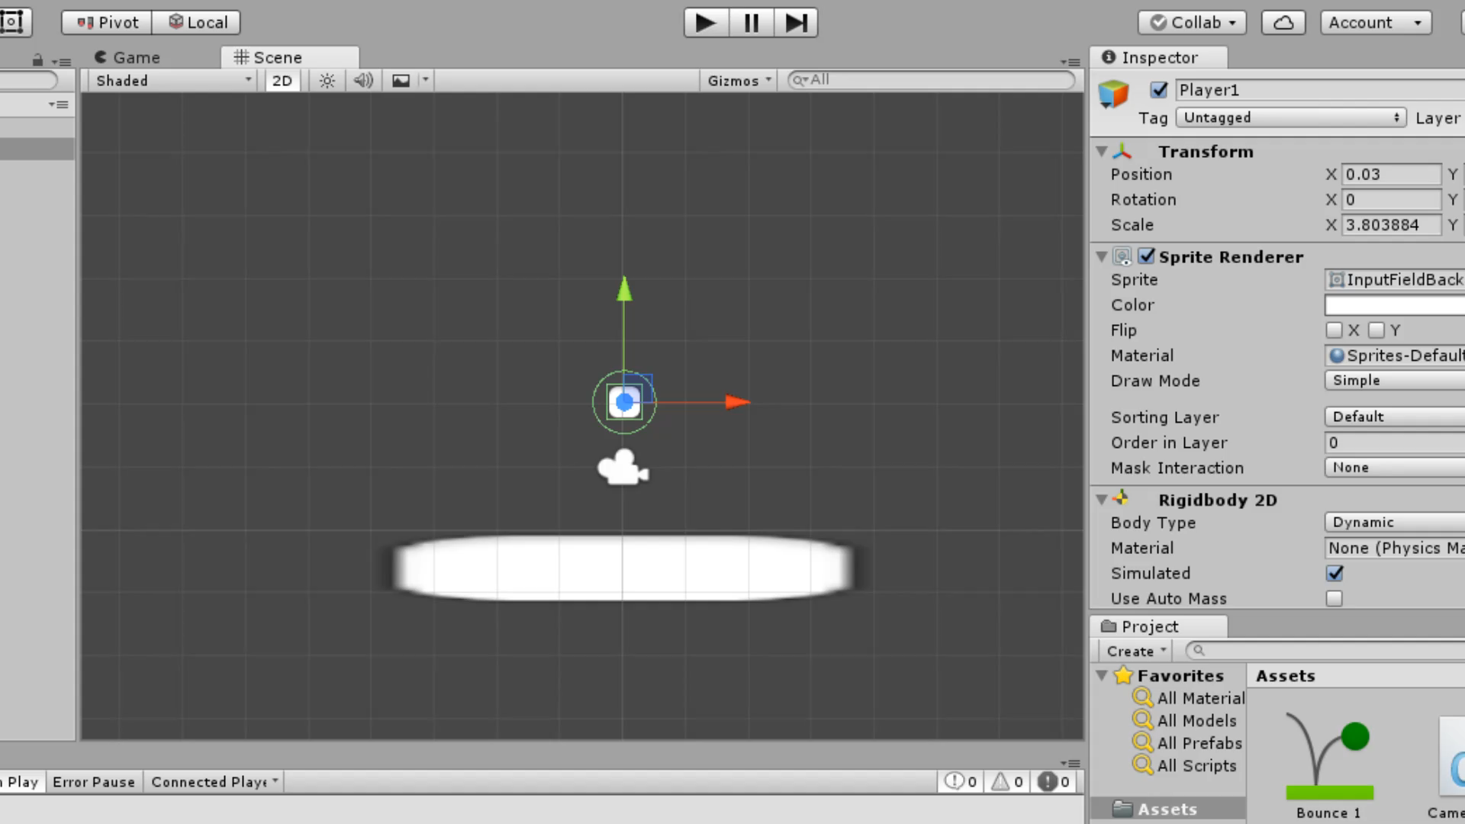
Step 7b: Press the play button at the top and see what happens!

Slide 17
Troubleshooting at this point
If you don’t see anything, move around the camera. It gives you a preview, so make sure your items are in view of the camera!
If you still don’t see anything, make sure your sprites are selected and are big enough. Use the scale tool (r) to make the sprites larger than normal, or import your own sprites.

Slide 18
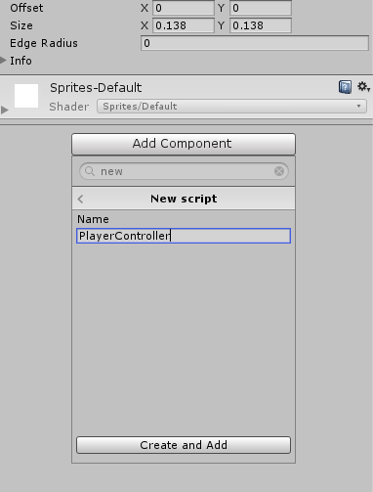
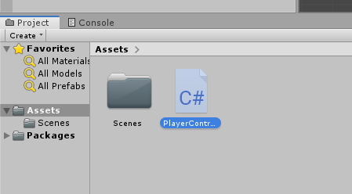
Step 8: Creating your first script
Now that you have your scene, you may want to have your object move around however you want. So let’s make a script!
With your Player, add a new component.
Instead of finding an existing component, click new script.
Name it whatever you want, and click “Create and Add”
Find your .cs script in the project browser, and double click on it

Slide 19
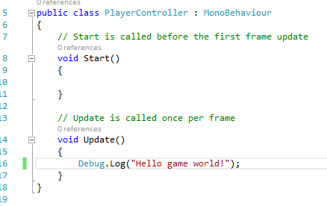
Step 8a: Hello game world!
Unity, by default, gives you two different methods: Start() and Update().
Start(): Called once whenever the script is initialized
Update(): Called once every frame, can be costly if used too much
Copy the following code into the Update() method:

Slide 20
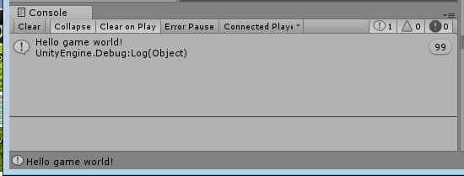
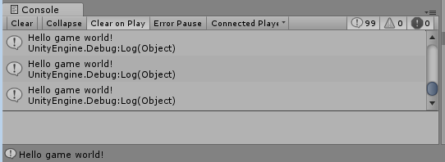
Step 8a: Continued
Press “Play” again and see what happens.
Click on the “console” tab on the bottom to view the game console.
OR
Depending on if you have the “collapse” button selected

Slide 21
Troubleshooting
Is your script compiling? Check the console.
If you didn’t rename your script after creating it, it may have the name as “NewBehaviourScript” still
The editor should highlight any other syntax errors
Did you accidentally not save your file?
Normally a * or a ° shows up by the filename if so
Press control+s to save in most editors

Slide 22
Step 8b: Giving your player movement
Now we want the player to move, based off of the keyboard inputs.
We are going to add forces to the Rigidbody2D component, based off of player input for each frame.
The two inputs are Horizontal and Vertical, which can be from a game controller, keyboard (wasd), or joystick. This can be configured in the drop down menu Edit->Project Settings->Input
In order to jump again, we force the player to release the vertical input, or else you would find yourself flying upwards.

Slide 23
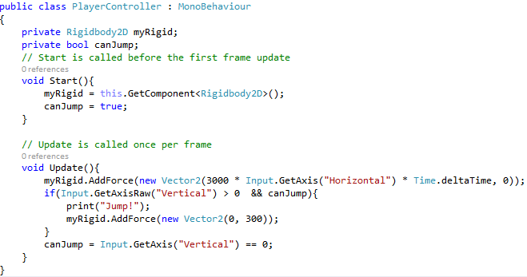
Step 8b: Code

Slide 24
Step 9: Limiting jumping
So you can jump, but infinitely. So to limit this, let’s try to tell the player to not jump again until they touch the ground.
When we come in contact with the floor, we can trigger a collision event.
OnCollisionEnter2D: Set the jump counter to zero, we just landed
OnCollisionExit2D: Increment the jump counter, as we just jumped away from it
Add the following lines to your code, as well as two private integers, “jumpCounter” and “maxJumps”

Slide 25
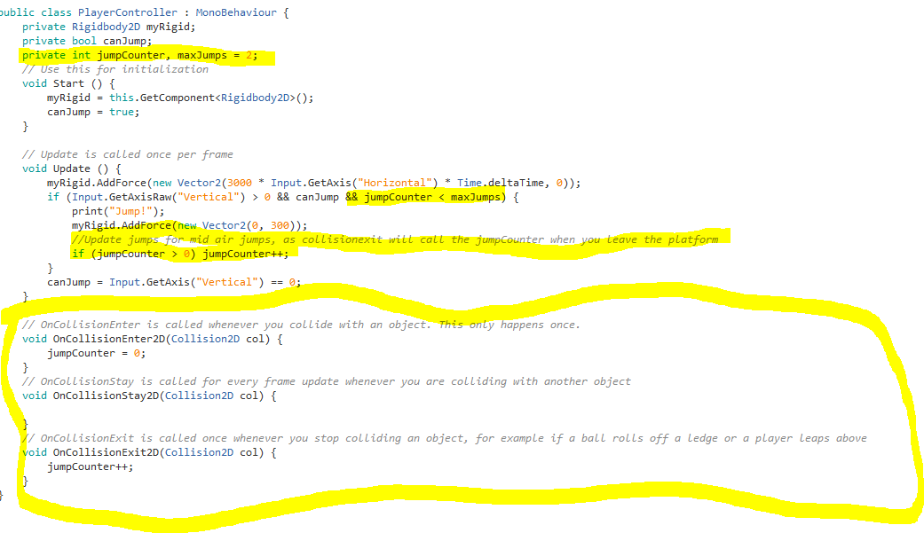
Step 9: Code

Slide 26
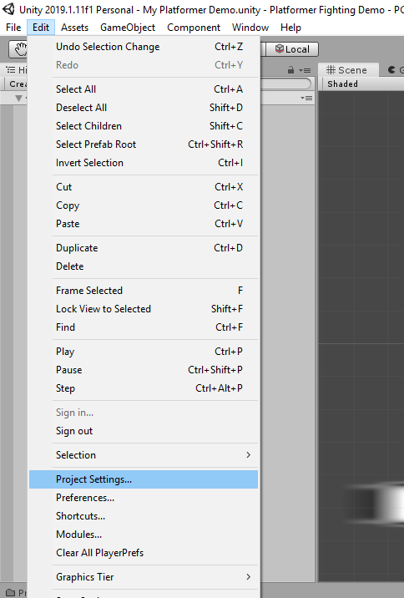
Step 10: Adding another player
Right now you have only one set of horizontal and vertical inputs. Now we want two.
Go to edit->project settings, then Input to open up the inputs menu.
The menu will open on the inspector tab.

Slide 27
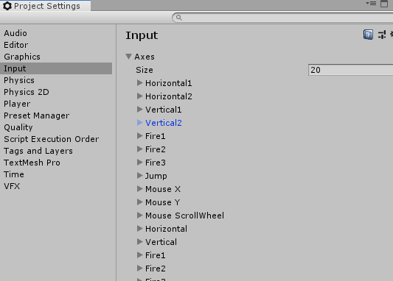
Step 10a: Continued
Click on “Axes” to open all input axes.
Click on each axis to open the menu, describing all the values you can change for them.
Rename Horizontal and Vertical to Horizontal1 and Vertical1
Right click on each and select “Duplicate Array Element” and rename those two new axes to Horizontal2 and Vertical2
Either remove the alt positive/negative buttons
Or change the horizontal alt buttons from A and D to J and L, respectively
Do the same for Vertical2, but from S and W to K and I.

Slide 28
Step 10a: Continued
Go back to your player script, and assign another global value, but make it public. Label it “playerID”
Go to each reference of Input.getAxis, and include the playerid. Compare it to the following code.

Slide 29
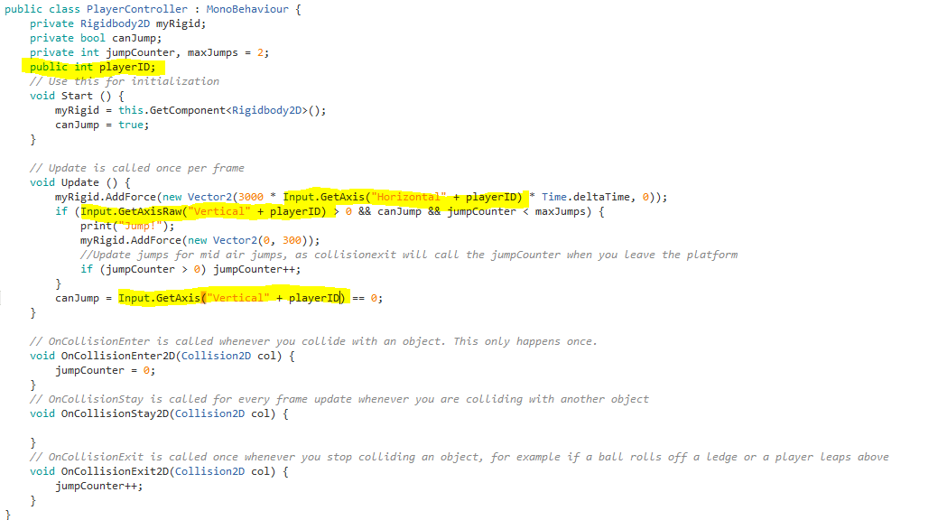
Step 10a: Code

Slide 30
Step 10b: Prefabs
You can create clones of gameobjects, called “Prefabs”. This saves the components and default values you want to have for any item.
Drag the player gameobject into the explorer in the bottom, this saves a prefab. Click and drag on the prefab object back into the scene, which will make a duplicate.
Move the copy away from the other player, and consider changing the color slider on the SpriteRenderer component to distinguish the two.
Scroll to the “PlayerController” component on the inspector, and change the PlayerID from 0 to 1 and 2 on the first and second players, respectively.

Slide 31
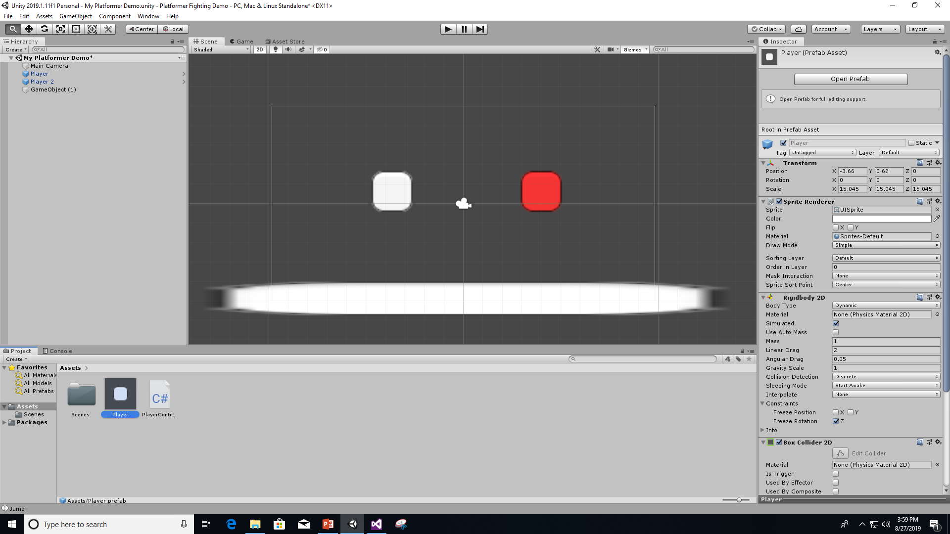
Step 10: Result

Slide 32
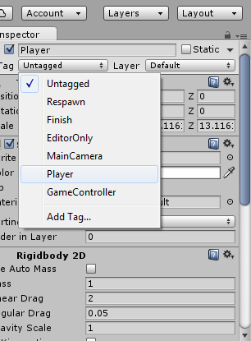
Step 11: Damage and Fighting
Click on “Tag” on the inspector, and select player, this helps us distinguish what kind of gameobject we are interacting with quickly
Changing the tag of Player prefab will update all other references of the Player prefab to have the same tag.
Click on Add Component and select “Circle Collider”, this will be our range for attacking other players.

Slide 33
Step 11a: Melee Range
Check the box “Is Trigger”. If a game object is a trigger, it sends collision messages to the script, but does not cause any physical collision. This helps if you want to see if an object is in an area, such as for opening doors or initiating any map events.
Click on “Edit Collider” and make it in a reasonable shape, depending on how far you want to have the player reach.
With the prefab, both the players get updated.

Slide 34
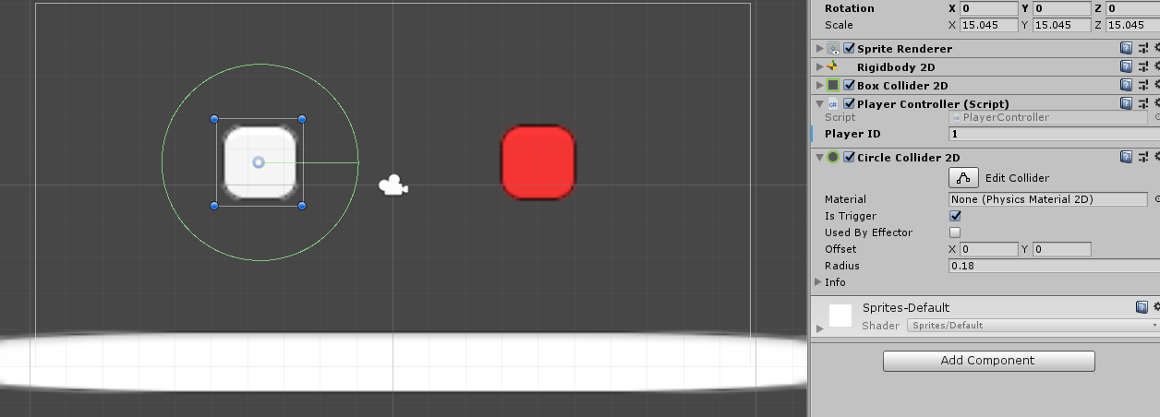
Step 11a: Continued

Slide 35
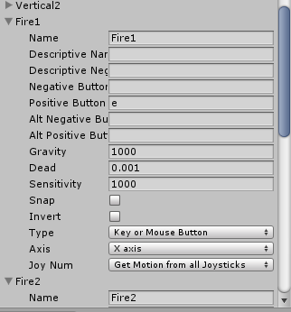
Step 11b: Adding inputs
We already have default input methods such as Fire1 and Fire2, but let’s make those conform to our other inputs.
Go back to edit->Project Settings->input and find the Fire methods
Set Fire1 to use “e” as the positive button, and Fire2 to use “o” as the positive button, with no other alternate buttons

Slide 36

Step 11c: Scripting
Add another public value “damage”. Make it an integer. This will be in a Super Smash bros-esque damage indicator, making your player fly farther with more damage they have taken.
Add a private bool named “canAttack”, and have it follow the same pattern for jumping, as seen on the next page
Add a private PlayerController (or whatever you named your script). This will be the player that you are able to attack, and you will be able to attack them as long as they are within your reach.
Add in 4 new methods. OnTriggerEnter2D, OnTriggerExit2D, Attack, and TakeDamage(int, Vector3), as seen on the slide after the next.

Slide 37
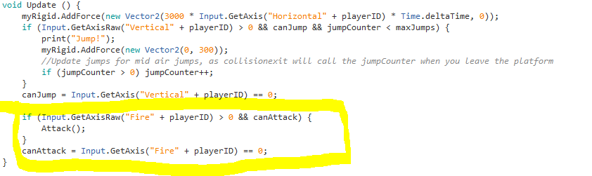
Step 11c: Code, update the update function

Slide 38
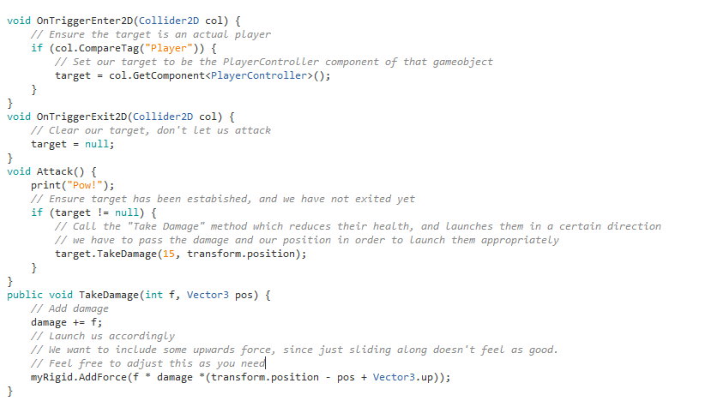
Step 11c: Continued

Slide 39
Step 11d: Try it out!
Click the play button and try out the fighting. You can finally punch around and try to knock the other player off the edge!
Troubleshooting:
If you are not getting any responses, make sure you have the Input axes configured to be correct. Remember, the string that you pass when getting an axis has to be correctly spelled and capitalized.
If you are still not getting punches, make sure your collision circles are big enough, and ensure “Is Trigger” is selected
If all else fails, try to add print() calls to figure out what functions are being called and what functions are not being called. They will be outputted on the console on the bottom tab.

Slide 40
Step 12a: Falling off and respawn
So now we want to actually have some kind of death and respawn, so the best way would be to create a boundary class.
Create a new gameobject, then add the component EdgeCollider2D. This is a single edge that comes in handy when making boundaries or what not. Make sure that the edgecollider2D is a trigger.
Place it where you want your boundary to go by selecting “Edit Collider”, and change “Points” “Size” to 5 for there to be 4 lines.

Slide 41
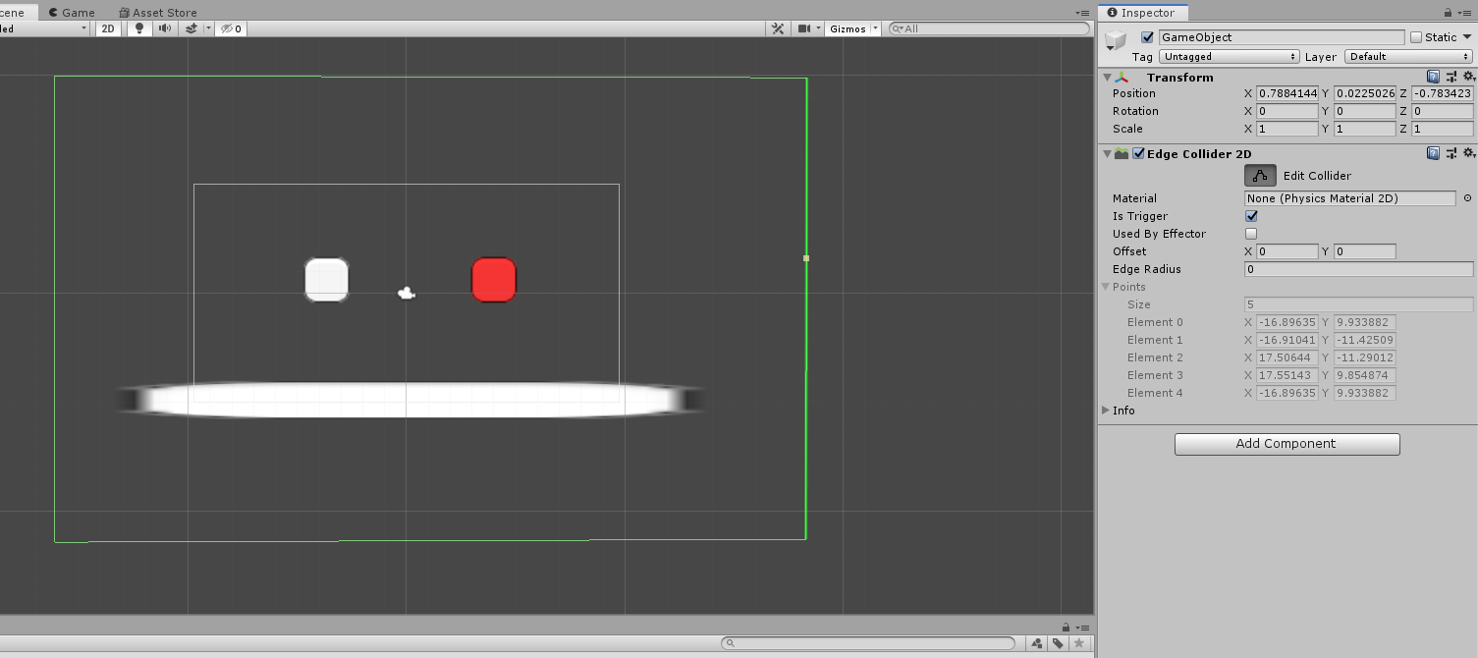
Section 12a: Continued

Slide 42

Section 12b: Boundary scripting
So now we want to have this script control where it puts the players when they “fall out of the map”.
First of all, we need to edit the player to respond to deaths. So add another public integer variable named “deaths”, and add a function named IncrementDeaths(). This will allow us to single out any other resets that may be needed when the player dies.
Create a new script on the boundary game object by clicking “Add Component”, and name it “Boundary”.
Open it up, and add the following code:

Slide 43
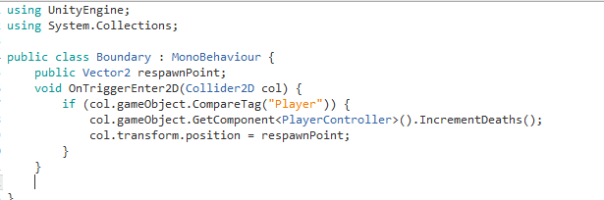
Section 12b: Boundary Scripting

Slide 44
Section 12: Troubleshooting
Is your boundary a trigger?
Is your boundary in the right place?
Is the boundary’s respawnPoint set to a correct spot? (if not, you can edit it through the inspector as long as you set it to be ‘public’)

Slide 45
Section 13a: Adding a GUI text
So now we have damage and deaths. How can we see them?
Easy! Let’s add some text on the GUI
Right click on the Hierarchy tab, and create an empty gameobject.
Search for the GUIText component, and add that component.
Set the position to be x=0.5, y=0.5, z=1. This centers it to the middle of the screen.
Add any text to the text field and ensure that the text shows up when you start the game. You can move it around, but make sure x and y stay from 0 to 1, as they correspond to the placement on the screen.

Slide 46
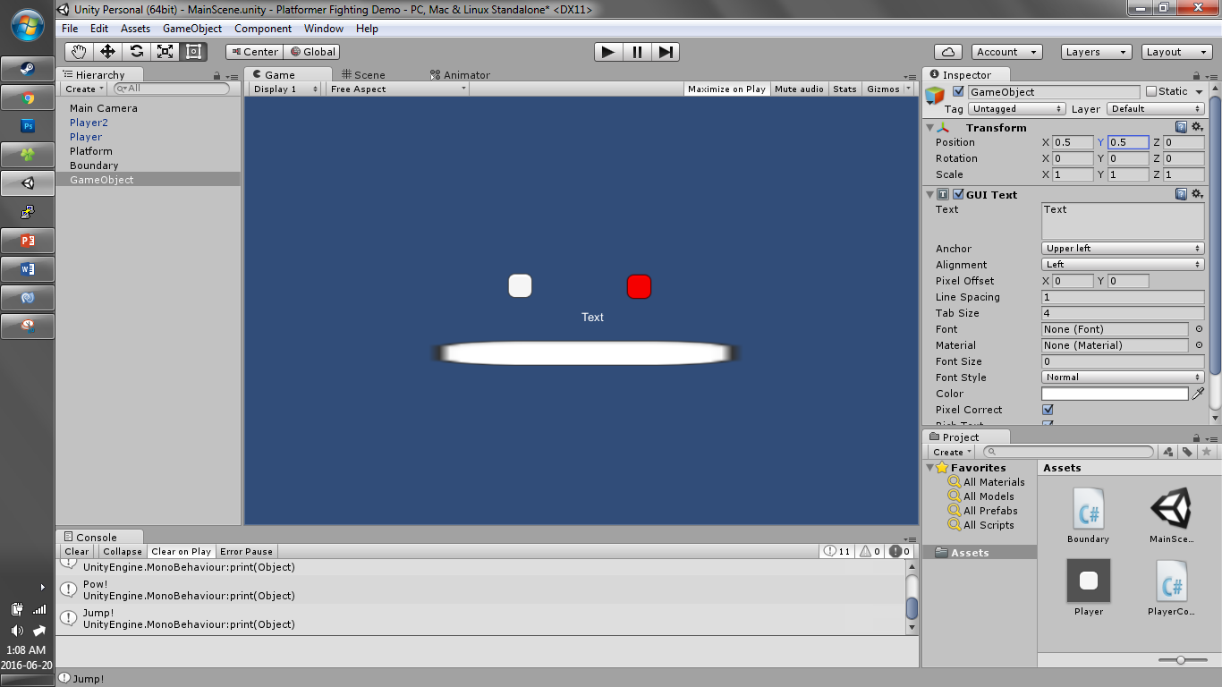
Section 13a: Continued

Slide 47
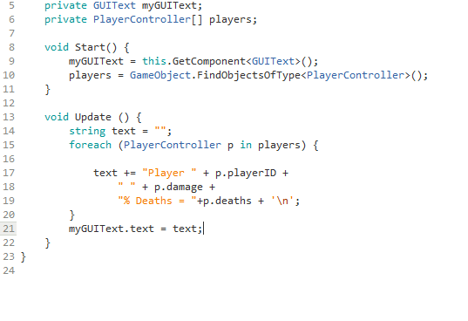
Section 13b: Updating the GUI text
So add another script to that GUIText game object, so it can read what is going on in the scene. Add the following code:
Go ahead and center the text, playing around with where you think it belongs.

Slide 48
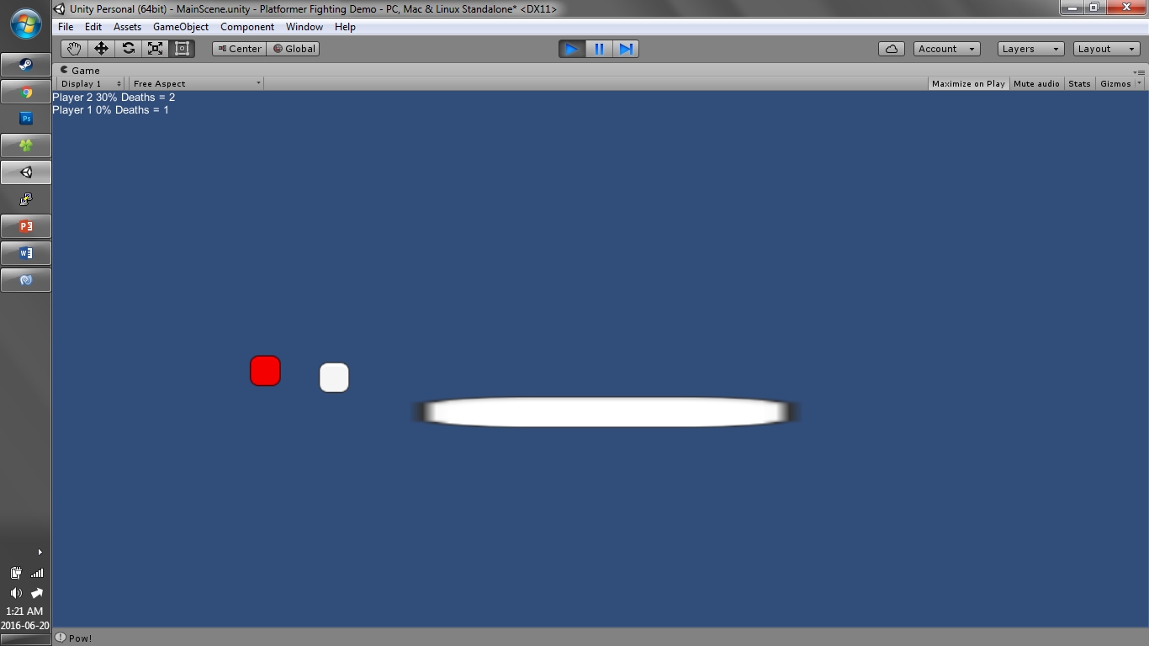
Section 13: Result

Slide 49
Section 14: Making a moving camera
Since we want all players to be visible, we should consider having a camera that tracks all players.
Select the “Main Camera” game object in the Hierarchy, and add a new component to it, this being a new script.
Name the script “Smooth Camera 2D”
Add the following code:

Slide 50
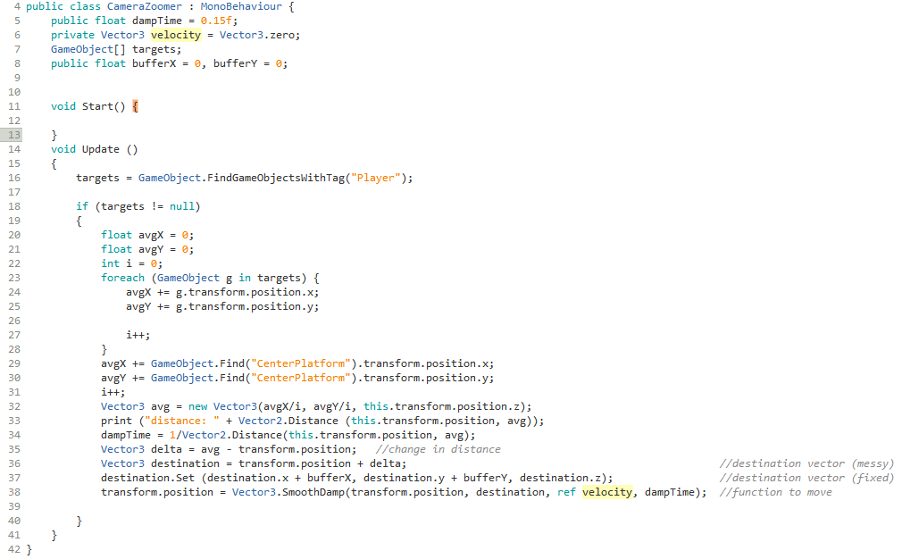
Section 14: Continued

Slide 51
Section 15: Your own personal tweaks
Consider changing different values to fit the needs and desires that you want for your game.
Options for simple tweaks are
Movement (vertical and horizontal)
Friction and drag for players and platforms
Punching power and speed
Respawn times
Camera speed

Slide 52
Section 15: Continued
There are some more advanced possibilities for your game, such as
Right now your jumps are reset after touching a wall, not just landing vertically. How can you change that?
Jumping is only reset when the input axis goes back to 0. How can you change the values in the input manager to make it as soon as you want?
Punching is fast as you can mash the buttons. Can you find a way to make a cooldown?
Consider other alternate fire options, powerups, or special items. How can you make different game objects spawn and affect the player?
Special map elements such as trampolines, death pits, or physics items. Unity is a powerful tool for physics items, how can you use this for your advantage?

Slide 53
This is your first (or one of your first) games. Do what you want and make your own game, as our next project will be doing that, but starting from scratch. You will be assigned teams to create your own new game. Brainstorm some ideas!

