Slide 1
csar: Query-driven Code Search and Refactoring Framework
Deniz Ozmus Supervised by Michael Tautschnig

Slide 2
What is the problem?
Suppose that you are a software developer working on a big project
You might be looking (i.e. searching) for some code
You might want to refactor some code
You definitely want these to be efficient and reliable

Slide 3
What is it?
A code searching and refactoring framework
A tool for the software development process

Slide 4
Why?
Unifies searching and refactoring
Scalable (multi-threaded and efficient)
Primary Requirements
Query-driven (SQL-esque)
Semantics-based code searching
Custom search domains
Supporting git repositories
Refactoring code
Language-agnosticism
Support for Java 8

Slide 5
Why?
Secondary Requirements
Support mercurial (hg) and subversion (svn) as well as git
Ignore file to narrow search domain
Index project code
Integrate into an IDE (e.g. IntelliJ IDEA)

Slide 6
Use Cases
I am going to modify a method and but first want to see how it is used to prevent unintended side effects
csar: SELECT method:use:final String appender(int, String)
I am going to rename a method and want to automate it
e.g. public int add(int a, int b, int c, int d) { return a + … + d; }
csar: SELECT method:def:public int add(4) REFACTOR rename:sum
I am going to modify a method signature to reduce redundancies and want to automate it
e.g. public int double(int a, int b) { return 2 * a; }
csar: SELECT method:def:public int double(2) REFACTOR changeparam:int a

Slide 7
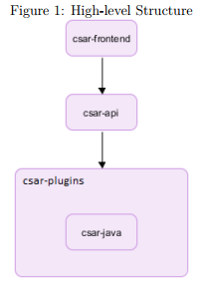
High-level Structure
csar is designed in a modular way
These modules can be described as:
Frontend
API
Plugins (multiple modules)

Slide 8
How it works
csar-frontend invoked with user input
csar-frontend invokes csar-api
csar-api carries out the following tasks:
Load plugins
Parse csar query
Parse project code
Post-process project code
Search project code
Refactor project code (if applicable)
csar-frontend prints search and then refactor results

Slide 9
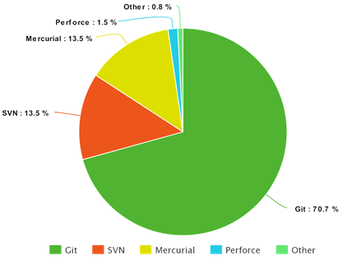
Achievements – Successes
Support for git, mercurial (hg), and subversion (svn) repositories
Implemented query language
Implemented support for Java 8
Searching for methods (definitions and usages)
Post-processing:
Map method usages to method definitions
Type hierarchy resolver
Overridden methods resolver
Qualified name resolver
Expression type resolver
Refactoring for methods (renaming and changing parameters)
Scalability (multi-threading)

Slide 10
Map method usages to method definitions
Suppose you have the following expression, can you predict in what class the method c might be in?
super.a.getB(i, Factory.class).c((Cooler) hot, 3, 100.0d, 0x30)
Resolving the LHS of these expressions is necessary, hence the expression type resolver

Slide 11


Achievements – Selected External Contributions
antlr/grammars-v4 (https://github.com/antlr/grammars-v4/): 2,500+
Disallow local enums/annotations in Java 8 grammar
Improve methodReference rule in Java 8 grammar
JCommander (https://github.com/cbeust/jcommander/): 1,000+
Flexible usage formatting
Fix locale-related issues in usage formatter tests

Slide 12
Issues
Does not support method references in Java 8 – they are hard to statically analyse!
e.g. this::methodName
Does not support the searching by `CONTAINS` clause in the query language
If two refactoring changes are on the same line, in rare cases, csar will make incorrect changes *
.csarignore has an operational bug *
Unfulfilled secondary requirements: index project code and integrate into IntelliJ IDEA.
Does not support external libraries, including the Java API
Notes:
* This is not mentioned in the report because it was not known at the time.

Slide 13
Future work
Better plugins
Better interfacing
Sandboxing (e.g. cannot access files outside of the current project or access the internet)
Secondary requirements: index project code and integrate into IntelliJ IDEA.
More searching and refactoring functionality
Implement another language to test language-agnositicism

Slide 14
References
Selected External Contributions: csar/design-docs/External Contributions.md
Popularity of Version Control Software: https://rhodecode.com/insights/version-control-systems-2016
Standard output stream: https://docs.oracle.com/javase/7/docs/api/java/lang/System.html

