Slide 1
csar: Query-driven Code Search and Refactoring Framework
Deniz Ozmus Supervised by Michael Tautschnig

Slide 2
What is the problem?
Suppose that you are a software developer working on a project
It is very common for developers to search for code
And sometimes, to then refactor it
Furthermore, these operations should be: simple, efficient, and reliable

Slide 3
What is it?
A code searching and refactoring framework
A tool for the software development process

Slide 4
What should it do?
Primary Requirements
Query-driven (SQL-esque)
Semantics-based code search
Custom search domains
Support git repositories
Refactor code
Language-agnosticism
Support for Java 8

Slide 5
What should it do?
Secondary Requirements
Support mercurial (hg) and subversion (svn) as well as git
Use ignore files to narrow search domain
Index project code
Integrate into an IDE (e.g. IntelliJ IDEA)
Non-functional Requirements
Unifies searching and refactoring
Scalable (multi-threaded and efficient)

Slide 6
Use Cases
I want to automate the following:
I am going to modify a method and but first want to see how it is used to prevent unintended side effects
csar: SELECT method:use:final String appender(int, String)
I am going to rename a method
e.g. public int add(int a, int b, int c, int d) { return a + b + c + d; }
csar: SELECT method:def:public int add(4) REFACTOR rename:sum
I am going to modify a method signature to reduce redundancies
e.g. public int double(int a, int b) { return 2 * a; }
csar: SELECT method:def:public int double(2) REFACTOR changeparam:int a

Slide 7
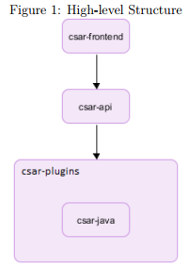
High-level Structure
csar is comprised of modules
These modules can be described as:
Frontend
API
Plugins (multiple modules)

Slide 8
How it works
csar-frontend invoked with user input (a csar query and some command-line arguments)
csar-frontend invokes csar-api
csar-api carries out the following tasks:
Load plugins
Parse csar query
Parse project code
Post-process project code
Search project code
Refactor project code (if applicable)
csar-frontend formats and prints search and then refactor results

Slide 9
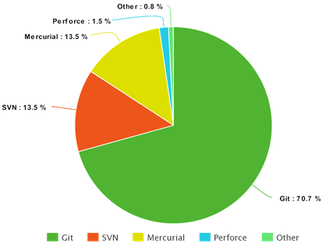
Achievements – Successes
Cross-platform
Implemented csar query language
Implemented a plugin for Java 8
Searching for methods (definitions and usages)
Post-processing:
Map method usages to method definitions
Type hierarchy resolver
Overridden methods resolver
Qualified name resolver
Expression type resolver
Refactoring for methods (renaming and changing parameters)
Support for git, hg, and svn repositories
Scalability (multi-threaded)

Slide 10
Map method usages to method definitions
Suppose you have the following expression, can you tell in which class the method c might be in?
super.a.getB(i, Factory.class).c((Cooler) hot, 3, 100.0d, 0x30)
The type of its LHS is where the method c should be, hence the expression type resolver

Slide 11


Achievements – Selected External Contributions
antlr/grammars-v4 (https://github.com/antlr/grammars-v4/): 2,500+
Disallow local enums/annotations in Java 8 grammar
Improve methodReference rule in Java 8 grammar
JCommander (https://github.com/cbeust/jcommander/): 1,000+
Flexible usage formatting
Fix locale-related issues in usage formatter tests

Slide 12
Issues
Does not support method references in Java 8 – they are hard to statically analyse!
e.g. this::methodName
Does not support the searching by `CONTAINS` clause in the query language
If two change parameters-related code changes are on the same line, in rare cases, csar will make incorrect changes *
Unfulfilled secondary requirements: index project code and integrate into IntelliJ IDEA.
Does not support external libraries, including the Java API
Notes:
This (issue *) is not mentioned in the report because it was not known at the time, furthermore it is an unlikely occurrence.
This will occur when a change parameters change is made on a line containing two such changes, where one change deletes the other, so then when the second change is applied it will break the consistency of the code.

Slide 13
Future work
A more complete csar query language
Better plugins
Better interfacing
Sandboxing (e.g. cannot access files outside of the current project or access the internet)
Secondary requirements: index project code and integrate into IntelliJ IDEA.
More searching and refactoring functionality
Maintain coding conventions when refactoring
Implement another language to test language-agnositicism (preferably a dynamic programming language)

Slide 14
References
Selected External Contributions: csar/design-docs/External Contributions.md
Popularity of Version Control Software: https://rhodecode.com/insights/version-control-systems-2016
Standard output stream: https://docs.oracle.com/javase/7/docs/api/java/lang/System.html

