Slide 1

Organs-Q1 Presentation
Wong kwok yin, kenny

Slide 2
‘We ought not take organs from the dead if they have requested not to donate their organs, or if their family does not want their organs to be donated.’ Discuss.

Slide 3
If they aren’t person……
They don’t have rational agency (No Rational Thinking/No Action) → Take the decision from their family who has rational agency.
Example: Children, Human Beings with cognitive disorders.

Slide 4
They have requested not to donate…
Respect Autonomy Principle
Negative Right to Property
Moral Obligation

Slide 5

Respect Autonomy Principle

Slide 6
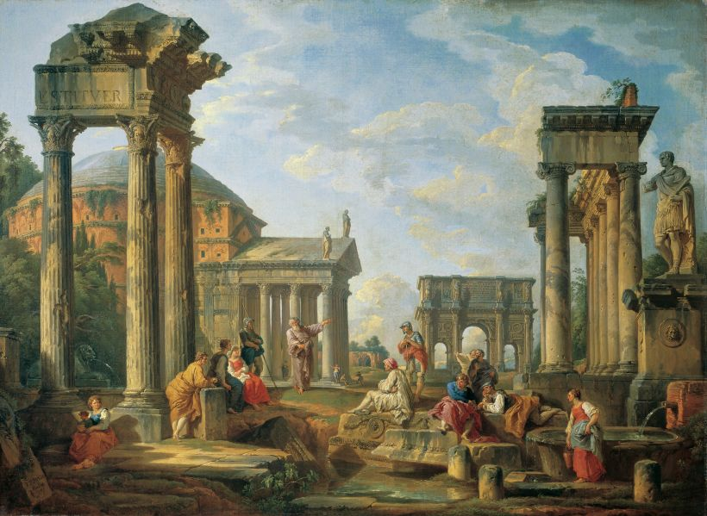

Slide 7
‘Justice and the Compulsory Taking of Live Body parts’
Fabre
“ It is unjust to deny one's organs to those who need them, even if one does not consent to be considered as a supplier”

Slide 8
John P. Flaherty
'Forcible extraction of living body tissue causes revulsion in the judicial mind ... You can picture the man being strapped to the table and then the extraction.'

Slide 9
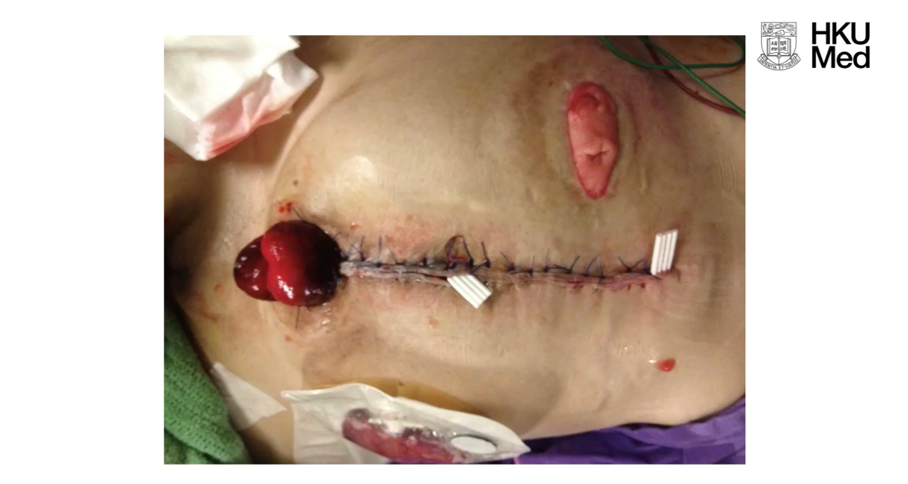

Slide 10
They Just Wanna Die Peacefully…..

Slide 11

Negative Right to Property

Slide 12
‘Justice and the Compulsory Taking of Live Body parts’
Fabre
“… apart from the brain, the heart, the lungs, and the liver as a whole, all body parts are the kind of goods of which it makes sense to say that the sick can have a right to them.”

Slide 13
Will and testament

Slide 14
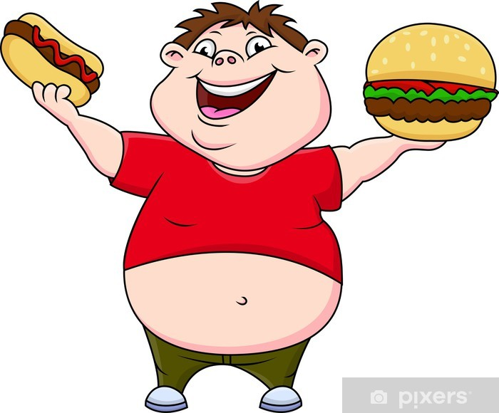


Slide 15
Non-Consequentialism
It is wrong to violate a right, even if you could do more good, by doing so

Slide 16

Would more lives be saved?
Moral Obligation

Slide 17
The Save More Lives Argument
It would increase the number of lives saved

Slide 18
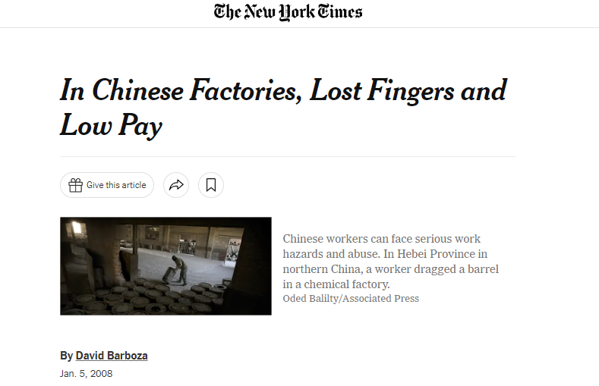
Sweat Factory & Nike

Slide 19
Moral Obligation
A
(Gonna Die)
B
(Need Organ)

Slide 20
Thank you for your attention

