Slide 1
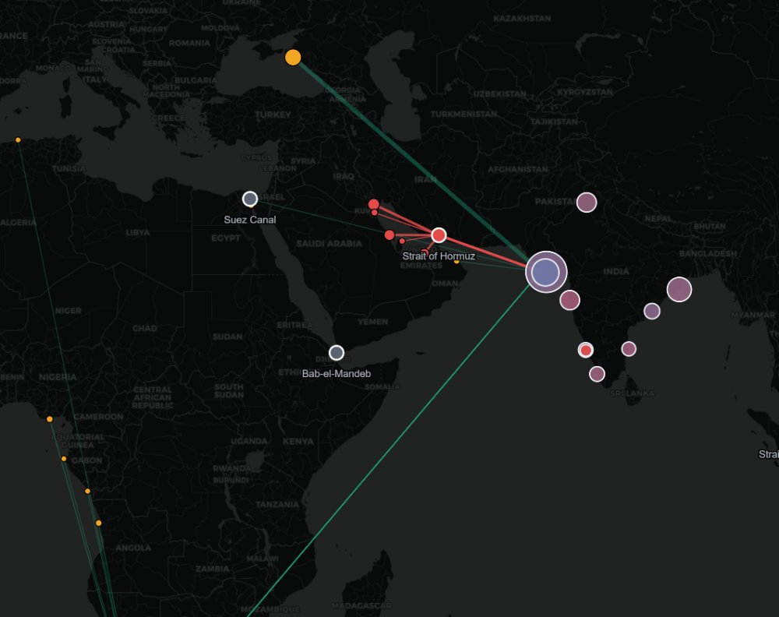
ET AI HACKATHON 2026 · PHASE 2 · PROBLEM #2 — ENERGY SUPPLY-CHAIN RESILIENCE
KARNADHAR
कर्णधार — the helmsman who steers the ship through the storm
India imports 88% of its crude. Nearly half transits one strait. KARNADHAR is the AI command center that turns a 47-day supply crisis
into a decision made in 45 milliseconds — grade-by-grade, refinery-by-refinery.
Mann Sutariya · Pandit Deendayal Energy University, Gandhinagar
Assumptions reviewed with: Lydia Powell (ORF) · Prof. U. K. Bhui (PDEU)
Notes:
Open: India runs on imported crude — 88%. Nearly half sails through a strait 3km wide at its narrowest. In June 2025 the world watched Hormuz almost close. KARNADHAR is our answer: an AI that watches the world, models the shock, and reroutes the country’s crude — in real time.

Slide 2
THE PROBLEM
One strait can strangle the world’s 3rd-largest oil importer
88%
46%
9.5 days
+8%
of India’s crude is imported
transits the Strait of Hormuz — derived from official trade records, not assumed
of strategic reserve cover — voluntary, vs the IEA’s 90-day norm
Brent in a single session when Hormuz was threatened (June 2025)
And the real constraint isn’t barrels — it’s dollars. India is a twin-deficit economy. A sustained price shock adds ~$190 bn/yr to the import bill, blowing the current-account deficit from 0.7% (FY24) to over 6% of GDP. Unlike trade-surplus Japan or Korea, India cannot sustain that dollar outflow — which is why unprepared economies take 47 days longer to stabilise supply (McKinsey). The data to act exists. The intelligence layer to act on it does not.
Sources: DGCIS trade records (May 2025–Apr 2026) · PPAC · ISPRL · EIA · twin-deficit framing reviewed with Lydia Powell, Distinguished Fellow, ORF
Notes:
Four numbers tell the story. 88% imported. 46% through one strait — and we didn’t copy that number from a report, our system derives it from official customs records. Reserves: 9.5 days, voluntary. And when Hormuz was threatened last June, Brent jumped 8% in one session. The deep problem is the twin deficit — India cannot pay for expensive crude in dollars for long. That’s the insight an ORF Distinguished Fellow validated for us.

Slide 3
THE INSIGHT EVERYONE MISSES
Crude oil is not fungible
Every other “resilience dashboard” treats oil as one number: barrels. Reality: a refinery is an engine tuned to a fuel. A deep-conversion coking refinery built for heavy, sour, asphaltene-rich crude physically cannot run ultra-light condensate — and a simple refinery cannot digest sour crude. When Hormuz closes, the question is not “where do we buy oil?” It is “which exact grade can each of our refineries actually run — and who has it?”
WHAT DECIDES IF A BARREL IS RUNNABLE
API gravity — light vs heavy
Sulphur — sweet vs sour
Asphaltene (SARA) — coke precursor
SAME COUNTRY, DIFFERENT MACHINES
RIL Jamnagar Nelson 21.1 runs almost anything — needs heavy feed
“That is — you are perfectly right.” Prof. U. K. Bhui, Petroleum Engineering, PDEU — on our refinery-constrained sourcing thesis. His guidance added the SARA dimension (asphaltenes) to our crude model.
BPCL/HPCL Mumbai Nelson 7.0 light, sweeter diet only — sour is a hard limit
Notes:
Here is our wedge. Everyone modeling this problem treats oil as fungible. It is not. Three properties decide whether a refinery can run a barrel — API gravity, sulphur, and asphaltene content, the SARA insight Prof. Bhui gave us. Jamnagar with Nelson complexity 21 can digest nearly anything; Mumbai at Nelson 7 cannot touch sour crude. Any reroute plan that ignores this is fiction.

Slide 4
WHAT WE BUILT
A multi-agent brain: signal → scenario → reroute → brief
SIGNAL
SCENARIO
REROUTE
BRIEF
→
→
→
GDELT news agent +
live AIS ship tracking
glass-box economic
cascade + twin deficit
grade-aware LP optimizer
over real refinery diets
executive decision memo,
numbers from the engine
REAL public data — no synthetic signals
45 ms
Explicit, testable assumptions (every parameter named & editable)
Knowledge graph: supplier → route → chokepoint → refinery (50 nodes, 163 edges)
end-to-end: signal to executable
recommendation
LLM writes words, never numbers — engine stays auditable
vs the 47-day average for economies without response intelligence
Notes:
Four specialist agents chained by an orchestrator. The signal layer ingests real GDELT news and real AIS ship positions. The scenario layer is a glass-box economic cascade. The reroute layer is a real linear-programming optimizer over each refinery’s actual diet. And the briefing layer writes the memo — the LLM handles words, never numbers. The whole chain runs in 45 milliseconds.

Slide 5
THE FOUNDATION
Built on official trade records — not synthetic data
Refinery (port) | MT/yr | Nelson | Hormuz exposure | Top real suppliers
RIL Jamnagar (Sikka + SEZ) | 76.3 | 21.1 | 43% | Russia 35 · Saudi 17 · Iraq 14
Nayara Vadinar | 41.7 | 11.8 | 29% | Russia 56 · Iraq 18 · Angola 6
IOCL Paradip | 34.8 | 12.2 | 50% | Iraq 24 · Russia 21 · UAE 14
HMEL Bathinda (Mundra) | 23.3 | 12.5 | 52% | Russia 32 · Saudi 18 · Iraq 16
BPCL/HPCL Mumbai | 23.2 | 7.0 | 60% | Saudi 25 · UAE 23 · US 21
BPCL Kochi | 12.4 | 8.0 | 54% | Russia 31 · UAE 23 · Iraq 16
46%
national Hormuz exposure —
DERIVED from customs data
10 × 36
refineries × supplier grades,
real volumes & landed prices
Every refinery’s crude diet, Hormuz dependence, and even its processing limits are grounded in what it actually imported — DGCIS port-wise records, PPAC capacities, public Nelson complexity, crude assay libraries.
DGCIS “India’s Import by Principal Commodity” May 2025–Apr 2026 · port→refinery mapping · country→grade assay mapping (crudemonitor/BP/ENI)
Notes:
This table is the heart of our credibility. These are not estimates — this is what each refinery actually imported last year, from official customs records. Vadinar runs 56% Russian crude and is only 29% Hormuz-exposed. Mumbai is 60% exposed. Our headline 46% national exposure is computed from this data — most teams will quote a number from a report; we derive it.

Slide 6
EVALUATION FOCUS 2 · PROCUREMENT EXECUTABILITY
The “fungible” plan is physically impossible. Ours is not.
NAIVE · “oil is oil”
KARNADHAR · grade-aware LP
INFEASIBLE
FEASIBLE
250 kb/d of ultra-light condensate assigned to deep coking refineries that physically cannot run it. A grade failure — not a logistics failure. This is the plan a fungible model would execute.
Every barrel runnable, sourced, within desulphurisation and asphaltene capacity. Heavy-sour rationed to the cokers (Jamnagar, Paradip); light-sweet routed to simple refineries (Mumbai, Chennai). Executable by a procurement desk.
$3.15 M/day
~$1.15 bn/yr
1,370 kb/d
product yield protected by grade-matching
annualised value of that decision quality
re-sourced across 10 refineries in one solve
Curated stress-demo (15 grades × 7 refineries, public assays) — the wedge REPRODUCES on the real DGCIS model: sulphur-blend breach at Vizag; 220 kb/d un-runnable under sanctions (next slides)
Notes:
We ran the same crisis through two planners. The naive planner — price-rational, supply-respecting, but grade-blind — produces a plan where 250,000 barrels a day go to refineries that cannot process them. It is infeasible for a grade reason, which is exactly our thesis. KARNADHAR’s linear program produces a fully feasible plan and protects over 3 million dollars a day of product yield — over a billion dollars a year. And the same failure mode reproduces on the real customs-data model — different numbers, same physics, which is the point.

Slide 7
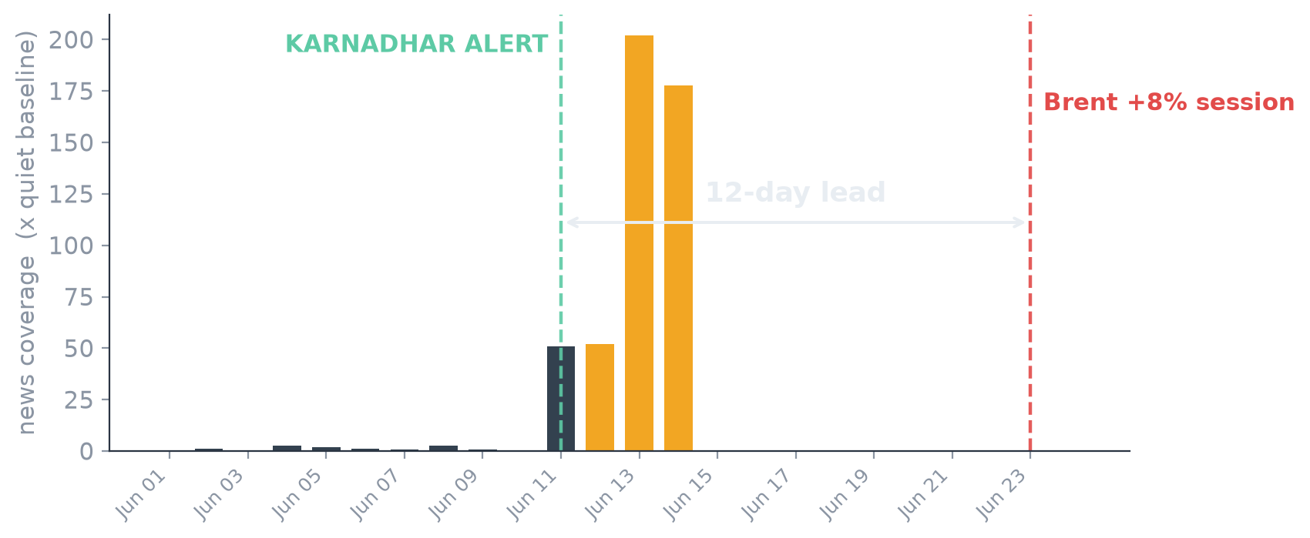
EVALUATION FOCUS 1 · DISRUPTION SIGNAL DETECTION
We saw the June 2025 Hormuz crisis 12 days before the market
12 days
alert lead over the
Brent +8% session
200×
peak news coverage vs
quiet baseline (real GDELT)
Method: 10-day rolling baseline → alert when coverage sustains ≥3× baseline for 2 days. Simple, explainable, testable — and fused with live AIS tanker traffic (congestion flags at chokepoints) for multi-source confirmation.
Real GDELT DOC 2.0 coverage-volume series, cached 1–14 June 2025 · backtest vs 23 June Brent session · aisstream.io live vessel feed (Malacca verified live)
Notes:
Our early-warning agent watches global news coverage of every chokepoint. In the real June 2025 data, coverage exploded to 200 times baseline. Our alert rule — deliberately simple and explainable — fired on June 11th, twelve days before the Brent 8% session. And it cross-confirms with live ship-tracking data.

Slide 8
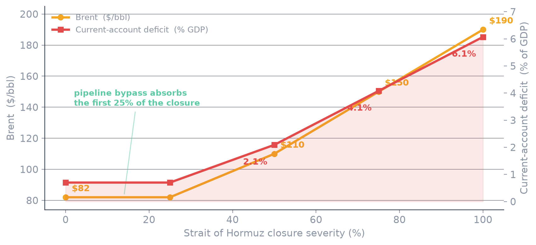
EVALUATION FOCUS 3 · SCENARIO MODEL FIDELITY
A glass-box cascade — ending in the deficit India cannot pay
₹125.5/L
retail fuel at full closure (+₹25.5)
−1.4 pp
GDP drag · +2.0 pp CPI
$191 bn/yr
extra import bill in USD
0.7% → 6.1%
Every parameter is named, sourced and editable; sensitivity is one function call. “The binding constraint is the balance of payments, not the barrels” — the twin-deficit reframe came from our review with ORF.
current-account deficit, % of GDP
Cascade: closure → net shortfall (after Saudi/UAE pipeline bypass) → Brent → import bill → pump price → CPI/GDP → CAD · reviewed with Lydia Powell, ORF
Notes:
The brief demands explicit, testable assumptions — so our cascade is a glass box. Notice the flat segment: a 25% closure is absorbed by the Saudi and UAE bypass pipelines — the model knows that nuance. At full closure: Brent 190, petrol above 125 rupees, and the number that matters most — the current-account deficit going from 0.7 percent to past 6 percent of GDP. And crucially, we do NOT use this global-shock model for every scenario. A Russia sanction is not a supply shock — those barrels redistribute to China — so global Brent barely moves; India’s real cost is the roughly 3.5 billion dollars a year of Urals discount it can no longer capture. Getting that channel distinction right is exactly what separates a real energy model from a dashboard. India can’t sustain the dollar outflow — which is why speed of response is a national-security variable.

Slide 9
BEYOND ONE SCENARIO
Block any chokepoint. Sanction any supplier. Model it.
Hormuz full closure
naive: INFEASIBLE — blend breaches Vizag’s sulphur limit
KARNADHAR: FEASIBLE — and priced: the reroute ties up +66 VLCC-equivalents (ton-mile)
Hormuz + OPEC+ squeeze
alternate suppliers squeezed to 60% of headroom
still feasible — grade-matching value rises to $1.95M/day of protected yield
Russia sanctioned
naive sends 220 kb/d to refineries that cannot run it
usable shortfall 220 → 0 — India’s #1 supplier is replaceable, at a price
Hormuz + Russia (compound)
the nightmare: 3,900 kb/d gap, 2 of top 3 suppliers gone
honest: 2,166 kb/d unmet, quantified — naive pretends, with 546 kb/d of fake fill
Also modelled: the brief’s Red Sea suspension — India’s crude barely moves (Cape-routed), but the commodity lens shows who is hit: Black-Sea edible oils (18%). And when a shock is too severe to reroute around, KARNADHAR quantifies the gap — the SPR scheduler answers hold / bridge / ration with a drawdown rate.
Notes:
The engine generalizes — any chokepoint, any supplier sanction, any combination, all on the real customs-data model. Notice two things no dashboard gives you. First, honesty: in the compound shock the naive plan pretends to fill the gap with 546,000 barrels a day of crude the refineries cannot run; we count only usable barrels and state the true shortfall — 2,166. Second, the decision layer: the optimizer prices the reroute in tankers — plus 66 VLCC-equivalents — and its shadow prices name the scarcest barrel. That is what makes it usable for policy.

Slide 10
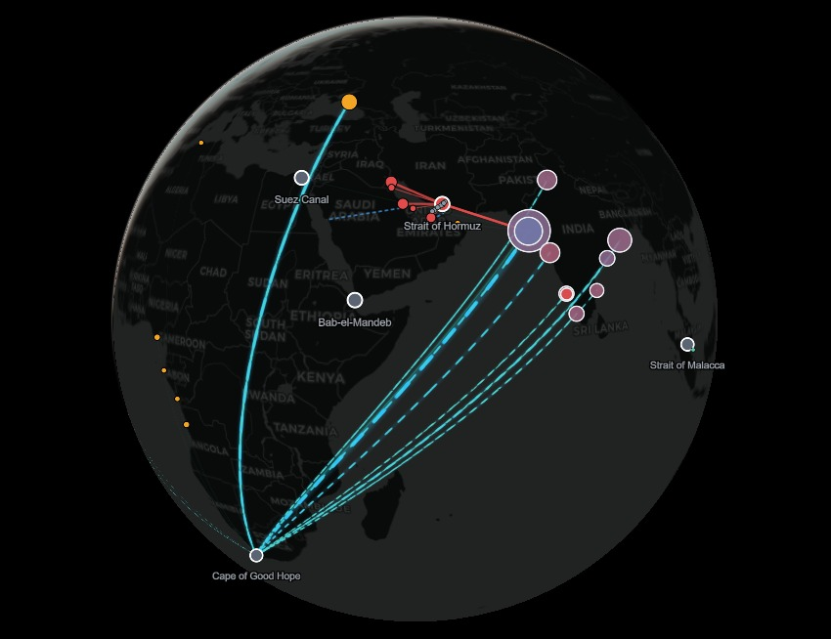
EVALUATION FOCUS 4 · GEOSPATIAL INTELLIGENCE
The war-room: India’s energy lifeline, live on one screen
Reroute deep-dive — routes ranked #1..N click a disruption: alternative corridors ranked by LP-committed volume, each self-defending; click one to isolate it on the map with its derivation
Optimizer flows — the plan, drawn every LP allocation becomes an animated arc: source → corridor → the exact refinery, width = kb/d
3D globe / 2D toggle · interactive KG globe or flat map, real AIS vessels, bypass pipelines; zoom/pan/drag the 50-node supplier→strait→refinery graph
Multi-commodity lens same disruption scored across 8 strategic imports — Hormuz hits 53% of LNG too
Decision layer shadow prices, VLCC ton-mile, SPR drawdown schedule + executive brief — on every scenario
Notes:
This is the product — and the map does not just show status, it shows the ANSWER. The red routes are the Gulf corridors dying when Hormuz closes. The bright animated flows are the optimizer’s plan itself: every allocation drawn from its source, around the Cape where that is the real voyage, into the exact refinery it feeds, width-weighted by barrels per day. Hover any flow and it tells you: Russia to Jamnagar, 658 thousand barrels a day, LP-assigned. Click a scenario and the whole picture re-solves in tens of milliseconds. Under it all: shadow prices, tanker cost, SPR schedule, executive brief.

Slide 11
WHY YOU CAN TRUST IT
Validated, evaluated, and reviewed by domain experts
AUTOMATED VALIDATION
EVALUATION FOCUS — ALL FIVE, COVERED
62 / 62
EF-1 signal lead time: 12 days, real GDELT + AIS
EF-2 procurement executability: feasible, grade-matched plans
EF-3 scenario fidelity: explicit, testable, sensitivity-swept
EF-4 geospatial depth: live routed map, real diets
EF-5 response time: 45 ms signal → recommendation
checks passed — one command, exit-code gated, run in CI
the wedge holds: naive infeasible for grade reasons; LP optimal
cascade monotonic + sanction ≠ global shock (discount-loss channel)
signal alert precedes market repricing on the real 2025 data
reroute ranked by LP-committed volume — no scarcity-artifact trap
decision layer: shadow prices · VLCC ton-mile · SPR scheduler
multi-commodity generalises — Red Sea spares crude, hits edible oils
EXPERT REVIEW
Lydia Powell — Distinguished Fellow, ORF: twin-deficit framing; SPR-as-voluntary-insurance; sourcing-first policy sequence. Prof. U. K. Bhui — Petroleum Engg., PDEU: wedge validated (“you are perfectly right”); SARA/asphaltene dimension added on his guidance.
Notes:
Three layers of trust. A validation suite — 45 falsifiable assertions about the engine’s behaviour, all green, one command, and run automatically in CI on every push to the public repo. Full coverage of the brief’s five evaluation-focus criteria. And two independent domain experts — a Distinguished Fellow at ORF for the economics, and a PDEU petroleum professor for the refining science — reviewed our assumptions.

Slide 12
BUSINESS IMPACT & SCALABILITY
Incumbents tell you what’s happening. We tell you what to do.
Kpler, Vortexa, S&P and Wood Mackenzie built a multi-billion-dollar market selling monitoring. KARNADHAR sells the decision layer — the feasible, grade-aware action plan — AI-native and India-first.
WHO PAYS
THREE AXES OF SCALE
Refiners IOCL · BPCL · HPCL · RIL · Nayara
Traders desks living on disruption signals
1 · Segments refiner → trader → insurer → sovereign (same engine, 7 buyer types)
2 · Geography 50+ import-dependent economies share this exact anatomy — Japan, Korea, Turkey, Philippines…
Shippers & insurers chokepoint risk = pricing
Government PPAC · ISPRL · MoPNG — the anchor
3 · Commodity demonstrated LIVE in-app: 8 strategic imports screened — LNG, pharma APIs, semiconductors… (Hormuz hits 53% of LNG)
Model: tiered SaaS — Monitor → Simulate → Orchestrate — plus API licensing. Land commercial desks first (months, not years); the sovereign deployment is the moat and the mission.
Notes:
Is this a business? The market already pays billions for energy intelligence — Kpler, Vortexa, Wood Mackenzie. But they sell monitoring. We sell the decision. Seven buyer segments, starting with refiners and traders. Fifty-plus import-dependent countries share India’s anatomy. And the engine is commodity-agnostic — crude today, LNG and critical minerals tomorrow.

Slide 13
India’s energy lifeline has no helmsman for the storm.
Now it does.
Real government data · a real optimizer · two domain experts · 62 green checks — running today.
Live: karnadhar-117722238113.asia-south1.run.app · github.com/PureGenius369/Karnadhar
KARNADHAR · Mann Sutariya · PDEU · mannsutaria2605@gmail.com
Notes:
Close: everything you saw runs today — real data, real signals, provable results, expert-reviewed. India’s energy lifeline has no helmsman for the storm. Now it does. Thank you.

