Slide 1
BUILD WITH AI · CODE FOR COMMUNITIES — TRACK 3: SMART HEALTH
Arogya Radar
Turning the paper registers of every health centre into a district-wide outbreak radar.
Kalahandi District, Odisha A frontline health command centre powered by Gemini
Mann Sutaria
Live on Google Cloud: arogya-radar-767054106508.asia-south1.run.app
Notes:
Open here. One line: 'Arogya Radar turns the paper daily registers that every PHC already keeps into a live outbreak radar and medicine-supply brain for the whole district.' Name the district — Kalahandi, Odisha — one of India's most health-challenged districts.

Slide 2
THE PROBLEM
Rural health runs on paper — and paper hides emergencies
1
2
3
Outbreaks surface too late
Medicines run out here, expire there
The burden falls on the last mile
Official surveillance (IDSP) aggregates weekly. A dengue cluster building across a block stays invisible for days — exactly the days that matter.
One centre stocks out of a drug while a neighbour lets the same drug expire on the shelf. Nobody sees both sides in time to act.
Every new digital form lands on a PHC pharmacist who is also seeing patients. So the data arrives late, partial, or not at all.
Arogya Radar
Build with AI · Code for Communities — Track 3: Smart Health
2
Notes:
Three consequences, all real in a district like Kalahandi. The through-line: the information exists on paper at the facility, but it never reaches the person who could act while it still matters.

Slide 3
THE INSIGHT
The register already contains next week's outbreak. Nobody is reading it.
When three centres in one block each log a few extra fever-with-rash cases on the same day, that is a dengue signal — days before it becomes an official report. The data is already flowing in. We are the first to read it, every day, automatically.
Arogya Radar
Build with AI · Code for Communities — Track 3: Smart Health
3
Notes:
This is the pivot. Every other team will build an inventory dashboard fed by data someone types in. We noticed the footfall data is a disease-surveillance goldmine — and we read it in real time.

Slide 4
WHAT IT DOES
One app, two sides
FACILITY SIDE
DISTRICT SIDE
Report the day in 30 seconds
The command centre
A voice note in Odia, Hindi or English, or a photo of the paper register
Gemini parses it into a structured daily record — footfall, symptoms, stock, expiries
The AI drafts; staff confirm. Uncertain fields are flagged for a human check
Outbreak radar — early warning across the district
Reporting compliance — silent centres flagged as blind spots
Stock forecasts — who runs out of what, and when
Expiry in rupees + transfers that fix both at once
A one-click weekly brief in plain language
→
Arogya Radar
Build with AI · Code for Communities — Track 3: Smart Health
4
Notes:
Left: the moat — intake that works with the paper-and-voice reality of a PHC, not a data-entry form nobody fills in. Right: everything the district officer needs, computed automatically from those reports.

Slide 5
TECHNICAL EXECUTION
AI where only AI works — auditable everywhere else
GEMINI DOES PERCEPTION & LANGUAGE
DETECTION IS CLASSICAL, AUDITABLE STATISTICS
Reads messy handwriting off a register photo
Understands code-switched Odia / Hindi / English voice notes
Writes the weekly brief in three languages
EARS-style aberration detection (CDC / WHO family)
Rolling baseline + block-level corroboration — no black box
An officer sees exactly why every alert fired
The design principle: AI sits only where nothing else can do the job. Everything between is honest arithmetic a judge — or a district pharmacist — can check.
Arogya Radar
Build with AI · Code for Communities — Track 3: Smart Health
5
Notes:
This directly answers the judging bar 'AI must do real work, not decorative.' Gemini does the two things only a large model can. Detection is deliberately transparent statistics, because health departments must be able to audit an alert.

Slide 6
THE OUTBREAK RADAR
It caught Lanjigarh's dengue signal days before the surge
41 vs ~3
cases today versus expected
16.6σ
peak centre, above its baseline
3 of 3
centres flagging together
Flagged ~28 June — before the case count was obvious to anyone on the ground.
Arogya Radar
Build with AI · Code for Communities — Track 3: Smart Health
6
Notes:
This is the headline. Real numbers from our simulation. The red line is fever-with-rash in Lanjigarh block; the grey dashed line is what the radar expected. It flagged around 28 June, when counts were still small — days before the late-June/early-July surge a human would have noticed.

Slide 7
FROM SIGNAL TO SUPPLY
The same reports turn into money saved
THE FLAGSHIP RECOMMENDATION
₹3.14 lakh
246 dengue NS1 test kits sitting near expiry at SDH Dharamgarh — in the west — are routed 64 km to the outbreak at CHC Lanjigarh in the east.
of medicines will expire unused across the district in the next 120 days — priced at real procurement rates.
One move, two wins: it saves ₹44,280 of stock from the bin and arms the outbreak response at the same time. Expiry prevention and disease response become the same decision.
Arogya Radar
Build with AI · Code for Communities — Track 3: Smart Health
7
Notes:
A rupee number is the most legible metric for a non-technical MP office. And the flagship transfer is the whole thesis in one line: because the radar and the stock engine run on the same data, the system routes expiring test kits straight to the outbreak — money saved and lives protected in one action.

Slide 8
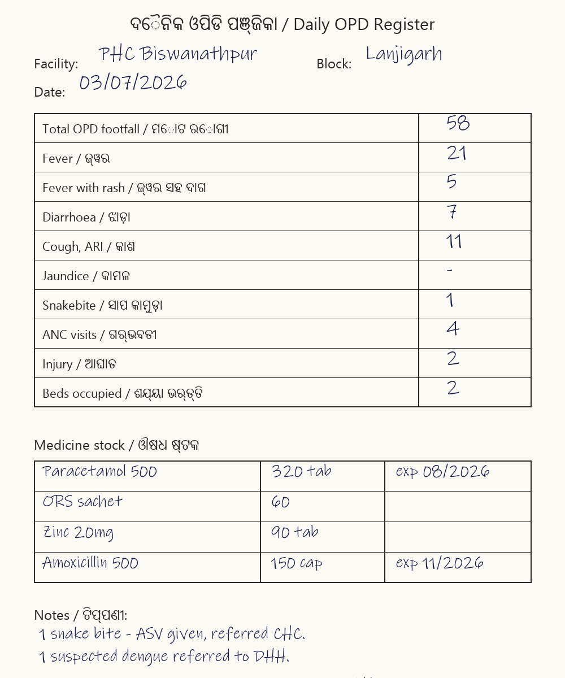
SEE IT WORKING
From a scribbled register to structured data in seconds
GEMINI PARSES IT LIVE
Footfall
58
Fever
21
→
Fever with rash
5 (kept separate)
Diarrhoea
7
Paracetamol 500
320 tab
ORS sachet
60
Verified live with Gemini — referral note captured too.
Arogya Radar
Build with AI · Code for Communities — Track 3: Smart Health
8
Notes:
This is a real parse of the bundled sample register — Gemini read the handwriting, kept fever-with-rash separate from plain fever, mapped medicine names to catalogue IDs, and pulled the free-text referral note. Judges can reproduce this in two clicks on the live site.

Slide 9
TRUST & PROVENANCE
Built on real public data — and honest about the rest
Real | Synthetic (and why)
Kalahandi's real block & facility network (DHH, SDH, block CHCs) | Daily facility-level activity — because it does not exist publicly. Creating it IS the product.
Medicines & prices: NLEM 2022 + Jan Aushadhi rates | The seeded dengue outbreak & expiry scenarios, for a reproducible demo
Syndrome categories aligned to IDSP reporting | Some PHC names and map coordinates (approximate)
Magnitudes calibrated on HMIS monthly & IDSP weekly data (data.gov.in) | Everything is labelled synthetic in-app — nothing is passed off as real
Arogya Radar
Build with AI · Code for Communities — Track 3: Smart Health
9
Notes:
Judges will wonder about the data. Get ahead of it: real facilities, real drugs and prices, real calibration — and a synthetic daily layer that stands in for the exact data our product is the first to capture. The gap is the reason the product exists.

Slide 10
DEPLOYABILITY & SCALE
Built to slot into the system that already exists
Live on Google Cloud Run
Works with today's reality
Containerised and deployed today — judges click a URL, not a video. Firebase/Firestore is the next step for durable storage.
No new hardware, no new habits: a voice note or a photo of the register the staff already keep.
Speaks the government's schema
District today, state tomorrow
Records map onto IDSP syndrome categories, so this plugs into the workflow the state already runs — it removes the paper and the week of lag.
The same pipeline scales from 36 facilities to a whole state; cross-district analytics land in BigQuery.
Built on Google Cloud: Gemini 2.5 (Pro for intake, Flash for briefs) · Cloud Run · roadmap: Firestore, BigQuery
Arogya Radar
Build with AI · Code for Communities — Track 3: Smart Health
10
Notes:
Deployability is where health wins as a track — a pilot in a real district is concrete. Emphasise: no new hardware, maps to IDSP, live URL, scales on the same pipeline.

Slide 11
INCLUSIVITY & ACCESSIBILITY
Designed for who actually uses it
ଓଡ଼ିଆ · हिन्दी · EN
Paper-first
Low-bandwidth
Less work, not more
Three languages, by voice
Works from a photo
Built for weak networks
Respects the last mile
Report by speaking in Odia, Hindi or English — the way a health worker actually talks, code-switching and all.
No smartphone form to learn. Snap the register page that already gets filled in by hand.
A short voice note or one photo — not a heavy app — reaches the district even on a rural connection.
The overlooked PHC pharmacist gets 30 seconds of speaking, not another form to type.
Arogya Radar
Build with AI · Code for Communities — Track 3: Smart Health
11
Notes:
Inclusivity is scored. Ours is built in, not bolted on: voice in three languages, a photo of paper, low bandwidth, and a genuine reduction in the last-mile worker's burden.

Slide 12
WHAT A PILOT IN KALAHANDI DELIVERS
Earlier response
Outbreaks caught days sooner, while the case count is still small
Less waste
Medicines redistributed before they expire — lakhs saved each quarter
A district in view
One officer sees every centre each morning, in plain language
Roadmap: Firestore · WhatsApp intake · BigQuery cross-district · IDSP / e-Aushadhi export
Live: arogya-radar-767054106508.asia-south1.run.app Repo: github.com/PureGenius369/arogya-radar
Mann Sutaria · mannsutaria2605@gmail.com Arogya Radar — the district's registers, finally read.
Arogya Radar
Build with AI · Code for Communities — Track 3: Smart Health
12
Notes:
Close on impact, not features. A pilot delivers earlier outbreak response, less medicine waste, and a district officer who can finally see their whole district every morning. End with the one-line promise.

