Slide 1
Containerization

Slide 2
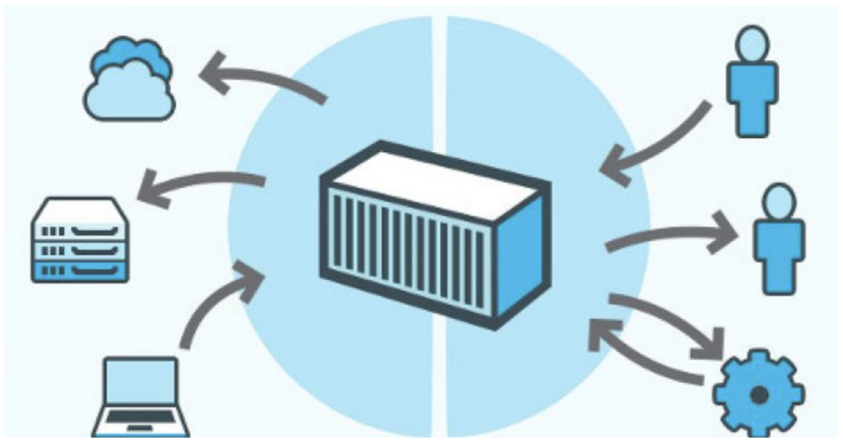
Summary
Containerization is a type of virtualization in which all the components of an application are bundled into a single container image and can be run in isolated user space on the same shared operating system

Slide 3
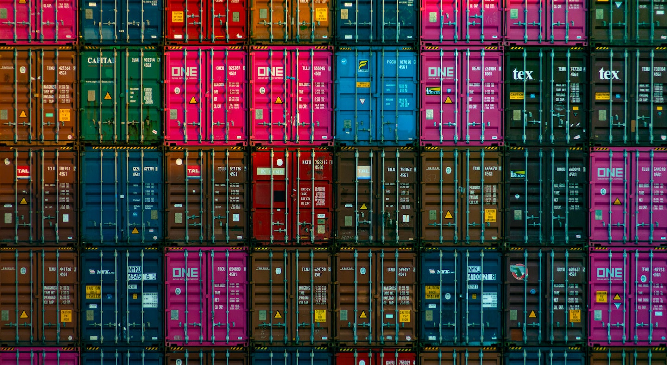
Benefits
Portability
Scalability
Fault tolerance
Agility

Slide 4

Portability
Deploy applications in multiple environments and operating system without rewriting the program code.

Slide 5

Scalability
Containers are lightweight software components that run efficiently.
Easily add multiple containers for different applications on a single machine.
The container cluster uses computing resources from the same shared operating system, but one container doesn't interfere with the operation of other containers.

Slide 6
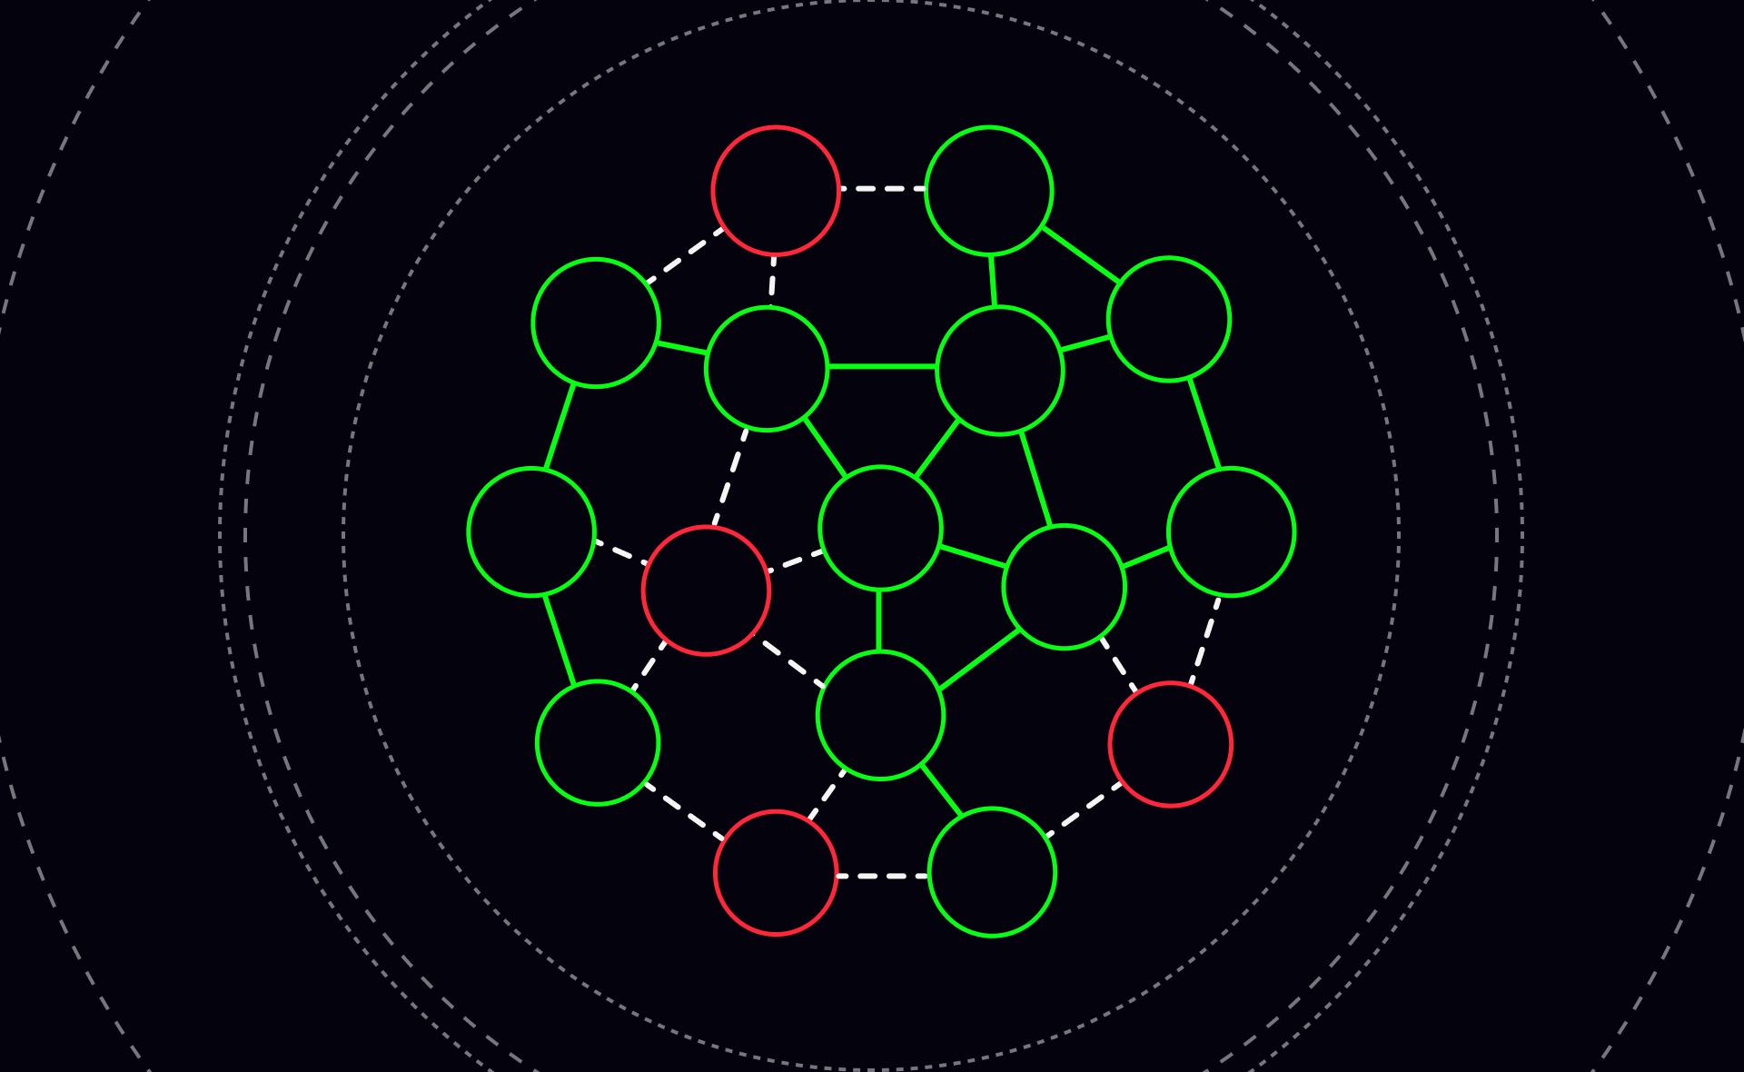
Fault tolerance
Use multiple containers to run microservices on the cloud.
microservices operate in isolated user spaces, a single faulty container doesn't affect the other containers.

Slide 7
Agility
Containerized applications run in isolated computing environments.
Software developers can troubleshoot and change the application code without interfering with the operating system, hardware, or other application services.
They can shorten software release cycles and work on updates quickly with the container model.

Slide 8
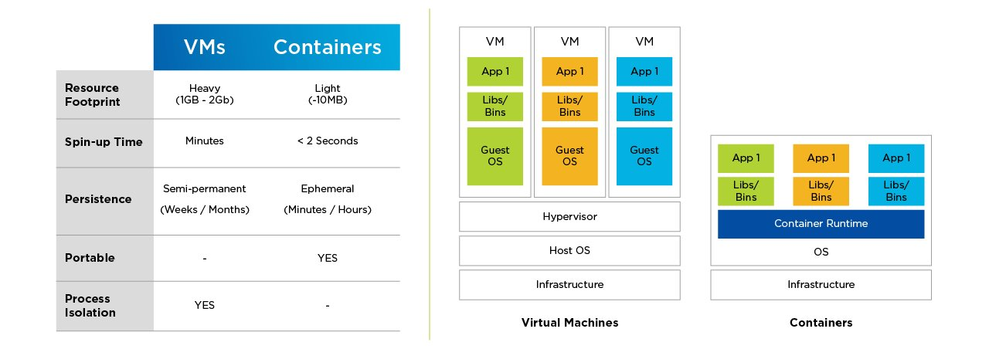
Containerization technology vs virtualisation

Slide 9
Layers of Containerization
Hardware infrastructure: The physical compute resources. Whether those resources are your own laptop or spread across multiple cloud datacenters.
Host operating system: Windows or Linux operating system running on your own computer or abstracted away completely by a cloud service provider.
Container engine: Container engines run on top of your host operating system and virtualize resources for containerized apps.
Containerized apps: Containerized apps are units of code that include all the libraries, binaries, and configuration an application requires to run. A containerized application is run as an isolated process in “user space” (outside of the operating system’s kernel).

Slide 10
Containerization architecture
The underlying IT infrastructure - A base layer that has the actual physical computing capabilities.
The host OS - An operating system layer that runs atop a compute instance that’s either virtual or physical. It provides a runtime environment for container engines and manages various system resources.
The container image - Sometimes called a “runtime engine,” this is the execution environment for the container’s code. The container image is a file that holds the information needed to run a containerized application.
Containerized applications - The software that runs in the containers.
Isolated in the kernel level - ensuring each container has its own view of the system resources

Slide 11
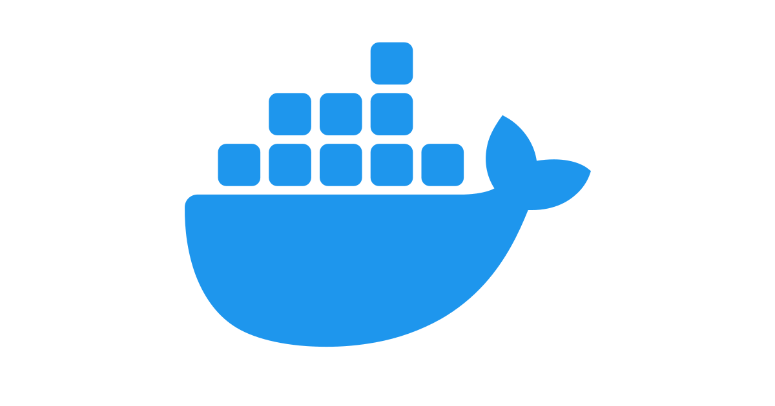

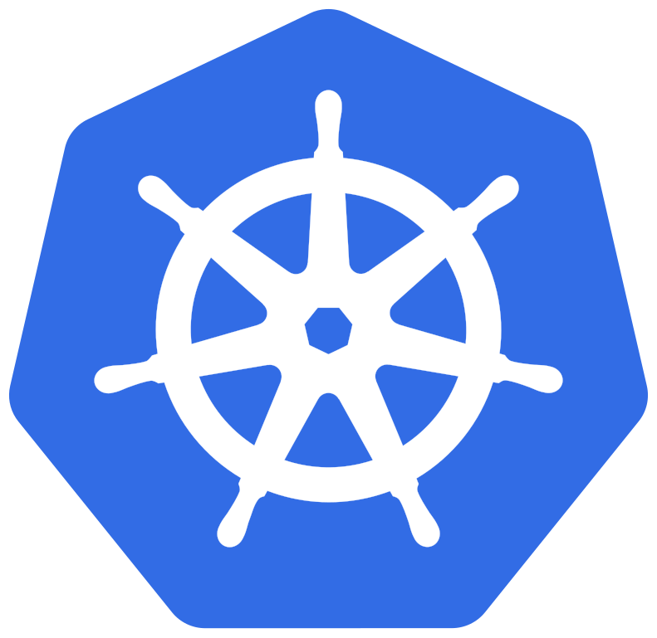
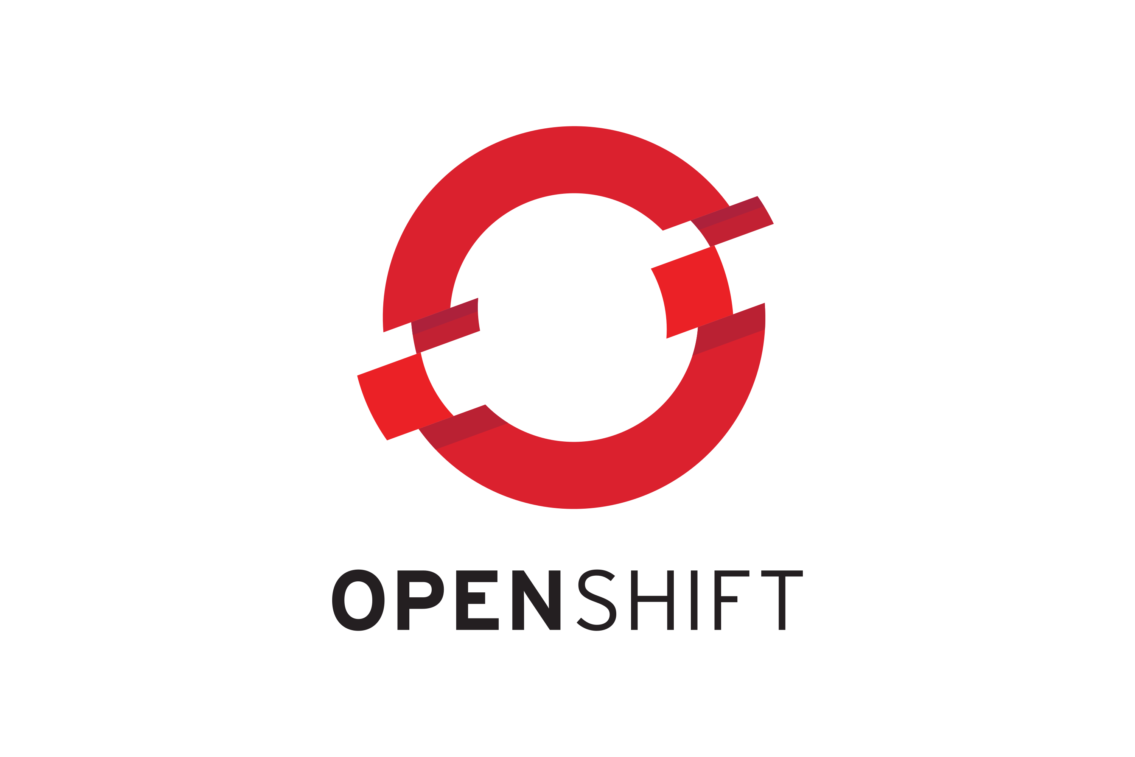

Containerization Tools
Docker
Podman
Openshift
Kubernetes
Rancher

Slide 12
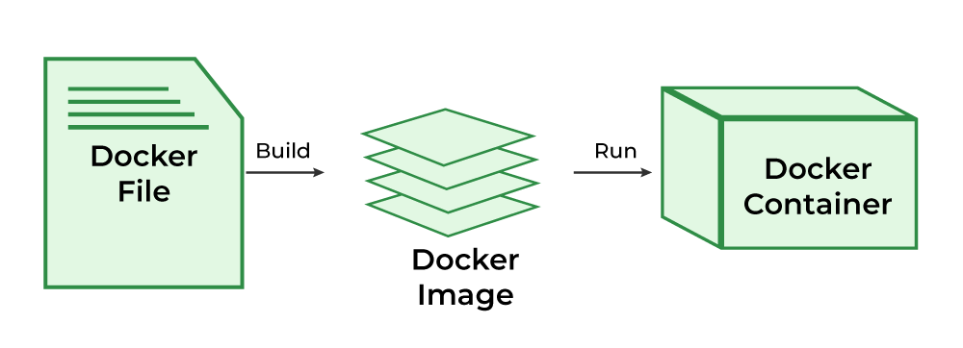
Creating a container image

Slide 13
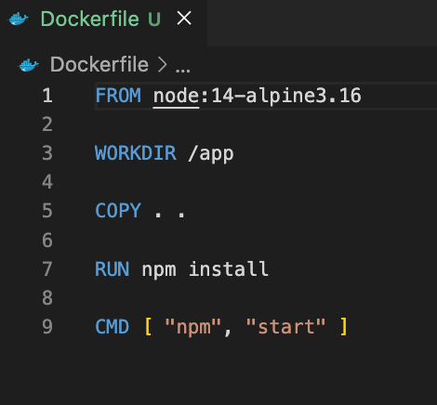
DockerFile basics
Always inheritance from base image
Will add layer to what your image needs
Don’t need to specify requirements that already exist in the original base image

Slide 14
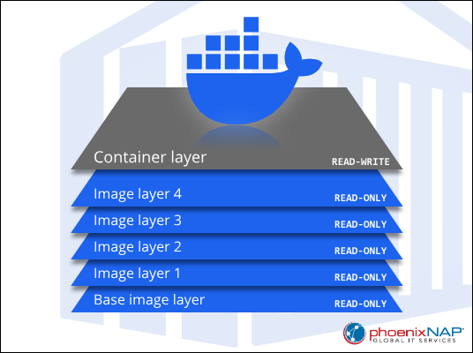
Image Layer
Each layer represents a specific modification to the file system (inside the container)
Once a layer is created, it becomes immutable
The layers of a Docker image are stored in the Docker engine's cache, which ensures the efficient creation of Docker images.
Each Docker image can have a max of 127 layer

Slide 15
DockerFile Cheat sheet
From <Image>:<Tag>
must be the first non-comment instruction in the Dockerfile
can appear multiple times within a single Dockerfile in order to create multiple images.
MAINTAINER <Name>
allows you to set the Author field of the generated images.
LABEL <key>=<value>
adds metadata to an image
EXPOSE <ports>
Informs Docker that the container listens on the specified network port(s) at runtime.
ENTRYPOINT [“<exec>”, “<param1>”, “<param2>”]
Allows you to configure a container that will run as an executable.
RUN <command>
RUN [“<executable>”,”<Param1>”,”<Param2>”]
The exec form makes it possible to avoid shell string munging, and to run commands using a base image that does not contain the specified shell executable.
CMD [“<executable>”,”<Param1>”,”<Param2>”]
provide defaults for an executing container. These defaults can include an executable, or they can omit the executable, in which case you must specify an entrypoint instruction as well.
There can only be one in a docker file.
ENV <key>=<value>
sets the environment variable
The value will be in the environment of all “descendant” Dockerfile commands and can be replaced inline as well.
ARG <name>*=<value>
Defines a variable that users can pass at build-time to the builder

Slide 16
DockerFile Cheatsheet
ADD <SRC> <Dest>
Copies new files, directories, or remote file URLs from source and adds them to the filesystem of the image at the path
COPY <SRC> <Dest>
Copies new files or directories, from source and adds them to the filesystem of the image at the path
EXPOSE <ports>
Informs Docker that the container listens on the specified network port(s) at runtime.
VOLUME [“path”, …]
Creates a mount point with the specified name and marks it as holding externally mounted volumes from native host or other containers.
USER <username | UID>
sets the user name or UID to use when running the image and for any RUN, CMD and ENTRYPOINT instructions that follow it in the Dockerfile.
WORKDIR <path>
Sets the working directory for any RUN, CMD, Entrypoint, COPY and ADD

Slide 17
Image optimization
Order from least frequently changing to most
Increase cache hits by separating dependencies
Group related commands
Use multi-stage builds to separate build and runtime environments
Use multi-stage builds to in parallel build stages

Slide 18
Minimize image size
Use the right base image
Combine RUN commands
Clean up after package installations

Slide 19
Right File-Copying Strategy
COPY vs. ADD
Use .dockerignore to remove unneeded files:
Version Control Directories (ex: .git)
Build Artifacts (ex: build)
Temporary Files (ex: .tmp)
Configuration Files (ex: .env)
Documentation (ex: .md)

