Slide 1
Docker

Slide 2
What is docker
Docker is an open platform for developing, shipping, and running applications.
Docker enables you to separate your applications from your infrastructure so you can deliver software quickly.

Slide 3
Advantages of using docker
Fast and consistent delivery
Portable and lightweight
More viable and cost efficient than Hypervisor-based virtual machines
Docker is perfect for high density environments and for small and medium deployments

Slide 4
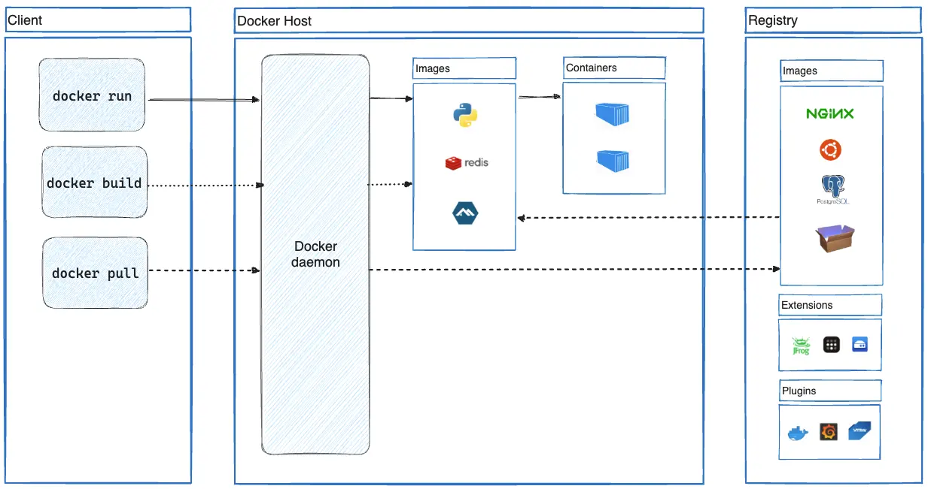
Docker architecture

Slide 5
Docker architecture
Dockerd: listens for Docker API requests and manages Docker objects such as images, containers, networks, and volumes.
Docker Client: is the primary way that many Docker users interact with Docker
Docker Desktop: application for your Mac, Windows or Linux environment that enables you to build and share containerized applications and microservices.
Docker Registry: public registry that anyone can use, and Docker looks for images on Docker Hub by default.

Slide 6
Registries
Docker Hub
Amazon Elastic(ECR)
Azure Container Registry (ACR)
Github Container Registry
Google Container Registry (GCR)
JFrog Container Registry
Red Hat Quay
Harbor

Slide 7
Docker engine
Open-source containerization technology for building and containerizing your applications.
A command line interface (CLI) client
A server with a long-running daemon process
APIs which specify interfaces that programs can use to talk to and instruct the Docker daemon

Slide 8
Docker desktop
Docker Desktop is an easy-to-install application for your Mac, Windows or Linux environment.
It provides a GUI (Graphical User Interface) that lets you manage your containers, applications, and images directly from your machine.
reduces the time spent on complex setups so you can focus on writing code.
integrates with your preferred development tools and languages and gives you access to a vast ecosystem of trusted images and templates via Docker Hub.

Slide 9
Cheat Sheet for Container Management
docker run: Creates and starts a new container from an image.
docker ps: Lists all running containers.
docker stop: Stops a running container.
docker start: Starts a stopped container.
docker restart: Restarts a container.
docker exec: Executes a command inside a running container.
docker rm: Removes a container.
docker rename: Renames a container.

Slide 10
Cheat Sheet Docker image management
docker pull: Downloads an image from a registry (like Docker Hub).
docker push: Pushes an image to a registry.
docker images: Lists all local images.
docker rmi: Removes an image.
docker build: Builds an image from a Dockerfile.
docker commit: Creates an image from a container's current state.

Slide 11
Cheat Sheet Other commands
docker login: Authenticates with a registry.
docker logout: Logs out of a registry.
docker inspect: Displays detailed information about a container or image.
docker logs: Fetches and displays the logs of a container.
docker cp: Copies files between the host and a container.
docker volume: Manages Docker volumes.
docker network: Manages Docker networks.
docker system prune: Removes unused data.
docker search: Searches for images in Docker Hub.

Slide 12
Docker Networking Basic’s
Purpose: Enables communication between containers, and between containers & external networks
Default Driver: Bridge – used when containers on the same host need to talk.
Other Built-in Drivers:
Host –shares the host’s network stack.
None – disables networking.
Overlay – connects containers across multiple hosts (Swarm mode).
Macvlan – gives a container its own MAC address on the physical network

Slide 13
Network Modules in Detail
Driver | Use Case | Example Command
Bridge | Local Host communication | Docker network create --driver bridge my_net
Host | High-performance networking, skips Docker’s NAT | Docker run --network host
None | Isolated container with no network | Docker run --network none
Overlay | Multi-host container communication | Docker network create --driver overlay my_overlay
Macvlan | Connect container direct to LAN | Docker network create --driver macvlan my_macvlan

Slide 14
Docker Network Cheat Sheet
Docker network connect: Connect a container to a network
Docker network create: Create a network
Docker network disconnect: Disconnect a container from a network
Docker network inspect: Display detailed information on one or more networks
Docker network ls: List networks
Docker network prune: Remove all unused networks
Docker network rm: Remove one or more networks

Slide 15
Docker Volumes Basics
Purpose: Persistent data storage for containers, the data will survive restarts or removal
Why Use Volumes?
Keep data independent of container lifecycle
Share data between containers
Better performance & management than bind mounts in many cases.
Default location: /var/lib/docker/volumes on the host

Slide 16
Docker Volume Types
Type | Description | Example Command
Named Volume | Managed by Docker, easy to reusue | Docker volume create my_data
Anonymous Volume | Automatically created, often temporary | Docker run -v /data
Bind Mount | Maps specific host directory to container | Docker run –v /host/path:/container/path

Slide 17
Docker Volume Cheat sheet
Docker volume create: Create a volume
Docker volume inspect: Display detailed information on one or more volumes
Docker volume ls: List volumes
Docker volume prune: Remove unused local volumes
Docker volume rm: Remove one or more volumes

Slide 18
Docker compose
A tool for defining and running multi-container applications.
Compose simplifies the control of your entire application stack, making it easy to manage services, networks, and volumes in a single YAML configuration file.
Deploys entire application architecture using a YAML file. Docker-compose.yml

Slide 19
Docker compose cheat sheet
docker-compose up: Builds, (re)creates, starts, and attaches to containers for all services defined in the docker-compose.yml file.
docker-compose down: Stops and removes containers, networks, and volumes created by up.
docker-compose ps: Lists the status of the services.
docker-compose logs [service_name]: View logs for a specific service.
docker-compose build: Builds or rebuilds services.
docker-compose pull: Pulls images for services defined in the docker-compose.yml file.
docker-compose exec [service_name] -- [command]: Executes a command in a running container.
docker-compose restart: Restarts containers.
docker-compose rm: Removes stopped containers.
docker-compose config: Validates and displays the compose file's configuration

