Slide 1
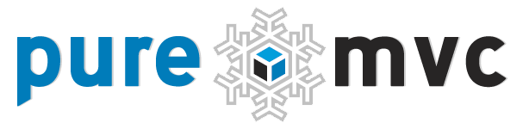

Slide 2
Topics
MVC – What is it? Why Use it?
Why PureMVC (Goals and Benefits)
Framework Overview
Implementation
Resources

Slide 3
MVC - What is it? Why use it?
What: The separation of application coding interests into 3 tiers: Model, View and Controller
Why: Eliminates the most harmful responsibility misplacement issues that hamper scalability and maintainability.
Notes:
Background

Slide 4
PureMVC - Framework Goals
Simple but appropriate framework scope
Reduce confusion over application layers as well as class roles, responsibilities and collaborations
Balance speedy implementation with scalability and maintainability
Avoid dependencies – entirely language-based; no Flex, Flash or AIR packages used
Hide complexity from the developer
Notes:
PureMVC is a lightweight framework for creating applications in ActionScript 3, based upon the classic Model-View-Controller design meta-pattern.
This free, open source framework does not depend on any Flash, Flex or Apollo classes, and is therefore suitable for architecting applications on any platform running AS3.
ActionScript 3 is a strongly-typed, fully object-oriented language based on the same standard as JavaScript (ECMAScript), though AS3 implements a more current edition (Edition 4). It is the internal scripting language for Adobe Flash, Flex, and Apollo, and is currently being integrated into the FireFox browser by the Mozilla Foundation as the next generation of JavaScript.
Due to its pattern-based nature, nearly any OOP language could be targeted. Though ActionScript3 is the first implementation platform for PureMVC, others are planned. Java, SilverLight, PHP and Curl are the next platforms in line for consideration.

Slide 5
PureMVC - Framework Benefits
Loosely-coupled Architecture
  ‘Publish/Subscribe’-style observer notification
  Promotes portability and reuse of boundary components (model/view)
Programmed to Interfaces
  Supports extensibility via sub-classing or interface implementation
Useful Base Implementation Classes
  Out-of-box functionality requires very little sub-classing, or even direct interaction with core Framework actors
Built on Proven Design Patterns
  All patterns described in the classic ‘Gang of Four’ book, Design Patterns – Elements of Reusable Object Oriented Software

Slide 6
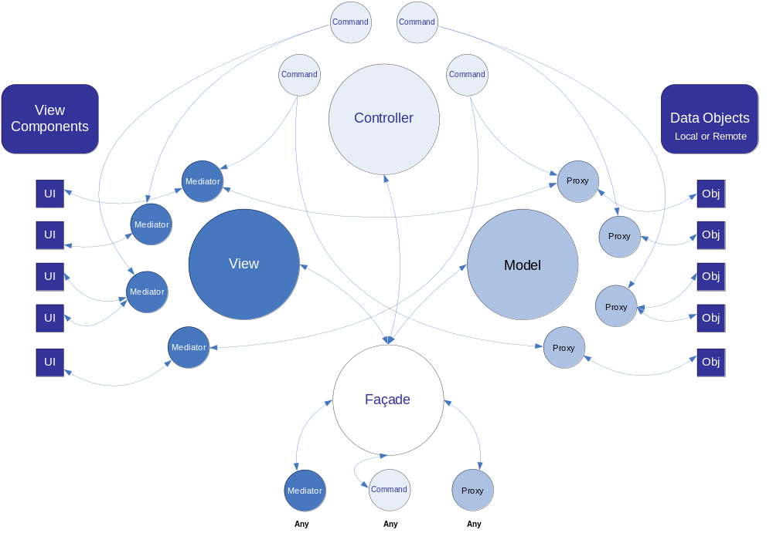
PureMVC - Framework Overview
Notes:
In this implementation of the MVC design meta-pattern, the application tiers are represented by three Singletons (a class where only one instance may be created).
A fourth Singleton, the Façade, provides a single interface for communications throughout the application.
As this conceptual diagram illustrates the Model, View and Controller Singletons maintain Proxies, Mediators and Commands, respectively.
The Model caches named references to Proxies, which expose an API for manipulating the Data Model (including data retrieved from remote services).
The View primarily caches named references to Mediators, which adapt and steward the View Components that make up the user interface.
The Controller maintains named mappings to Command classes, which are stateless, and only created when needed.
The Façade initializes and caches the Core actors (Model, View and Controller), and provides a single place to access all of their public methods.

Slide 7
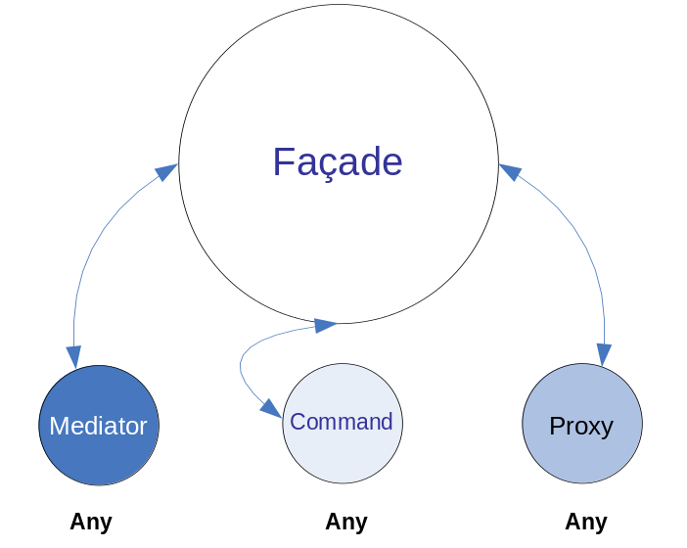
PureMVC - Framework Overview
Façade
  Any Proxy, Mediator or Command can access
  Has most commonly used Model, View and Controller methods
  Hides Model, View and Controller classes; no need to import or work directly with the core actors.
Notes:
The Façade makes it possible for the Proxies, Mediators and Commands that make up most of our final application to talk to each other in a loosely coupled way, without having to import or work directly with the Core framework actors.
When we create a concrete Façade implementation for our application, we are able to use the Core actors ‘out of the box’, incidental to our interaction with the Façade, minimizing the amount of API knowledge the developer needs to have to be successful with the framework.

Slide 8
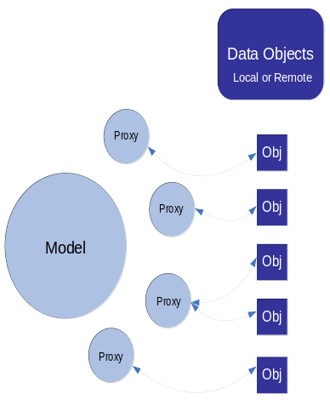
PureMVC - Framework Overview
Proxies and Data Objects
  Data Objects can be simple data holders, such as the common VO (Value Object)
  Proxies control access to Data Objects
  Proxies may interact with remote services…
  … or Delegate pattern may be used with Proxies
Notes:
Cached by and retrieved from the Model, a Proxy helps us to expose data structures, entity classes and the logic and services that support them to our application in such a way that they may be easily reused elsewhere, or refactored with a minimum amount of impact to the rest of the application.
A Data Object can be any ActionScript object. It might be a simple scalar value, a complex XML data structure or even an object that communicates with a remote service to retrieve and store data.

Slide 9
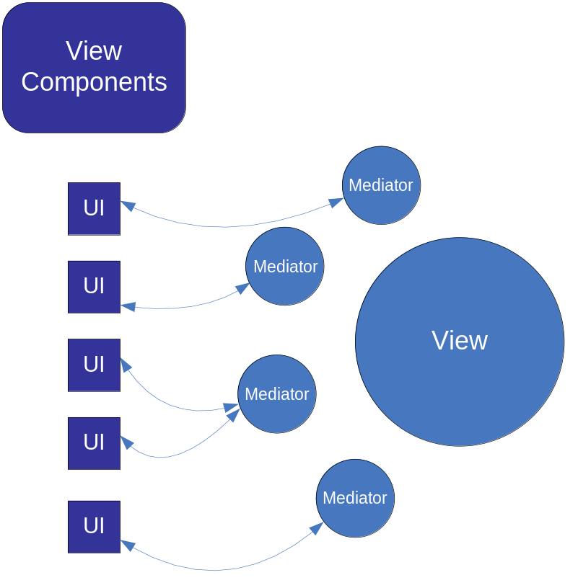
PureMVC - Framework Overview
Mediators and View Components
  View Components are any UI components; such as DataGrids or Custom Components
  Mediators steward View Components, listening for their Events, inspecting and setting their properties.
  Mediators interact with system on behalf of View Component
Notes:
A Mediator helps us to create or reuse existing user interface components without the need to imbue them with knowledge about the PureMVC application they communicate with.
View Components display data or accept user gestures. They typically communicate with their Mediators using Events.
The Mediator connects a View Component with its data and communicates with the rest of the system on its behalf.

Slide 10
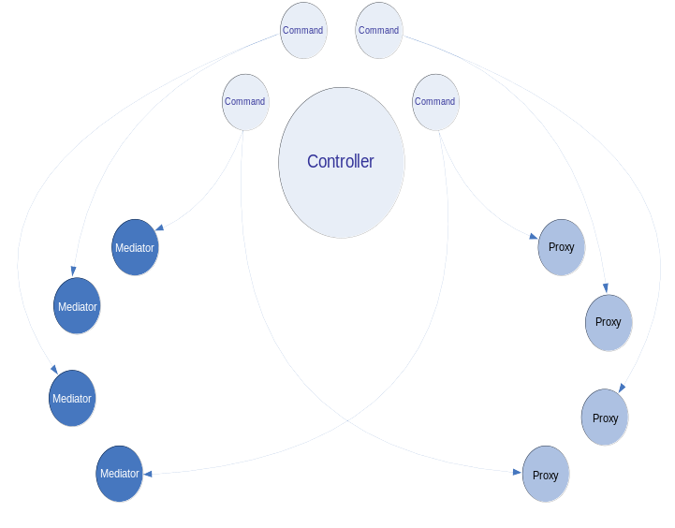
PureMVC - Framework Overview
Commands
  House the Business Logic of the application
  Coordinate complex activities
Notes:
A Command may retrieve and interact with Proxies, communicate with Mediators or execute other Commands, and are often used to orchestrate complex or system-wide activities such as application startup and shutdown.

Slide 11
PureMVC - Framework Overview
Notifications
  Work in conjunction with, not in place of Events
  Proxies
    May broadcast, but do not listen for Notifications
  Mediators
    Listen for and may broadcast Notifications
  Commands
    Are triggered by and may broadcast Notifications
Notes:
Proxies, Mediators and Commands communicate with each other in a loosely-coupled and platform-neutral way by broadcasting Notifications.

Slide 12
PureMVC - Implementation
Extend Façade, creating Concrete Façade
  Typically called ApplicationFacade, can be called anything
  Initialize Controller with Notification to Command mappings
  Define constants for Notification names, since all actors communicate via your concrete Façade
Write Commands
  Handle Business Logic, ensuring that use-cases of the system are executed properly
  May create and register Proxies and Mediators
  May retrieve and act upon Proxies
  May send Notifications to be responded to by Mediators
  May trigger or execute other Commands
  Will be executed by Controller when mapped Notification is broadcast

Slide 13
PureMVC - Implementation
Write View Components (any custom UI components)
  Expose API of Events and properties
  Make portable – embed no ‘knowledge’ of PureMVC or Mediator
Write Concrete Mediators
  Implement IMediator, typically by extending Mediator
  Holds reference to a View Component
  Listens for Events from View Component
  Inspects and sets properties on View Component
  Declares interest in and handles certain Notifications
  May send Notifications
  May create and register other Mediators (good at startup, or for deferred instantiation of children of the View Component)

Slide 14
PureMVC - Implementation
Write Data Objects (any data holding object)
  Enums, Collections, Value or Transfer Objects, XML structures, etc.
  Should not have any ‘knowledge’ of PureMVC or Proxy
Write Proxies
  Holds reference to a Data Object
  Exposes an API for accessing the Data Object
  May communicate with remote services to save or retrieve data
  If more than one Proxy uses same service, refactor service logic into Delegate pattern
  Sends Notifications to communicate with the application when data is received
  Handles Domain Logic, keeping Model data valid

Slide 15
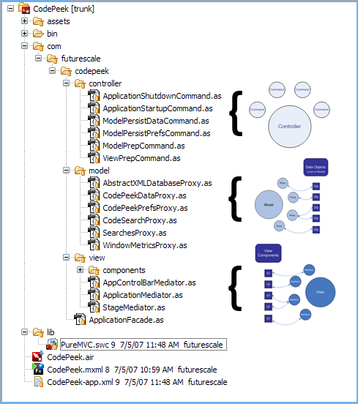
PureMVC - Implementation
Simple but intuitive package structure for application
Very clear separation of MVC tiers
Within model, view or controller folders, other folders support additional patterns
model folder may have:
  enum
  vo
  delegate or service
mediator folder typically has:
  components
ApplicationFacade is sibling to model, view and controller folders

Slide 16
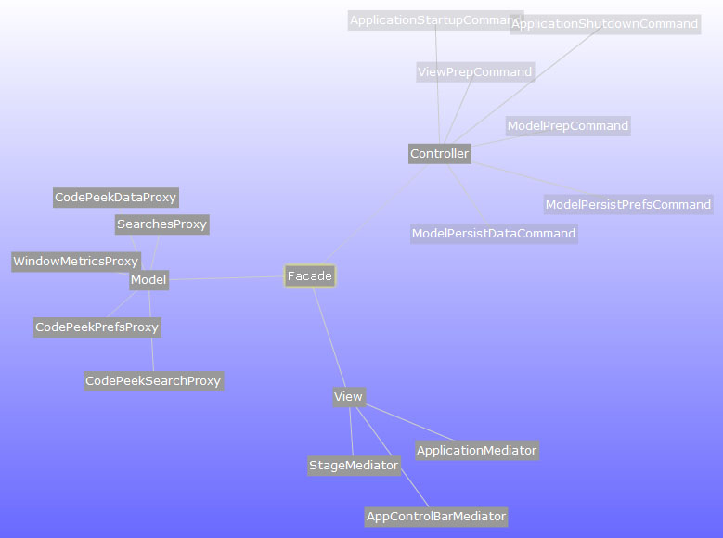
PureMVC - Implementation
Creating the separation between Model, View and Controller tiers makes the application easier to scale and maintain
Encourages portability and reusability of View components and Data Objects

Slide 17
PureMVC - Resources
Official Website
http://puremvc.org
Forums
http://forums.puremvc.org/
Ports, Demos, Utilities
http://trac.puremvc.org/PureMVC

Slide 18
PureMVC - Thank you

